Slide 1

Real-Time Traffic Analytics and Dynamic Signaling : A Next-Gen Approach to Traffic Management
Group Members:
Muhammad Talha (20P-0015)
Irsa Khan (20P-0016)
Project Supervisor
Mr. Usama Musharraf

Slide 2
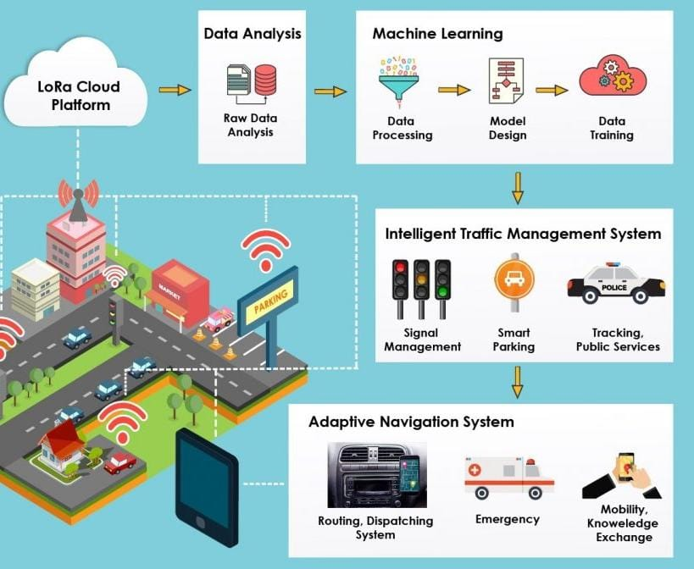
Introduction
Urban areas globally suffer from severe traffic congestion, leading to increased travel times, fuel consumption, and pollution.
Traditional traffic signals struggle with dynamic traffic patterns, leading to congestion issues.
Integrating AI into traffic signal control presents promising solutions, optimizing flow, reducing congestion, and enhancing management.
‹#›

Slide 3
Motivation
Traditional traffic management systems often struggle to keep pace with dynamically changing traffic patterns, leading to inefficiencies, longer travel times, increased fuel consumption, and heightened environmental pollution.
The motivation behind this topic lies in the potential of analytics-driven insights and real-time adjustments to revolutionize traffic management strategies
By harnessing the power of data analytics, cities can gain a deeper understanding of traffic behavior, identify bottlenecks, and implement targeted interventions to mitigate congestion and enhance urban mobility.
‹#›

Slide 4

Problem Statement
Traditional traffic signal systems struggle to adapt to changing traffic conditions, leading to congestion, delays and inefficiencies in traffic flow.
‹#›

Slide 5
Proposed Solution
Utilize real-time traffic data analyze traffic patterns, derive actionable insights, dynamically adjust signal timings and predict future conditions to optimize traffic flow
‹#›

Slide 6
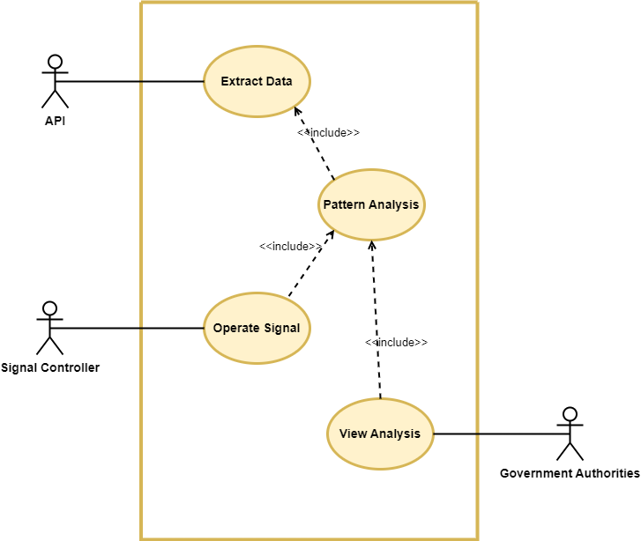
System Analysis (Use Case Diagram)

Slide 7
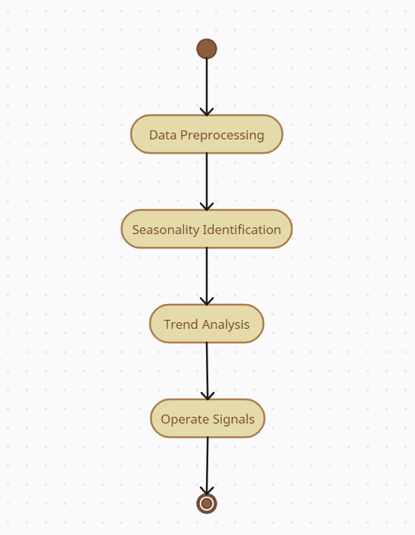
System Analysis (Activity Diagram of Pattern Analysis)

Slide 8
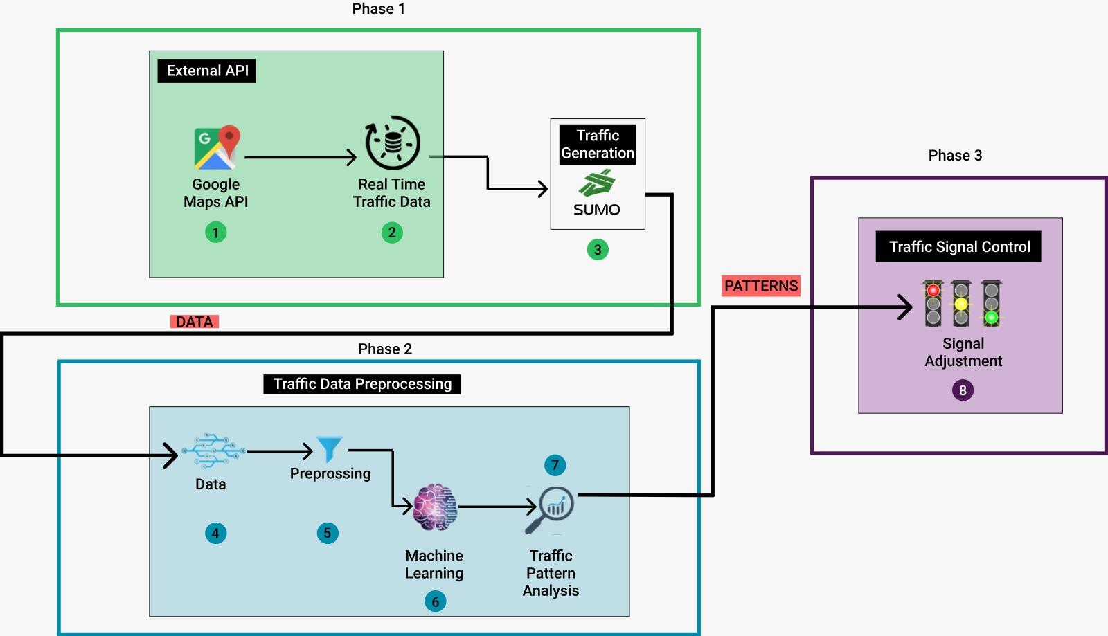
Proposed Architecture

Slide 9
Datasets
Custom Data Generation with Sumo
US Department of Transportation Traffic Data
Real Time Data with kafka

Slide 10
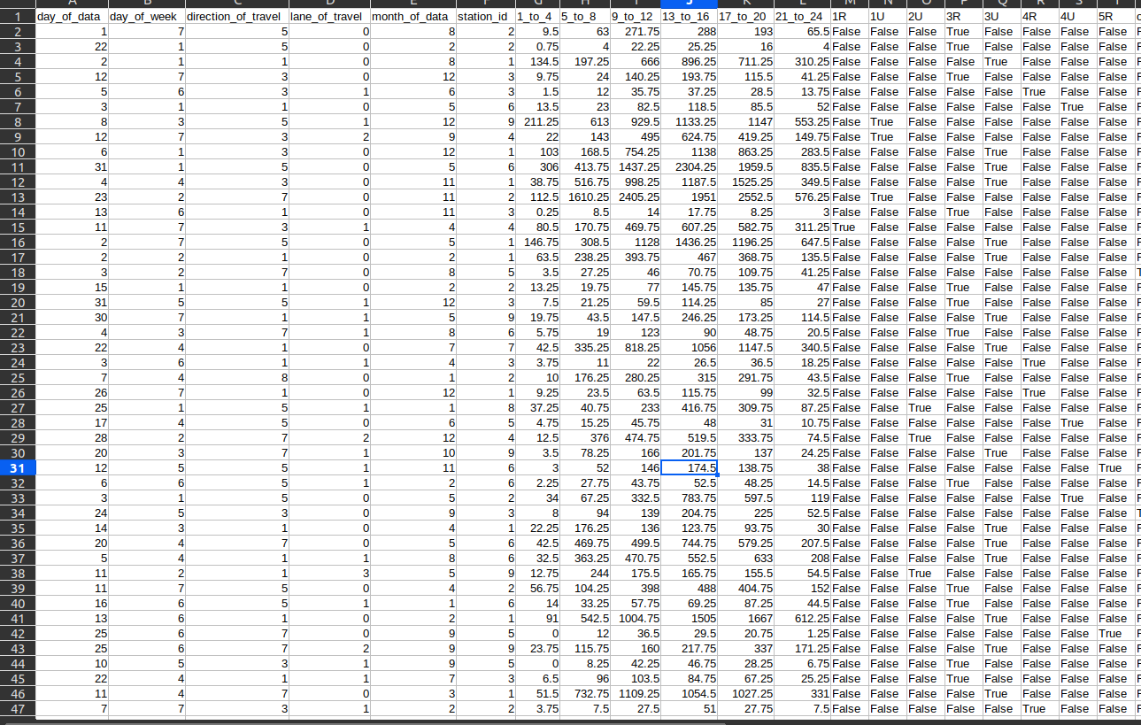
Sumo Data
Used for analyzing vehicle behavior over time

Slide 11
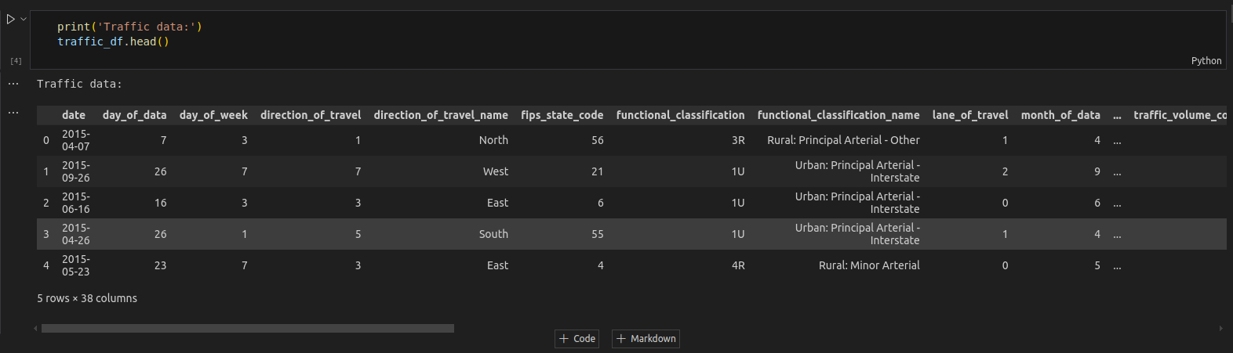
Dataset
Used to Train the model and Analyze Patterns

Slide 12
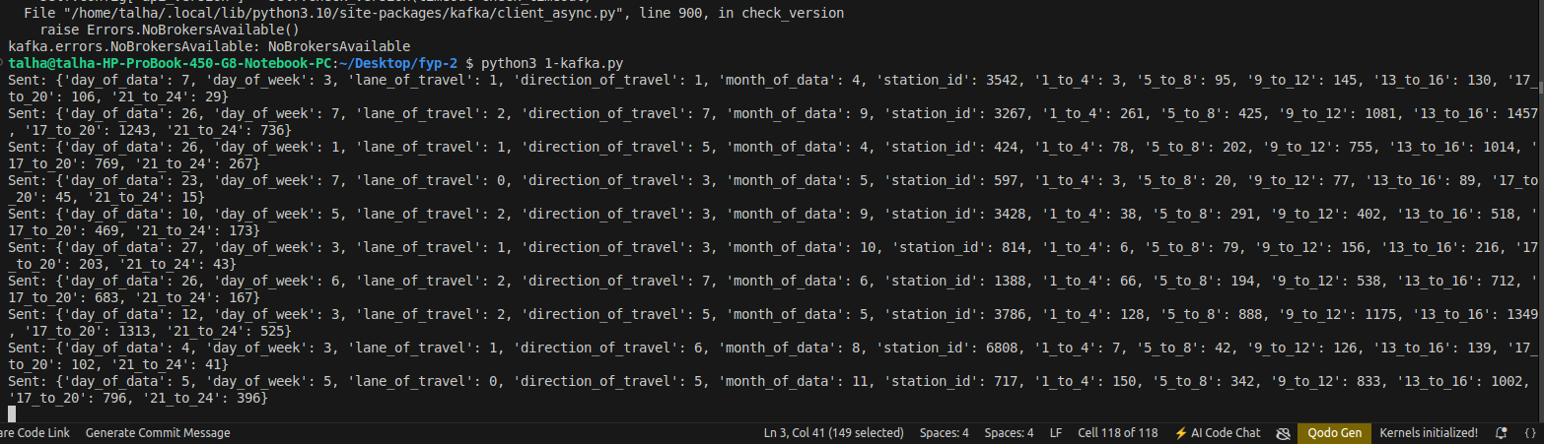
Real Time Data
To make predictions

Slide 13
Demo of the models and predictions

Slide 14
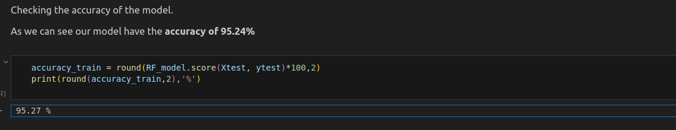
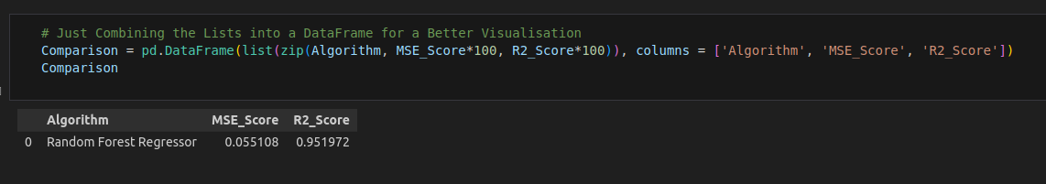
Model Evaluation

Slide 15
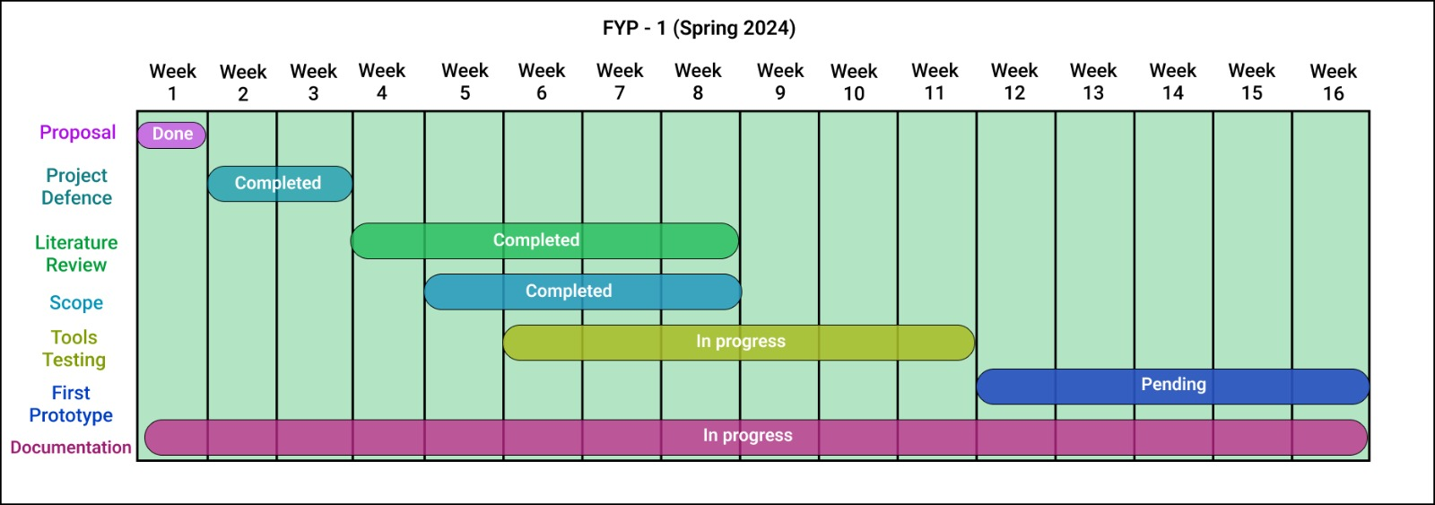
Objectives

Slide 16
Expected Results
A traffic system with:
Minimized wait times at intersections through congestion control.
Predictive analytics.
Increased throughput of vehicles at intersections.
‹#›

Slide 17
Team Work
18

Slide 18
Thank You!

