Slide 1
Gaussian Splatting using HPC
By
Mohammed Musthafa Rafi
COMS 625
Final Project

Slide 2




What is gaussian splatting?

Slide 3
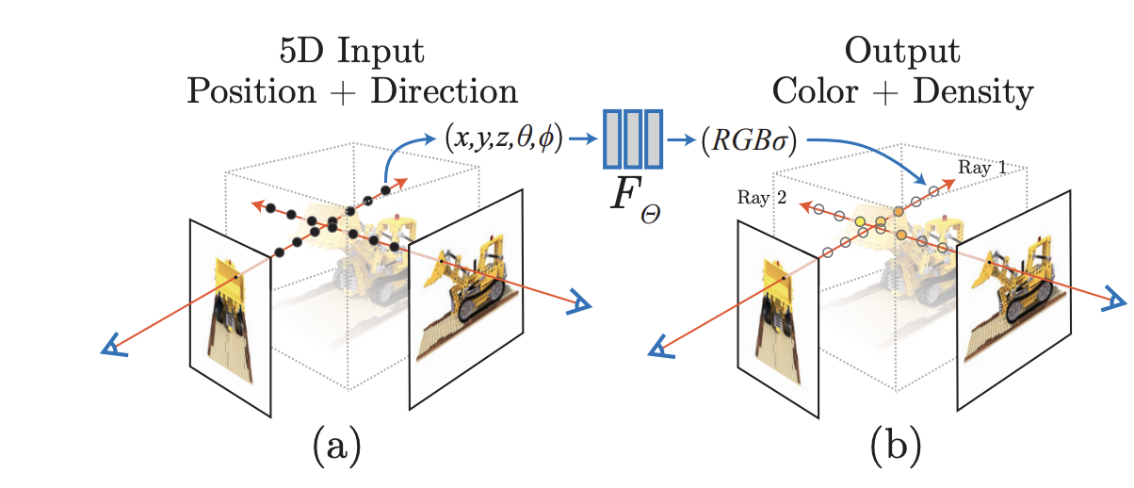
NeRF?
technique for 3D scene reconstruction and novel view synthesis

Slide 4


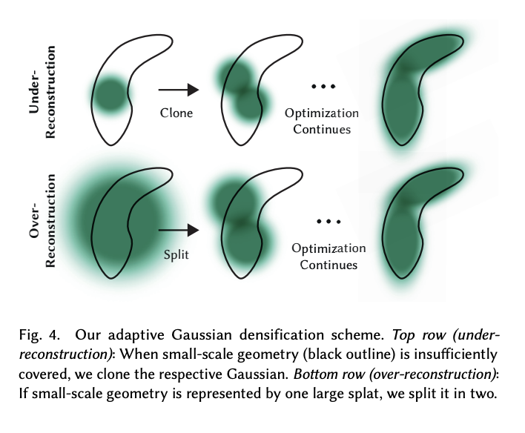
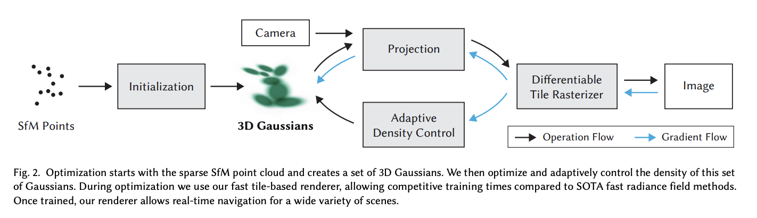

Gaussian splat

Slide 5
How it works
1. Structure from Motion
2. Convert to Gaussians
3. Training
4. Differentiable Gaussian Rasterization

Slide 6
Gaussian splatting for Real-Time Radiance Field Rendering
Novel 3D scene representation using explicit 3D Gaussians
Real-time rendering technique for novel view synthesis
Alternative to NeRF's implicit neural representation
The Problem with NeRFs
- Slow rendering: minutes to hours per frame
- Requires neural network evaluation for every pixel
- Not suitable for real-time applications (VR/AR, gaming)

Slide 7
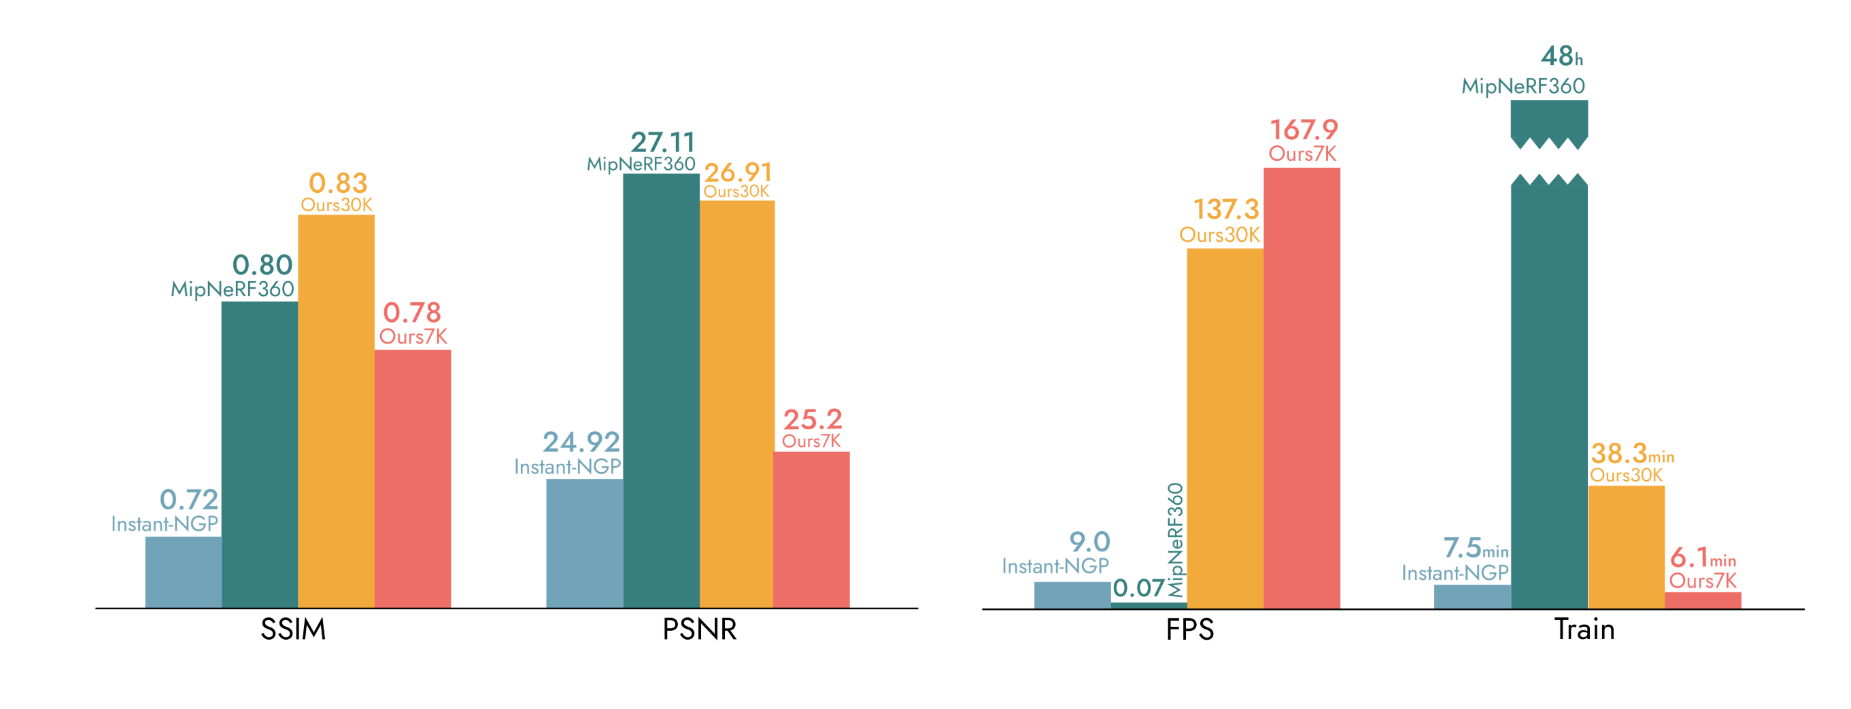
Comparison

Slide 8
Limitation
High memory usage
Hard for dynamic scenes
Editing and semantic is not easy

