Slide 1
Research Paper Text Simplification
Attempts at Pointer Generator Network

Slide 2
Introduction
Text Simplification = A set of techniques and processes aimed at reducing the complexity of a given text while retaining its essential meaning.
Makes the text more:
Understandable,
Accessible
Readable,
Useful for individuals with limited language proficiency, cognitive impairments, or those who are not familiar with the specific domain or subject matter.
Simplification Aspects : Lexical Simplification, Syntactic Simplification, Semantic Simplification, Readability Metrics, Evaluation Metrics, etc.

Slide 3
Problem Formulation
INPUT:
Complex Text: The research paper may contain sentences framed in a complex way which may not be understandable for general readers. We break down the paper into sentences and create word level tokens and vocabulary.
OUTPUT:
Simplified Text: The desired output is a simplified version of the complex text. This simplified text should be more accessible and easier to understand while retaining the core meaning and essential information of the original text.

Slide 4
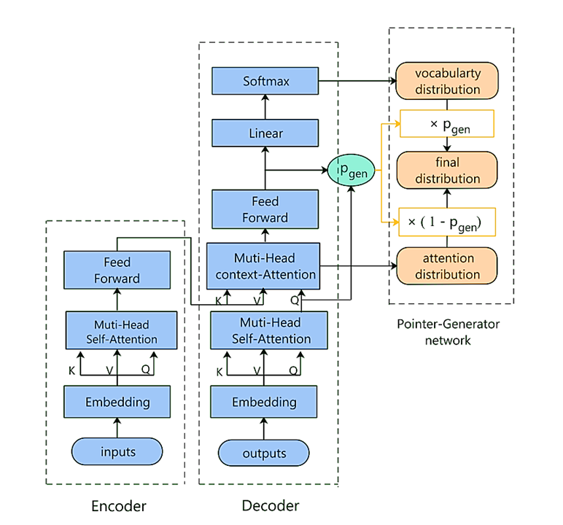
Model Architecture

Slide 5



Transformer
We adopted the multi-head attention formulation
Finally, Given d_{v} as the output vocabulary size, the decoder outputs a vocabulary distribution
where O is the output of the feedforward layer of decoder

Slide 6


Pointer-Generator Network
Pointer-Generator network calculates the generation probability
where o_{t} is the t^{th} row vector of matrix O and q_{t} is the t^{th} row vector of matrix Q* (output of multi-head self-attention layer for decoder)
The generation probability is used to weight and combine the vocabulary distribution and the attention distribution 𝛼_{t}, where 𝛼_{t} is the t^{th} row vector of attention distribution matrix A = softmax(QK^{T}/√d)

Slide 7
Rationale Behind the Model
The generation probability in a sense decides upon complex words or complex sentence framing and substitutes the word or a group of words with simpler word or group of words.
This architecture requires minimal adaptation of the transformer model and hence is an intuitive and explainable architecture for sentence simplification.

Slide 8
Hyperparameters, Loss Function, Optimizer and Result
Hyperparameters : max_enc_len=400, max_dec_len=100, batch_size=16, vocab_size=50000, num_layers=3, model_depth=512, num_heads=8, max_steps=230000, checkpoints_save_steps=10000
Loss function : Sparse Categorical Cross Entropy
Optimizer : Adam
Result : ['[START]', ',', ',', ',', ',', ',', ',', ',', ',', ',', ',', ',', ',', ',', ',', ',', ',', ',', ',', ',', ',', ',', ',', ',', ',', ',', ',', ',', ',', ',', ',', ',', ',', ',', ',', ',', ',', ',', ',', ',', ',', ',', ',', ',', ',', ',', ',', ',', ',', ',', ',', ',', ',', ',', ',', ',', ',', ',', ',', ',', ',', ',', ',', ',', ',', ',', ',', ',', ',', ',', ',', ',', ',', ',', ',', ',', ',', ',', ',', ',', ',', ',', ',', ',', ',', ',', ',', ',', ',', ',', ',', ',', ',', ',', ',', ',', ',', ',', ',', ',', ',']
Model requires huge amount of resources to train. Hence, this result.

Slide 9

Code

Slide 10
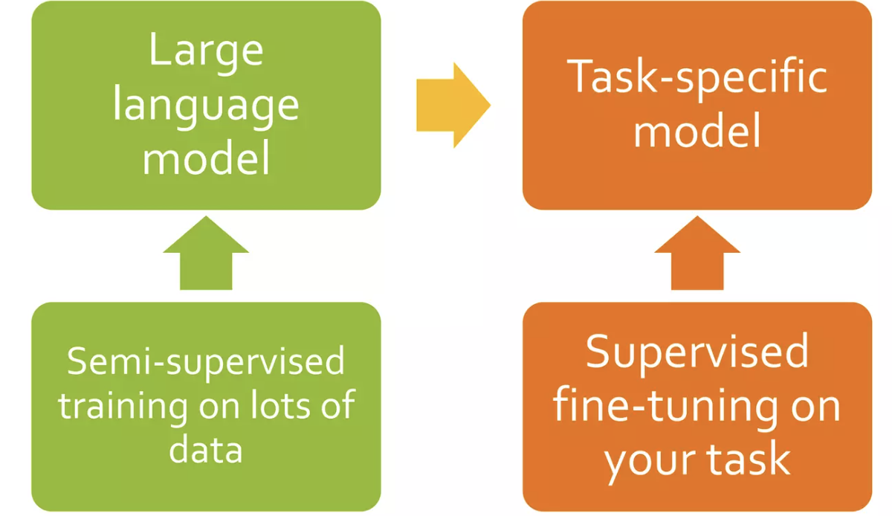
Fine-Tuning Pre-Trained models

Slide 11
Fine Tuning based Text Simplification

Slide 12
Dataset for Fine-Tuning models
149K rows in the dataset
Eg:
Text: lemon meringue pie is a type of baked pie usually served for dessert typically prepared with a bottom pie crust but with no upper crust.
Simple: lemon meringue pie is a type of sweet pie and dessert.

Slide 13
T5
mT5
Google introduced T5 model in 2020
Text-to-Text Transfer Transformer (T5)
Trained on common crawl web extracted text dataset
So the model pretrained based on Bert-base size encoder-decoder transformer with the denoising objective and C4 dataset, It trained for 2¹⁹ steps.
T5 trained on multilingual dataset
Trained on new Common Crawl-based dataset covering 101 languages

Slide 14
BART
BART (Bidirectional and Auto-Regressive Transformers) is a sequence-to-sequence model architecture designed for natural language processing tasks
BART leverages a pre-training and fine-tuning approach. It utilizes a transformer architecture and is unique in that it combines bidirectional and auto-regressive training objectives.
BART has demonstrated effectiveness in tasks such as text summarization and language generation by learning to reconstruct input sentences from corrupted versions during pre-training.

Slide 15
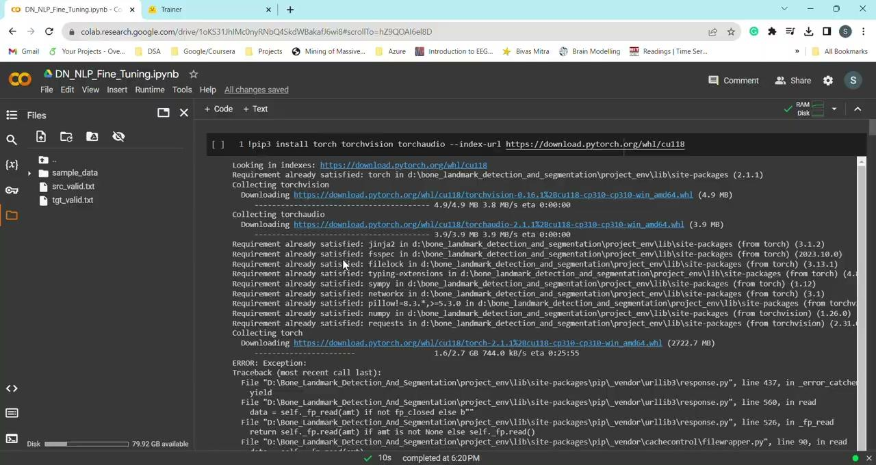
Code

Slide 16
Results
Model | BLEU | ROUGE1
T5 base | 0.4942 | 0.83
mt5 | 0.4957 | 0.82
BART | 0.2421 | 0.58

Slide 17
Results
Sentence to simplify : It was formerly one of the products of gasworks .
Original simplification : It used to be one of the results of gasworks.
Predicted simplification: It was one of the products of gasworks.
Sentence to simplify : As a C-type , it is probably composed of carbonaceous materials .
Original simplification : It is composed of carbonaceous materials since it is a C type
Predicted simplification: It is probably composed of carbonaceous materials.

Slide 18


