Slide 1

Term paper presentation
IT 594 DEEP NEURAL NLP & APPLICATIONS

Slide 2
Pretraining without attention
Junxiong Wang, Cornell.
Jing Nathan Yan, Cornell.
Albert Gu, DeepMind.
Alexander M. Rush, Cornell.

Slide 3
MOTIVATION
Is attention all you need?
Learning Capability vs computational convenience.
Explore alternative architecture to capture long range dependencies.
synthesize a scalable sequence routing model to capture long range dependencies with higher training speed.

Slide 4
PROBLEM FORMULATION
Given the prevalent use of attention-based models, particularly transformers, for pretraining in natural language processing (NLP), the paper aims to address the following technical challenges:
Exploring alternative approaches to pretraining in NLP.
Understanding the role of attention mechanisms.
Leveraging SSMs to develop a novel architecture for sequence routing and pretraining to perform efficiently on downstream tasks.

Slide 5
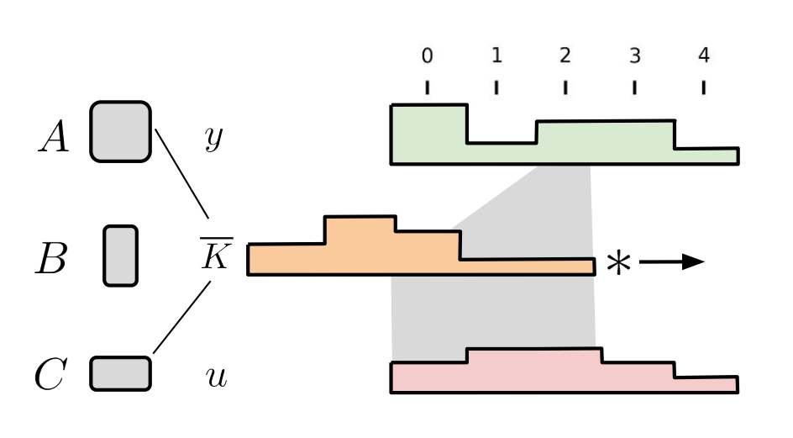
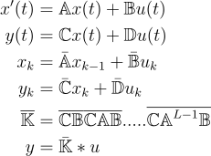
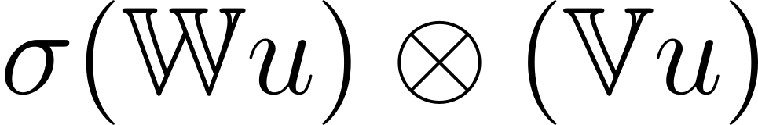
APPROACH
S S M
(State Space Models)
+
Multiplicative Gating
Describing relationship between a continuous time input to scalar output
Multiplicative Gating may restore some interaction capacity.

Slide 6
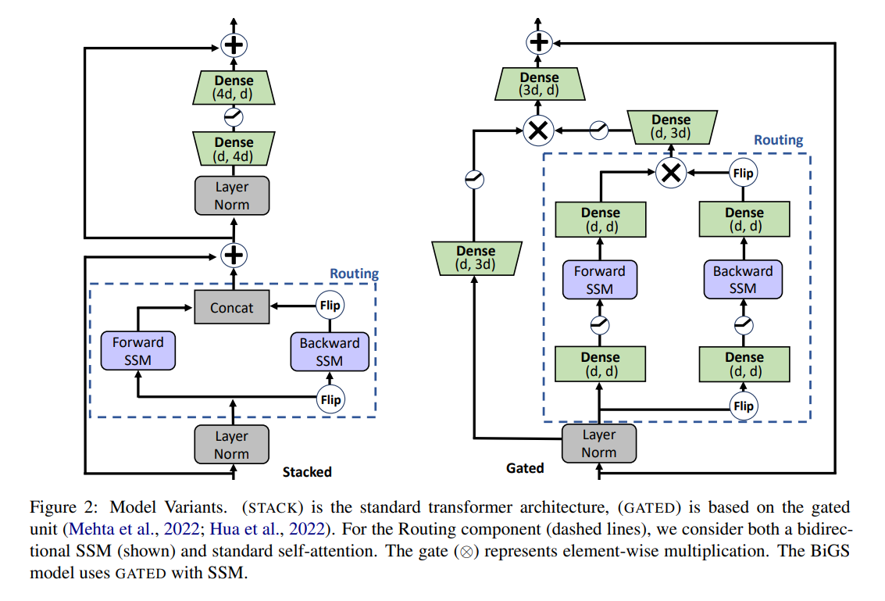
APPROACH
(SSM)
Stacked
&
Gated (BiGS)

Slide 7
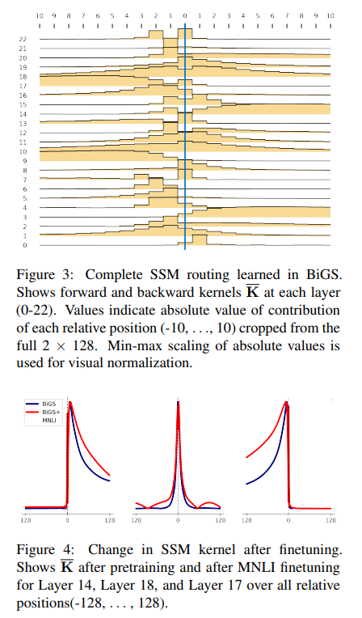
Role of ssm
Multi-head attention routing : L² attention coefficients per head per layer.
BiGS SSM routing : 2L static values.
Kernels correspond partially to local aggregations like next word or preceding trigram and partially to long-term future or past info.
During MNLI finetuning, the model needs to look at more long-distance information to match between sentences. This results in most local kernels remaining the same, but long distance kernels adjusting.
The figure shows three kernels expanding their scope outward.

Slide 8
APPROACH
Training
&
Experimental Setup
Controlled experiments:
Parameter Size : 350 M parameters.
Amount of training : 11B, 29B, 97B.
Masked Language Modelling like RoBERTa.
Max sequence length 128.
Cosine decay learning rate scheduling.

Slide 9
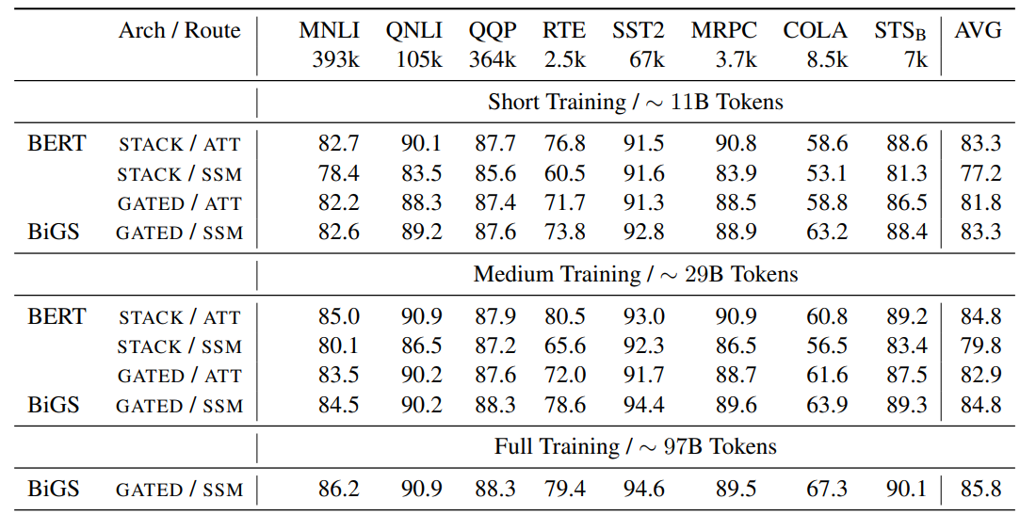
EVALUATION
GLUE
In short and medium training STACK with Attention is better than with SSM.
Results of GATED are competitive.
BiGS continues to improve in accuracy with training.

Slide 10
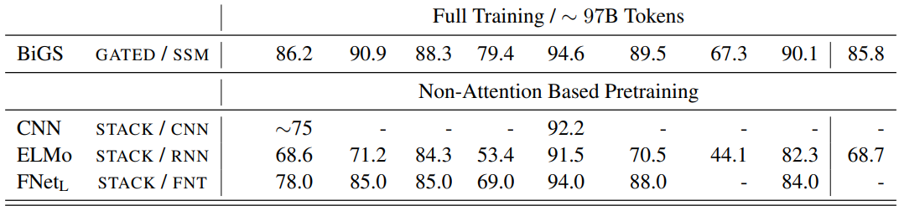
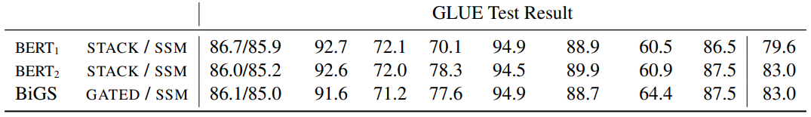
Comparison
GLUE

Slide 11
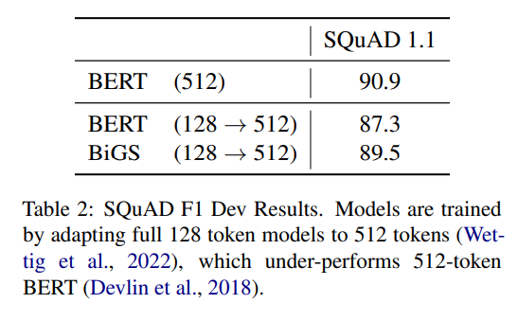
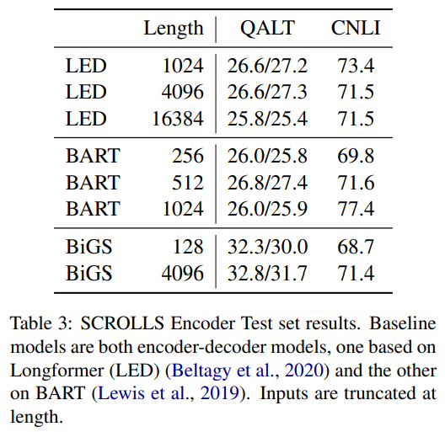
Comparison
Sequence elongation
&
Long Range Modelling
An advantage of SSM-based routing is that the models can extend to longer-ranges without requiring approximation.

Slide 12
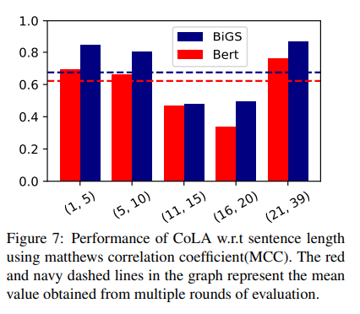
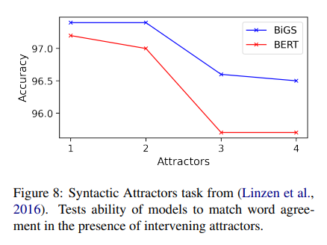
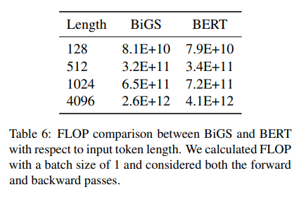
Comparison
Sequence elongation
&
Long Range Modelling
FLOPs measures a best case computational cost of models.
By comparing the FLOPs of BiGS and BERT for different input token lengths, we can better understand their relative efficiency and scalability.
While SSMs have a theoretical computational benefit compared to attention, current implementations and hardware do not yet show this benefit.

Slide 13
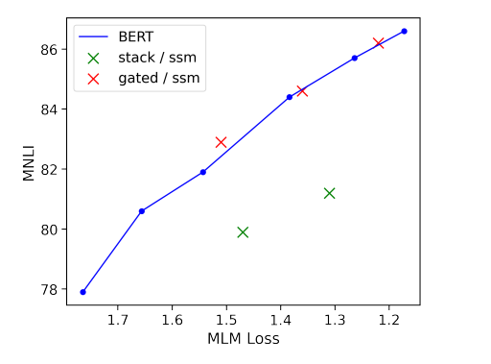
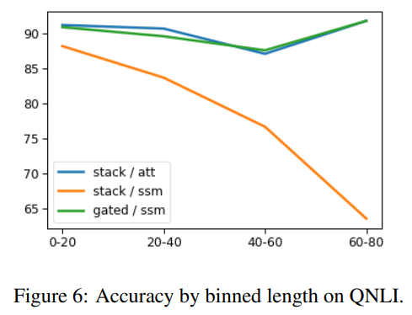
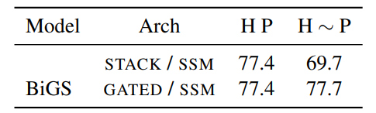
Role of Multiplicative gating
Multiplicative Gating
Helps SSM generalize to long distance interactions
GLUE results show significant improvement in downstream accuracy with GATED model
STACK SSM has a similar pretraining MLM loss.
GATED model tracks closely the anticipated pretraining gains, while STACK does not.
We see that the stack SSM decreases greatly in accuracy as the bins get larger, unlike for BERT and BiGS.
We add distractor phrases (∼), chosen to be non-ambiguous, in between the hypothesis (H) and premise (P) to see if the model has learned to skip over these to match H and P.

Slide 14
limitations
This work considers only pretraining on unlabelled text
No autoregressive language modelling
No direct benefit of SSM in long-range question answering
Some tasks have specialised loss functions which require additional care to adapt them to SSM training.
The SSM models potentially inherit the intrinsic bias in training data.

Slide 15
Takeaways
BiGS as a model for pretraining without attention.
First architecture to replicate BERT results without attention.
SSM based routing and Multiplicative Gating.
SSM alone in STACK architecture performs poorly.
GATING helps in generalizing to long range dependencies.

Slide 16

Transformers
Thank You!
Nisarg Suthar
Manjal Shah
Meet Kantesaria
Jay Joshi
Mohit Karelia

