Slide 1

Criczilla
Problem: To view stats of cricket players of all countries across different formats.

Slide 2
Features
Statistics overview across various formats
Live Score
Cricket news
Live searching across 93k player profiles
Dynamic table creation during stats display
EJS templates
Displaying players with birthdays and posting prewritten birthday message on Twitter
Typewriter effect in search bar

Slide 3
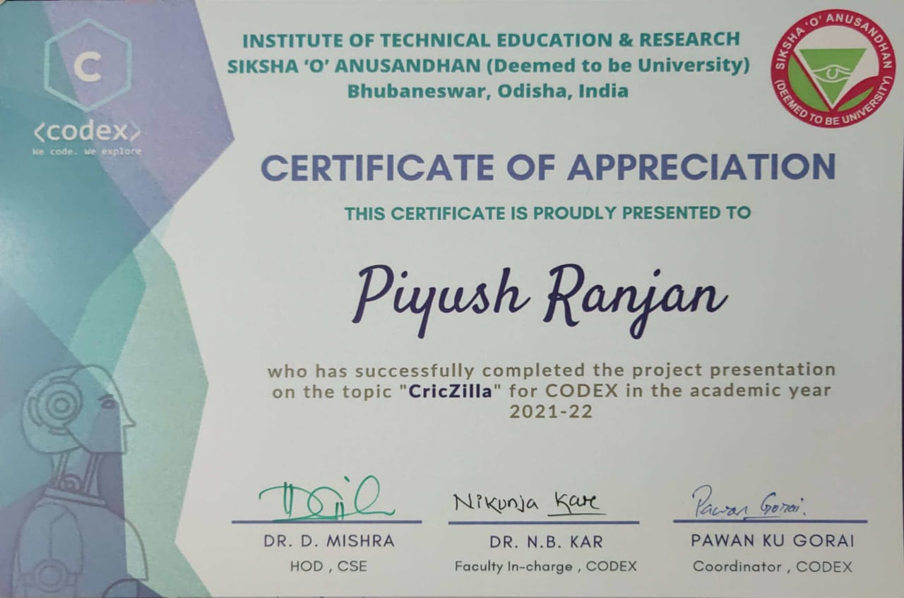

Slide 4
Technologies used
Front End
EJS Templates
CSS
Vanilla JavaScript
Backend
Express JS
MongoDB Atlas
APIs for live scores and news
Heroku for deployment

Slide 5
Contributions
Piyush Ranjan
UI Design
Fetching Players in Homepage
Search feature and Search suggestion
Deployment
Aditya Sharma
Live Scores and ScoreCard
Cricket News
Shubhanjan Dash
Data gathering of over 93k players
Database creation on Atlas

Slide 6
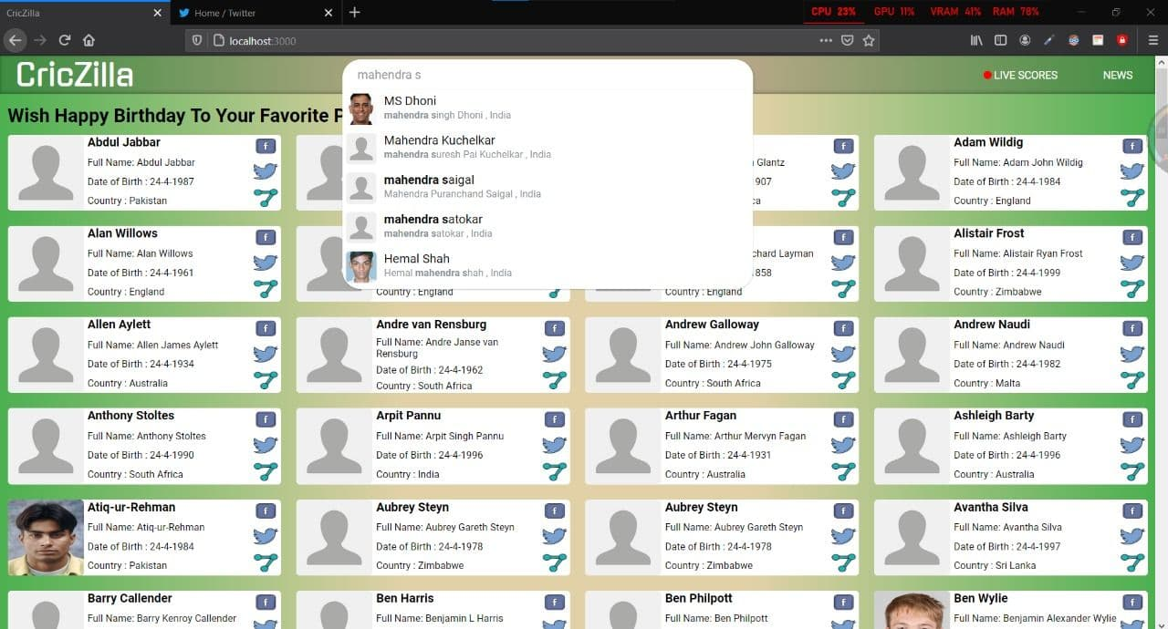
Screenshots

Slide 7
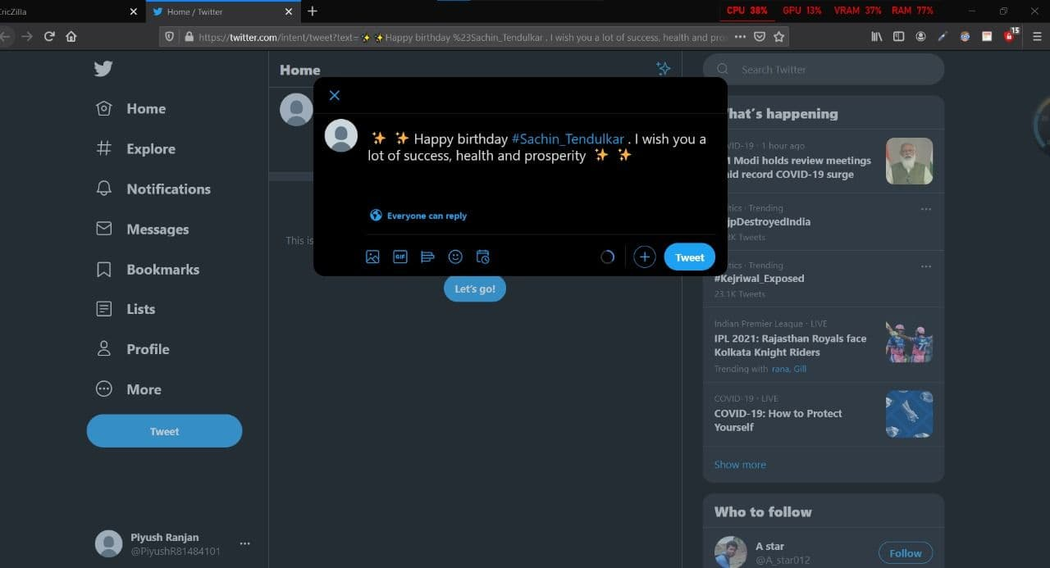

Slide 8
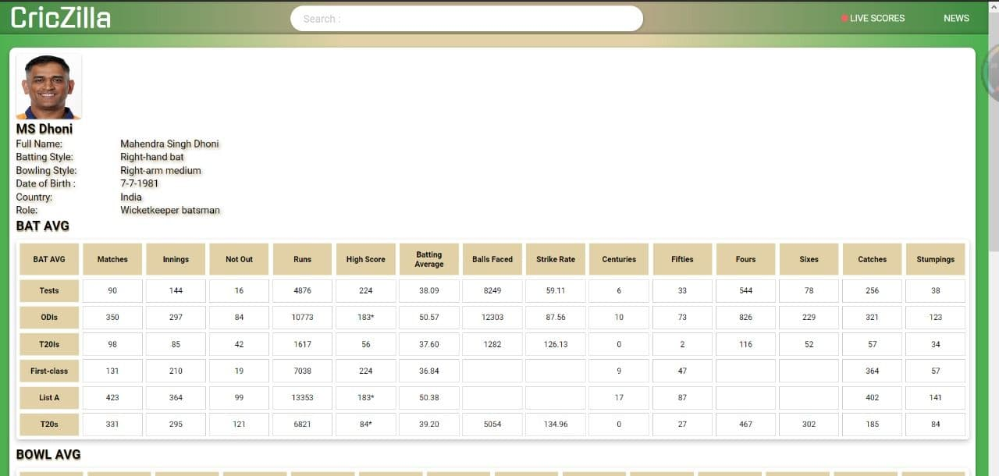

Slide 9
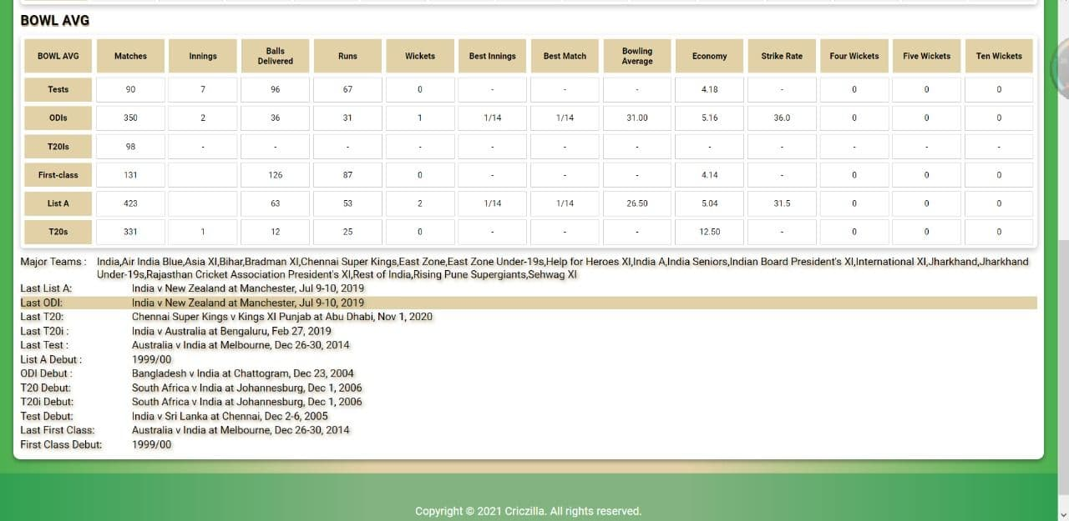

Slide 10
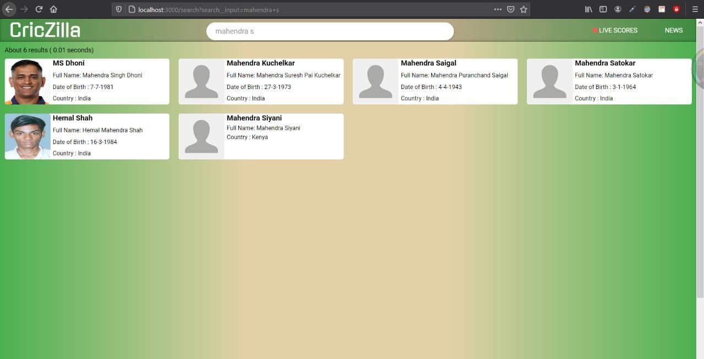

Slide 11
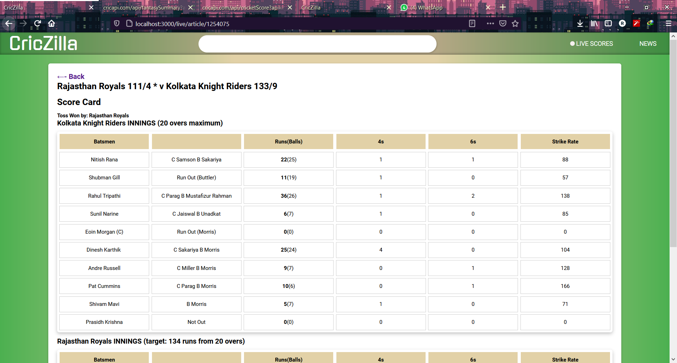
Live Score Card During Yesterdays Game!

Slide 12
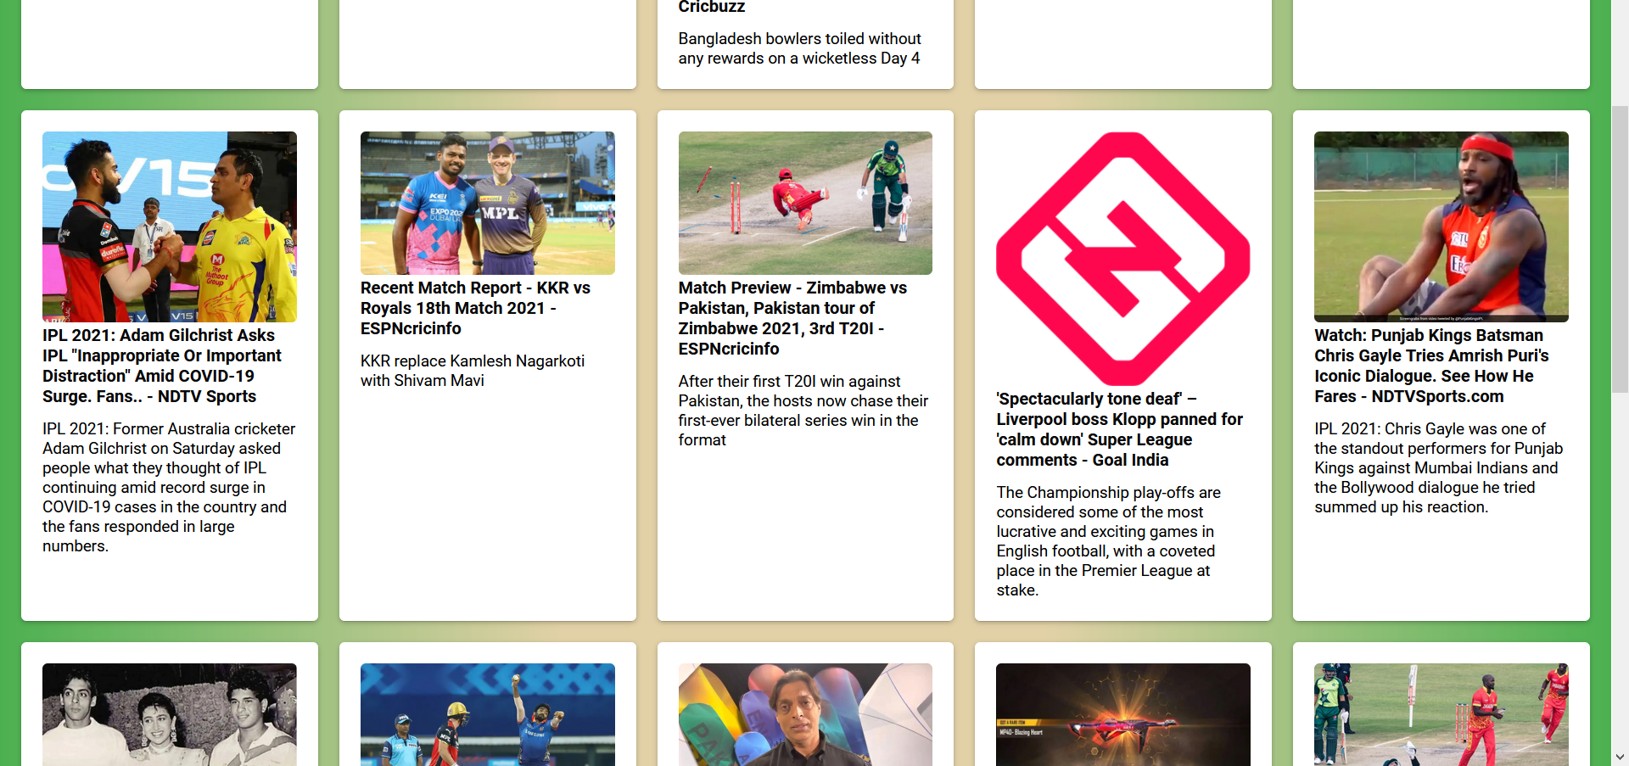
Latest Sports News

Slide 13
Future Prospects
Bio of players from Wikipedia
Best shot highlights from YouTube
Functionality with Facebook

Slide 14
Thank You ☺

