Slide 1
Variable to Java

Slide 2
First Java Program:
class Simple{
public static void main(String args[]){
System.out.println("Hello Java");
}
}
Save the above file as Simple.java.
Output: Hello Java
To compile: | javac Simple.java
To execute: | java Simple

Slide 3
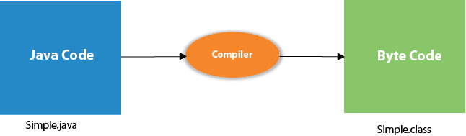
Compilation Flow:
When we compile Java program using javac tool, the Java compiler converts the source code into byte code.

Slide 4
Parameters used in First Java Program
class keyword is used to declare a class in Java.
public keyword is an access modifier that represents visibility. It means it is visible to all.
static is a keyword. If we declare any method as static, it is known as the static method. The core advantage of the static method is that there is no need to create an object to invoke the static method. The main() method is executed by the JVM, so it doesn't require creating an object to invoke the main() method. So, it saves memory.
void is the return type of the method. It means it doesn't return any value.
main represents the starting point of the program.
String[] args or String args[] is used for command line argument. We will discuss it in coming section.
System.out.println() is used to print statement. Here, System is a class, out is an object of the PrintStream class, println() is a method of the PrintStream class. We will discuss the internal working of System.out.println() statement in the coming section.

Slide 5
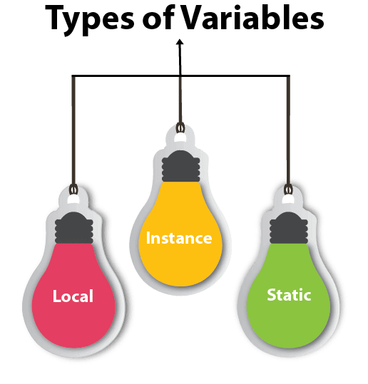
Java Variables
A variable is a container which holds the value while the Java program is executed. A variable is assigned with a data type.
Variable is a name of memory location. There are three types of variables in java: local, instance and static.
Ex: int data=50;//Here data is variable
Types of Variables:

Slide 6
1) Local Variable
A variable declared inside the body of the method is called local variable. You can use this variable only within that method and the other methods in the class aren't even aware that the variable exists.
A local variable cannot be defined with "static" keyword.
2) Instance Variable
A variable declared inside the class but outside the body of the method, is called an instance variable. It is not declared as static.
It is called an instance variable because its value is instance-specific and is not shared among instances.
3) Static variable
A variable that is declared as static is called a static variable. It cannot be local. You can create a single copy of the static variable and share it among all the instances of the class. Memory allocation for static variables happens only once when the class is loaded in the memory

Slide 7
Example to understand the types of variables in java
public class A
{
static int m=100;//static variable
void method()
{
int n=90;//local variable
}
public static void main(String args[])
{
int data=50;//instance variable
}
}//end of class

Slide 8
Java Variable Example: Add Two Numbers:
public class Simple{
public static void main(String[] args){
int a=10;
int b=10;
int c=a+b;
System.out.println(c);
}
}

Slide 9
Data Types in Java
Data types specify the different sizes and values that can be stored in the variable. There are two types of data types in Java:
Primitive data types: The primitive data types include boolean, char, byte, short, int, long, float and double.
Non-primitive data types: The non-primitive data types include Classes, Interfaces, and Arrays.
Data Type | Default Value | Default size
boolean | false | 1 bit
char | '\u0000' | 2 byte
byte | 0 | 1 byte
short | 0 | 2 byte
int | 0 | 4 byte
long | 0L | 8 byte
float | 0.0f | 4 byte
double | 0.0d | 8 byte

Slide 10
Boolean Data Type:
The Boolean data type is used to store only two possible values: true and false. This data type is used for simple flags that track true/false conditions.
Boolean b = false
Byte Data Type:
The byte data type is an example of primitive data type. It isan 8-bit signed two's complement integer. Its value-range lies between -128 to 127 (inclusive). Its minimum value is -128 and maximum value is 127. Its default value is 0.
ex: byte a = 10, byte b = -20
Short Data Type:
The short data type is a 16-bit signed two's complement integer. Its value-range lies between -32,768 to 32,767 (inclusive). Its minimum value is -32,768 and maximum value is 32,767. Its default value is 0.
Ex:
short s = 10000, short r = -5000

Slide 11
Int Data Type
The int data type is a 32-bit signed two's complement integer. Its value-range lies between - 2,147,483,648 (-2^31) to 2,147,483,647 (2^31 -1) (inclusive). Its minimum value is - 2,147,483,648and maximum value is 2,147,483,647. Its default value is 0.
Ex: int a = 100000, int b = -200000
Long Data Type
The long data type is a 64-bit two's complement integer. Its value-range lies between -9,223,372,036,854,775,808(-2^63) to 9,223,372,036,854,775,807(2^63 -1)(inclusive). Its minimum value is - 9,223,372,036,854,775,808and maximum value is 9,223,372,036,854,775,807. Its default value is 0.
Ex: long a = 100000L, long b = -200000L
Float Data Type
The float data type is a single-precision 32-bit IEEE 754 floating point.Its value range is unlimited. It is recommended to use a float (instead of double) if you need to save memory in large arrays of floating point numbers. The float data type should never be used for precise values, such as currency. Its default value is 0.0F.
float f1 = 234.5f

Slide 12
Double Data Type:
The double data type is a double-precision 64-bit IEEE 754 floating point. Its value range is unlimited. The double data type is generally used for decimal values just like float. The double data type also should never be used for precise values, such as currency. Its default value is 0.0d.
Ex: double d1 = 12.3
Char Data Type
The char data type is a single 16-bit Unicode character. Its value-range lies between '\u0000' (or 0) to '\uffff' (or 65,535 inclusive).The char data type is used to store characters.
char letterA = 'A'

Slide 13
Interview Preparation …..?
https://www.sanfoundry.com/tough-java-questions-answers/
https://www.scribd.com/document/497755267/Data-Types-in-Java
1.what is local variable
2.what is instance variable
3.data types ???
4.what is type Conversation ?
5.what is static variable ?

