Slide 1

Capstone Project / Major Project
Course Code: <Course Code>
SkipQ: Geofenced Campus Canteen Pre-Ordering & Queue Optimization Platform
Group ID | GRP-SQ-01
Enrollment No | [Your Enrollment Number(s)]
Name | [Student Name(s)]
Branch | Department of Computer Engineering
Guide Name | [Faculty Guide Name]

Slide 2
Index
• Introduction
• Background and Motivation
• Relevance and Importance
• Literature Survey
• Objectives
• UML Diagrams (Use Case, Class, Sequence)
• Work carried out till date (Table format)
• Timeline Chart
• References
DEPARTMENT OF COMPUTER ENGINEERING • *Proprietary material of SILVER OAK UNIVERSITY
2

Slide 3
Introduction
• Research Domain: Mobile Application Architecture, Localized Micro-Commerce, and Queueing Optimization in high-density institutional dining environments.
• Problem Statement: Higher education campuses face massive peak-hour dining congestion during designated 15–30 minute break windows, causing physical queue delays and lost instructional time.
• SkipQ Concept: An end-to-end geofenced pre-ordering platform combining a Student Radar interface with a real-time Canteen POS (Point of Sale) terminal.
• Core Philosophy: Zero-delivery campus self-pickup with live kitchen status, transparent preparation time estimation, and automated anti-hoarding queue management.
DEPARTMENT OF COMPUTER ENGINEERING • *Proprietary material of SILVER OAK UNIVERSITY
3

Slide 4
Background and Motivation
• Peak Synchronized Demand: College schedules release thousands of students simultaneously, overwhelming campus canteen billing counters.
• Manual Bottlenecks & Operational Chaos: Paper tokens lead to lost receipts, order mix-ups, verbal announcement miscommunication, and untracked kitchen queues.
• Commercial Platform Incompatibility: Public food delivery platforms (Zomato/Swiggy) charge high commissions (25-30%), demand high delivery fees, and fail to accommodate internal campus walking patterns.
• Motivation: To engineer a localized, cost-effective campus ecosystem empowering students to skip lines while enabling canteen vendors to level kitchen load effectively.
DEPARTMENT OF COMPUTER ENGINEERING • *Proprietary material of SILVER OAK UNIVERSITY
4

Slide 5
Relevance and Importance
• Value for Students: Saves 15–20 minutes per break; provides live prep timers, dietary tag filtering (Veg, Vegan, Spicy), and instant digital pickup passes.
• Value for Canteen Vendors: Digitized order queue with 'Rush Mode' throttling, zero-hardware overhead, live stock management, and immediate order throughput gains.
• Value for Campus Administration: Decongests dining halls, enhances safety/hygiene protocols, and modernizes campus digital infrastructure.
• Academic & Research Contribution: Introduces a practical integration of Haversine geofencing with client-side state machine queue orchestration and anti-hoarding penalties.
DEPARTMENT OF COMPUTER ENGINEERING • *Proprietary material of SILVER OAK UNIVERSITY
5

Slide 6
Literature Survey
Feature / Dimension | Commercial Apps (Zomato/Swiggy) | Traditional Campus POS | Proposed System (SkipQ)
Geofencing & Campus Focus | City-wide delivery; no campus micro-boundary restrictions | On-premise only; physical presence required at billing | Campus boundary geofencing via Haversine calculation
Cost & Commission Structure | High commission (20-30%) + delivery charges | Fixed POS terminal hardware + software AMC licensing | Zero delivery commission; runs on accessible mobile devices
Queue & Anti-Hoarding Mechanism | Delivery boy pickup; no student pickup pass countdown | Paper token slips prone to misplacement and fraud | Dynamic Digital Pickup Pass with verification code & ban policy
DEPARTMENT OF COMPUTER ENGINEERING • *Proprietary material of SILVER OAK UNIVERSITY
6

Slide 7
Objectives
• 1. Develop a Unified Dual-Role Application: Seamless toggle between Student Buyer (radar, cart, order) and Canteen Seller (POS ticket queue, inventory management).
• 2. Implement Campus Geofencing: Integrate real-time GPS location validation using the Haversine formula to enforce ordering eligibility within campus coordinates.
• 3. Live Kitchen Ticket Management: Enable real-time multi-stage order tracking (Pending ➔ In-Prep ➔ Ready for Pickup ➔ Completed) with Rush Mode rate-limiting.
• 4. Anti-Hoarding & Penalty Protocol: Build an automated penalty mechanism to identify unclaimed orders and temporarily restrict serial defaulters.
• 5. High Usability & Offline-First State: Ensure persistent state storage (AsyncStorage) with low latency, snappy navigation, and an intuitive dark-themed UI.
DEPARTMENT OF COMPUTER ENGINEERING • *Proprietary material of SILVER OAK UNIVERSITY
7

Slide 8
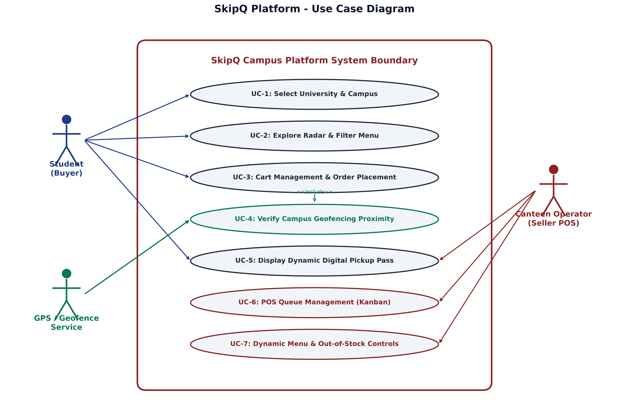
UML Diagram - Use Case Diagram
Actors & Functional Boundaries:
• Student Actor (Buyer):
• Select University Campus & view Radar
• Filter Menu (Veg/Vegan/Spicy)
• Add to Cart & Checkout
• View Live Dynamic Pickup Pass
• GPS Geofence Service:
• Automatically validates campus radius before payment <<include>>
• Canteen Operator (POS Seller):
• Manage ticket pipeline (Pending ➔ Prep ➔ Ready)
• Toggle Rush Mode & modify out-of-stock items
• Verify pass code & finalize order
DEPARTMENT OF COMPUTER ENGINEERING • *Proprietary material of SILVER OAK UNIVERSITY
8

Slide 9
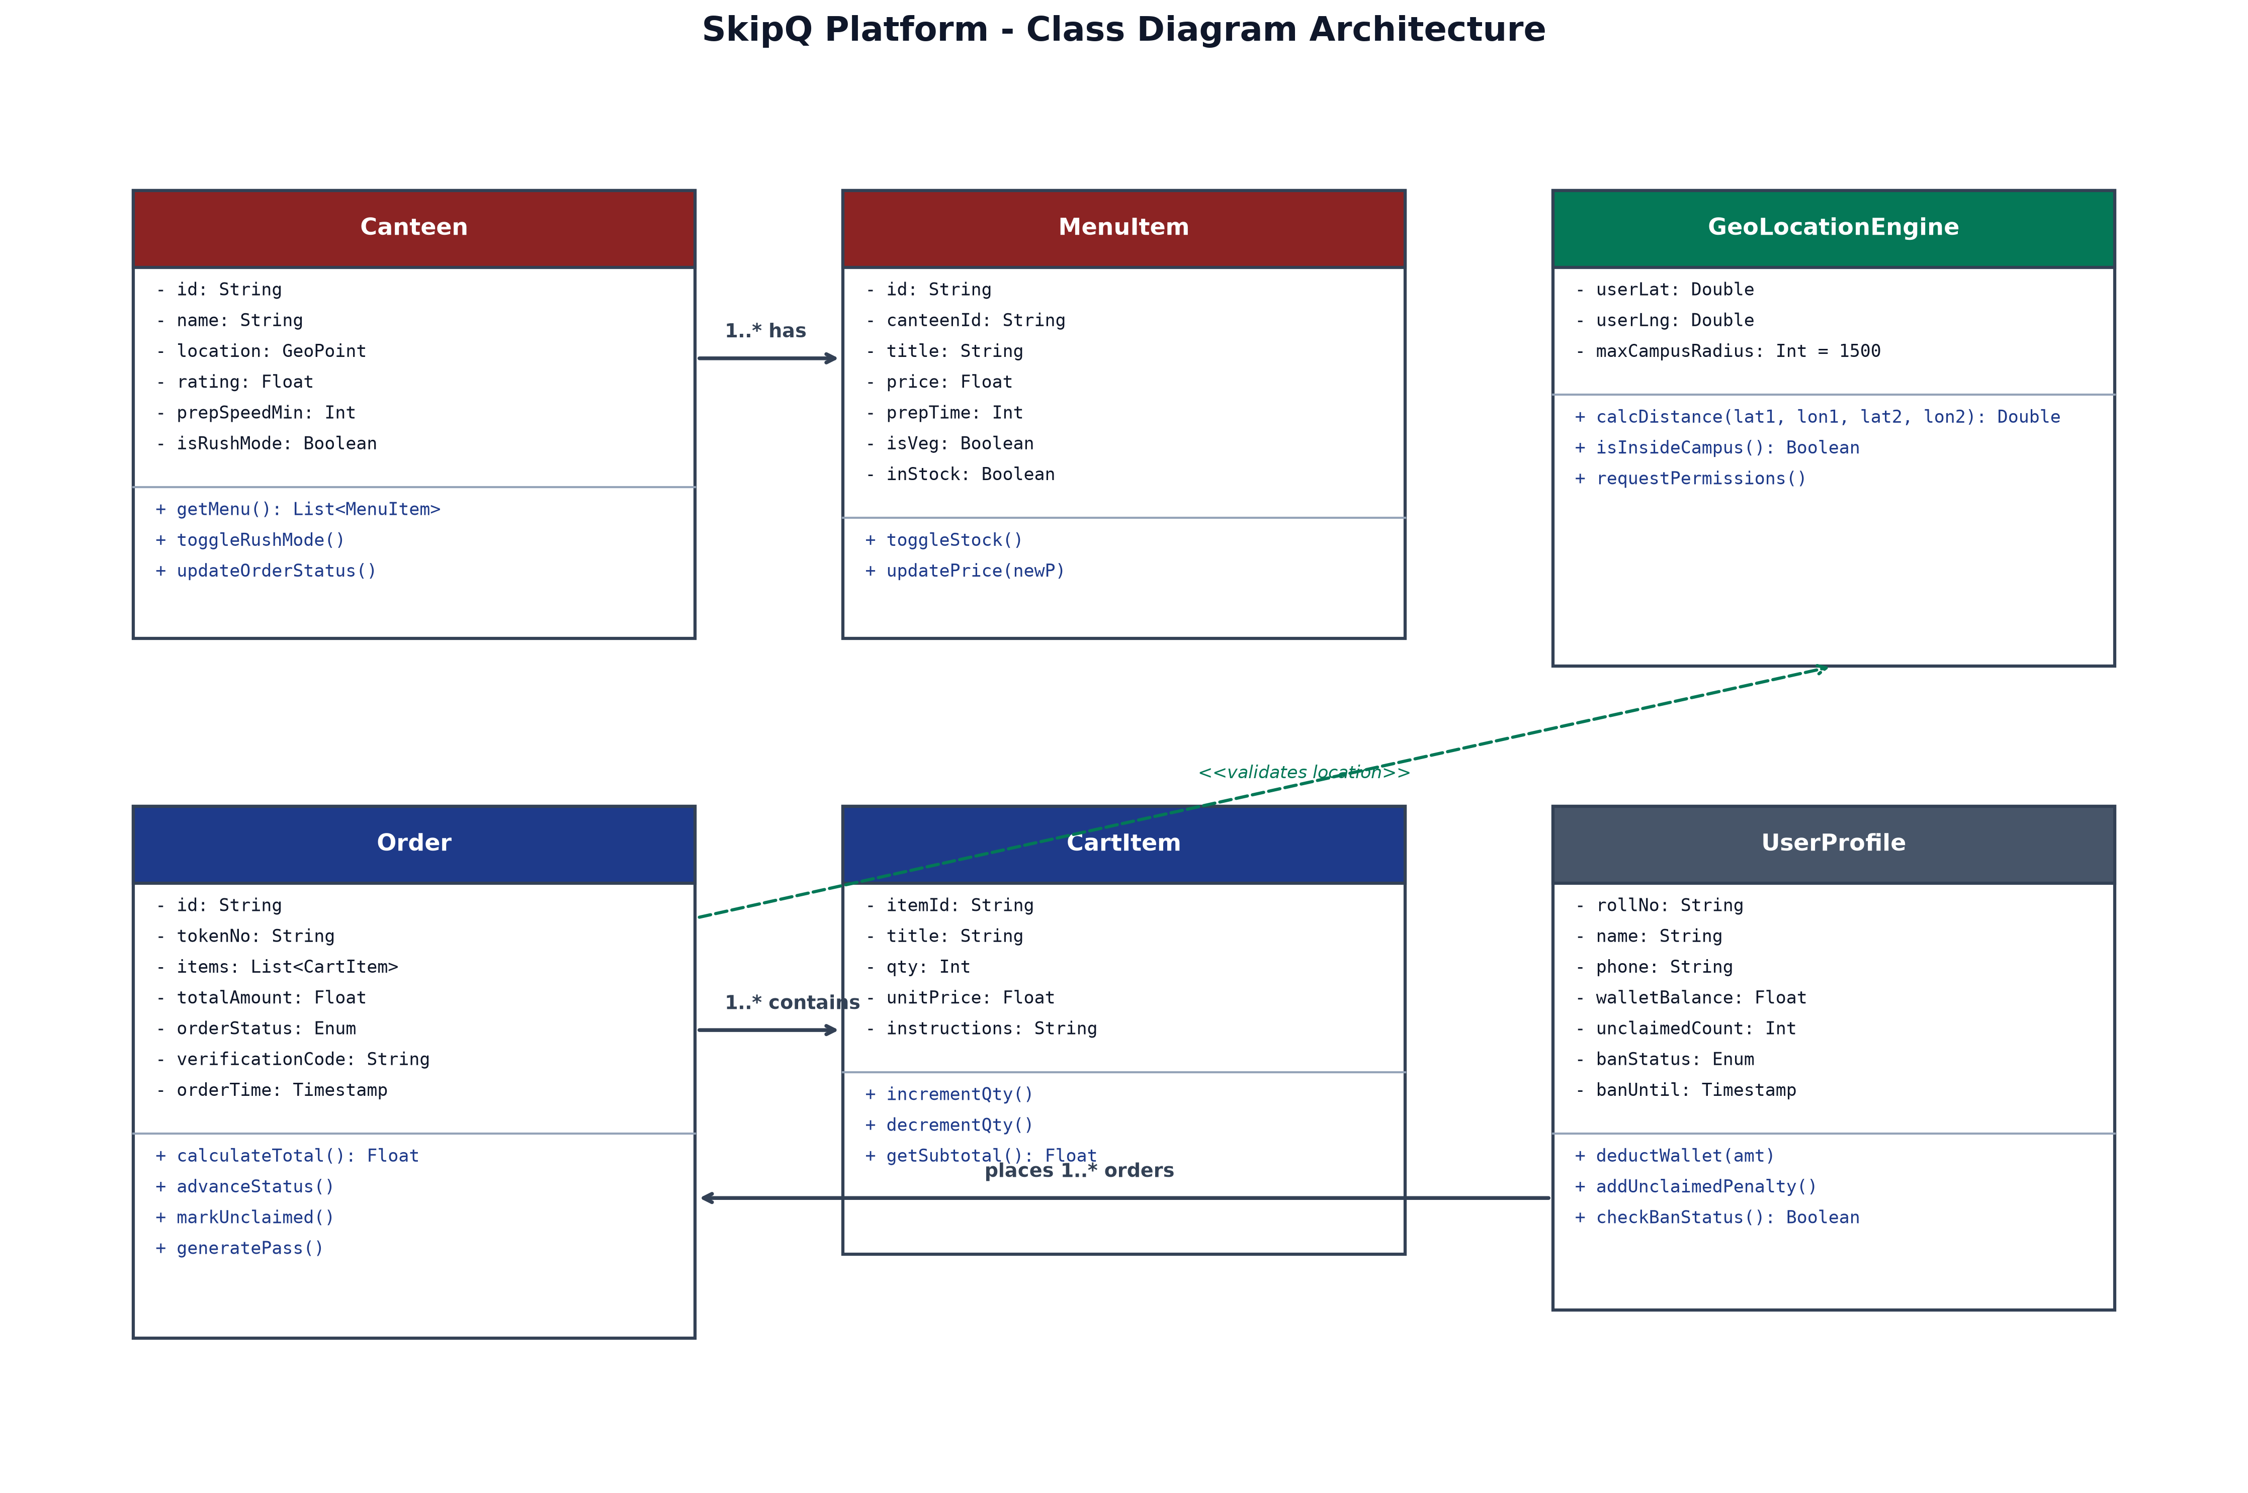
UML Diagram - Class Diagram
Core Data Entities & Logic:
• Canteen Class:
• Holds shop metadata, rush status & rating
• 1-to-many relationship with MenuItem
• MenuItem Class:
• Stores pricing, preparation time & dietary flags
• Order & CartItem Entities:
• Encapsulates order state transitions & token ID
• UserProfile Class:
• Tracks student wallet & penalty counter
• GeoLocationEngine Utility:
• Haversine formula calculation for campus bounding
DEPARTMENT OF COMPUTER ENGINEERING • *Proprietary material of SILVER OAK UNIVERSITY
9

Slide 10
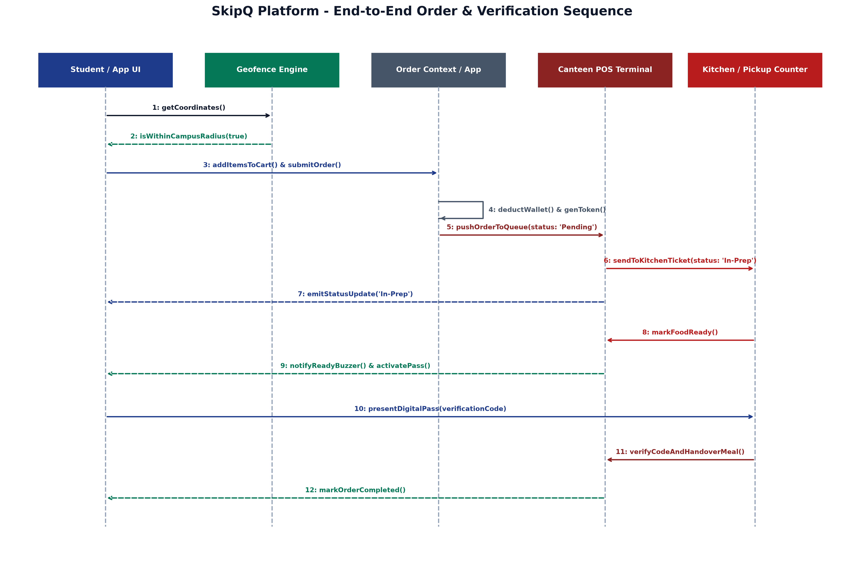
UML Diagram - Sequence Diagram
End-to-End Execution Flow:
• 1. Geofence Check:
• Student GPS polled & validated within 1500m radius
• 2. Order & Payment:
• Wallet deducted & ticket appended to Canteen POS
• 3. Kitchen Processing:
• POS advances state: Pending ➔ In-Prep
• 4. Ready Buzzer & Notification:
• Student app activates Digital Pickup Pass
• 5. Handover & Verification:
• Vendor verifies code & marks ticket 'Completed'
DEPARTMENT OF COMPUTER ENGINEERING • *Proprietary material of SILVER OAK UNIVERSITY
10

Slide 11
Work carried out till date
Sr. No. | Module / Component | Detailed Work Description | Tech Stack | Status (%)
1 | Campus Radar & UI | Built responsive Student Radar, dietary filter pills, search bar, and canteen cards | React Native, Vanilla CSS | 100% (Done)
2 | Geofencing Engine | Implemented GPS coordinates calculation using Haversine distance formula | expo-location, JS Math | 100% (Done)
3 | Canteen POS Terminal | Developed live Kanban order board, Rush Mode switch, and menu modifier modals | React Context, React Native | 100% (Done)
4 | Digital Pass & Ban Logic | Engineered live QR/Token pass, pickup countdown timer, and penalty ban trigger | AsyncStorage, JS Timers | 100% (Done)
5 | Backend & Live Sync | Integration with real-time database (Supabase / WebSockets) for multi-device sync | Node.js / REST / Socket | 65% (In Progress)
DEPARTMENT OF COMPUTER ENGINEERING • *Proprietary material of SILVER OAK UNIVERSITY
11

Slide 12
Timeline Chart
Phase | Milestone / Deliverable Tasks | Duration | Progress Status
Phase 1: Planning | Literature review, survey analysis, and requirement specification | Weeks 1 – 3 | Completed
Phase 2: Architecture | System modeling, UML diagrams, and UI/UX design wireframing | Weeks 4 – 6 | Completed
Phase 3: Core Frontend | Student Radar, Canteen POS, Geofencing, and Pass UI components | Weeks 7 – 10 | Completed
Phase 4: Order Engine | Cart management, token generation, anti-hoarding ban rules | Weeks 11 – 13 | Completed
Phase 5: Deployment | Cloud database synchronization, pilot testing, and user feedback | Weeks 14 – 16 | In Progress
DEPARTMENT OF COMPUTER ENGINEERING • *Proprietary material of SILVER OAK UNIVERSITY
12

Slide 13
References
[1] A. Kumar and S. Sharma, "Optimizing Campus Canteen Ordering Systems Using Mobile Geofencing and Queue Theory," *IEEE International Conference on Smart Technologies*, pp. 112-118, 2023.
[2] R. Patel, K. Mehta, and N. Shah, "Design and Implementation of Micro-Commerce Architecture for Educational Institutions," *International Journal of Computer Applications*, vol. 182, no. 45, pp. 24-31, 2022.
[3] React Native Core Documentation, "Building Cross-Platform Mobile Applications with Persistent Storage and Geolocation Services," Meta Open Source, 2024. [Online]. Available: https://reactnative.dev
[4] Expo Framework Guidelines, "Location Tracking, Foreground Permissions and Mobile State Management," Expo Documentation, 2025. [Online]. Available: https://docs.expo.dev
[5] M. Verma and D. Joseph, "Mitigating No-Show Defaulters in Queue-based Food Delivery Workflows using Temporal Token Bans," *Journal of Software Engineering and Applications*, vol. 15, no. 8, pp. 310-322, 2024.
DEPARTMENT OF COMPUTER ENGINEERING • *Proprietary material of SILVER OAK UNIVERSITY
13

