Slide 1
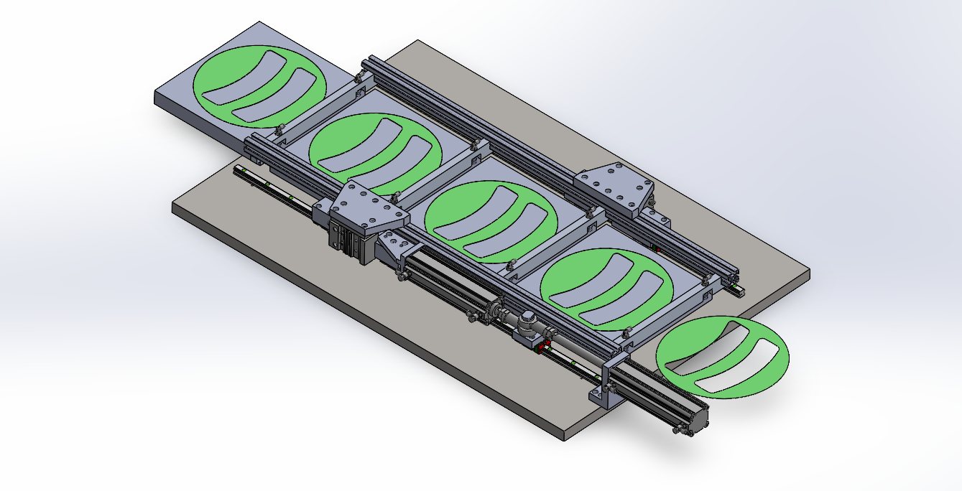
Position-1 Initial Condition
CQ2A40-150DCMZ(0_0)_1 =150
CQ2A40-150DCMZ(0_0)_2=0
MGPKFM25-10(0_0) =0

Slide 2
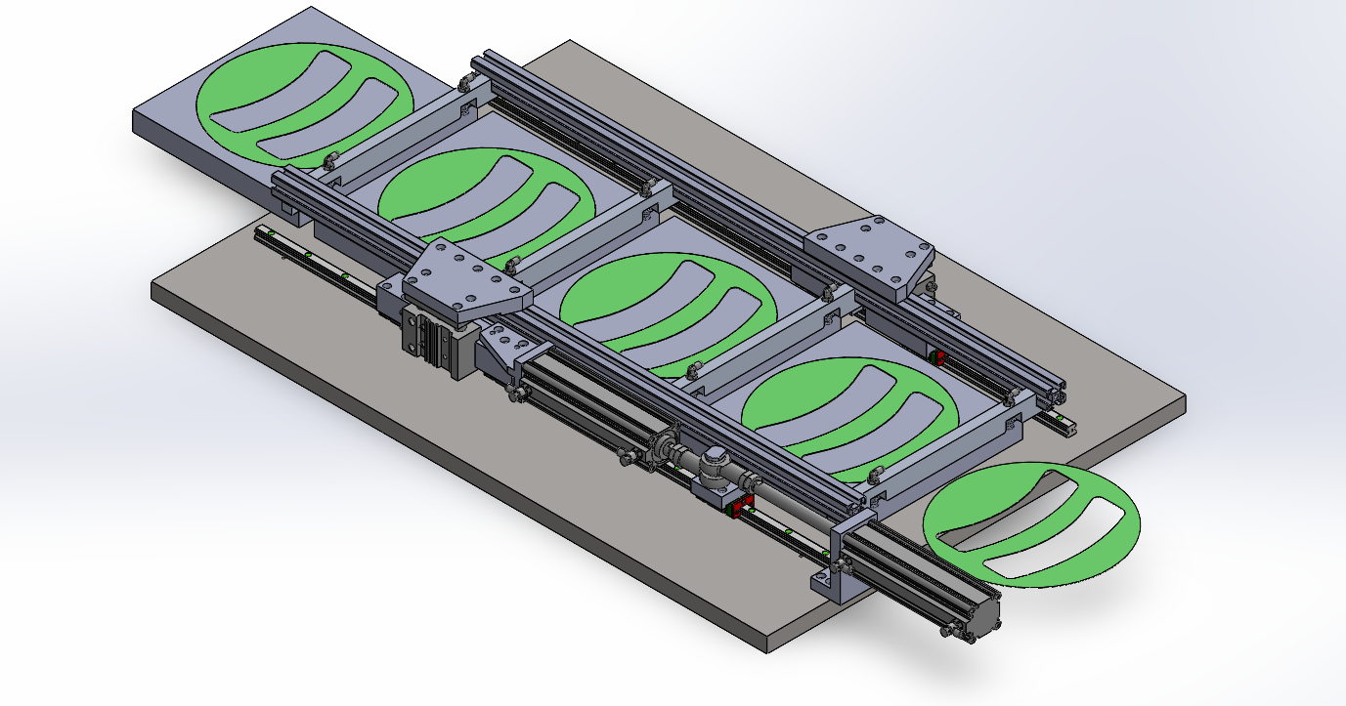
CQ2A40-150DCMZ(0_0)_1 =150
CQ2A40-150DCMZ(0_0)_2=0
MGPKFM25-10(0_0) =10
Position-2

Slide 3
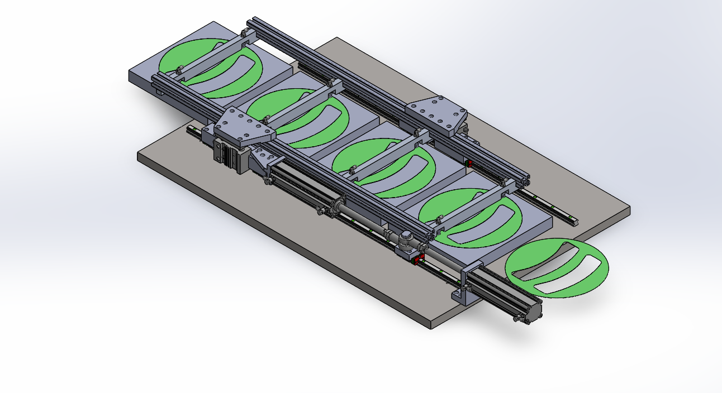
CQ2A40-150DCMZ(0_0)_1 =150
CQ2A40-150DCMZ(0_0)_2=147.5
MGPKFM25-10(0_0) =10
Position-3

Slide 4
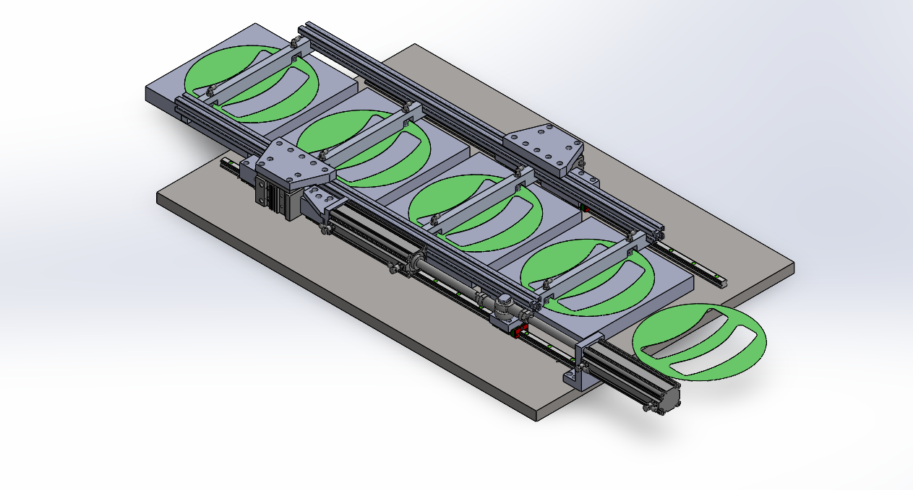
Position-4
CQ2A40-150DCMZ(0_0)_1 =150
CQ2A40-150DCMZ(0_0)_2=147.5
MGPKFM25-10(0_0) =0

Slide 5
Position-5
CQ2A40-150DCMZ(0_0)_1 =150
CQ2A40-150DCMZ(0_0)_2=147.5
MGPKFM25-10(0_0) =10

Slide 6
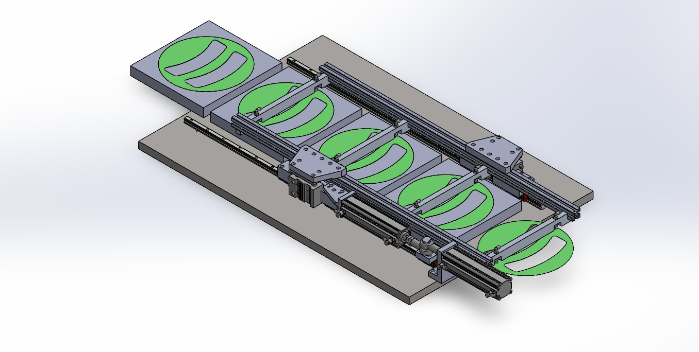
CQ2A40-150DCMZ(0_0)_1 =2.5
CQ2A40-150DCMZ(0_0)_2=0
MGPKFM25-10(0_0) =10
Position-6

Slide 7
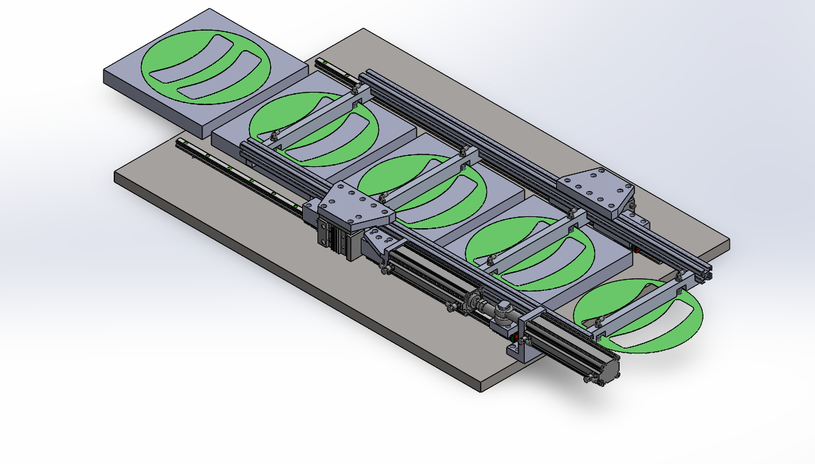
CQ2A40-150DCMZ(0_0)_1 =2.5
CQ2A40-150DCMZ(0_0)_2=0
MGPKFM25-10(0_0) =0
Position-7

Slide 8
Position-8
CQ2A40-150DCMZ(0_0)_1 =2.5
CQ2A40-150DCMZ(0_0)_2=0
MGPKFM25-10(0_0) =10

Slide 9
CQ2A40-150DCMZ(0_0)_1 =150
CQ2A40-150DCMZ(0_0)_2=0
MGPKFM25-10(0_0) =10
Position-9

Slide 10
Position-10
Back to Initial Condition
CQ2A40-150DCMZ(0_0)_1 =150
CQ2A40-150DCMZ(0_0)_2=0
MGPKFM25-10(0_0) =0

