Slide 1
Navigating The Future of Online Shopping
Ecommerce Analysis Using Python and SQL
SQL (MySQL) – Data Extraction, Querying
Python (Pandas, Matplotlib) – Data Analysis, Visualization
VsCode – Implementation
Workflow – Data Cleaning > Analysis > Visualization > Insights
-Shreyash Kale

Slide 2
About Company
This dataset captures transactional data from a multi-category e-commerce platform that connects customers and sellers across diverse regions. The platform supports a broad product catalog and flexible payment options, including installment plans.
As competition in the e-commerce landscape intensifies, analyzing customer behavior, sales performance, and seller contributions becomes essential for driving sustainable business growth.

Slide 3
Insights - Basics
Objective: Extract fundamental insights from the dataset.
Unique cities where customers are located – 4119 cities
Number of orders placed in 2017 – 45,101 orders
Total sales per category – health & Beauty Rs 1.25m
Percentage of orders paid in installments – 51.46%
Number of customers from each state – SP leads with 41,746

Slide 4

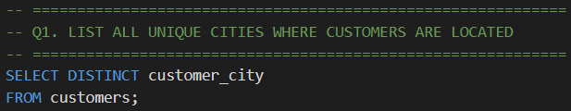
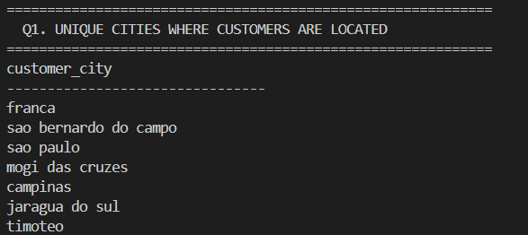
Q1. LIST ALL UNIQUE CITIES WHERE CUSTOMERS ARE LOCATED
Code: python
Query: Sql
Output
Output

Slide 5
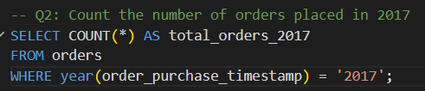
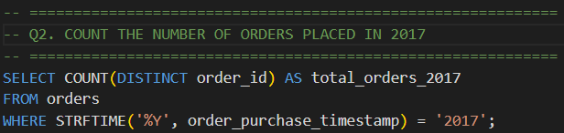
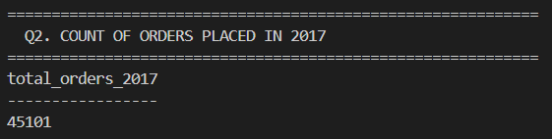
Q2. COUNT THE NUMBER OF ORDERS PLACED IN 2017
Code: python
Query: Sql
Output
Output

Slide 6
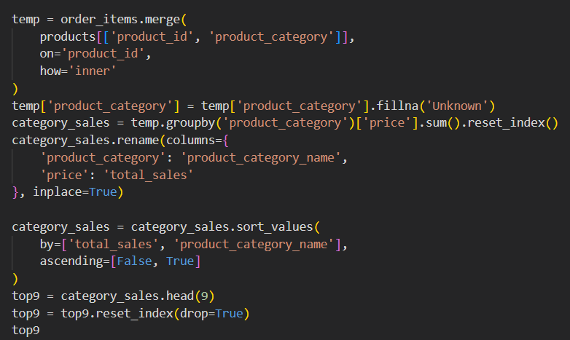
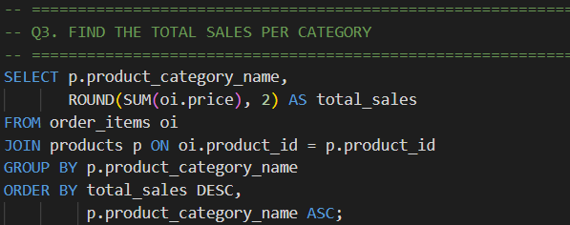
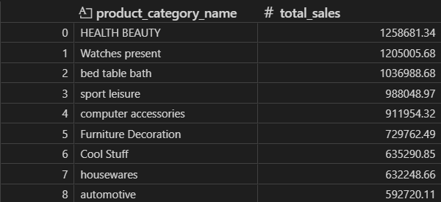
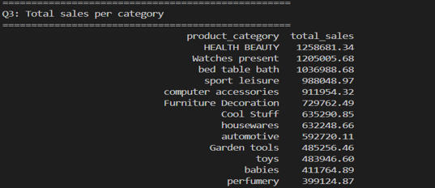
Q3. FIND THE TOTAL SALES PER CATEGORY
Code: python
Query: Sql
Output
Output

Slide 7
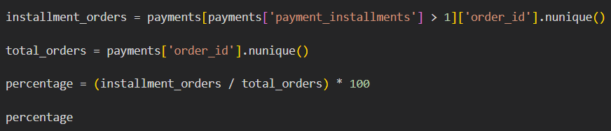
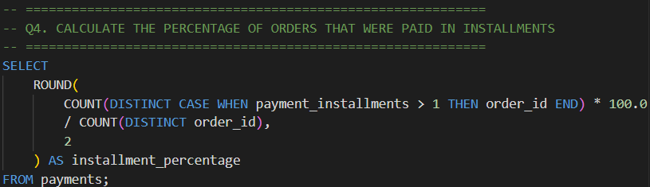
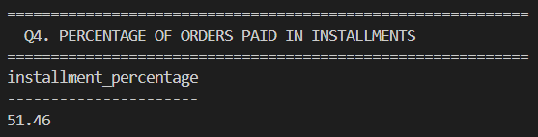
Q4. CALCULATE THE PERCENTAGE OF ORDERS THAT WERE PAID IN INSTALLMENTS
Code: python
Query: Sql
Output
Output

Slide 8

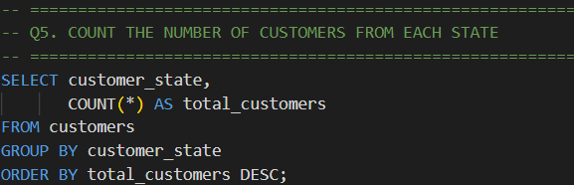
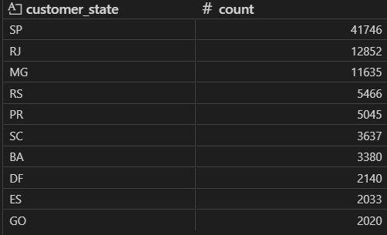
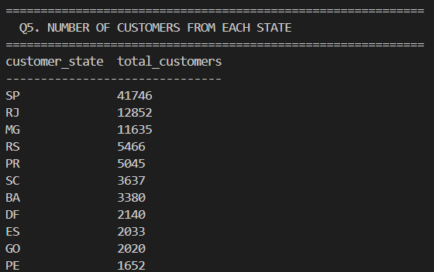
Q5. COUNT THE NUMBER OF CUSTOMERS FROM EACH STATE
Code: python
Query: Sql
Output
Output

Slide 9
Insights - Intermediate
Objective: Dive deeper into sales and order trends.
Orders per month in 2018 – January peak 7269 orders
Avg products per order by city – Padre Carvalho, 7 products/orders
Revenue % by product category – Health & Beauty 9.26%
Price vs purchase frequency – Most purchased products, 527 times
Total revenue by seller ranked – Top seller, Rs 2,29,472

Slide 10
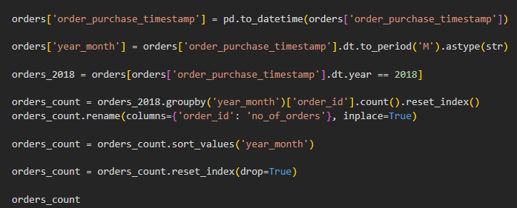
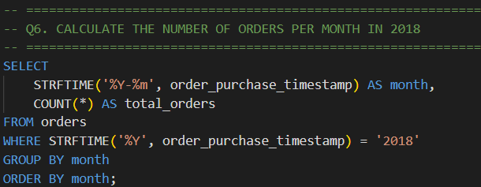
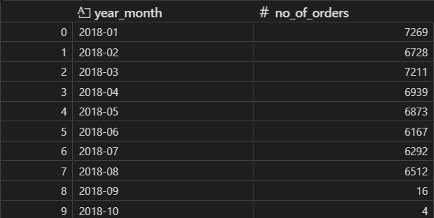
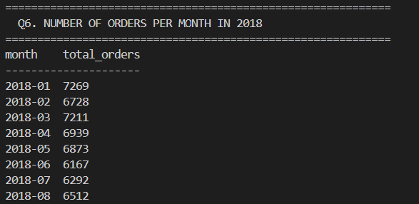
Q6. CALCULATE THE NUMBER OF ORDERS PER MONTH IN 2018
Code: python
Query: Sql
Output
Output

Slide 11
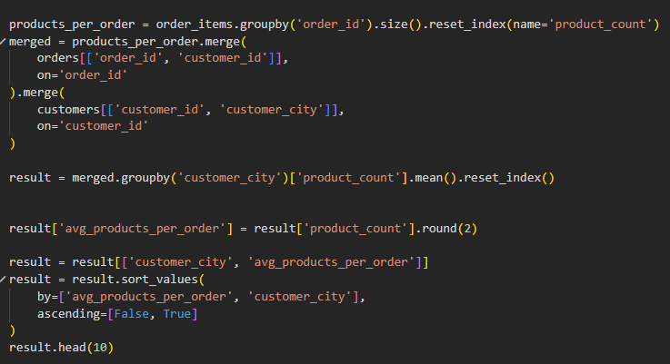
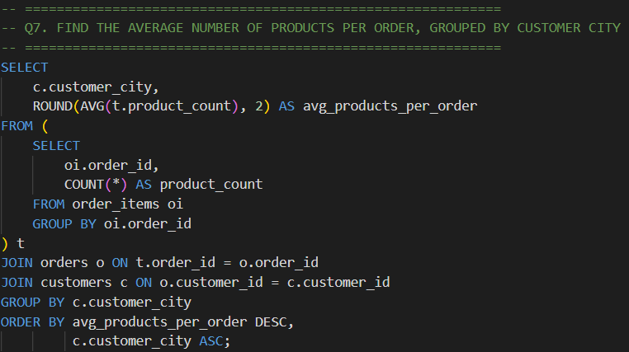
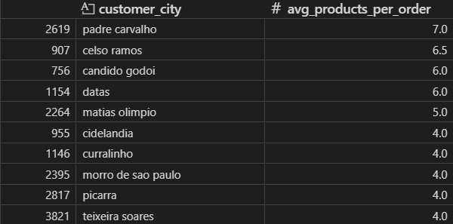
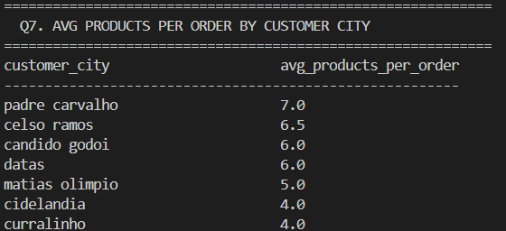
Q7. FIND THE AVERAGE NUMBER OF PRODUCTS PER ORDER, GROUPED BY CUSTOMER CITY
Code: python
Query: Sql
Output
Output

Slide 12
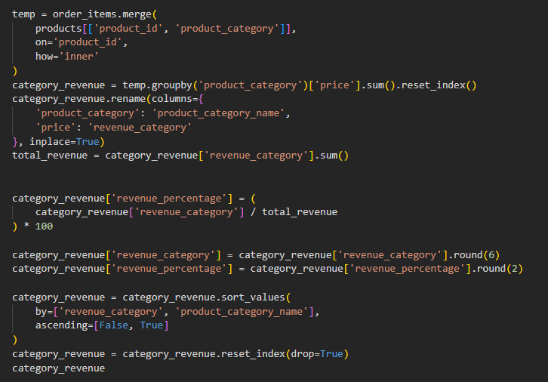
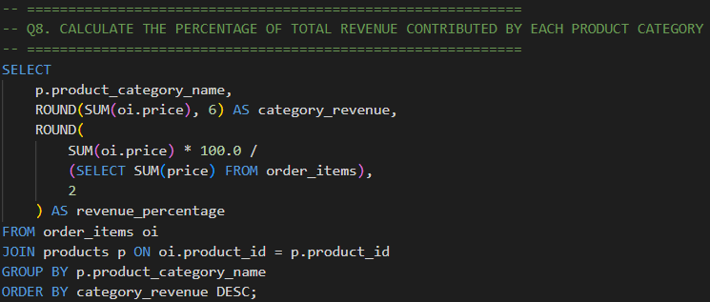
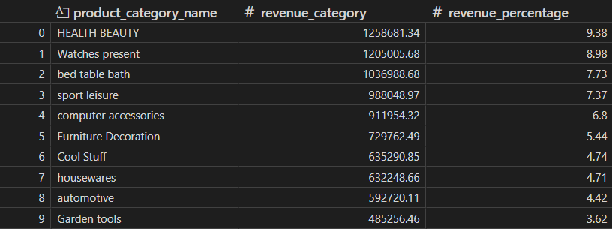
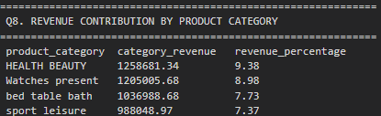
Q8. CALCULATE THE PERCENTAGE OF TOTAL REVENUE CONTRIBUTED BY EACH PRODUCT CATEGORY
Code: python
Query: Sql
Output
Output

Slide 13
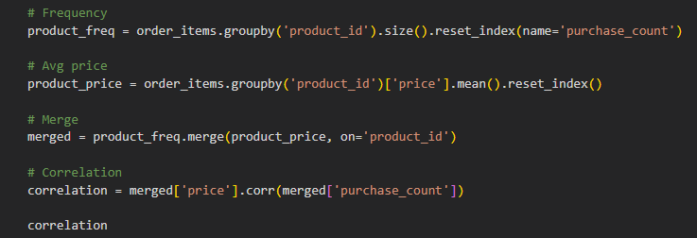
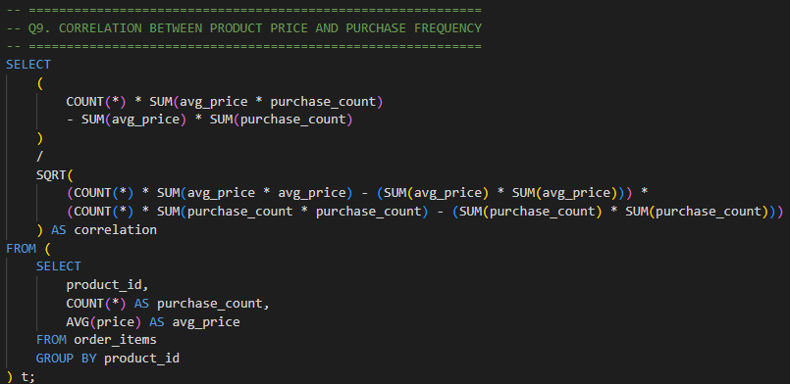
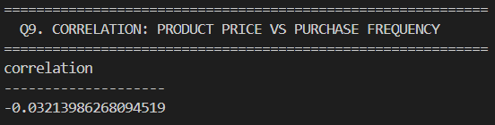
Q9. IDENTIFY THE CORRELATION BETWEEN PRODUCT PRICE AND THE NUMBER OF TIMES A PRODUCT HAS BEEN PURCHASED
Code: python
Query: Sql
Output
Output

Slide 14
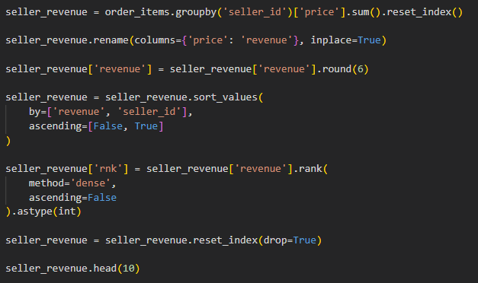
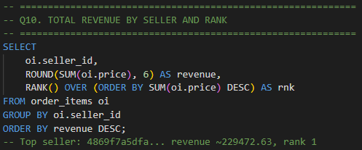
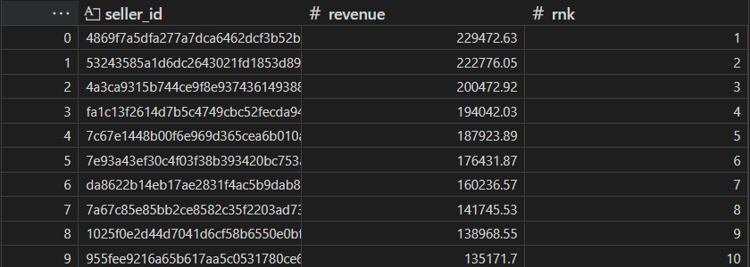
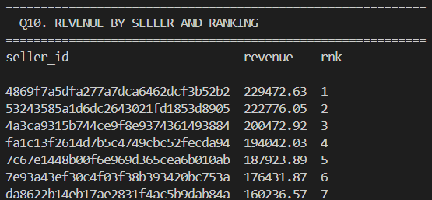
Q10. CALCULATE THE TOTAL REVENUE GENERATED BY EACH SELLER, AND RANK THEM BY REVENUE
Code: python
Query: Sql
Output
Output

Slide 15
Insights - Advanced
Objective: Generate strategic and customer-centric insights.
Moving average of order values – Tracks customer spending trends
Cumulative sales per month – 2018 hit, Rs 6.35 by August
Year-over-year growth rate – 2017 grew 12,745% vs 2016
Customer retention rate – 0% most buy only once
Top 3 customers per year – 2017 top spender, Rs 13,440

Slide 16
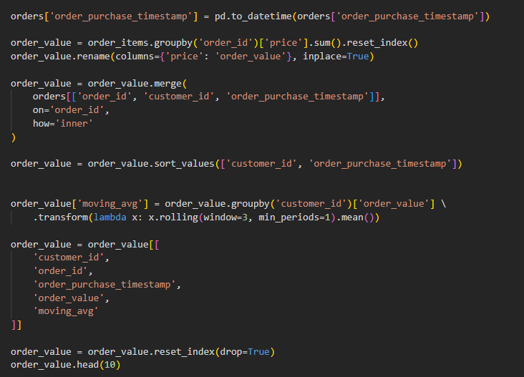
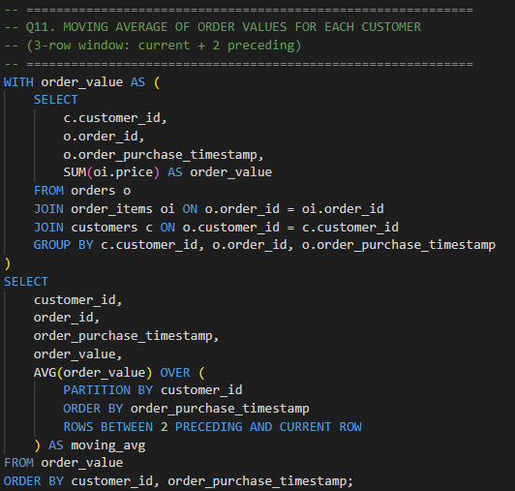
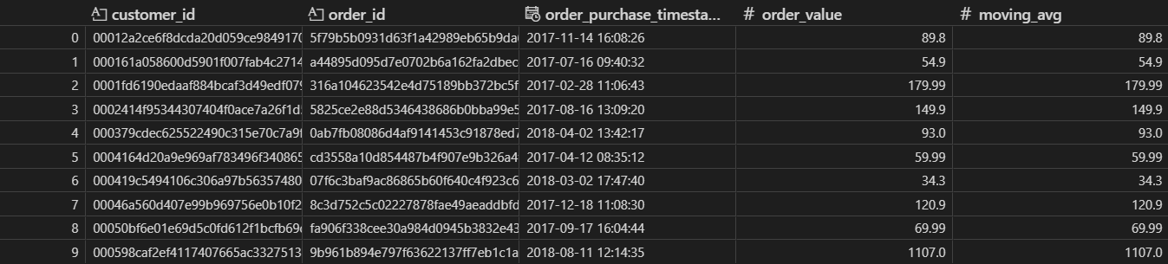
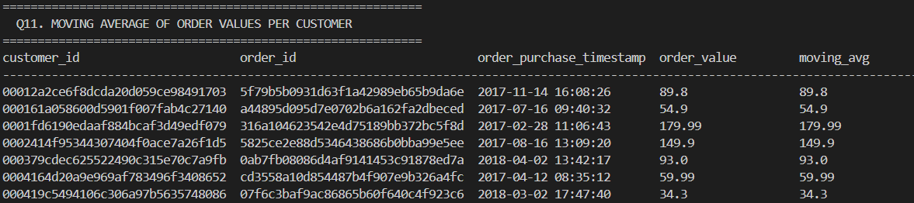
Q11. CALCULATE THE MOVING AVERAGE OF ORDER VALUES FOR EACH CUSTOMER OVER THEIR ORDER HISTORY
Code: python
Query: Sql
Output
Output

Slide 17
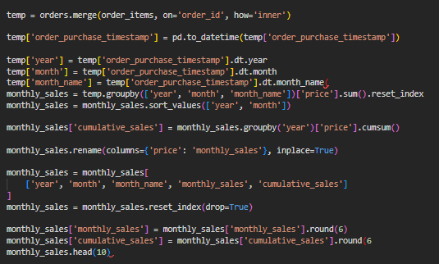
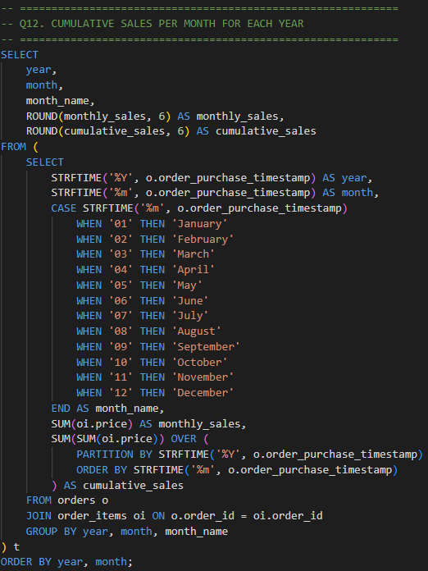
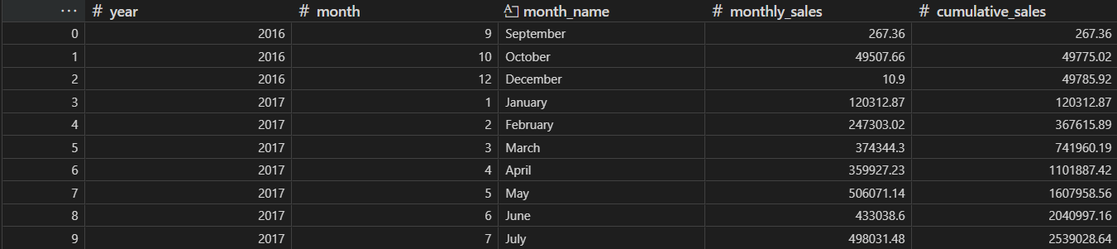
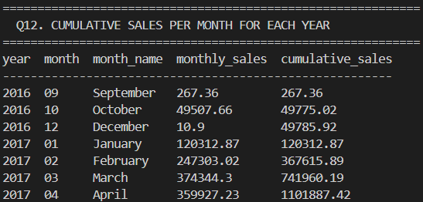
Q12. CALCULATE THE CUMULATIVE SALES PER MONTH FOR EACH YEAR
Code: python
Query: Sql
Output
Output

Slide 18
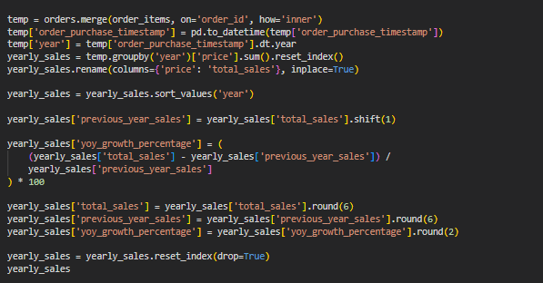
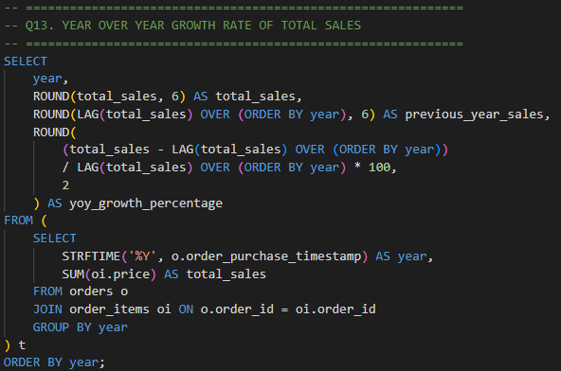
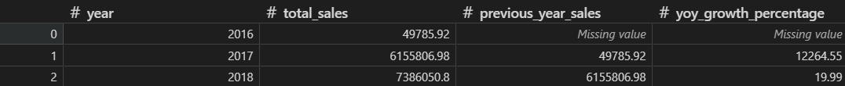
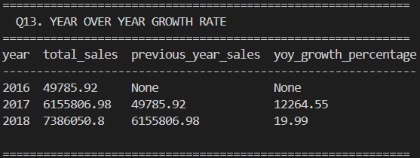
Q13. CALCULATE THE YEAR OVER YEAR GROWTH RATE OF TOTAL SALES
Query: Sql
Code: python
Output
Output

Slide 19
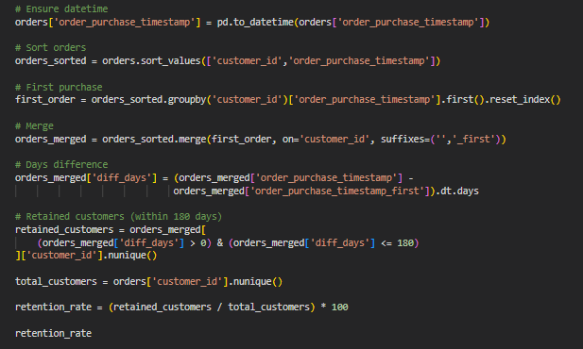
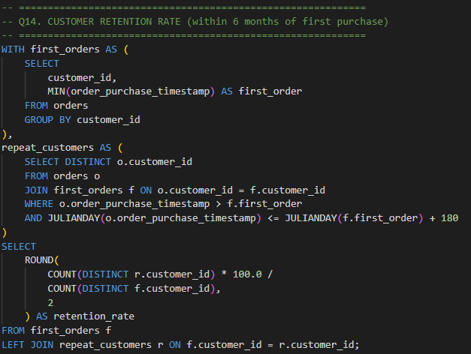

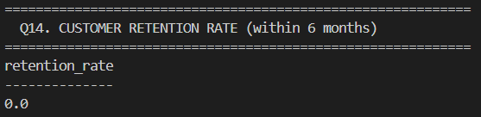
Q14. CALCULATE THE RETENSION RATE OF CUSTOMERS, DEFINED AS THE PERCENTAGE OF CUSTOMERS WHO MAKE ANOTHER PURCHASE WITHIN 6 MONTHS OF THEIR FIRST PURCHASE
Code: python
Query: Sql
Output
Output

Slide 20
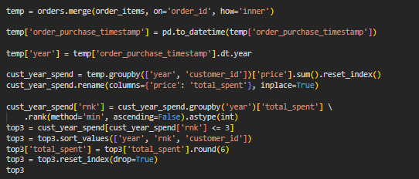



Q15. IDENTIFY THE TOP 3 CUSTOMERS WHO SPENT THE MOST MONEY IN EACH YEAR
Code: python
Query: Sql
Output
Output

Slide 21
Key Business Insight
1. São Paulo dominates — SP state has 42% of all customers
2. Health & Beauty is top category — Rs1.25M in total sales
3. Half of customers pay in installments — 49.42% use installment plans
4. Massive growth in 2017 — Business grew 12,745% compared to 2016
5. Low retention rate — Most customers purchase only once, suggesting need for loyalty programs
6. Seasonal peaks — November 2017 had highest monthly sales (Rs863K) likely due to Black Friday

Slide 22
Thank You
Github: https://github.com/itsShreyashkale
Linkedin: https://www.linkedin.com/in/shreyash-kale-204b0a228/

