Slide 1

Tanzir Hossain
20301154

Slide 2

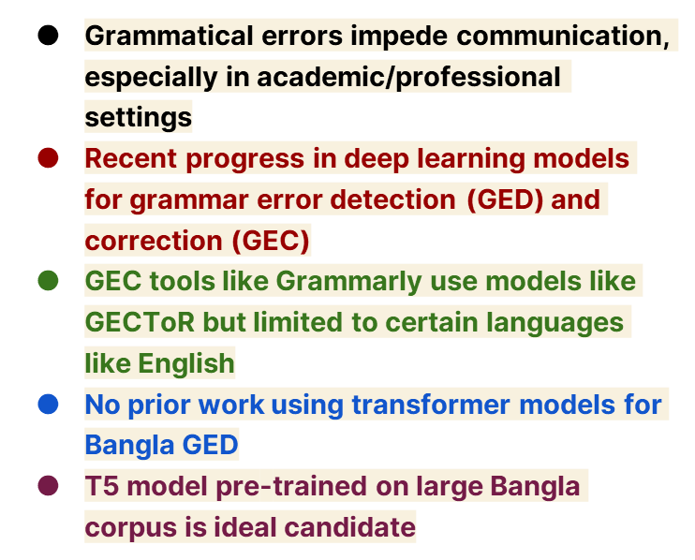

Slide 3

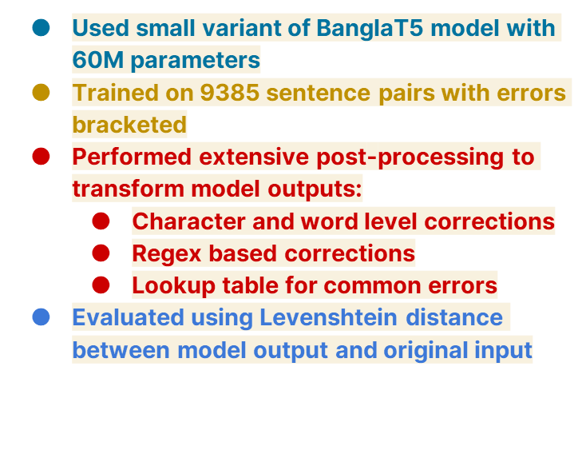

Slide 4





01
02
03
04

Slide 5
Conclusion

