Slide 1

FACEATT -A smart attendance system
TEAM : CYBER SQUAD
MEMBERS:
KAMBALAPALLY SAI SANJANA (20B81A6240)
PASPUNURI ABHISHEK (20B81A6202)
BEJAGAM ROHAN (20B81A6233)

Slide 2

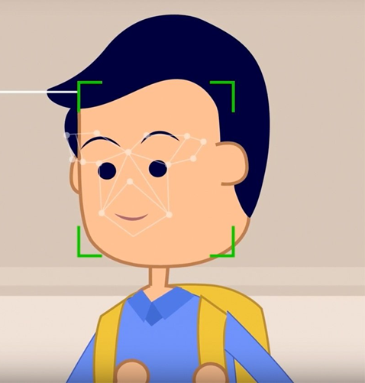

WHY SMART ATTENDANCE?
Traditionally, students’ attendance are taken manually by using attendance sheet given by faculty in class , which is a time consuming event.
It is very difficult to verify one by one student in a large classroom environment with different branches and sections.
Moreover, We don’t know whether the authenticated students are actually responding or not
This is the situation where our FACEATT comes into the picture to solve this problem.

Slide 3
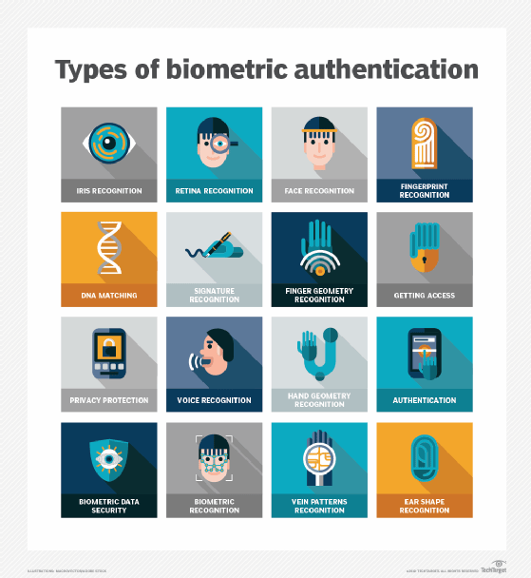
various ways of biometrics

Slide 4
HOW FACE RECOGNITION WORKS:
EVERY FACE HAS ATLEAST 80 DISTIGUISHABLE PATHS CALLED NODAL POINTS
SOME OF THEM ARE :
DISTANCE BETWEEN THE EYS
WIDTH OF NOSE
DEPTH OF EYE SOCKETS
STRUCTURE OF CHEEK BONE
LENGTH OF JAW LINE …..ETC
A GENERAL FACE RECOGNITION SOFTWARE CONDUCTS A COMPARISION OF THESE PARAMETERS TO THE IMAGES IN ITS DATABASE

Slide 5
How face recognition works???
EVERY FACE HAS ATLEAST 80 DISTIGUISHABLE PATHS CALLED NODAL POINTS
SOME OF THEM ARE :
DISTANCE BETWEEN THE EYS
WIDTH OF NOSE
DEPTH OF EYE SOCKETS
STRUCTURE OF CHEEK BONE
LENGTH OF JAW LINE …..ETC
A GENERAL FACE RECOGNITION SOFTWARE CONDUCTS A COMPARISION OF THESE PARAMETERS TO THE IMAGES IN ITS DATABASE

Slide 6

CONCEPT BEHIND FACEATT!!!
IMAGE ACQUISITION
IMAGE PROCESSING
EXTRACTION OF FACIAL FEATURES
MARKING THE ATTENDANCE
COMPARING WITH DATABASE

Slide 7

TECHNOLOGIES AND PACKAGES USED
TECHNOLOGIES:
FACE_RECOGNITION
OPENCV
MODULES:
PYTTSX3
OS
DATETIME
NUMPY

Slide 8
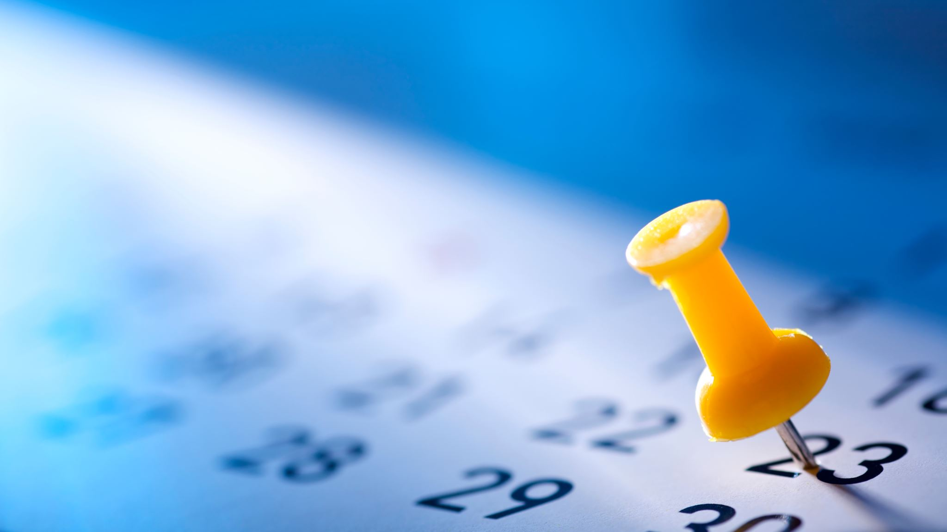
HOW FACEATT MARKS ATTENDANCE???
RECOGNIZES WHO THE PERSON IS !
RECORDING THE TIME
CALCULATING TIME LAPSE
MARKING ATTENDANCE BASED ON TIME LAPSE

Slide 9
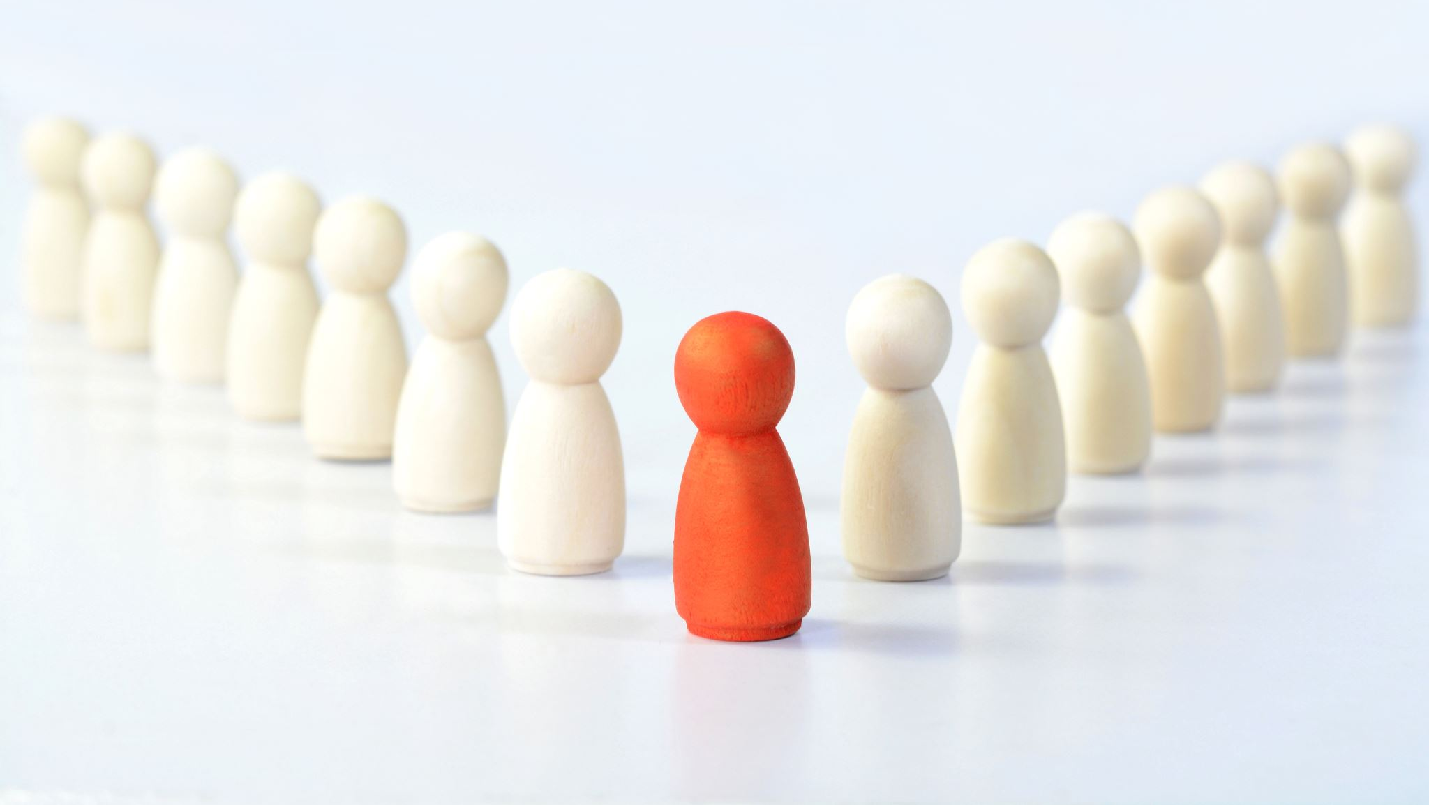
ADVANTAGES of faceatt
DECREASE THE FALSE ATTENDANCE
DECREASES BURDEN TO FACULTY
COST EFFICIENT
EASY TO IMPLEMENT

Slide 10


