Slide 1
Secure Data Hiding in Image Using Steganography
CAPSTONE PROJECT
Presented By: Vaibhav Sharma
Student Name : Vaibhav Sharma
College Name & Department : Madhav Institute of Technology & Science, Gwalior (Dept.: Centre For Artificial Intelligence)

Slide 2
OUTLINE
Problem Statement
Technology used
Wow factor
End users
Result
Conclusion
Git-hub Link
Future scope

Slide 3
Problem Statement
With the rise in cyber threats and data breaches, securing sensitive information has become a major concern. Traditional encryption methods protect data but can attract unwanted attention. This project implements steganography, a technique that hides secret data within images, making it nearly impossible to detect. Additionally, AES encryption ensures that even if the hidden data is extracted, it remains unreadable without the correct key.

Slide 4
Technology used
This project integrates multiple technologies to ensure secure and efficient data hiding:
Backend & Web Framework
Flask – Handles web requests and provides an intuitive user interface for encoding and decoding messages.
Image Processing
Pillow (PIL) – Modifies image pixels to embed encrypted data while maintaining the original quality.
NumPy – Performs pixel-level manipulations efficiently.
Security & Encryption
Cryptography (AES) – Encrypts the hidden message before embedding it into an image, adding an extra layer of security.

Slide 5
Wow factors
🔹 Dual-layer security: AES encryption ensures data remains unreadable even if extracted.
🔹 Minimal distortion: The original image quality remains virtually unchanged, making detection extremely difficult.
🔹 User-friendly interface: The project includes a simple web application where users can easily upload an image, embed data, and extract it later.
🔹 Multi-format support: Works with JPEG, PNG, BMP, and other common image formats.
🔹 Low computational overhead: Efficient use of NumPy ensures fast encoding and decoding.
🔹 Cross-platform: Can be deployed on Windows, Linux, and MacOS.

Slide 6
End users
This project benefits various groups by providing secure, hidden communication methods:
🔹 Cybersecurity Experts – Securely transmit sensitive information over public channels.
🔹 Journalists & Whistleblowers – Protect confidential sources and avoid surveillance.
🔹 Government Agencies – Securely share classified data without raising suspicion.
🔹 Organizations & Corporations – Protect trade secrets and internal communications.
🔹 Privacy Enthusiasts – Individuals who want to safeguard personal or sensitive information.

Slide 7
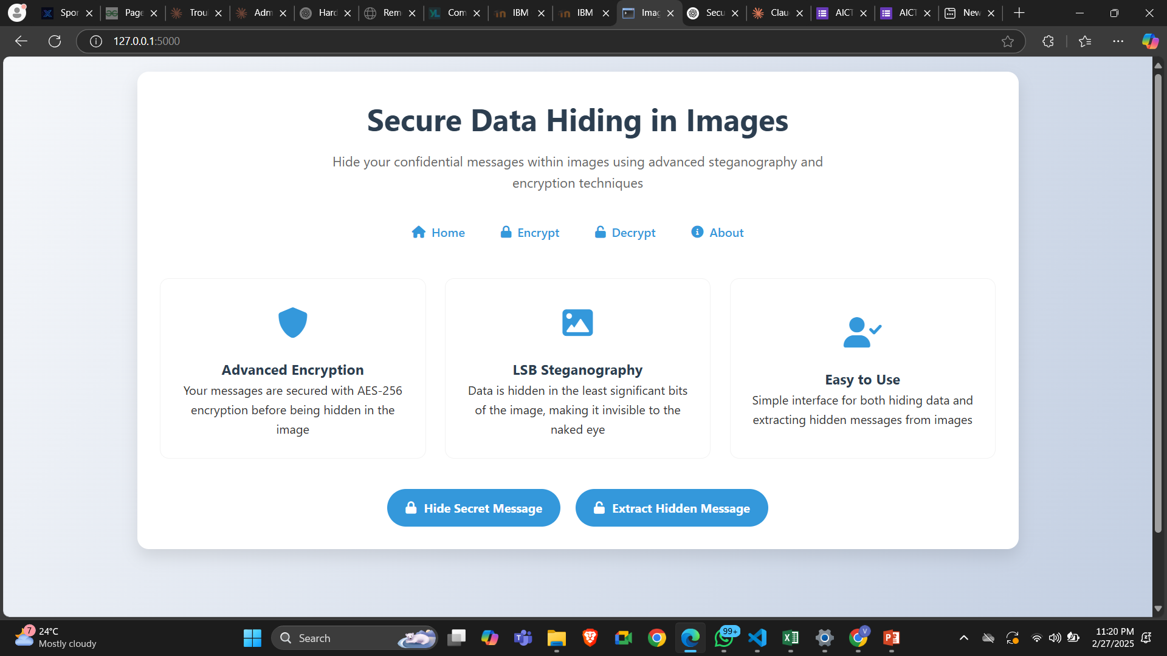
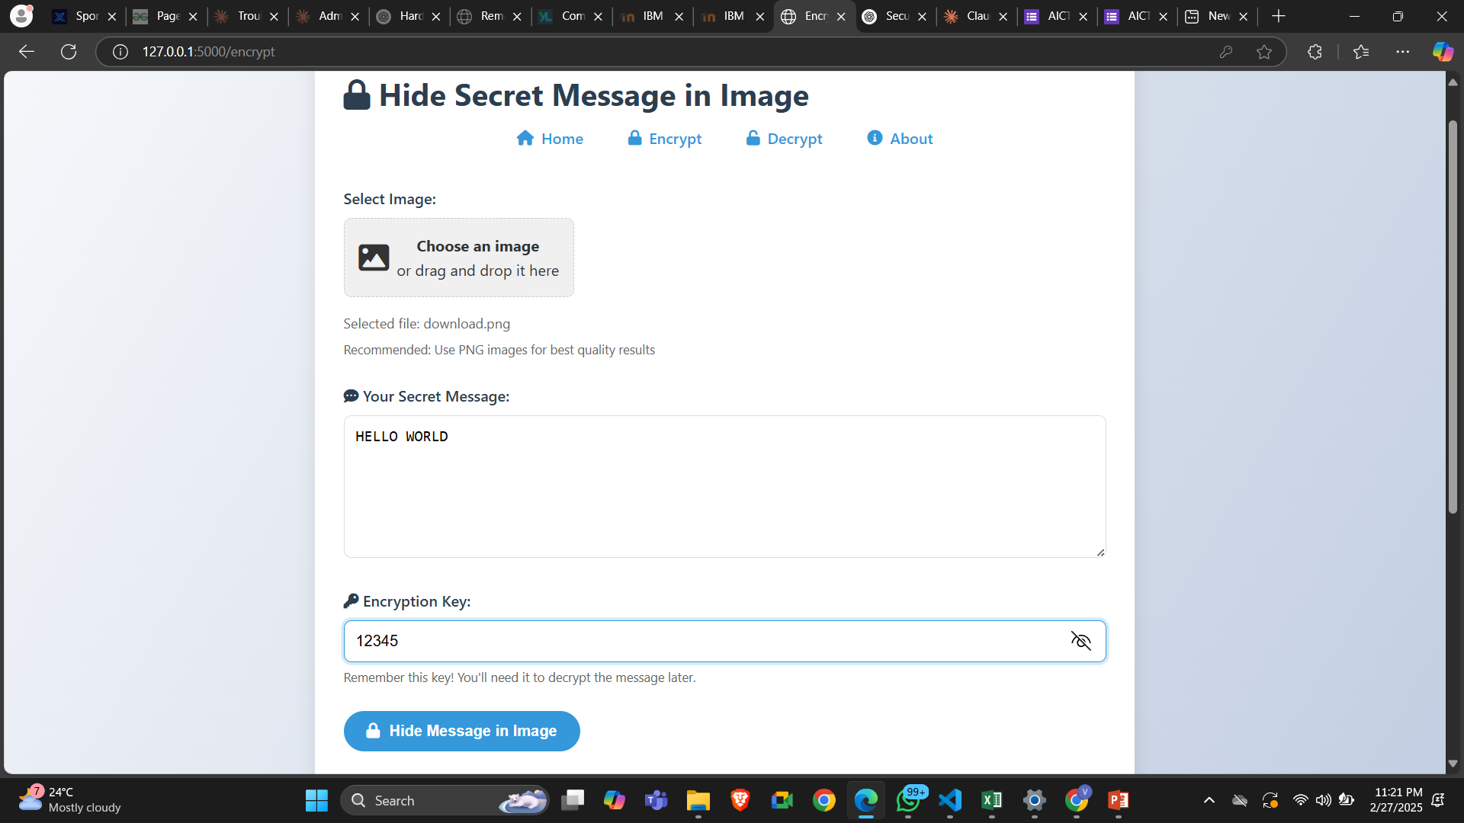
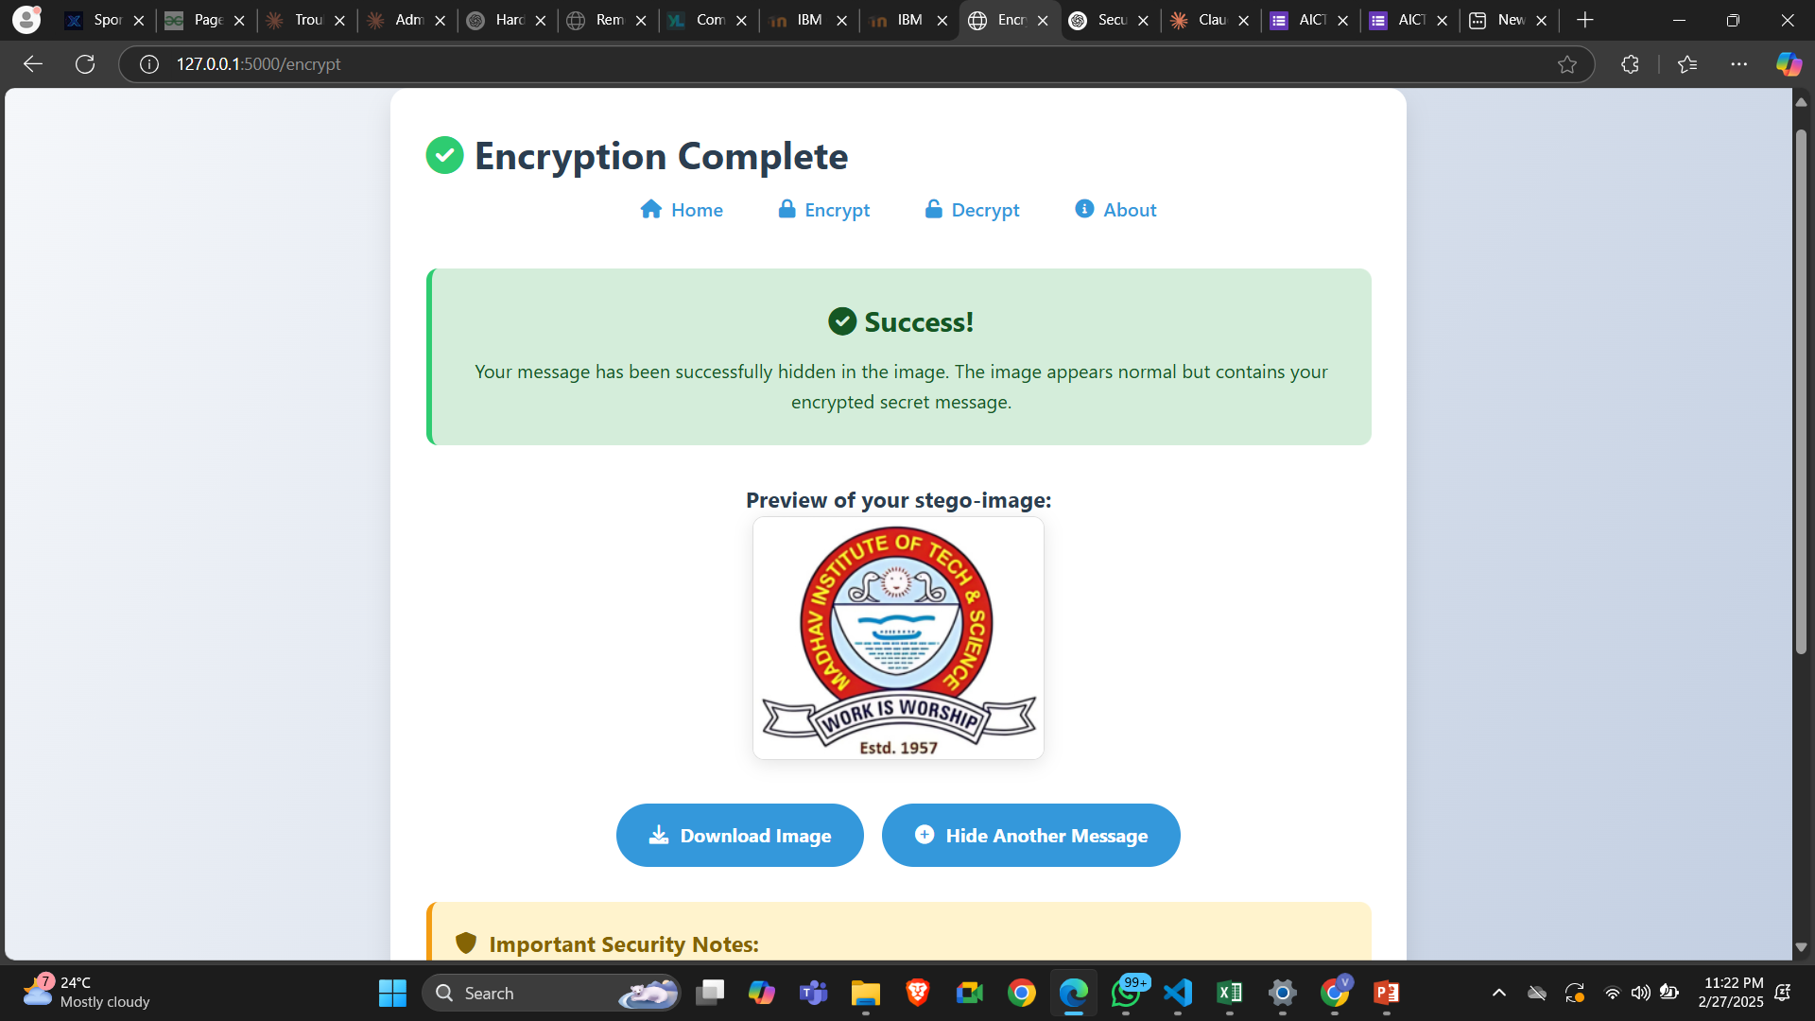

Results

Slide 8
Conclusion
This project demonstrates a powerful and practical solution for secure data hiding using steganography. By integrating AES encryption with steganographic techniques, it ensures that sensitive data remains both invisible and protected. This technique is highly beneficial for secure communication, data protection, and confidential transmissions, making it an effective tool in today's cybersecurity landscape.
✅ Successfully hides encrypted data within images while preserving their original quality.
✅ Ensures high-level security through AES encryption before embedding.
✅ Allows seamless retrieval of hidden information with the correct decryption key.
✅ Prevents unauthorized access by keeping the data hidden and encrypted.
✅ Can be used on any image format without significant visual distortion.

Slide 9
GitHub Link
https://github.com/itsVaibhavSharma/Stegnography

Slide 10
Future scope
🔹 Support for Video & Audio Steganography – Extending this concept to multimedia files.
🔹 Steganalysis Resistance – Implementing techniques to counter AI-based steganalysis detection.
🔹 Cloud-Based Secure Data Exchange – Allowing hidden data storage and retrieval over cloud platforms.
🔹 Blockchain Integration – Verifying hidden messages via immutable blockchain records.
🔹 Improved Data Capacity – Optimizing algorithms to store larger amounts of data within an image.
🔹 Mobile Application – Developing an Android/iOS app for secure steganographic communication.

Slide 11
THANK YOU

