Slide 1
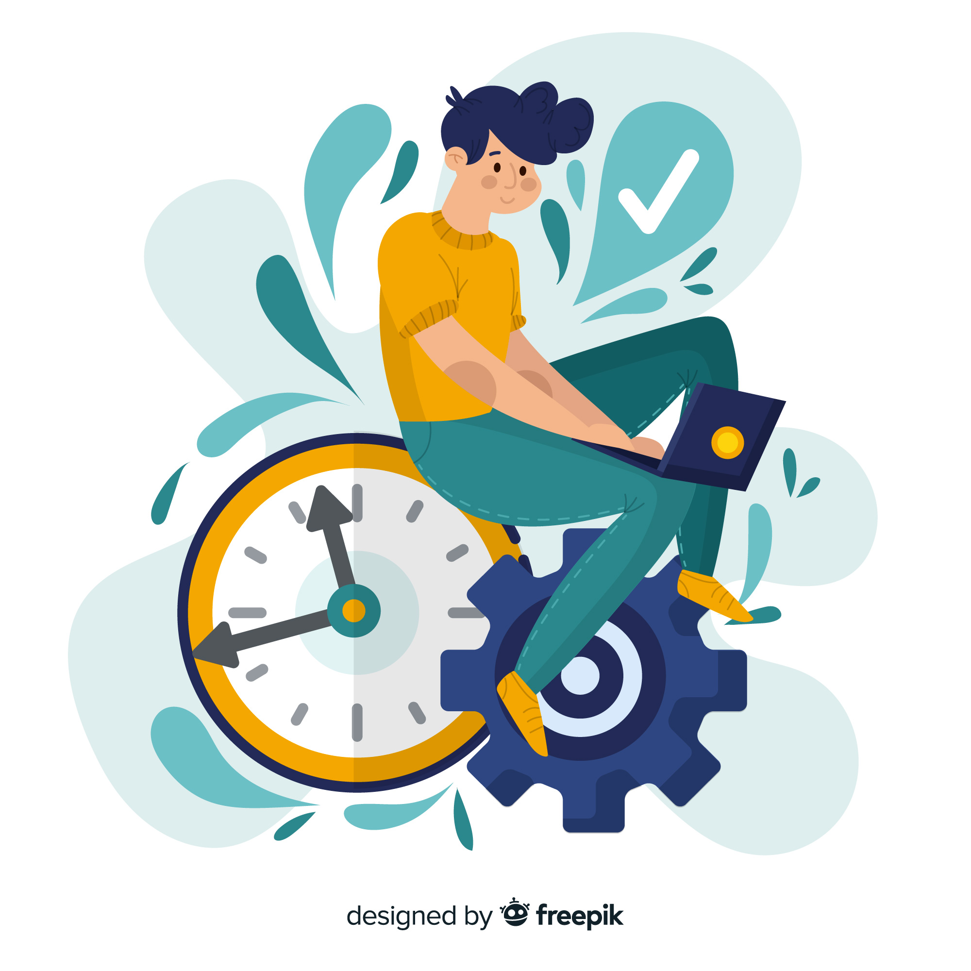
Digital Burnout & Workplace Productivity
Analytics Solution
A Data-Driven Framework to Reduce Digital Burnout Risk and Protect Workforce Productivity
Created by Aakash Kumar
1

Slide 2

SECTION 01
Project Overview
Digital Burnout & Workplace Productivity Analytics
PROJECT SCOPE
1.5M
34
7
End-to-End
Employee-Day Records
Data Attributes
Occupations Tracked
Analytics Solution
BUSINESS PROBLEM
Across 1.5 million logged employee-days spanning 7 occupations and 3 work modes, digital habits — screen time, notifications, doomscrolling, late-night device use — are quietly shaping how people work, sleep and cope. Organizations today have no systematic way to see this coming: screen-time, focus and wellbeing data sit disconnected from productivity outcomes, so HR and people-ops teams cannot tell which digital habits are eroding output, or intervene before burnout becomes attrition.
This project builds an end-to-end analytics solution — SQL validation, Python EDA, two predictive ML models and a 6-page Power BI dashboard — to close that gap.

Slide 3

SECTION 02
Business Context
The always-on digital workplace has quietly become one of the biggest risks to sustainable productivity.
Notification Overload
Sleep Debt
Doomscrolling & App-Switching
Employees average 209 notifications and 157 smartphone unlocks per day, fragmenting focus.
34.97% of employee-days show under 6 hours of sleep — a leading driver of chronic fatigue.
1.83 hrs/day of doomscrolling and heavy app-switching erode deep-work capacity across roles.
Invisible Burnout Risk
Uniform Exposure
Productivity at Stake
16.78% of records fall into high burnout risk, often with no visible productivity red flag yet.
Burnout risk is nearly flat across occupations, work modes and age bands — no group is immune.
Burnout state alone is linked to an 8.48-point drop in productivity score versus focused peers.

Slide 4
SECTION 03
Business Objectives
Objective | Purpose
Employee Analytics | Demographics, occupation & digital-habit segmentation
Performance Analysis | Quantify screen time, sleep & focus vs. productivity
Operational Analysis | Evaluate workspace quality, meetings & internet stability
Risk Analysis | Model burnout-risk probability to flag employees early
Strategic Growth | Use digital-wellness insight as a retention differentiator
Business Optimization | Right-size meeting load, notifications & remote-work mix

Slide 5

SECTION 03
Technology Stack
Tool | Usage
Python | Pandas, NumPy, Scikit-learn, Matplotlib for EDA & ML modeling
Jupyter / Scripted Pipeline | Data cleaning, feature engineering, model training (Analysis.py)
Scikit-learn (pickled models) | Logistic Regression & Linear Regression, persisted as .pkl
Power BI | Data modeling, DAX measures, 6-page interactive dashboard
Power BI Service | Publishing, scheduled refresh, cloud deployment
PowerPoint | Executive storytelling, insights & recommendations

Slide 6

SECTION 04
Available Data Sources
A single 1.5M-row, 34-column employee-day log — organized here into 7 logical attribute groups.
Attribute Group | Example Columns | Role
Demographic | age, occupation, work_mode | Segmentation
Digital Habit | daily_screen_time, notification_count, app_switch_frequency, doomscrolling_duration | Behavioral Feature
Focus & Work | focus_sessions, deep_work_hours, task_completion_rate, concentration_score | Behavioral Feature
Sleep & Recovery | sleep_hours, sleep_quality | Behavioral Feature
Psychological | stress_level, mental_fatigue, emotional_exhaustion, motivation_level, work_satisfaction | Wellbeing Indicator
Workplace Context | workspace_quality, meeting_hours, internet_stability, remote_work_days | Contextual Feature
Outcome / Target | mental_state, burnout_risk, productivity_score, productivity_category | ML Target / KPI

Slide 7

SECTION 04
Data Dictionary
Column | Description | Business Usage
occupation / work_mode | Job role (7 types) & work arrangement | Segmentation & benchmarking
daily_screen_time / social_media_hours | Total daily screen time & social usage (hrs) | Digital-habit exposure analysis
doomscrolling_duration / app_switch_frequency | Passive scrolling time & app-switch count | Attention-fragmentation analysis
notification_count / smartphone_unlocks | Daily notifications & phone unlocks | Interruption-load analysis
late_night_device_usage | Flag for device use during late-night hours | Sleep-hygiene risk indicator
focus_sessions / deep_work_hours | Focus-session count & hours of deep work | Productivity-capacity measurement
sleep_hours / sleep_quality | Hours slept & self-rated sleep quality | Recovery & fatigue-risk analysis
stress_level / mental_fatigue / emotional_exhaustion | Self-reported stress, fatigue & exhaustion | Core burnout-driver indicators
mental_state / burnout_risk | State category & risk score (0-100) | Primary wellbeing label & ML target
productivity_score / productivity_category | Productivity score (0-100) & tier | Core business outcome metric

Slide 8

SECTION 04
Key Observations
● | The dataset is a single flat, person-day-level table — there is no relational schema to join; every analysis works directly off user_id + tracked day.
● | burnout_risk and productivity_score are the two computed outcome variables — they anchor both diagnostic correlations and both ML models.
● | mental_state (Focused / Balanced / Distracted / Burnout) is a 4-category label derived from the same underlying signals as burnout_risk, so the two move together.
● | Digital-habit columns (screen time, notifications, app-switching, doomscrolling) form the core behavioral feature set used across diagnostic and predictive analysis.
● | 4 columns (sleep_hours, social_media_hours, deep_work_hours, motivation_level) carry ~2% nulls each, requiring median imputation before modeling.
● | No duplicate user_id records and no invalid ages were found — the dataset passed structural integrity checks cleanly.
● | At 1.5M rows and 34 columns, the table is large enough for statistically robust correlation analysis and machine learning without sampling.

Slide 9

SECTION 04
Dataset Structure Overview
Unlike a multi-table relational schema, this is one flat log — the diagram below shows how its 34 columns logically group into features and outcomes.
Demographic
Digital Habit
Focus & Work
Sleep & Recovery
Psychological
Workplace Context
EMPLOYEE-DAY RECORD
(1.5M rows × 34 columns)
mental_state
burnout_risk
productivity_score
4-category wellbeing label
0–100 risk score → ML classifier target
0–100 output score → ML regression target
These 3 outcome fields are the anchor for every diagnostic correlation, both predictive models, and all 6 Power BI dashboard pages.

Slide 10

SECTION 05
Data Validation & Consistency Checks
● | Imported the 1.5M-row CSV extract into a validated Python analysis environment (Analysis.py).
● | Verified schema — 34 columns, expected numeric vs. categorical data types confirmed for every field.
● | Checked user_id for duplicates — zero duplicate records found across all 1.5 million rows.
● | Validated numeric ranges — age (18–59) and all 0–100 / hour-based fields fall within plausible bounds.
● | Cross-checked categorical consistency — occupation, work_mode, device_usage_type and mental_state values matched their expected category lists with no stray labels.
● | Verified logical consistency between burnout_risk, mental_state and productivity_score — labels move together as expected.

Slide 11

SECTION 05
Data Discrepancies (1/2)
Missing Values
Column | Issue
social_media_hours | ~2.00% null (≈30,000 rows)
deep_work_hours | ~2.00% null (≈30,000 rows)
sleep_hours | ~2.01% null (≈30,150 rows)
motivation_level | ~1.99% null (≈29,850 rows)
Only 4 of 34 columns are affected, totaling 120,118 null values — no other column has any missing data.

Slide 12
SECTION 05
Data Discrepancies (2/2)
Range, Duplicate & Structural Checks
● | Age range confirmed 18–59 with no invalid, negative or zero values.
● | Zero duplicate user_id rows found across all 1.5 million records.
● | burnout_risk, productivity_score, concentration_score, sleep_quality, workspace_quality and internet_stability all fall within their documented 0–100 / 0–10 scoring ranges.
● | Unlike a transactional banking log, this dataset carries no timestamp column — it required no date-format standardization, only null handling for the 4 flagged columns.

Slide 13

SECTION 05
Recommendations for Data Cleaning
● | Impute the 4 null-prone columns using median values — robust to outliers and preserves distribution shape.
● | Validate imputed values against the original distribution before finalizing the cleaned dataset.
● | Standardize categorical text (occupation, work_mode, device_usage_type) to consistent casing.
● | Preserve the raw CSV extract untouched; perform all cleaning in a derived working copy.
● | Use the same cleaned dataset consistently across Python EDA, diagnostic analysis and ML model training.
● | Document the imputation logic in the analysis script for reproducibility (see Analysis.py).

Slide 14
SECTION 06
Exploratory Data Analysis (EDA)
OBJECTIVE
The purpose of Exploratory Data Analysis was to understand workforce demographics, digital-habit behavior, sleep patterns, mental-state distribution and productivity performance before performing diagnostic and predictive analysis.
KEY OUTCOME
EDA transformed the raw 1.5M-row log into meaningful business insights by identifying digital-habit patterns, sleep behavior and productivity trends that support the diagnostic analysis and both predictive models that follow.

Slide 15

SECTION 06 · DESCRIPTIVE ANALYSIS
Workforce Demographic Analysis (1/2)
Age-Band Distribution
Occupation Distribution (7 Roles)
38.5 yrs
18–59
7
0
Average Age
Age Range
Occupations (~14.3% each)
Duplicate Records Found

Slide 16
SECTION 06 · DESCRIPTIVE ANALYSIS
Workforce Demographic Analysis (2/2)
KEY INSIGHTS
● | The workforce spans ages 18–59 with a mean age of 38.5 — a broad, multi-generational population, not concentrated in one life stage.
● | 46–59 is the largest single age band (33.3%), followed by a near-even 26–35 / 36–45 split (~23.8% each).
● | All 7 occupations are represented almost equally (14.20–14.35% each) — this is a balanced, stratified sample, not skewed toward one job type.
● | Because both age and occupation are evenly spread, later differences in burnout risk or productivity across these groups can be attributed to behavior, not a sampling artifact.
RECOMMENDATION Use occupation and age purely as reporting filters in the dashboard — this analysis shows neither should be used to target interventions.

Slide 17

SECTION 06 · DESCRIPTIVE ANALYSIS
Work-Mode & Device Usage Analysis (1/2)
Work-Mode Split
Device Usage Type Split
44.98%
71.39–71.54
35.02%
Remote Work Share
Productivity Range (All Modes)
Balanced Device Usage
DIGITAL BURNOUT & WORKPLACE PRODUCTIVITY ANALYTICS · FINAL PROJECT REPORT

Slide 18
SECTION 06 · DESCRIPTIVE ANALYSIS
Work-Mode & Device Usage Analysis (2/2)
KEY INSIGHTS
● | Remote work is the dominant arrangement (44.98% of employee-days), followed by Hybrid (34.95%) and Office (20.06%) — this is a remote-first workforce.
● | Device usage splits almost evenly across Balanced, Work-Centric and Entertainment-Centric patterns (30–35% each) — no single usage style dominates.
● | Average productivity holds flat across all 3 work modes (71.39–71.54) — confirming work location is not, by itself, a meaningful productivity lever.
● | Combined with the demographic finding, this shows policy decisions about remote/hybrid/office mix should be based on burnout & productivity data — not assumption.
RECOMMENDATION Benchmark future work-mode policy changes against these baseline figures rather than assuming remote or office work is inherently riskier.

Slide 19

SECTION 06 · DESCRIPTIVE ANALYSIS
Digital Habit Analysis (1/2)
Average Daily Digital-Habit Load
8.00 hrs
209.35
157.06
129.57
1.83 hrs
Avg Daily Screen Time
Avg Daily Notifications
Avg Smartphone Unlocks
Avg App-Switch Frequency
Avg Doomscrolling Duration
Doomscrolling Duration — Top Quartile vs. Rest
READING THIS
26.63% of employee-days cross 2.6+ hours of daily doomscrolling — the 75th-percentile threshold. This segment is examined in detail in the Diagnostic Analysis section, where it shows a measurably higher average burnout-risk score.

Slide 20
SECTION 06 · DESCRIPTIVE ANALYSIS
Digital Habit Analysis (2/2)
KEY INSIGHTS
● | Employees average 8 hours of daily screen time, 209 notifications and 157 phone unlocks — a highly fragmented digital day.
● | Doomscrolling averages 1.83 hrs/day, with the top quartile (26.63% of employee-days) crossing 2.6+ hours.
● | App-switch frequency averages ~130/day but shows almost no linear relationship with burnout risk on its own (r ≈ -0.001) — it is a symptom of fragmentation, not a standalone driver.
● | These habits are uniform across occupations and work modes — digital exposure is a workplace-wide pattern, not a team-specific one.
RECOMMENDATION Prioritize notification batching and doomscrolling-focused nudges over app-switching controls — they show the stronger individual link to burnout risk.

Slide 21

SECTION 06 · DESCRIPTIVE ANALYSIS
Sleep & Recovery Analysis (1/2)
Sleep-Hours Distribution
SLEEP & LATE-NIGHT USAGE SNAPSHOT
6.50 hrs
Average Sleep Hours
5.5 / 10
Average Sleep Quality
65.00%
Late-Night Device Usage Rate
34.97%
21.07%
Sleep-Deficit Rate (<6 hrs)
In the Healthy 7-8hr Band

Slide 22
SECTION 06 · DESCRIPTIVE ANALYSIS
Sleep & Recovery Analysis (2/2)
KEY INSIGHTS
● | 34.97% of employee-days show under 6 hours of sleep — the single largest band, well above the 6-7hr band (27.61%).
● | Average sleep quality sits at 5.5/10 — a mediocre, not catastrophic, baseline that still leaves clear room for improvement.
● | 65% of employee-days include late-night device usage — nearly two-thirds of the workforce is cutting into recovery time with screens.
● | Sleep hours correlate negatively with burnout risk (r = -0.13) — a real but comparatively modest protective effect versus digital-habit intensity.
RECOMMENDATION Launch a device wind-down / sleep-hygiene pilot targeting the 65% late-night-usage population — the largest single behavioral segment identified in this analysis.

Slide 23
SECTION 06 · DESCRIPTIVE ANALYSIS
Mental State & Burnout Analysis (1/2)
Mental-State Mix (4 Categories)
Burnout Risk Snapshot
48.58
16.78%
Avg Burnout Risk (0–100)
High Burnout Risk Rate
251,636
19.98%
High-Risk Employee-Days
Active "Burnout" State Share
Focused → 75.00 vs. Burnout → 66.52 avg. productivity score — an 8.48-point gap between the best and worst mental-state groups.

Slide 24
SECTION 06 · DESCRIPTIVE ANALYSIS
Mental State & Burnout Analysis (2/2)
KEY INSIGHTS
● | Distracted is the most common mental state (30.03%), followed by a near-even Focused/Balanced split (~25% each) and Burnout at 19.98%.
● | Average burnout-risk score sits at 48.58/100, with 16.78% of employee-days (251,636 records) crossing the high-risk threshold (>70).
● | Focused employees outproduce Burnout employees by 8.48 points on average (75.00 vs. 66.52) — the mental-state label tracks a real, material productivity difference.
● | Roughly 1 in 5 employee-days is in an active Burnout state — a population large enough to justify a dedicated monitoring and intervention program.
RECOMMENDATION Treat "Distracted" and "Burnout" (50% of all employee-days combined) as the two priority mental-state segments for proactive people-ops attention.

Slide 25
SECTION 06 · DESCRIPTIVE ANALYSIS
Productivity Category Analysis
KEY INSIGHTS
● | Nearly half of all employee-days (47.49%) fall in the High productivity tier, while 16.79% fall in Low.
● | The gap between High and Low tiers is the clearest opportunity — moving even a fraction of the Low-tier population upward has an outsized impact at 1.5M-record scale.
● | Productivity category aligns closely with mental state and burnout risk, confirming these are different views of the same underlying wellbeing signal rather than independent metrics.
RECOMMENDATION Use the Low-productivity tier (16.79%, ~251,700 records) as the primary target population for the productivity-driver interventions covered later in this report.

Slide 26
SECTION 07 · DIAGNOSTIC ANALYSIS
Diagnostic Analysis Framework
“Why is it happening?” — six root-cause questions tested against the descriptive patterns above.
Business Question | Analysis Performed | KPI
Which employee-days show excessive doomscrolling? | Top-quartile threshold comparison (≥ 2.6 hrs/day) | High-Doomscroll Burnout Gap
How prevalent is high burnout risk workforce-wide? | Burnout-risk threshold analysis (>70) | High Burnout Risk Rate
Do specific occupations carry more burnout risk? | Occupation vs. high-risk-rate comparison | Risk Penetration Rate
Does late-night device use elevate burnout risk? | Late-night usage vs. burnout-risk comparison | Late-Night Risk Gap
Are there disengaged, low-focus employees? | Deep-work & focus-session thresholding | Low-Engagement Productivity Gap
Does age affect burnout or productivity outcomes? | Age-band trend analysis | Age-Band Trend Spread

Slide 27
SECTION 07 · DIAGNOSTIC ANALYSIS
High Doomscrolling Ratio Analysis (1/2)
Avg Burnout Risk — High vs. Low Doomscrolling
THE GAP
7.76 points
higher average burnout risk for the top-quartile doomscrolling group. r = 0.201 correlation between doomscrolling duration and burnout risk — one of the strongest single digital-habit signals in the dataset.

Slide 28
SECTION 07 · DIAGNOSTIC ANALYSIS
High Doomscrolling Ratio Analysis (2/2)
KEY INSIGHTS
● | The top quartile of doomscrolling (≥ 2.6 hrs/day, 26.63% of employee-days) shows an average burnout risk of 54.28 — nearly 8 points higher than the remaining 73.37% (46.52).
● | Doomscrolling duration correlates positively with burnout risk (r = 0.20) — one of the strongest single digital-habit signals in the dataset, ahead of app-switch frequency (r ≈ -0.001).
● | This is a clean, actionable segment: roughly 1 in 4 employee-days, identifiable directly from a single behavioral metric.
RECOMMENDATION Flag and support the ~27% of employee-days crossing the high-doomscroll threshold with targeted digital-wellness nudges — this is the single highest-precision behavioral segment found in the analysis.

Slide 29
SECTION 07 · DIAGNOSTIC ANALYSIS
Burnout Risk Prevalence (1/2)
48.58
16.78%
251,636
19.98%
Avg Burnout Risk Score (0–100)
High Burnout Risk Rate (>70)
High-Risk Employee-Days
Active "Burnout" Mental-State Share
Avg High-Risk Rate by Occupation — Essentially Flat

Slide 30
SECTION 07 · DIAGNOSTIC ANALYSIS
Burnout Risk Prevalence (2/2)
KEY INSIGHTS
● | 1 in 6 employee-days (16.78%, ~251,636 records) crosses the high burnout-risk threshold — a population large enough to require a systematic monitoring process, not ad hoc review.
● | High-risk rate is consistent regardless of occupation, ranging only 16.66%–16.85% across all 7 roles — a spread of just 0.19 points.
● | This confirms burnout-risk exposure is workplace-wide rather than concentrated in a specific team, department or role.
RECOMMENDATION Deploy the ML classifier (90.4% ROC-AUC, detailed in the Predictive Analytics section) to continuously score and flag this population for HR review.

Slide 31
SECTION 07 · DIAGNOSTIC ANALYSIS
Occupation-Wise Risk Penetration (1/2)
High-Risk Employee-Day Count by Occupation
Unlike a typical “penetration” analysis where one segment stands out, the finding here is the opposite: high-risk record counts differ by less than 550 out of ~36,000 per occupation — burnout risk does not concentrate anywhere.

Slide 32
SECTION 07 · DIAGNOSTIC ANALYSIS
Occupation-Wise Risk Penetration (2/2)
KEY INSIGHTS
● | High-risk employee-day counts range from 35,684 (Software Engineer) to 36,201 (Designer) — a spread of just 517 records out of ~36,000 per occupation.
● | High-risk rate itself ranges only 16.66%–16.85% — statistically indistinguishable across roles at this scale.
● | This mirrors the age-band and work-mode findings: none of the standard demographic or role-based segments explain burnout-risk variation in this workforce.
RECOMMENDATION Apply digital-wellness support evenly across all roles rather than targeting by job title — role-based targeting would miss the vast majority of at-risk employees.

Slide 33
SECTION 07 · DIAGNOSTIC ANALYSIS
Late-Night Device Usage Impact (1/2)
Avg Burnout Risk — Late-Night Usage vs. None
Avg Sleep Hours — Late-Night Usage vs. None
65.00%
+7.37 pts
0.00 hrs
Late-Night Usage Rate
Burnout Risk Gap
Sleep-Hours Gap

Slide 34
SECTION 07 · DIAGNOSTIC ANALYSIS
Late-Night Device Usage Impact (2/2)
KEY INSIGHTS
● | 65% of employee-days include late-night device usage, and that group shows a 7.37-point higher average burnout risk (51.16 vs. 43.79) than employees without late-night usage.
● | Sleep hours are nearly identical whether or not late-night usage occurs (6.50 hrs either way) — late-night usage appears linked to burnout through a pathway other than simple sleep duration (e.g. sleep quality, timing, or evening stress).
● | This makes late-night usage a distinct behavioral signal from the sleep-deficit finding earlier — both matter, but they are not the same lever.
RECOMMENDATION Track late-night device usage as its own KPI, separate from total sleep hours — a wind-down nudge should target usage timing, not just sleep duration.

Slide 35

SECTION 07 · DIAGNOSTIC ANALYSIS
Low Engagement Analysis
Employee-days with both minimal deep-work hours (<1 hr) and near-zero focus sessions (≤1) — a distinct disengagement signature.
2.49%
43.33
72.17
28.84 pts
of Employee-Days Are “Disengaged”
Avg Productivity — Disengaged Group
Avg Productivity — Everyone Else
Productivity Gap (Largest Found)
KEY INSIGHTS
● | Just 2.49% of employee-days show both very low deep-work hours and minimal focus sessions — a small but sharply distinct “disengaged” segment.
● | This segment's average productivity score is 43.33 vs. 72.17 for everyone else — a 28.84-point gap, the single largest productivity gap found in the entire analysis.
● | Unlike burnout state, this disengaged segment is not concentrated in the “Burnout” mental-state label (still only ~20% Burnout) — current mental-state tagging alone would miss most of this group.
RECOMMENDATION Monitor deep-work hours and focus-session counts directly as a standing KPI — not just burnout-risk score — to catch this specific disengagement pattern.

Slide 36
SECTION 07 · DIAGNOSTIC ANALYSIS
Age & Productivity Trend Analysis (1/2)
Avg Burnout Risk by Age Band
Avg Productivity Score by Age Band
Both lines are essentially flat: burnout risk spans just 0.10 points (48.51–48.61) and productivity spans just 0.09 points (71.43–71.52) across all 4 age bands.
DIGITAL BURNOUT & WORKPLACE PRODUCTIVITY ANALYTICS · FINAL PROJECT REPORT

Slide 37
SECTION 07 · DIAGNOSTIC ANALYSIS
Age & Productivity Trend Analysis (2/2)
KEY INSIGHTS
● | Average burnout risk is virtually identical across all 4 age bands (48.51–48.61) — a spread of just 0.10 points.
● | Productivity score shows the same flat pattern (71.43–71.52) — age is not a meaningful predictor of either outcome in this workforce.
● | Combined with the occupation and work-mode findings, this reinforces the project's core thesis: burnout and productivity are driven by digital habits and behavior, not demographic or role attributes.
RECOMMENDATION Design any wellness or productivity intervention to be behavior-targeted (screen time, sleep, deep work) rather than age- or tenure-targeted.

Slide 38


SECTION 08 · PREDICTIVE ANALYTICS
Predictive Analytics (1/3) — Objective & Workflow
OBJECTIVE Predict burnout risk and productivity score directly from digital-habit and wellbeing signals, enabling proactive HR intervention and policy simulation before problems surface in output.
TWO MODELS DEPLOYED
Model 1 — Logistic Regression
Model 2 — Linear Regression
Classifies each employee-day as High Burnout Risk or not, from 26 numeric + 3 categorical features.
Predicts the continuous productivity_score (0–100) from the same feature set.
ANALYSIS WORKFLOW
Feature Selection
(26 numeric + 3 categorical)
Train/Test Split
(80/20, stratified)
Preprocessing Pipeline
(scaling + one-hot encode)
Model Fit
(Logistic + Linear)
Held-Out Evaluation
(metrics + coefficients)

Slide 39
SECTION 08 · PREDICTIVE ANALYTICS
Predictive Analytics (2/3) — Burnout-Risk Classifier
80.96%
46.26%
83.42%
0.595
0.904
Accuracy
Precision
Recall
F1 Score
ROC-AUC
Held-out test set — 20% split (n = 300,000), stratified · random_state = 42
Confusion Matrix
Top Standardized Coefficients
 | Predicted: Not High Risk | Predicted: High Risk
Actual: Not High Risk | 200,902 | 48,771
Actual: High Risk | 8,346 | 41,981
class_weight="balanced" deliberately trades precision for recall — it over-flags to make sure real burnout cases reach HR review, not to auto-decide.

Slide 40
SECTION 08 · PREDICTIVE ANALYTICS
Predictive Analytics (3/3) — Productivity Predictor
0.798
7.66 pts
9.66 pts
R² (Variance Explained)
Mean Absolute Error
RMSE
Held-out test set — 20% split (n = 300,000) · random_state = 42 · productivity_score is a 0–100 scale
Top Standardized Coefficients
WHAT THIS MEANS
Each additional hour of Deep Work is associated with roughly +11.9 points of productivity score — nearly triple the next-largest driver. Emotional Exhaustion and Social Media Hours are the strongest drags, echoing the burnout classifier's own findings. R² = 0.80 means digital-habit and wellbeing signals alone explain about 4 out of every 5 points of variation in productivity.

Slide 41

SECTION 08 · PREDICTIVE ANALYTICS
Why Logistic Regression?
Advantage | Business Value
Interpretability | Coefficients map directly to business drivers HR can act on
Binary Classification Fit | Purpose-built for the High-Risk / Not-High-Risk decision
Fast at Scale | Trains and scores 1.5M rows in seconds, enabling daily re-scoring
Class-Weight Balancing | Handles the ~17% high-risk imbalance without synthetic sampling
Transparent Enough to Deploy | Explainable to HR & compliance stakeholders, unlike a black-box model

Slide 42
SECTION 08 · PREDICTIVE ANALYTICS
Why Linear Regression?
Advantage | Business Value
Simple, Interpretable Coefficients | Quantifies exactly how many points a habit change moves productivity
Fast Training & Scoring | Scales cleanly to 1.5M rows for workforce-wide simulation
Policy Simulation Ready | Lets teams model the productivity impact of a policy before rollout
Strong, Transparent Baseline | R² = 0.798 sets a benchmark before trying ensemble methods
No Black-Box Risk | Easy to communicate and defend to non-technical stakeholders

Slide 43

SECTION 09 · DASHBOARD
Power BI Dashboard Overview
A 6-page interactive executive & people-ops digital-wellbeing dashboard, built on the same cleaned 1.5M-row dataset.
1. Executive Overview
2. Occupation & Work-Mode
3. Digital Habit Explorer
Total employees tracked, avg burnout risk, avg productivity, high-risk rate
Burnout & productivity benchmarks across 7 roles and Remote/Hybrid/Office
Screen time, notifications, doomscrolling & app-switching patterns
4. Sleep & Recovery Monitor
5. Burnout Risk Monitor
6. Productivity Driver Analysis
Sleep-hours distribution, sleep-quality, late-night usage tracking
Burnout-risk distribution, mental-state mix, high-risk employee watchlist
Correlation view of digital habits, sleep & stress against productivity

Slide 44
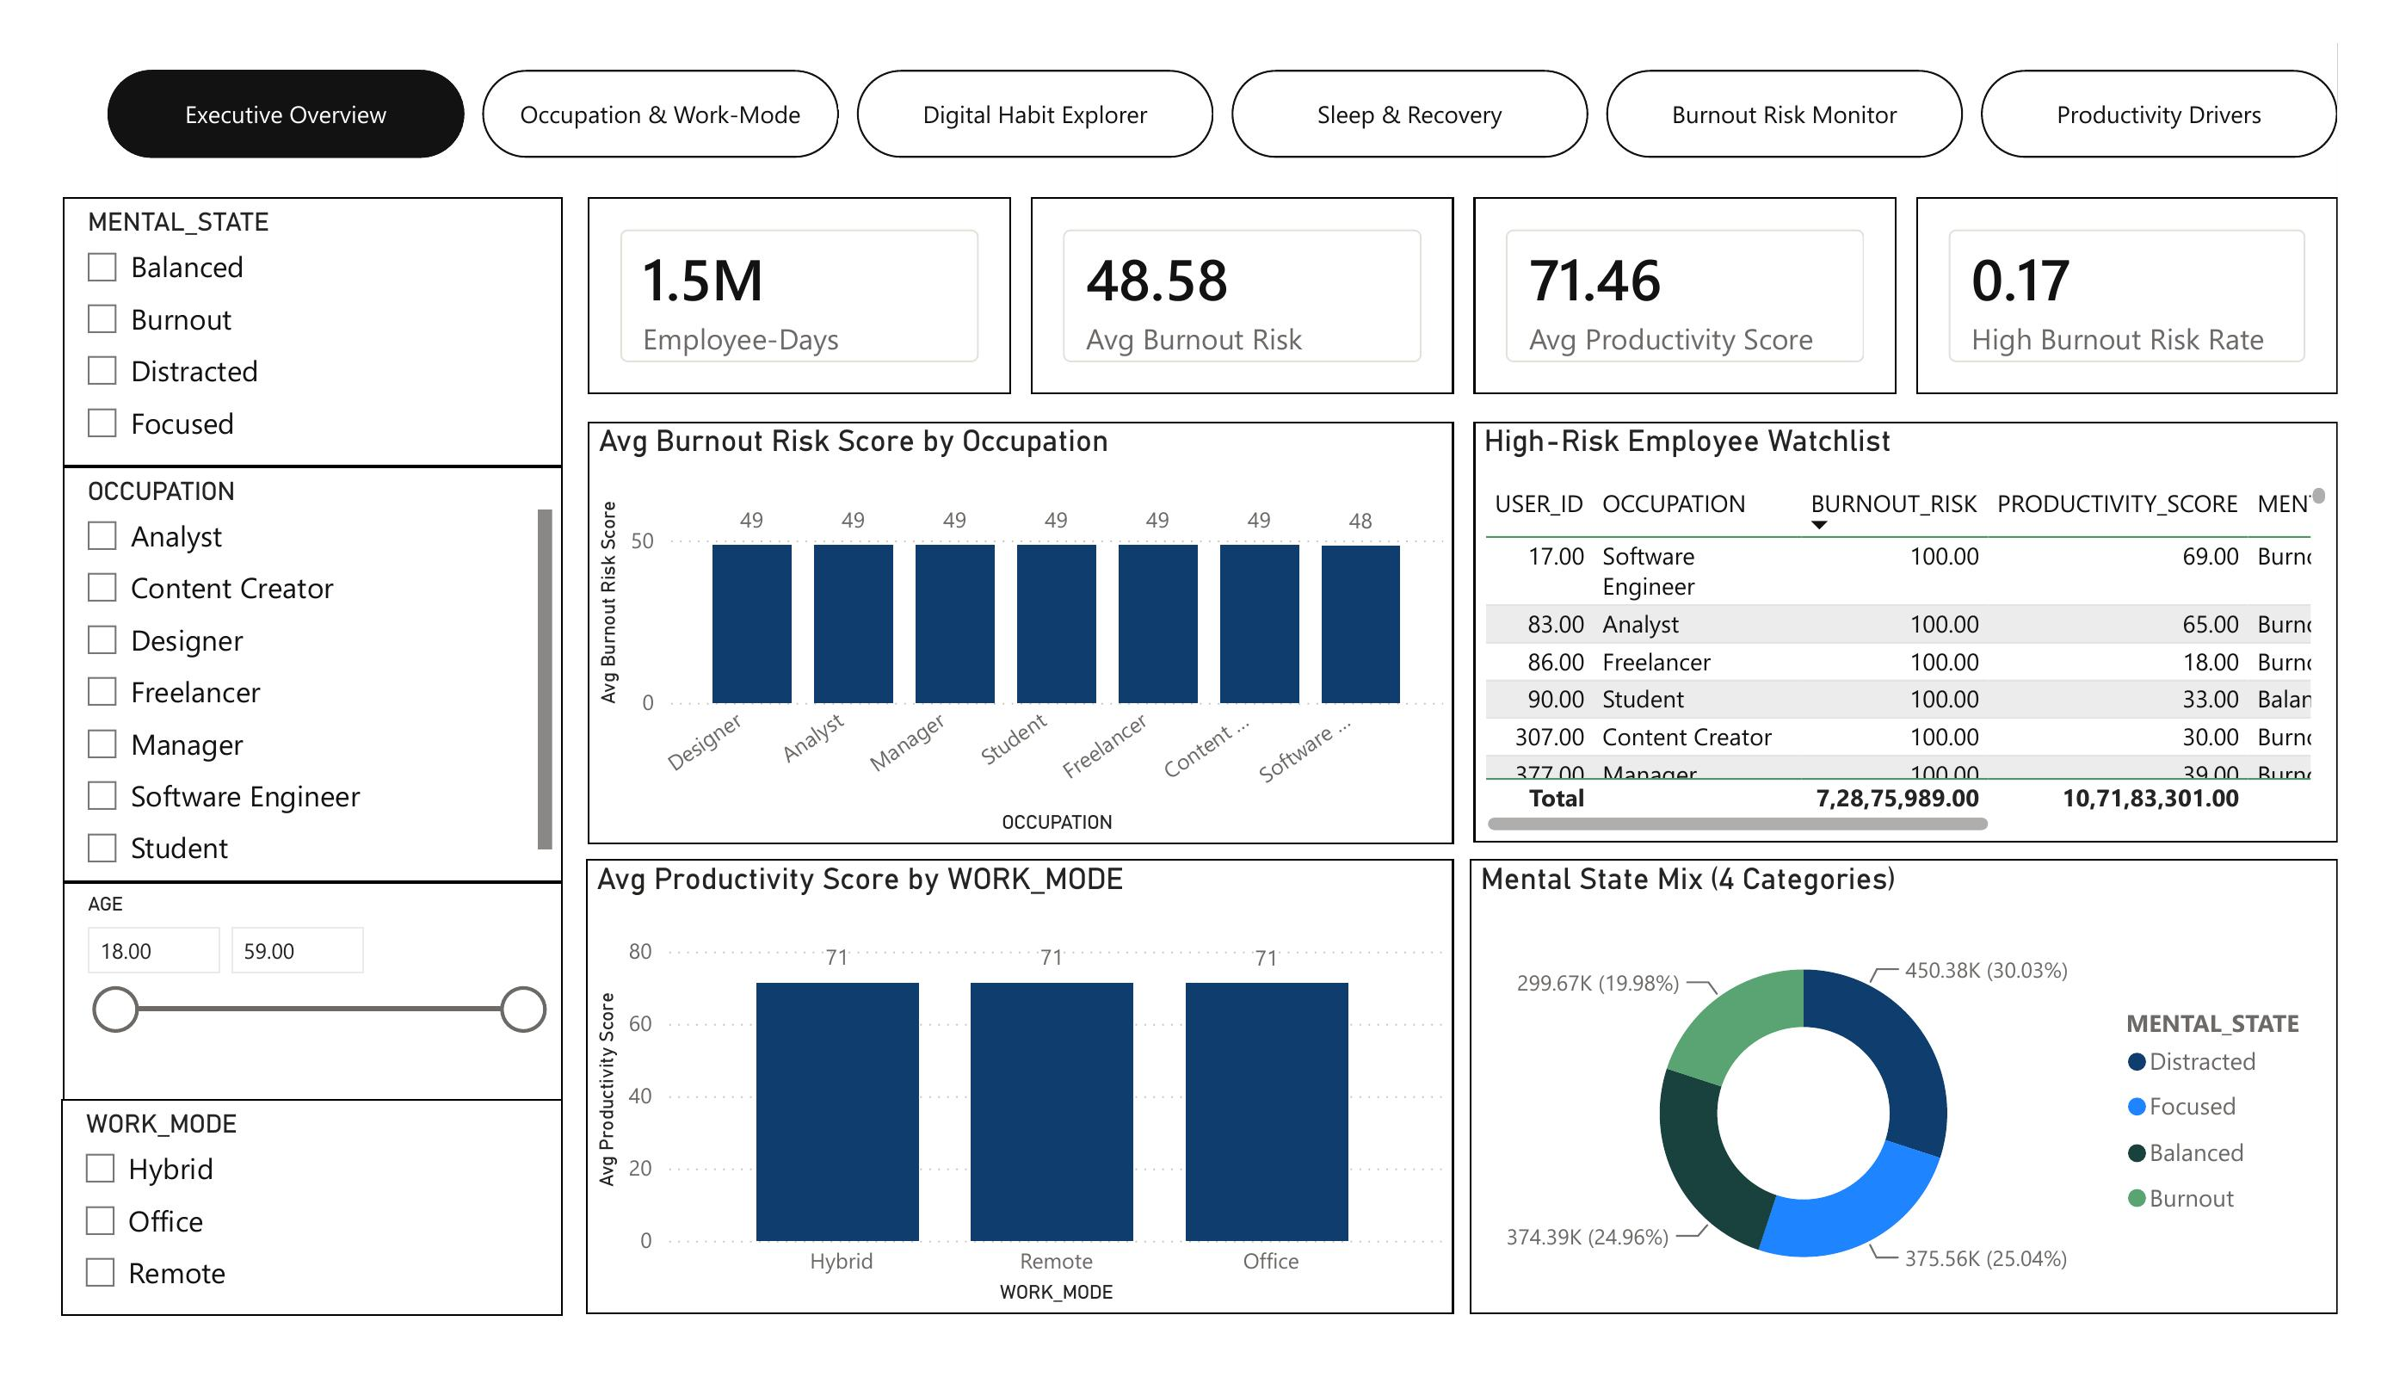
SECTION 09 · DASHBOARD · PAGE 1 OF 6
Executive Overview Dashboard (1/2)
1.5M employee-days at a glance — avg burnout risk 48.58, avg productivity 71.46, 16.8% high-risk rate.

Slide 45
SECTION 09 · DASHBOARD · PAGE 1 OF 6
Executive Overview Dashboard (2/2)
KEY INSIGHTS
● | The dashboard tracks 1.5M employee-days with an average burnout-risk score of 48.58 and average productivity score of 71.46.
● | 16.78% of employee-days cross the high-burnout-risk threshold, representing roughly 251,600 records requiring attention.
● | Mental state splits across 4 categories with Distracted leading at 30.0%, followed by Focused (25.0%), Balanced (25.0%) and Burnout (20.0%).
● | The high-risk employee watchlist table lets HR drill directly into the specific records driving the aggregate risk numbers.
RECOMMENDATION Use this page as the weekly executive check-in view — track the 3 headline KPIs and the high-risk watchlist count as a standing agenda item.

Slide 46
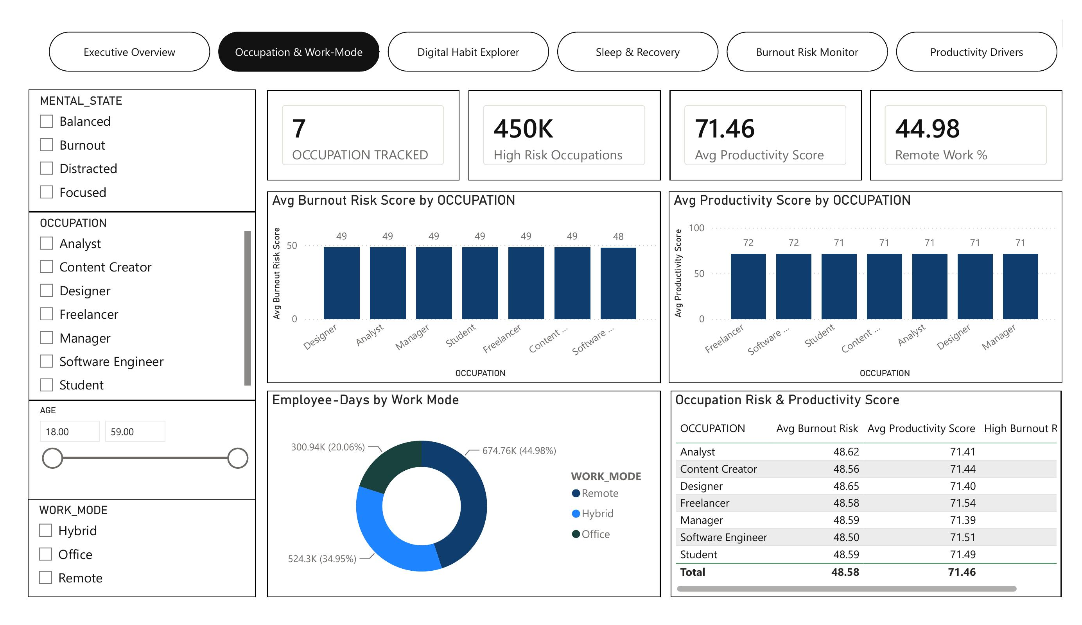
SECTION 09 · DASHBOARD · PAGE 2 OF 6
Occupation & Work-Mode Dashboard (1/2)
Productivity holds flat (71.39–71.54) across all 7 occupations and all 3 work modes.

Slide 47
SECTION 09 · DASHBOARD · PAGE 2 OF 6
Occupation & Work-Mode Dashboard (2/2)
KEY INSIGHTS
● | Average productivity holds within a narrow 71.39–71.54 band across all 7 occupations — confirming role does not meaningfully change output.
● | Burnout risk is similarly flat (48.50–48.65) across occupations, a spread of just 0.15 points.
● | Remote work is the dominant arrangement at 44.98% of employee-days, followed by Hybrid (34.95%) and Office (20.06%).
● | Neither occupation nor work mode shows a standout high-risk or high-productivity segment.
RECOMMENDATION Don't segment digital-wellness programs by job title or work mode — apply support workforce-wide instead.

Slide 48
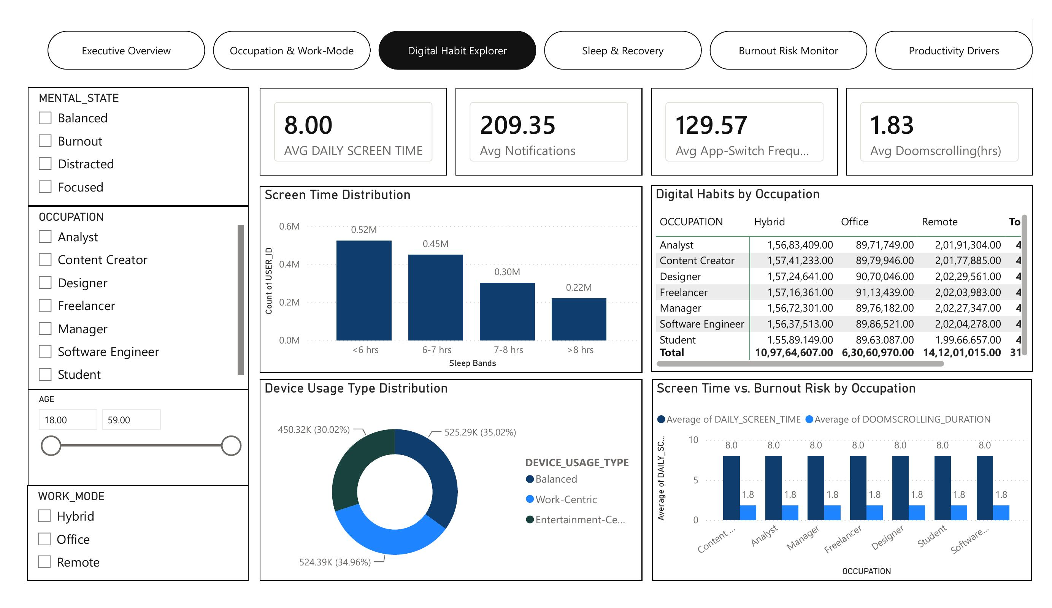
SECTION 09 · DASHBOARD · PAGE 3 OF 6
Digital Habit Explorer Dashboard (1/2)
Screen time (8.0 hrs), notifications (209/day) and app-switching (130/day) are uniform across occupations.

Slide 49
SECTION 09 · DASHBOARD · PAGE 3 OF 6
Digital Habit Explorer Dashboard (2/2)
KEY INSIGHTS
● | Average daily screen time is a consistent 8.0 hours across every occupation, alongside ~209 notifications and ~130 app-switches per day.
● | Doomscrolling duration averages 1.83 hours, with the top quartile (26.6% of records) crossing 2.6+ hours and showing a 7.8-point higher average burnout risk.
● | Device usage type splits nearly evenly across Balanced (35.0%), Work-Centric (35.0%) and Entertainment-Centric (30.0%) patterns.
● | These digital-habit metrics are uniform across occupations — this is a workplace-wide pattern, not a team-specific one.
RECOMMENDATION Target notification load and doomscrolling directly through policy (batching, screen-time nudges) rather than role-based programs.

Slide 50
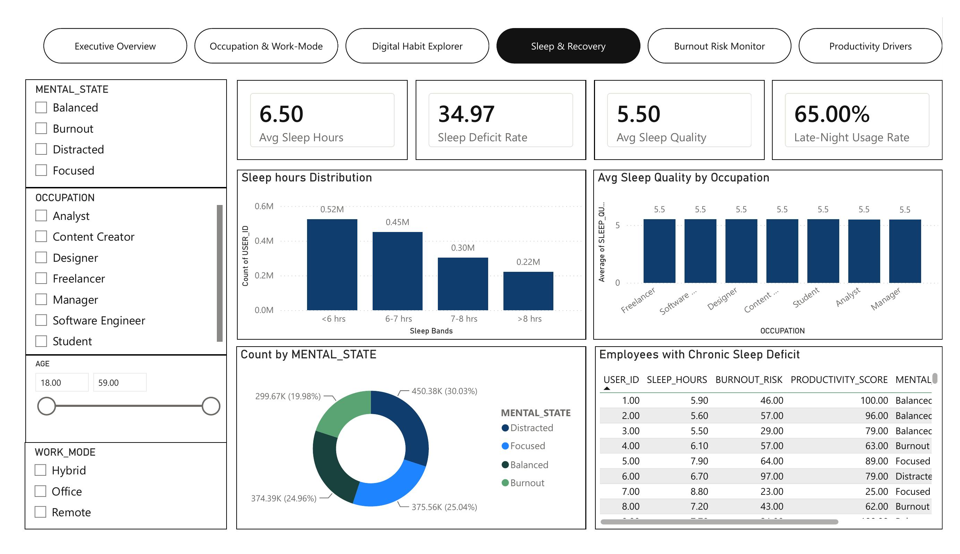
SECTION 09 · DASHBOARD · PAGE 4 OF 6
Sleep & Recovery Monitor Dashboard (1/2)
65% late-night device usage and a 34.97% sleep-deficit rate make sleep hygiene a clear lever.

Slide 51
SECTION 09 · DASHBOARD · PAGE 4 OF 6
Sleep & Recovery Monitor Dashboard (2/2)
KEY INSIGHTS
● | 34.97% of employee-days show under 6 hours of sleep, the largest single sleep band in the distribution.
● | Average sleep quality sits at 5.5/10 and average sleep hours at 6.5 — both indicate room for improvement, not crisis levels.
● | 65% of employee-days include late-night device usage, and that group shows a 7.4-point higher average burnout risk (51.16 vs. 43.79) than employees without late-night usage.
● | Sleep hours are similar whether or not late-night usage occurs (6.5 hrs either way) — late-night usage appears linked to burnout through a pathway other than simple sleep duration.
RECOMMENDATION Launch a device wind-down / sleep-hygiene pilot targeting the 65% late-night-usage population, and track its impact on burnout risk specifically.

Slide 52
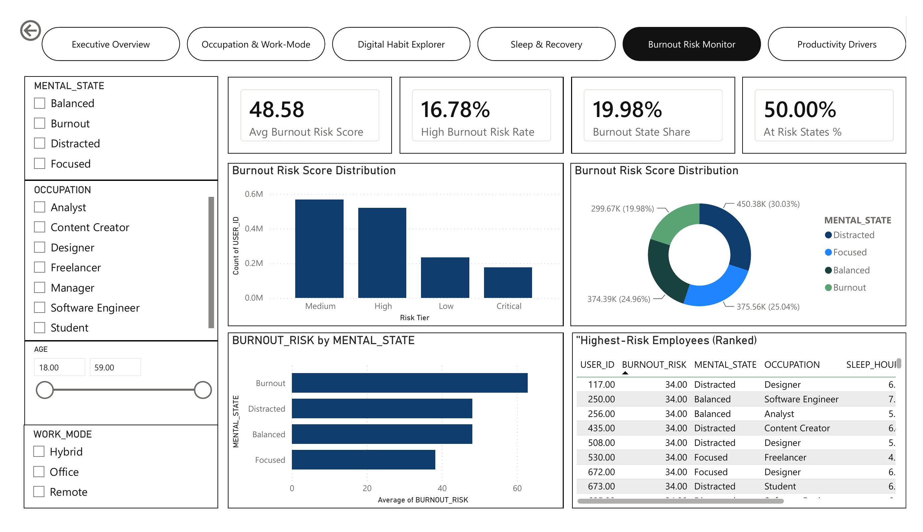
SECTION 09 · DASHBOARD · PAGE 5 OF 6
Burnout Risk Monitor Dashboard (1/2)
Employees in an active "Burnout" mental state carry visibly higher average burnout-risk scores.

Slide 53
SECTION 09 · DASHBOARD · PAGE 5 OF 6
Burnout Risk Monitor Dashboard (2/2)
KEY INSIGHTS
● | Average burnout risk sits at 48.58/100 with 16.78% of employee-days in the high-risk tier.
● | Employees in an active "Burnout" mental state show a visibly higher average burnout-risk score than any other mental-state group, confirming label consistency.
● | The Burnout mental state accounts for 19.98% of all employee-days — roughly 1 in 5.
● | 50% of the 4 mental-state categories (Distracted + Burnout) can be considered “at-risk,” reinforcing the case for proactive monitoring.
RECOMMENDATION Operationalize the ML burnout classifier (90.4% ROC-AUC) against this page's watchlist so flags route straight into an HR review queue.

Slide 54
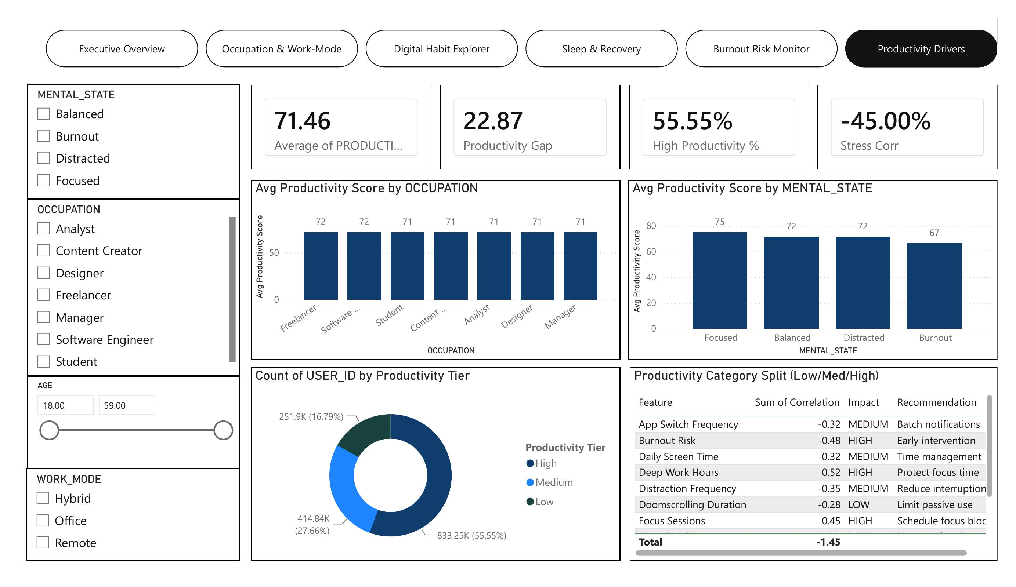
SECTION 09 · DASHBOARD · PAGE 6 OF 6
Productivity Driver Analysis Dashboard (1/2)
Deep Work Hours (+0.52) and Burnout Risk (-0.48) are the two highest-impact correlated features.

Slide 55
SECTION 09 · DASHBOARD · PAGE 6 OF 6
Productivity Driver Analysis Dashboard (2/2)
KEY INSIGHTS
● | 55.55% of employee-days fall into the High productivity tier on the dashboard's own tier definition, vs. 16.79% Low — a 22.9-point productivity gap between tiers.
● | Deep Work Hours (+0.52) and Burnout Risk (-0.48) are the two highest-impact correlated features on the live panel — matching the standalone Python correlation analysis almost exactly.
● | Productivity by mental state ranges from 75 (Focused) down to 67 (Burnout) — an 8-point swing tied directly to wellbeing state.
● | Stress correlation with productivity sits at -45%, the single strongest psychological driver on this page.
RECOMMENDATION Prioritize deep-work protection and stress reduction as the two highest-leverage productivity interventions — both dashboard-confirmed and model-confirmed.

Slide 56

SECTION 10 · SYNTHESIS
Overall Business Insights
● | Workforce is broad and balanced: ages 18–59 (mean 38.5), 7 occupations near-equally represented — no demographic or role skew.
● | Digital exposure is workplace-wide: ~8 hrs screen time, ~209 notifications/day, uniform across occupations and work modes.
● | Sleep debt is common: 34.97% of employee-days under 6 hours; 65% include late-night device usage.
● | Burnout risk is real and measurable: avg 48.58/100, 16.78% high-risk (~251,600 records), correlates -0.38 with productivity.
● | Deep work is the strongest productivity lever (r = 0.554), far ahead of any other single factor.
● | Both ML models validate the diagnostic findings: 90.4% ROC-AUC burnout classifier, R² = 0.80 productivity model.
● | Neither occupation, work mode, nor age meaningfully changes burnout risk — this is a behavioral problem, not a demographic one.

Slide 57
SECTION 11 · RECOMMENDATIONS
Recommendations
Digital Habit Strategy
Sleep & Recovery Strategy
Risk Management Strategy
Cap or batch non-urgent notifications; target the 26.6% of doomscroll-heavy employee-days directly.
Launch a device wind-down / sleep-hygiene pilot for the 65% late-night-usage population.
Deploy the burnout classifier (90.4% ROC-AUC) for continuous, HR-reviewed flagging.
Productivity Strategy
Operational Strategy
Monitoring Strategy
Protect deep-work blocks on calendars — the single highest-leverage lever (r = 0.554).
Apply wellness support evenly across roles/work modes — risk doesn't concentrate anywhere.
Automate the Power BI dashboard refresh for real-time people-ops monitoring.

Slide 58

SECTION 12 · FINAL RECOMMENDATIONS
Final Recommendations (1/3)
The core workforce — digital engagement, output, and role distribution — is stable and healthy at the aggregate level. The real opportunity is early, targeted intervention on the specific behavioral segments the diagnostic and predictive analysis have now precisely identified.
Behavioral Targeting
Risk Screening
Burnout risk isn't role- or age-based — target by habit (screen time, doomscrolling, late-night usage), not demographic.
16.78% high-risk rate (~251,600 records) — deploy the classifier as a continuous, human-reviewed screen.
Productivity Protection
Disengagement Watch
Deep work hours is 6× more predictive than the next digital-habit driver — protect it structurally.
A distinct 2.49% “disengaged” segment shows a 28.8-point productivity gap — needs its own tracking metric, separate from burnout-risk score.

Slide 59
SECTION 12 · FINAL RECOMMENDATIONS
Final Recommendations (2/3)
Business Area | Key Metric | Recommendation
Digital Habits | 8.0 hrs screen time; 209 notifications/day; 26.6% high-doomscroll | Cap/batch notifications; target high-doomscroll segment with nudges
Sleep & Recovery | 34.97% sleep-deficient; 65% late-night usage | Launch device wind-down pilot; monitor burnout-risk impact, not just sleep hours
Burnout Risk | 48.58 avg risk; 16.78% high-risk (251.6K records) | Deploy classifier (90.4% ROC-AUC) as a continuous, human-reviewed screen
Productivity Drivers | Deep Work r=0.554; regression model R²=0.798 | Protect deep-work calendar blocks; use model for policy simulation
Workforce Segmentation | Flat across 7 occupations, 3 work modes, 4 age bands | Apply support workforce-wide; don't target by role, mode or age

Slide 60
SECTION 12 · FINAL RECOMMENDATIONS
Final Recommendations (3/3) — Priority Roadmap
Short Term
Medium Term
Long Term
0–3 Months
3–9 Months
9+ Months
● | Cap/batch non-urgent notifications workplace-wide
● | Launch device wind-down nudge pilot for late-night users
● | Deploy burnout-risk classifier into HR review workflow
● | Roll out deep-work block protection policy org-wide
● | Build disengagement tracking (deep-work + focus thresholds) as a standing metric
● | Upgrade both models to ensemble methods and validate causally via pilot

Slide 61

Questions & Discussion
Thank you for your time and consideration.
Digital Burnout & Workplace Productivity Analytics · Final Project Report
Prepared by Aakash Kumar

