Slide 1
Retail Trends Analyzer
Analyzing Retail Sales Data using Python
By - Abhishek

Slide 2
Project Overview
A comprehensive data analysis project focusing on retail sales data was conducted using Python.
The project aimed to uncover significant trends and patterns within the sales dataset to enable stakeholders to make informed decisions and optimize sales strategies.

Slide 3
Project Objectives
Data Analysis: Conduct a thorough analysis of a large dataset of retail sales transactions to identify significant trends and patterns.
Visualization: Generate insightful visualizations and graphical representations to effectively communicate findings.
Insight Generation: Extract actionable insights from the sales data to enable stakeholders to make informed decisions and strategic planning.

Slide 4
Development Process
Data Collection and Preparation: Collect retail sales data from various sources, clean it to ensure consistency and accuracy, and preprocess it using Python programming.
Data Analysis: Utilize Python libraries such as pandas, NumPy, and matplotlib to conduct comprehensive data analysis, including exploratory data analysis techniques.
Data Visualization: Generate insightful visualizations using Python libraries such as matplotlib, seaborn, and Plotly to present sales trends and patterns.
Insight Generation: Apply statistical analysis and data mining techniques such as regression analysis, clustering, and association rule mining to extract actionable insights from the sales data.

Slide 5
Content :
Sales Trend Over Time
Profit Margin Over Time
Quarterly Sales/Sales & Profit % by year
Sales by Customer Segment
Sales by Product Category/Sub-Category
Sales by Region/Province
Sales Trend by Ship Mode

Slide 6
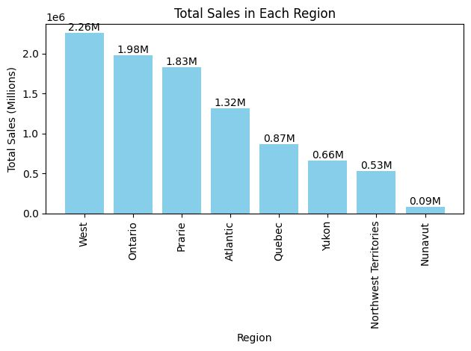
Sales By region
The West region accounted for the highest total sales, amounting to $2.26 million.
Ontario followed closely behind with total sales reaching $1.98 million.
Additionally, the Prarie region demonstrated significant sales performance, contributing $1.83 million to the overall sales revenue.
In contrast, the Nunavut region exhibited the lowest total sales among all regions, with sales amounting to a modest $0.09 million.

Slide 7
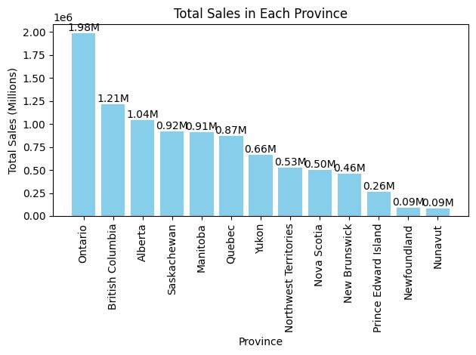
Sales By province
Ontario emerged as a significant contributor to total sales, generating $1.98 million in revenue.
Following closely, British Columbia accounted for $1.21 million in sales, demonstrating strong performance in the region.
Conversely, Nunavut exhibited the lowest sales figures among all provinces, with sales amounting to just $0.09 million.

Slide 8
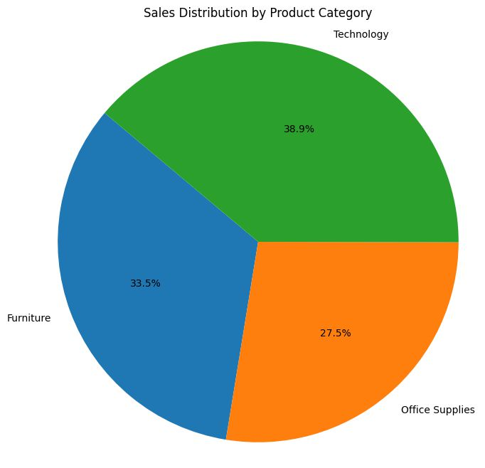
Sales By Product Category
technology products command the largest share of sales, constituting 38.9% of total revenue.
Furniture items follow closely behind, comprising 33.5% of the sales revenue.
Office supplies represent a significant portion of sales, contributing 27.5% to the overall revenue.

Slide 9
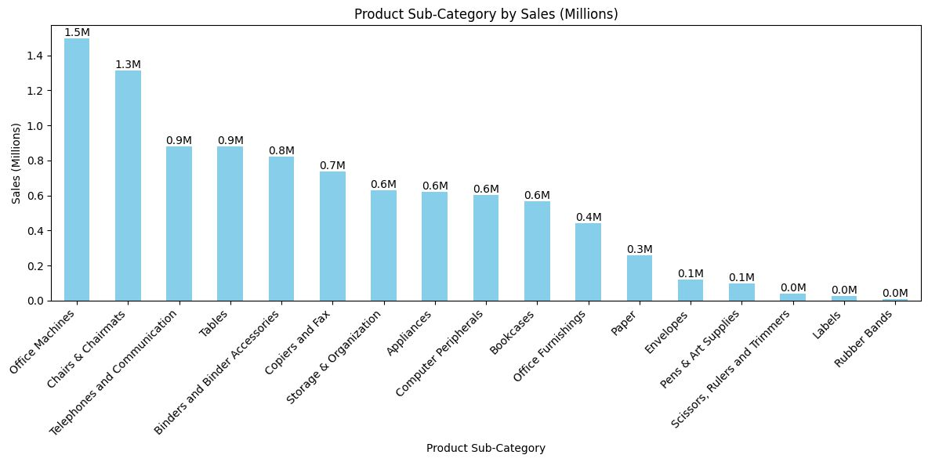
Sales By Product sub-Category
Office Machines emerged as the top-selling subcategory, generating $1.5 million in revenue.
Chairs and Chair mats followed closely behind, contributing $1.3 million to the overall sales.
The analysis further indicates that the last three product subcategories, namely Rubber Bands, Labels, and Scissors, Rubbers & Trimmers, each contributed sales revenue of $0.0 million. This suggests a potential opportunity for further evaluation or strategic adjustments in these subcategories to enhance their sales performance.

Slide 10
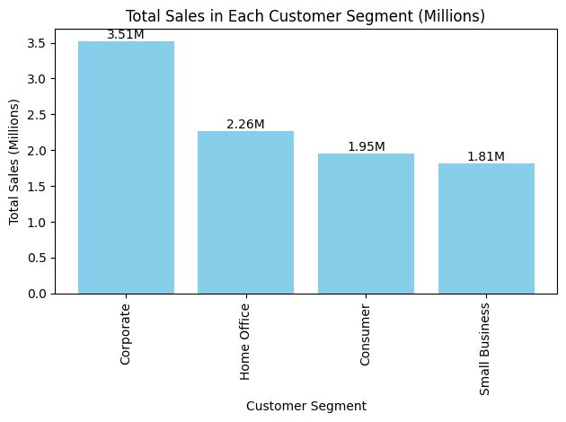
Sales By customer segment
Corporate customers accounted for the highest sales revenue, generating $3.51 million.
Home Office segment followed closely behind, contributing $2.26 million to the total sales.
Consumer segment demonstrated significant sales performance, with sales amounting to $1.95 million.
Small Business segment also contributed notably to the overall revenue, with sales reaching $1.81 million.

Slide 11
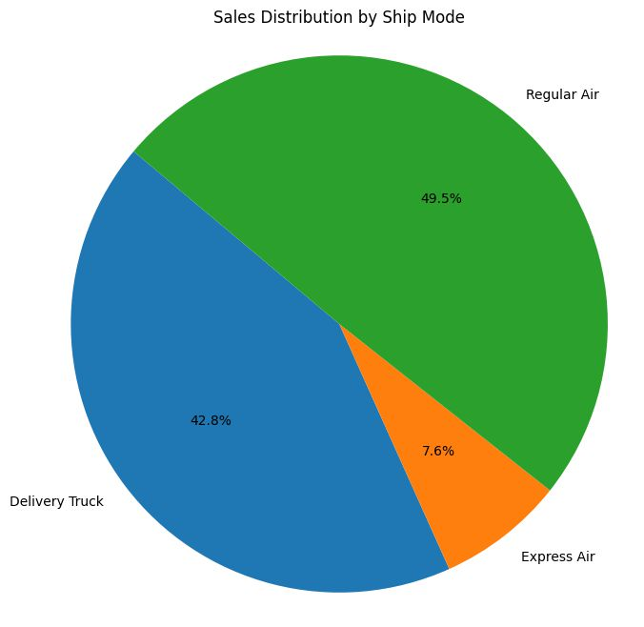
Sales By ship Mode
Regular Air shipping mode accounted for the majority of sales, representing 49.5% of total revenue.
Delivery Truck shipping mode followed closely behind, comprising 42.8% of the sales revenue.
Express Air shipping mode, while representing a smaller portion, still contributed significantly, with 7.6% of the total revenue.
Express Air shipping mode's contribution, albeit smaller in percentage terms, raises concerns about its operational efficiency and cost-effectiveness.

Slide 12
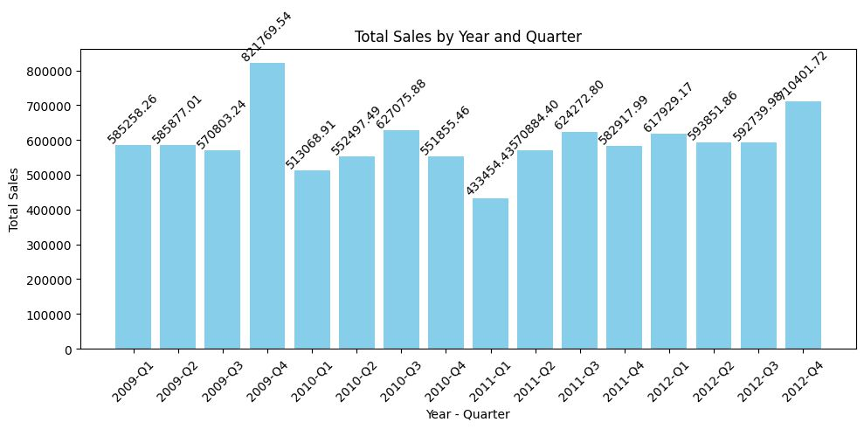
Quarterly Sales
The analysis of quarterly sales data reveals notable fluctuations in revenue across different quarters. Specifically, the fourth quarter of 2009 stood out as the period with the highest sales, amounting to approximately $0.821 million. However, by the fourth quarter of 2012, there was a noticeable decline in sales, with revenue totaling around $0.710 million. While the sales figures for the remaining quarters hover around the $0.5 million mark, these top two quarters signify significant shifts in sales performance over the years.

Slide 13
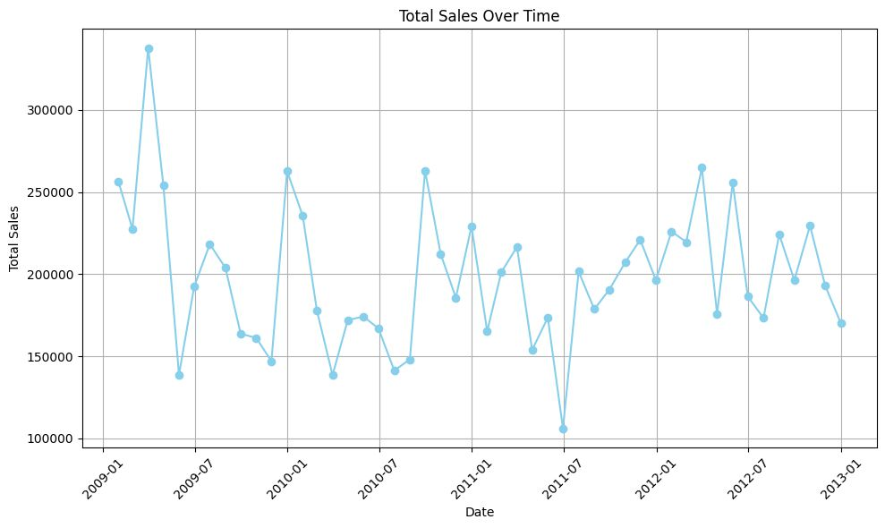
Total Sales Over Time
In the analysis of total sales over time, it's evident that the highest point occurred between January 2009 and July 2009. Conversely, the lowest point in total sales was observed in July 2011. This fluctuation in sales performance over time underscores the importance of closely monitoring sales trends and implementing strategic measures to mitigate downturns and capitalize on periods of growth. By understanding the underlying factors contributing to these fluctuations, businesses can adapt their strategies to optimize sales performance and drive sustained growth.

Slide 14
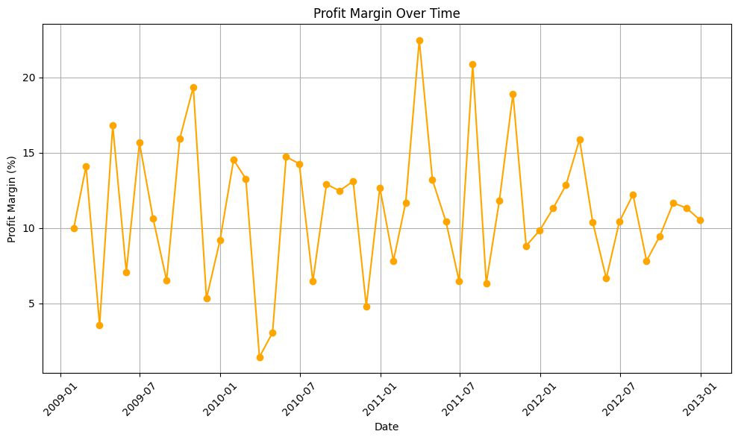
Profit Margin Over Time
The analysis of profit margin reveals noteworthy fluctuations over time. Specifically, the profit margin reached its peak between January 2011 and July 2011, signaling a period of robust profitability. In contrast, the lowest point in profit margin was observed between January 2010 and July 2010, suggesting a period of diminished profitability or potentially increased costs relative to revenue during that timeframe. Understanding these fluctuations in profit margin is crucial for strategic decision-making, enabling businesses to identify and address factors impacting profitability and implement measures to sustain or enhance profit margins over time.

Slide 15
Thank You
Sales Distribution:
Regional sales varied, with the West region leading in total sales, followed by Ontario and Paris.
Nunavut exhibited the lowest sales figures among all regions.
Product Performance:
Technology products accounted for the largest share of sales, followed by furniture and office supplies.
Office machines and chairs/chair mats were the top-selling product subcategories.
Customer Segmentation:
Corporate customers contributed the most to total sales revenue, followed by home office and consumer segments.
Small business segment also made a notable contribution to overall sales.
Shipping Mode Analysis:
Regular air shipping mode dominated in terms of sales percentage, followed by delivery truck and express air.
Profitability Trends:
Profit margins peaked between January 2011 and July 2011, while hitting a low point between January 2010 and July 2010.
Despite fluctuations, overall sales and profit margins demonstrated both peaks and troughs over time, indicating the dynamic nature of the business environment.

