Slide 1

Wearable Acoustic Monitor
Team - VSM-5
Team members:
Mayur Sanap, Smriti Puntamkar, Vedant Deshpande, Atharva
Thorat, Abhishek Deshpande, Shivang Bhargava
Advisor:
Dr. H Troy Nagle
(Tutorial Presentation)

Slide 2
Presentation Outline
Team Introduction
Background
Medical Significance of Asthma
Available Market Solutions
Literature Review
Need for Wearable Technology
Project Overview
Conclusion
References

Slide 3

Background
Most significant respiratory illnesses are asthma, chronic obstructive pulmonary disease (COPD), and lung cancer, affecting around 34 million lives in U.S.
Out of them, asthma affects approximately 25 million people in the U.S., with 7 million being children[2].
Asthma exacerbations are triggered by allergens, pollutants, and environmental factors like cold air[3].
References - "Wearable Wireless Sensors for Chronic Respiratory Disease Monitoring" Dieffenderfer, J., et al. (2015)

Slide 4
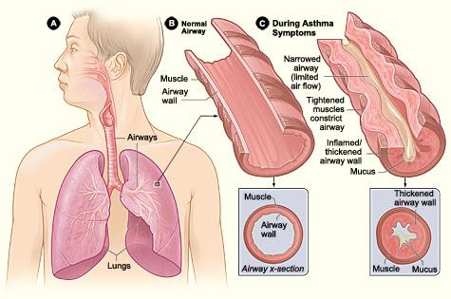
Medical Significance of Asthma
Asthma Formation: Caused by airway inflammation and narrowing due to allergens, irritants, or genetics.
Symptoms: Wheezing, shortness of breath, chest tightness, and coughing, often triggered by exercise or allergens.
1 in 12 individuals in the U.S. is affected by asthma​.
In 2007, asthma cost $56 billion in medical expenses​.
Ozone and volatile organic compounds (VOCs) are major triggers for asthma[4]​.
References - "Low-power wearable systems for continuous monitoring of environment and health for chronic respiratory disease" Dieffenderfer, J., Goodell, H., et al. (2016), https://nurseslabs.com/asthma/

Slide 5
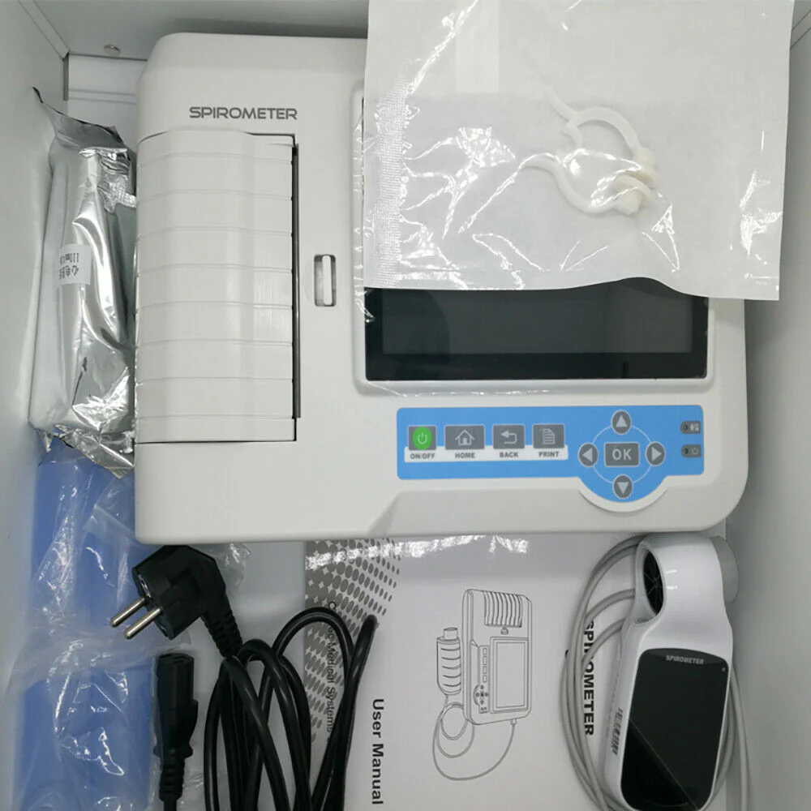
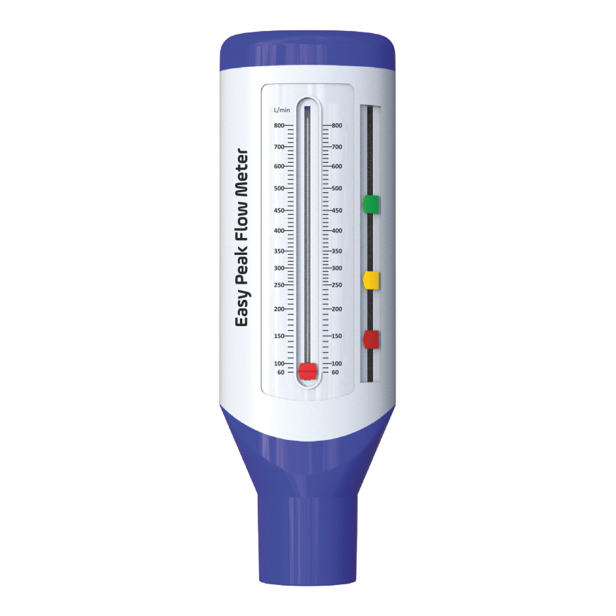
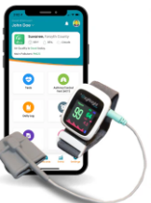
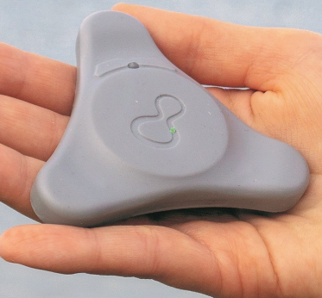
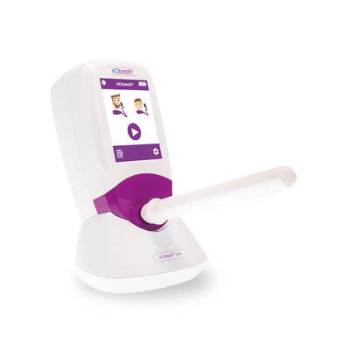
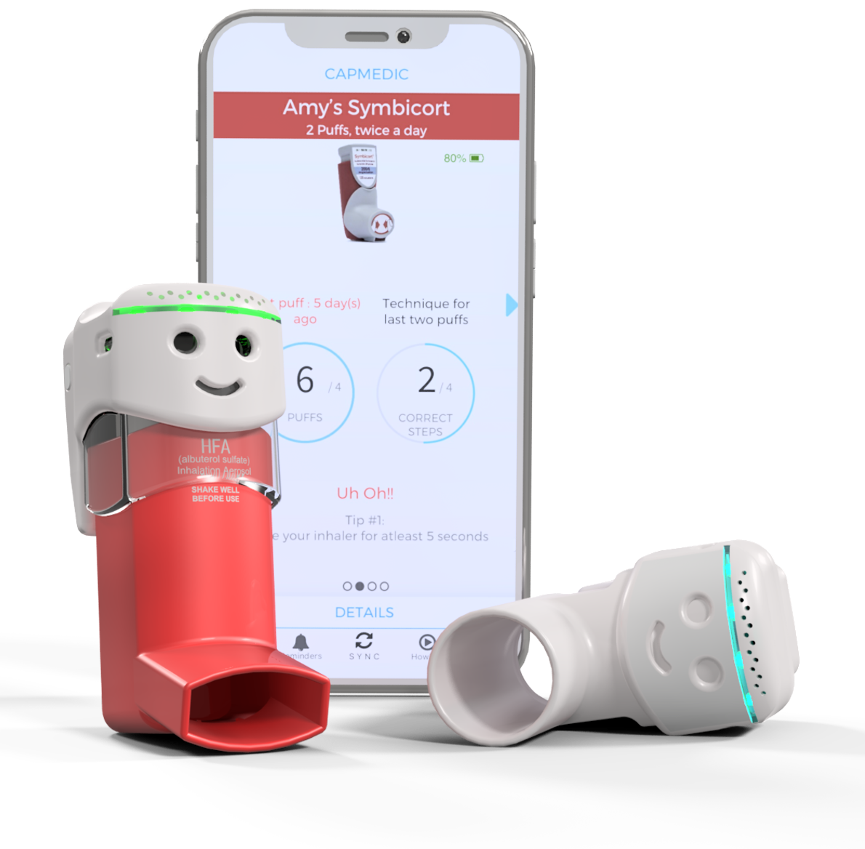
Available Market Solutions
Spirometer[5]
Peak Flow meter[6]
FeNO Monitors[7]
Smart Inhalers [8]
Wearable Devices
References - Website Link - https://www.cmihealth.com
Notes:
Example 1:
Now, consider a spirometer. Spirometer can help in detection and they also monitor disease progression but in order to use a spirometer, a person needs to be trained on the device or should have adequate technical expertise in the field. Incorrect technique will lead to inaccurate readings which will lead to wrong diagnosis. Spirometers cost between 400$ to 54,000$ depending on the functionality and the size. The ones used for Asthma detection are quite costly and not at all portable!
Example 2:
Pulse oximeters are used to determine the oxygen content in your body. They are non-invasive, affordable, convenient and very easy to use. But this device alone cannot determine the severity of asthma. In mild or moderate asthma, the oxygen levels in the patient’s body remain or appear normal due to which asthma might not be detected by pulse oximeter. They have to be paired with spirometry or peak flow meters in order to determine if the patient has asthma or not. Pulse oximeters used now a days are also not entirely accurate nor are they robust!
Spirometers: These measure lung function by assessing how much air you can inhale and exhale, and how quickly you can do it. They are crucial for diagnosing asthma and monitoring its progression. (https://www.cmihealth.com/collections/spirometer?srsltid=AfmBOooSlkMxxCK1ldUAFh3xJoZDZ6hkn2-oO_QPOQSaE5wUlFOVB4E1)
Peak Flow Meters: These are portable devices that measure the peak expiratory flow rate (PEFR), which indicates how well air is moving out of the lungs. Regular monitoring can help manage asthma and identify early signs of worsening symptoms. (https://www.lung.org/lung-health-diseases/lung-disease-lookup/asthma/treatment/devices/peak-flow#:~:text=What%20is%20a%20Peak%20Flow,pushed%20out%20of%20your%20lungs.)
FeNO Monitors: Fractional exhaled nitric oxide (FeNO) monitors measure the level of nitric oxide in exhaled breath. Elevated levels can indicate airway inflammation, which is common in asthma. (https://www.medicalexpo.com/medical-manufacturer/feno-breathing-monitor-59187.html)
Smart Inhalers: These are inhalers equipped with sensors that track medication usage and provide data to both patients and healthcare providers. They often include features like reminders and tracking apps. (https://sensirion.com/products/applications/medical/smart-inhaler)
Wearable Devices: Some advanced wearables can monitor physiological signals like heart rate, respiratory rate, and even detect patterns that may indicate an asthma exacerbation.
Pulse Oximeters: These devices measure blood oxygen levels and can help monitor the severity of an asthma attack, though they are not specific for asthma.

Slide 6
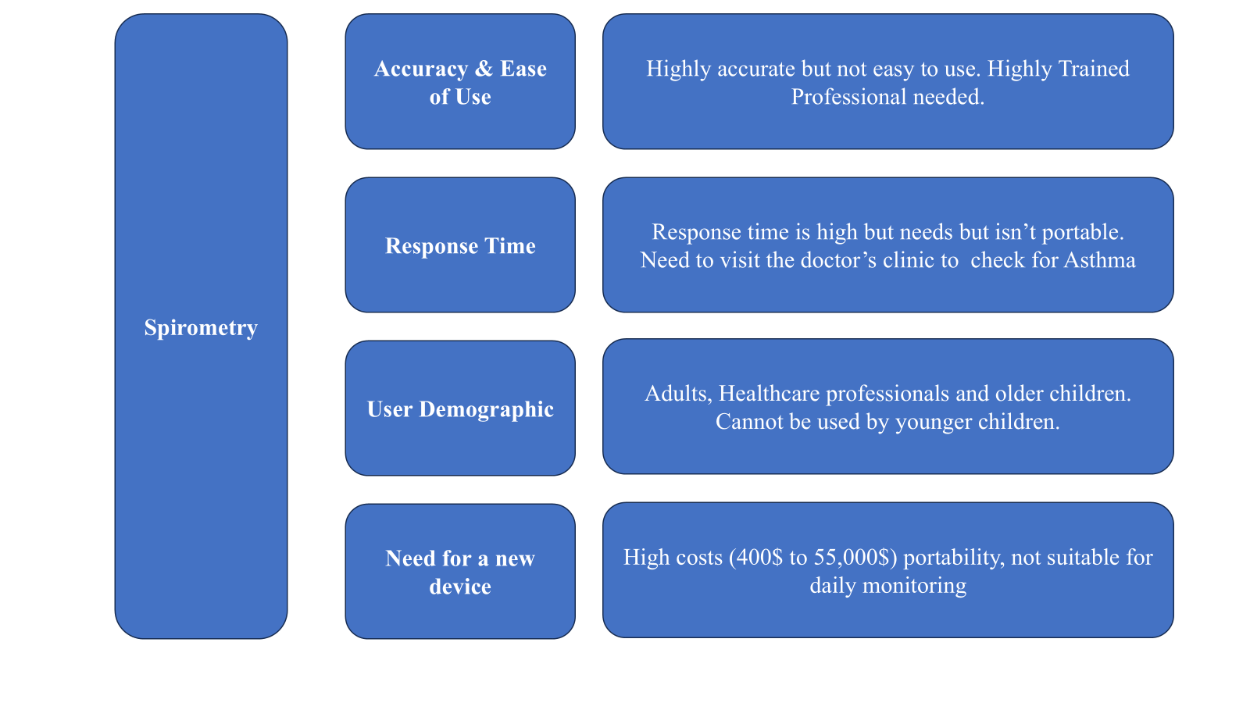
Available Market Solutions : Spirometry
Notes:
Example 1:
Now, consider a spirometer. Spirometer can help in detection and they also monitor disease progression but in order to use a spirometer, a person needs to be trained on the device or should have adequate technical expertise in the field. Incorrect technique will lead to inaccurate readings which will lead to wrong diagnosis. Spirometers cost between 400$ to 54,000$ depending on the functionality and the size. The ones used for Asthma detection are quite costly and not at all portable!
Example 2:
Pulse oximeters are used to determine the oxygen content in your body. They are non-invasive, affordable, convenient and very easy to use. But this device alone cannot determine the severity of asthma. In mild or moderate asthma, the oxygen levels in the patient’s body remain or appear normal due to which asthma might not be detected by pulse oximeter. They have to be paired with spirometry or peak flow meters in order to determine if the patient has asthma or not. Pulse oximeters used now a days are also not entirely accurate nor are they robust!
Spirometers: These measure lung function by assessing how much air you can inhale and exhale, and how quickly you can do it. They are crucial for diagnosing asthma and monitoring its progression. (https://www.cmihealth.com/collections/spirometer?srsltid=AfmBOooSlkMxxCK1ldUAFh3xJoZDZ6hkn2-oO_QPOQSaE5wUlFOVB4E1)
Peak Flow Meters: These are portable devices that measure the peak expiratory flow rate (PEFR), which indicates how well air is moving out of the lungs. Regular monitoring can help manage asthma and identify early signs of worsening symptoms. (https://www.lung.org/lung-health-diseases/lung-disease-lookup/asthma/treatment/devices/peak-flow#:~:text=What%20is%20a%20Peak%20Flow,pushed%20out%20of%20your%20lungs.)
FeNO Monitors: Fractional exhaled nitric oxide (FeNO) monitors measure the level of nitric oxide in exhaled breath. Elevated levels can indicate airway inflammation, which is common in asthma. (https://www.medicalexpo.com/medical-manufacturer/feno-breathing-monitor-59187.html)
Smart Inhalers: These are inhalers equipped with sensors that track medication usage and provide data to both patients and healthcare providers. They often include features like reminders and tracking apps. (https://sensirion.com/products/applications/medical/smart-inhaler)
Wearable Devices: Some advanced wearables can monitor physiological signals like heart rate, respiratory rate, and even detect patterns that may indicate an asthma exacerbation.
Pulse Oximeters: These devices measure blood oxygen levels and can help monitor the severity of an asthma attack, though they are not specific for asthma.

Slide 7
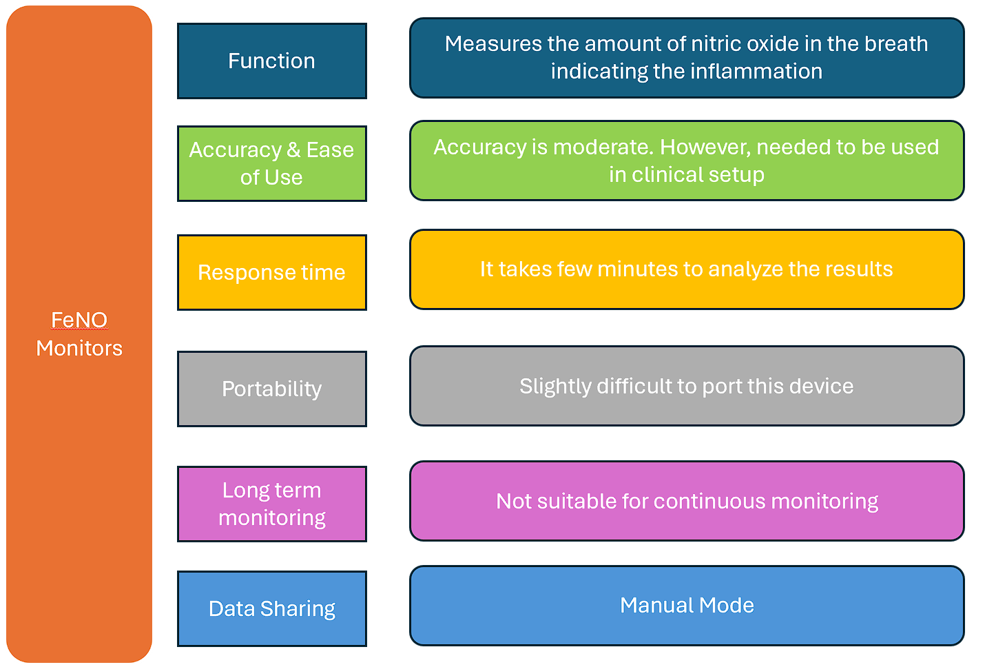
Available Market Solutions : FeNO Monitors
Notes:
Example 1:
Now, consider a spirometer. Spirometer can help in detection and they also monitor disease progression but in order to use a spirometer, a person needs to be trained on the device or should have adequate technical expertise in the field. Incorrect technique will lead to inaccurate readings which will lead to wrong diagnosis. Spirometers cost between 400$ to 54,000$ depending on the functionality and the size. The ones used for Asthma detection are quite costly and not at all portable!
Example 2:
Pulse oximeters are used to determine the oxygen content in your body. They are non-invasive, affordable, convenient and very easy to use. But this device alone cannot determine the severity of asthma. In mild or moderate asthma, the oxygen levels in the patient’s body remain or appear normal due to which asthma might not be detected by pulse oximeter. They have to be paired with spirometry or peak flow meters in order to determine if the patient has asthma or not. Pulse oximeters used now a days are also not entirely accurate nor are they robust!
Spirometers: These measure lung function by assessing how much air you can inhale and exhale, and how quickly you can do it. They are crucial for diagnosing asthma and monitoring its progression. (https://www.cmihealth.com/collections/spirometer?srsltid=AfmBOooSlkMxxCK1ldUAFh3xJoZDZ6hkn2-oO_QPOQSaE5wUlFOVB4E1)
Peak Flow Meters: These are portable devices that measure the peak expiratory flow rate (PEFR), which indicates how well air is moving out of the lungs. Regular monitoring can help manage asthma and identify early signs of worsening symptoms. (https://www.lung.org/lung-health-diseases/lung-disease-lookup/asthma/treatment/devices/peak-flow#:~:text=What%20is%20a%20Peak%20Flow,pushed%20out%20of%20your%20lungs.)
FeNO Monitors: Fractional exhaled nitric oxide (FeNO) monitors measure the level of nitric oxide in exhaled breath. Elevated levels can indicate airway inflammation, which is common in asthma. (https://www.medicalexpo.com/medical-manufacturer/feno-breathing-monitor-59187.html)
Smart Inhalers: These are inhalers equipped with sensors that track medication usage and provide data to both patients and healthcare providers. They often include features like reminders and tracking apps. (https://sensirion.com/products/applications/medical/smart-inhaler)
Wearable Devices: Some advanced wearables can monitor physiological signals like heart rate, respiratory rate, and even detect patterns that may indicate an asthma exacerbation.
Pulse Oximeters: These devices measure blood oxygen levels and can help monitor the severity of an asthma attack, though they are not specific for asthma.

Slide 8
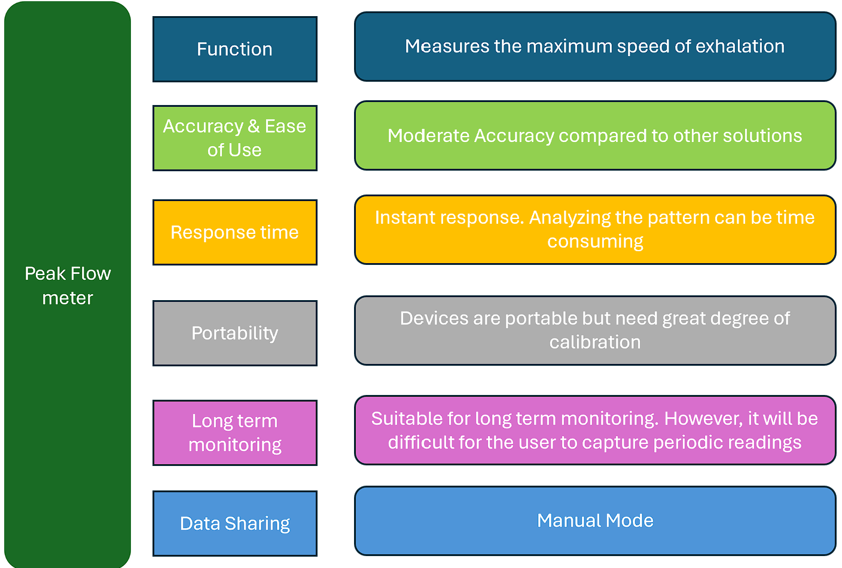
Available Market Solutions : Peak Flow Meter
Notes:
Example 1:
Now, consider a spirometer. Spirometer can help in detection and they also monitor disease progression but in order to use a spirometer, a person needs to be trained on the device or should have adequate technical expertise in the field. Incorrect technique will lead to inaccurate readings which will lead to wrong diagnosis. Spirometers cost between 400$ to 54,000$ depending on the functionality and the size. The ones used for Asthma detection are quite costly and not at all portable!
Example 2:
Pulse oximeters are used to determine the oxygen content in your body. They are non-invasive, affordable, convenient and very easy to use. But this device alone cannot determine the severity of asthma. In mild or moderate asthma, the oxygen levels in the patient’s body remain or appear normal due to which asthma might not be detected by pulse oximeter. They have to be paired with spirometry or peak flow meters in order to determine if the patient has asthma or not. Pulse oximeters used now a days are also not entirely accurate nor are they robust!
Spirometers: These measure lung function by assessing how much air you can inhale and exhale, and how quickly you can do it. They are crucial for diagnosing asthma and monitoring its progression. (https://www.cmihealth.com/collections/spirometer?srsltid=AfmBOooSlkMxxCK1ldUAFh3xJoZDZ6hkn2-oO_QPOQSaE5wUlFOVB4E1)
Peak Flow Meters: These are portable devices that measure the peak expiratory flow rate (PEFR), which indicates how well air is moving out of the lungs. Regular monitoring can help manage asthma and identify early signs of worsening symptoms. (https://www.lung.org/lung-health-diseases/lung-disease-lookup/asthma/treatment/devices/peak-flow#:~:text=What%20is%20a%20Peak%20Flow,pushed%20out%20of%20your%20lungs.)
FeNO Monitors: Fractional exhaled nitric oxide (FeNO) monitors measure the level of nitric oxide in exhaled breath. Elevated levels can indicate airway inflammation, which is common in asthma. (https://www.medicalexpo.com/medical-manufacturer/feno-breathing-monitor-59187.html)
Smart Inhalers: These are inhalers equipped with sensors that track medication usage and provide data to both patients and healthcare providers. They often include features like reminders and tracking apps. (https://sensirion.com/products/applications/medical/smart-inhaler)
Wearable Devices: Some advanced wearables can monitor physiological signals like heart rate, respiratory rate, and even detect patterns that may indicate an asthma exacerbation.
Pulse Oximeters: These devices measure blood oxygen levels and can help monitor the severity of an asthma attack, though they are not specific for asthma.

Slide 9
Literature Review
Research Paper | Data | Result Accuracy | Limitations | Future Scope
Smartphone based Cough detection[9] | Median age 39 years,62.5% female, and 75.0% never smokers. | 83% of cough sensitivity. | 2-hour recording may miss full wake period, patient-selected times reduce reliability | Real-time monitoring and integration with larger datasets
Detection and Recognition of Cough Sounds Using Deep Learning [10] | 15,000 cough samples from healthy and diseased patients | 78.09% accuracy | Issues with sound variability and intra-class differences | Improve detection in noisy environments and public places like hospitals
Deep learning based cough detection camera using enhanced features[11] | Seven datasets including HUMAN20200923, Google AudioSet, DCASE2016-2019 | F1 score: 90.0% | Cannot detect COVID-19 directly | Enhance performance in real environments, optimize inception module
Automatic cough detection from realistic audio recordings using C-BiLSTM with boundary regression[12] | 9969 coughs over 168 hours from 42 patients with respiratory diseases | 84.13% sensitivity | Based on controlled/artificial data; real environments pose challenges | Develop online API for user-uploaded detection
Past and Trends in Cough Sound Acquisition, Automatic Detection and Automatic Classification[13] | 54% male vs. 46% female test subjects | 84 - 85% accuracy | Difficulty in covering real-life conditions for the validation | Combining big data and deep learning

Slide 10
Need for Wearable Technology:
Research scope and data creation
There is an increase in research projects on respiratory devices, creating a need for hardware to collect data, including support from the NCSU research community
Increased in patients aged of 18-24
In UNC, over 75% experienced an asthma symptoms [4]
Need?
The clinical gold-standard device does not provide accurate results under real-time conditions
Increased in wearable devices in youth
In 2016, 26% of individual aged 18-34 use wearable devices
48% used apps to track their health [14]
Asthma is prevalent and costly.
In 2009, U.S., Asthma costs - $56 billion per year [15]

Slide 11

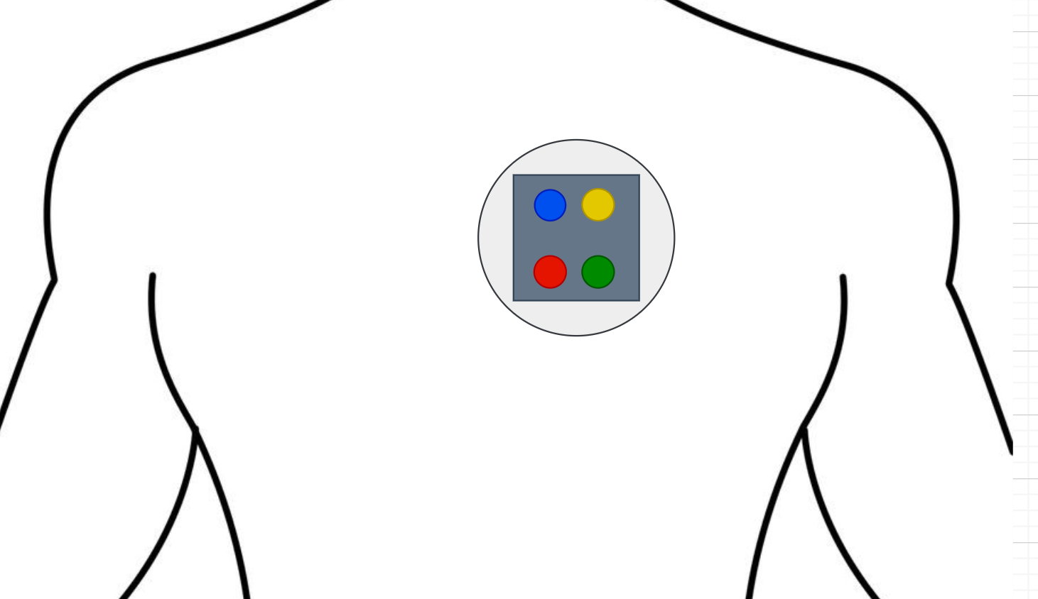
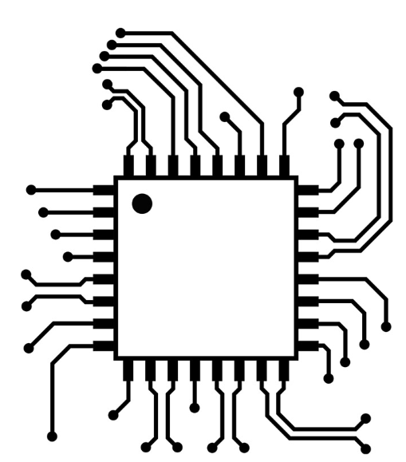
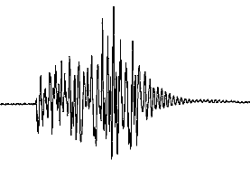


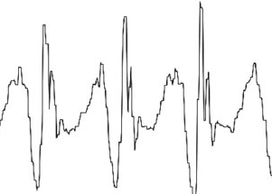
Project Overview
Cough Bot
Base station
Storage
Database
Signal Processing
Cough + Other Audio
Cough Inferences
algorithms
Cough freq + Other freq.
Battery
Charging Station
Cough Characteristics
IMU Data
Battery
Notification about the Cough intensity, Frequency, Duration etc.
Raw sensor data and information about cough inferences are sent to the cloud.

Slide 12
Conclusion
Research Focus: Study early symptoms of asthma and analyze ongoing research and existing devices to better understand the problem statement.
Sensor Integration: Plan to integrate sensors such as an external microphone, contact microphone, IMU, and other relevant sensors to monitor and analyze cough characteristics. Employ sensor fusion techniques to enhance accuracy in detecting cough parameters.
Cough Bot Design and base station: Develop a "Cough Bot" for hardware-based data collection, with a base station serving as an inference platform. This station will analyze cough characteristics, notify the user, and send data to a database if required.
Techniques for Detection: Utilize techniques such as sensor fusion, signal processing, and machine learning (if necessary) for accurate cough detection.
Modular Packaging: Design modular, user-friendly packaging using 3D printing technology for ease of use.

Slide 13
References
Website link - https://aspioneer.com/asthma-and-copd-monitoring-an-ai-powered-wearable-might-keep-track-on-respiratory-health/
K. Bahadori, M. M. Doyle-Waters, C. Marra, L. Lynd, K. Alasaly, J. Swiston, “Economic burden of asthma: a systematic review,” BMC Pulmonary Medicine, vol. 9, no. 1, 2009.
“Consumer Technology Association - Health and Fitness Technology Division.” December 2018.
A. J. Stoppelenburg, V. Salimi, M. Hennus, M. Plantinga, R. H. I. . Veld, J. Walk, J. Meerding, F. Coenjaerts, L. Bont, M. Boes, and et al., “Local il-17a potentiates early neutrophil recruitment to the respiratory tract during severe rsv infection,” PLoS ONE, vol. 8, no. 10, 2013
Website link - https://www.cmihealth.com/collections/spirometer?srsltid=AfmBOooSlkMxxCK1ldUAFh3xJoZDZ6hkn2-oO_QPOQSaE5wUlFOVB4E1
Website link - https://www.lung.org/lung-health-diseases/lung-disease-lookup/asthma/treatment/devices/peak-flow
Website link - https://www.medicalexpo.com/medical-manufacturer/feno-breathing-monitor-59187.html
Website link - https://sensirion.com/products/applications/medical/smart-inhaler
“Asthma,” January 2017
J. Dieffenderfer, H. Goodell, S. Mills, M. McKnight, S. Yao, F. Lin, E. Beppler, B. Bent,B. Lee, V. Misra, Y. Zhu, O. Oralkan, J. Strohmaier, J. Muth, and A. Peden, David amd Bozkurt, “Low-power wearable systems for continuous monitoring of environment and health for chronic respiratory disease,” IEEE journal of biomedical and health informatics, vol. 20, no. 5, pp. 1251–1264, 2016
J. P. Dieffenderfer et al., “Wearable wireless sensors for chronic respiratory disease monitoring,” in Proc. IEEE 12th Int. Conf. Wearable Implantable Body Sens.Networks, 2015, pp. 1–6.
L. Taylor, X. Ding, D. Clifton and H. Lu, "Wearable Vital Signs Monitoring for Patients With Asthma: A Review," in IEEE Sensors Journal, vol. 23, no. 3, pp. 1734-1751, 1 Feb.1, 2023, doi: 10.1109/JSEN.2022.3224411.
Kuhn M, Nalbant E, Kohlbrenner D, Alge M, Kuett L, Arvaji A, Sievi NA, Russi EW, Clarenbach CF. Validation of a small cough detector. ERJ Open Res. 2023 Jan 23;9(1):00279-2022. doi: 10.1183/23120541.00279-2022. PMID: 36699651; PMCID: PMC9868968.
Mouomene Moffo, F., Vigny Noumsi Woguia, A., Mvogo Ngono, J., Bowong Tsakou, S., Nguekeu Metepong Lagpong, N. (2024). Detection and Recognition of Cough Sounds Using Deep Learning for Medical Monitoring. In: Tchakounte, F., Atemkeng, M., Rajagopalan, R.P. (eds) Safe, Secure, Ethical, Responsible Technologies and Emerging Applications. SAFER-TEA 2023. Lecture Notes of the Institute for Computer Sciences, Social Informatics and Telecommunications Engineering, vol 566. Springer, Cham. https://doi.org/10.1007/978-3-031-56396-6_18
Gyeong-Tae Lee, Hyeonuk Nam, Seong-Hu Kim, Sang-Min Choi, Youngkey Kim, Yong-Hwa Park, Deep learning based cough detection camera using enhanced features, Expert Systems with Applications, Volume 206, 2022, 117811, ISSN 0957-4174, https://doi.org/10.1016/j.eswa.2022.117811.
Mingyu You, Weihao Wang, You Li, Jiaming Liu, Xianghuai Xu, Zhongmin Qiu, Automatic cough detection from realistic audio recordings using C-BiLSTM with boundary regression,
Biomedical Signal Processing and Control, Volume 72, Part A, 2022, 103304, ISSN 1746-8094, https://doi.org/10.1016/j.bspc.2021.103304.
K. Safavi, R. Ratliff, K. Webb, and L. MacCracken, “Patients want a heavy dose of digital,” 2016.
K. Bahadori, M. M. Doyle-Waters, C. Marra, L. Lynd, K. Alasaly and J. Swiston, “Economic burden of asthma: a systematic review,” BMC Pulmonary Medicine, vol. 9, no. 1, 2009.
Website link - https://chatgpt.com/ (Use for grammar checking and rephrasing the content)

Slide 14
User Experience
Data collection
from patient
The data is fed into the cough detection algorithms.
Potential Patient
If a doctor detects asthma symptoms and decides to monitor them..
Retrieve cough parameters such as intensity, amplitude, and more.
A patient receives a 'cough bot'
The doctor will decide the next steps based on the cough characteristics
Patient used the device for 48 hrs
Finding Out cough characteristics
The 'cough bot' is submitted to the doctor

Slide 15
Societal Impact
Impact on People:
Usable outside of specialized medical settings.
Modular, wearable design for ease of use (DIY approach).
Cost-efficient solution.
Early detection enables preventive care.
Research Impact:
Accurate data collection through multi-sensor integration.
Machine learning-based prognosis supported by data.
Potential for application in the study and detection of other conditions.
References - L. Taylor, X. Ding, D. Clifton and H. Lu, "Wearable Vital Signs Monitoring for Patients With Asthma: A Review," in IEEE Sensors Journal, vol. 23, no. 3, pp. 1734-1751, 1 Feb.1, 2023, doi: 10.1109/JSEN.2022.3224411.

Slide 16
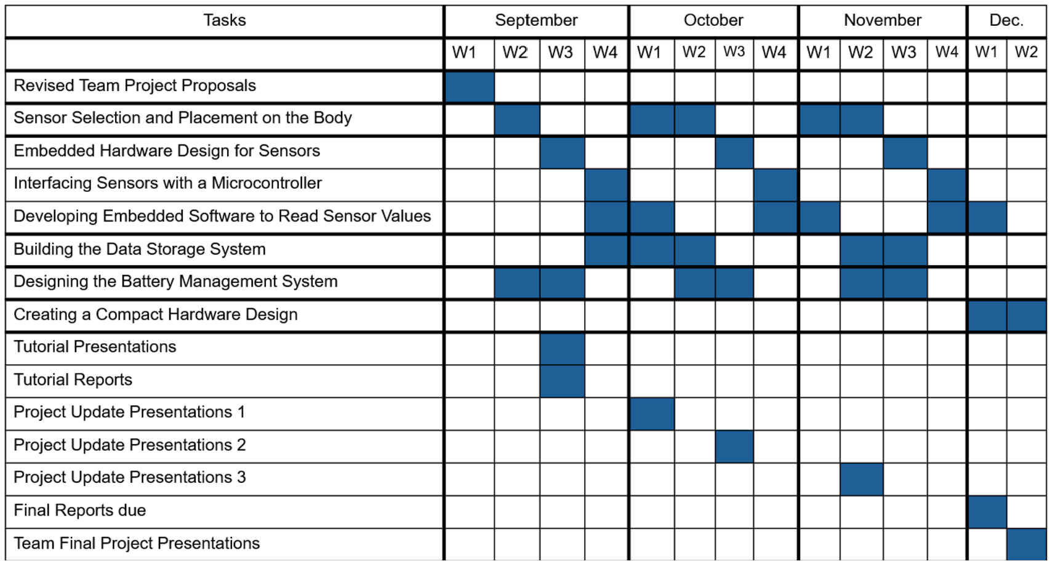
Project Plan
Note - For this project, there are distinct parts: the first part involves designing the cough bot hardware and software, while the second part focuses on cough detection and analyzing cough-related features. Additionally, we are considering an extra parallel study to optimize sensor placement on the body for better detection.

Slide 17
Future Steps
Challenges
Select and purchase sensors as needed.
Set up software for controller programming.
Search for batteries.
We need to determine the types of sensors that will accurately detect body signals, including their size and the interfacing protocols that are suitable for our needs.
Set up the environment for controller programming.
Search for lightweight and compact batteries suitable for powering the controller.

Slide 18
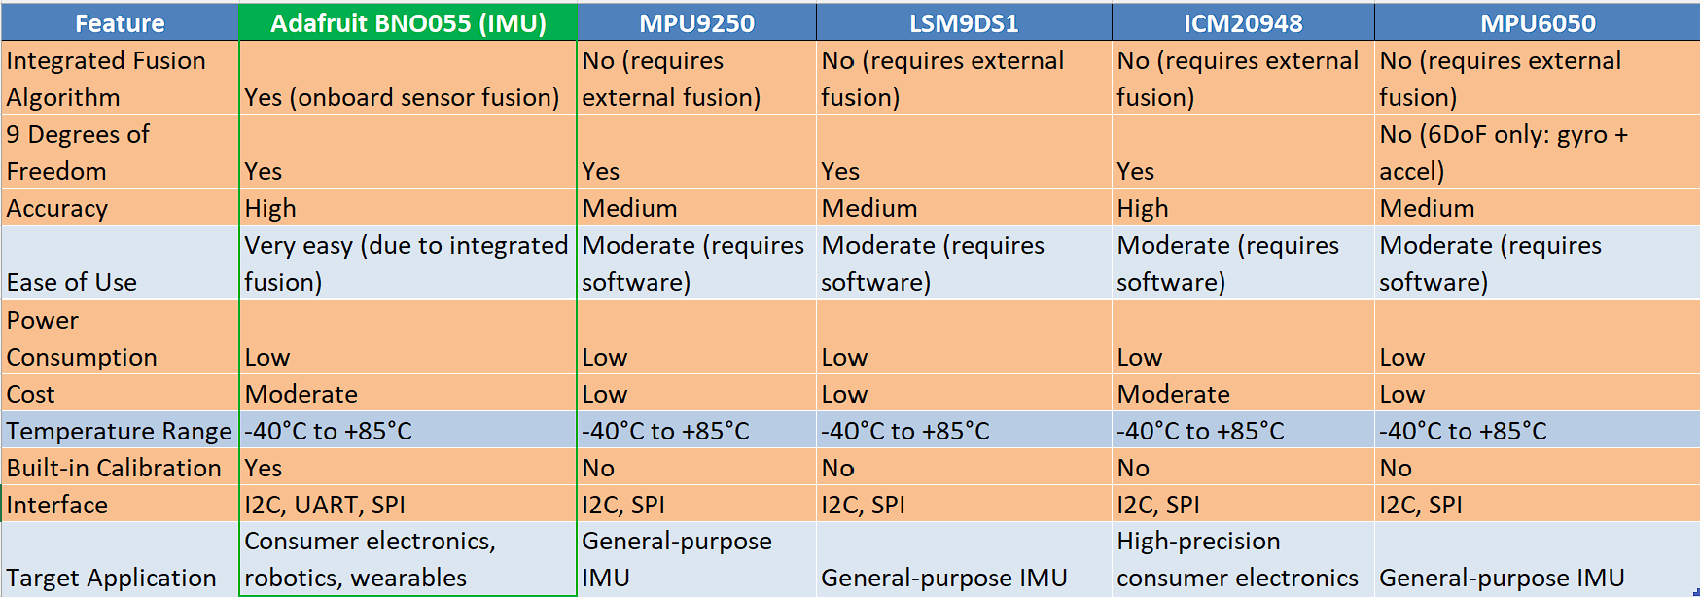
Comparative analysis: IMU sensors
Notes:
Advantages of BNO055
Low Power consumption
On board Sensor fusion and calibration
High accuracy
Good serial interface
Optimal cost

Slide 19
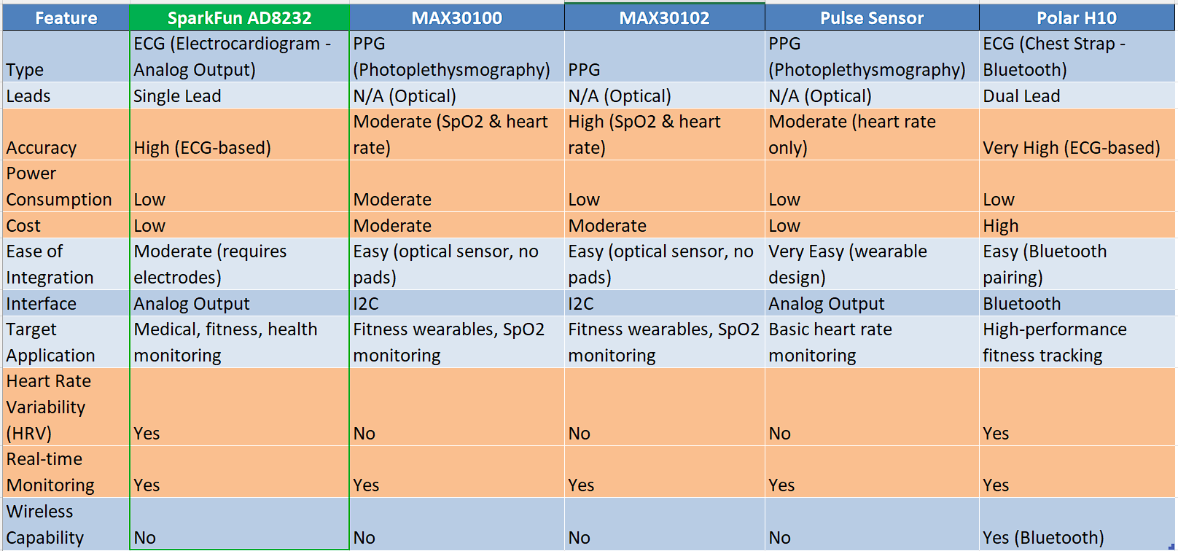
Comparative analysis: Heart rate monitoring sensors
Notes:
Advantages of AD8232
Good Accuracy
Low power consumption
HRV support
Uses ECG over PPG
Low cost device

Slide 20
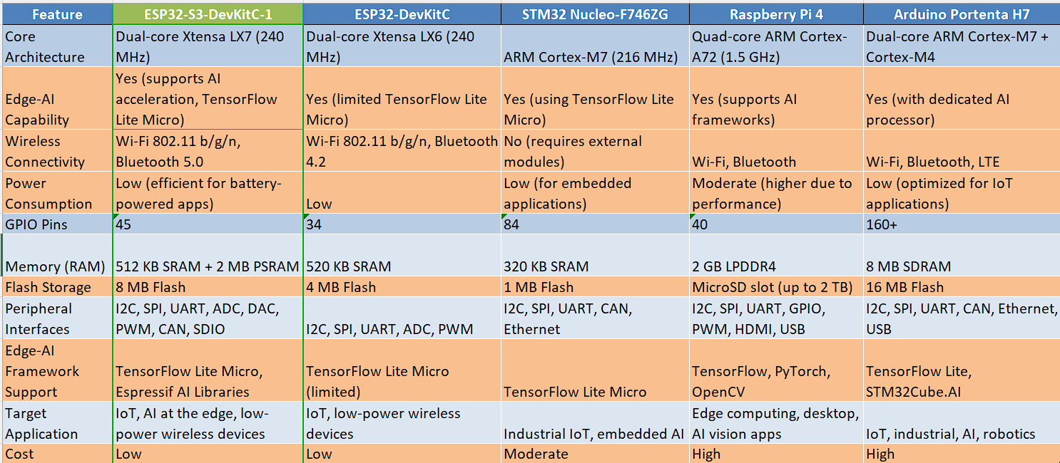
Comparative analysis: Dev Kits for Base Station
Notes:
Advantages of ESP32-S3-DevkitC-1
Suitable for Edge-AI
Supports most of the AI frameworks (TF Lite)
Low power consumption
Enough Flash storage
Low cost

Slide 21
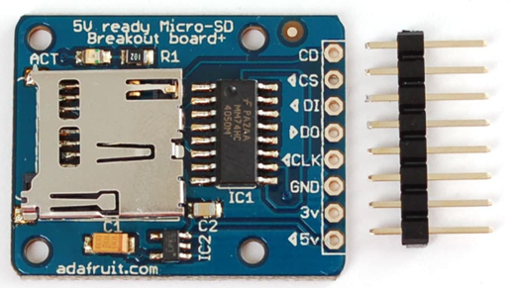
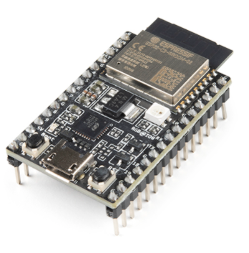
Interface SD card with ESP32
Hardware Setup:
Connect the SD card module to ESP32 using SPI (Serial Peripheral Interface).
Current Work:
Initialization and Mounting
Code to initialize the SD card.
Manage SD card initialization errors (e.g., card not detected, format issues).
Next Tasks:
Implement code for basic file operations: read, write, delete, open, and close files.
Test for reliability and error handling during file operations.
Analyze the storage capacity.
Interface between ESP32 and MAx controller.

Slide 22
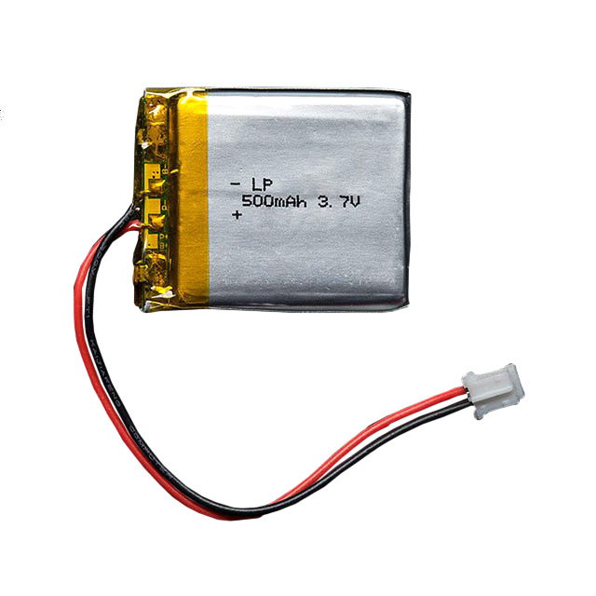
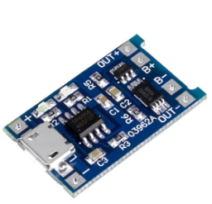
Power Management Circuitry
MCU supply required: 100mA at 3 - 3.6V.
Power requirement about 0.3 - 0.369W.
Current battery selected: LiPo 503035.
Planning to utilise TP4056 based board to implement battery management.
Future Tasks:
Attempt to fully utilize battery capacity.
Adjusting power supply to accommodate new components and changes in MCU use.
Implementing safety factor.
MCU
LiPo Battery
Charging Circuit
3-5V Supply
Notes:
Reference: https://power-calculation.com/battery-storage-calculator.php
https://www.addicore.com/cdn/shop/products/AD310-2.jpg?v=1689765930&width=1214

Slide 23
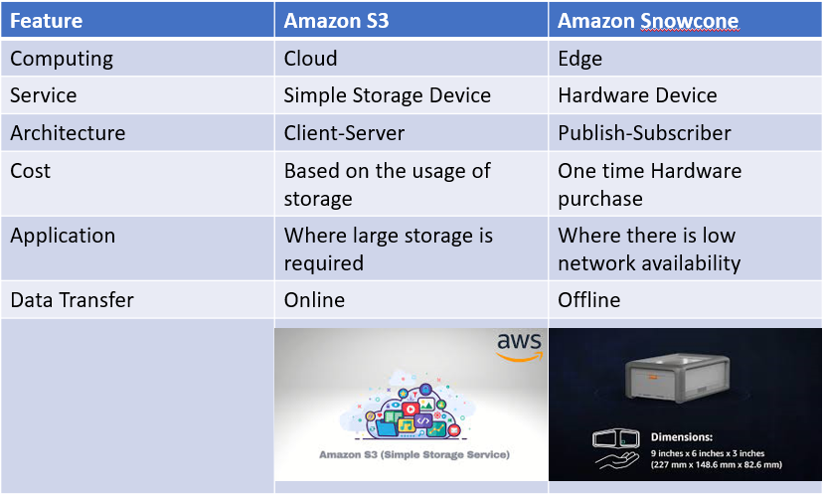
Amazon Web Services!

Slide 24
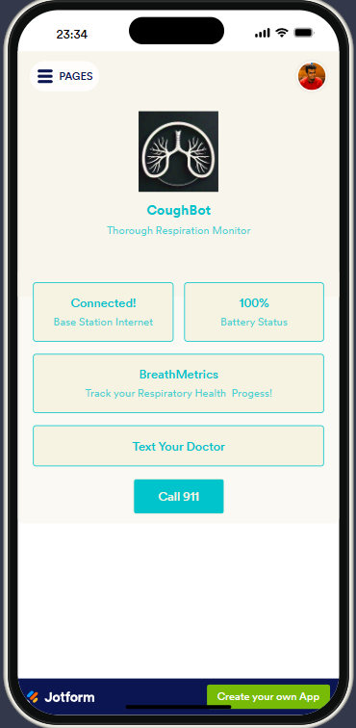
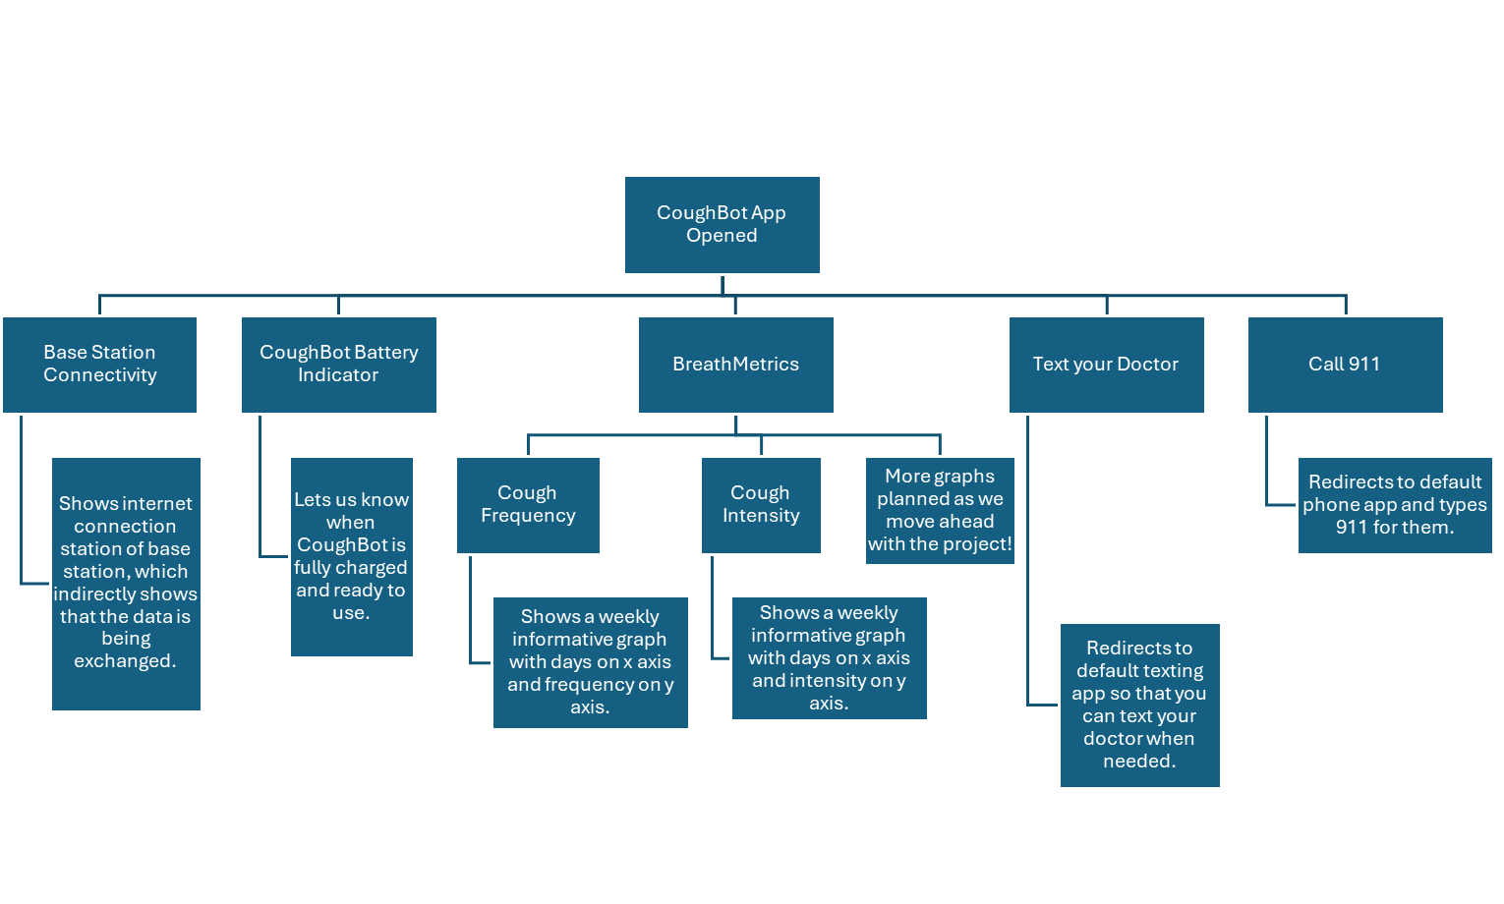
Android Application Interface

