Slide 1

VSM 5 WEARABLE ACOUSTIC MONITOR
Presentation By: Abhishek Ajit Deshpande

Slide 2
THE CONCEPT
Design and develop an energy-efficient data acquisition system for real-time respiratory signal monitoring and detailed analysis of cough patterns, supporting the accurate diagnosis of respiratory conditions such as asthma.

Slide 3
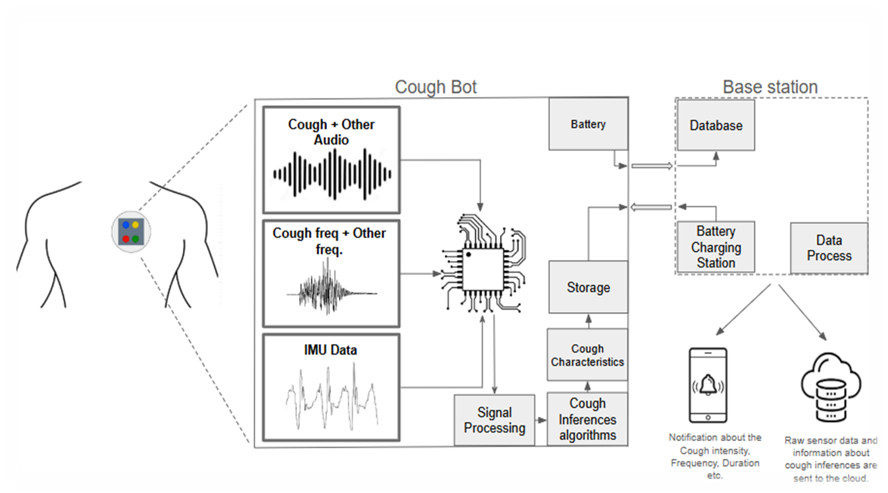
SYSTEM ARCHITECTURE

Slide 4
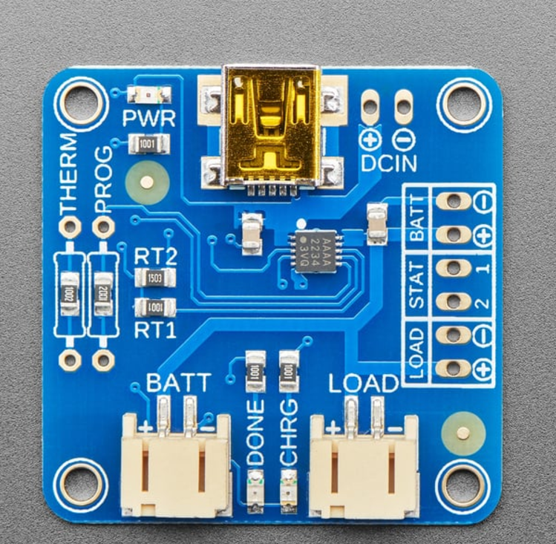
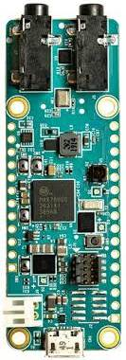

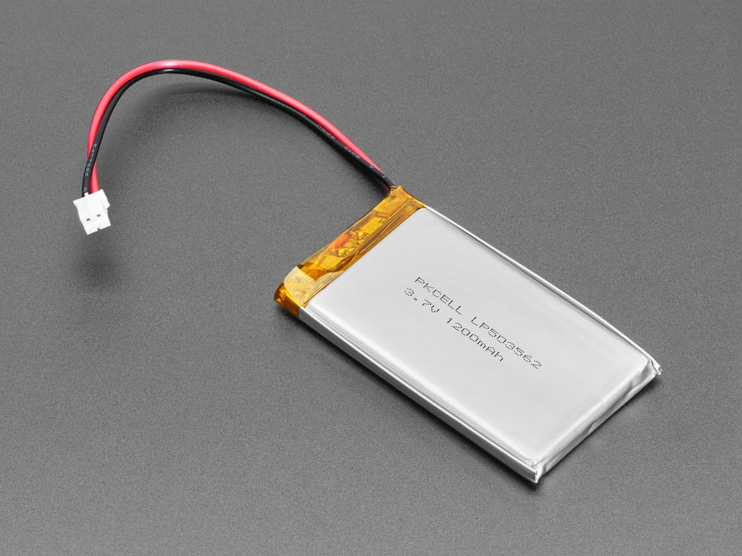
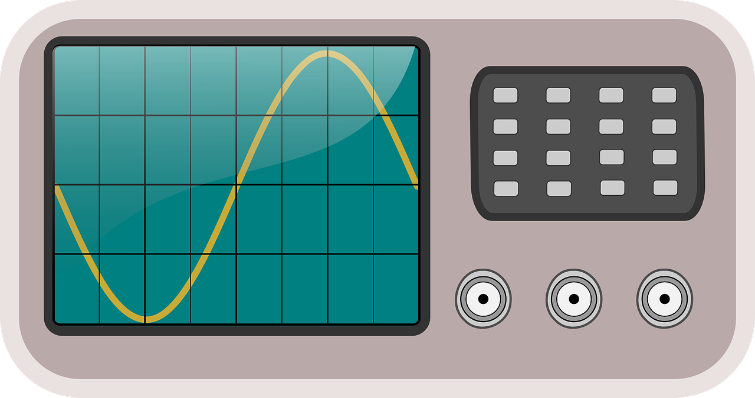
POWER MANAGEMENT
The Need:
Rechargeable cough bot requires stable operation.
Low power and low voltage consumption.
Fast and stable charging for
battery-based system.
The Solution:
5V DC
MCU Unit
Monitoring

Slide 5
THE PROCESS
Identifying system requirements.
Optimal selection of power management IC.
Making suitable component changes for our requirement.
Testing the circuit
Integration into the system architecture.

Slide 6
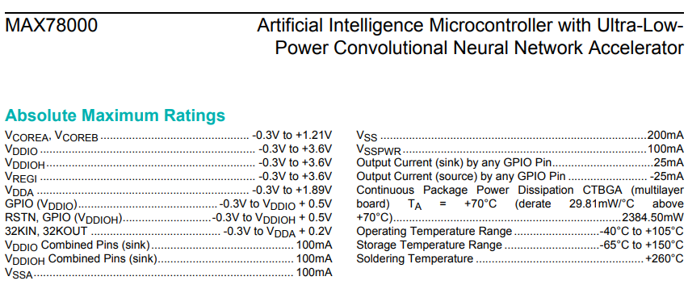
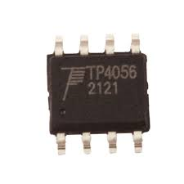
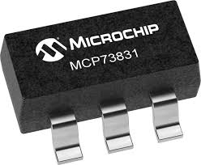


Identify the peak voltage and current ratings, consider a safety margin of 1.5 while selecting components.
Advantages of MCP73831:
Modular packaging with few external components.
Wide operating range.
Thermal stability.
Efficient dynamic charge control.

Slide 7
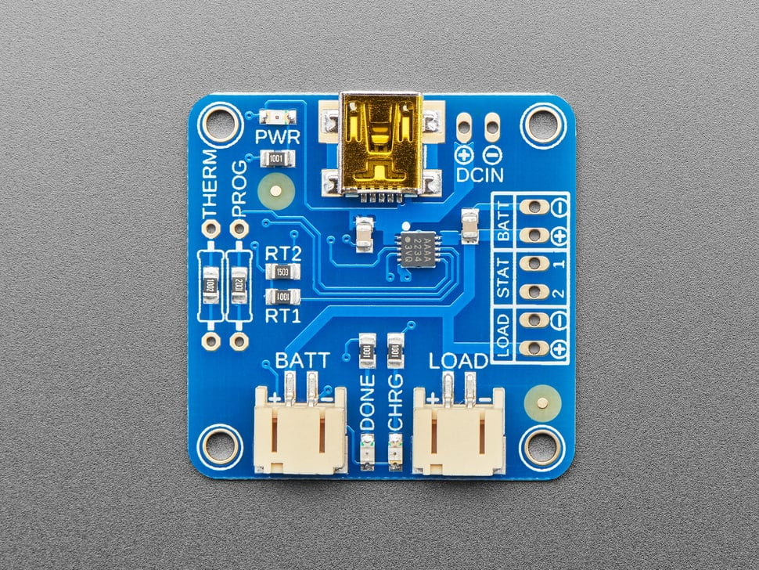
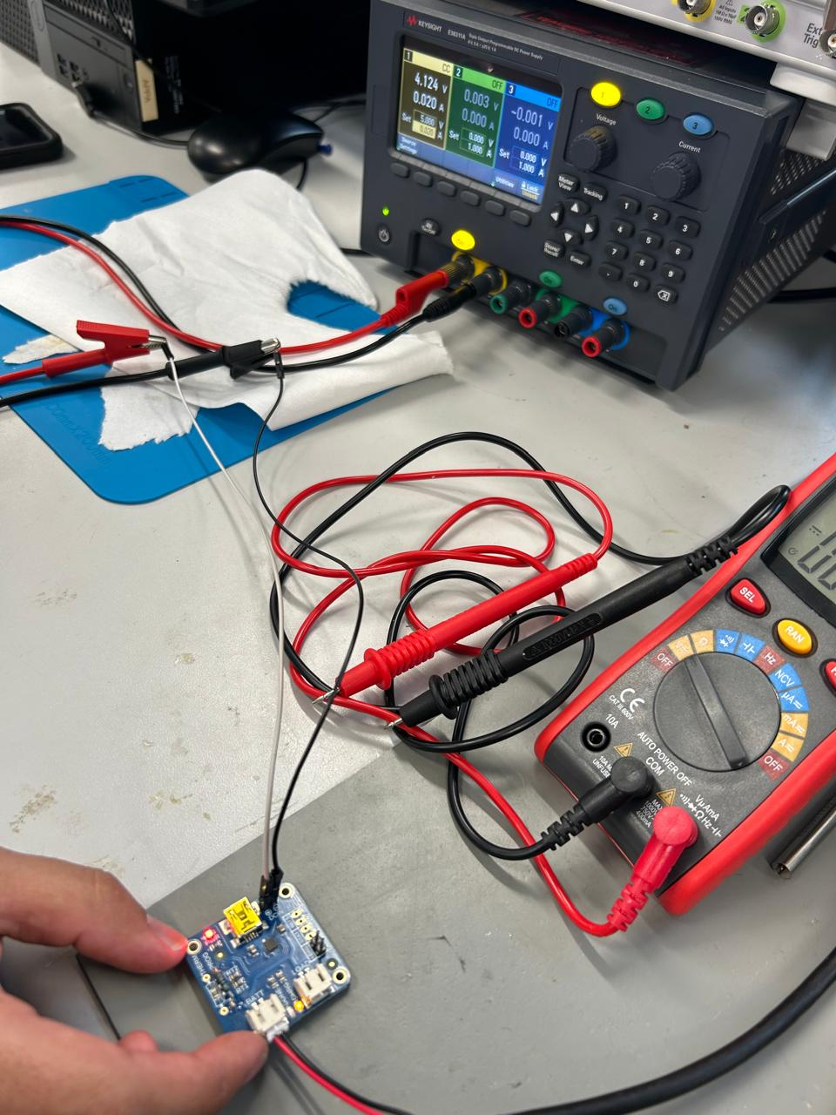
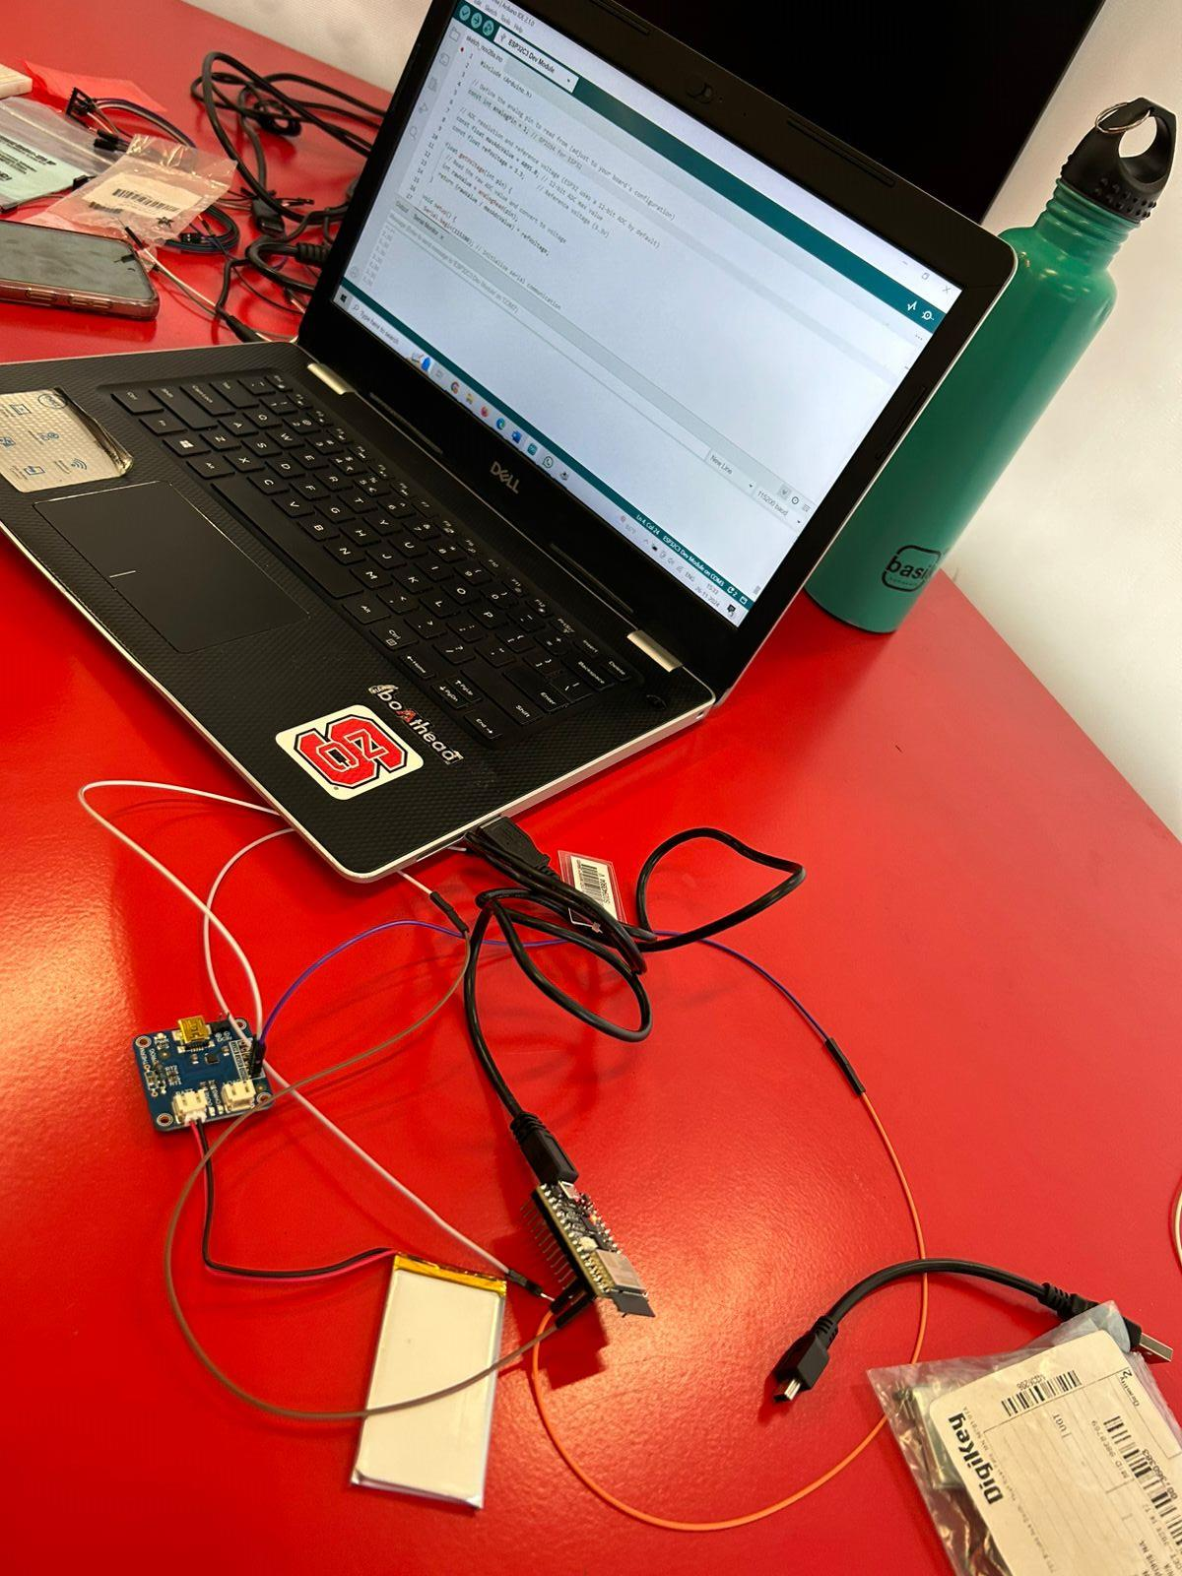
Change programmable resistor to achieve desired voltage. Testing using a resistive divider
TESTING AND ANALYSIS
Voltage and current stability measurement. (Left)
Continuous charging output voltage monitoring using ESP32. (Right)

Slide 8
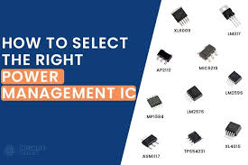

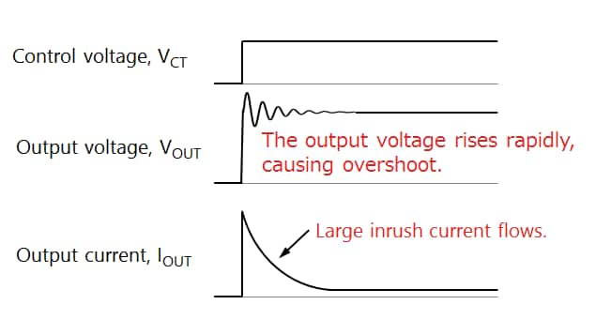
CHALLENGES FACED
Selection of proper IC and power delivery board.
Modifications to the module in accordance with design requirements for proper charging.
Prevention of voltage overshoots and transients and providing consistent, stable output to the battery.
Exercising caution while testing battery.

Slide 9
CONCLUSION
The VSM-5 team successfully developed a prototype for a Wearable Acoustic Monitor capable of real-time monitoring of respiratory irregularities, including cough detection, with potential applications in asthma diagnosis. Additionally, the project involved the development of a power management system to ensure stable, reliable, and efficient battery charging while adhering to all safety standards.

Slide 10
REFERENCES
MAX78000: https://www.analog.com/media/en/technical-documentation/data-sheets/MAX78000.pdf
Power Delivery Board and Battery: https://www.adafruit.com/product/259
Oscilloscope Image: https://pixabay.com/vectors/wave-length-oscillograph-30493
TP4056: https://www.ebay.com/itm/385067574251
MCP73831: https://www.microchip.com/en-us/product/mcp73831
Choosing proper power IC: https://components101.com/articles/how-to-select-the-right-power-management-ic-pmic-for-your-voltage-regulation-needs
Voltage overshoot: https://toshiba.semicon-storage.com/us/semiconductor/knowledge/e-learning/basics-of-load-switch-ics/chap2/chap2-4.html

