Slide 1
Identifying the predictability of National Football League Teams success based on Team and Quarterback elo ratings, game location and referee favorability
Group Members:
Ajay Kumar
Anthony Craig Senatore
Joe Erste
Lane Melton

Slide 2
Executive Summary
ELO scores were developed and assigned to various factors such as:
Field Ratings (Home Team Advantage).
Quarterback Ratings (Scoring QBs).
Team Ratings (Scoring Each Team).
Referee Favorability (Did Teams Using Same Referee Consistently Win).
Teams with Higher ELO Scores Usually Won.
Teams with Consistent Usage Referee Usually Won.

Slide 3
Research Questions
Can the success of a team (winning the game) in the National Football Leagued (NFL) be predicted based on Team ELO and Quarterback ELO ratings, location of the game itself (home or away) and referee favorability?

Slide 4
Scope/project overview
The purpose of this project was to locate a dataset with reasonably clean data which could be queried to establish a predictive outcome based on an event.
Sports Statistics was determined to have ample data and the basic research approach could be applied to multiple sports.
Data would range from 1920 – 2023.
Variables and influencing factors were not consistent across then entire timeframe but consistent in linear blocks of time. Some variables were not recorded until 1950 – 2023.
Examined Variables:
Team ELO ratings.
Quarterback ELO ratings (Brief Exp. of how its achieved).
Game Location.
Referee Favorability.

Slide 5
approach
Artificial Intelligence (ChatGPT) was utilized to take project criteria and develop suggested areas for further research.
The group struggled at first to obtain a dataset that related to a specific query or problem statement. After much research, a topic was determined, and the group obtained a clean dataset.
Dataset location - https://projects.fivethirtyeight.com/nfl-api/nfl_elo.csv
Referee dataset location - Joe?
Data format – CSV file format.
The data was trained – multiple logistic regression, decision tree, sk-learn, et.al.

Slide 6
Predictive Power
Predictive Power was low in that it never achieved above 68.6%. This is theoretically attributed to complete data not spanning entire timeline.
Actual achievement of 68%
Adjust test size from .2 - .25 – Logistical Regression.
All predictive power ranged between 65 – 68.5.

Slide 7
Data collection
Data Collection was obtained from https://projects.fivethirtyeight.com/nfl-api/nfl_elo.csv.
Methodology of ELO development –
Developed by Arpad Elo for Ches Games.
Applied to sports on head-to-head matchup.
Various factors are assigned established values.
Home field – 65 points.
ELO formula for predictive win - Pr(A) = 1 / (10^(-ELODIFF/400) + 1).
Overall explanation - https://fivethirtyeight.com/features/introducing-nfl-elo-ratings/.

Slide 8
Data Cleanup
Dataset content was relatively clean but needed minor adjustment.
Instances where Team and Quarterback ELO 1 or 2 were null, the row was dropped.
Dates were converted to datetime.
Team and Quarterback ELO numbers were changed to floats.
If no clear winner the data was removed – tie or not recorded.
Dropped unnecessary columns.

Slide 9
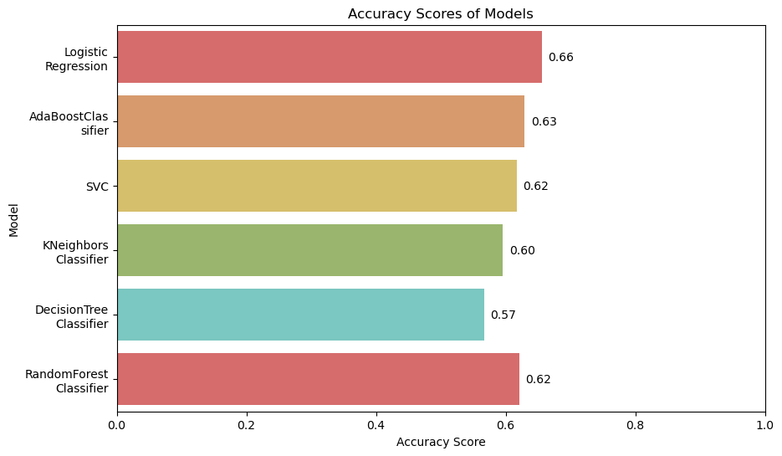
Modeling Approach
Processed data with all classification models from sklearn to see which model has better fit for this data.
All the models scored in the range of 60% - 65% score, 3 models highlighted in green scored almost same with train and test scores and others we overfit.

Slide 10
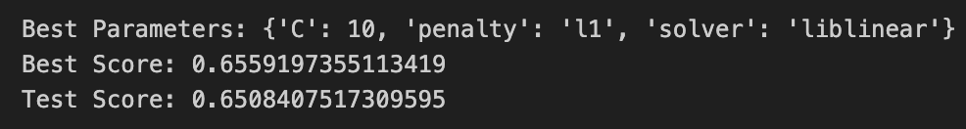
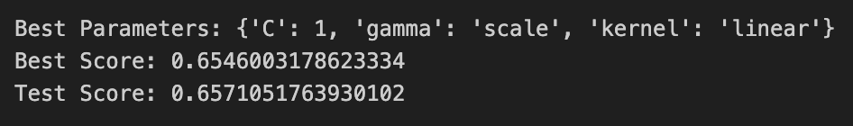
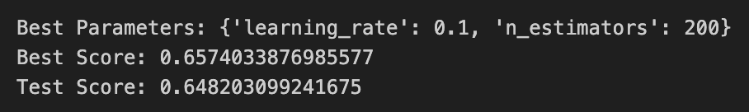
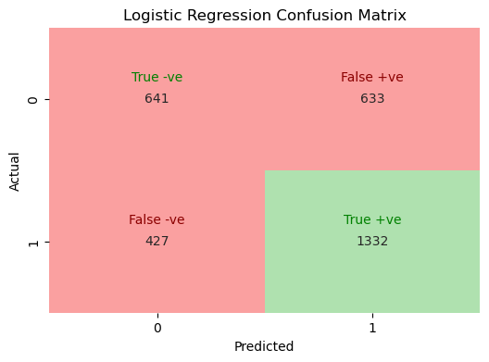
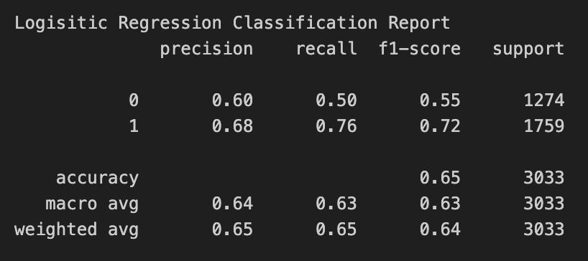
Optimizing Model
Did more analysis on the top 3 models by changing different hyper-parameters for those models using GridSearch.
LR
SVC
Ada
Next, run more metrics using Logistic Regression like classification reports, confusion matrix, prediction probabilities.

Slide 11
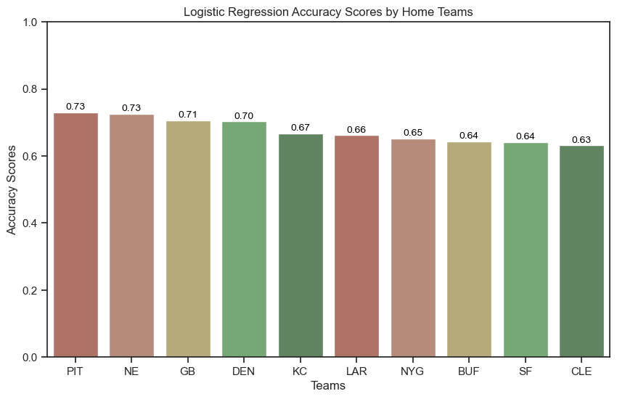
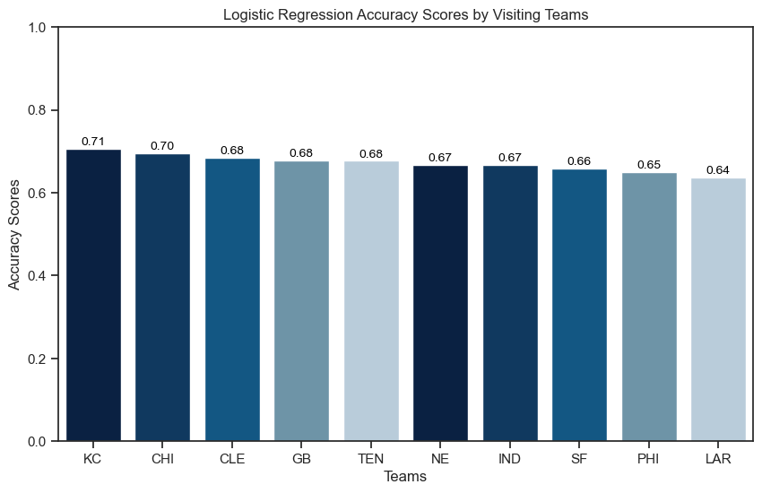
Training by Teams
Grouped teams with more than 500 games and ran the model to fit and predict individual Home teams and Visiting teams.
The accuracy is better when it is by team, considering the data and features.

Slide 12
Analysis and conclusion
Analysis shows – Team or Quarterback with higher ELO had higher or better chance of victory.
Definite shift right for Team 1 if the ELO is higher.
Anyone could win the game regardless.
Game location – Was an influential factor. Team 1 won slightly more often than the away team.
Referee involvement revealed – Joe?

Slide 13
Analysis and conclusion
Although the accuracy scores never achieved over 68.5 there is consistency in the predictive outcome of the head-to-head match based on teams and quarterback ELO scores, and home field advantage.
Higher scores in each category resulted in a “win” for that team.
Referee favorability resulted in X and should be an individual contributing factor. Joe?

Slide 14
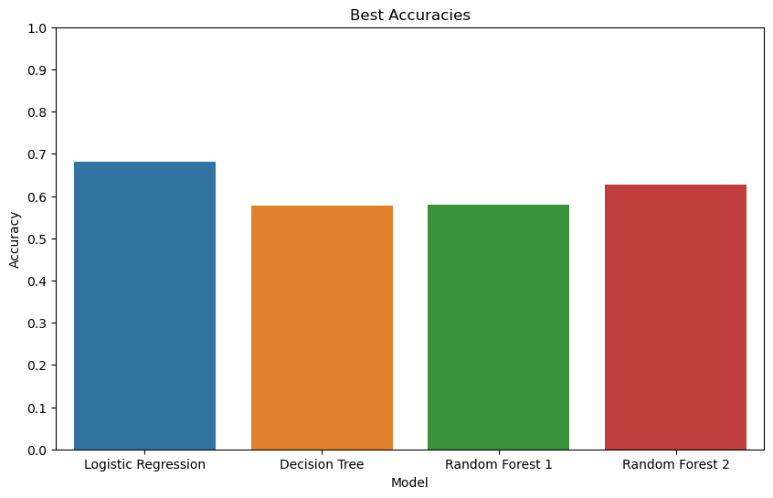
Best Accuracies

Slide 15
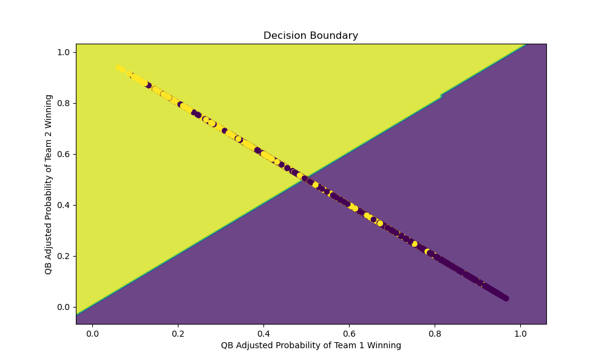
Decision Boundary

Slide 16
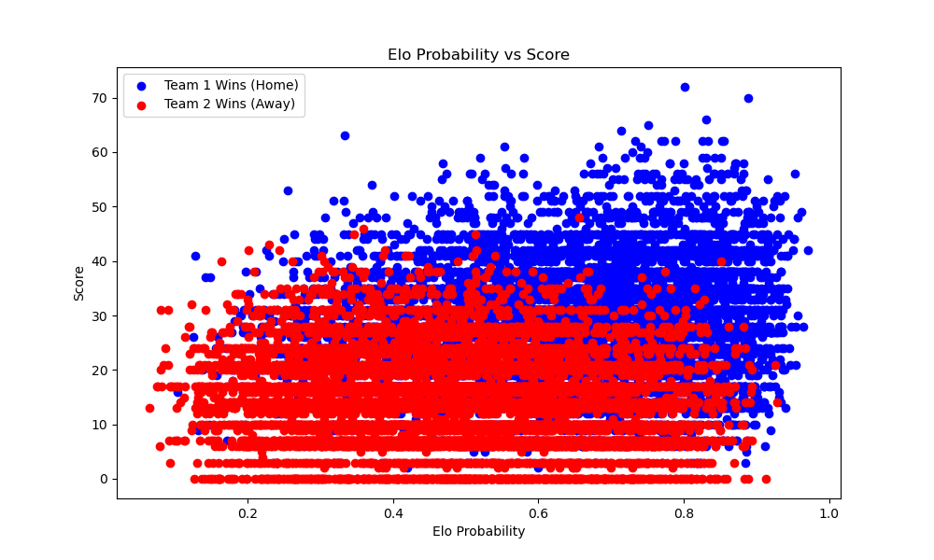
ELO Probablity vs score

Slide 17
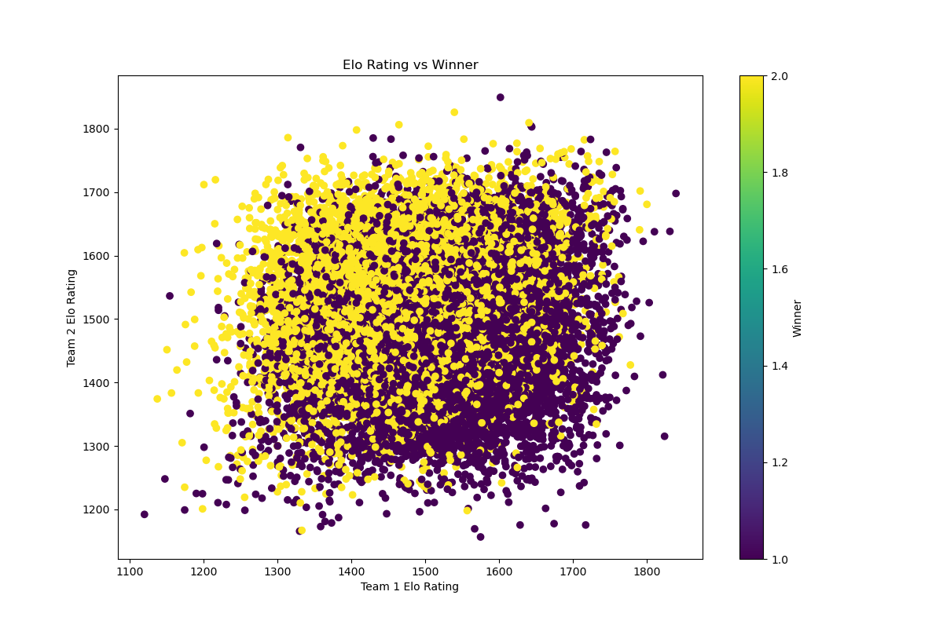
ELO rating vs winner

Slide 18
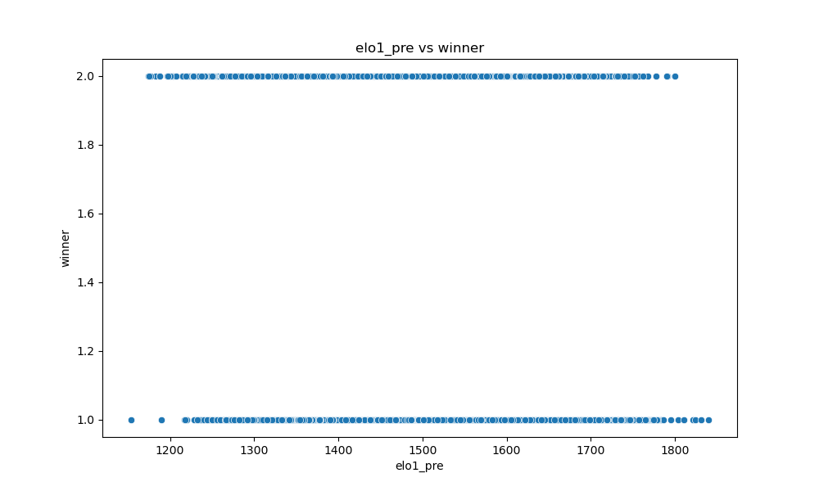
Elo pregame vs winner

Slide 19
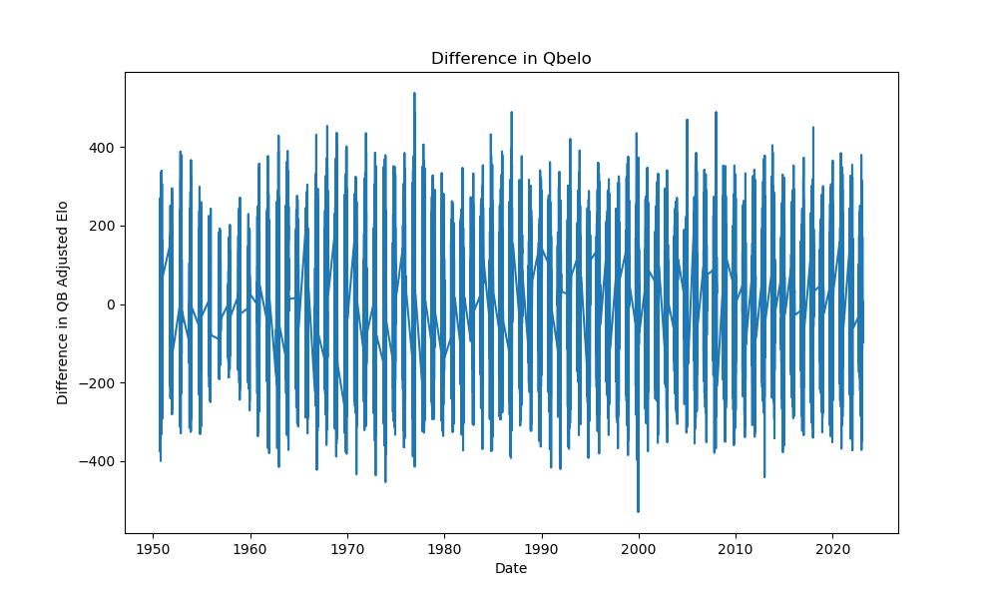
Difference in qb elo

Slide 20
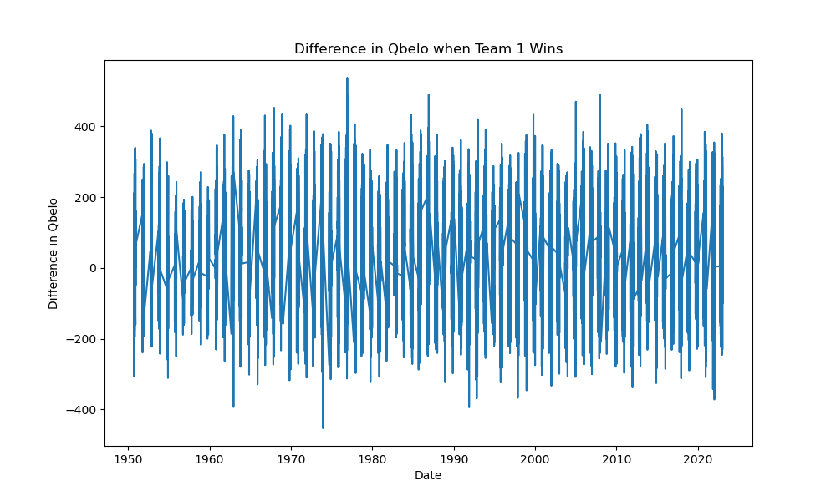
Difference in qb elo when team 1 wins

Slide 21
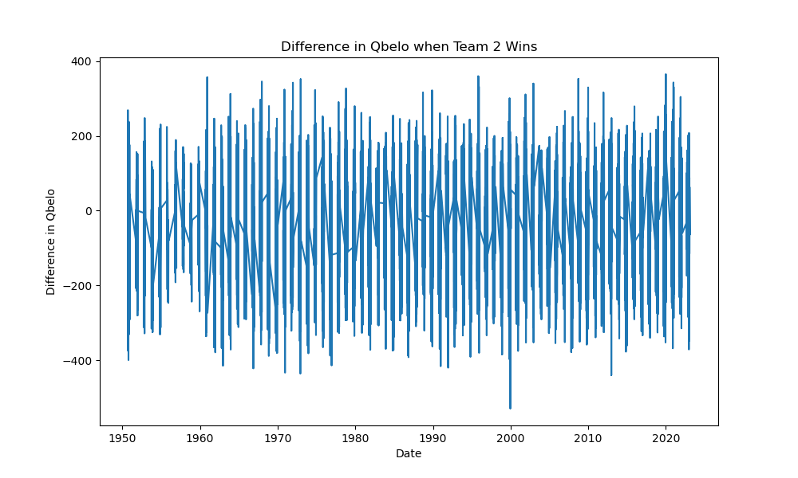
Difference in qb elo when team 2 wins

Slide 22
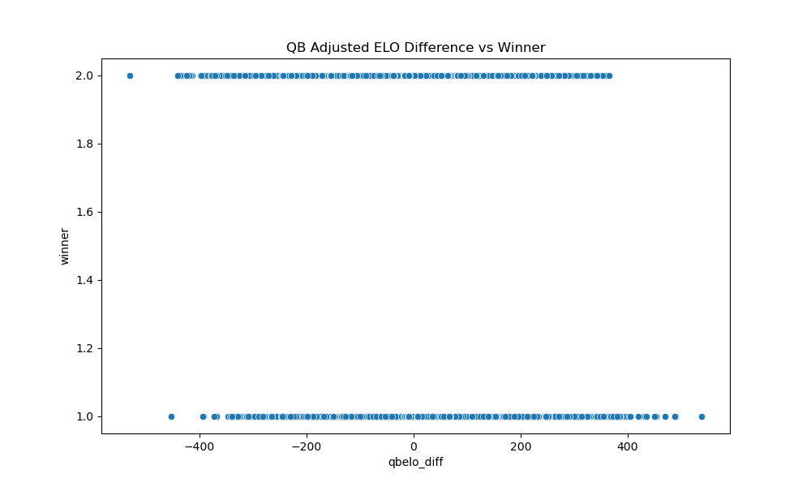
Qb adjusted elo difference vs winner

Slide 23
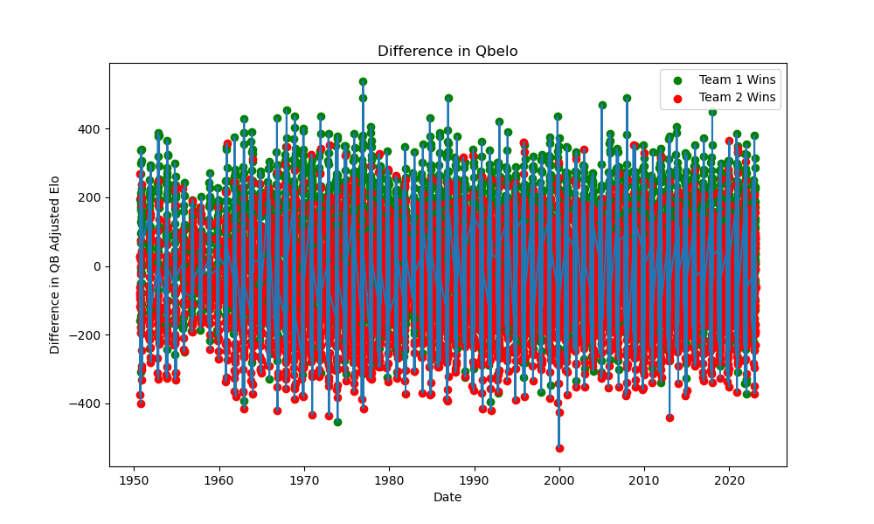
Difference in qb elo

Slide 24
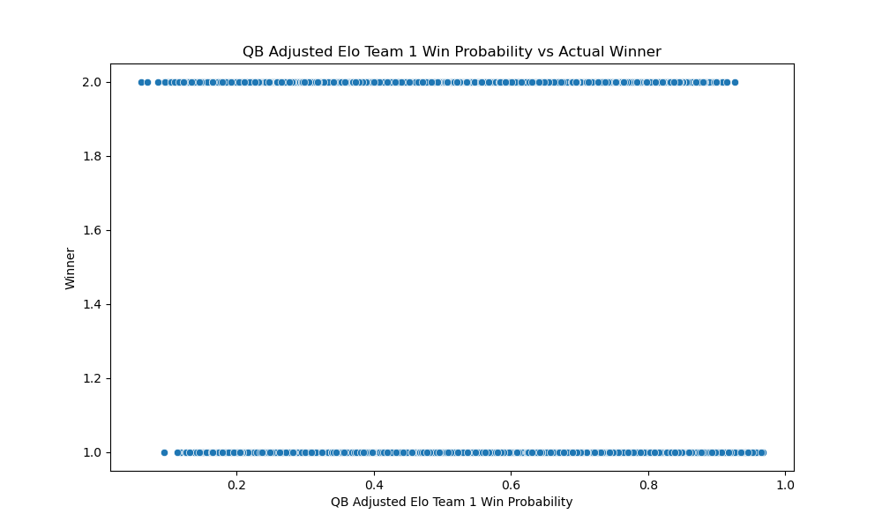
Qb adjusted for elo team 1 win probability vs actual winner

Slide 25
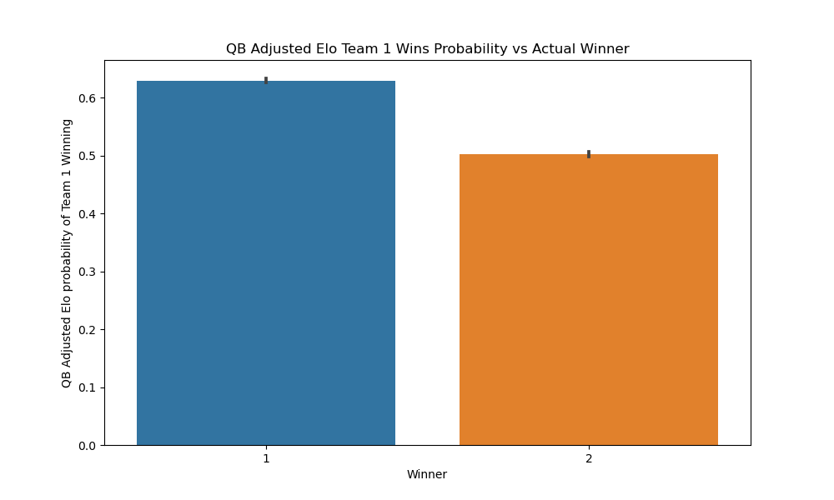
Qb adjusted elo team 1 wins probability vs actual winner

Slide 26
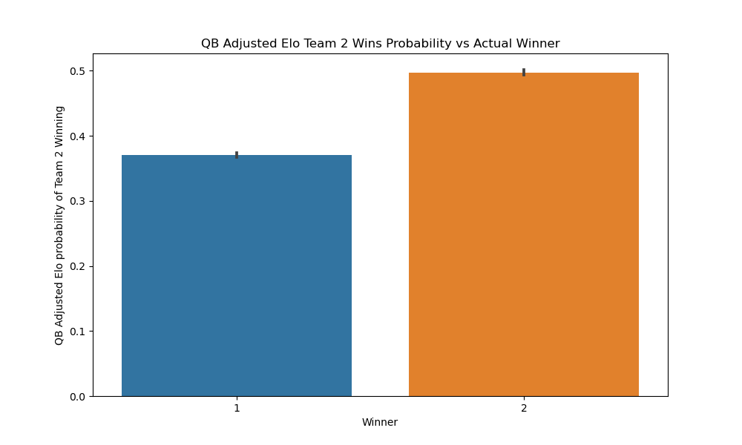
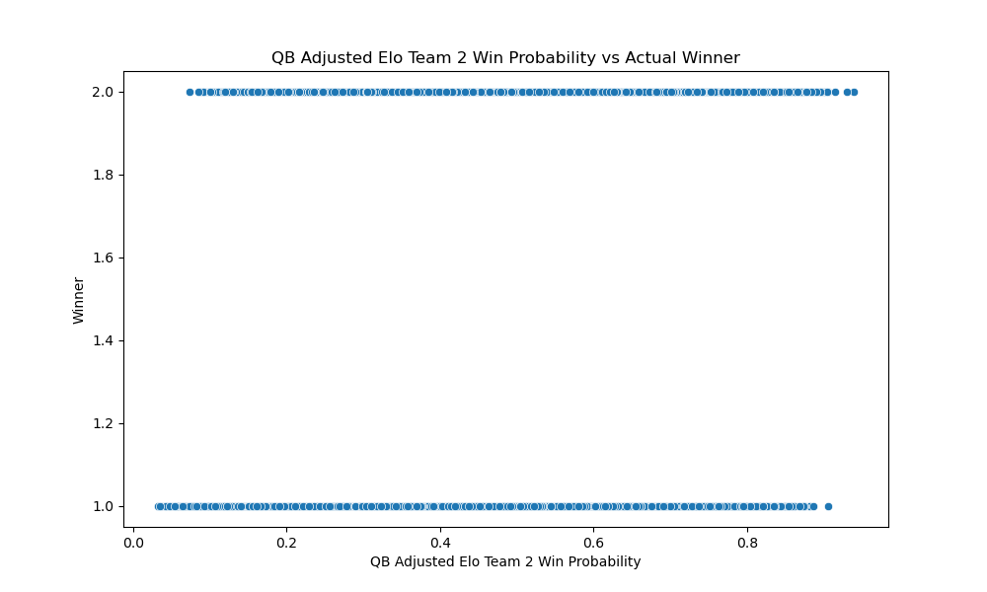
Qb adjusted elo team 2 wins probability vs actual winner

Slide 27
Graph Placeholder

Slide 28
Graph placeholder

Slide 29
Graph placeholder

Slide 30
Graph - placeholder

Slide 31
Findings and implications

Slide 32
Software version control
Created a GitHub repository.
Members of the group added/edited to repository.
Multiple files uploaded to repository by group members in support of findings.

Slide 33
Future development
Methodology/ELO Rating and calculation can be applied to any head-to-head match.
This can provide predictive participants with a slight edge mathematically.
This edge can also be combined with standard observation factors along with momentum to provide a substantial indication of a predictive “win”.
This can be applied not only to sports but to societal events such as an election.

Slide 34
Additional Questions
What variables can be added to the ELO mathematical formula?
More variables or contributing factors can be added to determine additional information.
Playing Surface
Weather
Day of the Week
Expanded to Other Sports Based on the Dataset

Slide 35
THANK YOU

