Slide 1

Project Details:
Project Title - Forecasting Air Quality Using Historical Pollution Data
Project Purpose - To predict AQI and pollutant levels using historical pollution data and support healthier, data-driven decisions. The system
provides alerts, dashboards, and trend analysis to help authorities and the public take timely preventive actions.
Tools and Technologies - Python (Pandas, NumPy, Matplotlib, Sci-kit Learn) for data analysis and forecasting, and Streamlit for building the
interactive dashboard and UI.
Mentor - Ms. Umme Asma S
Batch Number - 3
Start Date - 22-September-2025
Intern Name – Pala Jyothi Akshaya
GitHub Repository - https://github.com/itsakshaya/Infosys6.0_Python_Batch3

Slide 2
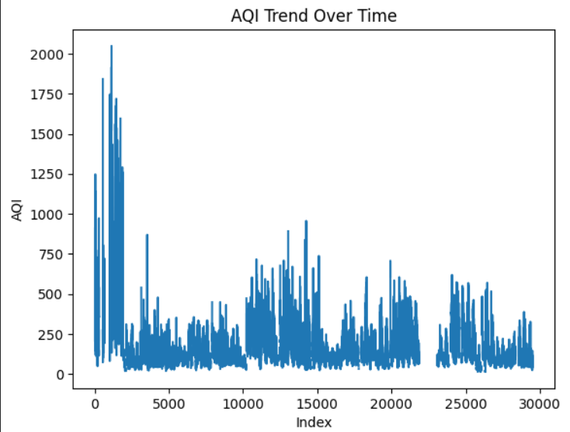
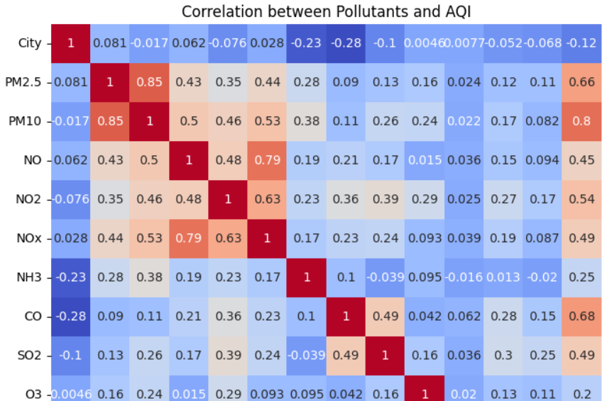
MILESTONE1: Data Preprocessing & EDA

Slide 3
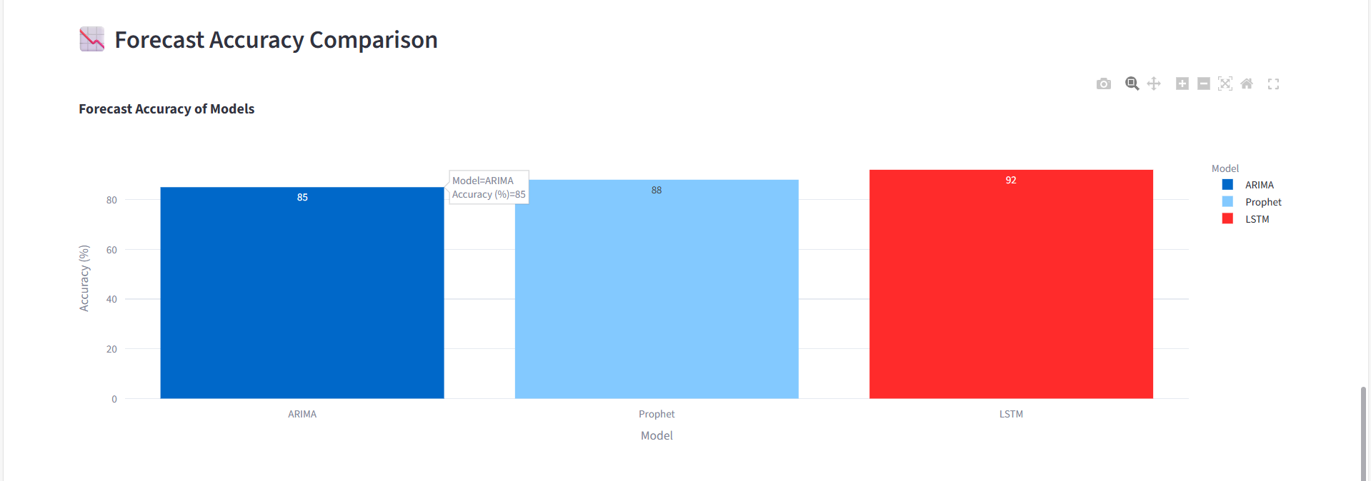
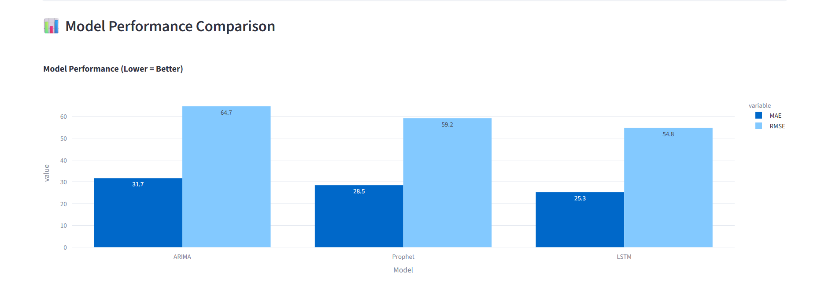
MILESTONE2: Model Training & Evaluation

Slide 4
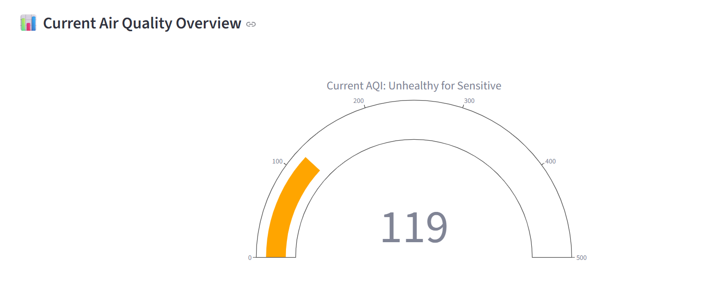
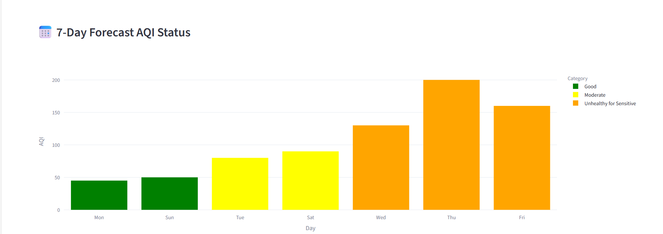
MILESTONE3: Alert Logic & Trend Visualization

Slide 5
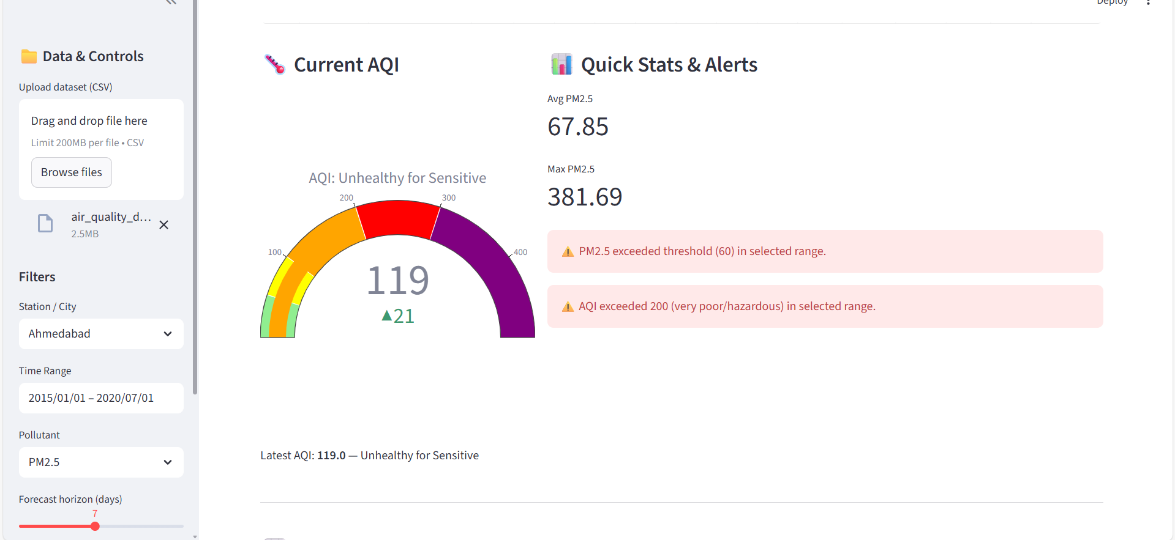
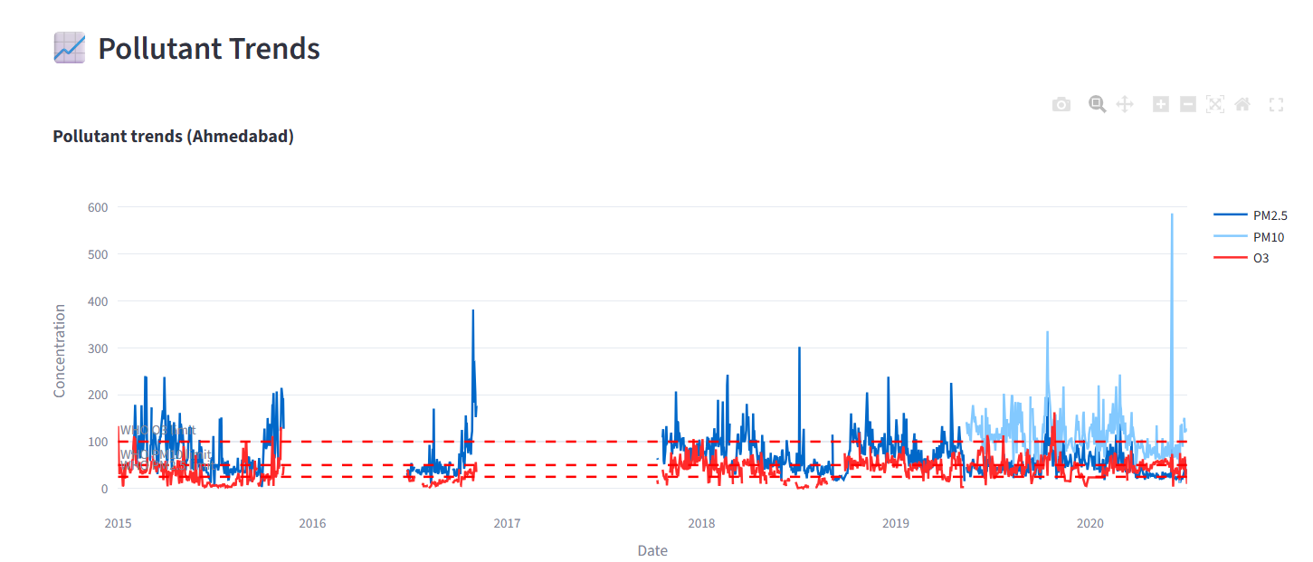
MILESTONE4: Streamlit Dashboard

Slide 6
Weekly Progress Overview
Week | Planned Tasks | Work Completed
Week 1 | Understanding the problem statement, studying AQI requirements, exploring available datasets. | Project scope finalized, data sources verified, and initial dataset downloaded.
Week 2 | Preparing raw data, fixing inconsistencies, performing early visual checks on pollutants. | Data cleaned, missing values resolved, and initial trends/graphs generated.
Week 3 | Designing features based on time, season, and pollutant behavior; preparing modeling dataset. | Feature transformations completed, dataset normalized, and ready for model training.
Week 4 | Training forecasting models such as ARIMA, Prophet, and LSTM; comparing performance. | All models trained; evaluation done using RMSE & MAE; best-performing model identified.
Week 5 | Building AQI calculation logic and defining alert rules for different AQI categories. | AQI category mapping implemented; alert mechanism working based on threshold exceedance.
Week 6 | Creating charts for pollutant contribution, seasonal patterns, and trend analysis. | Visualization module ready with clear pollutant insights and time-based patterns.
Week 7 | Developing Streamlit dashboard with user inputs, forecast charts, and admin features. | Interactive dashboard completed — includes forecast plots, AQI gauge, file upload, and alerts.
Week 8 | Testing full workflow, preparing documentation, and creating final presentation material. | End-to-end workflow validated, report compiled, and final demo prepared for submission.

