Slide 1

OpenFastTrace
The free requirement tracing suite.
Notes:
Requirements define your product. They tell you and your users what the product is supposed to be able to do.
They exist on different levels of abstraction that reflect the view different roles in a project have on the product.
The requirements are chained through the levels.
Tracing requirements means checking the chain integrity.

Slide 2
Requirements?
Tracing?
Why?
Notes:
Do you need requirements? Or tracing?
After all that takes time and money that could be invested into building the product. Or testing it. Marketing or selling it?
But are you sure you know exactly what to build? Much less what to test without requirements?
What if you are wrong? How will you find out?
Hopefully not in the product presentation where your customers tell you that this is nowhere near what they wanted and that next time they will chose a competitor who listens.

Slide 3
Your Product
Your Product
Mobile View
Mobile View
Import
Reports
Import
Reports
Logging
Logging
Editor
User Management
Editor
User Management
Flood Protection
Flood Protection
Full text Search
Full text Search
What nobody ordered
Export
Export
Obsolete Feature
Sharing
Sharing
Customization
Permissions
Customization
Permissions
Backup
Export
Schedules
Schedules
Metrics
Metrics
Online Help
What you forgot
Online Help
Spell Check
Live
View
Spell Check
Live
View
Rule Sets
Rule Sets
Notes:
Take this picture as the mental image a typical project team has of their complex product.
There are shiny and exiting features that everyone talks about, nice add-ons and then there is the rest.
What happens over time in non-trivial products?
People forget features that were once necessary but now aren’t anymore.
Or pet features that someone cramped in just for the heck of it.
Both increase complexity and what you are left with is simply obsolete bloat.

Slide 4
What
you
forgot
Customer
satisfaction
Reliability
Costs
Time to
market
Team
satisfaction
Maintenance
effort
What
nobody
ordered
Obsolete
feature
Complexity
Notes:
Forgotten requirements mean unplanned extra work that strains your budget and prolongs your time to market.
Stuff that no one ordered is complete waste of time and money.
And obsolete features are the worst of all since you spend your time maintaining nothing but dead weight without even realizing it.
This will impact both customer and team satisfaction.

Slide 5
Enter OFT.
Notes:
OFT solves a very distinct part of the requirement engineering process.
The part where you figure out whether your plans still reflect the reality.

Slide 6
1
Author.
2
Split work.
3
Trace upward.
4
Trace the whole chain.
Notes:
In a nutshell you can separate requirement tracing into four main functions.
Authoring (the process of writing requirement or annotating code).
Splitting the requirement chain along the lines of responsibilities.
Tracing from your part to the ones above to see if you got everything covered.
Tracing all the chain all the way down from the top to verify that it is intact.

Slide 7
## Requirement Tracing
`feat~requirement-tracing~1`
OFT traces requirements from specification to any kind of coverage (document, implementation, test, etc.).
Needs: req
Feature
1
System
Requirement
### Link Cycle
`req~tracing.link-cycle~1`
OFT detects if specification items are linked in a cycle.
Covers:
* [feat~requirement-tracing~1](#requirement-tracing)
Needs: dsn
2
3
Design
4
Unit Test
Implementation
// [impl->dsn~tracing.link-cycle~1]
private DeepCoverageStatus getDeepCoverageStatus…
Notes:
In OFT requirements look similar to code. This is very much intentional.
If there is one thing that software makers are usually good at, its handling code. Implementation, tests, infrastructure as code are all the rage. So why not requirements too?
The main authoring format is Markdown. It’s dead simple, everyone can learn it in 5 minutes. It’s ubiquitous. And it is robust. You will still be able to read it in 50 years from now.
You simply annotate implementation and tests in comments to tell OFT what is covered where in the code.

Slide 8
1
Product Owner
Architect
Developer
2
SR
D
C
3
Features
User requirements
Business risks
Budget constraints
Design decisions
Structure
Behavior
Technical risks
Technical constraints
Implementation
Test
Test results
4
Notes:
How deep your requirement chain is depends on the complexity of your project, the involved teams and roles and personal preferences.
For most projects the OFT team worked on, three layers were sufficient: system requirements (the users’ view), design (the software maker’s plan) and code annotations (the software maker’s actual product).
You can either exchange the original documents between the teams (e.g. Markdown) or use the XML-based SpecObject exchange format.

Slide 9
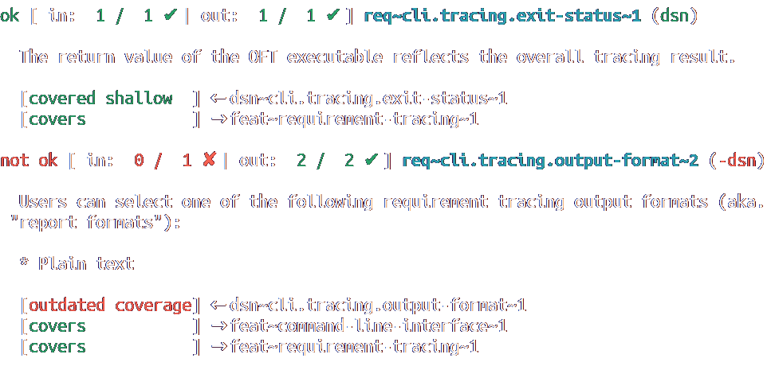
oft trace -a feat,req,dsn doc/spec/
1
2
3
4
Notes:
Tracing one level down tells you whether you covered everything that you or your team in your role got as input requirements.
If so, your job is pretty much done.
In OFT you simply restrict the artifact types to the ones on your level and the level above, run a trace command and fill the gaps until the report is green.
For quick day-to-day work we have a console version. This is ideal for the gritty debugging work in case you broke a link somewhere.

Slide 10
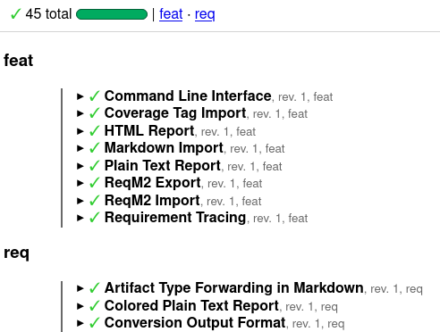
oft trace -a feat,req doc/spec/ -o html -f /tmp/report_feat_req.html
1
2
3
4
Notes:
The HTML report looks nice and is very accessible.
This is also what you would hand to decision makers. They like shiny things, progress bars and check marks and just enough detail for people with the attention span of your average TikTok viewer.

Slide 11
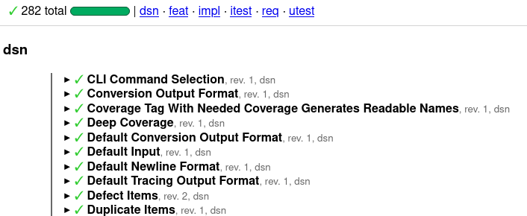
find . -name java -o -name spec | xargs oft trace -o html -f /tmp/full_report.html
1
2
3
4
real 0m0,471s
user 0m1,976s
sys 0m0,105s
Notes:
OFT follows the Unix philosophy:
- Do one thing. Do it well.
- Use files for data exchange.
- Allow chaining tools to solve more complex problems.
So you can use a find command to collect all relevant documents from a file system and pipe the list into OFT to produce a trace over all of them.
And OFT is indeed fast. The command pipeline above traces all sub-projects of OpenFastTrace within less than half a second including rendering an storing the HTML report.

Slide 12
Interfaces and formats

Slide 13
Markdown
Tag
Importer
SpecObject
Zip
Markdown
OFT
Exporter
SpecObject
Plain Text
ASpec
Reporter
HTML
Notes:
OpenFastTrace supports Markdown, SpecObject format, code annotations (Tag format) and ZIP archives with any of the above as input formats.
Archives are useful for exchanging documents across teams.
OFT can export to Markdown and SpecObject.
And it can create reports for the text console, HTML reports and SpecObjects augmented with tracing results (Aspec).

Slide 14
But what if my favorite format is not supported?
Well, it’s Open Source and you are a software maker, so…
what are you waiting for?

Slide 15
OpenFastTrace
Fast.
Free.
Flexible.
Forgetting requirements was yesterday.

