Slide 1


EVS – Business Case – Sustainable Supply Chain
Dounia Czorniak
Deputy CPO
May, 2023
→ evs.com

Slide 2





Contact Details
Dounia CZORNIAK – Deputy CPO
D.czorniak@evs.com
0494/68.59.56
Anytime
Before 9 AM or after 5 PM

Slide 3
Business Case: Sustainable Procurement Practices
Introduction: The broadcast industry is a significant contributor to global carbon emissions, which is why sustainable procurement practices are necessary. Sustainable procurement is the process of purchasing goods and services while considering their environmental, social, and economic impacts. Sustainable procurement practices can have a significant impact on reducing the carbon footprint of a company and contribute to the overall sustainability of the industry.
Objectives: The primary objective of this business case is to outline the benefits of sustainable procurement practices for a broadcast company. The case will also identify the steps required to implement sustainable procurement practices successfully. The key objectives are:
1. Reduce carbon emissions associated with procurement processes
2. Ensure that the company is compliant with relevant environmental, social, and economic regulations
3. Create a sustainable supply chain that promotes ethical and socially responsible practices
4. Build a reputation as a sustainable and responsible company in the industry

Slide 4
Skills needed
Identifying the steps required to implement sustainable procurmenet practices requires a combination of knowledge, analytical skills, teamwork, critical mindset,…
Analytical skills: Being able to analyze the data, identify the key performance indicators, and measure the impact of sustainable procurement practices is crucial.
Teamwork skills: Sustainable procurement practices require collaboration with stakeholders across different departments, suppliers, and customers. Having strong collaboration skills is essential to ensure the implementation of sustainable procurement practices.
Innovation and creativity: Sustainable procurement practices require new and innovative approaches to procurement. Having creativity and innovation skills can help in identifying new ways to integrate sustainability into procurement practices.
A critical mindset involves questioning assumptions, challenging existing practices, and seeking out new ideas and perspectives. It requires the ability to think critically about the impact of procurement practices on sustainability, to identify potential areas for improvement, and to assess the effectiveness of different approaches. A critical mindset can help to ensure that sustainable procurement practices are grounded in sound reasoning, evidence, and analysis, and that they are continuously evaluated and improved over time.

Slide 5

Become Industry Leader in Sustainable Value Creation
Continuously improve the Environmental Social & Governance rating thanks to ambitious and focused action plan.
4
Planet
People & Communities
Governance
1
Energy requirements of EVS products & solutions
Recycled input materials used
Company Carbon Footprint
Well-being of Team Members
Diversity & Inclusion
Local social contribution
Talent management
Customers’ Experience
Cyber Security
Sustainable Supply Chain
Business Process Management
High
8
2
10
9
Medium
Stakeholders Priority
3
7
5
6
High importance for external stakeholders and for EVS business
In 2023, we are going to redo our materiality assessment in order to ensure that our sustainability strategy is built on strong basis and to prepare for the upcoming sustainability reporting obligation (CSRD).
Low
11
Medium importance for external stakeholders and for EVS business
Internal Business Priority
Low importance for external stakeholders and for EVS business
Low
Medium
High
Transitional

Slide 6
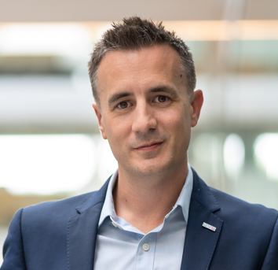


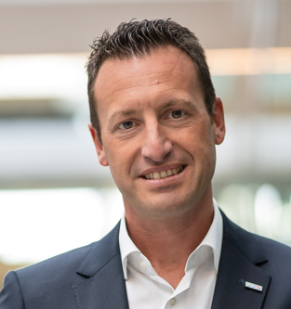
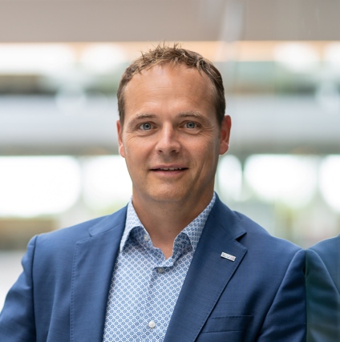
EVS sustainability strategy
Team allocation
Planet
People
Governance
Customers Carbon Footprint
LT member: Alex Redfern
Topic: Eco-design - Martin Castin
Focus points :
Reduce the energy footprint of our products and Solutions
Eco-design
LT member: Pierre Matelart
Topics:
Work Environment – Kristel Skilbecq
Talent management – Dounia Czorniak
Diversity & Inclusion – Floriane Magera
LT member: Veerle De Wit
Topics:
Cyber Security of our company – Geoffrey Crespin
Sustainable Supply Chain – Loïc Bologne
BPM – Aïcha Rahmani
Company Carbon Footprint
LT member: Veerle De Wit
Topic: GHG emissions – Julien Noir
Focus points :
Reduce the carbon footprint from own operations
Logistics
Mobility
Infrastructure (including Water and Waste)
Communities
Business Ethics
LT member: Nicolas Bourdon
Topics:
Customer Experience – Sébastien Verlaine
Cyber Security of our products & solutions – Geoffrey Crespin
Local Social Contribution – Elisa Crepin
LT member: Quentin Grutman
Nicolas Bayers
Topics:
Code of Conduct
Corruption or bribery
Human rights
No whistle blowing

Slide 7



DEFINE 2030 AMBITION AND THE ACTION PLAN TO GET THERE
Our Ambition
ESG
2023

Slide 8
Planet
EXAMPLE
Our ambition
We will lower our environmental footprint and those of our customers.
Our targets
Primary Targets
Supporting Targets
Customers Carbon Footprint
Reduce the energy footprint of our products by 20% (vs 2021) (measured as watt/delivered capability)
Improve the data collection for the energy consumption of our products
Increase client awareness on shutdown mode (reduction estimation 5%)
Improve the energy efficiency of the standby mode (reduction estimation 5%)
Increase by 5% recycled input materials used (vs 2021)
Company Carbon Footprint
By 2030 reduce the carbon footprint from own operations by 35% (vs. 2021) thanks to a reduction of
50% on Logistics
10% on Mobility
20% on Infrastructure
Logistic: 100% green transport (suppliers to EVS)
Mobility :
No more flights for less than 400km each year
Reduce the number of flights by TM by 5% each year
Infrastructure:
All offices supplied with renewable energy
Reduce energy consumption of all office by 5% each year

Slide 9
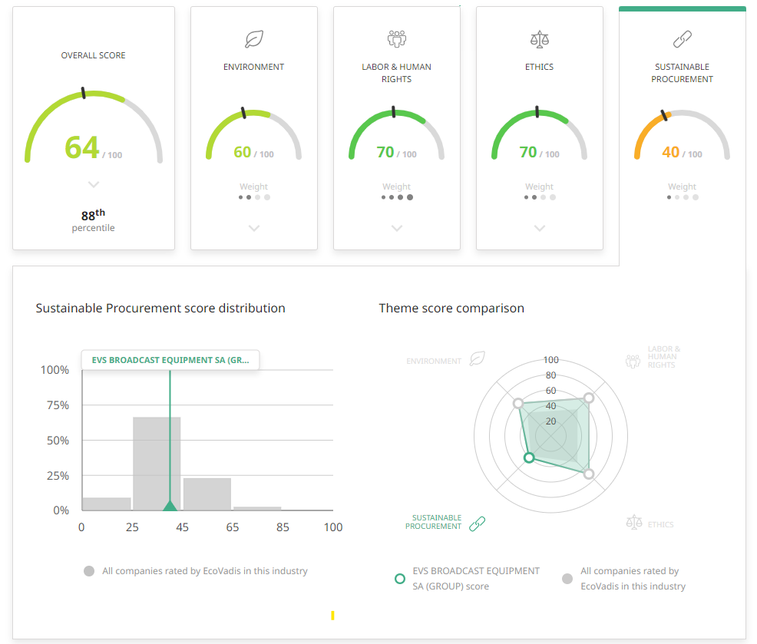
ECOVADIS
https://evs.com/company/news/evs-achieves-ecovadis-silver-status-its-first-csr-sustainability-rating

Slide 10
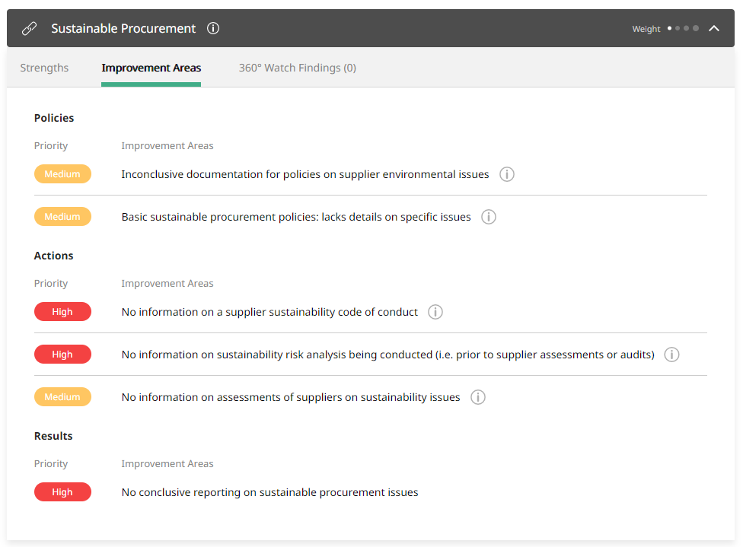
ECOVADIS

