Slide 1
FACIAL EMOTION DETECTION USING CNN
Submitted in the partial fulfillment for the award of the degree of
BACHELOR OF ENGINEERING
IN
AI-ML
Submitted by:
Tanmay Gupta (20BCS6619)
Aman Mishra (20BCS6594)
Lokesh (20BCS6692)
Ayush Raj (20BCS6612)
Under the Supervision of:
Jayashree Mam
Department of AIT-CSE
DISCOVER . LEARN . EMPOWER

Slide 2
Outline
Sr.no | Title
1 | Introduction to Project
2 | Problem Formulation
3 | Objectives of the work
4 | Methodology used & Design Selection
5 | Constraint Identification
6 | Analysis of Features
7 | Results and Outputs
8 | Conclusion
9 | Future Scope
10 | References

Slide 3
Introduction to Project
The ability to discern and understand human emotions plays a fundamental role in effective communication and interaction. While humans effortlessly interpret facial expressions to infer emotions, automating this process using technology is a complex challenge that holds immense potential. In recent years, advancements in deep learning and neural network techniques have paved the way for creating intelligent systems capable of recognizing and categorizing emotions from facial expressions. This project focuses on leveraging the power of neural networks to develop an accurate and efficient facial emotion detection system.
The main objective of this project is to design and implement an intelligent system that can accurately recognize and classify a range of human emotions from facial images.

Slide 4
Problem Formulation
This project aims to create a novel neural network-based system for Facial Emotion Detection.
Develop a neural network-based model capable of accurately recognizing and classifying facial emotions.
Achieve real-time processing speeds to ensure the system's feasibility for interactive applications.
Enable the system to handle variations in lighting conditions, facial orientations, and image quality.

Slide 5
Objectives of the Work
The main objective of this project is to design and implement an intelligent system that can accurately recognize and classify a range of human emotions from facial images. This involves training a neural network to learn the intricate patterns and features that define different emotional expressions. The neural network's capacity to generalize from the training data will allow it to accurately predict emotions from new, unseen facial images.

Slide 6
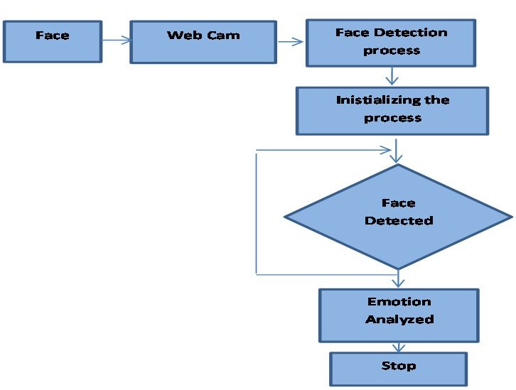
Methodology used

Slide 7
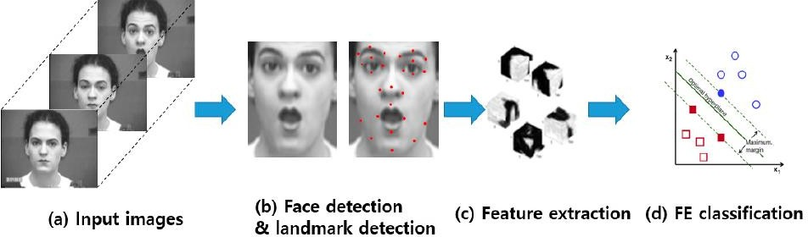
Preliminary Design

Slide 8
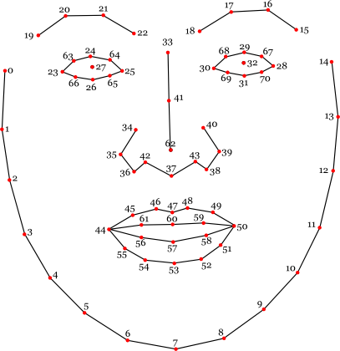
Analysis of Facial Feature

Slide 9
Analysis of Facial Feature
Feature Analysis:
Real-time Emotion Detection: The real-time facial emotion detection feature stands pivotal in applications requiring instantaneous response, such as human-computer interactions, mental health monitoring, and personalized user experiences.
Emotion Recognition Accuracy: The system's emotion recognition feature boasts high accuracy, enabling precise identification and interpretation of a diverse range of emotions expressed through facial expressions. This accuracy contributes to nuanced emotional analysis and response.
User Interface Efficiency:The intuitive user interface simplifies the interaction process, facilitating easy integration and utilization by a broad spectrum of users, including developers, researchers, and end-users.
Planned Updates:
We are committed to enhancing the project further.
Planned updates include improving detection accuracy, enhancing processing speed, and refining the user experience.

Slide 10
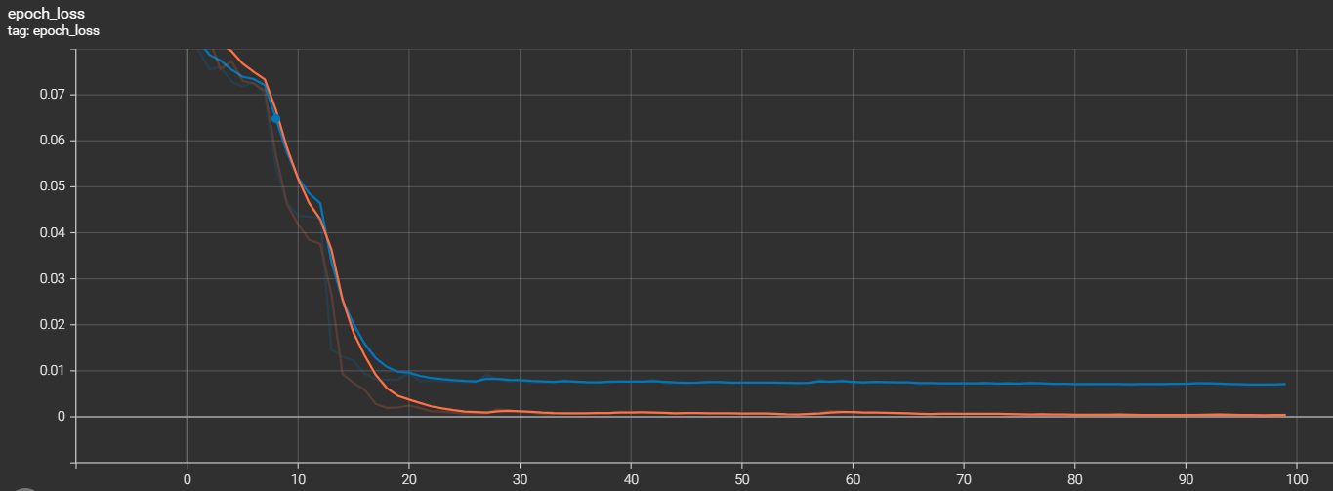
Results and Outputs
Train
Validation

Slide 11


Slide 12
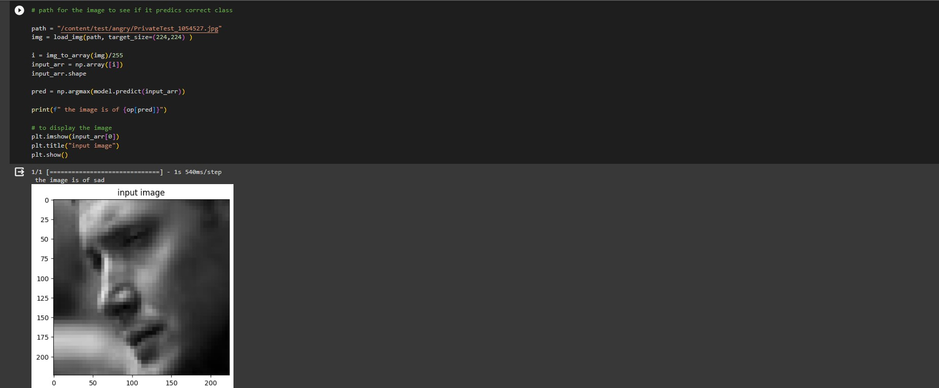

Slide 13
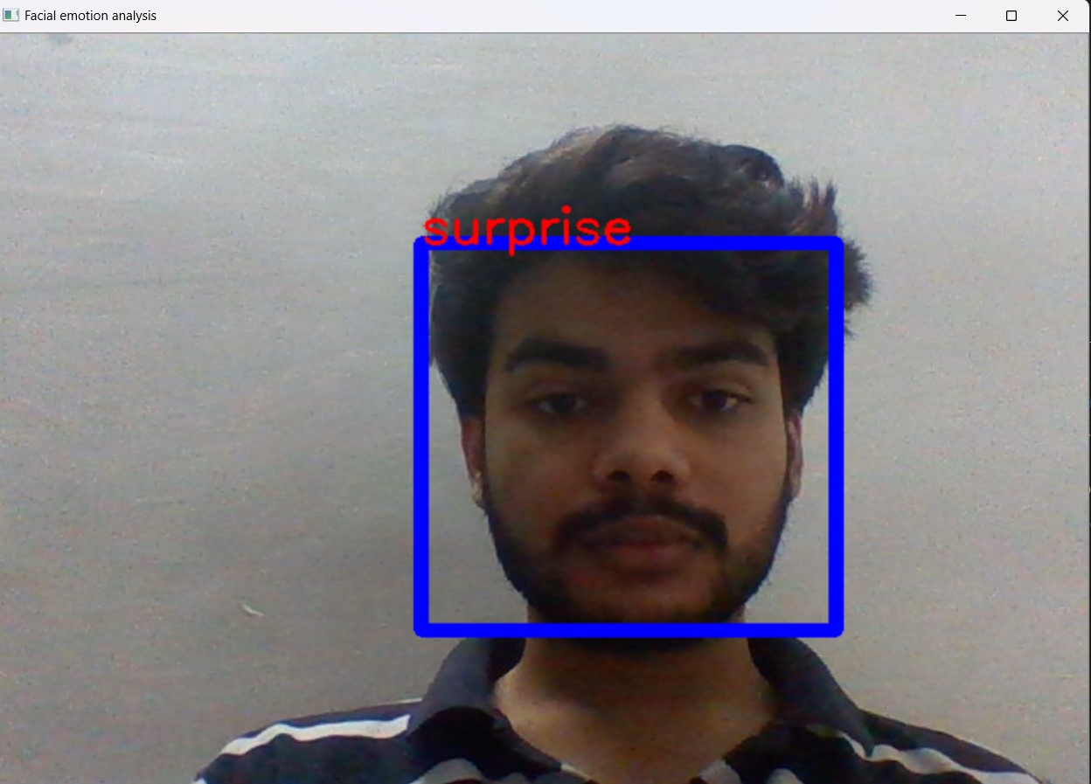

Slide 14
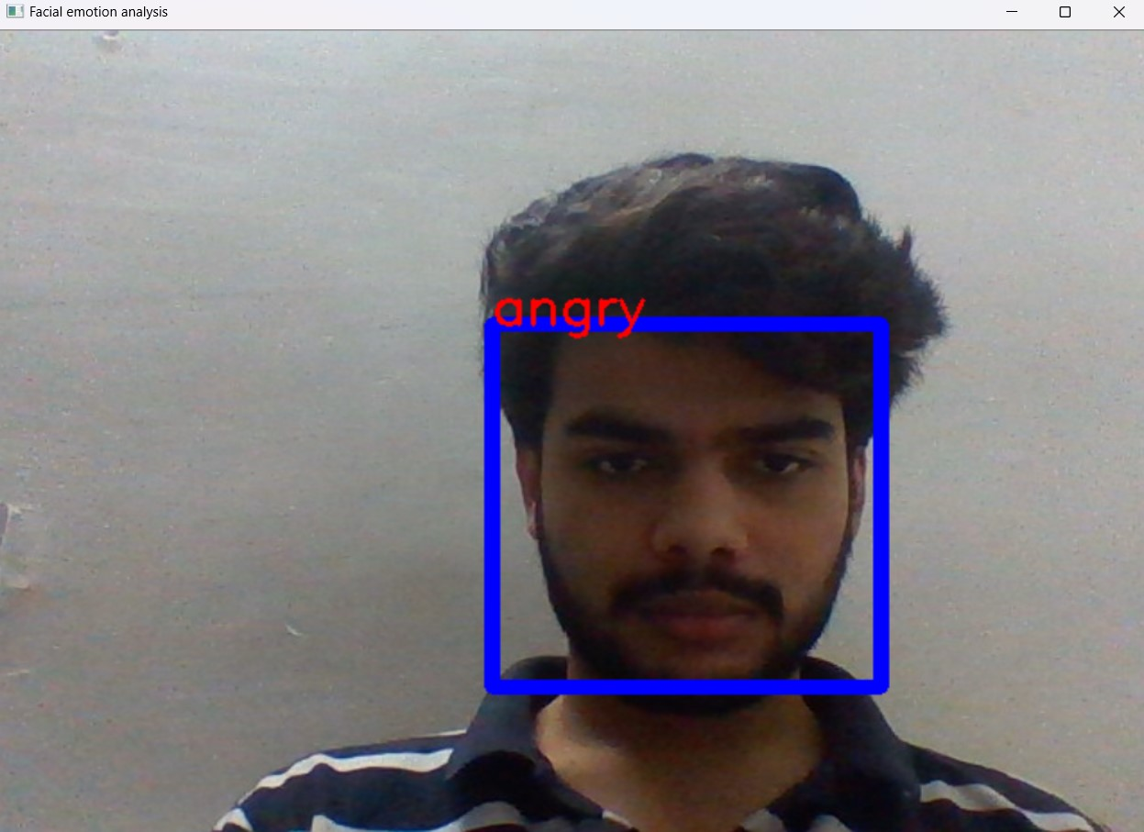

Slide 15
Conclusion
Our pursuit to develop a Facial Emotion Detection system culminates in an innovative solution achieved through the fusion of CNNs, Python, and image processing techniques. This project stands as a testament to the transformative potential of technology in deciphering human emotions from facial expressions in real-time.
​​This project not only enhances efficiency in various applications but also serves as a testament to the power of technology in transforming everyday processes. As we reflect on our achievements and the lessons learned, we're excited to present a solution that embodies adaptability, accuracy, and user-centric design.​

Slide 16
Future Scope
Improved Model Architecture: Future endeavors could focus on refining the CNN architecture by exploring novel network structures and leveraging advancements in deep learning. This would aim to enhance accuracy, especially in recognizing nuanced emotions and expressions across diverse demographics and cultural contexts.
Real-Time Edge Computing: The implementation of edge computing infrastructure could be a promising avenue. This shift would allow the deployment of our system directly onto devices, minimizing latency and enabling real-time processing without continual reliance on cloud-based resources.
Emotion Contextualization: Beyond mere emotion recognition, future exploration might involve delving into semantic analysis to understand the context behind facial expressions. This advancement could lead to a more profound comprehension of emotional states, considering factors like situational cues and individual differences.
Adaptive Learning Algorithms: Developing adaptive algorithms capable of learning from dynamic facial expressions in varying environments would be crucial. This adaptive capability could ensure robust performance across diverse settings, adapting to changes in lighting, facial angles, and environmental conditions.

Slide 17
References
Liu, Z., & Deng, Y. (2018). Facial Expression Recognition Using CNN: A Comprehensive Review. In 2018 IEEE 4th International Conference on Computer and Communications (ICCC) (pp. 179-183). IEEE
Zhang, Z., & Lyons, M. J. (2018). A review of automatic facial expression recognition systems. In 2018 13th IEEE International Conference on Automatic Face & Gesture Recognition (FG 2018) (pp. 298-305)IEEE.​
Ekman, P., & Friesen, W. V. (1971). Constants across cultures in the face and emotion. Journal of personality and social psychology, 17(2), 124-129.​
Goodfellow, I., Bengio, Y., Courville, A., & Bengio, Y. (2016). Deep learning (Vol. 1). MIT press Cambridge.​
LeCun, Y., Bengio, Y., & Hinton, G. (2015). Deep learning. Nature, 521(7553), 436-444
Sharma, G., & Dhar, S. (2017). A comprehensive review of deep learning. arXiv preprint arXiv:1712.04248.​
(2023). Dogo Rangsang Research Journal, 13(04). doi:10.36893/drsr.2023​

