Slide 1
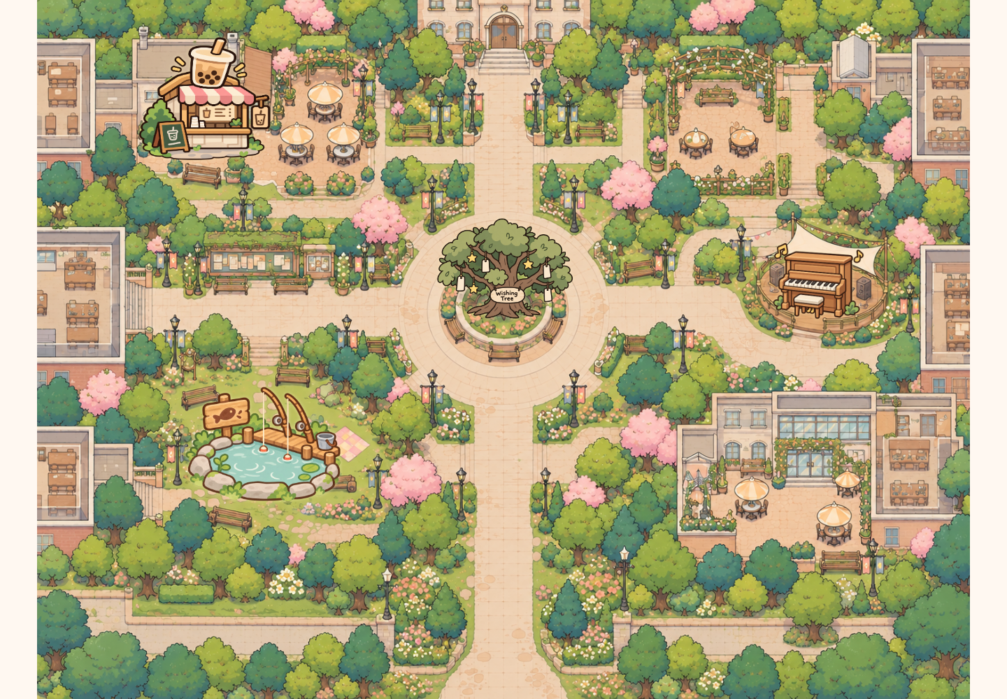
EXHIBITION SHOWCASE
Shared
Campus
Small moments.
Shared connections.
A public map, personal phones
and playful first encounters.
[Your name] · A2 · 2026
SHARED CAMPUS / GRDE2053 Social Interactive Experiences
01
Notes:
SLIDE 1 | 0:00–0:20
ENGLISH SCRIPT
Hello, today I’m presenting Shared Campus: a multiplayer campus map designed to make a first connection feel less awkward. People join on their own phones, see one another on a public screen, and choose a small activity to share.
中文理解版
大家好，今天展示的是 Shared Campus：一个希望降低初次交流压力的多人校园地图。参与者用自己的手机加入，在公共大屏上看见彼此，并选择一个简短的共同活动。
PRESENTER CUE
介绍项目，不要逐个列举功能。填上你的名字。

Slide 2
01 / SOCIAL FOCUS
A small invitation to connect
How might a shared campus
space make a first interaction
easier?
PRIMARY
SECONDARY
ALSO
Connection
Joy
Reflection
A small shared action before a
conversation.
Playful choices and unexpected
outcomes.
Leave a wish. Read someone
else’s.
Audience focus: international students and other campus visitors.
Images: prototype assets / controlled browser screenshots, project repository (2026).
SHARED CAMPUS / GRDE2053 Social Interactive Experiences
02
Notes:
SLIDE 2 | 0:20–0:55
ENGLISH SCRIPT
My social focus is connection, especially the first interaction between international students who may not already know each other. Instead of asking strangers to begin a conversation, I offer something they can do together. The map also supports joy through playful outcomes, and reflection through shared wishes. These are design intentions, rather than measured social outcomes.
中文理解版
核心社会目标是连接，特别是不熟悉彼此的国际学生之间的第一次互动。我没有要求陌生人先开口聊天，而是提供可以共同完成的小事。趣味结果带来快乐，许愿树提供表达与反思的空间。这些是设计目标，不代表已经测量并证明能改善孤独感或归属感。
PRESENTER CUE
清楚说出 Connection 是主要焦点；不要把设计动机说成调研结论。

Slide 3
02 / PARTICIPANT JOURNEY
One shared place. Your own way in.
01
02
03
04
05
Scan
Choose
Explore
Notice
Share
Use your own
phone.
Nickname +
avatar.
See others
nearby.
Follow a glowing
invitation.
Make, play, wish
or listen.
A first encounter in approximately two minutes or less.
The whole map can be explored at your own pace.
Images: prototype assets / controlled browser screenshots, project repository (2026).
SHARED CAMPUS / GRDE2053 Social Interactive Experiences
03
Notes:
SLIDE 3 | 0:55–1:20
ENGLISH SCRIPT
The entry flow is simple: scan the code, choose a nickname and character, and explore. The public display makes other participants visible, while each phone follows its own character. A first encounter is designed to fit within about two minutes. People can collaborate, leave a wish, listen, or observe before joining.
中文理解版
入口流程很简单：扫码、选择昵称和角色、进入地图。公共大屏让参与者看见彼此，手机则跟随自己的角色。第一次简短互动以约两分钟内为目标。参与者可以合作、留言许愿、听琴，也可以先观察。
PRESENTER CUE
指出“两分钟”指一次简短参与，不是要求在两分钟内体验完全部地图。

Slide 4
03 / SHOWCASE FILM
From noticing to participating
INSERT YOUR SHOWCASE VIDEO
75 seconds / two participants + phones + public display
Join → meet → collaborate → reflect → listen
Replace this page with real recorded footage before presenting.
Brief requirement: a 1–2 minute showcase video of the experience in use.
Images: prototype assets / controlled browser screenshots, project repository (2026).
SHARED CAMPUS / GRDE2053 Social Interactive Experiences
04
Notes:
SLIDE 4 | 1:20–2:35
ENGLISH SCRIPT
This short film shows how people enter the shared space and move from noticing each other to participating together.
中文理解版
这段短片展示参与者如何进入共享空间，并从注意到彼此，走向共同参与。
PRESENTER CUE
播放你实拍的75秒展示视频。当前文件没有嵌入真实参与者视频，必须替换此页占位。不要朗读拍摄分镜。

Slide 5
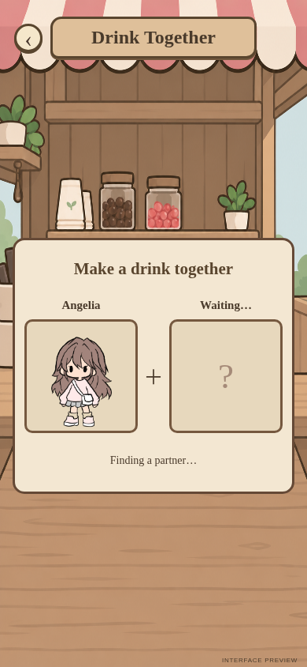
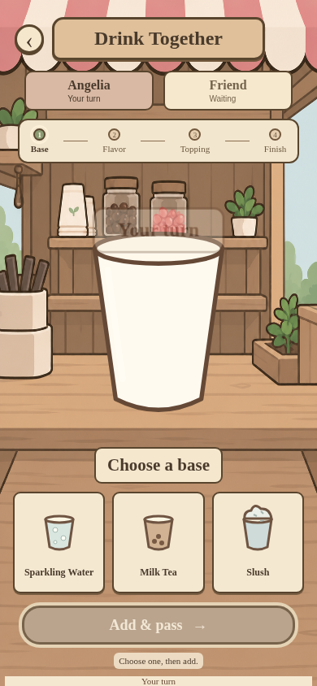
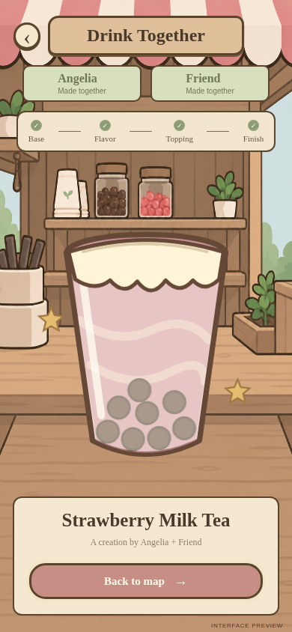

04 / LIVE DEMONSTRATION
Two people. Four choices. One shared drink.
LIVE DEMO
Room: showcase
Two phones, one display
Target: 60 seconds
Open public display ↗
Images: prototype assets / controlled browser screenshots, project repository (2026).
SHARED CAMPUS / GRDE2053 Social Interactive Experiences
05
Notes:
SLIDE 5 | 2:35–3:35
ENGLISH SCRIPT
Now I’ll demonstrate the drink activity with two phones. Each person makes alternating choices, and both receive the drink they created together.
中文理解版
现在用两台手机现场演示饮品制作。两人轮流选择，最后共同得到制作完成的饮品。
PRESENTER CUE
提前让两台手机加入 showcase 房间并到饮品店附近。进入匹配→A选基底→B选风味→A选配料→B选装饰→同时展示同一饮品结果→返回地图。控制在60秒内。

Slide 6
05 / SOCIAL UX REFLECTION
The six course principles, applied
A course framework connected to concrete design decisions.
01
02
03
Sensory Feedback
Embodied Interaction
Social Dynamics
Piano sound confirms actions.
Dragging maps to movement.
Co-presence and split roles.
04
05
06
Resilience & Motivation
Proactivity & Clarity
Ethics & Inclusion
Gentler fishing and retry.
Proximity glow and turn cues.
Temporary IDs, mute and exits.
Framework: Session 2, p. 6; Session 3, p. 8. Grounding: CSCW / affordances / signifiers (Sessions 2 & 5).
Images: prototype assets / controlled browser screenshots, project repository (2026).
SHARED CAMPUS / GRDE2053 Social Interactive Experiences
06
Notes:
SLIDE 6 | 3:35–4:25
ENGLISH SCRIPT
Here I use the course’s six principles. Sensory Feedback appears in piano sound. Embodied Interaction connects dragging to movement. Social Dynamics comes from shared presence and split roles. Resilience and Motivation shaped easier fishing and retry. Proactivity and Clarity appear in proximity glow and turn messages. Ethics and Inclusion informed temporary identities, mute and clear exits. The lectures’ CSCW perspective explains the shared roles; affordances and signifiers explain how people discover actions. However, phone and network requirements still exclude some visitors.
中文理解版
这里使用课堂中六项原则。感官反馈体现在钢琴声音；具身互动体现在拖动与移动的对应；社会动态来自共同在场与角色分工；韧性与动机促成更宽松的钓鱼和重试；主动引导与清晰性体现在靠近发光及轮次提示；伦理与包容影响了临时身份、静音和退出设计。课件的CSCW视角帮助解释共享角色，affordances和signifiers解释人们怎样发现可做的事。不过，手机和网络要求仍会排除部分访客。
PRESENTER CUE
六项名称已核实：Session 2 PDF第6页、Session 3 PDF第8页；Session 5第6–7页也列出同一框架。CSCW来自Session 2第8页；affordances/signifiers来自Session 5第10页。具身互动仅是手机触控与映射，不要夸大为全身沉浸；未实现触觉反馈。伦理设计不等于全面可访问，公共昵称与愿望仍需隐私、内容和可访问性反思。

Slide 7
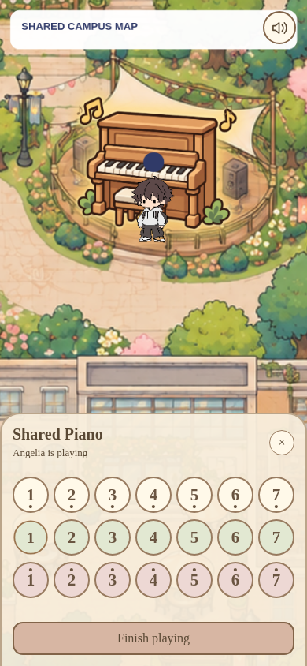
06 / ATMOSPHERE + SENSORY EXPERIENCE
A familiar campus, with small invitations
A narrative setting
A shared campus rather than a linear quest.
Visual invitation
Consistent icons, soft colours and proximity glow.
Sensory reward
A shared result, a surprising fish, a live melody.
Images: prototype assets / controlled browser screenshots, project repository (2026).
SHARED CAMPUS / GRDE2053 Social Interactive Experiences
07
Notes:
SLIDE 7 | 4:25–4:50
ENGLISH SCRIPT
Rather than a linear story, the experience uses a familiar campus setting as its narrative frame. Warm colours, illustrated characters and consistent activity icons create a welcoming atmosphere. Nearby objects glow to invite interaction. Shared drinks, unexpected fish and music provide small sensory rewards, while the public screen makes these individual actions part of a collective scene.
中文理解版
体验没有使用线性剧情，而是把熟悉的校园作为叙事框架。暖色、插画角色和统一活动图标营造友好的氛围。靠近时发光的入口引导探索；饮品、意外的鱼和音乐带来小小的感官回报，公共大屏则把个人行动呈现在同一个场景里。
PRESENTER CUE
结合截图说明视觉和声音怎样服务体验，不只说“好看”。

Slide 8
07 / DEVELOPMENT + REFINEMENT
From initial concept to refined interactions
Concept shift
Cultural prompts / shared visuals
Free exploration + shared activities
Reliability
Missing players / messages
Refined presence + shared state
Mobile view
Small avatar / unused space
35% zoom + full viewport
Cooperation
Jerky / difficult fishing
Smoothing + gentler timing
Shared access
Separate piano page / idle use
Map controls + 8-second release
Initial concept: Social Interactive, slides 5, 7–8. Tokens not carried forward; unused streetlight placeholder removed.
Images: prototype assets / controlled browser screenshots, project repository (2026).
SHARED CAMPUS / GRDE2053 Social Interactive Experiences
08
Notes:
SLIDE 8 | 4:50–5:30
ENGLISH SCRIPT
My initial concept proposed cultural prompts, shared visuals and tokens. The final version keeps the connection goal but uses an explorable map and short activities, without tokens. Device feedback led to clearer presence, a larger phone view and gentler fishing. The piano became an on-map panel, with eight-second inactivity release. I also removed the unused streetlight placeholder.
中文理解版
最初概念提出文化相关提示、共享视觉结果和代币。最终版本保留连接目标，但改为可探索地图与短活动，没有加入代币。设备反馈促成更清楚的共同在场、更大的手机视角与更宽松的钓鱼。钢琴变为地图上的操作面板，8秒无音符后自动让位；未使用的路灯占位被移除。
PRESENTER CUE
初始概念依据Social Interactive.pptx第5、7、8页：日常生活/文化提示、共享地图、代币想法。若该文件不是正式A1提交版，展示前与提交版核对；不宣称这些是导师要求改动。技术迭代依据开发记录和设备反馈，不虚构正式访谈或观众人数。

Slide 9
08 / TECHNICAL IMPLEMENTATION
A small architecture for shared participation
PERSONAL INPUT
SHARED STATE
COMMON VIEW
Phones
Firebase
Public display
Choose, move and interact.
↔
Positions, turns, notes and
wishes.
↔
See co-presence and shared
outcomes.
p5.js renders the world. GitHub Pages hosts the site.
Verification: 26 local checks + browser checks + reported device trials.
Exhibition needs: stable internet, charged phones and a recorded fallback.
Automated checks are not a substitute for audience evaluation.
Images: prototype assets / controlled browser screenshots, project repository (2026).
SHARED CAMPUS / GRDE2053 Social Interactive Experiences
09
Notes:
SLIDE 9 | 5:30–6:00
ENGLISH SCRIPT
The original p5.js project remains the foundation. Firebase shares positions and activity state; GitHub Pages hosts the site. Phones provide personal control, and the screen provides a common view. I checked simulated clients, browsers and actual devices, including iPhone sound. Exhibition still needs stable internet, charged devices and a recorded backup.
中文理解版
原有p5.js项目仍然是基础。Firebase同步玩家位置和活动状态，GitHub Pages托管页面。手机负责个人操作，大屏提供共同视角。开发检查包括独立模拟客户端与浏览器测试；实际手机测试也在修复后确认了iPhone出声。展览时仍需准备稳定网络、充足电量和录像备份。
PRESENTER CUE
不要把26项自动测试说成26位用户；不要声称在所有设备、所有网络环境下都稳定。

Slide 10
09 / REFLECTION + AUTHORSHIP
Small invitations. Shared experiences.
Watch. Listen. Leave a wish.
Or do something together.
AI USE
Code + debugging
Some activity artwork
Presentation drafting
Next evaluation:
Can unfamiliar participants begin independently?
Confirm tutor approval,
permitted use and the required
declaration before submission.
AI-assisted development was selected, tested and
refined — not treated as finished output.
Impact on belonging has not yet been established through an independent participant study.
Images: prototype assets / controlled browser screenshots, project repository (2026).
SHARED CAMPUS / GRDE2053 Social Interactive Experiences
10
Notes:
SLIDE 10 | 6:00–6:35
ENGLISH SCRIPT
People can watch, listen, leave a wish or cooperate. The value is in these small invitations. I used generative AI for parts of the code, debugging, artwork and presentation, then selected, tested and refined its outputs. Next, I would observe whether unfamiliar participants can begin an interaction independently, rather than adding more activities.
中文理解版
最终体验提供不同程度的社交投入：观看、聆听、留下愿望，或共同合作。价值不在功能数量，而在这些功能创造的小邀请。我在部分代码、调试、活动素材及演示准备中使用了生成式AI，再进行选择、测试与调整。下一步更值得观察不熟悉的参与者是否能独立开始有意义的互动，而不是继续堆加功能。
PRESENTER CUE
务必核实并补齐AI来源、导师批准和单元允许范围。不要把AI辅助内容宣称为完全独立编写或手绘。

Slide 11
REFERENCES + CREDITS
Thank you. Try it together.
Course sources
GRDE2053. A2 assignment brief, pp. 1–5. Supplied course document, n.d.
GRDE2053. SIE–DCI A2 Exhibition Showcase marking rubric. Supplied course document, n.d.
GRDE2053. Sessions 2 (p. 6), 3 (p. 8) and 5 (slides 6–10). Course slides, n.d.
Initial concept: Social Interactive.pptx, slides 5, 7–8. User-supplied concept deck, n.d.
Project media + implementation
Prototype screens: public-map-project repository, 2026; controlled browser captures.
Map / avatars: user-supplied assets; confirm original creators and licences.
Some activity icons / fish cut-outs: AI-generated or AI-refined; list individual assets.
p5.js • Firebase Realtime Database • GitHub Pages • Web Audio API.
References here use a provisional author–date format. Match the referencing style in your unit outline.
SHARED CAMPUS / GRDE2053 Social Interactive Experiences
11
Notes:
SLIDE 11 | 6:35–6:40
ENGLISH SCRIPT
Thank you. I’d like to invite you to try the map together.
中文理解版
谢谢，欢迎大家一起体验这个地图。
PRESENTER CUE
参考资料页保留在屏幕上；不逐条朗读参考文献。

Slide 12
APPENDIX / NOT PART OF THE TIMED TALK
Before you submit
01 Fill in your name; check the verified theory mapping and initial-concept comparison.
02 Record and insert a real 1–2 minute showcase film.
03 Rehearse a 5–7 minute presentation including video and live demo.
04 Prepare the separate development PDF: maximum 15 pages, excluding title / references.
05 Include coversheet, requested MP4 / SharePoint link and tutor access.
06 Confirm AI approval, declaration and media attribution; check milestone completion.
SHARED CAMPUS / GRDE2053 Social Interactive Experiences
12
Notes:
SLIDE 12 | APPENDIX — do not present
ENGLISH SCRIPT
中文理解版
PRESENTER CUE
备查页，不计入课堂展示。按brief还需封面、独立development documentation PDF、MP4及SharePoint可访问链接；这套PPT不替代过程文档。

