Slide 1
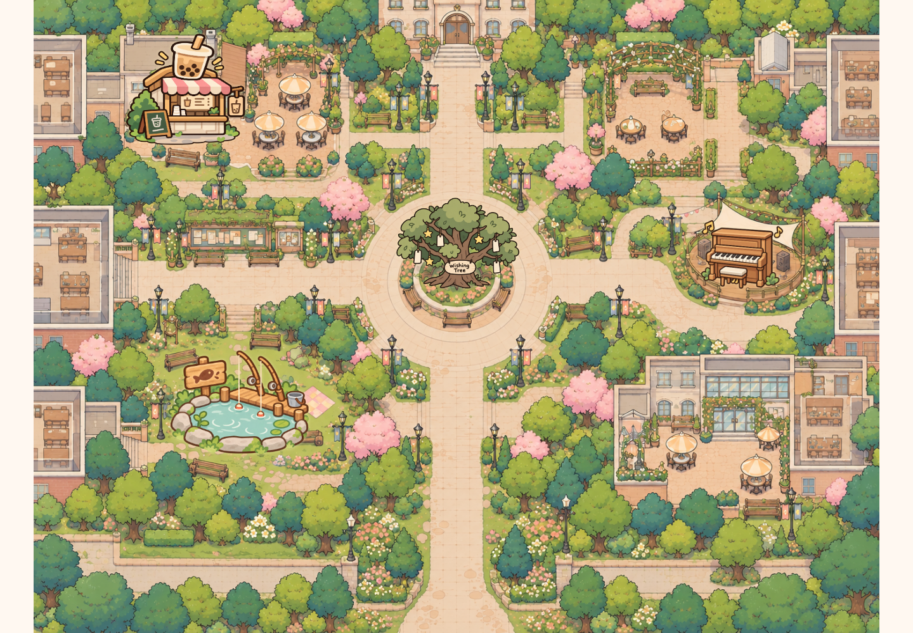
EXHIBITION SHOWCASE
Shared
Campus
Small moments.
Shared connections.
A public map, personal phones
and playful first encounters.
[Your name] · A2 · 2026
SHARED CAMPUS / GRDE2053 Social Interactive Experiences
01
Notes:
SLIDE 1 | 0:00–0:15
ENGLISH SCRIPT
My project is Shared Campus. People join an illustrated campus through a public screen and their own phones, with small activities that make starting an interaction easier.
中文理解版
我的项目叫Shared Campus。大家通过公共大屏和自己的手机进入插画校园，用小活动更轻松地开始互动。
PRESENTER CUE
介绍项目，不要逐个列举功能。填上你的名字。

Slide 2
SOCIAL FOCUS
A small invitation to connect
How might a shared campus
space make a first interaction
easier?
PRIMARY
SECONDARY
ALSO
Connection
Joy
Reflection
A small shared action before a
conversation.
Playful choices and unexpected
outcomes.
Leave a wish. Read someone
else’s.
Audience focus: international students and other campus visitors.
Images: prototype assets / controlled browser screenshots, project repository (2026).
SHARED CAMPUS / GRDE2053 Social Interactive Experiences
02
Notes:
SLIDE 2 | 0:15–0:36
ENGLISH SCRIPT
The concept began with international students finding it difficult to approach unfamiliar people. A shared activity offers a reason to interact first. Connection is the main focus, with joy through play and reflection through wishes.
中文理解版
概念从国际学生接近不熟悉的人时面临的困难出发。共同活动为开始互动提供理由。主要目标是连接，玩乐带来快乐，愿望提供反思空间。
PRESENTER CUE
清楚说出 Connection 是主要焦点；不要把设计动机说成调研结论。

Slide 3
PARTICIPANT JOURNEY
One shared place. Your own way in.
01
02
03
04
05
Scan
Choose
Explore
Notice
Share
Use your own
phone.
Nickname +
avatar.
See others
nearby.
Follow a glowing
invitation.
Make, play, wish
or listen.
Exhibition target: join and share one short activity.
Designed for a short encounter, with free exploration afterwards.
Images: prototype assets / controlled browser screenshots, project repository (2026).
SHARED CAMPUS / GRDE2053 Social Interactive Experiences
03
Notes:
SLIDE 3 | 0:36–0:56
ENGLISH SCRIPT
Visitors scan a QR code and choose a nickname and character, without downloading an app. Phones control individual players; the display shows everyone together. The intended short route is to join and share one activity.
中文理解版
参与者扫码、选择昵称与角色，不需要下载应用。手机控制个人玩家，大屏显示大家。计划的简短路径是加入并共同参与一个活动。
PRESENTER CUE
约两分钟是展览设计目标，指加入后完成一项短活动，不是实测完成时间。用两名玩家实际排练扫码、进入、匹配和操作全过程；把等待也计入。不能把快速录屏剪辑当作完成时间的证据。

Slide 4
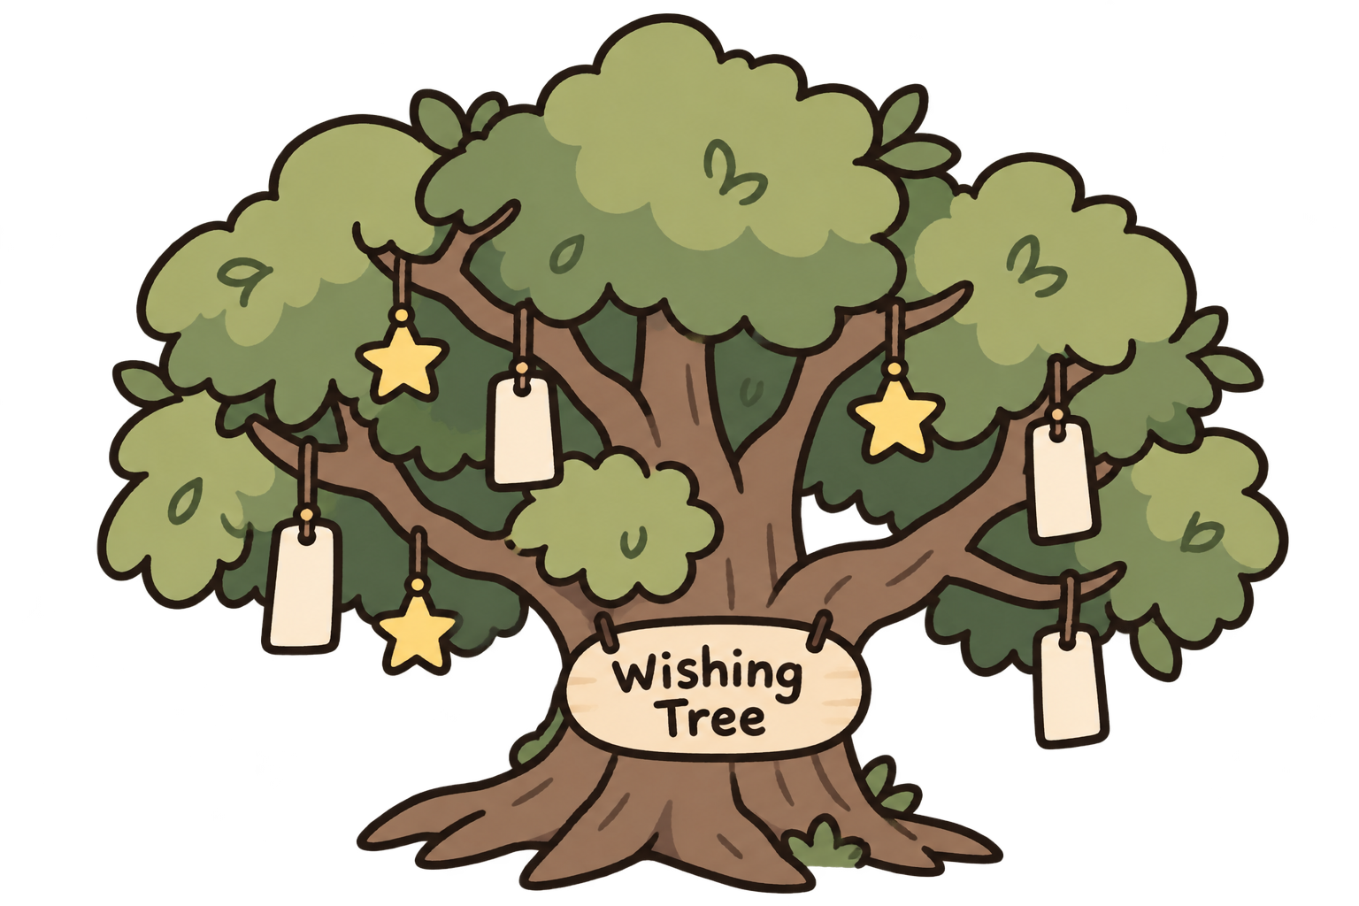
EXPERIENCE / EXPRESSION
Meet, speak and leave a little hope
JOIN + MOVE
LIVE CHAT
Be present
Speak in the map
QR entry, nickname, three
avatars; independent
movement.
Shared head bubbles
disappear after 5 seconds.
WISHING TREE
A message someone can discover
Hang a wish. A 4–5-word preview sways; open the note for
nickname, date and full text. Bless it once per player.
Images: prototype assets / controlled browser screenshots, project repository (2026).
SHARED CAMPUS / GRDE2053 Social Interactive Experiences
04
Notes:
SLIDE 4 | 0:56–1:23
ENGLISH SCRIPT
Typed messages appear above characters for five seconds. Wishes offer a slower interaction: write a note, hang it, and discover someone else’s. A short, gently moving preview invites a click. The full wish shows its nickname and date, with a blessing button to respond.
中文理解版
输入的文字会在角色头顶显示5秒。许愿提供更慢的互动：写纸条、挂起来，再发现别人的愿望。简短、轻轻摆动的预览邀请点击；完整愿望显示昵称与日期，并提供祝福按钮回应。
PRESENTER CUE
强调聊天与许愿是两种不同的表达：即时交流与保留在树上的留言。纸条仅预览4–5个英文词；每人对同一愿望祝福一次。

Slide 5
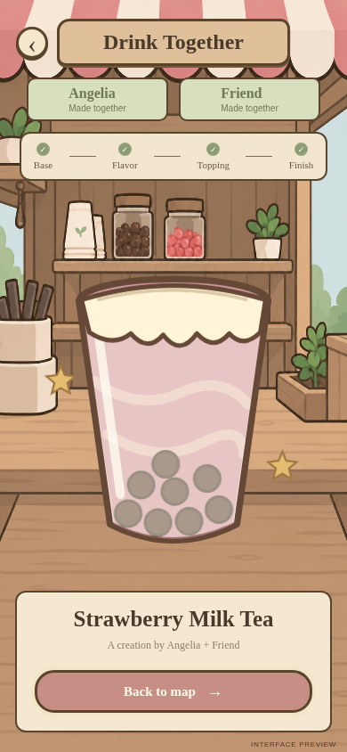
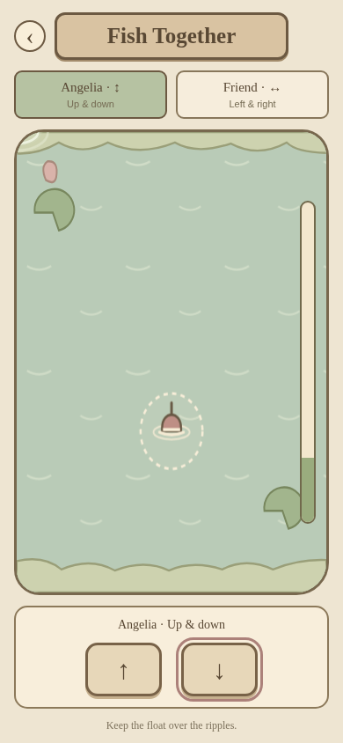
EXPERIENCE / COOPERATION
Two players. Two kinds of cooperation.
Make a drink
Catch together
Four alternating turns
Three options per stage
Both players shape the recipe
Your turn notification
One shared, named result
Countdown to start
Split vertical / horizontal control
Aim the float at ripples
Progress rises or falls
Four named catches + retry
Base → flavour → topping →
decoration
Start 20% · +10% / −4% per
second
Drink choices: sparkling water / milk tea / slush; strawberry / matcha / mango; pearls / coconut jelly / red bean; foam / ice cream / lemon.
Images: prototype assets / controlled browser screenshots, project repository (2026).
SHARED CAMPUS / GRDE2053 Social Interactive Experiences
05
Notes:
SLIDE 5 | 1:23–1:51
ENGLISH SCRIPT
In the drink shop, two players take turns making four choices. Both shape one drink together. Fishing needs continuous cooperation: one controls up and down, the other left and right. Neither controls both directions alone. They aim at moving ripples to build progress and reveal a random, named fish.
中文理解版
饮品店里，两名玩家轮流完成四次选择，共同决定一杯饮品。钓鱼需要持续合作：一人控制上下，一人控制左右，任何一人都不能单独控制两个方向。双方共同对准会换位的涟漪来积累进度，成功揭晓随机、有名字的鱼。
PRESENTER CUE
饮品：基底/风味/配料/装饰，81种组合。钓鱼：倒计时后开始，20%初始进度，对准+10%/秒，偏离−4%/秒，降至0失败。目标3.5秒换位，容错范围扩大10%。

Slide 6
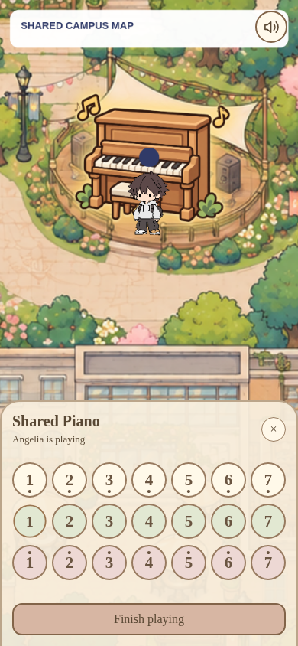

EXPERIENCE / MUSIC + SHARED ACCESS
One performer. A shared audience.
Play without leaving the map
21 keys in an on-map panel
One performer; others can listen
Occupied notice shows the nickname
Playing icon moves with musical notes
8 seconds idle → seat released
Sound control and a clear exit
All activity entrances share proximity cues and a route back to the
map.
Images: prototype assets / controlled browser screenshots, project repository (2026).
SHARED CAMPUS / GRDE2053 Social Interactive Experiences
06
Notes:
SLIDE 6 | 1:51–2:13
ENGLISH SCRIPT
The piano offers another role: listening. One person plays; others can listen after enabling sound. A notice identifies the performer. Eight seconds without a note releases the seat, keeping the shared instrument available to others.
中文理解版
钢琴提供另一种角色：聆听。一人弹奏，其他人开启声音后可以聆听。提示显示演奏者昵称。8秒不按音符就释放座位，让其他人也有机会使用共享乐器。
PRESENTER CUE
地图仍可见；旁观者不会打开同步键盘。靠近活动入口会出现提醒。说明观看、听琴也属于参与方式。

Slide 7
SHOWCASE FILM
From noticing to participating
INSERT YOUR SHOWCASE VIDEO
75 seconds / two participants + phones + public display
Join → meet → collaborate → reflect → listen
Replace this page with real recorded footage before presenting.
Brief requirement: a 1–2 minute showcase video of the experience in use.
Images: prototype assets / controlled browser screenshots, project repository (2026).
SHARED CAMPUS / GRDE2053 Social Interactive Experiences
07
Notes:
SLIDE 7 | 2:13–3:33
ENGLISH SCRIPT
This video shows visitors joining and sharing the activities.
中文理解版
这段视频展示参与者加入地图并共同参与活动。
PRESENTER CUE
播放你实拍的75秒展示视频。当前文件没有嵌入真实参与者视频，必须替换此页占位。不要朗读拍摄分镜。

Slide 8
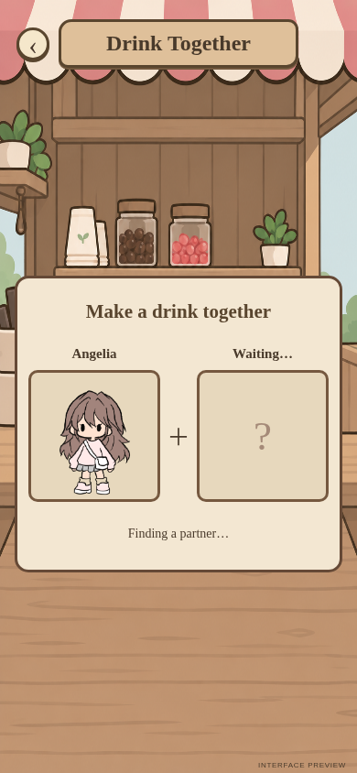
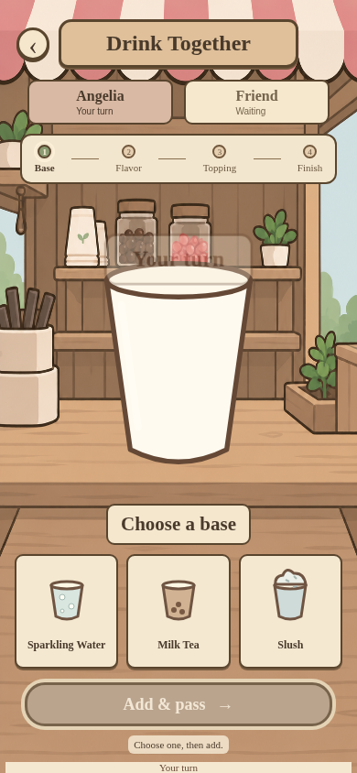

LIVE DEMONSTRATION
Two people. Four choices. One shared drink.
LIVE DEMO
Room: showcase
Two phones, one display
Target: 55 seconds
Open public display ↗
Images: prototype assets / controlled browser screenshots, project repository (2026).
SHARED CAMPUS / GRDE2053 Social Interactive Experiences
08
Notes:
SLIDE 8 | 3:33–4:28
ENGLISH SCRIPT
For the live demonstration, we’ll make one drink together. Watch how control passes between the two players, and how both phones receive the same result.
中文理解版
现场演示中，我们一起制作一杯饮品。请注意操作权怎样在两位玩家之间交替，以及两台手机怎样收到同一个结果。
PRESENTER CUE
总计55秒，包括约14秒引入和操作。演示前安排搭档：两台手机进入showcase房间，角色停在饮品店附近。使用实物展台/摄像头拍两台手机，或投屏一台并轮流切换展示另一台；公共地图本身不显示制作面板，不可只让老师远看手机。0–14秒引入并指出两玩家；14–42秒双方轮流做四次选择；42–50秒展示一致结果；50–55秒结束。提前排练投屏兼容性与声音。若不能投屏，需用摄像头让手机画面可读。

Slide 9
SOCIAL UX REFLECTION
The six course principles, applied
A course framework connected to concrete design decisions.
01
02
03
Sensory Feedback
Embodied Interaction
Social Dynamics
Piano sound responds to touch.
Touchscreen control; limited
embodiment.
Split controls make cooperation
necessary.
04
05
06
Resilience & Motivation
Proactivity & Clarity
Ethics & Inclusion
Gentler fishing and retry.
Proximity glow and turn cues.
Choice and fair access; barriers
remain.
Framework: Session 2, p. 6; Session 3, p. 8. Grounding: CSCW / affordances / signifiers (Sessions 2 & 5).
Images: prototype assets / controlled browser screenshots, project repository (2026).
SHARED CAMPUS / GRDE2053 Social Interactive Experiences
09
Notes:
SLIDE 9 | 4:28–5:21
ENGLISH SCRIPT
I evaluated the design through the six Social UX principles. Sensory Feedback appears in piano sound. Embodied Interaction is limited to touchscreen control, rather than full-body interaction. Social Dynamics is strongest in fishing: the split roles make cooperation necessary, as discussed in the course’s computer-supported cooperative work perspective. Resilience and Motivation informed easier fishing and retry. Proactivity and Clarity appear in glowing entrances and turn prompts: signifiers that communicate available actions. Ethics and Inclusion shaped sound control, exits and fair access to the piano. These support choice, but do not make the experience fully accessible.
中文理解版
我通过六项Social UX原则评估设计。感官反馈体现在琴声；具身互动仅限于触屏控制，而不是全身互动；社会动态在钓鱼中最突出：角色分工使合作成为必要条件，对应课堂中计算机支持协同工作的视角。韧性与动机影响了更宽松的钓鱼和重试；主动引导与清晰性体现在发光入口与轮次提示，它们作为signifiers传达可用操作；伦理与包容影响了声音控制、退出和钢琴的公平使用。这些支持参与者选择，但不代表体验已全面无障碍。
PRESENTER CUE
六项名称见Session2 p6、Session3 p8；CSCW见Session2 p8，signifiers见Session5 slides9–11。按设计回顾来讲，不声称一开始每一步都按该框架实施。手机触控是有限的具身互动，不是全身追踪。钓鱼使用方向按钮，不能说拖动浮标。昵称不等于匿名或充分隐私保护。未实现触觉震动，也未验证全面无障碍。

Slide 10
ATMOSPHERE + SENSORY EXPERIENCE
A familiar campus, with small invitations
A narrative setting
A shared campus rather than a linear quest.
Visual invitation
Consistent icons, soft colours and proximity glow.
Sensory reward
A shared result, a surprising fish, a live melody.
Images: prototype assets / controlled browser screenshots, project repository (2026).
SHARED CAMPUS / GRDE2053 Social Interactive Experiences
10
Notes:
SLIDE 10 | 5:21–5:38
ENGLISH SCRIPT
The campus provides a setting, without a fixed storyline. Familiar places give activities context. Consistent illustration, soft colours, proximity effects and music create a welcoming, responsive space.
中文理解版
校园提供场景，没有固定剧情。熟悉的地点让活动有相应背景。统一插画、柔和配色、靠近效果和音乐营造友好、会回应参与者的空间。
PRESENTER CUE
结合截图说明视觉和声音怎样服务体验，不只说“好看”。

Slide 11
DEVELOPMENT + REFINEMENT
From initial concept to refined interactions
Concept shift
Cultural prompts / shared visuals
Free exploration + shared activities
Reliability
Missing players / messages
Refined presence + shared state
Mobile view
Small avatar / unused space
35% zoom + full viewport
Cooperation
Jerky / difficult fishing
Smoothing + gentler timing
Shared access
Separate piano page / idle use
Map controls + 8-second release
Initial concept: Social Interactive, slides 5, 7–8. Tokens not carried forward; unused streetlight placeholder removed.
Images: prototype assets / controlled browser screenshots, project repository (2026).
SHARED CAMPUS / GRDE2053 Social Interactive Experiences
11
Notes:
SLIDE 11 | 5:38–6:04
ENGLISH SCRIPT
The initial concept proposed cultural prompts, shared visuals and tokens. The final version keeps the connection goal through freely chosen activities, without tokens. Device checks exposed missing players and jerky fishing. I prioritised shared visibility, smoothed movement, enlarged the phone view and reduced fishing difficulty after play feedback.
中文理解版
初始概念提出文化提示、共享视觉和代币。最终版本通过自由选择的活动保留连接目标，没有加入代币。设备检查暴露了玩家不可见与钓鱼卡顿。我优先处理共同可见性、平滑移动、放大手机视角，并根据游玩反馈降低钓鱼难度。
PRESENTER CUE
初始概念依据Social Interactive.pptx第5、7、8页：日常生活/文化提示、共享地图、代币想法。若该文件不是正式A1提交版，展示前与提交版核对；不宣称这些是导师要求改动。技术迭代依据开发记录和设备反馈，不虚构正式访谈或观众人数。

Slide 12
TECHNICAL IMPLEMENTATION
A small architecture for shared participation
PERSONAL INPUT
SHARED STATE
COMMON VIEW
Phones
Firebase
Public display
Choose, move and interact.
↔
Positions, turns, notes and
wishes.
↔
See co-presence and shared
outcomes.
p5.js renders the world. GitHub Pages hosts the site.
Checks: shared player visibility, messages, activity state and iPhone sound.
Exhibition needs: stable internet, charged phones and a recorded fallback.
Automated checks are not a substitute for audience evaluation.
Images: prototype assets / controlled browser screenshots, project repository (2026).
SHARED CAMPUS / GRDE2053 Social Interactive Experiences
12
Notes:
SLIDE 12 | 6:04–6:20
ENGLISH SCRIPT
p5.js renders the map; Firebase synchronises shared state; GitHub Pages hosts it. Phones provide personal control, while the public screen makes participation visible.
中文理解版
p5.js绘制地图，Firebase同步共享状态，GitHub Pages托管体验。手机提供个人操作，大屏让共同参与可见。
PRESENTER CUE
技术名称慢读并停顿。本页不宣称所有网络和设备都稳定。展览准备稳定网络、电量与备用录像；这些属于准备安排，不是已有正式用户研究。

Slide 13
REFLECTION + AUTHORSHIP
Small invitations. Shared experiences.
Watch. Listen. Leave a wish.
Or do something together.
AI USE
Code + debugging
Some activity artwork
Presentation drafting
Next evaluation:
Do shared activities prompt cultural exchange?
My decisions: visual selection,
interaction refinement and
device feedback.
AI-generated outputs were selected, tested and refined.
Impact on belonging has not yet been established through an independent participant study.
Images: prototype assets / controlled browser screenshots, project repository (2026).
SHARED CAMPUS / GRDE2053 Social Interactive Experiences
13
Notes:
SLIDE 13 | 6:20–6:40
ENGLISH SCRIPT
The map supports first contact, but cultural exchange needs further evaluation. Device checks do not establish improved belonging. AI assisted code, selected artwork and presentation drafting; I selected and refined the outputs.
中文理解版
地图支持初次接触，但文化交流仍需进一步评估。设备检查不能证明归属感得到提升。AI辅助了代码、部分素材和演示初稿，我进行了选择与修改。
PRESENTER CUE
AI使用属真实项目过程，需如实提交工具/用途/修改方式声明并核实导师批准。手机/网络、语言与视听要求会影响包容性；公开愿望也需内容管理。下一步是评估，不是承诺马上加新功能。

Slide 14
REFERENCES + CREDITS
Thank you. Try it together.
Course sources
GRDE2053. A2 assignment brief, pp. 1–5. Supplied course document, n.d.
GRDE2053. SIE–DCI A2 Exhibition Showcase marking rubric. Supplied course document, n.d.
GRDE2053. Sessions 2 (p. 6), 3 (p. 8) and 5 (slides 6–10). Course slides, n.d.
Initial concept: Social Interactive.pptx, slides 5, 7–8. User-supplied concept deck, n.d.
Project media + implementation
Prototype screens: public-map-project repository, 2026; controlled browser captures.
Map / avatars: supplied project assets; original attribution pending in source register.
Activity icons / fish cut-outs: AI-assisted media; see the accompanying source register.
p5.js • Firebase Realtime Database • GitHub Pages • Web Audio API.
Supporting credits and AI-use details accompany this presentation.
SHARED CAMPUS / GRDE2053 Social Interactive Experiences
14
Notes:
SLIDE 14 | 6:40–6:45
ENGLISH SCRIPT
Thank you. Please try Shared Campus together.
中文理解版
谢谢，欢迎一起体验Shared Campus。
PRESENTER CUE
结束后保留参考资料页，不朗读资料清单。媒体来源尚待核实事项仅在备注与来源登记中列出，不作已完成引用。

Slide 15
APPENDIX / NOT PART OF THE TIMED TALK
Before you submit
01 Fill in your name; check the verified theory mapping and initial-concept comparison.
02 Record and insert a real 1–2 minute showcase film.
03 Rehearse a 5–7 minute presentation including video and live demo.
04 Prepare the separate development PDF: maximum 15 pages, excluding title / references.
05 Include coversheet, requested MP4 / SharePoint link and tutor access.
06 Confirm AI approval, declaration and media attribution; check milestone completion.
SHARED CAMPUS / GRDE2053 Social Interactive Experiences
15
Notes:
SLIDE 15 | APPENDIX — do not present
ENGLISH SCRIPT
中文理解版
PRESENTER CUE
备查页，不计入课堂展示。按brief还需封面、独立development documentation PDF、MP4及SharePoint可访问链接；这套PPT不替代过程文档。

