Slide 1
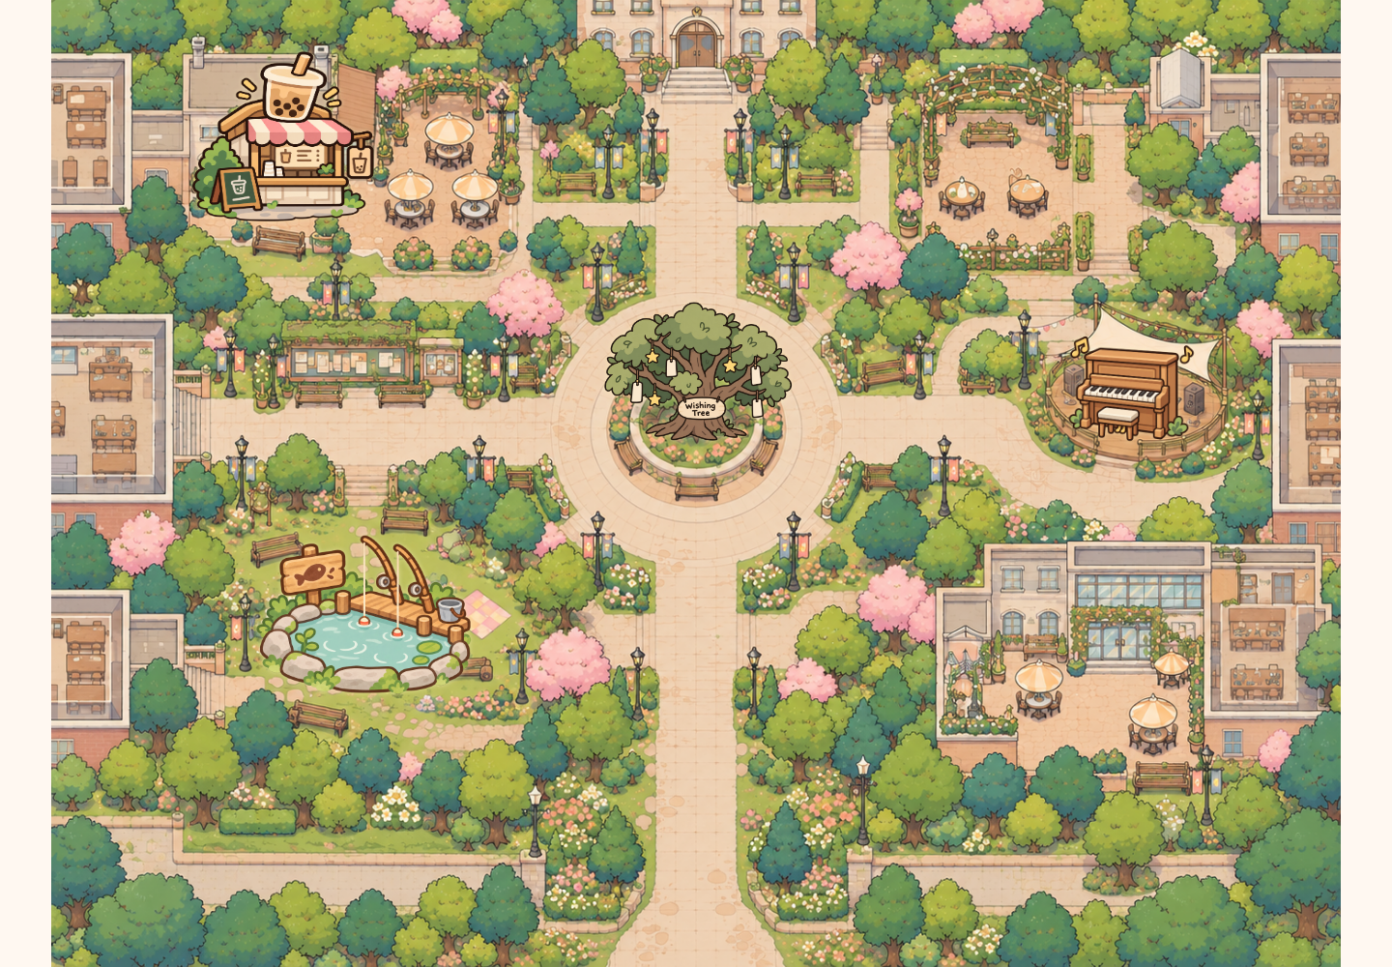
EXHIBITION SHOWCASE
Shared
Campus
Small moments.
Shared connections.
A public map, personal phones
and playful first encounters.
[Your name] · A2 · 2026
SHARED CAMPUS / GRDE2053 Social Interactive Experiences
01
Notes:
SLIDE 1 | 0:00–0:20
ENGLISH SCRIPT
Hello, today I’m presenting Shared Campus: a multiplayer campus map designed to make a first connection feel less awkward. People join on their own phones, see one another on a public screen, and choose a small activity to share.
中文理解版
大家好，今天展示的是 Shared Campus：一个希望降低初次交流压力的多人校园地图。参与者用自己的手机加入，在公共大屏上看见彼此，并选择一个简短的共同活动。
PRESENTER CUE
介绍项目，不要逐个列举功能。填上你的名字。

Slide 2
01 / SOCIAL FOCUS
A small invitation to connect
How might a shared campus
space make a first interaction
easier?
PRIMARY
SECONDARY
ALSO
Connection
Joy
Reflection
A small shared action before a
conversation.
Playful choices and unexpected
outcomes.
Leave a wish. Read someone
else’s.
Audience focus: international students and other campus visitors.
Images: prototype assets / controlled browser screenshots, project repository (2026).
SHARED CAMPUS / GRDE2053 Social Interactive Experiences
02
Notes:
SLIDE 2 | 0:20–0:55
ENGLISH SCRIPT
My social focus is connection, especially the first interaction between international students who may not already know each other. Instead of asking strangers to begin a conversation, I offer something they can do together. The map also supports joy through playful outcomes, and reflection through shared wishes. These are design intentions, rather than measured social outcomes.
中文理解版
核心社会目标是连接，特别是不熟悉彼此的国际学生之间的第一次互动。我没有要求陌生人先开口聊天，而是提供可以共同完成的小事。趣味结果带来快乐，许愿树提供表达与反思的空间。这些是设计目标，不代表已经测量并证明能改善孤独感或归属感。
PRESENTER CUE
清楚说出 Connection 是主要焦点；不要把设计动机说成调研结论。

Slide 3
02 / PARTICIPANT JOURNEY
One shared place. Your own way in.
01
02
03
04
05
Scan
Choose
Explore
Notice
Share
Use your own
phone.
Nickname +
avatar.
See others
nearby.
Follow a glowing
invitation.
Make, play, wish
or listen.
A first encounter in approximately two minutes or less.
The whole map can be explored at your own pace.
Images: prototype assets / controlled browser screenshots, project repository (2026).
SHARED CAMPUS / GRDE2053 Social Interactive Experiences
03
Notes:
SLIDE 3 | 0:55–1:20
ENGLISH SCRIPT
The entry flow is simple: scan the code, choose a nickname and character, and explore. The public display makes other participants visible, while each phone follows its own character. A first encounter is designed to fit within about two minutes. People can collaborate, leave a wish, listen, or observe before joining.
中文理解版
入口流程很简单：扫码、选择昵称和角色、进入地图。公共大屏让参与者看见彼此，手机则跟随自己的角色。第一次简短互动以约两分钟内为目标。参与者可以合作、留言许愿、听琴，也可以先观察。
PRESENTER CUE
指出“两分钟”指一次简短参与，不是要求在两分钟内体验完全部地图。

Slide 4
03 / SHOWCASE FILM
From noticing to participating
INSERT YOUR SHOWCASE VIDEO
75 seconds / two participants + phones + public display
Join → meet → collaborate → reflect → listen
Replace this page with real recorded footage before presenting.
Brief requirement: a 1–2 minute showcase video of the experience in use.
Images: prototype assets / controlled browser screenshots, project repository (2026).
SHARED CAMPUS / GRDE2053 Social Interactive Experiences
04
Notes:
SLIDE 4 | 1:20–2:35
ENGLISH SCRIPT
This short film shows how people enter the shared space and move from noticing each other to participating together.
中文理解版
这段短片展示参与者如何进入共享空间，并从注意到彼此，走向共同参与。
PRESENTER CUE
播放你实拍的75秒展示视频。当前文件没有嵌入真实参与者视频，必须替换此页占位。不要朗读拍摄分镜。

Slide 5
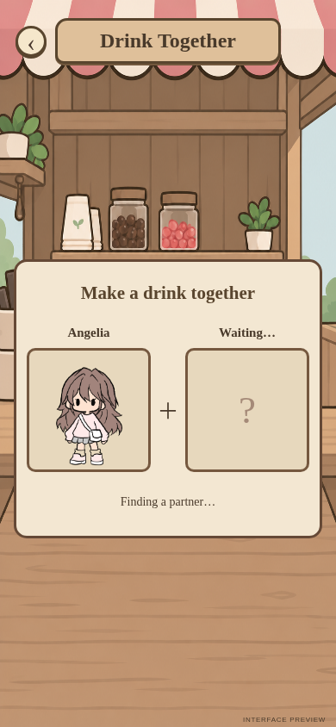
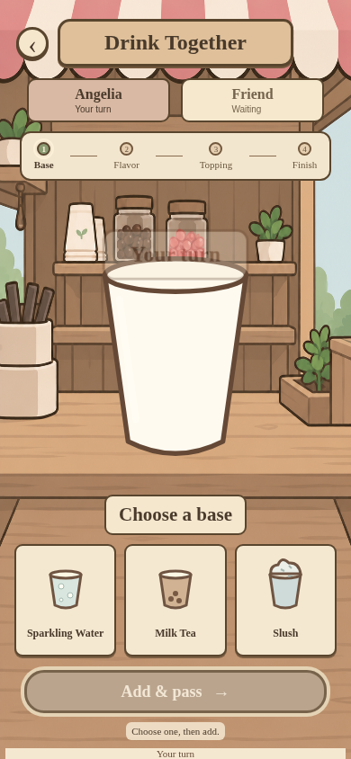
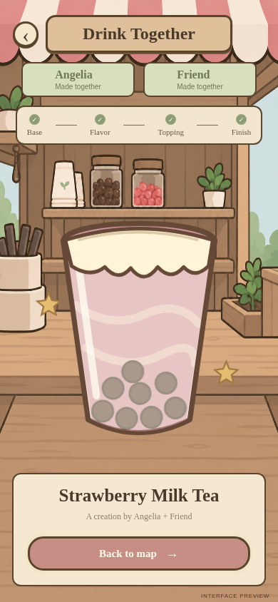

04 / LIVE DEMONSTRATION
Two people. Four choices. One shared drink.
LIVE DEMO
Room: showcase
Two phones, one display
Target: 60 seconds
Open public display ↗
Images: prototype assets / controlled browser screenshots, project repository (2026).
SHARED CAMPUS / GRDE2053 Social Interactive Experiences
05
Notes:
SLIDE 5 | 2:35–3:35
ENGLISH SCRIPT
Now I’ll demonstrate the drink activity with two phones. Each person makes alternating choices, and both receive the drink they created together.
中文理解版
现在用两台手机现场演示饮品制作。两人轮流选择，最后共同得到制作完成的饮品。
PRESENTER CUE
提前让两台手机加入 showcase 房间并到饮品店附近。进入匹配→A选基底→B选风味→A选配料→B选装饰→同时展示同一饮品结果→返回地图。控制在60秒内。

Slide 6
05 / SOCIAL UX REFLECTION
Turn course principles into design evidence
COURSE TERMS TO CONFIRM — these are design examples, not verified principle names.
01
02
03
Notice others
Lower the threshold
Share influence
Visible avatars on a shared map.
QR entry and temporary
identities.
Alternating drink choices.
04
05
06
Need one another
Offer quieter
participation
Share access
Split-axis fishing controls.
Clear exits and 8-second piano
release.
Wishes, observation and
listening.
Images: prototype assets / controlled browser screenshots, project repository (2026).
SHARED CAMPUS / GRDE2053 Social Interactive Experiences
06
Notes:
SLIDE 6 | 3:35–4:15
ENGLISH SCRIPT
Visible avatars help people notice others. QR entry makes joining easy. Alternating drink choices give both players influence, while fishing needs cooperation. Wishes support quieter expression; the piano includes listeners. Clear exits and automatic release help people share access. I will connect these decisions to the six principles using our course’s exact terminology.
中文理解版
这个设计提供了多种参与方式。可见的角色让人注意到他人；简短入口降低参与门槛；共同配方让两人都能影响结果，分工钓鱼则需要协作。许愿支持较安静的表达，钢琴让聆听也成为参与。清晰退出与钢琴8秒无操作让位，也帮助大家共享使用机会。正式版需用课堂六原则的准确术语解释这些决定。
PRESENTER CUE
待补：请提供课堂六原则名称和课件来源。当前六张卡片是项目设计证据，不是擅自命名的课堂理论。最终演讲替换最后一句，并为每项原则指出一个具体案例。

Slide 7
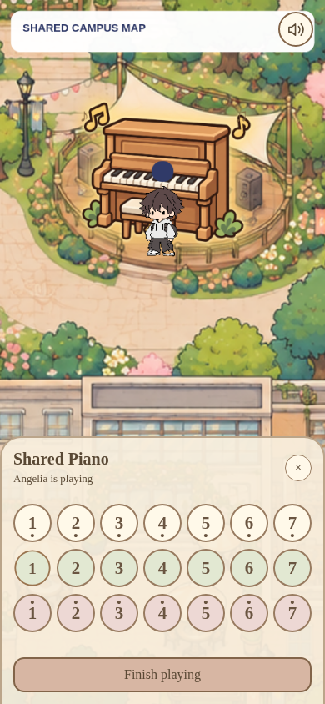
06 / ATMOSPHERE + SENSORY EXPERIENCE
A familiar campus, with small invitations
A narrative setting
A shared campus rather than a linear quest.
Visual invitation
Consistent icons, soft colours and proximity glow.
Sensory reward
A shared result, a surprising fish, a live melody.
Images: prototype assets / controlled browser screenshots, project repository (2026).
SHARED CAMPUS / GRDE2053 Social Interactive Experiences
07
Notes:
SLIDE 7 | 4:15–4:45
ENGLISH SCRIPT
Rather than a linear story, the experience uses a familiar campus setting as its narrative frame. Warm colours, illustrated characters and consistent activity icons create a welcoming atmosphere. Nearby objects glow to invite interaction. Shared drinks, unexpected fish and music provide small sensory rewards, while the public screen makes these individual actions part of a collective scene.
中文理解版
体验没有使用线性剧情，而是把熟悉的校园作为叙事框架。暖色、插画角色和统一活动图标营造友好的氛围。靠近时发光的入口引导探索；饮品、意外的鱼和音乐带来小小的感官回报，公共大屏则把个人行动呈现在同一个场景里。
PRESENTER CUE
结合截图说明视觉和声音怎样服务体验，不只说“好看”。

Slide 8
07 / DEVELOPMENT + REFINEMENT
Specific feedback changed specific decisions
Co-presence
Missing players / messages
Refined presence and shared state
Mobile view
Small avatar / unused space
35% zoom, full map viewport
Cooperation
Jerky or difficult fishing
Smoothing + gentler timing
Shared access
Separate piano screen / idle use
Map overlay + 8-second release
Scope
Unused streetlight placeholder
Removed from final experience
Evidence: development log, prototype iterations and device feedback — not a formal audience study.
Images: prototype assets / controlled browser screenshots, project repository (2026).
SHARED CAMPUS / GRDE2053 Social Interactive Experiences
08
Notes:
SLIDE 8 | 4:45–5:25
ENGLISH SCRIPT
Development was iterative. Early multi-device checks exposed missing players and unreliable message visibility, so presence and shared state needed refinement. Phone feedback led to a larger local view, less empty space and slower movement. Fishing feedback led to smoother display and more forgiving timing. The piano changed from a separate-looking screen to controls over the live map, with clearer spacing and automatic release after eight seconds without a note. The unused streetlight placeholder was removed.
中文理解版
开发是逐步迭代的。早期多设备检查发现玩家缺失、消息显示不稳定，因此改进了在线状态和共享数据。手机反馈促使我放大局部视角、减少留白并减慢移动；钓鱼反馈带来了更平滑的显示与更宽松的时机；钢琴则从类似独立页面改为地图上的操作面板，并增加按键间距和8秒无音符自动让位。未完成的路灯占位功能最终被删除。
PRESENTER CUE
这些是本项目对话和开发记录可支持的迭代，不要称为正式访谈或大样本用户测试。A1原提案未提供；如有不同，应补上一句最重要的变化。

Slide 9
08 / TECHNICAL IMPLEMENTATION
A small architecture for shared participation
PERSONAL INPUT
SHARED STATE
COMMON VIEW
Phones
Firebase
Public display
Choose, move and interact.
↔
Positions, turns, notes and
wishes.
↔
See co-presence and shared
outcomes.
p5.js renders the world. GitHub Pages hosts the site.
Verification: 26 local checks + browser checks + reported device trials.
Exhibition needs: stable internet, charged phones and a recorded fallback.
Automated checks are not a substitute for audience evaluation.
Images: prototype assets / controlled browser screenshots, project repository (2026).
SHARED CAMPUS / GRDE2053 Social Interactive Experiences
09
Notes:
SLIDE 9 | 5:25–6:00
ENGLISH SCRIPT
The original p5.js project remains the foundation. Firebase shares positions and activity state; GitHub Pages hosts the site. Phones provide personal control, and the screen provides a common view. I checked simulated clients, browsers and actual devices, including iPhone sound. Exhibition still needs stable internet, charged devices and a recorded backup.
中文理解版
原有p5.js项目仍然是基础。Firebase同步玩家位置和活动状态，GitHub Pages托管页面。手机负责个人操作，大屏提供共同视角。开发检查包括独立模拟客户端与浏览器测试；实际手机测试也在修复后确认了iPhone出声。展览时仍需准备稳定网络、充足电量和录像备份。
PRESENTER CUE
不要把26项自动测试说成26位用户；不要声称在所有设备、所有网络环境下都稳定。

Slide 10
09 / REFLECTION + AUTHORSHIP
Small invitations. Shared experiences.
Watch. Listen. Leave a wish.
Or do something together.
AI USE
Code + debugging
Some activity artwork
Presentation drafting
Next evaluation:
Can unfamiliar participants begin independently?
Confirm tutor approval,
permitted use and the required
declaration before submission.
AI-assisted development was selected, tested and
refined — not treated as finished output.
Impact on belonging has not yet been established through an independent participant study.
Images: prototype assets / controlled browser screenshots, project repository (2026).
SHARED CAMPUS / GRDE2053 Social Interactive Experiences
10
Notes:
SLIDE 10 | 6:00–6:35
ENGLISH SCRIPT
People can watch, listen, leave a wish or cooperate. The value is in these small invitations. I used generative AI for parts of the code, debugging, artwork and presentation, then selected, tested and refined its outputs. Next, I would observe whether unfamiliar participants can begin an interaction independently, rather than adding more activities.
中文理解版
最终体验提供不同程度的社交投入：观看、聆听、留下愿望，或共同合作。价值不在功能数量，而在这些功能创造的小邀请。我在部分代码、调试、活动素材及演示准备中使用了生成式AI，再进行选择、测试与调整。下一步更值得观察不熟悉的参与者是否能独立开始有意义的互动，而不是继续堆加功能。
PRESENTER CUE
务必核实并补齐AI来源、导师批准和单元允许范围。不要把AI辅助内容宣称为完全独立编写或手绘。

Slide 11
REFERENCES + CREDITS
Thank you. Try it together.
Course sources
GRDE2053. A2 assignment brief, pp. 1–5. Supplied course document, n.d.
GRDE2053. SIE–DCI A2 Exhibition Showcase marking rubric. Supplied course document, n.d.
[Add lecture source and exact six Social UX principles before submission.]
Project media + implementation
Prototype screens: public-map-project repository, 2026; controlled browser captures.
Map / avatars: user-supplied assets; confirm original creators and licences.
Some activity icons / fish cut-outs: AI-generated or AI-refined; list individual assets.
p5.js • Firebase Realtime Database • GitHub Pages • Web Audio API.
References here use a provisional author–date format. Match the referencing style in your unit outline.
SHARED CAMPUS / GRDE2053 Social Interactive Experiences
11
Notes:
SLIDE 11 | 6:35–6:40
ENGLISH SCRIPT
Thank you. I’d like to invite you to try the map together.
中文理解版
谢谢，欢迎大家一起体验这个地图。
PRESENTER CUE
参考资料页保留在屏幕上；不逐条朗读参考文献。

Slide 12
APPENDIX / NOT PART OF THE TIMED TALK
Before you submit
01 Fill in your name and exact six course principles + lecture citations.
02 Record and insert a real 1–2 minute showcase film.
03 Rehearse a 5–7 minute presentation including video and live demo.
04 Prepare the separate development PDF: maximum 15 pages, excluding title / references.
05 Include coversheet, requested MP4 / SharePoint link and tutor access.
06 Confirm AI approval, declaration and media attribution; check milestone completion.
SHARED CAMPUS / GRDE2053 Social Interactive Experiences
12
Notes:
SLIDE 12 | APPENDIX — do not present
ENGLISH SCRIPT
中文理解版
PRESENTER CUE
备查页，不计入课堂展示。按brief还需封面、独立development documentation PDF、MP4及SharePoint可访问链接；这套PPT不替代过程文档。

