Slide 1
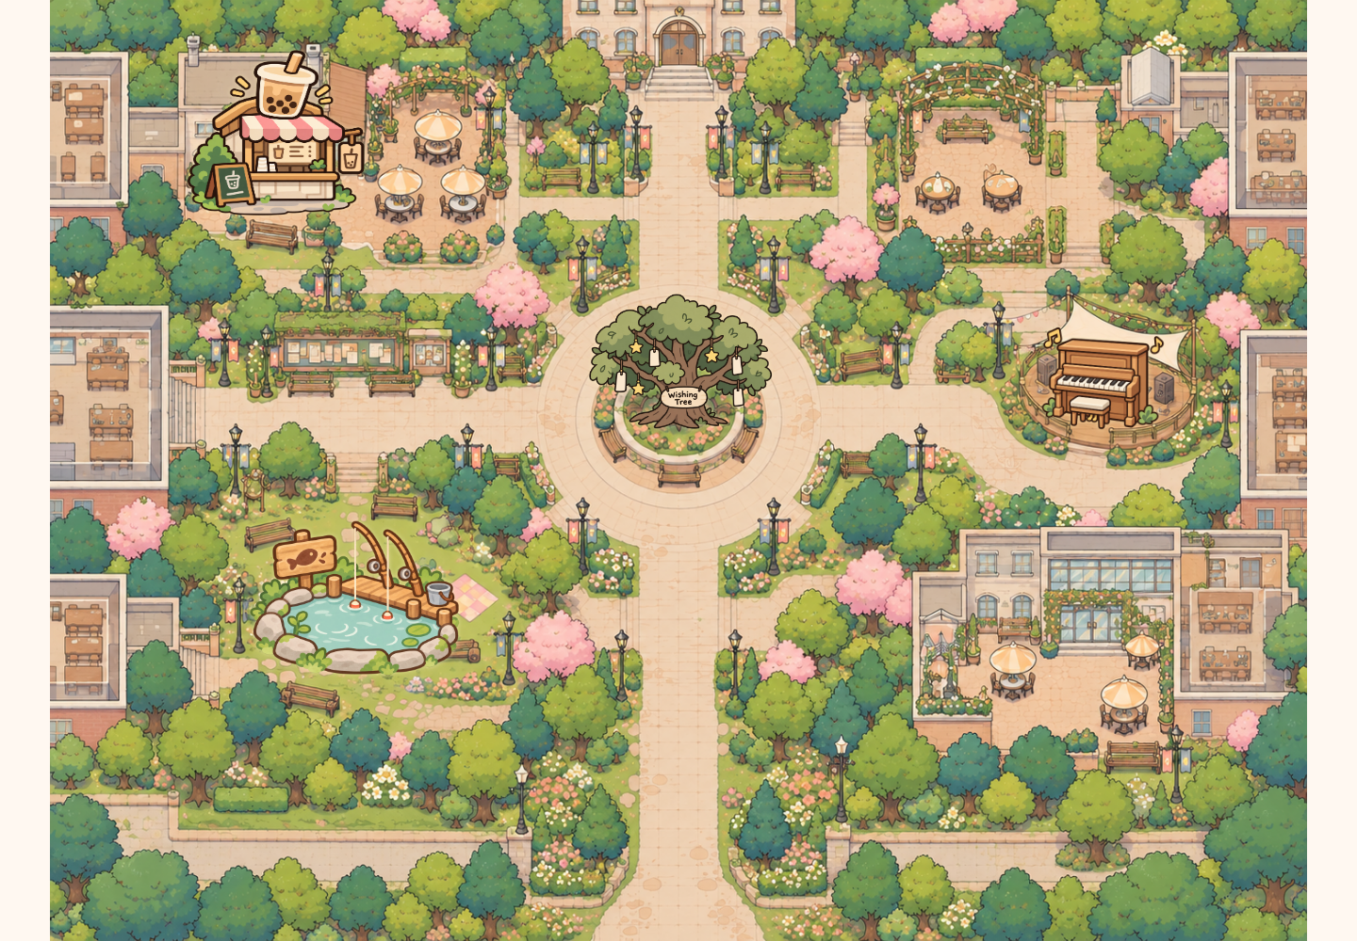
EXHIBITION SHOWCASE
Shared
Campus
Small moments.
Shared connections.
A public map, personal phones
and playful first encounters.
[Your name] · A2 · 2026
SHARED CAMPUS / GRDE2053 Social Interactive Experiences
01
Notes:
SLIDE 1 | 0:00–0:15
ENGLISH SCRIPT
My project is Shared Campus. People join an illustrated campus through a public screen and their own phones, with small activities that make starting an interaction easier.
中文理解版
我的项目叫Shared Campus。大家通过公共大屏和自己的手机进入插画校园，用小活动更轻松地开始互动。
PRESENTER CUE
介绍项目，不要逐个列举功能。填上你的名字。

Slide 2
01 / SOCIAL FOCUS
A small invitation to connect
How might a shared campus
space make a first interaction
easier?
PRIMARY
SECONDARY
ALSO
Connection
Joy
Reflection
A small shared action before a
conversation.
Playful choices and unexpected
outcomes.
Leave a wish. Read someone
else’s.
Audience focus: international students and other campus visitors.
Images: prototype assets / controlled browser screenshots, project repository (2026).
SHARED CAMPUS / GRDE2053 Social Interactive Experiences
02
Notes:
SLIDE 2 | 0:15–0:38
ENGLISH SCRIPT
The concept began with international students and the difficulty of approaching someone unfamiliar. Instead of requiring a conversation immediately, the map offers a shared activity first. Connection is the main focus. Joy and reflection come through playful results and personal wishes.
中文理解版
这个概念从国际学生出发，关注向不熟悉的人迈出交流第一步的困难。地图让大家先共同参与一件事，而不必马上展开对话。主要目标是连接，趣味结果和个人愿望也带来快乐与反思。
PRESENTER CUE
清楚说出 Connection 是主要焦点；不要把设计动机说成调研结论。

Slide 3
02 / PARTICIPANT JOURNEY
One shared place. Your own way in.
01
02
03
04
05
Scan
Choose
Explore
Notice
Share
Use your own
phone.
Nickname +
avatar.
See others
nearby.
Follow a glowing
invitation.
Make, play, wish
or listen.
A first encounter in approximately two minutes or less.
The whole map can be explored at your own pace.
Images: prototype assets / controlled browser screenshots, project repository (2026).
SHARED CAMPUS / GRDE2053 Social Interactive Experiences
03
Notes:
SLIDE 3 | 0:38–0:54
ENGLISH SCRIPT
Visitors scan a QR code, choose a nickname and character, and enter. Phones control individual characters; the public display shows everyone together. Each activity offers a short encounter.
中文理解版
参与者扫码，选择昵称与角色后进入。手机控制个人角色，大屏显示所有人。每个活动提供一次简短的参与。
PRESENTER CUE
指出“两分钟”指一次简短参与，不是要求在两分钟内体验完全部地图。

Slide 4
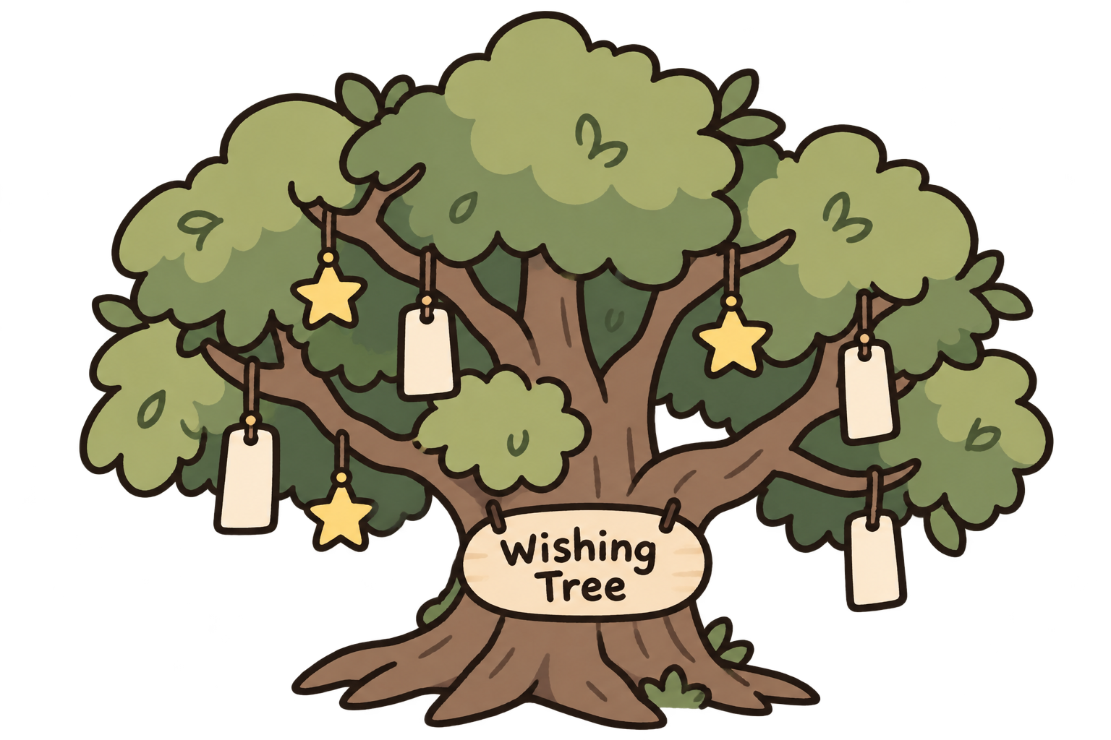
EXPERIENCE / EXPRESSION
Meet, speak and leave a little hope
JOIN + MOVE
LIVE CHAT
Be present
Speak in the map
QR entry, nickname, three
avatars; independent
movement.
Shared head bubbles
disappear after 5 seconds.
WISHING TREE
A message someone can discover
Hang a wish. A 4–5-word preview sways; open the note for
nickname, date and full text. Bless it once per player.
Images: prototype assets / controlled browser screenshots, project repository (2026).
SHARED CAMPUS / GRDE2053 Social Interactive Experiences
04
Notes:
SLIDE 4 | 0:54–1:22
ENGLISH SCRIPT
Chat bubbles let players speak in the shared space and disappear after five seconds. Wishes offer a slower interaction: write a note, hang it, and discover someone else’s. A short, gently moving preview invites a click. The full note shows its author’s nickname and date, with a blessing button to respond.
中文理解版
聊天气泡让玩家在共享空间交流，并在5秒后消失。许愿提供更慢的互动：写纸条、挂起来，再发现别人的愿望。简短、轻轻摆动的预览吸引点击；完整纸条显示作者昵称与日期，也有祝福按钮回应。
PRESENTER CUE
强调聊天与许愿是两种不同的表达：即时交流与保留在树上的留言。纸条仅预览4–5个英文词；每人对同一愿望祝福一次。

Slide 5
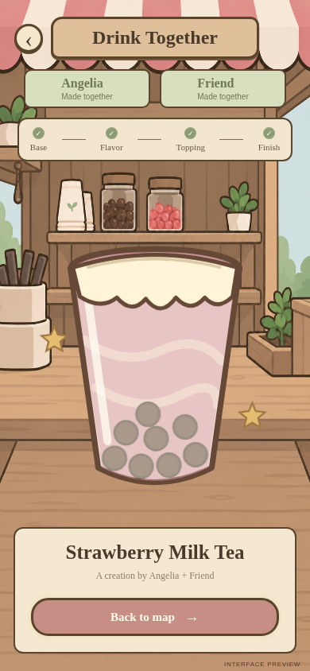
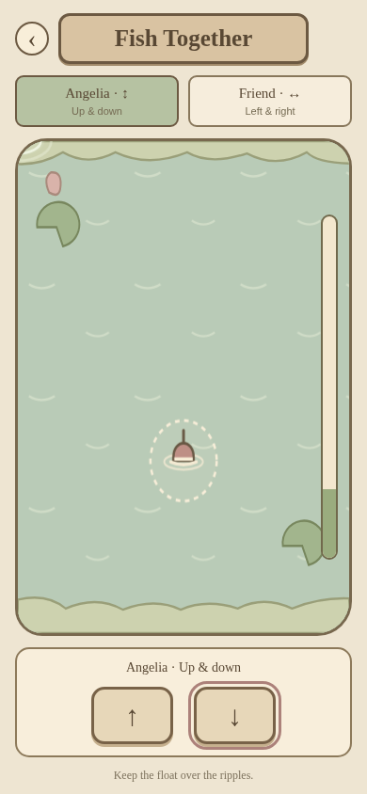
EXPERIENCE / COOPERATION
Two players. Two kinds of cooperation.
Make a drink
Catch together
Four alternating turns
Three options per stage
Both players shape the recipe
Your turn notification
One shared, named result
Countdown to start
Split vertical / horizontal control
Aim the float at ripples
Progress rises or falls
Four named catches + retry
Base → flavour → topping →
decoration
Start 20% · +10% / −4% per
second
Drink choices: sparkling water / milk tea / slush; strawberry / matcha / mango; pearls / coconut jelly / red bean; foam / ice cream / lemon.
Images: prototype assets / controlled browser screenshots, project repository (2026).
SHARED CAMPUS / GRDE2053 Social Interactive Experiences
05
Notes:
SLIDE 5 | 1:22–1:49
ENGLISH SCRIPT
In the drink shop, two players alternate four decisions. Their shared, named drink contains both their choices. Fishing needs continuous cooperation: one player controls vertical movement, the other horizontal. Together, they aim one float at moving ripples to build progress. Success reveals a random, named fish.
中文理解版
饮品店里，两名玩家轮流完成四次选择，共同得到有名字的饮品，包含双方的决定。钓鱼需要持续合作：一人控制上下，一人控制左右，共同把一个浮标对准会换位的涟漪来积累进度。成功后随机揭晓有名字的鱼。
PRESENTER CUE
饮品：基底/风味/配料/装饰，81种组合。钓鱼：倒计时后开始，20%初始进度，对准+10%/秒，偏离−4%/秒，降至0失败。目标3.5秒换位，容错范围扩大10%。

Slide 6
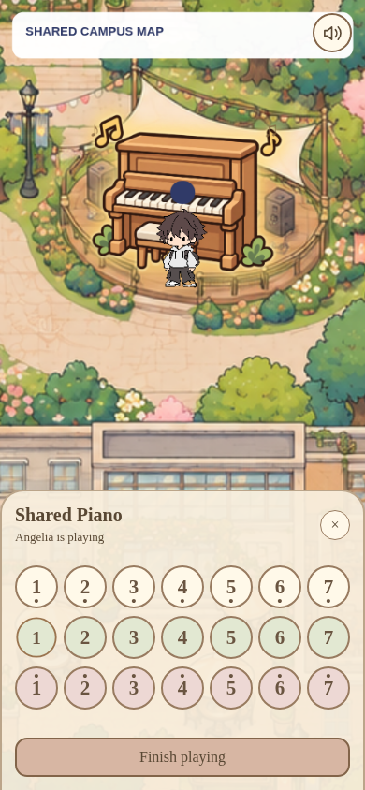

EXPERIENCE / MUSIC + SHARED ACCESS
One performer. A shared audience.
Play without leaving the map
21 keys in an on-map panel
One performer; others can listen
Occupied notice shows the nickname
Playing icon moves with musical notes
8 seconds idle → seat released
Sound control and a clear exit
All activity entrances share proximity cues and a route back to the
map.
Images: prototype assets / controlled browser screenshots, project repository (2026).
SHARED CAMPUS / GRDE2053 Social Interactive Experiences
06
Notes:
SLIDE 6 | 1:49–2:13
ENGLISH SCRIPT
The piano offers another social role: listening. One person plays while others hear the music in the map. An occupied notice identifies the performer. After eight seconds without a note, the piano becomes available again, preventing one idle player from holding the shared instrument.
中文理解版
钢琴提供另一种社交角色：聆听。一人弹奏，其他人在地图里听到音乐。占用提示显示演奏者昵称；8秒没有按音符就会自动让位，避免闲置玩家一直占据共享乐器。
PRESENTER CUE
地图仍可见；旁观者不会打开同步键盘。靠近活动入口会出现提醒。说明观看、听琴也属于参与方式。

Slide 7
03 / SHOWCASE FILM
From noticing to participating
INSERT YOUR SHOWCASE VIDEO
75 seconds / two participants + phones + public display
Join → meet → collaborate → reflect → listen
Replace this page with real recorded footage before presenting.
Brief requirement: a 1–2 minute showcase video of the experience in use.
Images: prototype assets / controlled browser screenshots, project repository (2026).
SHARED CAMPUS / GRDE2053 Social Interactive Experiences
07
Notes:
SLIDE 7 | 2:13–3:33
ENGLISH SCRIPT
This video shows visitors joining and sharing the activities.
中文理解版
这段视频展示参与者加入地图并共同参与活动。
PRESENTER CUE
播放你实拍的75秒展示视频。当前文件没有嵌入真实参与者视频，必须替换此页占位。不要朗读拍摄分镜。

Slide 8
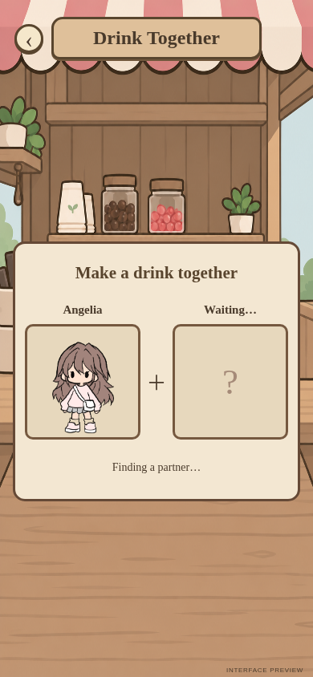
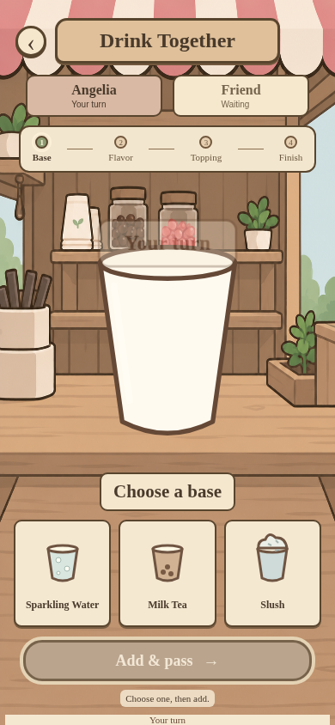

04 / LIVE DEMONSTRATION
Two people. Four choices. One shared drink.
LIVE DEMO
Room: showcase
Two phones, one display
Target: 55 seconds
Open public display ↗
Images: prototype assets / controlled browser screenshots, project repository (2026).
SHARED CAMPUS / GRDE2053 Social Interactive Experiences
08
Notes:
SLIDE 8 | 3:33–4:28
ENGLISH SCRIPT
For the live demonstration, we’ll make one drink together. Watch how control passes between the two players, and how both phones receive the same result.
中文理解版
现场演示中，我们一起制作一杯饮品。请注意操作权怎样在两位玩家之间交替，以及两台手机怎样收到同一个结果。
PRESENTER CUE
提前让两台手机加入 showcase 房间并到饮品店附近。进入匹配→A选基底→B选风味→A选配料→B选装饰→同时展示同一饮品结果→返回地图。控制在55秒内。

Slide 9
05 / SOCIAL UX REFLECTION
The six course principles, applied
A course framework connected to concrete design decisions.
01
02
03
Sensory Feedback
Embodied Interaction
Social Dynamics
Piano sound confirms actions.
Dragging maps to movement.
Co-presence and split roles.
04
05
06
Resilience & Motivation
Proactivity & Clarity
Ethics & Inclusion
Gentler fishing and retry.
Proximity glow and turn cues.
Temporary IDs, mute and exits.
Framework: Session 2, p. 6; Session 3, p. 8. Grounding: CSCW / affordances / signifiers (Sessions 2 & 5).
Images: prototype assets / controlled browser screenshots, project repository (2026).
SHARED CAMPUS / GRDE2053 Social Interactive Experiences
09
Notes:
SLIDE 9 | 4:28–5:21
ENGLISH SCRIPT
The six Social UX principles guided the design. Sensory Feedback uses sound and visible responses. Embodied Interaction maps touch movement to avatars and the float. Social Dynamics shaped turn-taking and split controls, giving both players influence. Resilience and Motivation led to gentler fishing and retry. Proactivity and Clarity shaped glowing entrances and turn prompts. Ethics and Inclusion informed nicknames, mute, exits and piano release. Phone access and public messages still raise inclusion and moderation questions. The course’s CSCW perspective explains cooperation; signifiers explain how available actions are communicated.
中文理解版
六项Social UX原则指导了设计。感官反馈采用声音和可见回应；具身互动把触控动作映射到角色与浮标；社会动态影响了轮流选择和分轴控制，让双方都能影响结果；韧性与动机促成更宽松的钓鱼和重试；主动引导与清晰性影响了发光入口及轮次提示；伦理与包容影响了昵称、静音、退出和钢琴让位。手机使用条件与公开留言仍有包容性及内容管理问题。课堂的CSCW视角解释合作，signifiers解释系统怎样传达可用操作。
PRESENTER CUE
六项名称已核实：Session 2 PDF第6页、Session 3 PDF第8页；Session 5第6–7页也列出同一框架。CSCW来自Session 2第8页；affordances/signifiers来自Session 5第10页。具身互动仅是手机触控与映射，不要夸大为全身沉浸；未实现触觉反馈。伦理设计不等于全面可访问，公共昵称与愿望仍需隐私、内容和可访问性反思。

Slide 10
06 / ATMOSPHERE + SENSORY EXPERIENCE
A familiar campus, with small invitations
A narrative setting
A shared campus rather than a linear quest.
Visual invitation
Consistent icons, soft colours and proximity glow.
Sensory reward
A shared result, a surprising fish, a live melody.
Images: prototype assets / controlled browser screenshots, project repository (2026).
SHARED CAMPUS / GRDE2053 Social Interactive Experiences
10
Notes:
SLIDE 10 | 5:21–5:39
ENGLISH SCRIPT
The campus is the narrative setting rather than a fixed storyline. Consistent illustrated icons and soft colours connect the activities visually. Proximity effects invite exploration, while unexpected fish and live music reward participation.
中文理解版
校园提供叙事场景，没有固定剧情。统一的插画图标与柔和配色在视觉上连接各活动。靠近效果邀请探索，意外的鱼和现场音乐则回应参与。
PRESENTER CUE
结合截图说明视觉和声音怎样服务体验，不只说“好看”。

Slide 11
07 / DEVELOPMENT + REFINEMENT
From initial concept to refined interactions
Concept shift
Cultural prompts / shared visuals
Free exploration + shared activities
Reliability
Missing players / messages
Refined presence + shared state
Mobile view
Small avatar / unused space
35% zoom + full viewport
Cooperation
Jerky / difficult fishing
Smoothing + gentler timing
Shared access
Separate piano page / idle use
Map controls + 8-second release
Initial concept: Social Interactive, slides 5, 7–8. Tokens not carried forward; unused streetlight placeholder removed.
Images: prototype assets / controlled browser screenshots, project repository (2026).
SHARED CAMPUS / GRDE2053 Social Interactive Experiences
11
Notes:
SLIDE 11 | 5:39–6:05
ENGLISH SCRIPT
The initial concept proposed cultural prompts, shared visuals and tokens. I kept the connection goal, developing freely chosen activities without tokens. Device testing revealed missing players, so shared visibility became a priority. I enlarged the phone view, smoothed fishing movement and adjusted difficulty in response to play feedback.
中文理解版
初始概念提出文化提示、共享视觉与代币。我保留连接目标，发展为自由选择的活动，没有加入代币。设备测试发现玩家不可见问题，所以共同可见性成为优先事项。我放大手机视角、平滑钓鱼移动，并根据游玩反馈调整难度。
PRESENTER CUE
初始概念依据Social Interactive.pptx第5、7、8页：日常生活/文化提示、共享地图、代币想法。若该文件不是正式A1提交版，展示前与提交版核对；不宣称这些是导师要求改动。技术迭代依据开发记录和设备反馈，不虚构正式访谈或观众人数。

Slide 12
08 / TECHNICAL IMPLEMENTATION
A small architecture for shared participation
PERSONAL INPUT
SHARED STATE
COMMON VIEW
Phones
Firebase
Public display
Choose, move and interact.
↔
Positions, turns, notes and
wishes.
↔
See co-presence and shared
outcomes.
p5.js renders the world. GitHub Pages hosts the site.
Checks: shared player visibility, messages, activity state and iPhone sound.
Exhibition needs: stable internet, charged phones and a recorded fallback.
Automated checks are not a substitute for audience evaluation.
Images: prototype assets / controlled browser screenshots, project repository (2026).
SHARED CAMPUS / GRDE2053 Social Interactive Experiences
12
Notes:
SLIDE 12 | 6:05–6:17
ENGLISH SCRIPT
p5.js renders the map, Firebase synchronises shared data, and GitHub Pages hosts the experience. This setup supports personal control on phones and shared visibility on the display.
中文理解版
p5.js绘制地图，Firebase同步共享数据，GitHub Pages托管体验。这种结构支持手机上的个人操作和大屏上的共同可见性。
PRESENTER CUE
不要把26项自动测试说成26位用户；不要声称在所有设备、所有网络环境下都稳定。

Slide 13
09 / REFLECTION + AUTHORSHIP
Small invitations. Shared experiences.
Watch. Listen. Leave a wish.
Or do something together.
AI USE
Code + debugging
Some activity artwork
Presentation drafting
Next evaluation:
Can unfamiliar participants begin independently?
Confirm tutor approval,
permitted use and the required
declaration before submission.
AI-assisted development was selected, tested and
refined — not treated as finished output.
Impact on belonging has not yet been established through an independent participant study.
Images: prototype assets / controlled browser screenshots, project repository (2026).
SHARED CAMPUS / GRDE2053 Social Interactive Experiences
13
Notes:
SLIDE 13 | 6:17–6:37
ENGLISH SCRIPT
People can talk, wish, cooperate or listen. Device checks helped refine the prototype; its effect on belonging still needs participant evaluation. AI assisted code, selected artwork and this presentation. My role included selecting, testing and refining those outputs.
中文理解版
大家可以交流、许愿、合作或聆听。设备检查帮助完善原型；它对归属感的影响仍需参与者评估。AI辅助了代码、部分素材及本次演示。我进行了输出的选择、测试和修改。
PRESENTER CUE
务必核实并补齐AI来源、导师批准和单元允许范围。不要把AI辅助内容宣称为完全独立编写或手绘。

Slide 14
REFERENCES + CREDITS
Thank you. Try it together.
Course sources
GRDE2053. A2 assignment brief, pp. 1–5. Supplied course document, n.d.
GRDE2053. SIE–DCI A2 Exhibition Showcase marking rubric. Supplied course document, n.d.
GRDE2053. Sessions 2 (p. 6), 3 (p. 8) and 5 (slides 6–10). Course slides, n.d.
Initial concept: Social Interactive.pptx, slides 5, 7–8. User-supplied concept deck, n.d.
Project media + implementation
Prototype screens: public-map-project repository, 2026; controlled browser captures.
Map / avatars: user-supplied assets; confirm original creators and licences.
Some activity icons / fish cut-outs: AI-generated or AI-refined; list individual assets.
p5.js • Firebase Realtime Database • GitHub Pages • Web Audio API.
References here use a provisional author–date format. Match the referencing style in your unit outline.
SHARED CAMPUS / GRDE2053 Social Interactive Experiences
14
Notes:
SLIDE 14 | 6:37–6:40
ENGLISH SCRIPT
Thank you. Please try Shared Campus together.
中文理解版
谢谢，欢迎一起体验Shared Campus。
PRESENTER CUE
参考资料页保留在屏幕上；不逐条朗读参考文献。

Slide 15
APPENDIX / NOT PART OF THE TIMED TALK
Before you submit
01 Fill in your name; check the verified theory mapping and initial-concept comparison.
02 Record and insert a real 1–2 minute showcase film.
03 Rehearse a 5–7 minute presentation including video and live demo.
04 Prepare the separate development PDF: maximum 15 pages, excluding title / references.
05 Include coversheet, requested MP4 / SharePoint link and tutor access.
06 Confirm AI approval, declaration and media attribution; check milestone completion.
SHARED CAMPUS / GRDE2053 Social Interactive Experiences
15
Notes:
SLIDE 15 | APPENDIX — do not present
ENGLISH SCRIPT
中文理解版
PRESENTER CUE
备查页，不计入课堂展示。按brief还需封面、独立development documentation PDF、MP4及SharePoint可访问链接；这套PPT不替代过程文档。

