Slide 1

  Semester Project - I “Krishisetu”
By
1. Rohit Borse (251106003 & 03)
2. Tanmay Mahajan (251106005 & 05)
3. Anupkumar Patil(251106006 & 06)
4. Yashodeep Ahire (251106061 & 55)
Under the Guidance of
Prof. Dr. U. M. Patil Mam
Department of Computer Science & Engineering (Data Science)
The Shirpur Education Society’s
R. C. Patel Institute of Technology, Shirpur - 425405.
[2026-27]

Slide 2
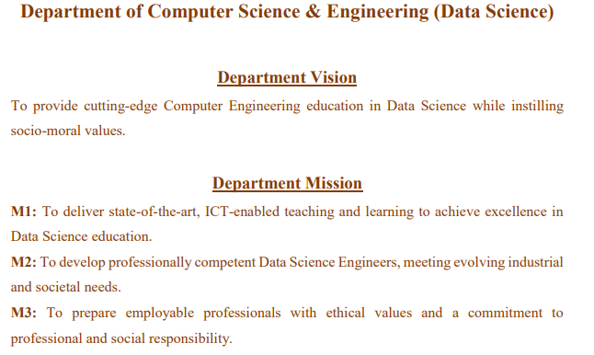

Slide 3
Department of Computer Science & Engineering (Data Science) Department Vision
To provide cutting-edge Computer Engineering education in Data Science while instilling socio-moral values.
Department Mission
M1: To deliver state-of-the-art, ICT-enabled teaching and learning to achieve excellence in Data Science education.
M2: To develop professionally competent Data Science Engineers, meeting evolving industrial and societal needs.
M3: To prepare employable professionals with ethical values and a commitment to professional and social responsibility.

Slide 4
Semester Project-I (RCP23XSC201P)
Course Objective(s): Students are expected to design, simulate/implement a project based on the knowledge acquired from current semester subjects
Course Outcomes
CO1 Analyze a survey of several available literatures in the preferred field of study.
CO2 Describe various/alternate approaches to complete a project.
CO3 Apply a collaborative project environment by interacting and dividing project work among team members.
CO4 Use technical communication skills to present project work in the form of a technical report/paper.
CO5 Apply teamwork and project management skills to plan, execute, and manage the research study.

Slide 5

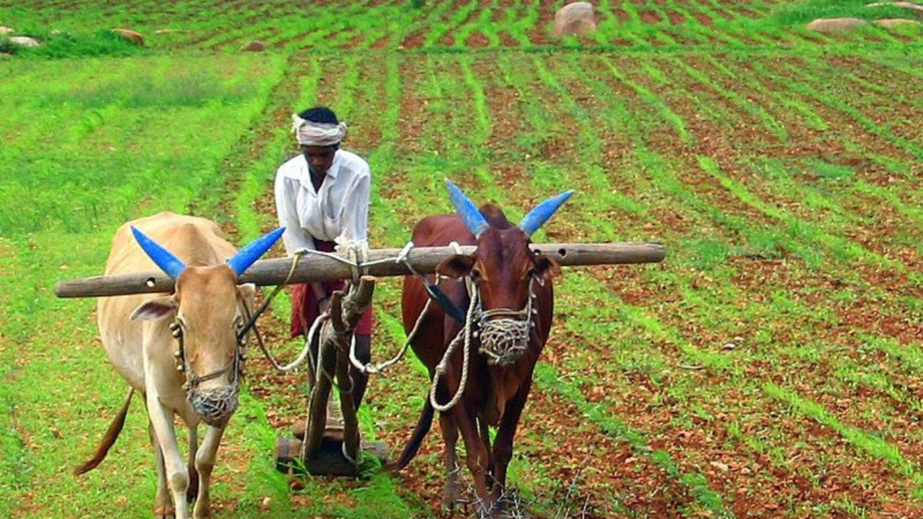
Introduction
Krishisetu – Smart Agricultural Marketplace & Equipment Rental Platform
A digital platform designed to help Indian farmers access agricultural e-commerce and equipment rental.
Provides two main modules:
  🛒 Agricultural Marketplace
  🚜 Equipment Rental System
Farmers can purchase seeds, fertilisers, and pesticides from vendors.
Farmers can also search and book agricultural equipment.
Equipment rental uses an FCFS queue with automatic 24-hour confirmation for fair booking.

Slide 6
Project Objectives
To provide farmers with easy access to agricultural marketplace.
To allow farmers to compare products, prices and availability.
To provide an organized platform for renting agricultural equipment.
To make equipment booking fair and systematic using FCFS.
To reduce dependency on informal phone-based rental arrangements.
To provide a simple, mobile-friendly platform suitable for rural users

Slide 7
Existing System survey
Farmers mainly purchase inputs through local dealers/wholesalers.
Limited ability to compare prices and products from different sellers.
Equipment rental is often handled through phone calls or informal contacts.
No standardized booking or queue system.
Multiple farmers may request the same equipment without a clear fairness mechanism.

Slide 8
Problems Identified
Limited price/availability comparison
Informal equipment booking
Difficulty managing multiple booking requests
Lack of transparent queue management

Slide 9
Module Design
Module 1 – Input Marketplace 🛒
Farmer registration/login
Vendor registration
Product listing
Product search & filtering
Cart and checkout
Order tracking/history

Slide 10
Module 2 – Equipment Rental 🚜
Equipment listing
Equipment search/filter
Availability checking
Booking request
FCFS queue management
24-hour confirmation window
Booking status tracking

Slide 11
Module 3 – Admin
Manage users
Approve listings
Monitor orders and bookings
Handle disputes/suspensions

Slide 12
Software Requirements
Frontend
React
Tailwind (CSS)
Backend
FastAPI (Python)
Database
PostgreSQL
Authentication
FastAPI Security Tools
JSON Web Token [JWT]

Slide 13
Software Requirements
Payment:
Razorpay – Test Mode
Automation:
Spring @Scheduled
Deployment:
Frontend → Vercel / Netlify
Backend → Supabase
Database → Managed PostgreSQL

Slide 14
Implementation Phase - I
Project requirements and problem definition finalised.
System workflow and modules identified.
Basic system architecture designed.
Database entities and relationships planned.
Technology stack selected.
Initial project structure/setup completed.
Development of authentication and core marketplace/rental modules initiated.

Slide 15
Details of Remaining Workplan
Phase I | Research about problem statement
Phase II | User authentication & role management
Phase III | Product listing, search & marketplace
Phase IV | Equipment listing & booking
Phase V | FCFS queue + 24-hour expiry automation
Phase VI | Cart & Razorpay integration
Phase VII | Admin panel & order/booking history
Phase VIII | Testing & bug fixing
Phase IX | Deployment & final demonstration

Slide 16
Conclusion
Krishisetu aims to provide a unified digital platform for agricultural purchasing and equipment rental.
It addresses problems of input accessibility and informal equipment booking.
The system combines marketplace functionality with a fair FCFS rental mechanism.
The project is being developed using React, Spring Boot and PostgreSQL.
Future scope includes multi-language support, notifications, logistics tracking and other enhancements.

Slide 17
Thank You

