Slide 1

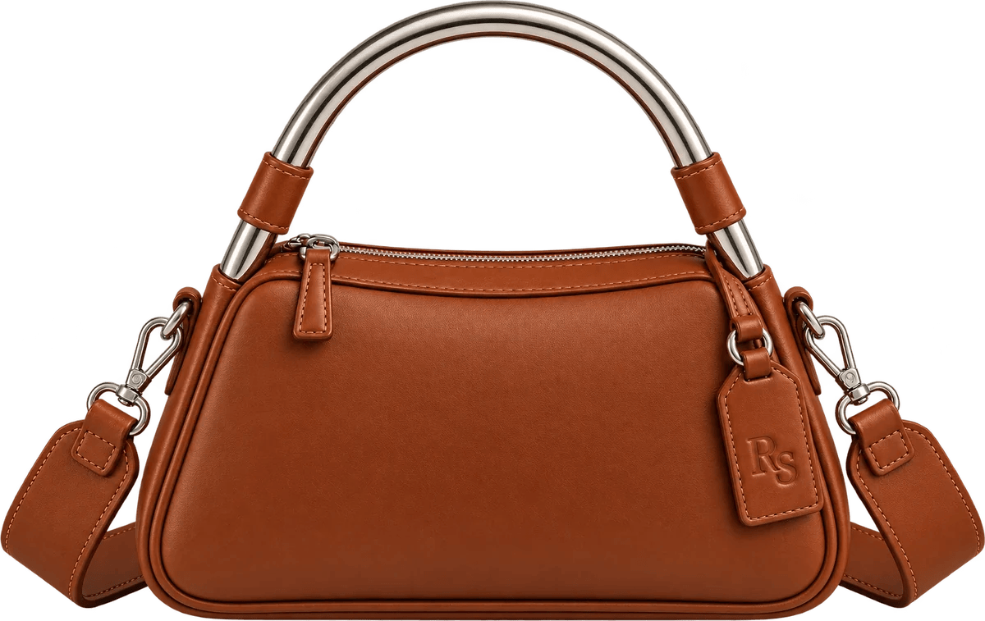
CREATIVE SYSTEM / ISSUE 01
DECK 02 / IDENTITY & GUIDELINES
The art of being off duty.
HYPOTHETICAL CASE STUDY · OCTOBER 2026

Slide 2
One brand. Many expressions.
THE FOUNDATION
Resort Sport Ltd. brings the design discipline of luxury leather goods to the optimism of leisure.
Considered
Expressive
Off duty
Precision in product, material, and visual execution.
Confident character without novelty or costume.
Ease, movement, and pleasure without pretension.
PILLAR 02 · CONSIDERED FOR REAL LIFE
PILLAR 01 · DESIGN WORTH RECOGNIZING
PILLAR 03 · A LIFE OFF THE CLOCK

Slide 3


The identity architecture
BRAND ARCHITECTURE
MASTER BRAND
PRODUCT SIGNATURE
Resort Sport Ltd. Customer-facing wordmarks and corporate identity.
RS only: embossing, leather tags, zipper hardware, product marks.
SECONDARY SHORTHAND
The Time Off Club
CULTURAL PROPERTIES
RSL
RSL: approved editorial, stationery and packaging contexts only.
The Time Off Club; The Journal editorial; Limited Issues seasonal products.
The Journal
Limited Issues
RULE
Never use RSL, the full wordmark or the Time Off Club on physical bags.

Slide 4

Primary wordmark
LOGO SYSTEM
APPROVED MASTER ARTWORK
Notes:
The stacked italic serif wordmark is the leading brand signature. Preserve the approved drawing, baseline, proportions and underline. Use original artwork; never recreate by typing the name.

Slide 5
Compact wordmark and monogram
LOGO SYSTEM
COMPACT WORDMARK
RS MONOGRAM
Editorial, navigation and narrow formats: the site header, email headers and sign-offs.
The only mark permitted on physical products. May also appear in editorial and packaging.

Slide 6
Clear space and scale
LOGO SYSTEM
SAFE AREA
Keep a clear margin at least the height of the capital R stem on every side of the wordmark. Treat this as a working rule until the vector masters are approved.
R
MINIMUM SIZES
No hard minimums until vector masters exist. Test small-format legibility before production.

Slide 7





Correct uses. Incorrect uses.
LOGO SYSTEM
DO: APPROVED COLOR COMBINATIONS
CABANA RED ON IVORY
IVORY ON DEEP NAVY
IVORY ON CABANA RED
DON'T
×
×
×
×
×
Resort Sport Ltd.
RETYPE THE NAME
STRETCH
ROTATE
RECOLOR
ADD EFFECTS

Slide 8
A palette made for escape
COLOR SYSTEM
Cabana Red
Deep Navy
Pool Aqua
Ivory
Sand
Palm Green
#811E23
#11293A
#98C6C5
#F1E9DD
#CFB9A2
#123F34

Slide 9
Color roles, not just colors
COLOR SYSTEM
Cabana Red
Deep Navy
Brand authority, signature headlines, logo, primary buttons.
Text, navigation, editorial structure and quiet contrast.
Ivory
Pool Aqua
The primary canvas for presentation and commerce.
Resort accent and campaign cover; inspiration for the Curaçao Limited Issue.
Palm Green
Sand
Supporting accent; Bijou is its racing-green Limited Issue expression.
The lining of every bag; the packaging neutral.
PRODUCT COLORS (COGNAC, AVORIO, NERO) APPEAR ONLY AS COLORWAY SWATCHES, NEVER AS DECORATION.

Slide 10
Typography is a system
TYPOGRAPHY
The art of being off duty.
INSTRUMENT SERIF · DISPLAY AND BODY TEXT, REGULAR AND SELECTIVE ITALIC
OFFICIAL EQUIPMENT FOR TIME OFF.
SPACE GROTESK · LABELS, NAVIGATION, BUTTONS, PRICES AND SPECS
Body text stays direct and readable. Product specifications are never sacrificed for tone. The wordmark is logo artwork, not type.

Slide 11
Type hierarchy and usage
TYPOGRAPHY
DISPLAY
A very good entrance.
Instrument Serif Regular and Italic. Editorial statements in sentence case; italic emphasis sparingly.
40–54 PT
SECTION
The Details
Instrument Serif, or Space Grotesk in functional contexts.
26–34 PT
BODY
Supple leather. A polished aluminum arch.
Instrument Serif Regular. Practical language, comfortable leading.
14–18 PT
UTILITY
RS-04 · $695 · 30-DAY RETURNS
Space Grotesk Medium. Navigation, captions, SKUs and UI labels.
9–12 PT

Slide 12
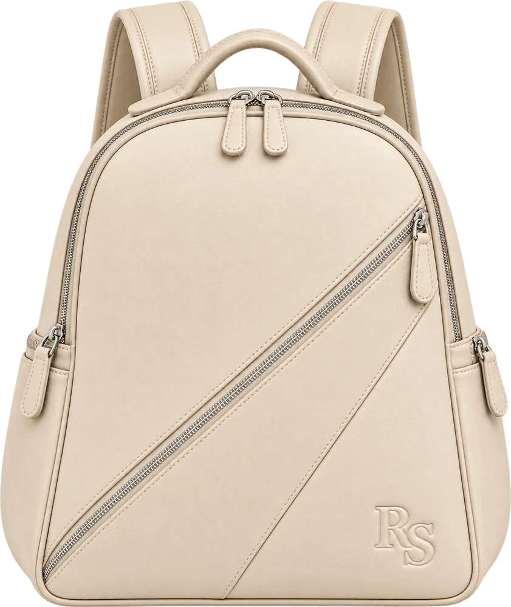
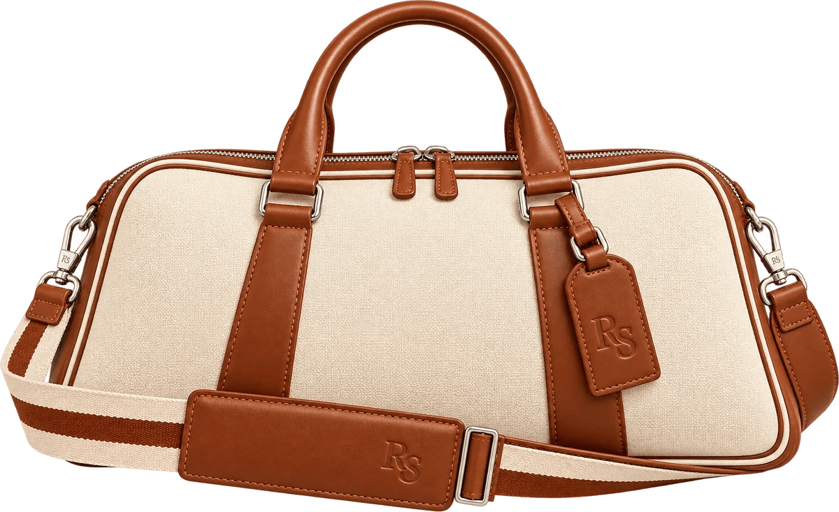
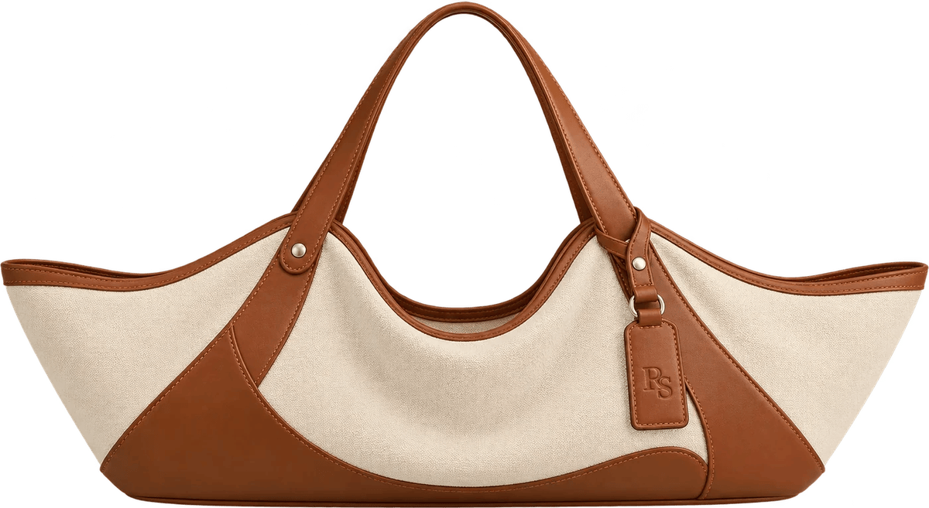
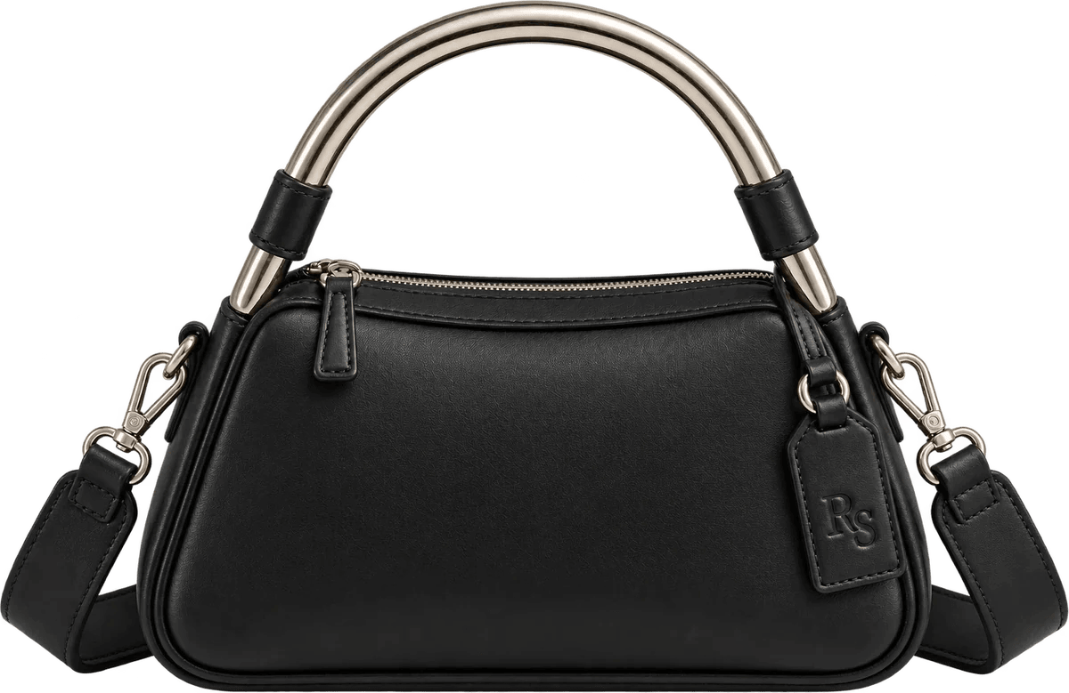
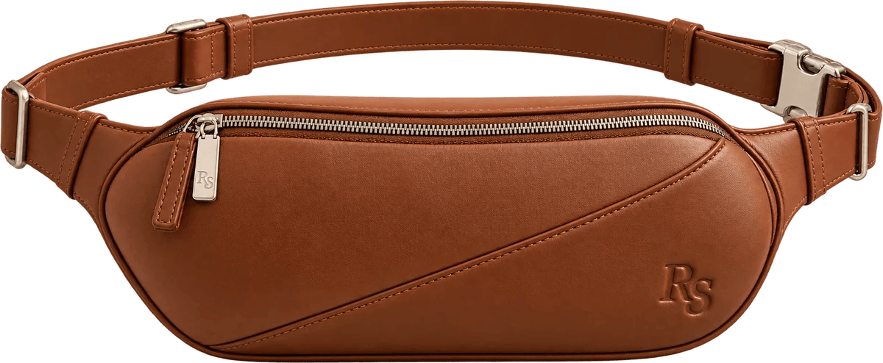
One family. Five signatures.
PRODUCT DESIGN
Monaco
Rally
Riviera
Portofino
Regatta
HERITAGE
COGNAC
HERITAGE
NERO
AVORIO

Slide 13
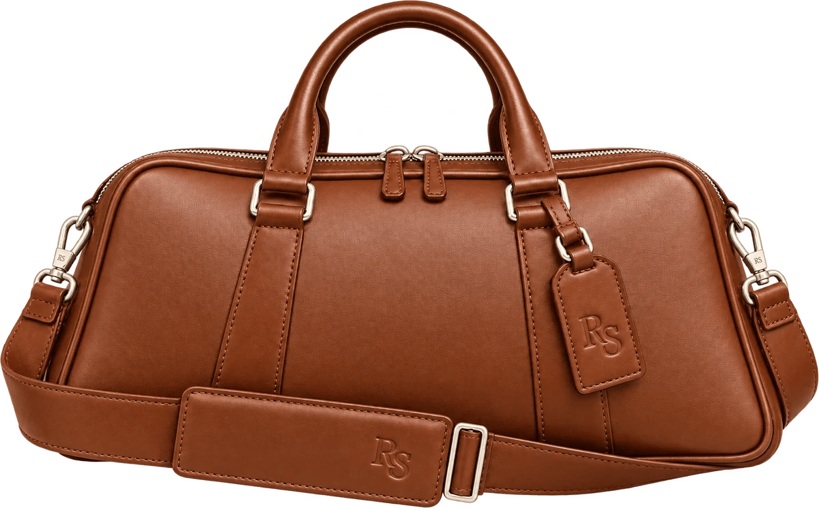
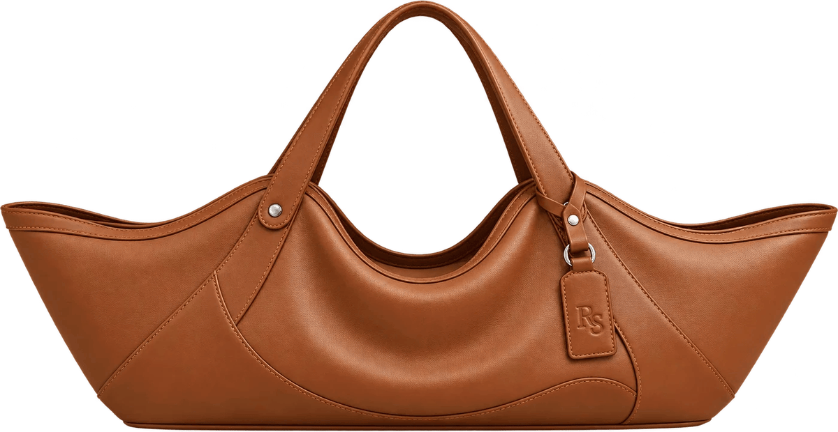
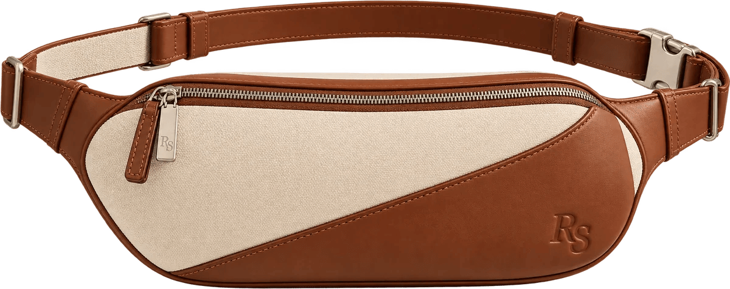
Product signatures: 01–03
PRODUCT DESIGN
RS-01 · TRAVEL DUFFEL
RS-02 · BELT BAG
RS-03 · OVERSIZED CARRYALL
Monaco
Rally
Riviera
Aerodynamic east–west duffel; vertical leather panels; two handles; removable strap.
Low curved belt bag; diagonal panel; single-zip access; adjustable waist or shoulder strap.
Extra-wide winged carryall; dipped center; flowing leather corner panels and handles.

Slide 14
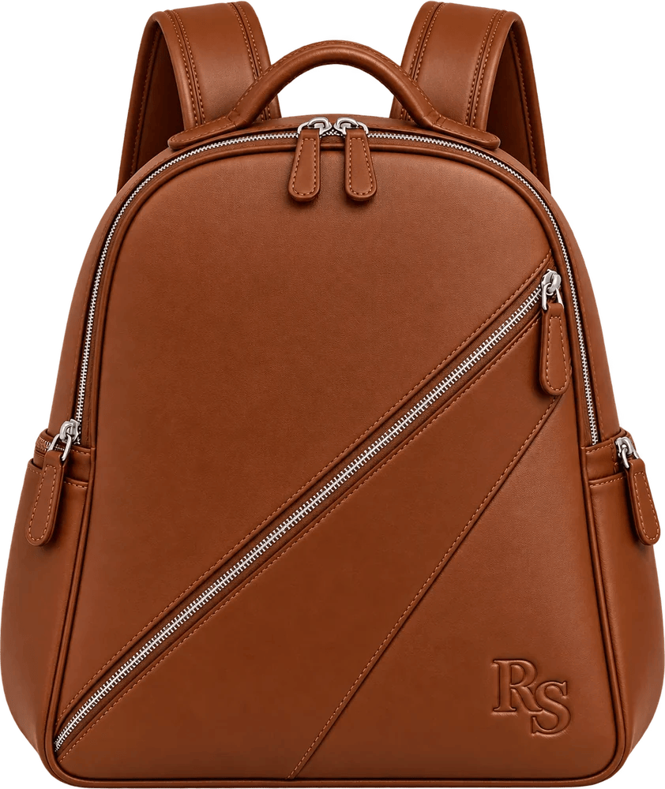
Product signatures: 04–05
PRODUCT DESIGN
RS-04 · HANDBAG
RS-05 · BACKPACK
Portofino
Regatta
Compact trapezoid; polished aluminum tubular arch handle (prototype direction); leather collar mounts; removable strap.
Sculptural zip-top daypack; asymmetric front panel; diagonal zip front pocket; separate 16-inch laptop access.

Slide 15
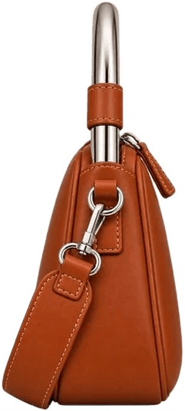
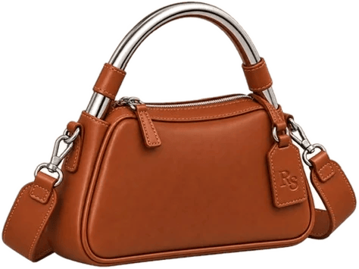
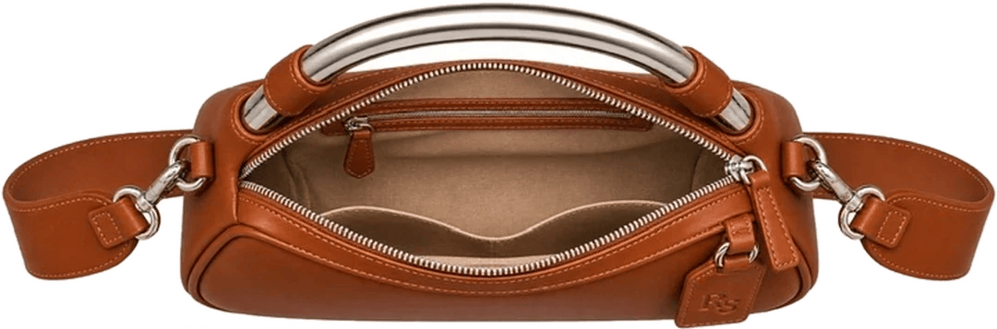
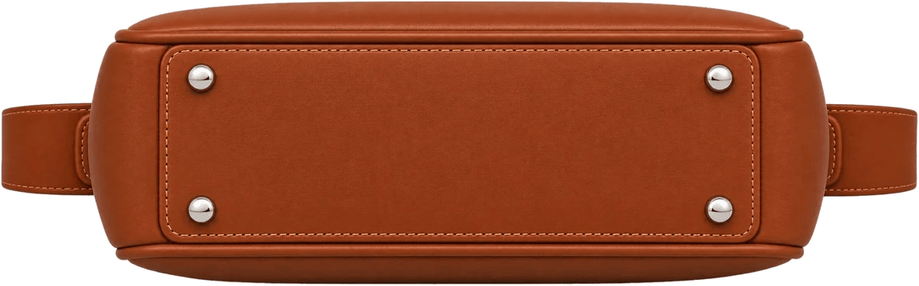
The Portofino, from every side
PRODUCT DESIGN / RS-04
45°
SIDE
INTERIOR
BASE
The arch handle, leather collars and RS hang tag.
A tapered profile; the strap clips to the side rings.
Sand lining, a zip pocket and a slip pocket.
A stitched base panel on four silver-tone feet.
SHOWN IN COGNAC · PRODUCT PHOTOGRAPHY STANDARD: CENTERED, FAITHFUL MATERIALS, FRONT, 45°, SIDE, INTERIOR

Slide 16
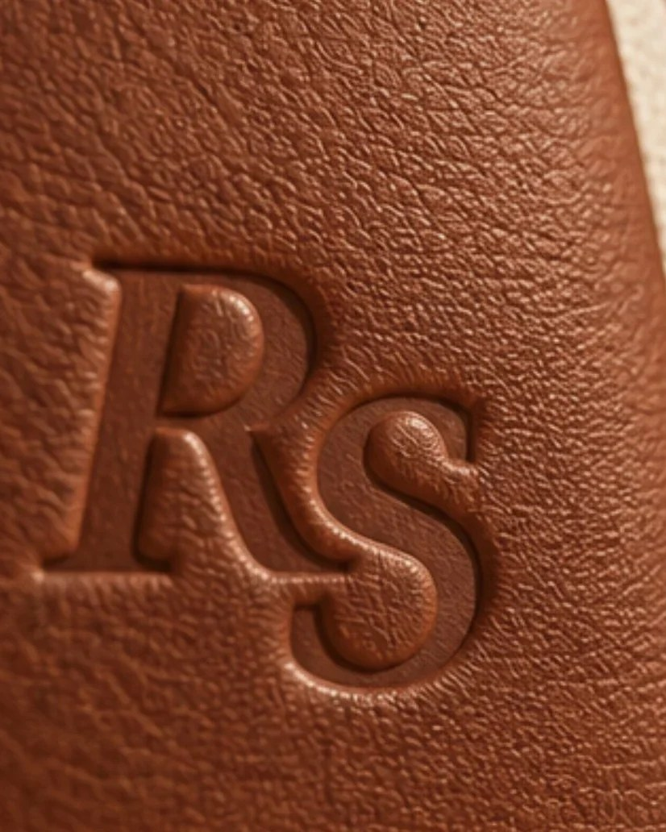
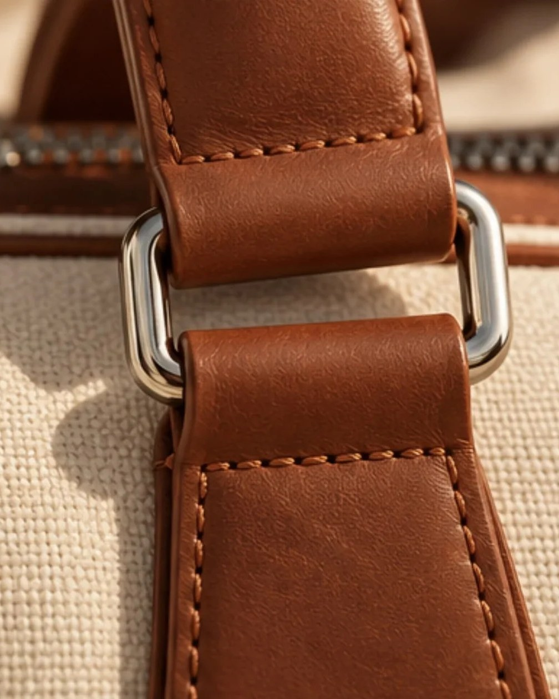
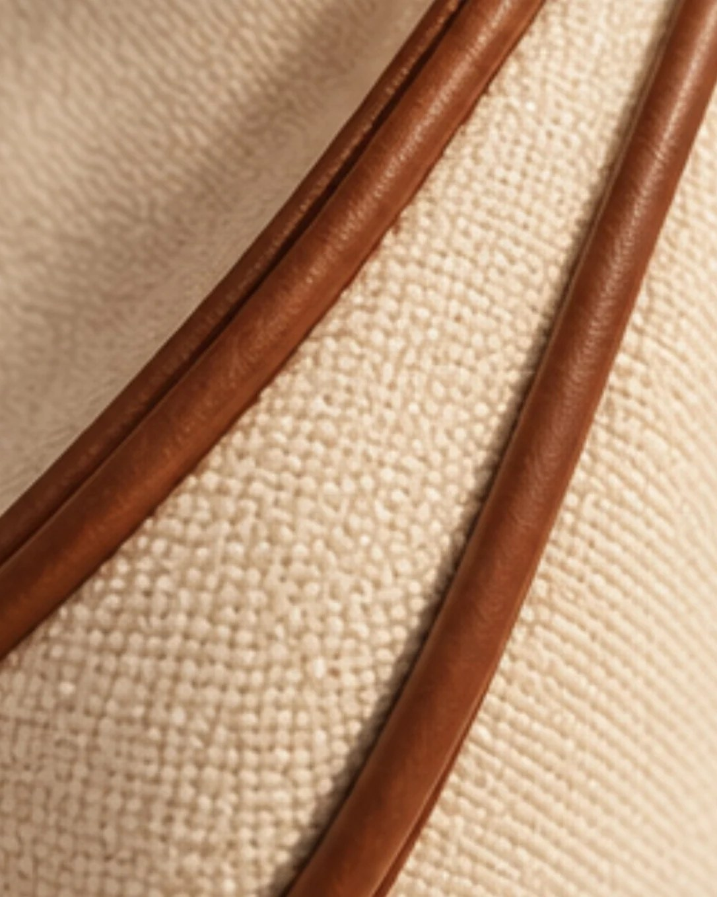
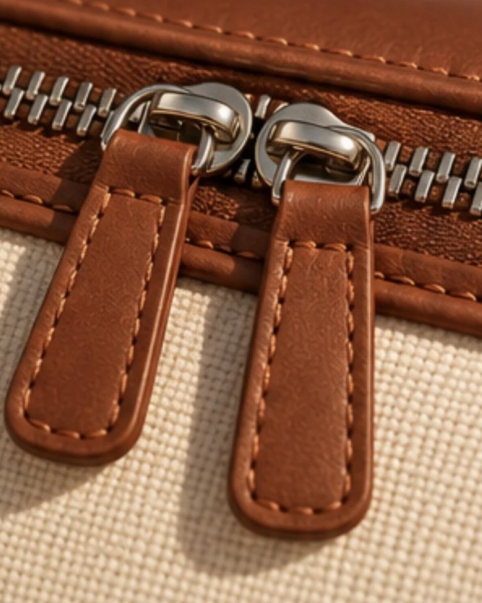
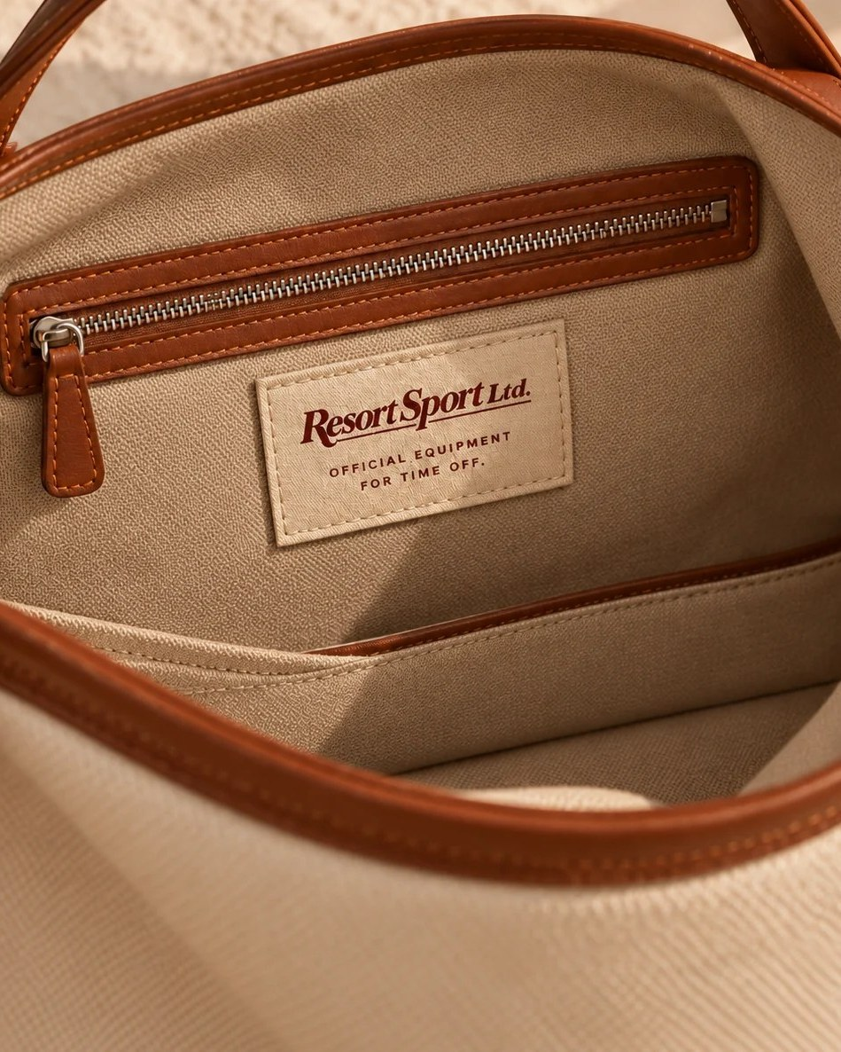
Non-negotiable construction rules
PRODUCT STANDARDS
PRODUCT MARK
METAL
SURFACES
RS only. Tonal blind debossing or discreet RS metal engraving.
Brushed silver-tone hardware. Portofino: polished 6061-T6 aluminum arch, under prototype testing.
Supple, protected fine-grain leather. Heritage: natural canvas and cognac leather.
SEAMS
INTERIOR
×
NO EXCEPTIONS
Tonal stitching that preserves each model's geometry and curvature.
Sand lining on every silhouette and every exterior colorway.
No gold metal, prominent exterior wordmark, alternate linings or material substitutions.

Slide 17
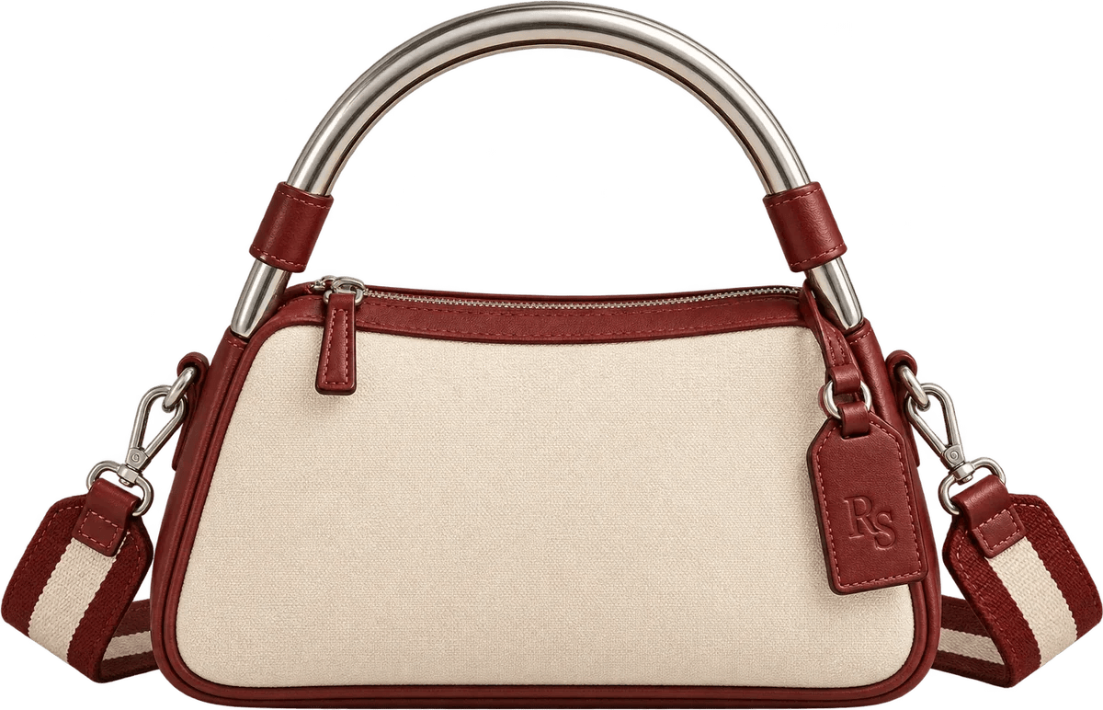
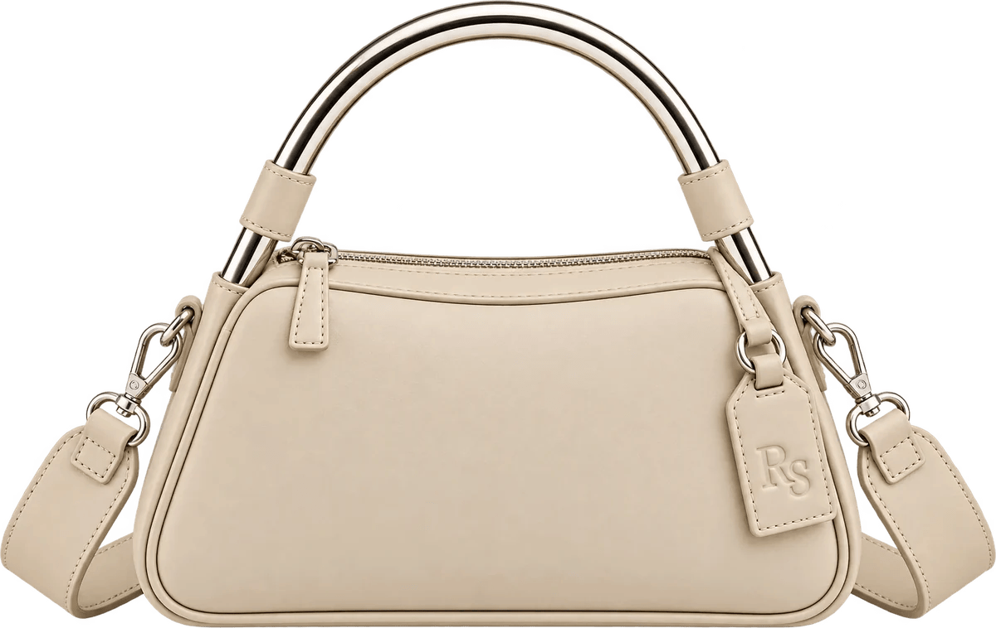
Four permanent expressions
COLORWAYS
Heritage
Cognac
Avorio
Nero
NATURAL CANVAS & COGNAC LEATHER
COGNAC LEATHER
IVORY LEATHER
BLACK LEATHER
EVERY COLORWAY USES A SAND LINING · SHOWN ON THE PORTOFINO

Slide 18
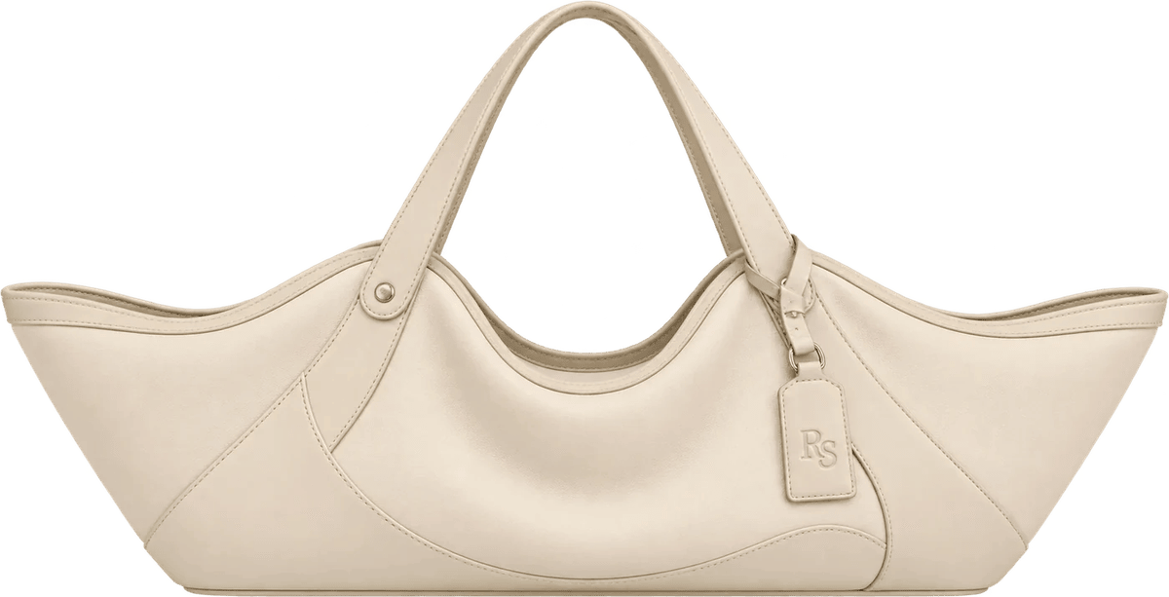
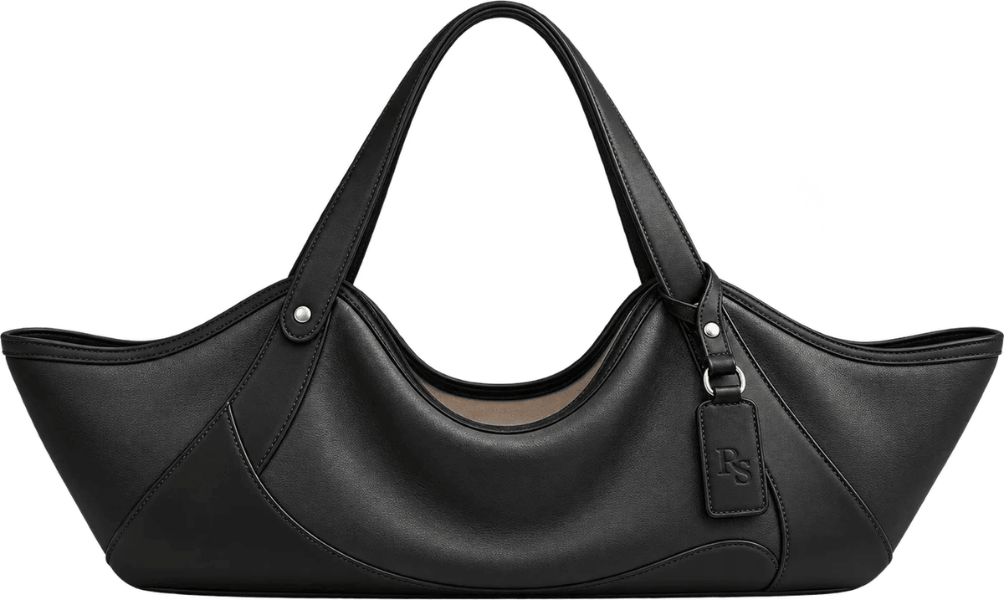
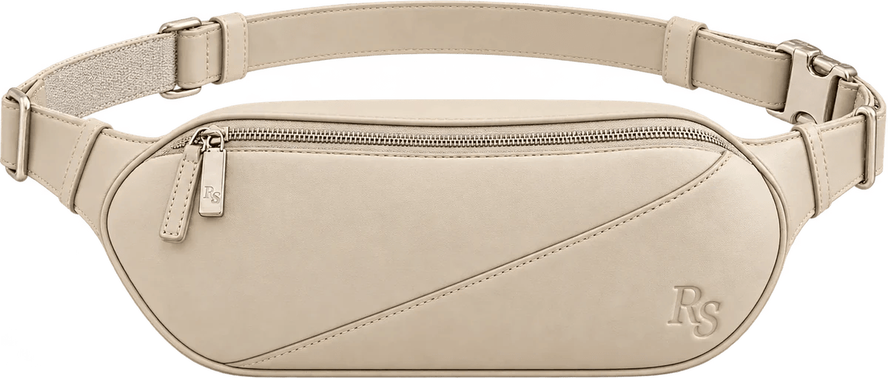
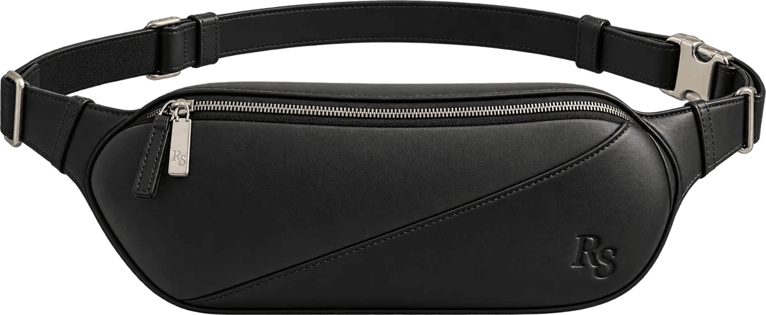
The colorway system at scale
COLORWAYS
RIVIERA / HERITAGE
RIVIERA / COGNAC
RIVIERA / AVORIO
RIVIERA / NERO
RALLY / HERITAGE
RALLY / COGNAC
RALLY / AVORIO
RALLY / NERO

Slide 19
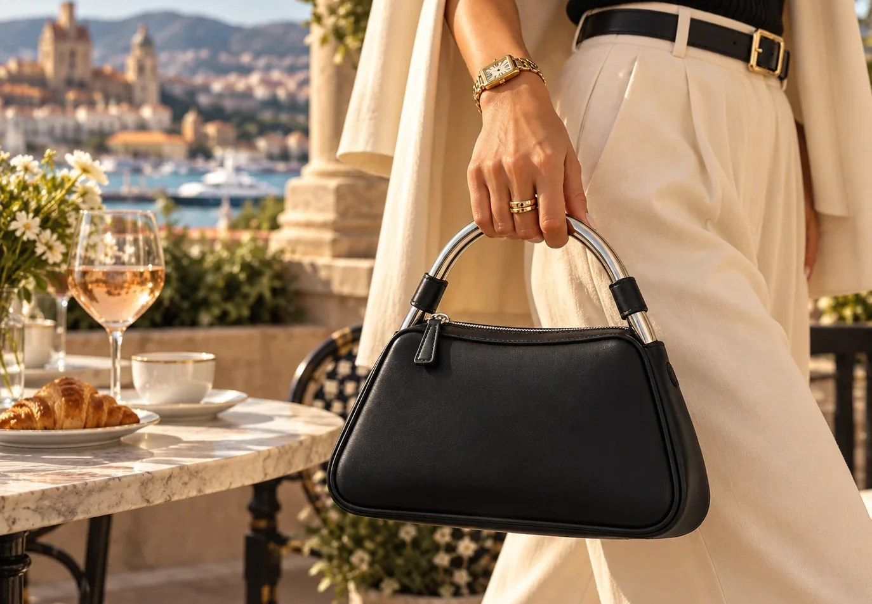
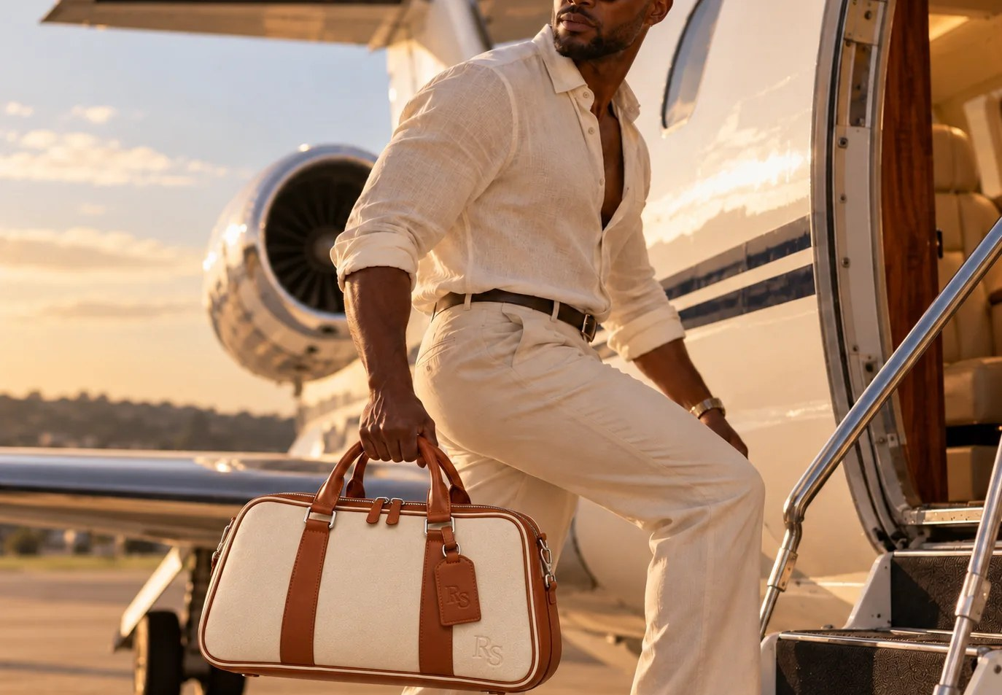
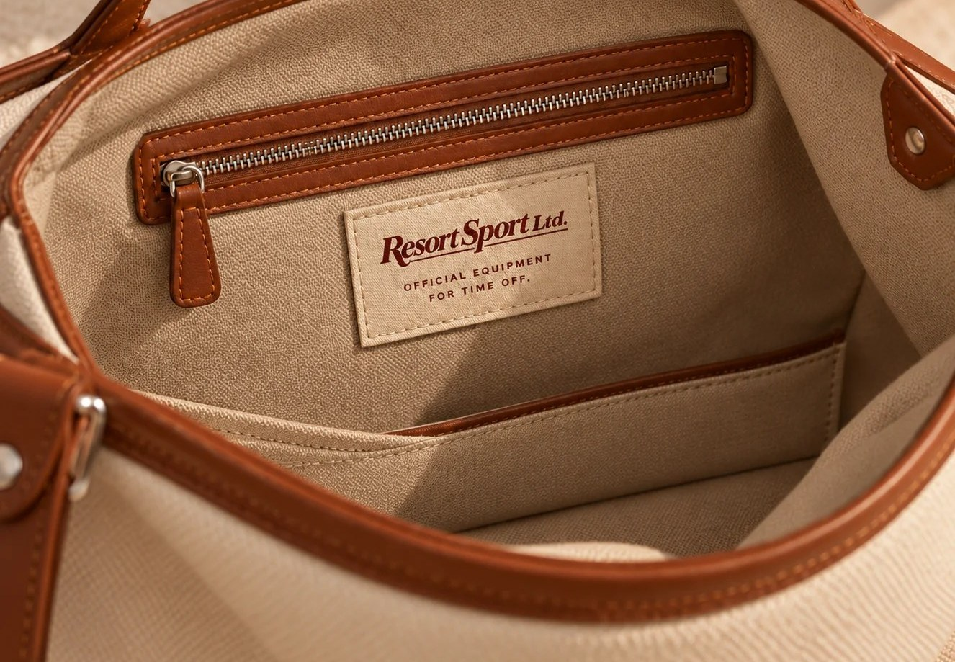
Material logic by use
CRAFT AND FINISH
CITY / FASHION
TRAVEL / DAILY
RESORT / CARRYALL
Portofino and Rally: soft hand, refined drape, tactile appeal, protected leather finishes.
Monaco and Regatta: supple but abrasion-resilient leather, functional hardware, reinforced stress points.
Riviera: soft sculptural body, durable anchoring, practical interior organization.
MATERIAL PERFORMANCE SPECIFICATIONS ARE INTENDED DESIGN STANDARDS, NOT CERTIFIED MANUFACTURING CLAIMS.

Slide 20
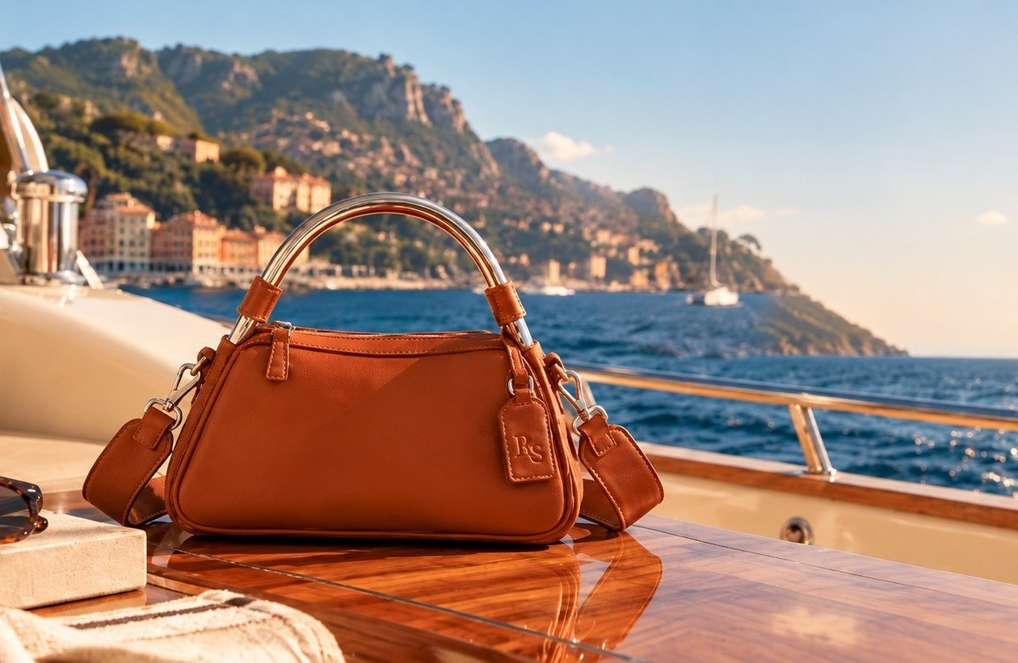
Two visual worlds. One identity.
PHOTOGRAPHY
PRODUCT / PRECISE
EDITORIAL / CINEMATIC
Centered, true transparent PNG, front and 45° angles, faithful materials.
Mediterranean light, real leisure, the bag clearly visible in the scene.

Slide 21
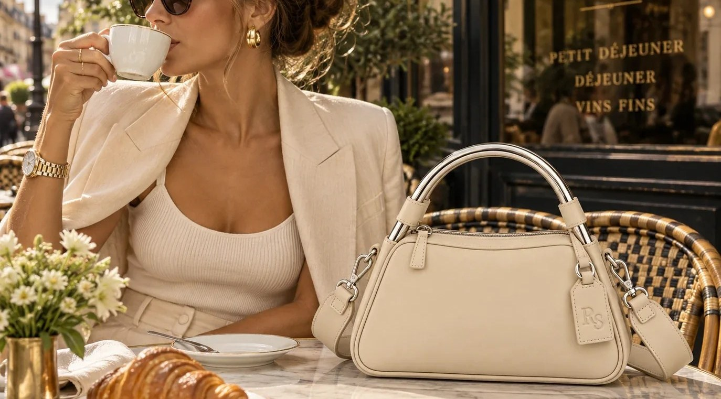
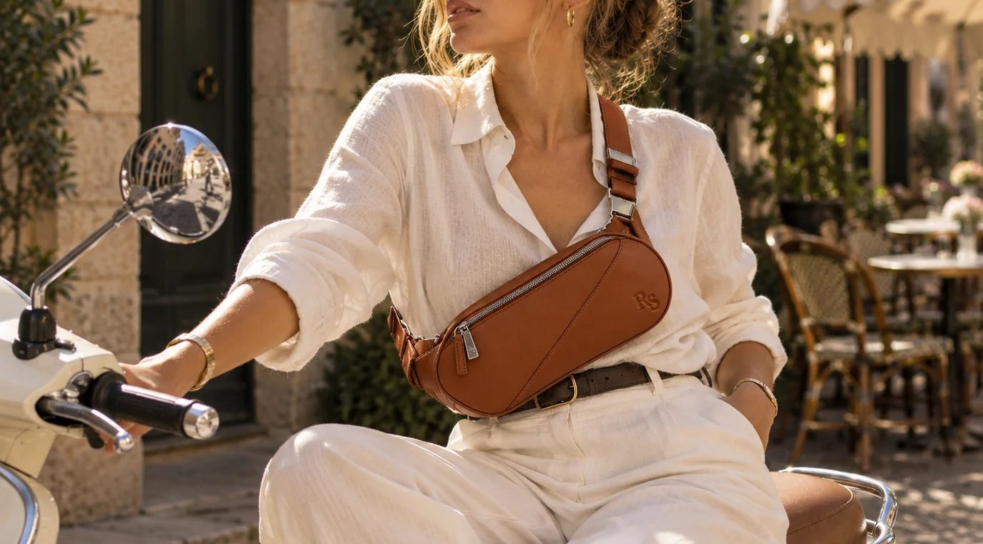
Editorial art direction
PHOTOGRAPHY
LIGHT
FRAMING
STYLING
Mediterranean daytime clarity; late-afternoon warmth; considered nocturnal scenes.
Architectural lines, directional movement, negative space for copy.
Lived-in luxury; effortless clothes; no costume nostalgia or artificial excess.
HUMANITY
RETOUCHING
EXCLUSIONS
Natural gesture, real leisure, people living in the scene, not posing for wealth.
Keep leather grain and true color. No harsh halos, inconsistent shadows or reshaped products.
No stock wealth clichés, cartoon retro filters, neon overload or irrelevant props.

Slide 22
VERBAL IDENTITY
Clever, never cute.
CONFIDENT
OBSERVANT
DRYLY WITTY
CLEAR WHEN IT COUNTS
Assertive. Understated. Never boastful.
Culturally fluent, attentive to the details of leisure.
A subtle wink. No puns, exclamation points or manufactured urgency.
Dimensions, materials, warranty, delivery and care are plain and exact.

Slide 23
One voice, different jobs
VERBAL IDENTITY
CAMPAIGN
Out of office. In our element.
PRODUCT
A very good entrance.
SPECIFICATION
Supple leather. Detachable shoulder strap. Sand lining.
SERVICE
We're happy to help you choose the right bag.
EDITORIAL
A strong case for the long weekend.
MICROCOPY
A fine choice. · Until next time. · Plans optional.

Slide 24
Writing guidelines in practice
VERBAL IDENTITY
WRITE THIS
NOT THIS
“The Portofino. Sculptural metal handle. Soft leather body. Made for a very good entrance.”
“Introducing the ultimate must-have iconic luxury handbag! Elevate your lifestyle with unmatched quality!”
PRINCIPLE
Personality creates interest; details earn trust. Never substitute wit for useful information.

Slide 25
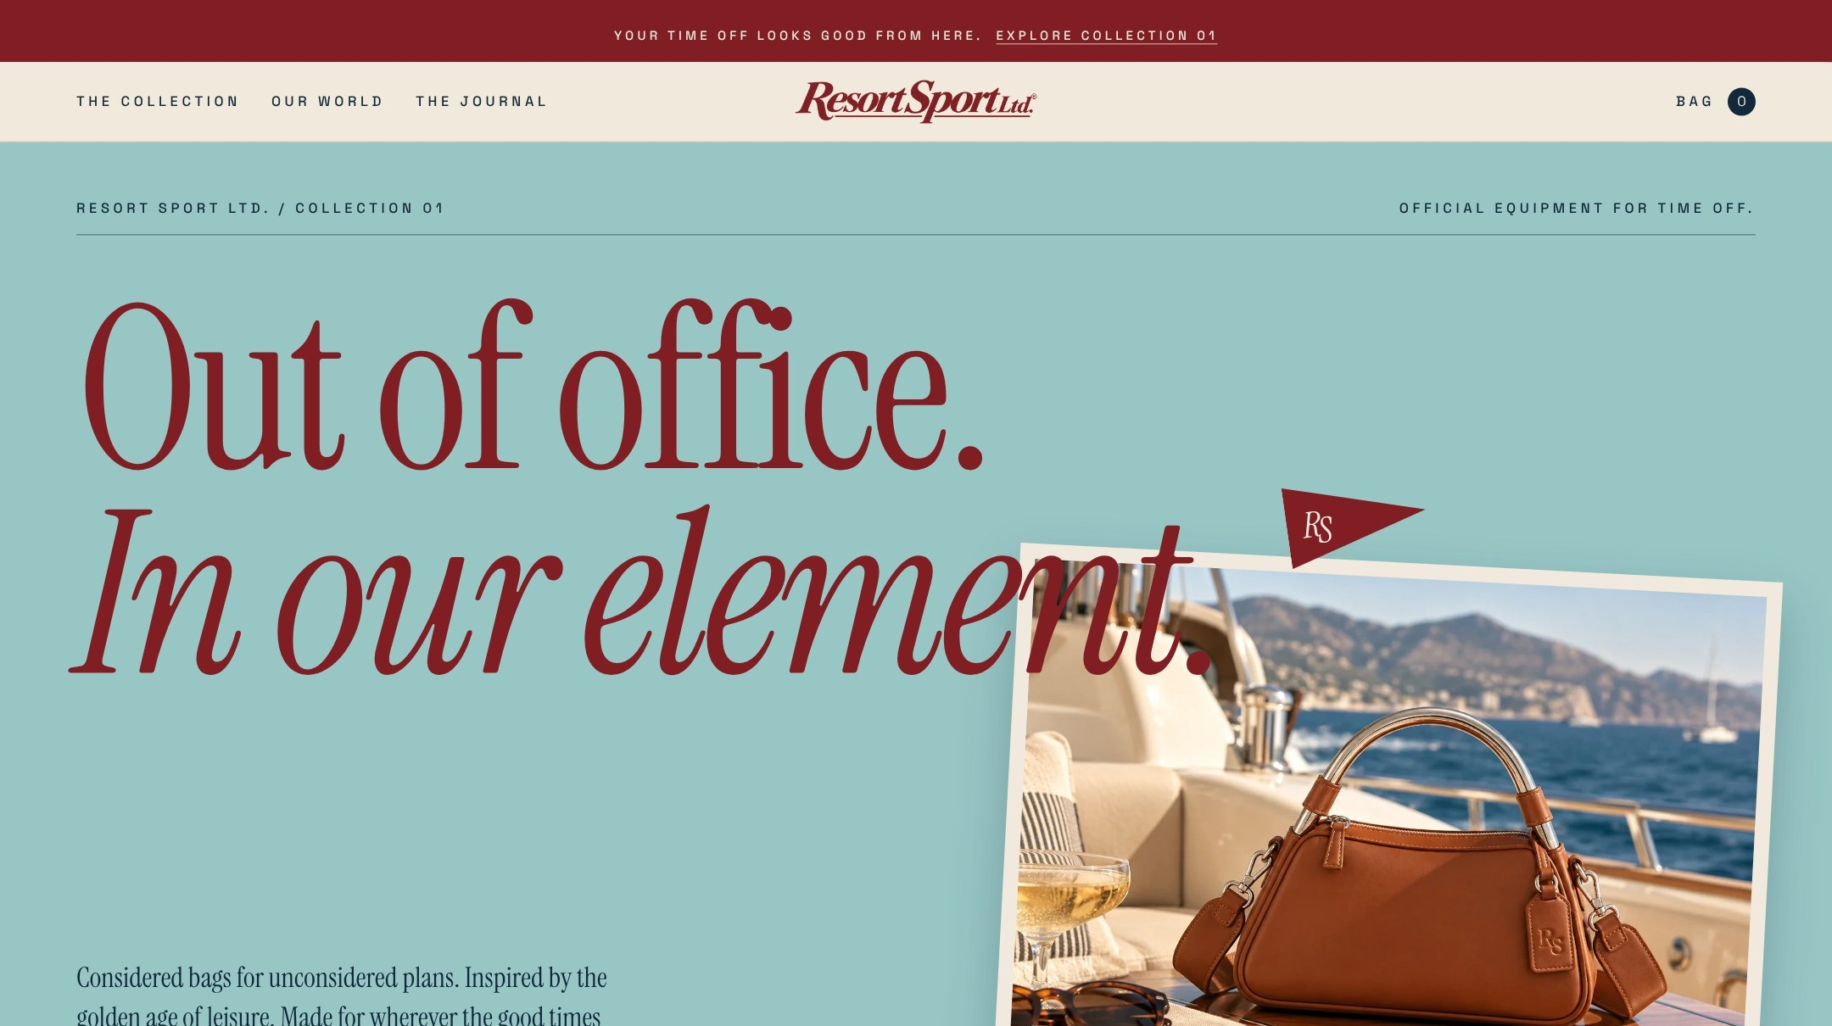
Identity in commerce
APPLICATIONS / HOMEPAGE
The homepage opens on the campaign line, the Pool Aqua cover and the Portofino in Cognac. The compact wordmark leads the navigation; Cabana Red marks the announcement bar and every primary action.

Slide 26
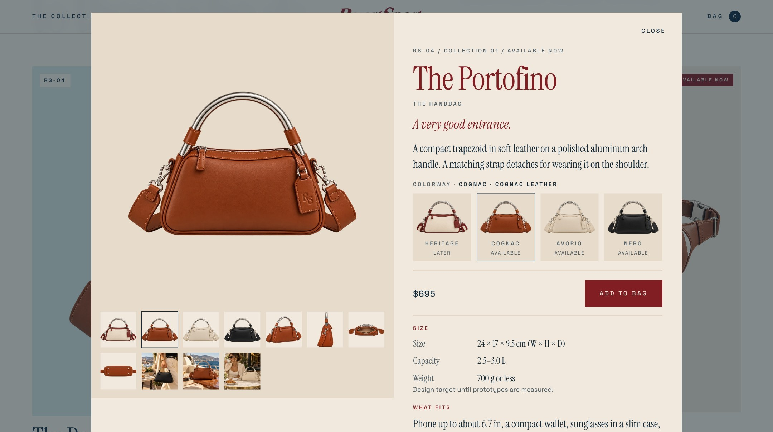
A product page that earns trust
APPLICATIONS / PRODUCT PAGE
Show, explain, reassure, close. Colorways first, then the line, the price and the button, then size, what fits, materials, care, delivery and returns, stated plainly.

Slide 27

Unboxing is a brand moment
APPLICATIONS / PACKAGING
THE BOX
THE DUST BAG
HANG TAG AND CARD
Ivory board, master wordmark in Cabana Red.
Sand cotton, RS monogram only.
Monogram on the tag; wordmark on the card.
SAND INTERIOR IS A BAG-LINING RULE, NOT A PACKAGING REQUIREMENT

Slide 28
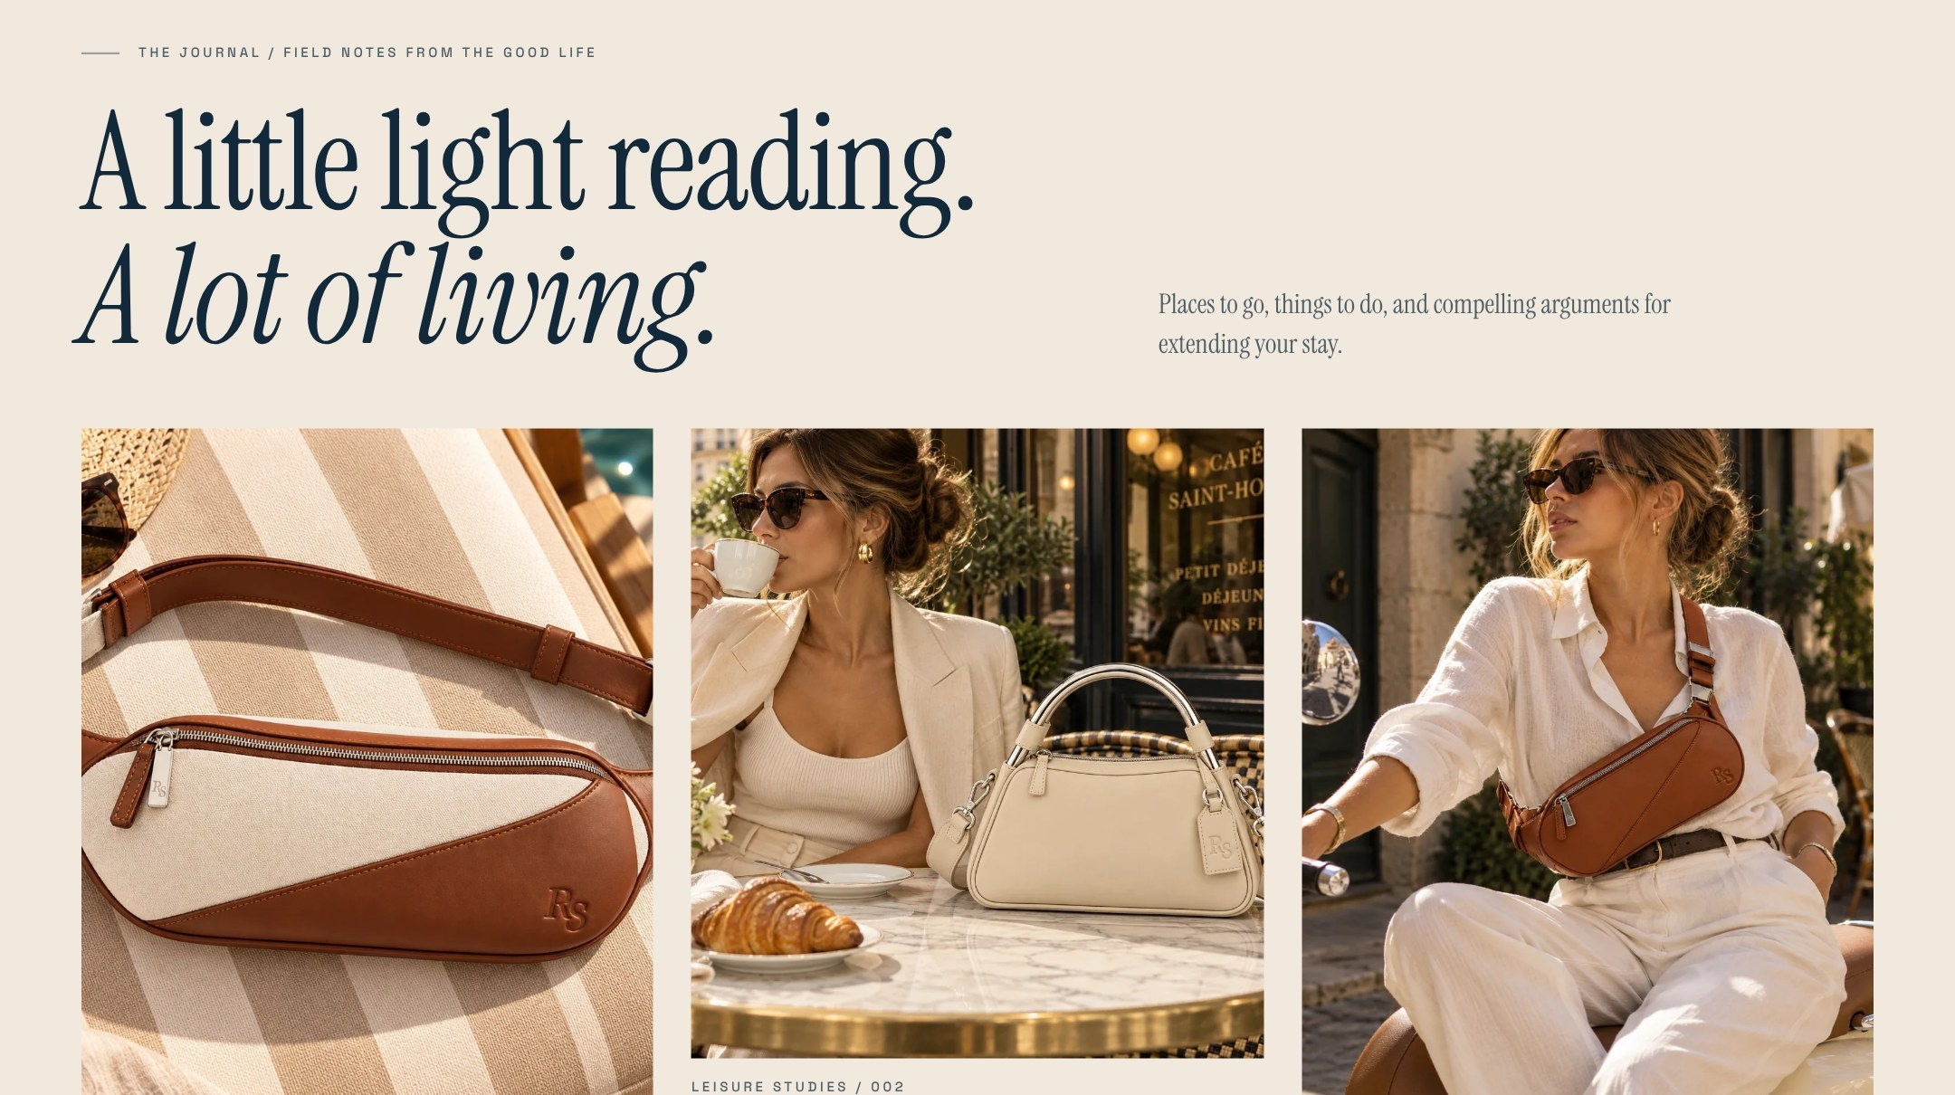
Editorial culture, not decorative nostalgia
APPLICATIONS / THE JOURNAL
Field notes, leisure studies and destinations. The Journal gives people a reason to return when they aren't shopping, and shows the bags living in the scene.

Slide 29
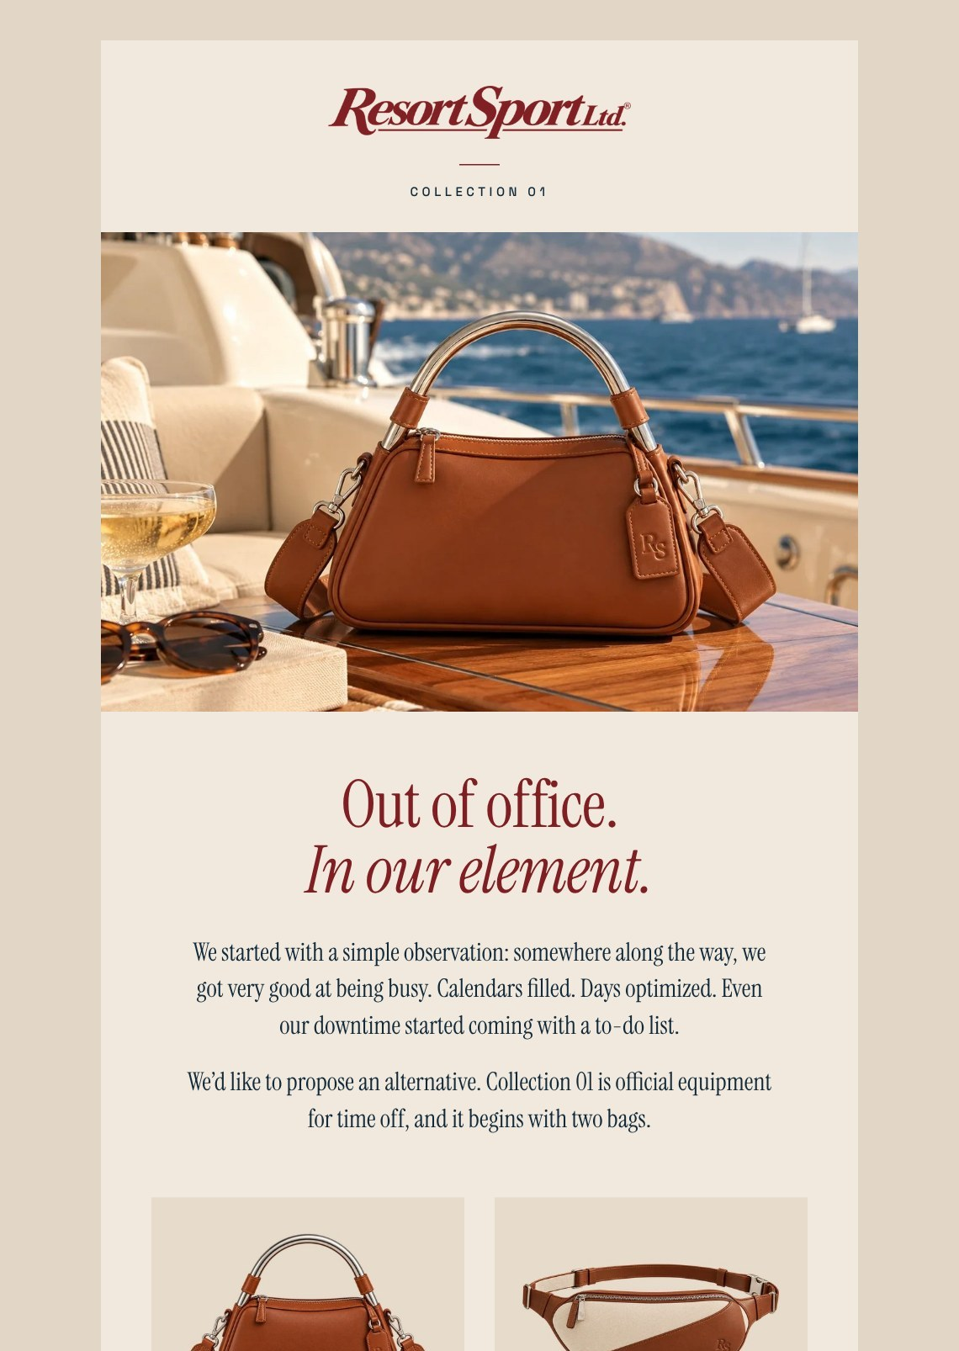
Email that keeps its promises
APPLICATIONS / CORRESPONDENCE
The Time Off Club writes when something good comes up. Five lifecycle emails share one template: the compact wordmark, Instrument Serif, square Cabana Red buttons. No countdowns, no discount codes, full price always.
WELCOME
We'll keep this brief.
LAUNCH
Out of office. In our element.
WAITLIST
For leaving well.
ORDER
A fine choice.
LIMITED ISSUE
Some things are worth making an exception for.

Slide 30
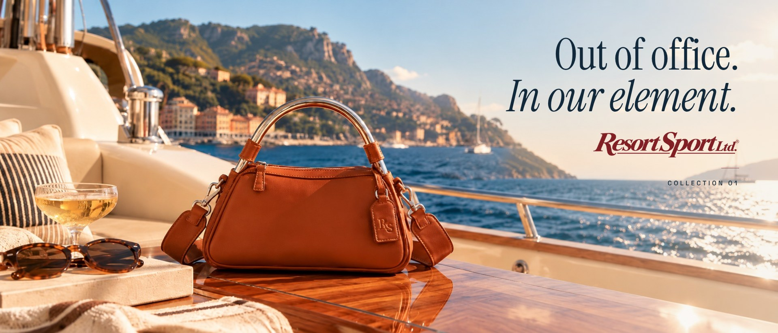
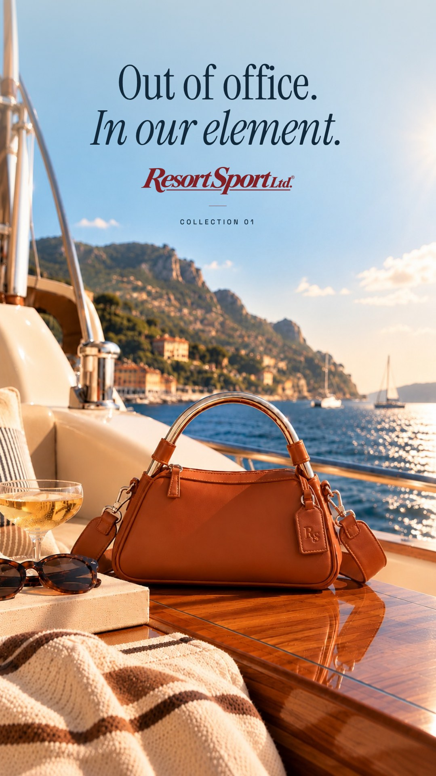
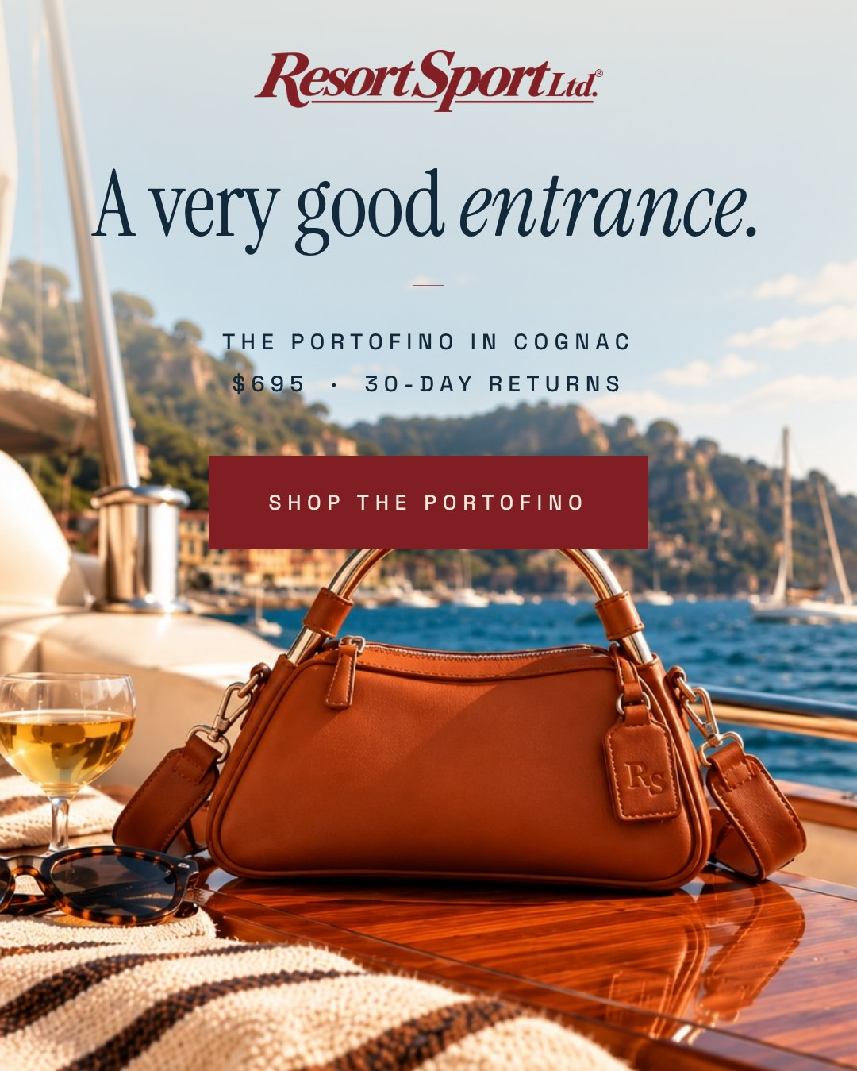
One idea, every placement
APPLICATIONS / CAMPAIGN
Text-free photography with live type and the master wordmark, so every placement matches the guidelines exactly: billboard, story, feed and paid social.

Slide 31
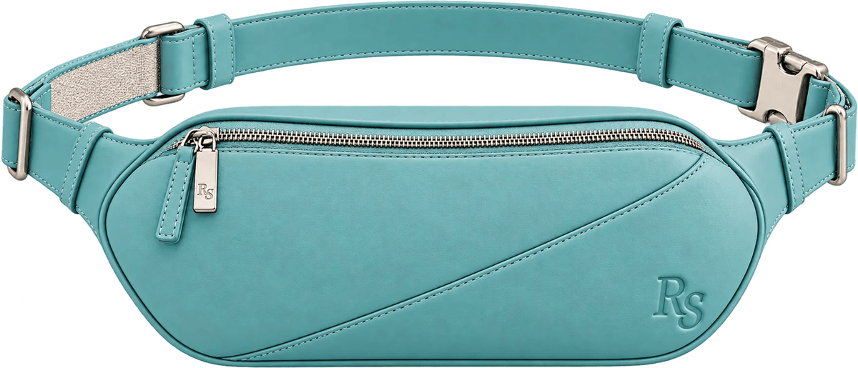
The cocktail menu
COLOR SYSTEM / LIMITED ISSUES
Seasonal color names evoke leisure culture. They never replace the four permanent colorways.
Curaçao
Negroni
Limoncello
Bijou
POOL AQUA · #98C6C5
BITTER ORANGE · #C2502E
BUTTER YELLOW · #F4E19A
RACING GREEN · #183D31
ISSUE 001 / THE RALLY IN CURAÇAO
Rules: cocktail names only for Limited Issues. RS-only branding, silver-tone hardware and Sand lining stay constant. Release numbers and products beyond Issue 001 are not yet assigned.

Slide 32
THE SYSTEM IN THE WORLD
One mark. Five forms. Endless time off.
OFFICIAL EQUIPMENT FOR TIME OFF.

