Slide 1


DECK 03 / COMMERCIAL STRATEGY
Create desire.
Establish value.
Capture demand.
Product positioning and go-to-market strategy: a proposed commercial system for the art of being off duty.
HYPOTHETICAL CASE STUDY · OCTOBER 2026

Slide 2
The executive mandate
EXECUTIVE BRIEF
Build desire for an unknown brand. Earn trust at a premium price. Scale without diluting the point of view.
THE BUSINESS QUESTION
THE PRODUCT QUESTION
THE MARKETING QUESTION
How does an emerging accessories label become a credible alternative to established leather-goods brands?
Which distinctive silhouette earns the first purchase, and which builds long-term brand recognition?
How does a world of leisure translate into qualified discovery, confidence and conversion?

Slide 3
One proposition. Three engines.
COMMERCIAL THESIS
01
02
03
Desirability
Credibility
Accessibility
Recognizable silhouettes and an editorial world worth entering.
Material clarity, design details and low-friction product evidence.
Accessible-premium price positioning and intentional entry products.
PILLARS 01 + 03
PILLAR 02
DECK 01 PRICE ROLE
OPERATING PRINCIPLE
Emotional differentiation earns attention; product substance earns the transaction.

Slide 4
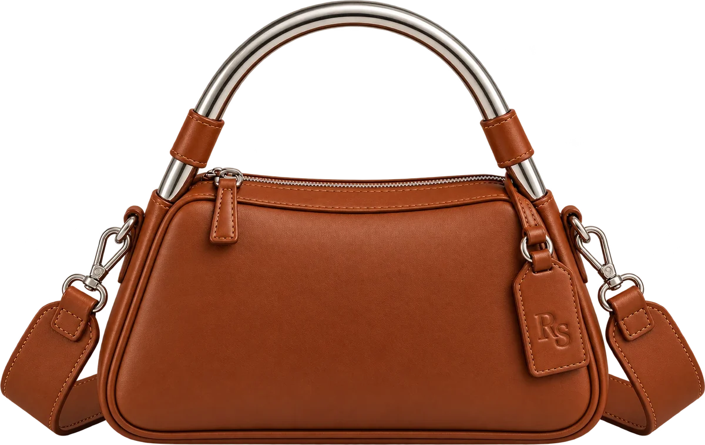
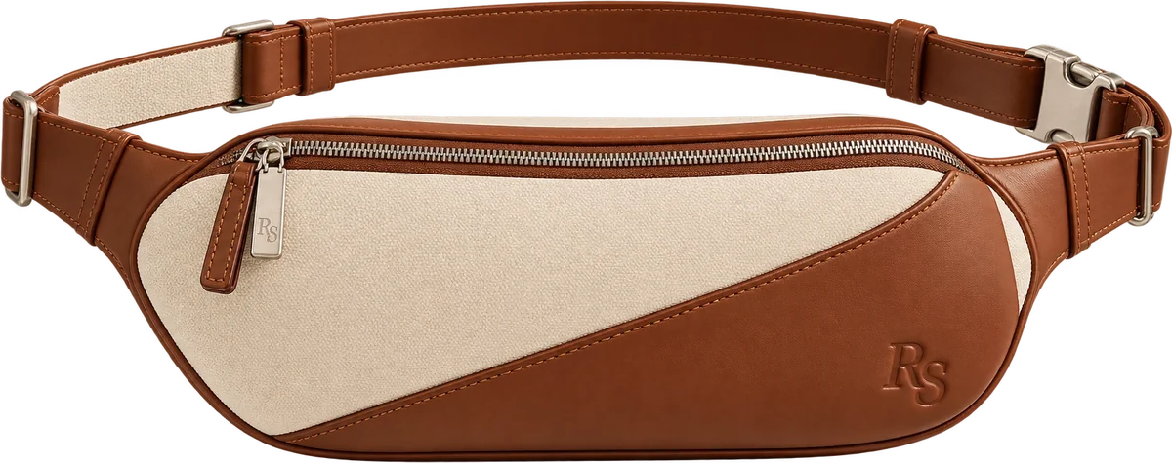
Prioritize buyers, not personas
SEGMENTATION
PRIMARY
SECONDARY
The design seeker
The off-duty mover
OCCASION
A distinctive everyday handbag
OCCASION
Travel, weekend, hands-free use
TRIGGER
Tired of interchangeable premium bags
TRIGGER
Wants a beautiful bag that earns its keep
VALUES
Silhouette, leather, signature hardware
VALUES
Ease, durability, modular versatility
BARRIER
Unfamiliar brand, unproven quality
BARRIER
Practicality versus price
HERO: PORTOFINO
ENTRY: RALLY · EXPANSION: MONACO, REGATTA
Decision: lead with design-led handbag demand; use utility-led buyers to widen occasions. A lower price does not imply a lower acquisition cost.

Slide 5
The switching argument
COMPETITIVE CHOICE
CURRENT ALTERNATIVE | WHAT IT ALREADY OWNS | OUR INTENDED REASON TO SWITCH
Polène | Sculptural shapes | Leisure-led versatility beyond handbags
Mansur Gavriel | Soft leather minimalism | A more differentiated cultural world
Cuyana | Utility and value | More ownable shape and personality
DeMellier | Refined hardware | Sport and resort movement language
STAUD / BY FAR | Playful fashion | Timeless materials within a broader system

Slide 6
The trade-offs a buyer actually makes
PRODUCT-LEVEL COMPETITIVE INTELLIGENCE
DECISION CRITERION | PORTOFINO / CONCEPT | POLÈNE NUMÉRO NEUF MINI | DEMELLIER SMALL HUDSON
Retail price | $695 leather launch colorways; $495–695 band | $540 US | £425 UK
Body size (W×H×D) | 24 × 17 × 9.5 cm target | 22 × 14 × 12.5 cm | 24 × 16.5 × 10 cm base
Weight | ≤700 g design target | 430 g published | 435 g published
Exterior and finish | Protected fine-grain leather; polished aluminum arch (target) | Full-grain Italian calfskin; leather drape | Italian grained cowhide; gold hardware
Carry and closure | Rigid arch handle; detachable strap; top zip | Hand, shoulder, crossbody; magnetic | Top handle, crossbody; magnetic flap
Distinctive strength | Polished aluminum signature; secure top zip | Proven sculptural execution; lighter bag | Established craft and service; expandable sides
PMM IMPLICATION
Position the aluminum arch as a lightweight design target, not a proven advantage. Validate finish wear, structural load and comfort before making claims.
Notes:
Source: Polène US Numéro Neuf Mini; DeMellier Small Hudson Mocha Small Grain (official product pages). Portofino specifications are illustrative design targets. Prices in native market currencies.

Slide 7
Compact, not impractically small
RS-04 / PROPOSED PRODUCT REQUIREMENTS
24 cm
17 cm
9.5 cm
2.5–3.0 L
≤700 g
BASE WIDTH
BODY HEIGHT
MAX DEPTH
USABLE CAPACITY
EMPTY WEIGHT TARGET
WHAT FITS
ENGINEERING TRADE-OFFS
Phone up to about 6.7 in, a compact wallet, sunglasses in a slim case, keys, lipstick. Not made for a tablet, a large water bottle or full-size headphones.
Prototype hollow 6061-T6 polished aluminum and benchmark steel. Compare clear protective finishes for wear. Verify reinforced mounts, strength, comfort and corrosion isolation. Preserve the top zip and check real usable volume.
DECISION GATE
Approve the aluminum arch only if strength, comfort, finish durability and the ≤700 g target pass prototype review.

Slide 8
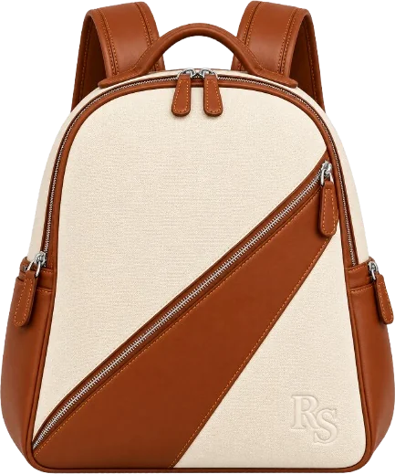

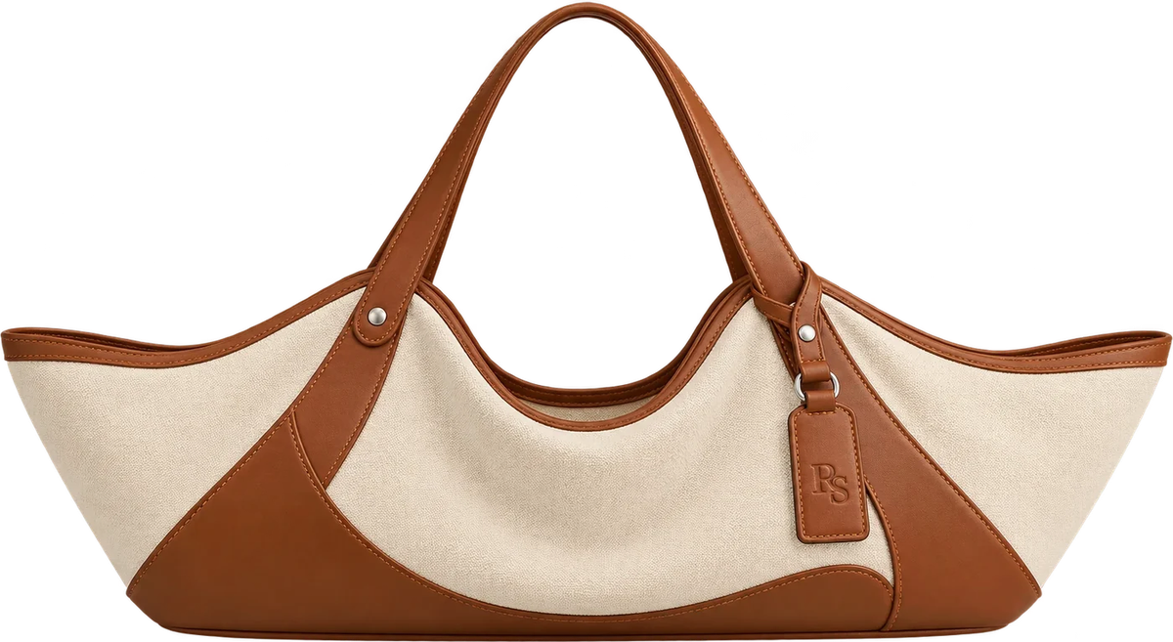
The complete line. The selective launch.
PORTFOLIO ARCHITECTURE
LAUNCH
LAUNCH
RS-01
RS-02
RS-03
RS-04
RS-05
Monaco
Rally
Riviera
Portofino
Regatta
TRAVEL AUTHORITY
PRICE ENTRY / TRIAL
LEISURE HALO
DESIGN HERO
UTILITY BRIDGE
$695–895
$275–350
$595–795
$495–695
$525–725
PRICE BANDS ARE PROPOSED US RETAIL HYPOTHESES, NOT QUOTES OR VALIDATED WILLINGNESS TO PAY.

Slide 9

HERO PRODUCT / RS-04 THE PORTOFINO
Portofino creates the image of the brand
CUSTOMER JOB
Own a recognizable, versatile handbag without conspicuous logos.
HERO ASSET
The polished aluminum arch handle (proposed; finish validation pending).
VALUE PROPOSITION
Architectural elegance, everyday ease.
LAUNCH
Cognac, Avorio, Nero · $695
“A very good entrance.”

Slide 10

ENTRY PRODUCT / RS-02 THE RALLY
Rally expands the entry occasion
CUSTOMER JOB
Hands-free freedom without the sporty-nylon aesthetic.
SIGNATURE
A low aerodynamic profile, sweeping seam, fine-grain leather.
VALUE PROPOSITION
Lighter commitment, daily usefulness.
LAUNCH
Heritage $275 · Cognac, Nero $350
“Hands free. Plans optional.”

Slide 11
Marketing shapes what gets built
PRODUCT-MARKET FEEDBACK LOOP
CUSTOMER SIGNAL | PRODUCT RESPONSE | PMM ROLE
Brand trust | Leather sourcing proof; finish close-ups | Set the buyer's evidence requirements
Carry comfort | Prototype strap width, weight and grip | Turn objections into usability criteria
Value for price | Prioritize visible quality over hidden cost | Separate must-have from nice-to-have features
Versatility | Detachable straps, Sand interiors, capacity | Specify usage scenarios and acceptance tests
Distinctiveness | Protect the recognizable arch and geometry | Defend the features that create preference
PMM leads customer insight and market requirements; Product, Design and Operations own technical specification and feasibility.

Slide 12
Use breadth to expand, never to blur
PORTFOLIO STRATEGY
Riviera
Monaco
Regatta
RESORT CARRY / LEISURE CREDIBILITY
WEEKEND TRAVEL / BRAND AUTHORITY
WORK-TO-WEEKEND / FUNCTIONAL BRIDGE

Slide 13
The launch choice is not inevitable
INVESTMENT OPTIONS
REJECT
SELECT
DEFER
Portofino only
Portofino + Rally
All five
UPSIDE
UPSIDE
UPSIDE
Sharpest visual and message focus
Recognition plus a second use occasion
Broad ecosystem and more categories
TRADE-OFF
TRADE-OFF
TRADE-OFF
Higher entry price; narrower daily use
Needs distinct messaging and buyer proof
20-SKU complexity; inventory and focus risk

Slide 14

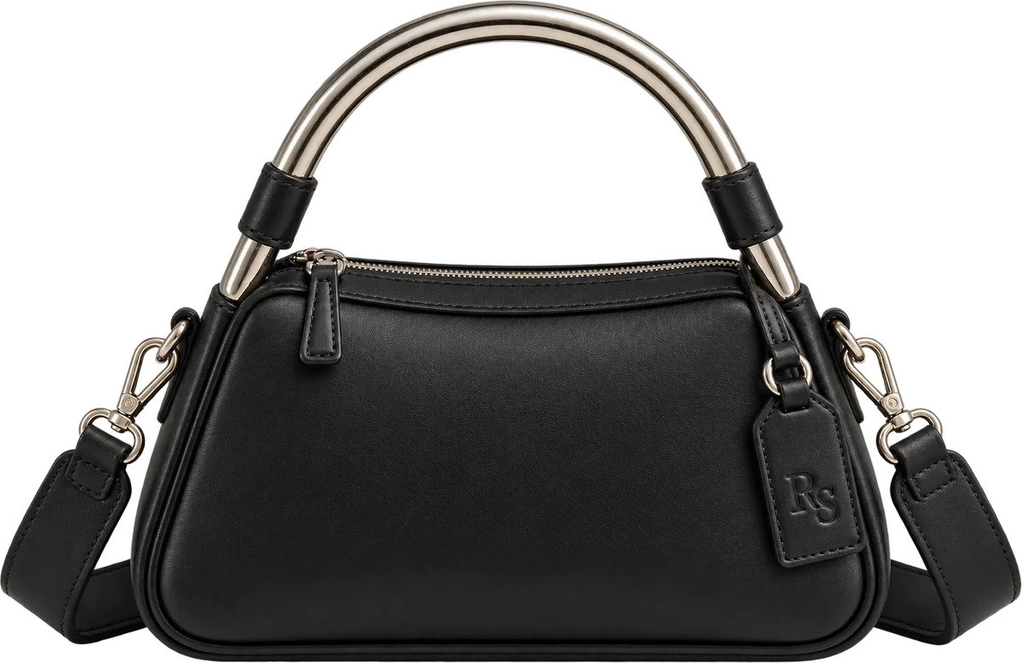
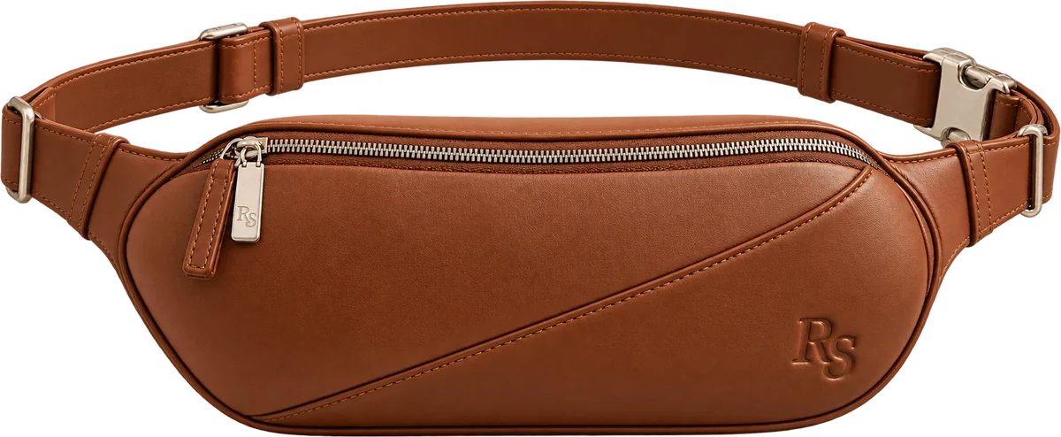
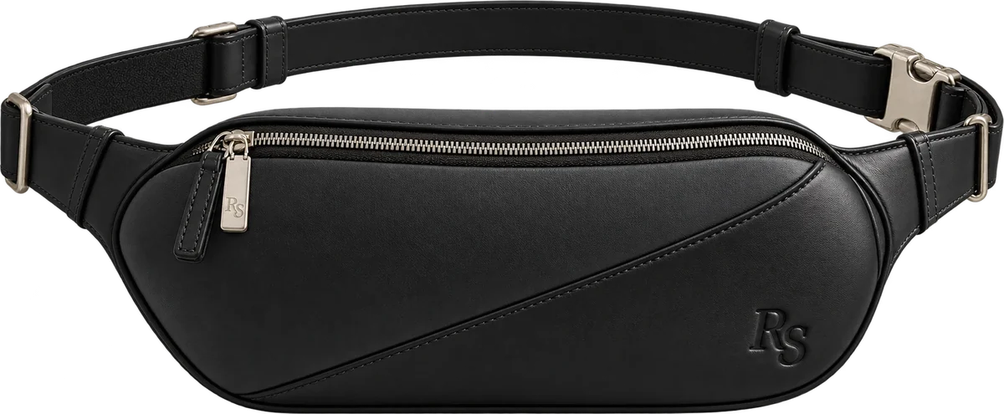
20 permanent options are not 20 launch bets
ASSORTMENT DISCIPLINE
Portofino
Portofino
Portofino
Rally
Rally
Rally
COGNAC
AVORIO
NERO
HERITAGE
COGNAC
NERO
CHOSEN / SIX SKUS
EXPANSION / STAGED
A recognizable hero plus an accessible entry; controlled inventory and a coherent visual assortment.
Add Riviera and Monaco after hero evidence; test Regatta separately for fit, weight and laptop use. Extend color depth only after demand signals.

Slide 15
Six SKUs: concentrate where the story is strongest
ASSORTMENT CHOICE LOGIC
THE HERO / THREE COLORS
THE ENTRY / THREE COLORS
Portofino: Cognac, Avorio, Nero
Rally: Heritage, Cognac, Nero
Cognac establishes rich leather character; Avorio supports editorial fashion imagery; Nero answers classic demand. Heritage is held back for later learning.
Heritage communicates resort identity; Cognac carries the leather signature; Nero supports everyday use. Avorio can follow observed demand.
WHY NOT FOUR EACH?
Six options keep the core contrast while limiting early color-by-product inventory fragmentation.

Slide 16
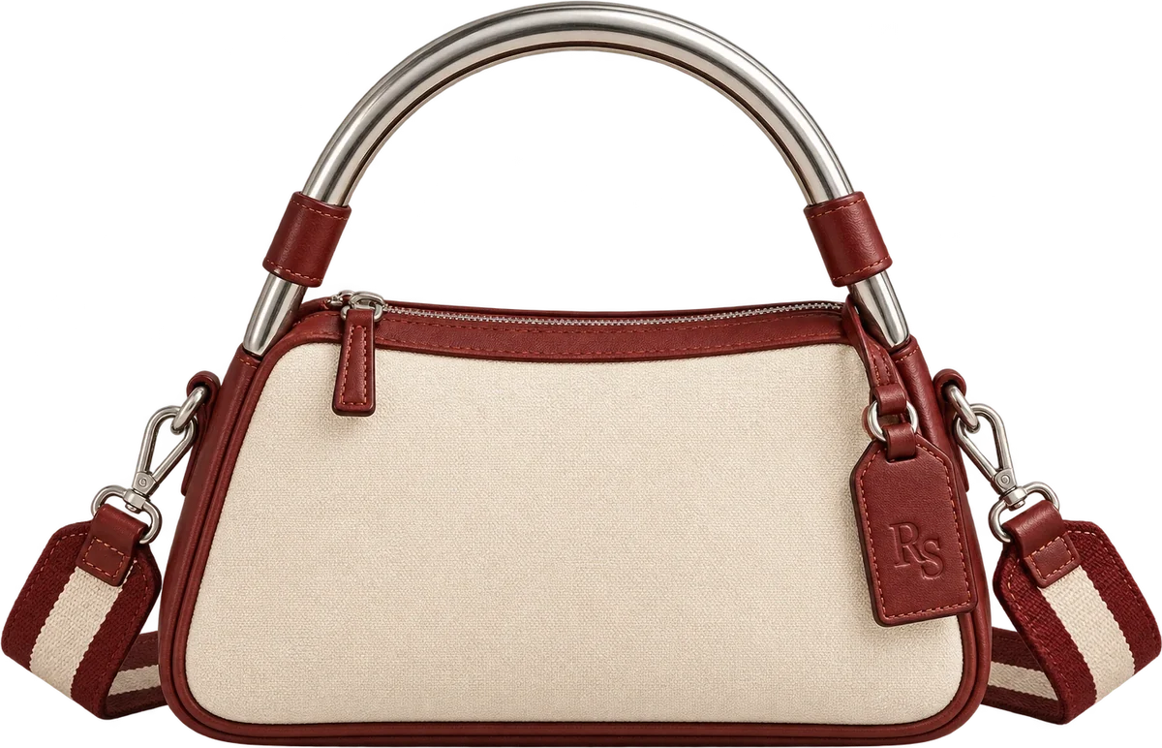
Permanent discipline. Seasonal permission.
MERCHANDISING
LIMITED ISSUES / COCKTAIL COLORWAYS
Curaçao
Negroni
Limoncello
Heritage
Avorio
Cognac
Nero
NATURAL CANVAS & COGNAC LEATHER
SOFT IVORY LEATHER
WARM COGNAC LEATHER
BLACK LEATHER
Bijou
The four permanent colorways never change. Limited Issues add a seasonal reason to talk, without replacing them.

Slide 17
Price follows value and portfolio role
PRICE POSITIONING
Rally
ENTRY TO BRAND
$275–350
Portofino
ICONIC HANDBAG
$495–695
Regatta
UTILITY INVESTMENT
$525–725
Riviera
LARGE-SCALE LEISURE
$595–795
Monaco
TRAVEL FLAGSHIP
$695–895
$200
$400
$600
$800
Full-price DTC positioning. No introductory discount; perceived value comes from product evidence and service. Launch products shown in Cabana Red.

Slide 18
Price and unit economics must agree
COMMERCIAL GUARDRAILS
01
02
03
04
Retail price
→
Landed cost
→
Servicing cost
→
Channel cost
Fix the market position and the customer's value perception.
Target a product cost compatible with contribution margin.
Include packaging, complimentary delivery, free returns and support.
Budget creative, partnerships and acquisition against net margin.
GATE
Do not authorize a price and product combination before sourcing and modeled contribution clear the hurdle.

Slide 19
Illustrative unit economics: Portofino
COMMERCIAL MODEL / $695 DTC CASE
Retail price, net of tax
$695
51.8%
Landed unit cost
−$160
−$65
CONTRIBUTION AFTER ACQUISITION, AS A SHARE OF NET REVENUE
Fulfillment, payment, packaging, returns
Contribution before acquisition
$470
The $65 servicing line covers complimentary US delivery, free return labels and packaging. All cost and acquisition values are invented scenario inputs; the model excludes fixed operating expenses and income taxes.
New-customer CAC
−$110
Contribution after acquisition
$360

Slide 20
A plan is only useful if it survives stress
ECONOMICS / SENSITIVITY
CAC $110 · COST $160
CAC $110 · COST $192
CAC $220 · COST $160
CAC $220 · COST $192
Continue controlled learning
Pressure-test construction and sourcing
Stop scaling; fix efficiency and conversion
Revisit offer, channel, materials and launch scale
Scenario math: contribution = $695 retail − landed cost − $65 servicing − CAC. Before fixed operating expenses.

Slide 21
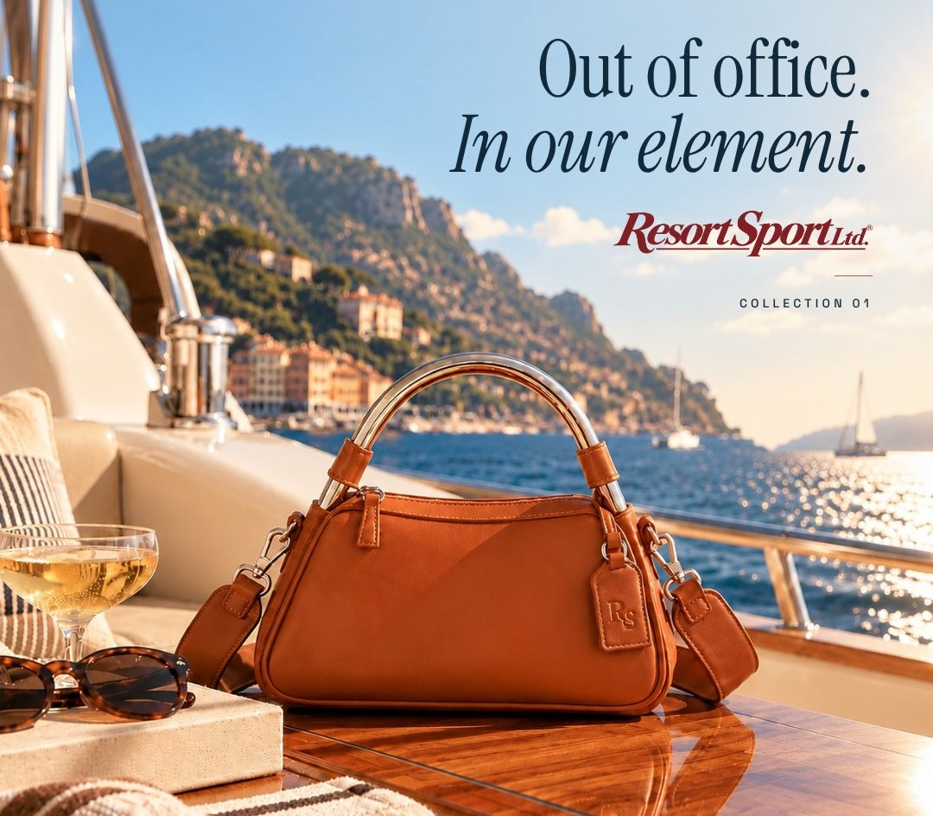

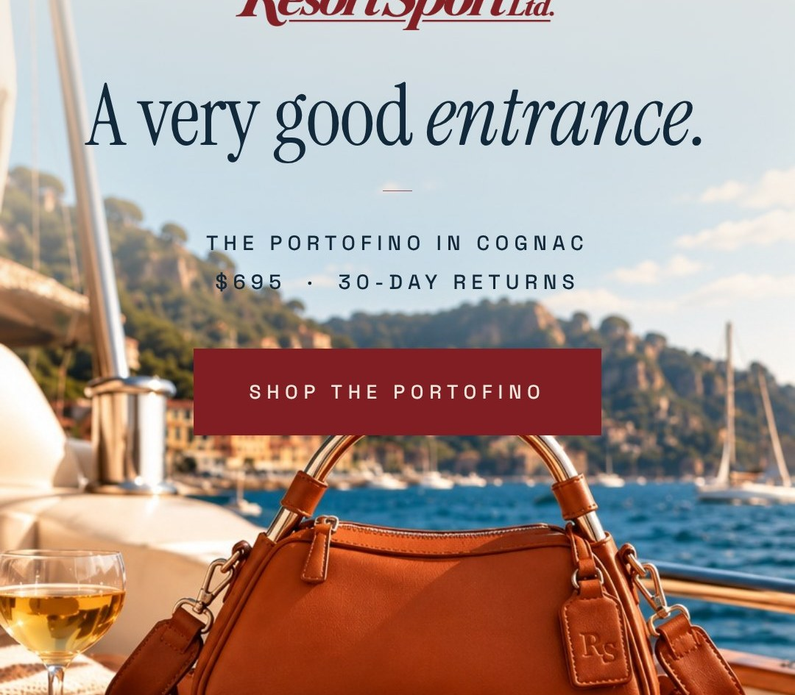

Messaging that moves from feeling to proof
MESSAGE ARCHITECTURE
AWARENESS
CONSIDERATION
DECISION
POST-PURCHASE
Out of office. In our element.
Design worth recognizing.
A very good entrance.
See you out there.
The leisure world; strong product geometry
Leather, silver hardware, Sand lining, silhouette
Dimensions, capacity, scale, delivery, returns
Care, use, support, collection cross-sell

Slide 22
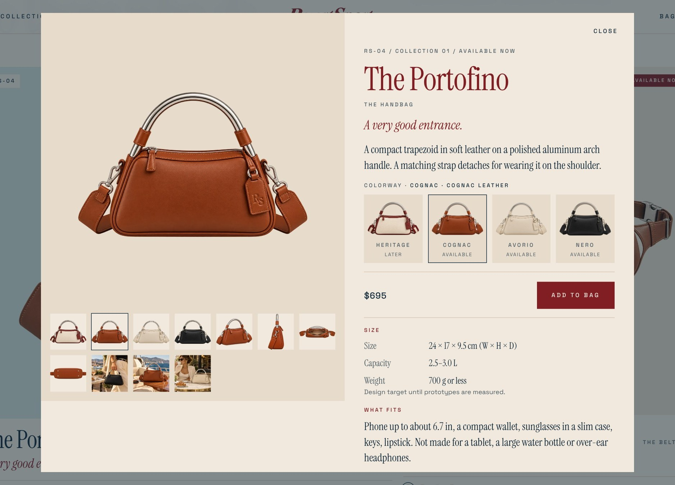
Make the product page do the selling
CONVERSION DESIGN
01
Show
Front, 45°, on-body scale, interior
02
Explain
Leather, shape, silver hardware, Sand lining
03
Reassure
Dimensions, weight, capacity, care; complimentary US delivery; 30-day returns
04
Close
Clear colorway selection, price and one action

Slide 23

CAMPAIGN PLATFORM
One idea, adapted by channel, never rewritten into generic luxury advertising. Collection 01 · “Your time off looks good from here.”

Slide 24
Earn attention before buying reach
CHANNEL PRIORITIES
Owned / site + email
HIGH
Editorial destination, product education, waitlist and lifecycle email.
PR + cultural seeding
HIGH
Design, travel, fashion and resort culture; earned credibility.
Creator partnerships
HIGH
Selected aesthetic alignment; credible on-body demonstrations.
Paid social + search
TEST
Retargeting and high-intent capture after message and creative signals.
Physical experiences
SELECTIVE
Pop-ups and partnerships only when audience fit is compelling.

Slide 25
Allocate capital in learning stages
LAUNCH / ILLUSTRATIVE INVESTMENT MIX
CREATIVE & PROOF
Must-have product, scale and detail assets
EARNED & CREATORS
Selective brand-fit relationships
PAID TESTING
Controlled tests after content and readiness
OWNED & CRM
Conversion information and retention
EXPERIENTIAL
Released only if fit and economics work
ILLUSTRATIVE ALLOCATION OF DISCRETIONARY LAUNCH MARKETING, NOT TOTAL COMPANY BUDGET.

Slide 26
Sequence the launch to build conviction
12-WEEK ILLUSTRATIVE PLAN
WEEKS 1–4
WEEKS 5–8
WEEKS 9–12
Prep
Reveal
Convert
Prototype proof, product content, press kit, creator shortlist, waitlist.
Campaign launch, Portofino hero, Rally education, earned placements.
Release six SKUs, lifecycle email, retargeting, product feedback and restock signals.
DATES, AVAILABILITY AND LAUNCH TARGETS ARE CASE-STUDY SCENARIOS

Slide 27
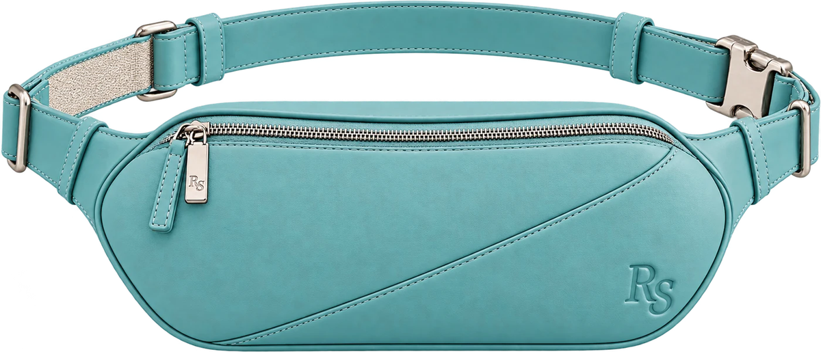
SEASONAL DROP
LIMITED ISSUE 001
The Rally in Curaçao.
THE ROLE
A collectible color story after core recognition. Not a discount event, and not a replacement for the permanent collection.
Issue 001 creates the next conversation.

Slide 28
Measure the decisions, not just the metrics
EXECUTIVE SCORECARD
OUTCOME | SIGNAL | IF IT UNDERPERFORMS
Desire | Qualified waitlist; hero preference | Revise hero storytelling or assortment
Trust | Product-page engagement; objections | Add proof, change copy, solve product friction
Conversion | Add-to-cart, checkout, return reasons | Fix fit, product information, offer or checkout
Economics | Contribution margin; acquisition payback | Limit paid scale or redesign cost structure
Loyalty | Repeat engagement; second-category interest | Advance the next silhouette or retention program
THRESHOLDS COME FROM PROTOTYPE, FINANCIAL AND PILOT EVIDENCE, NOT INVENTED HISTORY.

Slide 29
Define the decision, then choose the metric
EXECUTIVE CONTROL PANEL
Hero not preferred
Compare product-level preference and reasons
→
Refine product claims or hero selection
Conversion weak
Examine product comprehension and checkout
→
Improve proof, sizing or checkout
Return rate elevated
Segment by defect, fit and expectation
→
Fix product or merchandising before scaling
CAC exceeds headroom
Evaluate contribution after acquisition
→
Reallocate spend; stop unprofitable scale
Second-category interest
Track qualified demand for follow-on models
→
Authorize a Riviera or Monaco test

Slide 30
Decision rights and accountability
LEADERSHIP / OPERATING MODEL
DECISION AREA | WHO DECIDES | PARTNERS
Customer and competitive intelligence | PMM leads synthesis | Research + Product
Positioning and messaging | PMM accountable | Brand + Creative
Product readiness and claims | Product and Ops approve; PMM sets the buyer bar | Quality + Legal
Price and financial guardrails | Finance and GM approve; PMM recommends | Finance + Product
Integrated launch | PMM accountable for the plan | Growth + PR + Ecommerce
Scaling capital | GM and Finance authorize | PMM + Growth propose
Cadence: weekly launch-readiness reviews; monthly demand and margin decisions; explicit escalation on cost, quality or claims.

Slide 31
Three executive authorization gates
DECISION SYSTEM
GATE 1
GATE 2
GATE 3
Product
Market
Scale
Approve only after prototype feel, weight, comfort, hardware and target cost meet requirements.
Release only after competitive product tests and price acceptance support the launch proposition.
Expand paid investment only with positive contribution after acquisition and manageable returns.

Slide 32
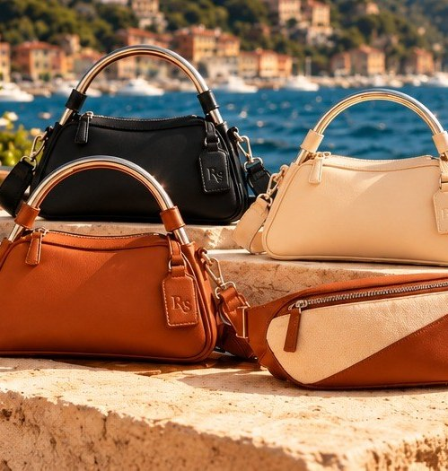
STRATEGIC OUTCOME
An ambitious brand.
A disciplined launch.
Build recognition through the Portofino.
Earn the first purchase through the Rally.
Expand the customer's world through the collection.
OFFICIAL EQUIPMENT FOR TIME OFF.

Slide 33
Working assumptions and handoff
APPENDIX / MODEL BOUNDARIES
LOCKED BRAND STANDARDS
OPEN COMMERCIAL VARIABLES
Product marks: RS only.
Actual materials cost, fabrication and quality.
Hardware: brushed silver-tone; aluminum arch pending tests.
Consumer preference and willingness to pay.
Interior: Sand lining in every bag.
Channel CAC and conversion performance.
Permanent: Heritage, Avorio, Cognac, Nero.
Packaging, logistics and returns cost.
Limited: Curaçao, Negroni, Limoncello, Bijou.
Launch timing and feasible inventory.
Service: complimentary US delivery; 30-day returns.
This is a hypothetical, self-initiated commercial strategy. Assortment, pricing, segments, channels and sequencing are proposed decisions; no consumer testing, sales or manufactured-product performance is claimed.

