Slide 1
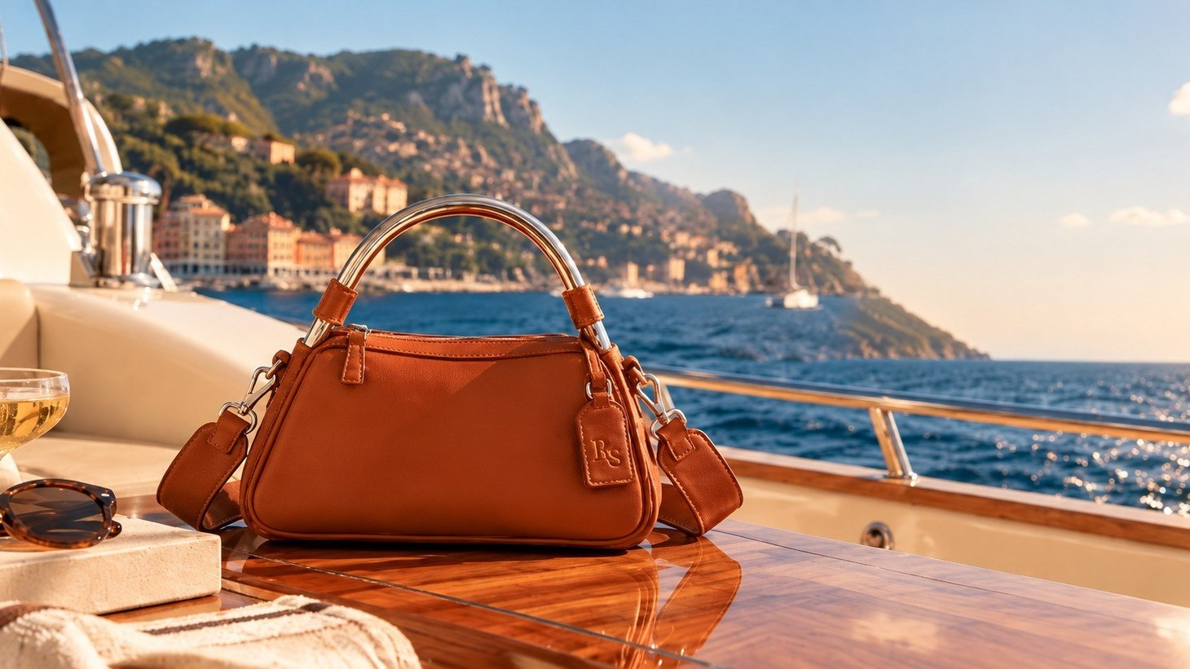

DECK 01 / THE BRAND STRATEGY
The art of being off duty.
HYPOTHETICAL CASE STUDY · OCTOBER 2026

Slide 2
Three things the brand has to earn
THE STRATEGIC TEST
01
02
03
Differentiation
Desirability
Credibility
A point of view no established leather-goods label already owns.
Product and a world people want before they need either.
Proof that an unknown brand's materials and build are worth the price.

Slide 3
A large market, growing slowly
MARKET CONTEXT
€358B
2–4%
SIGNAL
Experience-led luxury interest is relevant context, not category demand evidence.
2025 PERSONAL LUXURY GOODS MARKET
BAIN 2026 BASE-CASE GROWTH FORECAST
INTERPRETATION
An accessory may express an experience-oriented way of living, but this does not establish bag demand, switching or price acceptance.
Source: Bain & Company / Altagamma luxury market update, June 25, 2026.

Slide 4
THE CATEGORY TENSION
Luxury goods can communicate excellence through heritage and restraint. Not every shopper wants those codes to define their personal style.
Expressive leisure brands demonstrate the power of a cultural worldview. The question: can that worldview create preference for a distinctive, premium leather accessory?

Slide 5
Different benchmarks. Distinct competitive jobs.
COMPETITIVE LANDSCAPE
DIRECT LEATHER-GOODS COMPETITORS / THE BUYER'S REAL ALTERNATIVES
DESIGN & CRAFT
Loewe: sculptural, recognizable leather silhouettes. The Row: restrained material expression. Peserico: refined Italian material sensibility.
Polène
Mansur Gavriel
Cuyana
Sculptural, signature leather forms
Material-led, understated luxury
Everyday versatility and practical utility
PRICE ANCHOR
THREAT: PRODUCT DISTINCTIVENESS
THREAT: TACTILE VALUE AND RESTRAINT
THREAT: FUNCTIONAL VALUE
Longchamp full-leather collections: a direct price and product reference, not its nylon lines.
DeMellier
STAUD
BY FAR
CULTURAL BENCHMARKS
Recognizable metalwork and polished build
Playful silhouettes and expressive appeal
Retro-inflected styling and relevance
Sporty & Rich: lifestyle identity. Vacation Inc.: an ownable editorial world. Neither replaces a leather handbag.
THREAT: HARDWARE SIGNATURE AND FINISH
THREAT: RECOGNIZABLE PERSONALITY
THREAT: NOSTALGIA AND DESIRABILITY

Slide 6
The whitespace is in the combination, not the components
EXISTING POLES
Luxury houses
Leisure labels
Premium leather
Heritage, prestige and recognizable design.
Cultural expression, often led by apparel or beauty.
Competing alternatives on design, function and price.
STRENGTH
WHO DELIVERS IT TODAY
RESORT SPORT UNITES IT AS
Product design
Polène, DeMellier
Recognizable geometry + architectural hardware
Material value
Mansur Gavriel, Cuyana
Supple leather and finish standards at an accessible-premium target
Personality
STAUD, BY FAR
Optimistic resort culture, not conventional fashion nostalgia
Product breadth
Across the competitors
A cohesive bag family spanning daily, beach and travel use

Slide 7
From signal to product
STRATEGIC INTERPRETATION
SIGNAL
HYPOTHESIS
PRODUCT RESPONSE
Experiences carry meaning
Objects can carry that meaning
Design for the life, not the logo
→
→
Luxury demand increasingly reflects a search for personal value beyond visible prestige.
A distinctive accessory may express a way of living, not merely function as a status symbol.
Sculptural bags with intended everyday utility and a recognizable off-duty point of view.
KEY TEST
Does this promise create preference over a known leather-goods label at a comparable price?

Slide 8
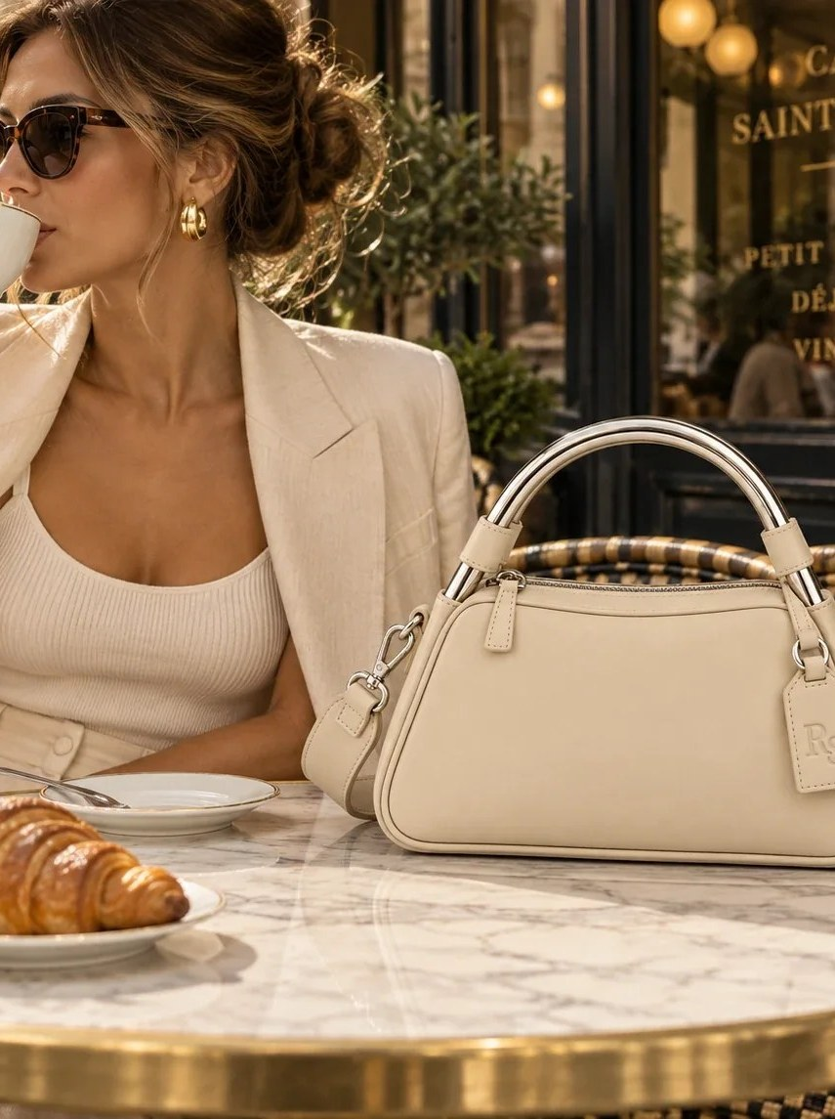
THE CUSTOMER TENSION
“I want the substance of luxury without having to perform the seriousness of luxury.”
DESIRES
Design authorship and tactile quality.
RESISTS
Generic silhouettes or conspicuous status codes.
NEEDS TO BELIEVE
Unknown-brand material claims, comfort and durability must be proven before purchase.

Slide 9
Who we build for
TARGET BUYER
JOBS TO BE DONE
PRIMARY BUYER
Leather-accessory shoppers comparing established premium and luxury options, drawn to signature design over logos.
Functional
Emotional
Carry essentials across daily and leisure use.
Feel prepared and spontaneous.
TRIGGERS
Social
Switching
Style refresh, travel, everyday replacement.
Express individual taste without logos.
Better design must outweigh familiar-brand trust.
BARRIERS
Unknown materials, durability, fit and price-value.

Slide 10
What earns a switch from a trusted label
THE SWITCHING ARGUMENT
CUSTOMER WANTS
Distinctive leather design, tactile quality and versatility across workaday and off-duty settings.
CURRENT TRADE-OFF
Established options may deliver trusted quality, prestige or utility, but not combined with this design and leisure identity.
WHY CONSIDER RESORT SPORT
Strong silhouette signatures, intentionally useful forms and a consistent, expressive brand world.
WHY HESITATE
Unfamiliar brand; uncertain leather quality, practical comfort, durability, servicing and value.
WHAT EARNS THE SWITCH
Physical product proof, transparent specs, fit demonstrations, credible policies and direct value comparison.

Slide 11
POSITIONING STATEMENT
FOR
design-conscious consumers seeking luxury design with more freedom and personality,
RESORT SPORT LTD. IS
an accessible-premium leather accessories brand inspired by the art of being off duty.
UNLIKE
brands built on prestige codes or utility-first propositions, it combines identifiable form, intended utility and a leisure-led cultural identity.

Slide 12
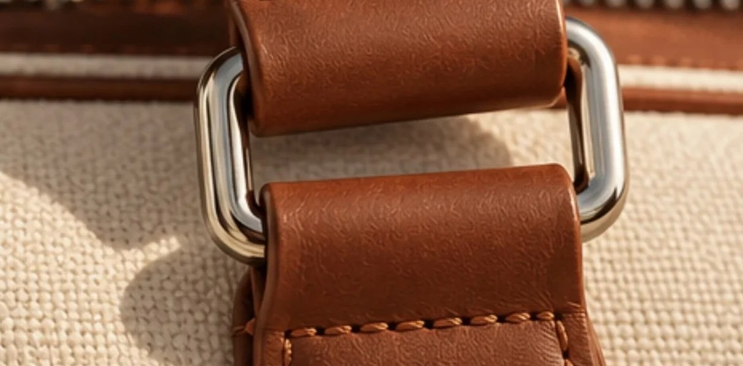
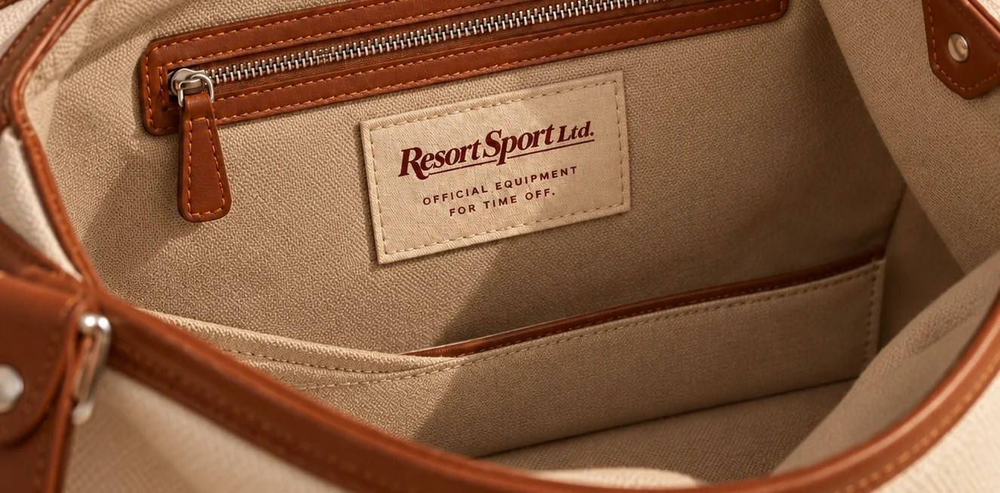
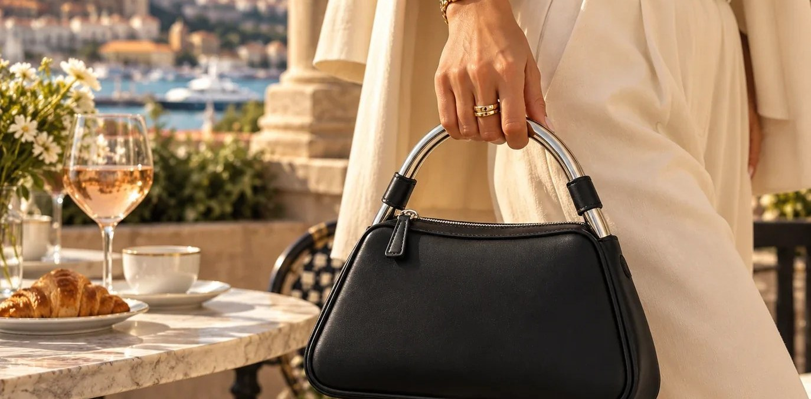
One idea, three strategic pillars
BRAND PILLARS
01
02
03
Design worth recognizing
Considered for real life
A life off the clock
Signature geometry and thoughtful detailing that earn attention without overt logos.
Function, construction and category-appropriate materials that justify use beyond the photograph.
Optimistic leisure storytelling and a culturally rich editorial identity: a heritage of leisure, not of aristocracy.
PORTOFINO HANDLE, RIVIERA SCOOP, REGATTA SWEEP.
FIT, WEIGHT, FINISH AND WEAR TO VALIDATE.

Slide 13
THE BRAND PLATFORM IN A SENTENCE
The art of being off duty.
CUSTOMER PROMISE
TAGLINE
CREATIVE PROVOCATION
Distinctive, considered accessories that bring the freedom and optimism of leisure into everyday life.
Official equipment for time off.
Luxury doesn't have to be serious to be considered.

Slide 14
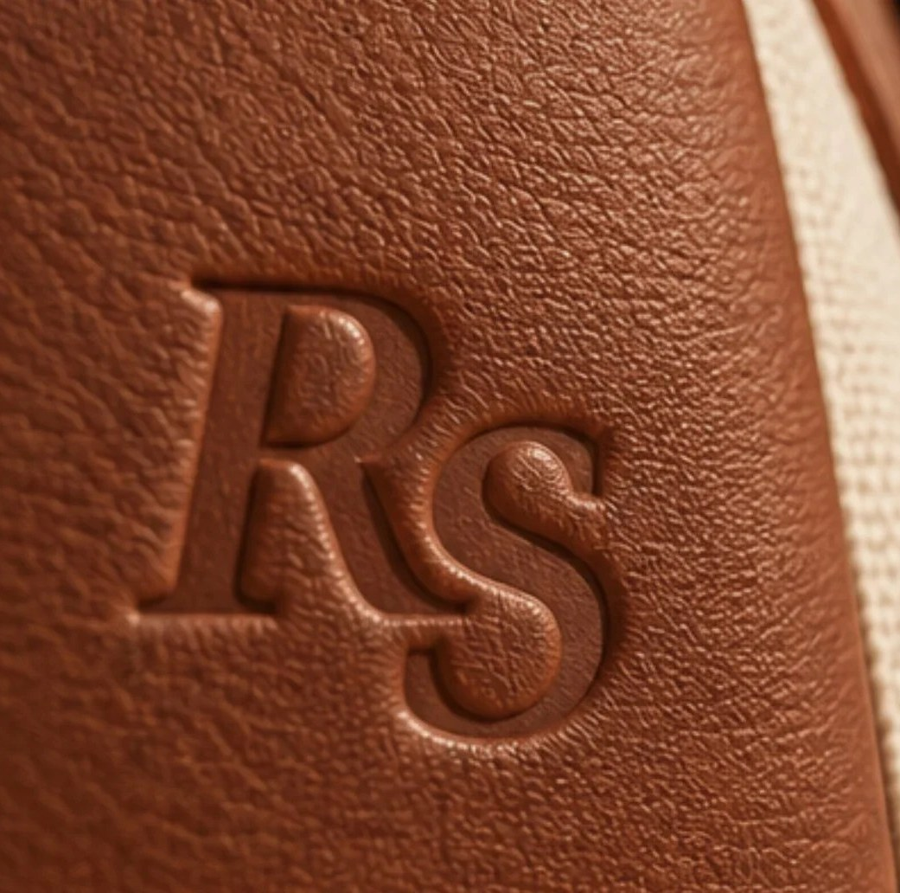
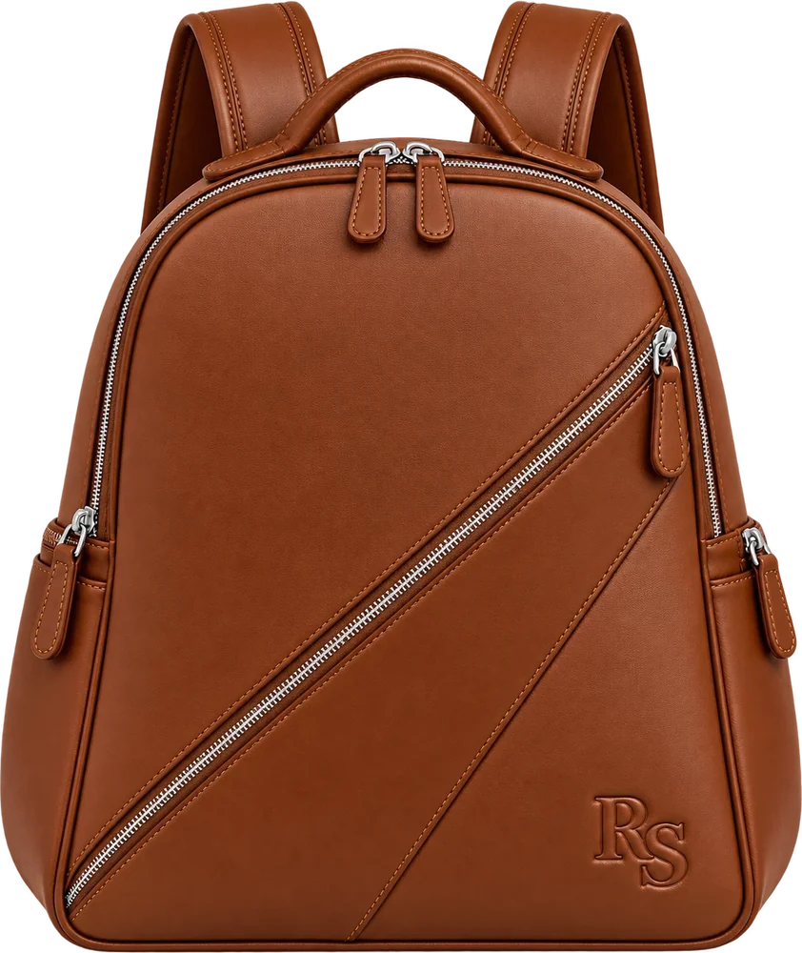
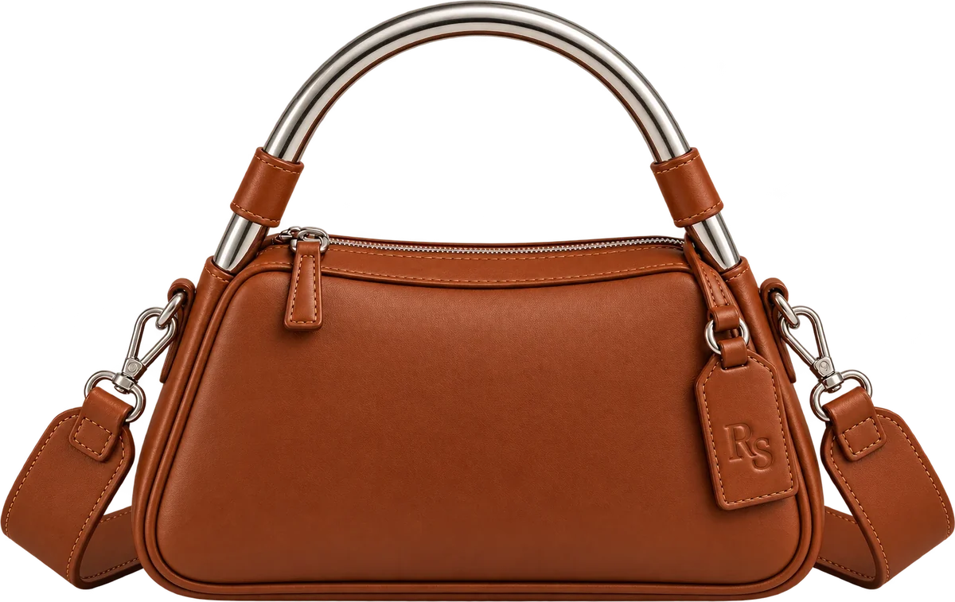
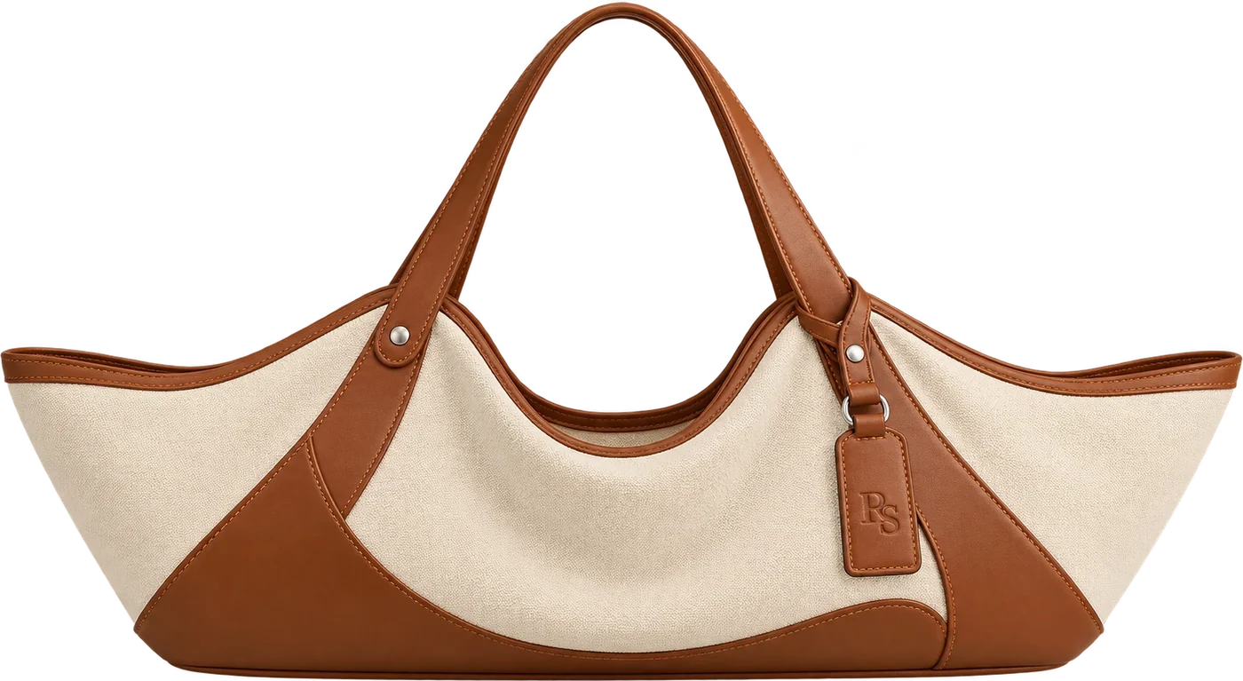
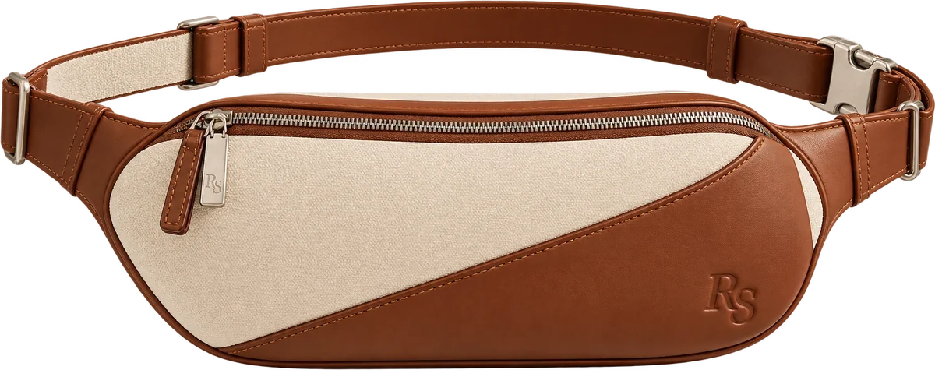
Strategy becomes product design
PRODUCT PRINCIPLES
No oversized logos
Signature handle on Portofino
Heritage + tonal leathers
Riviera wide scoop
Regatta zip + laptop fit
Let silhouettes, hardware and materials build recognition.
A focal design code, not a repeating ornament.
Continuity, utility and seasonless merchandising.
An ownable carryall shape for resort leisure.
Sculptural design that works in daily use.

Slide 15
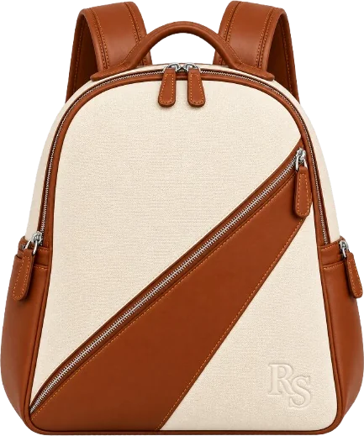
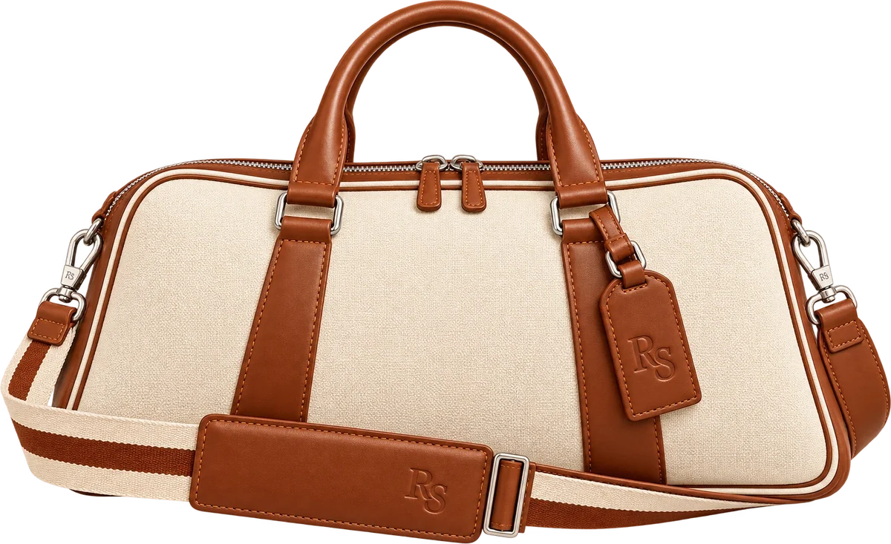
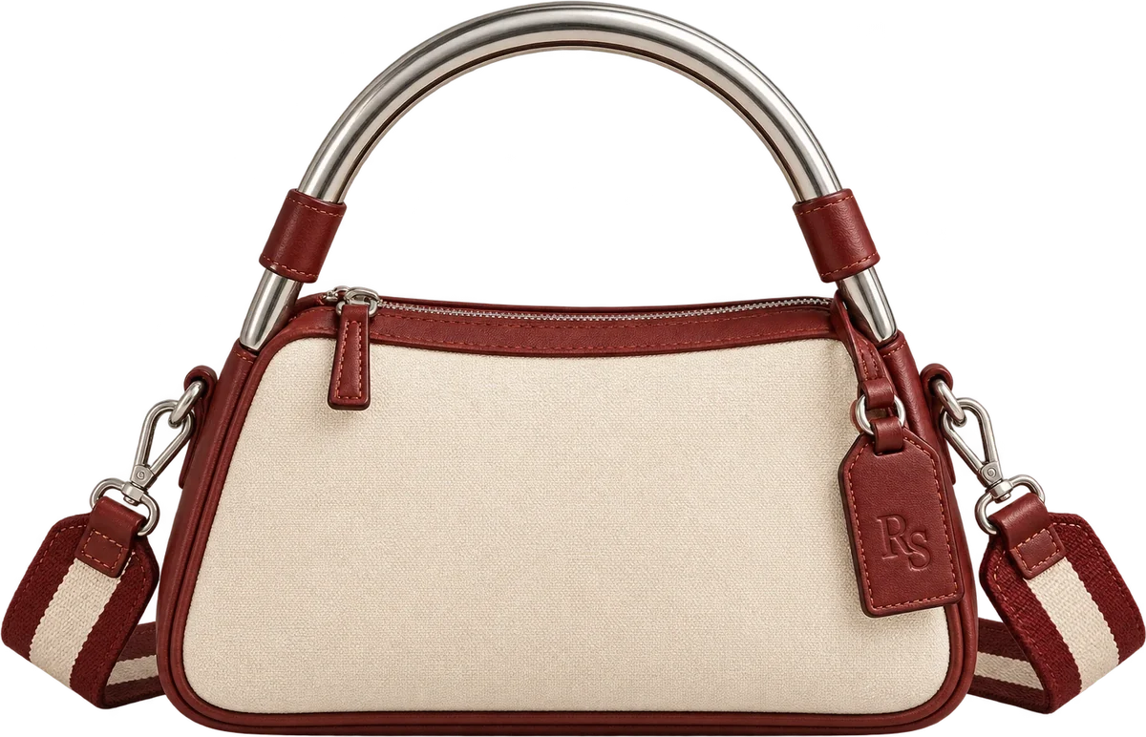
Five silhouettes, one philosophy
COLLECTION 01
RS-01
RS-02
RS-03
RS-04
RS-05
The Monaco
The Rally
The Riviera
The Portofino
The Regatta
TRAVEL DUFFEL
BELT BAG
OVERSIZED CARRYALL
HANDBAG
BACKPACK
SHOWN IN HERITAGE: NATURAL CANVAS AND COGNAC LEATHER

Slide 16
Priced against full leather, not discount luxury
COMPETITIVE PRICE CONTEXT
LONGCHAMP / LE PLIAGE XTRA LEATHER, US EXAMPLES
$425
$570
$700
$780
RESORT SPORT LTD. / COLLECTION 01, PROPOSED BANDS
$275–350
$495–695
$525–725
$595–795
$695–895
RALLY
PORTOFINO
REGATTA
RIVIERA
MONACO
STRATEGIC USE
A directional retail price reference: not a ceiling, a quality-equivalence claim or a validated margin model.
Source: Longchamp USA, Le Pliage Xtra leather collection, accessed October 30, 2026. Prices change.

Slide 17
What we will, and will not, compete on
POSITIONING MATTERS ONLY WHEN IT CONSTRAINS DECISIONS
WE WILL COMPETE ON
WE WILL NOT CHASE
Recognizable sculptural design
Oversized status logos
Material and finish credibility
The lowest ticket price
Thoughtful daily and leisure versatility
Feature volume for its own sake
A distinctive editorial worldview
Short-lived seasonal trend dependence
A disciplined, coherent assortment
Unlimited SKUs at launch

Slide 18

Two advantages, both still to be proven
SOURCES OF ADVANTAGE
PRODUCT
BRAND
Distinctive geometry offers a visible reason to notice and evaluate the products. Memorability, preference and price justification must be tested.
A repeatable leisure-led worldview can connect product, copy, campaign and commerce without depending on seasonal trend cues.

Slide 19
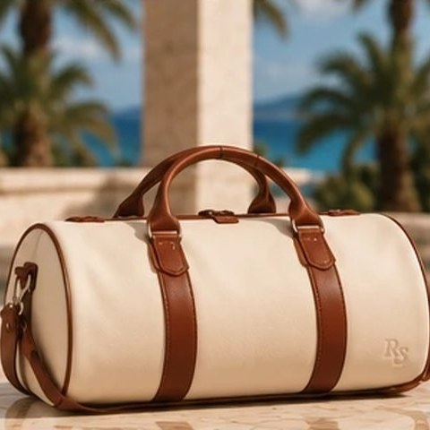
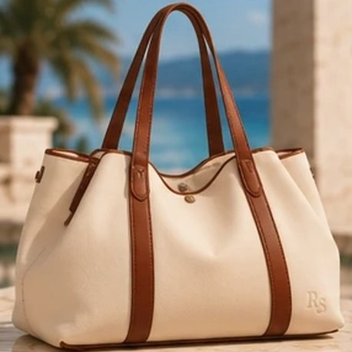
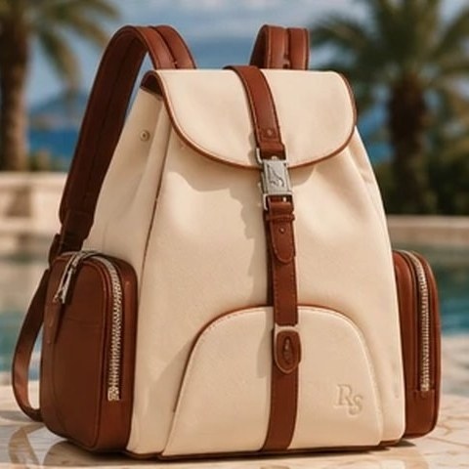
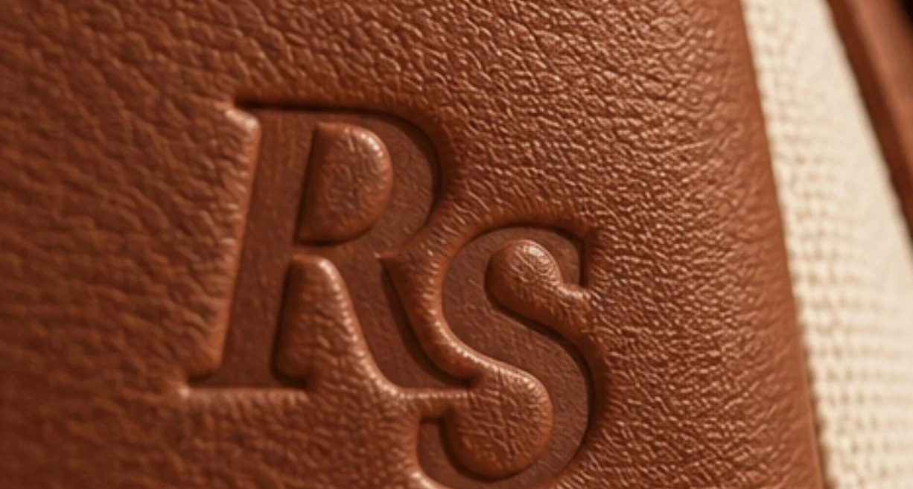
What we rejected, and why
DESIGN DECISIONS
REJECTED
REJECTED
REJECTED
REJECTED
Generic barrel duffel
Conventional beach tote
Drawstring heritage backpack
RESORT
SPORT
RESORT
Logo-heavy resort graphics
CHOSEN
CHOSEN
CHOSEN
CHOSEN
A lower, aerodynamic Monaco creates stronger distinction while keeping travel utility.
The extra-wide, scooped Riviera is more expressive and ownable.
Regatta trades flap and drawstring cues for zip access and a laptop compartment.
A small blind-debossed RS keeps the focus on the silhouettes.

Slide 20
Three decisions that determine success
WHAT WOULD CHANGE THE DECISION
01
02
03
DESIRABILITY
VALUE
DELIVERY
Do the designs create preference?
Will the target buyer trust the proposition?
Can the intended product promise be built?
Compare Portofino and Riviera against established sculptural bags. If preference is weak, refine product geometry before expanding the range.
Test material perception, price expectations and credibility signals. If price resistance dominates, reconsider specification or assortment, not just messaging.
Validate supplier costs, hardware, abrasion resistance and carry comfort. If quality at target prices is infeasible, prioritize fewer hero silhouettes.

Slide 21
The strategy makes choices
AN INTENTIONAL BRAND PLATFORM
POSITIONING
CUSTOMER
PORTFOLIO
Design-led leisure accessories, not logo-led status goods.
Buyers seeking distinctive design, tactile quality and versatile carry.
Five complementary silhouettes; hero signatures over assortment breadth.
PRICE ROLE
EXPRESSION
GROWTH
Accessible-premium, anchored to full-leather competitors, not discount luxury.
An optimistic resort editorial world with quiet product branding.
Permanent, recognizable products first; limited color issues later.

Slide 22
Sources and scope
SOURCES AND METHODOLOGY
RESEARCH
Bain & Company / Altagamma, June 25, 2026 luxury market outlook (market slide).
PRICE BENCHMARK
Longchamp US, Le Pliage Xtra full-leather collection (US retail).
DIRECT BRANDS
polene-paris.com · mansurgavriel.com · cuyana.com · demellierlondon.com · staud.clothing · byfar.com
QUALITY AND DESIGN REFERENCE
loewe.com · therow.com · peserico.com
METHOD
Comparisons reflect publicly presented product categories and brand positioning; assessment is qualitative.
SCOPE
Customer, market and product statements are hypotheses for validation, not research findings. Product images are conceptual renders. No equivalence of materials, build quality or consumer preference is asserted.

Slide 23
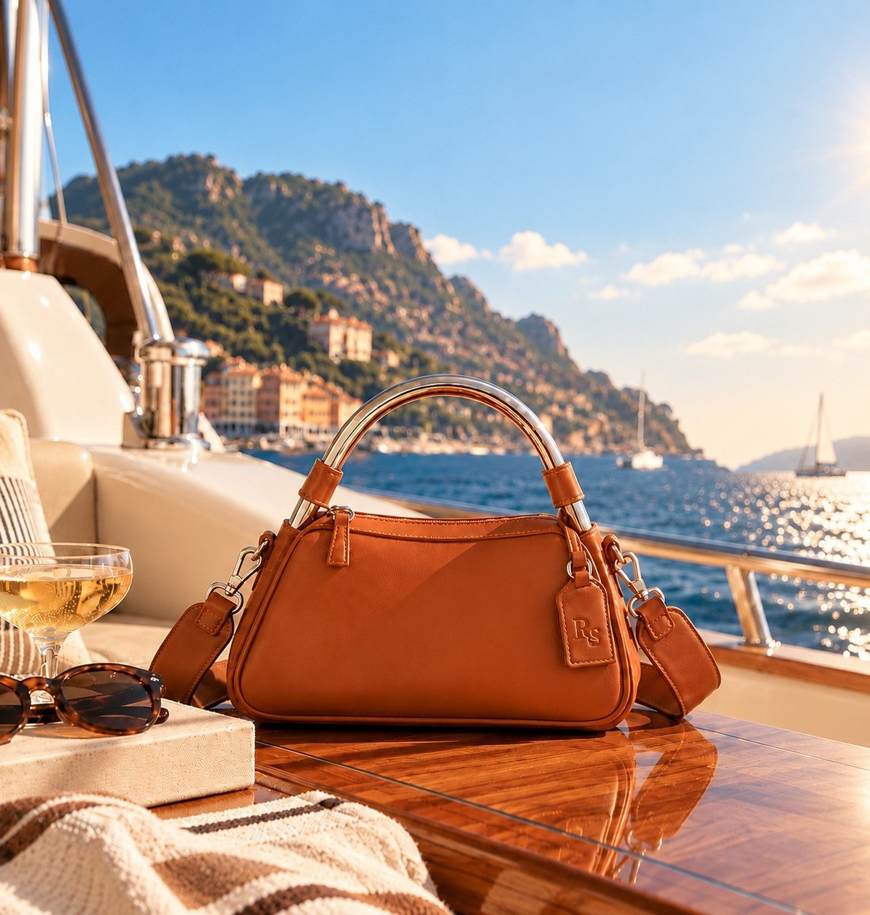

THE STRATEGIC OUTCOME
A different expression of luxury.
Resort Sport Ltd. brings the discipline of luxury design to the freedom of leisure. A deliberate position. Five complementary silhouettes. A cohesive creative and product language.
Luxury doesn't have to be serious to be considered.

