Slide 1
DEPARTMENT OF COMPUTER ENGINEERING AND COMPUTER SCIENCE
CUSTOM METRICS DRIVEN HORIZONTAL POD AUTOSCALING IN KUBERNETES
CECS 574 - Topics in Distributed Computing
Instructor: Prof. Pooria Yaghini
Presented By
Aravind Anand (030821269)
Dhanush Giddanapalya Chandrappa (031114146)
Hetvi Nimesh Choksi (030833294)
Nikita Lalwani (030861790)

Slide 2
Contents of the Presentation
01
02
03
04
05
06
Introduction
HPA
Custom Metrics
Basics of Containerization and Kubernetes
Understanding the Horizontal Pod AutoScaler (HPA)
Overview and the need for Custom metrics
Architecture
Implementation
Use-cases
The Setup required for using Custom Metrics
A demo of autoscaling with Custom Metrics
The real-world uses of custom metrics driven HPA
1 / 23

Slide 3

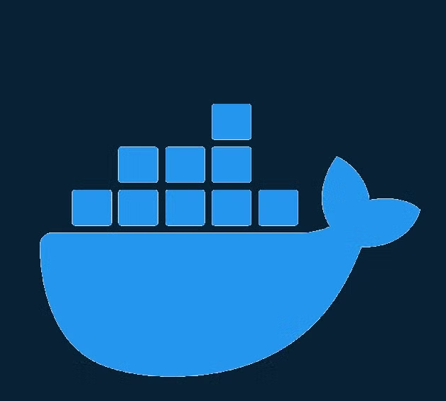
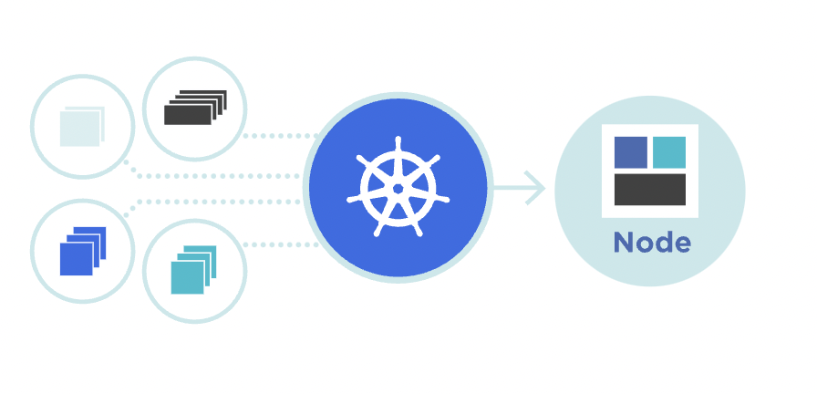
Containerization & Orchestration
The History:
Containerization Origins: Rooted in technologies like FreeBSD Jails and Solaris Zones, which offered resource segregation and isolation.
Docker Revolution: Docker, launched in 2013, simplified container deployment and drove widespread adoption.
Container Orchestration: Tools like Mesos, Docker Swarm, and Kubernetes emerged to manage growing container usage and complexity.
Containerization
Docker
Orchestration
2 / 23

Slide 4
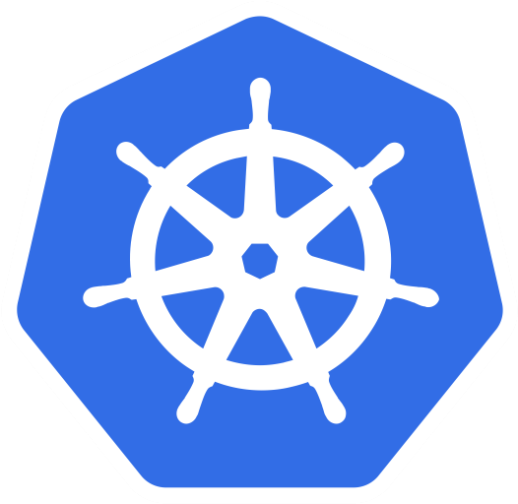
Overview of Kubernetes
Kubernetes Origins: Developed by Google, now maintained by the Cloud Native Computing Foundation (CNCF).
Open-Source Platform: Automates deployment, scaling, and management of containerized applications.
Cluster Management: Manages containers at scale with features like load balancing, self-healing, and rolling updates.
Simplifies Operations: Abstracts container management complexities, allowing developers to focus on application development over infrastructure.
Kubernetes
3 / 23

Slide 5
Basic Terminologies in Kubernetes
Deployment: Manages the rollout and scaling of a set of identical pods. It ensures the desired number of replicas are running at all times.
Service: Exposes a set of pods to the network, providing stable endpoints for communication. Services can load balance traffic to multiple pod replicas.
ConfigMap: Stores configuration data in key-value pairs, which can be injected into pods as environment variables or configuration files.
Pod: The smallest, most basic deployable unit in Kubernetes, consisting of one or more containers that share storage and network.
Namespace: A way to divide cluster resources between multiple users or applications, providing isolation for workloads.
4 / 23

Slide 6
Importance of Scaling in Container Orchestration
Scaling in Kubernetes: Adjusts resources (pods/deployments) to handle fluctuating traffic patterns dynamically.
Two Forms of Scaling
  Horizontal Scaling: Adds or removes pod replicas based on workload changes.
  Vertical Scaling: Adjusts CPU and memory allocation for individual containers.
Benefits of Scaling:
  Enhances application performance.
  Maintains system reliability.
  Reduces operational costs by aligning resources with real-time demand.
Consequences of Ineffective Scaling:
  Under provisioning leads to poor performance.
  Overprovisioning results in unnecessary resource consumption.
5 / 23

Slide 7
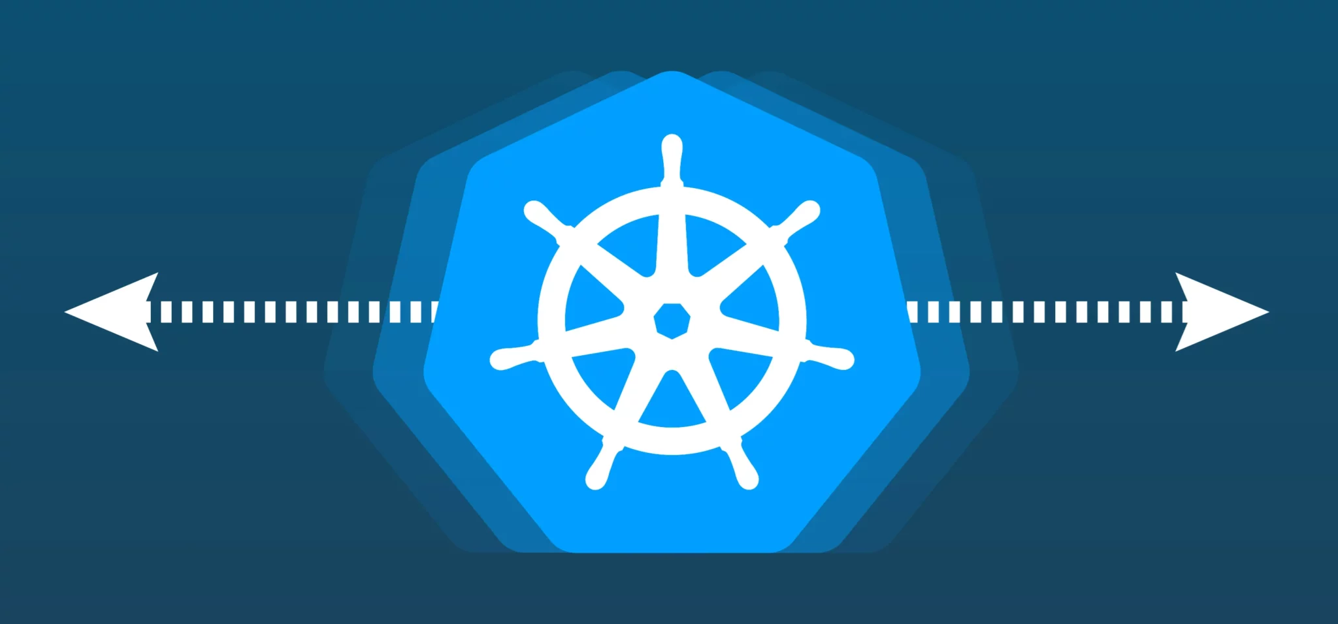
Understanding Horizontal Pod Autoscaler (HPA)
Horizontal Pod Autoscaler (HPA): A Kubernetes feature that adjusts the number of pods in a deployment or stateful set based on metrics.
Horizontal Scaling: HPA increases or decreases pod replicas in response to workload demands.
Resource Efficiency: HPA optimizes resource utilization by adjusting pods based on real-time metrics.
Replica Count Control: HPA directly impacts the desired replica count to maintain optimal performance.
Kubernetes HPA
6 / 23

Slide 8
How HPA Works?
HPA Monitoring: Continuously tracks pod performance metrics and adjusts pod count based on predefined thresholds.
Process of HPA:
  Monitoring: HPA fetches pod metrics (e.g., CPU usage) from the Kubernetes Metrics Server.
  Calculation: HPA calculates whether to scale up or down based on the average observed metrics.
  Scaling: HPA scales up when the metric exceeds the target and scales down when below, optimizing resource usage
7 / 23

Slide 9
Default Metrics Used by HPA
CPU Utilization:
  HPA scales pods based on CPU utilization by default, targeting a percentage of the requested CPU per pod.
  If average CPU usage exceeds the target, HPA increases pod count.
Memory Utilization:
  HPA can be configured to scale based on memory usage during high-demand periods.
8 / 23

Slide 10
Need for Custom Metrics in HPA
Limitations of Default Metrics:
  Default CPU and memory metrics are insufficient for complex applications.
  Cannot scale based on specific application requirements (e.g., request processing speed).
Scenarios Requiring Custom Metrics:
  Scaling based on application-specific performance (e.g., HTTP request rate, database latency).
  Dynamic scaling for business use cases (e.g., active users, queue length).
9 / 23

Slide 11
Custom Metrics Overview
HPA supports custom metrics for tailored scaling, helping maintain performance under varying workloads.
What Are Custom Metrics?:
  Application-specific metrics beyond basic resource usage.
  Metrics can reflect business logic or performance needs.
Types of Custom Metrics:
  Business Metrics: Revenue per transaction, user activity.
  Application Performance Metrics: Request rate, error rates, queue length.
10 / 23

Slide 12
Setting Up Custom Metrics in Kubernetes
Components and Tools Involved:
  Horizontal Pod Autoscaler (HPA): Configured with custom metrics enabled for dynamic scaling.
  Metrics Monitoring: Scrapes and monitors metrics from the application.
  Metrics Adapter: Provides metrics to Kubernetes through the Custom Metrics API, enabling scaling decisions.
High-Level Architecture:
  Application exposes custom metrics.
  Metrics are collected by a monitoring tool.
  A metrics adapter provides metrics to Kubernetes via the Custom Metrics API.
  HPA uses these metrics to dynamically autoscale pods.
11 / 23

Slide 13
Implementation of Custom Metrics
Acts as a message queuing system, processing tasks and tracking queue_length as the custom metric.
An Orchestrator Application: A deployment that acts as a message queuing system, processing tasks and tracking queue_length as the custom metric.
Task Details: Each task includes a Timestamp, Task Name, Status (READY, IN_PROGRESS, COMPLETED), and Processing Time.
Custom Metric: queue_length represents the number of tasks in READY status.
Monitoring Tool: Prometheus is used to scrape and monitor the custom metric.
Metrics Adapter: Prometheus Adapter bridges the custom metrics with Kubernetes.
Horizontal Pod Autoscaler (HPA): Automatically scales the orchestrator deployment based on the queue_length metric.
12 / 23

Slide 14
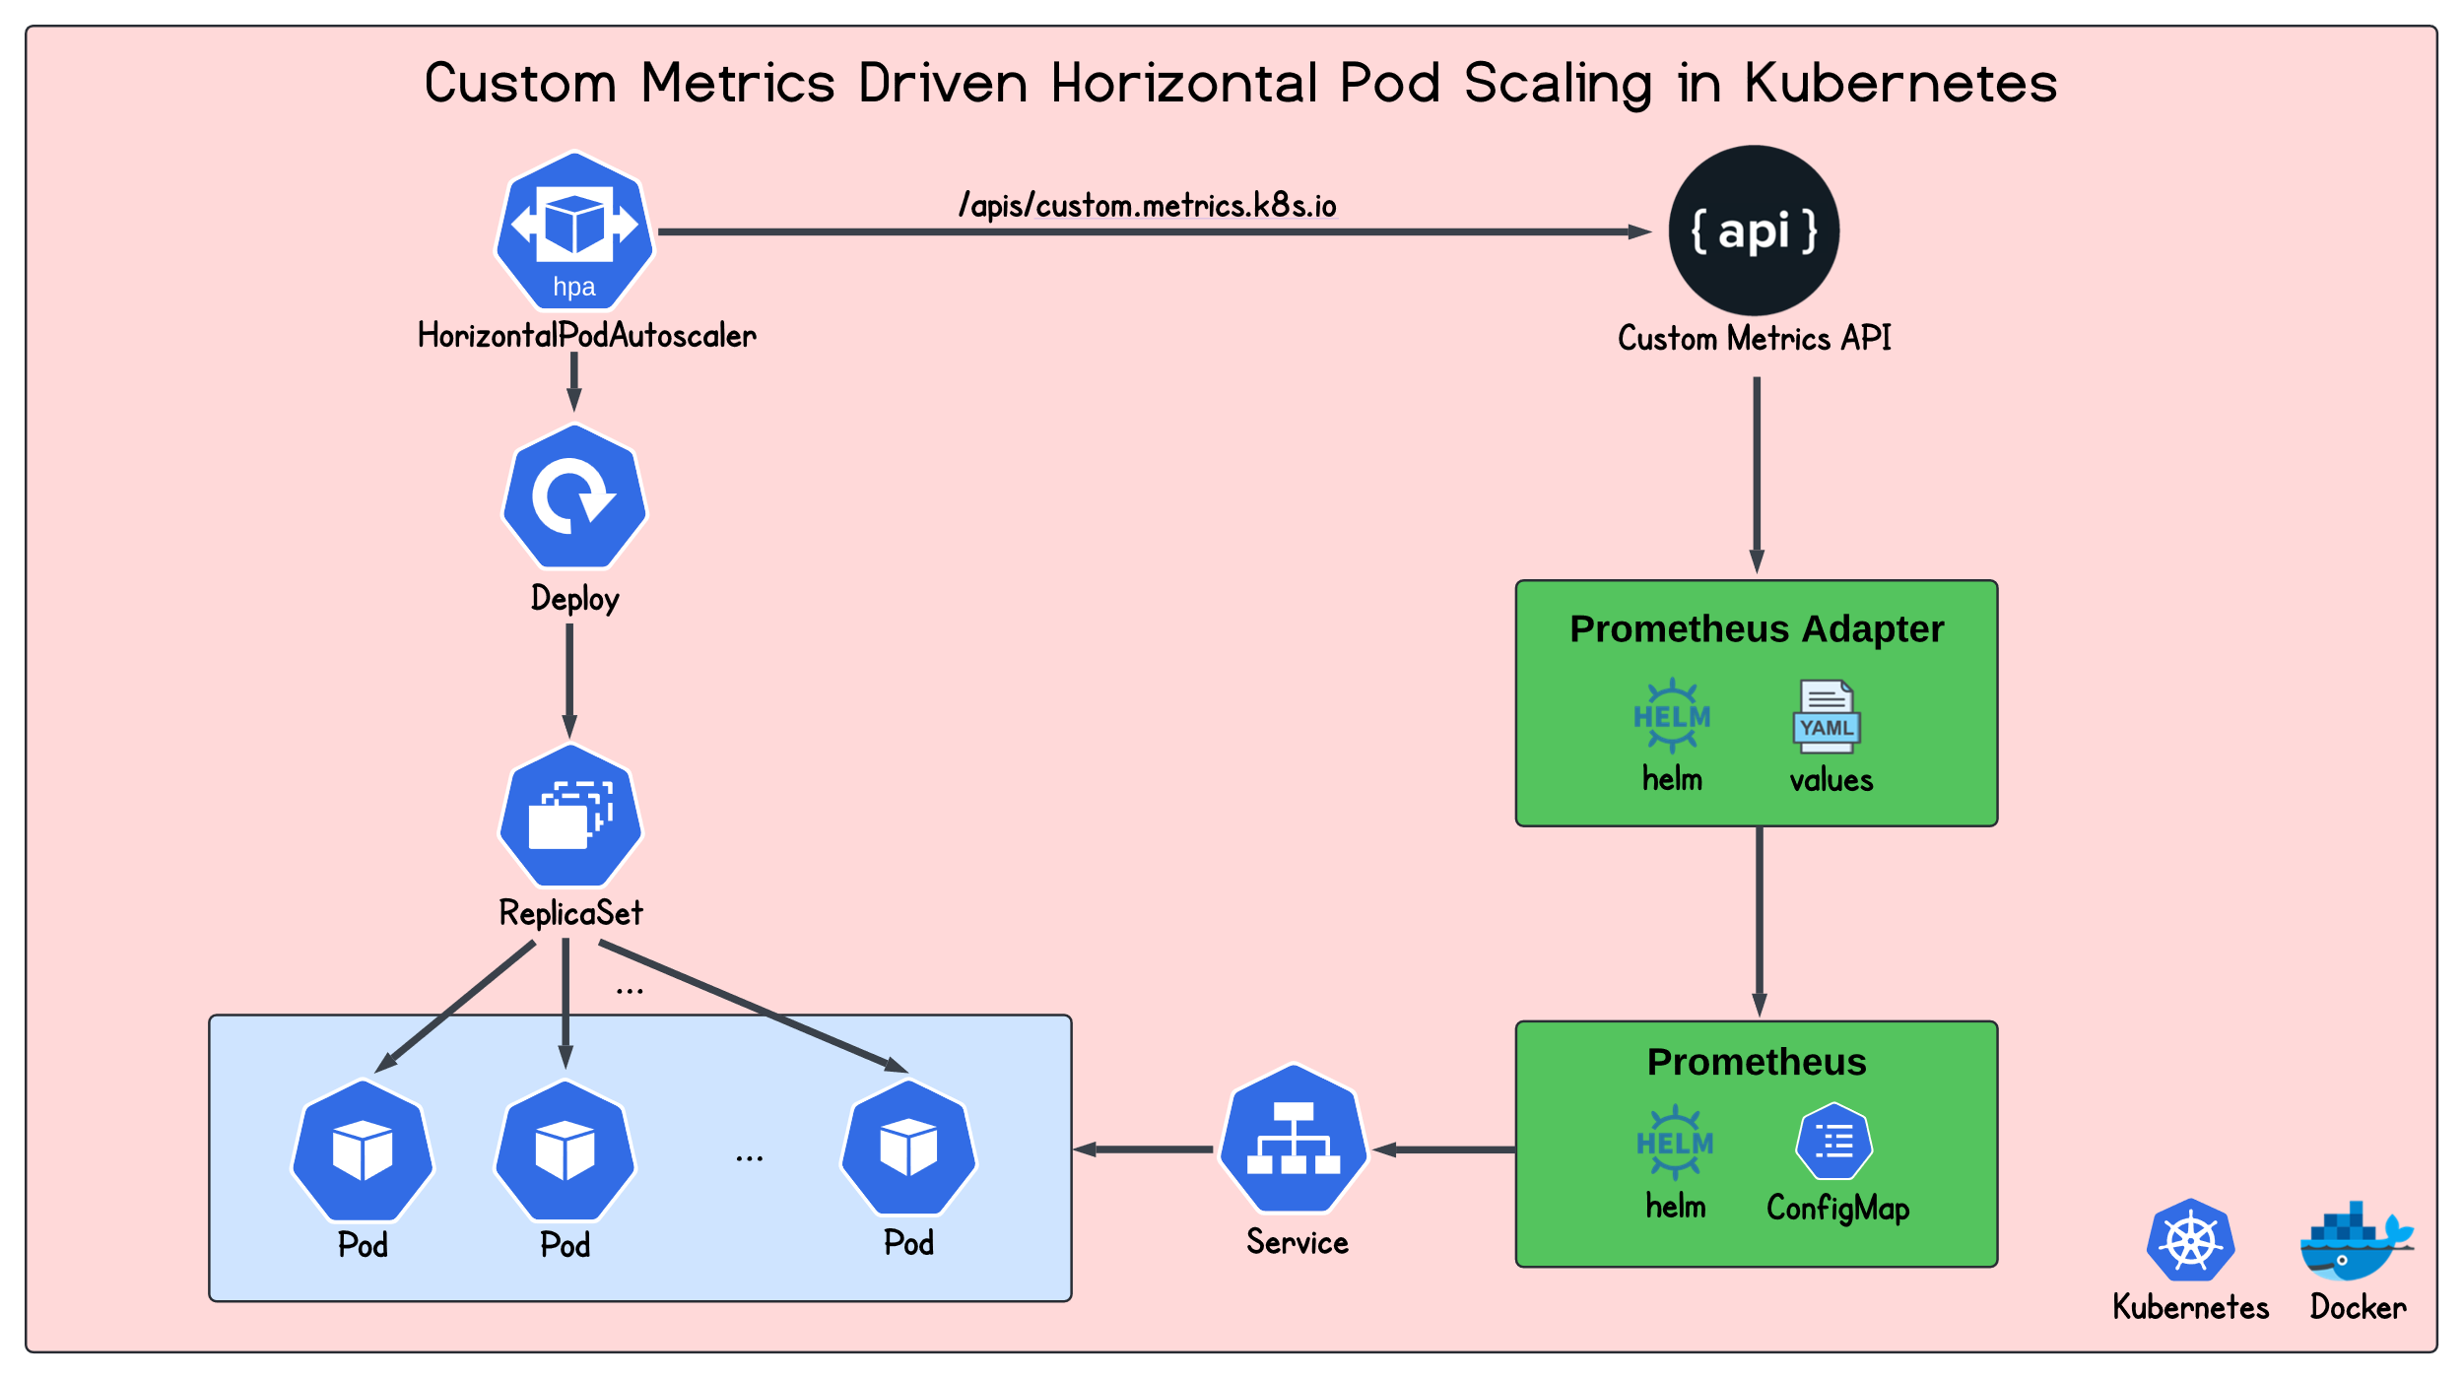
WORKFLOW!
13 / 23

Slide 15
Technology Stack
Technology | Usage | Additional Details
Docker | For running MySQL Container and Kubernetes cluster. | Docker (v27.0.3), Docker Desktop, MySQL 8.0
Spring Boot | Backend framework for the Orchestrator Application. | Maven, Spring Boot (v3.3.4), Spring Data JPA for database Interaction
Minikube | For Kubernetes cluster creation and management. | Minikube (v1.31.1)
ReactJS | Frontend for adding and viewing tasks. | Uses material UI for components
Helm | For managing Kubernetes application deployment. | For Prometheus and Prometheus Adapter installation with custom value files
14 / 23

Slide 16
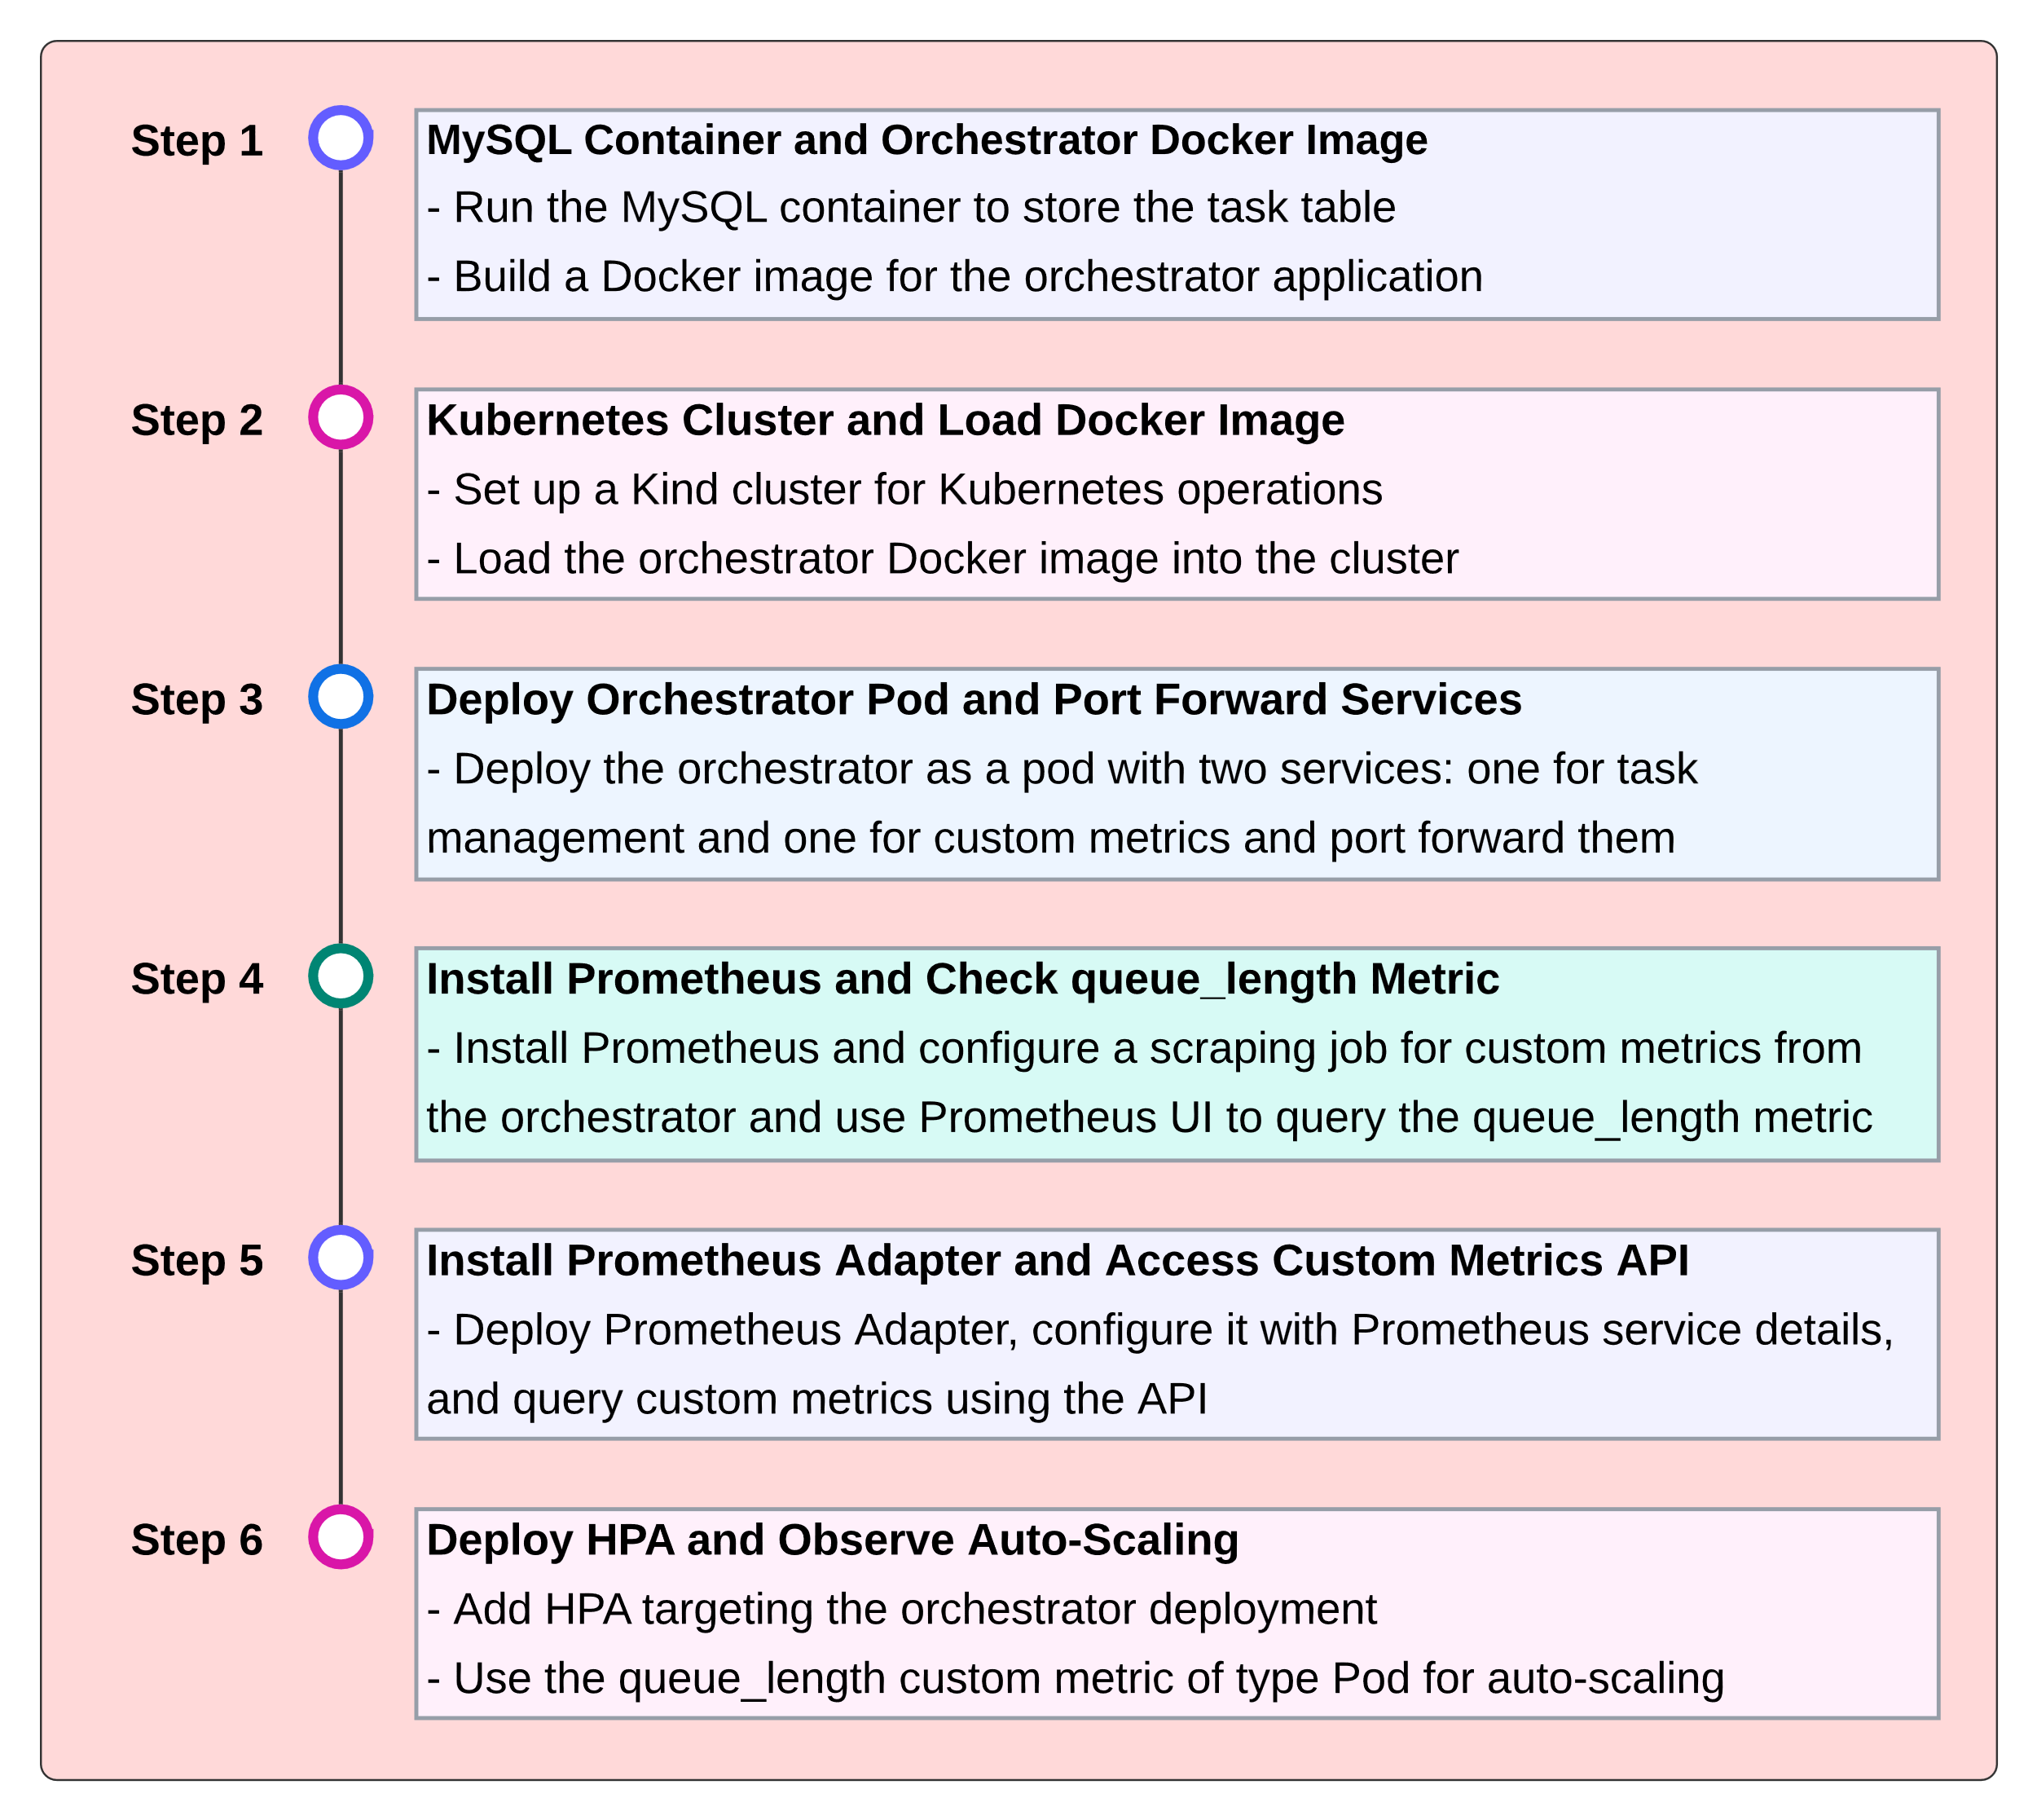
IMPLEMENTATION
OVERVIEW
15 / 23

Slide 17
DEMO!
The Implementation of the HPA using Custom Metric (queue_length)
Access Project files here!
16 / 23

Slide 18
Application Interface Components
Queue Length Viewer:
Fetches and displays the queue_length custom metric from Prometheus via an API call, with error handling and a formatted display.
Add Task Functionality:
Allows users to create tasks by inputting task name and processing time, with form validation and success/error notifications.
Task Queue Display:
Displays tasks in a grid with details like task name, status, and processing time, with a refresh button to update the list.
Task Management:
Provides options to reschedule or delete selected tasks, with actions enabled only when a task is selected and updates the list dynamically.
17 / 23

Slide 19
Backend Spring Boot Application - Orchestrator
Task Entity: Defines Task with attributes like id, name, status, taskTime, and created_time.
TaskRepository: Provides methods to find tasks by status and retrieve the first "ready" task.
Task Controller:
  Prometheus Integration:
    Tracks queue_length using a Gauge.
    Exposes metrics via Prometheus HTTP Server.
  Task Endpoints:
    Create, reschedule, delete, and fetch tasks via REST APIs.
  Scheduler:
    Updates queue_length and processes tasks at fixed intervals.
    Manages task lifecycle (READY, IN_PROGRESS, COMPLETED).
18 / 23

Slide 20
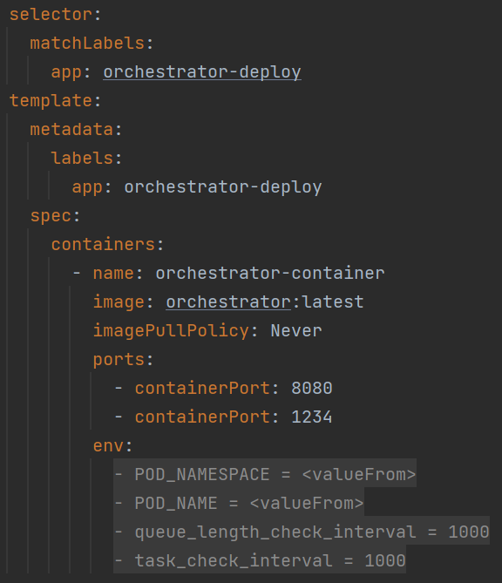
Orchestrator Deployment
The orchestrator.yaml defines a deployment named orchestrator-deploy.
It runs a container using orchestrator:latest image and exposes two ports: 8080 for the application's API and 1234 for Prometheus metrics.
The environment variables include POD_NAMESPACE and POD_NAME, which are automatically set from Kubernetes metadata.
The queue_length_check_interval determines how often to check the current queue length
The task_check_interval defines how often tasks are checked and processed.
The deployment includes two services: orchestrator-service to expose the application API on port 8080, and orchestrator-metrics to expose Prometheus metrics on port 1234.
19 / 23

Slide 21
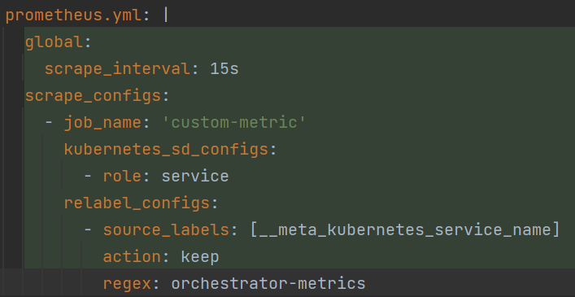
Prometheus and Prometheus Adapter Values
Prometheus Configuration:
Defines a scraping job for custom metrics.
The job custom-metric is configured to scrape metrics from the orchestrator-metrics service.
The scrape interval determines how frequently Prometheus collects metrics.
Prometheus Adapter Configuration:
The metrics query fetches the queue_length custom metric from Prometheus.
Maps the queue_length metric to Kubernetes resources like namespace and pod.
Enables Kubernetes to use this custom metric (queue_length) for scaling decisions.
20 / 23

Slide 22
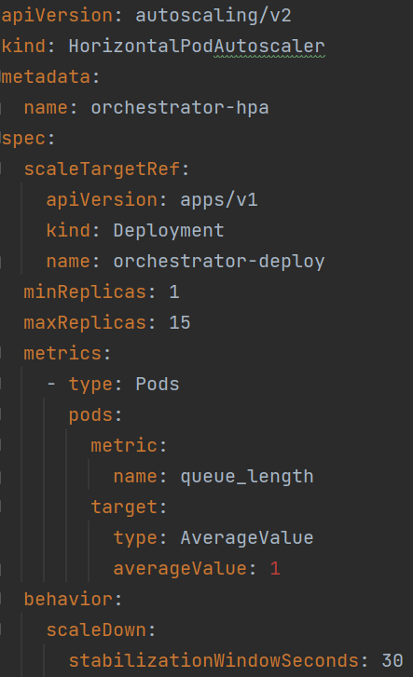
Horizontal Pod Autoscaler (HPA) Configuration
Target: scaleTargetRef defines the deployment to be replicated and this setup scales the orchestrator-deploy deployment.
Replica Range: Min replicas: 1, Max replicas: 15.
Custom Metric: Uses queue_length as the metric to trigger scaling based on the number of tasks in the queue.
Scaling Policy: Adjusts pod replicas based on the queue_length average value, with a target of 1.
Scale-Down Behavior: The stabilization- WindowSeconds is set to 30 seconds, defining the time interval for scaling down.
21 / 23

Slide 23
Real World Use Cases of Custom Metrics
E-commerce Platform Scaling Based on Order Volume
  custom metrics like the number of incoming orders, rather than just CPU or memory usage
Video Streaming Service Scaling on Concurrent Streams
  Automatically scale media transcoding services based on the number of active video streams
IoT Data Processing Scaling on Event Ingestion
  For IoT platforms, scale up or down based on the rate sensor data events
Financial Trading System Scaling on Transaction Load
  custom metrics like transaction volume or the number of completed trades
Machine Learning Model API Scaling Based on Prediction Requests
  custom metrics like the number of incoming prediction requests or the average response time
And much more…
22 / 23

Slide 24
Conclusion
Custom Metrics Driven HPA in Kubernetes allows for efficient scaling beyond default CPU and memory metrics.
Scaling based on application-specific metrics like queue_length improves resource utilization and system performance.
The implementation leverages tools such as Prometheus for metric scraping and Prometheus Adapter to integrate these metrics with Kubernetes for autoscaling.
The Horizontal Pod Autoscaler (HPA) dynamically adjusts pod replicas, ensuring that the application scales according to real-time workload demands.
This solution is highly adaptable, making it ideal for complex, business-specific scaling needs in diverse use cases like e-commerce, IoT, and financial systems.
23 / 23

Slide 25
THANK YOU!
Any Questions?

