Slide 1
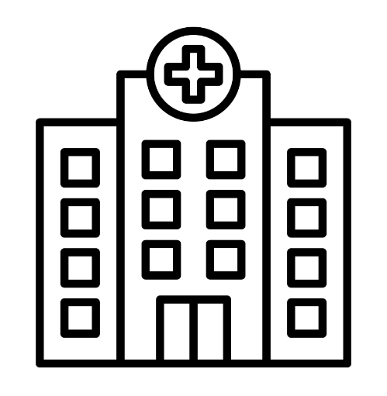
HOSPITAL MANAGEMENT SYSTEM

Slide 2


INDEX
Introduction
Features
Data flow diagram
User related features
Admin related features
Doctor related features
ER diagram
Use case diagram
Conclusion
References

Slide 3


INTRODUCTION
The Hospital Management System (HMS) is designed to streamline hospital operations,
making it easier to manage patient information, doctor schedules, and administrative tasks.
Key objectives include:
Improving patient care through efficient management.
Reducing administrative workload.
Enhancing data accuracy and security.

Slide 4

FEATURES

Slide 5
FEATURES
AUTHENTICATION
Secure login system for different types of users (patients, doctors, admins).
USER MANAGEMENT
Register new patients
Book and manage appointments
DOCTOR MANAGEMENT
Set and update Availability
Cancel and manage appointments
ADMIN FUNCTIONS
Add or remove user or doctors
Manage overall hospital schedules and appointments.

Slide 6
DATA FLOW
DIAGRAM

Slide 7


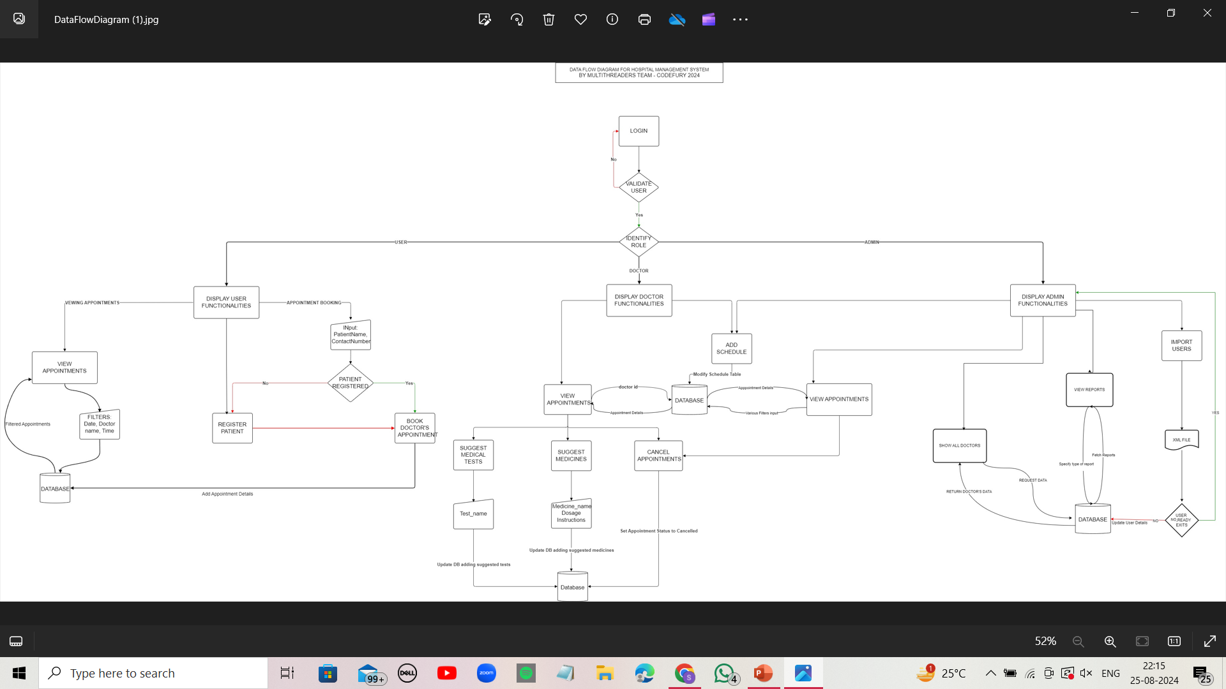

Slide 8

USER
RELATED
FEATURES

Slide 9
BOOKING APPOINTMENTS
Users can search for doctors by specialization.
View available slots based on the selected doctor and date.
Book appointments directly through the system.
Patients can check available slots for a doctor on a particular date before booking.
REGISTERING A PATIENT:
New patients can register by providing their name, contact details, and other relevant information.
System automatically assigns a unique patient ID.

Slide 10
DOCTOR RELATED
FEATURES

Slide 11
MANAGING SCHEDULE:
Doctors can set their availability every three days.
Scheduling is allowed only for the upcoming three days and is repeated exactly every three days.
Example: If today is Monday, the schedule can be set for Tuesday, Wednesday, and Thursday only.
CANCELLING INDIVIDUAL APPOINTMENTS
Doctors have the ability to cancel specific patient appointments.
Patients receive notifications about appointment cancellations.
The system updates the appointment status to "Cancelled."

Slide 12
ADDING SLOTS:
Doctors can add new available slots every three days, ensuring no overlapping with other appointments.
The system automatically restricts doctors to set availability for only the next three days.
UPDATING AVAILABILITY:
Doctors can update their status from "Available" to "Unavailable."
When availability is changed:
All future slots for that period are canceled.
Patients with booked appointments in those slots are notified about cancellations.
The system updates the appointment and slot status.

Slide 13
ADMIN
RELATED
FEATURES

Slide 14
ADDING DOCTORS AND USERS:
Admins have the authority to add new doctors and users (patients).
A user form collects necessary information like name, contact details, and specialization for doctors.
A unique ID is generated for each new user.
GENERATING REPORTS :
Patient Reports: Details of appointments, history, and upcoming schedules.
Doctor Reports: Information on doctor schedules, patient appointments, and availability.
User Reports: General reports on system usage, user engagement, and appointment metrics.

Slide 15
UPDATING DOCTOR SCHEDULE:
Admins can modify a doctor's schedule from "Available" to "Unavailable."
This action automatically cancels all slots and appointments scheduled for that period.
Patients are notified of any cancellations.
CANCELING INDIVIDUAL APPOINTMENTS:
Admins can cancel specific patient appointments on behalf of doctors.
Patients receive notifications about these cancellations.

Slide 16
REMOVING EMPLOYEES
Admins can deactivate employees (doctors or other staff) by setting their isActive status to false.
Deactivated users cannot log in or access the system.
Existing appointments associated with the deactivated doctor are canceled and affected patients are notified.

Slide 17
AUTHENTICATION
FEATURES

Slide 18
SECURE LOGIN SYSTEM:
Each user type (patient, doctor, admin) has a unique login.
Passwords are securely hashed and stored.
ROLE BASED ACCESS CONTROL:
Patients can book and view their appointments.
Doctors can manage their schedule and patient appointments.
Admins have full access to manage users, doctors, and system settings.

Slide 19
ER
DIAGRAM

Slide 20
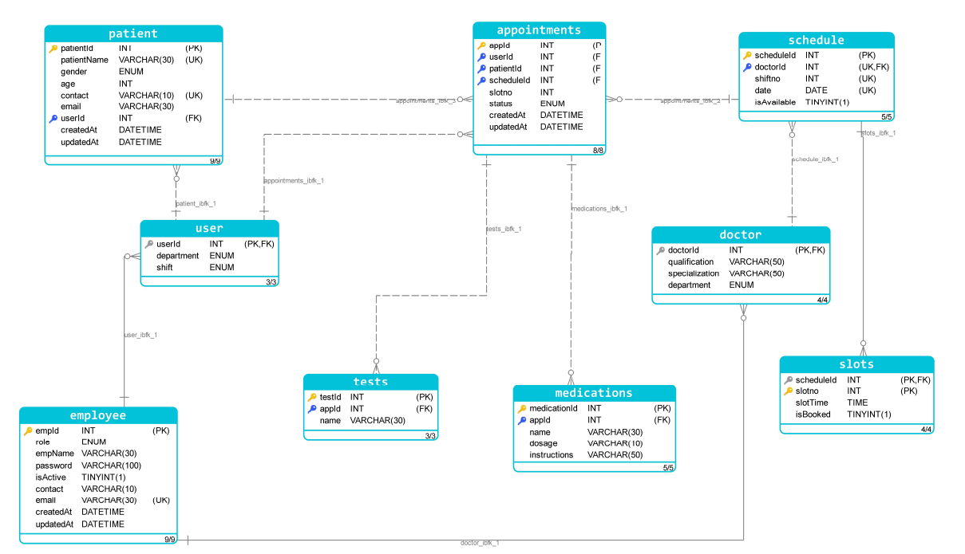

Slide 21

USE CASE DIAGRAM

Slide 22
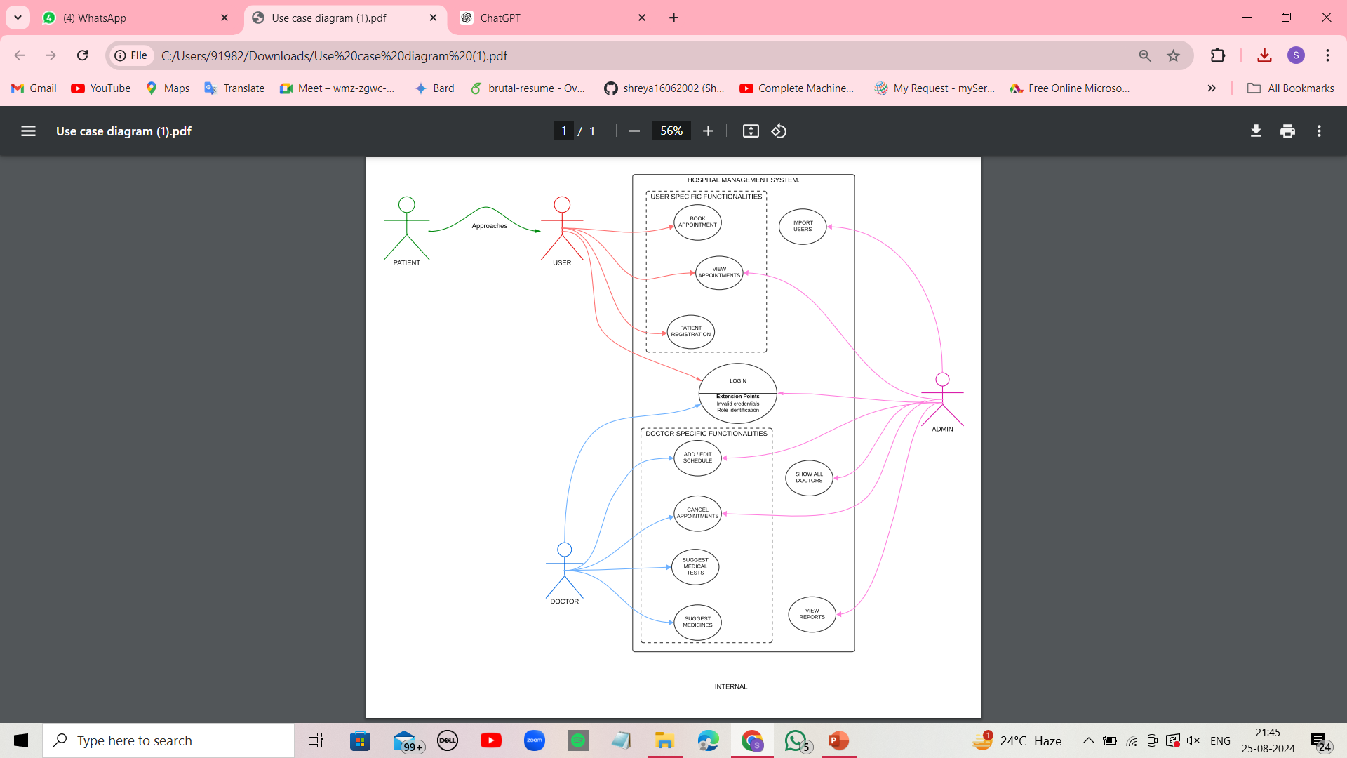

Slide 23

CONCLUSIONS

Slide 24
The Hospital Management System offers a comprehensive solution to manage hospital operations effectively.
Enhances patient care through efficient scheduling and appointment management.
Provides robust tools for doctors and admins to manage their tasks.
Future developments can include more sophisticated analytics and patient feedback systems.

