Slide 1
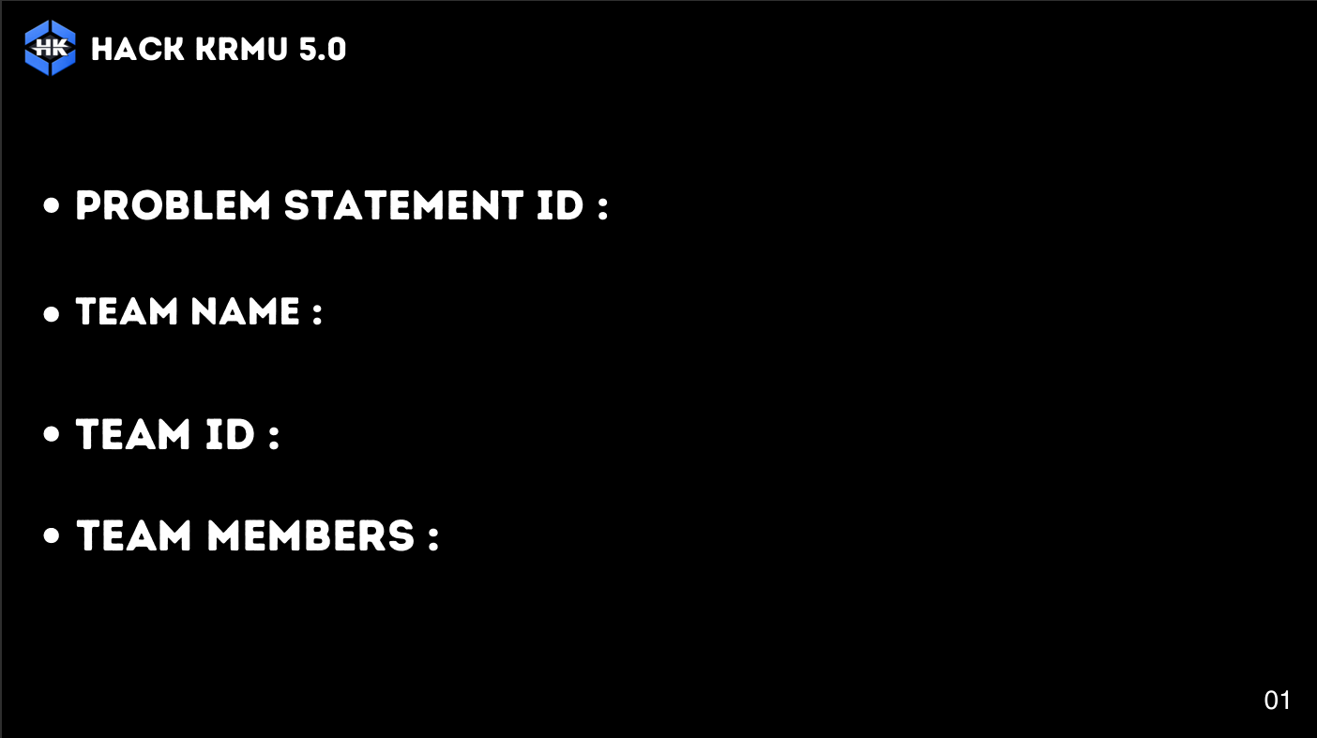
HK-SAFETY-012
Error 404
HK-84
Ashish Yadav (2301010413)
Kundan Singh (2301010404)
Ritik Kumar (2401730227)
Harshit Jaiswal (2301010397)

Slide 2
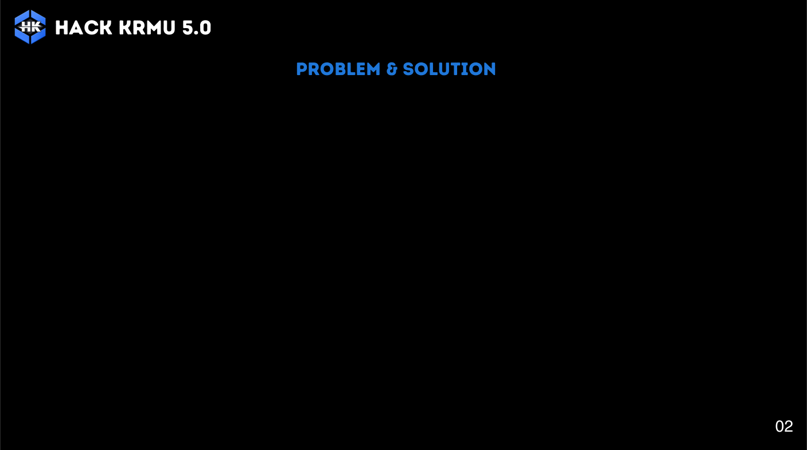
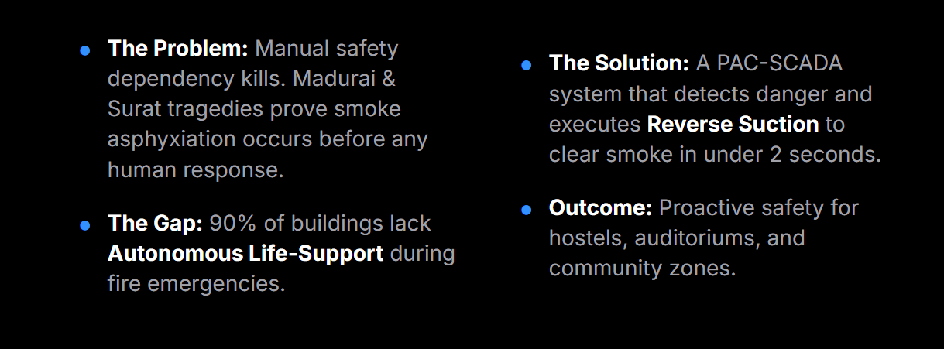

Slide 3
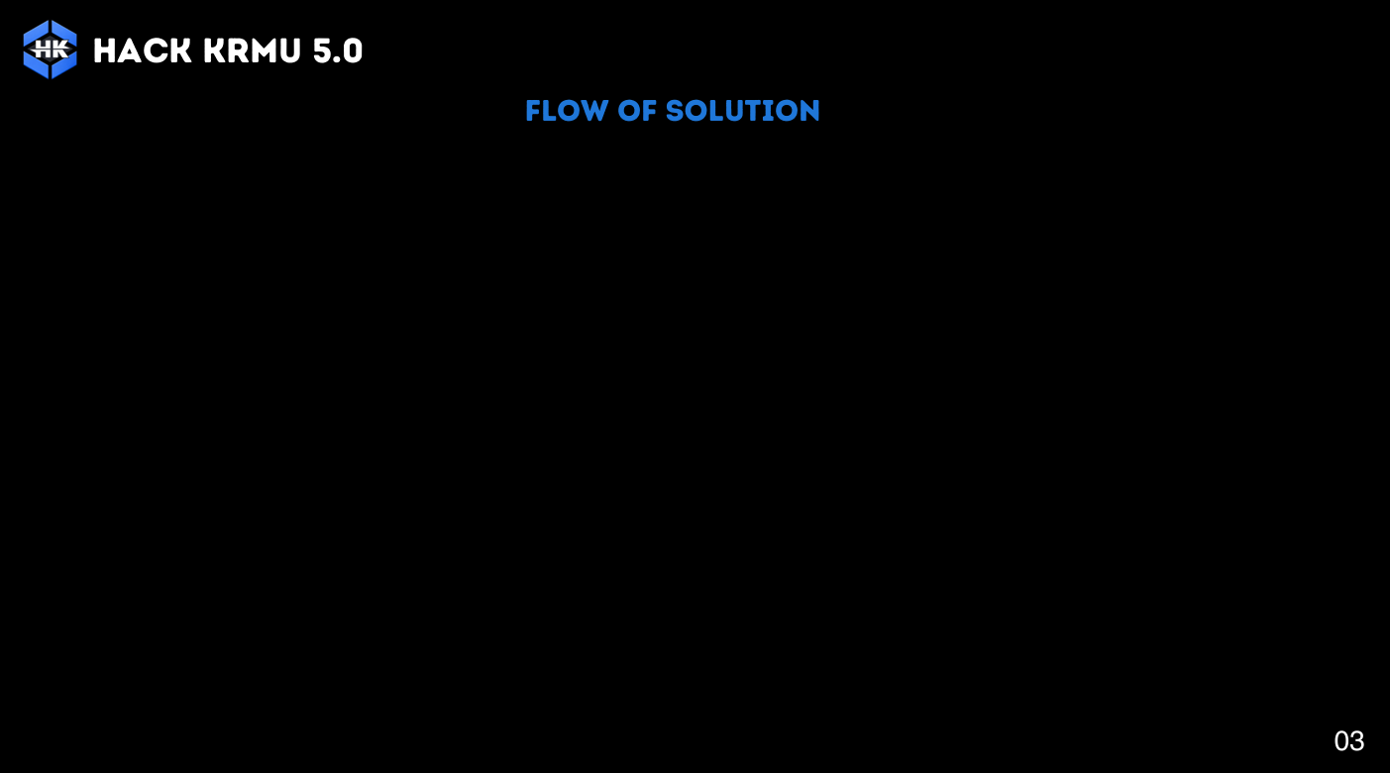

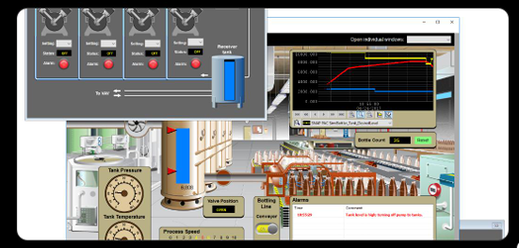

Slide 4

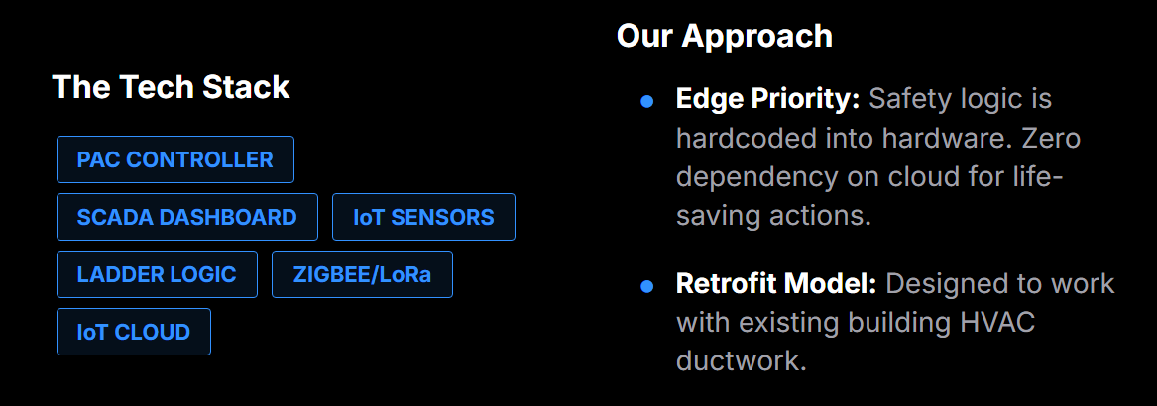

Slide 5



Slide 6
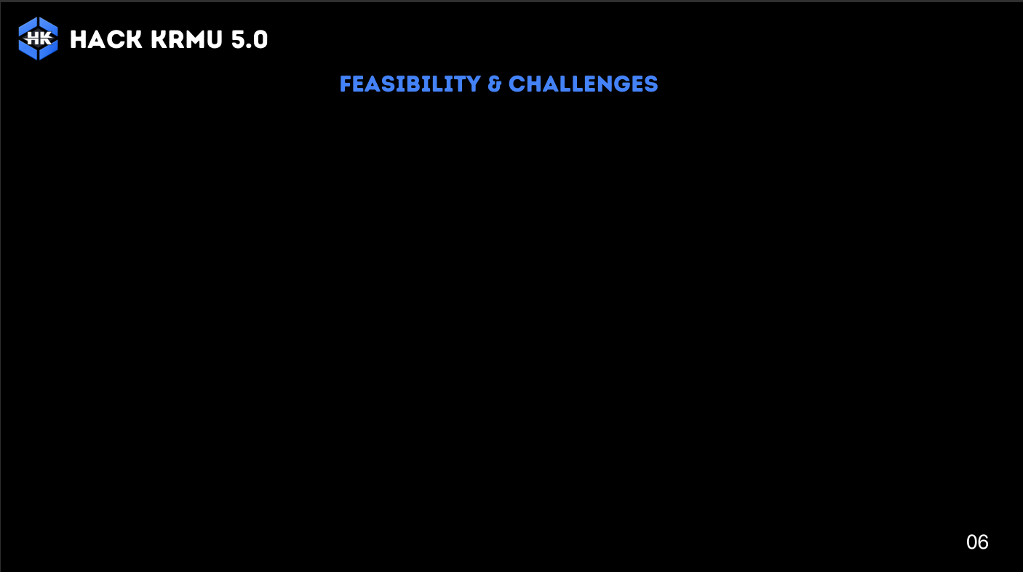


Slide 7
