Slide 1
SAC Neural Network Architecture Comparison
Battery arbitrage case study | 1000 random 24-hour evaluation windows per architecture
Best Architecture
[256,256,256]
Mean RL Cost
-11.13 EUR
RL - Pyomo
-2.85 EUR
Speedup
41.9x
Key takeaway
Moderate depth performed best: the three-layer [256,256,256] SAC policy achieved the lowest mean evaluation cost among the six tested architectures.
Source: model_comparison.txt snapshots from the last 6 architecture commits.

Slide 2
Architecture Ranking
Ranked by mean RL cost. Lower / more negative cost is better.
Rank
Architecture
RL cost mean +/- std
RL - Pyomo
Abs. gap
Speedup
1
[256,256,256]
-11.1282 +/- 2.8993
-2.8526
2.9434
41.93x
2
[128,128]
-11.0937 +/- 3.3805
-2.6163
2.7480
43.77x
3
[768,768]
-11.0876 +/- 2.8875
-2.8010
2.8962
50.52x
4
[512,512]
-11.0521 +/- 3.2562
-2.6413
2.7600
44.45x
5
[256,256]
-10.9481 +/- 2.8097
-2.6798
2.7890
43.60x
6
[512,512,512]
-10.9336 +/- 3.1466
-2.6985
2.7863
48.20x
Interpretation: larger networks helped up to a point, but simply widening the policy did not monotonically improve cost.

Slide 3
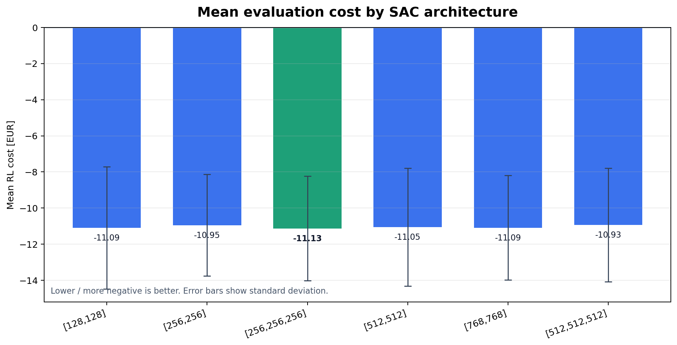
Mean Cost by Architecture
Best by mean cost: [256,256,256]. Error bars show variability across the 1000 evaluation windows.

Slide 4
How to Present the Result
Recommended claim
The [256,256,256] SAC architecture was selected because it achieved the lowest mean evaluation cost while preserving real-time inference.
[256,256,256] achieved the best mean RL cost: -11.1282 EUR.
Very wide models such as [768,768] did not clearly outperform the moderate-depth model.
All tested architectures retained fast inference compared with Pyomo.
Use this as evidence for architecture selection, not as proof of global optimality.
Caveat for thesis defense
The comparison windows were sampled randomly in each run; the final ranking should be confirmed with fixed windows and seeds before making a strong statistical claim.

