Slide 1
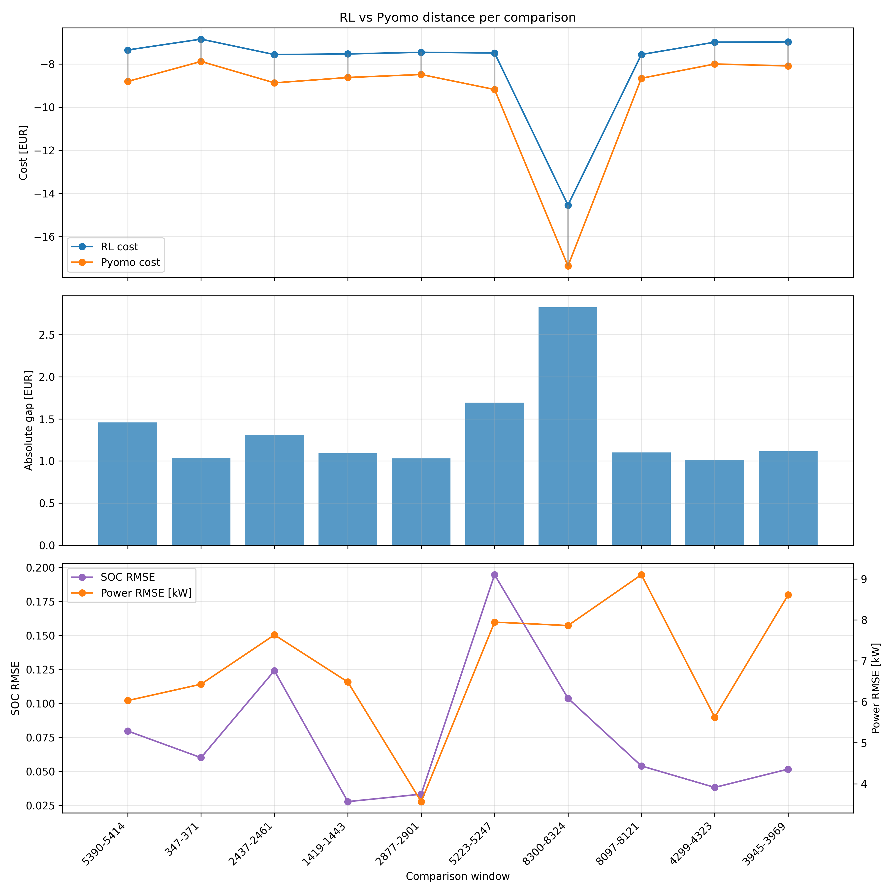
Battery Model: RL Policy vs Pyomo Baseline
A compact validation case before the nonlinear cookie-factory energy system
Why include it
Clean storage use case: electricity-price arbitrage with SOC and power limits
Shows the same thesis question in a simpler, explainable setting
Key comparison over 10 random 24h windows
Cost gap
+1.225 EUR
RL vs Pyomo, 13.4% worse
Inference speed
7.23x faster
0.021s RL vs 0.152s Pyomo
MDP formulation
State: SOC, current price, time, feasible charge/discharge limits, 24h forecast
Action: continuous a in [-1, 1], scaled to battery power
Reward: -grid cost - infeasible-action penalty
Dynamics: SOC(t+1) = SOC(t) + P_actual * dt / E_max
Training and benchmark
SAC learns a continuous charge/discharge policy on random 24h price windows
Pyomo/IPOPT solves the finite-horizon mathematical optimization baseline
Learning-rate schedules were tested; linear was marginally best in mean cost
Distance plot: cost, absolute gap, SOC RMSE and power RMSE per comparison window
Takeaway: RL gives near-instant decisions but still trails the optimizer; discuss terminal SOC and aligned cost definitions before claiming optimality.

Slide 2
Why Soft Actor-Critic (SAC)?
The control task needs continuous setpoints, sample-efficient learning, and stable exploration under changing electricity prices
Algorithm
Why it was not the main choice
Why SAC fits this thesis
Q-learning
Works best for small discrete states/actions; continuous battery power would need coarse discretization.
Continuous actor outputs the charge/discharge setpoint directly
Off-policy replay reuses simulation data efficiently
Entropy term keeps exploration alive during price spikes and SOC trade-offs
After training, inference is a direct state-to-action mapping
Same algorithm family can scale from battery power to cookie-factory continuous controls
DQN
Deep version of Q-learning, but still mainly discrete-action; loses precise setpoint control.
PPO
Can handle continuous actions and is stable, but on-policy learning usually needs more fresh simulation data.
DDPG
Continuous and off-policy, but deterministic exploration can be fragile for price-driven storage policies.
TD3
Strong deterministic baseline, but SAC gives more deliberate exploration through entropy regularization.
SAC was chosen for fit, not because simpler RL is invalid: it matches continuous, constrained, time-coupled energy setpoints.
Speaker note: mention that Q-learning is useful pedagogically, but discretizing power and SOC would make the policy less precise and harder to scale.

Slide 3
Next Step: Compare Reward Signals
Goal: identify whether policy quality is limited by the SAC algorithm, reward design, or constraint handling
Experimental design
Reward variants to test
What to measure
Keep SAC, model architecture, training budget and price windows fixed
Train each reward variant over multiple seeds
Evaluate on unseen 24h windows
Compare against Pyomo/IPOPT baseline
Use the same metrics for battery and cookie-factory studies
1. Cost only
Total operating cost
Constraint violation frequency and magnitude
Terminal SOC / TES error
Training stability across seeds
Inference time and qualitative policy behavior
r = - grid cost
2. Cost + constraints
penalize SOC/TES, mode and coupling violations
3. Terminal storage
penalize |final state - initial state|
4. Normalized reward
scale costs/penalties for steadier SAC updates
5. Shaped reward
small step-wise guidance for feasible storage behavior
Contribution: choose a reward that balances low cost, feasibility, and stable learning before final cookie-factory comparison.
Control variable: only reward changes
Deliverable: cost-feasibility trade-off plot
Speaker note: this turns reward design into an experiment instead of a tuning detail.

Slide 4
Second Use Case: RL vs Mathematical Optimization
Same time period comparison for the cookie-factory energy system; prioritize decision time for real-time operation
Primary result: computation time
Objective value
922.5x faster
RL
2669.56
Optimization
2418.92
RL: 0.02 s | Optimization: 18.45 s
Objective gap: +250.64 (10.4% higher for RL)
This is the strongest argument for RL in the second use case: once trained, the policy gives a near-instant setpoint decision while the mathematical optimizer must solve the nonlinear problem again.
The mathematical optimizer still gives the better objective value; the current RL value is a speed-quality trade-off, not an optimality claim.
How to present this result
Message: RL provides real-time feasible scheduling potential; optimization remains the quality benchmark.
Next work: compare reward signals to close the objective gap while keeping the 0.02 s inference advantage.
Speaker note: lead with time, then acknowledge the objective gap transparently.

