Slide 1
An adaptive multi-objective evolutionary algorithm based on grid subspaces
Memetic Computing (2021)
https://doi.org/10.1007/s12293-021-00336-7
Atefe Rajabi
40230563

Slide 2
Content
Methodology
Subspace System
Proposed AGMOEA
Subspaces division method based on the grid
Adaptive selection strategy of subspaces
Evolutionary scheme with adaptive solution selection
Adaptive crossover selection
Capacity management of subspaces
External archive extension mechanism
Problems
Result

Slide 3
AGMOEA: Subspaces division method based on the grid
Ideal point
nadir point
Each objective dimension
divides into K interval
grid interval vector
grid coordinate

Slide 4
AGMOEA: Subspaces division method based on the grid

Slide 5
Methodology: Subspace systems: Dominance relation
Subspace dominance (SD)
Strong Subspace dominance (SSD)
Weak Subspace dominance (WSD)

Slide 6
Methodology: Subspace systems: Dominance relation
K_1 = 1, 1
K_2 = 1, 2

Slide 7
AGMOEA: Adaptive selection strategy of subspaces
The smaller SR an individual has, the more evolutionary
opportunities it will get.
Subspace Ranking

Slide 8
AGMOEA: Adaptive selection strategy of subspaces
the subspaces selected from G–S will obtain evolutionary opportunities.

Slide 9
AGMOEA: Evolutionary scheme with adaptive solution selection
A smaller SWS value
means closer position to the ideal solution.

Slide 10
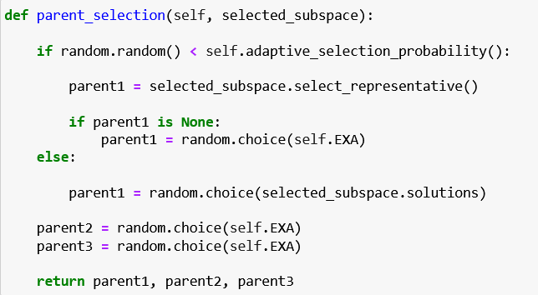
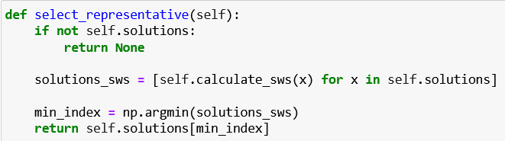
AGMOEA: Evolutionary scheme with adaptive solution selection

Slide 11
Crossover:
SBX
PCX
SPX: multimodality
BLX_alpha: surrounding area in the parameter space
DE/Rand/1: high-dimensional spaces

Slide 12
AGMOEA: (referenced other papers) Adaptive crossover selection
External Archive List:
Solution made by Crossover1
Solution made by Crossover1
Solution made by Crossover2
Solution made by Crossover2
Solution made by Crossover1
Solution made by Crossover3
Solution made by Crossover1
Solution made by Crossover2
Roulette Wheel mechanism:
r1
r2
r1
r2
r1
r2
r1
r3

Slide 13
Mutation:
Polynomial

Slide 14
EXA Extension:
Local search based on subspace
Capacity Management
Divide into Subspace
Generate Offspring

Slide 15
Benchmark Problem:
WFG series:
WFG1
WFG2
WFG3
…
Pymoo Library
HV
IGD
Problems

Slide 16
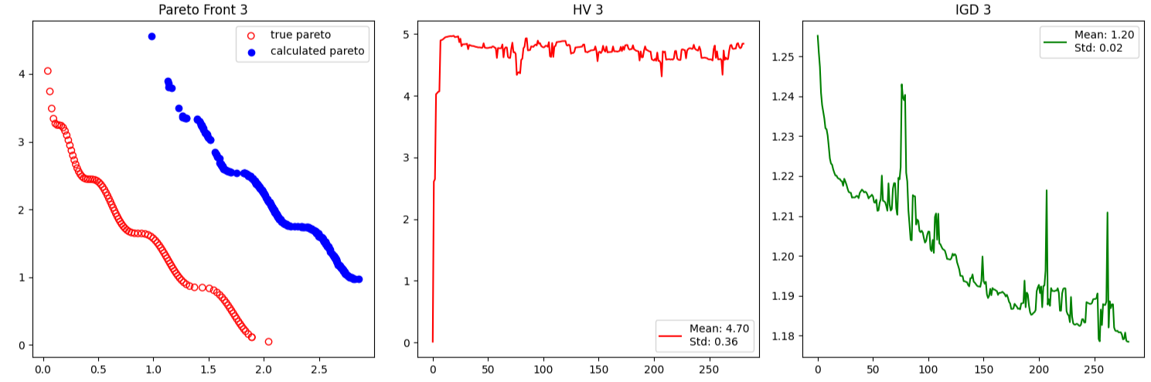
Result:
WFG1

Slide 17
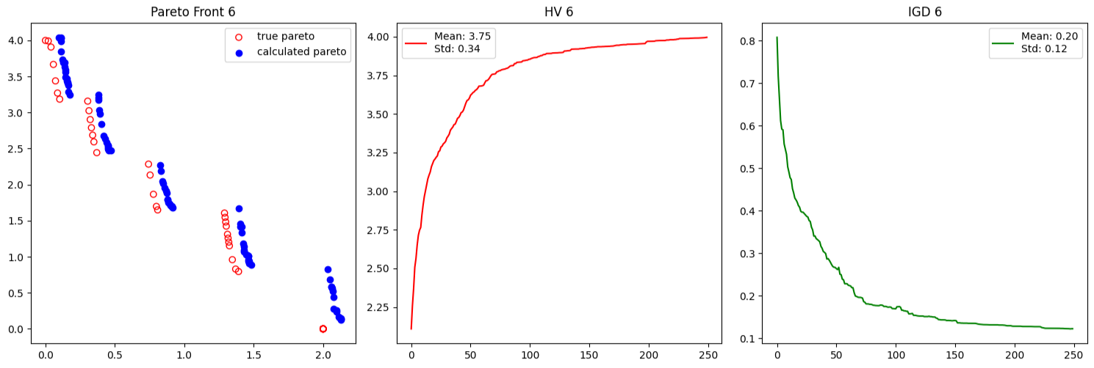
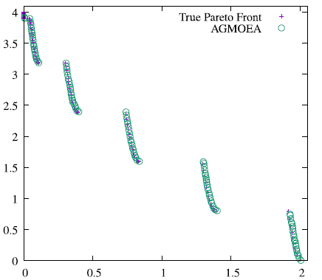
Result:
WFG2

Slide 18
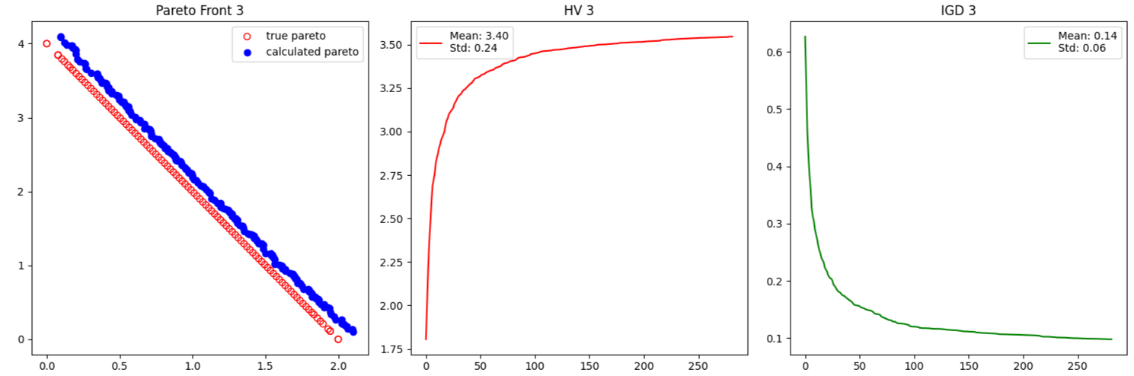
Result:
WFG3

Slide 19
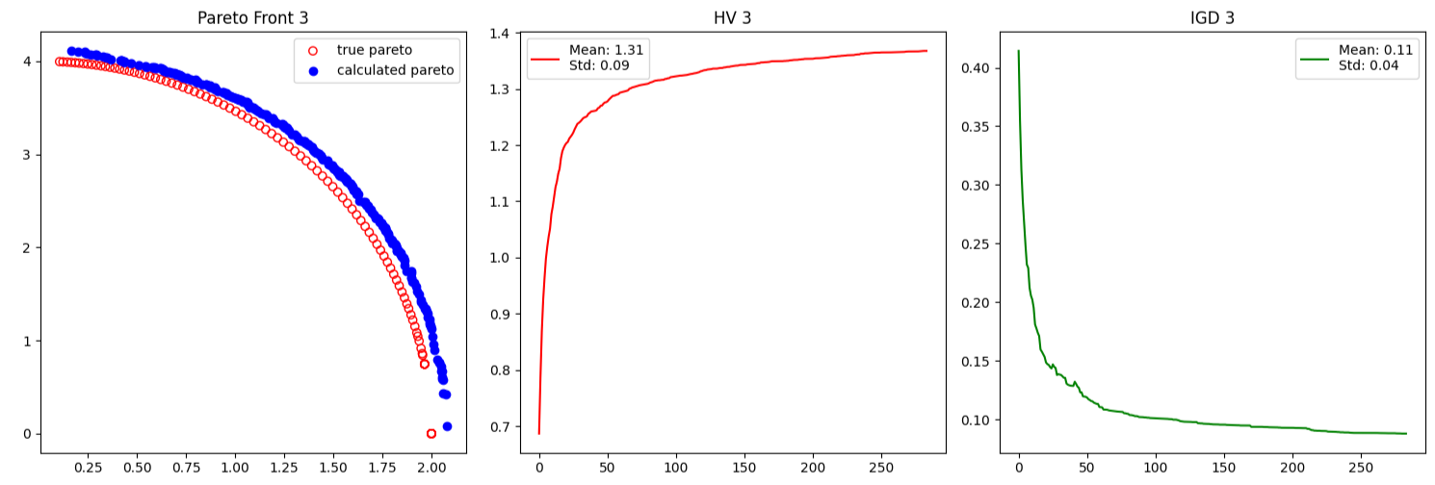
Result:
WFG4

Slide 20
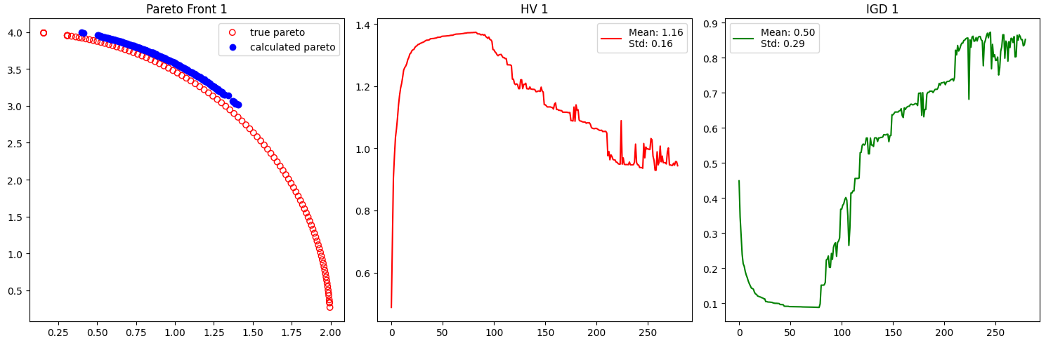
Result:
WFG5

Slide 21
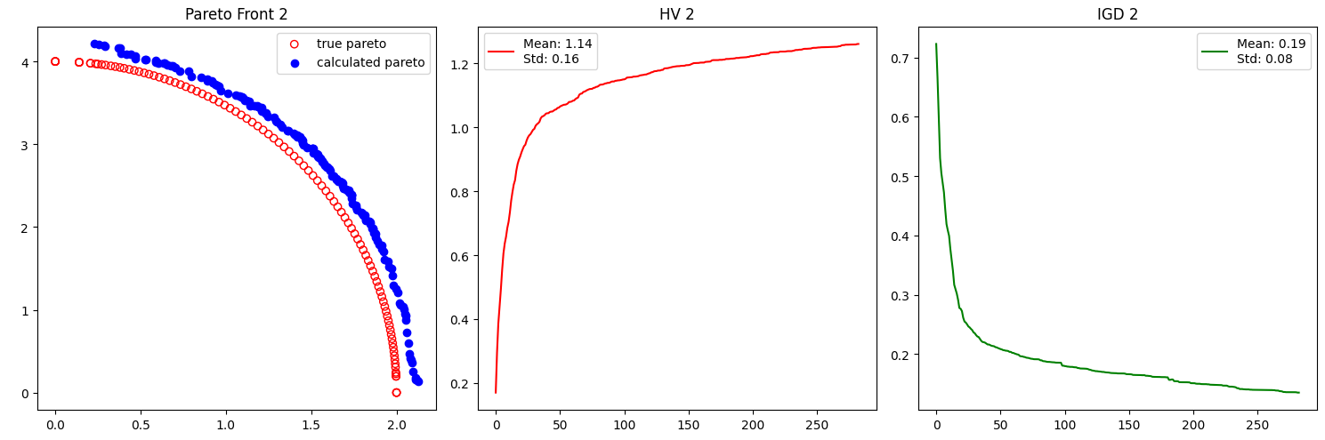
Result:
WFG6

Slide 22
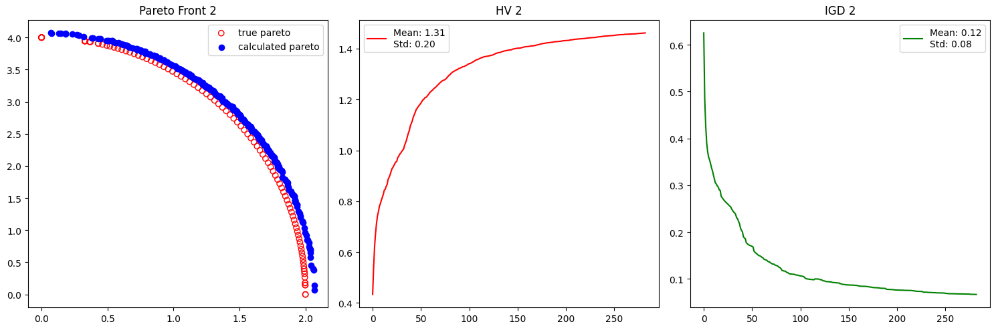
Result:
WFG7

Slide 23
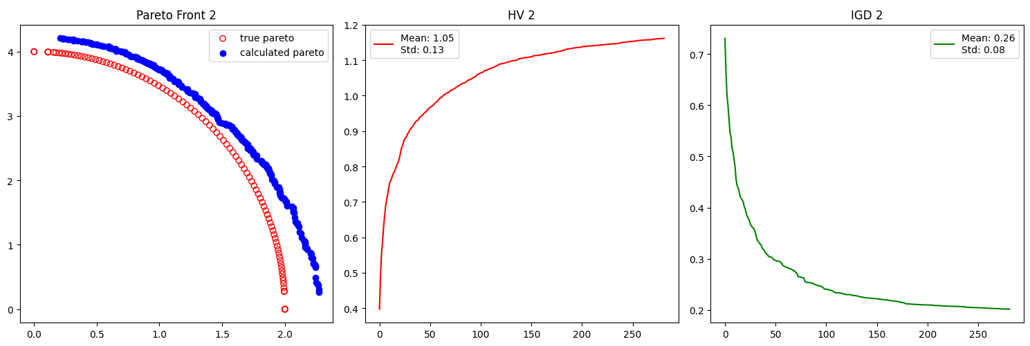
Result:
WFG8

Slide 24
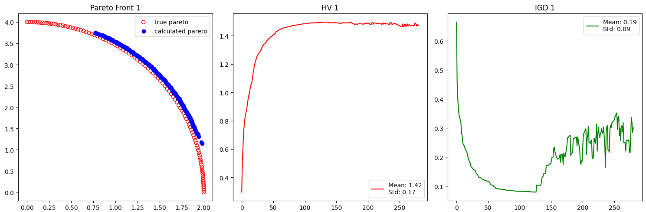
Result:
WFG9

Slide 25
Overall:
Adaptive selection => better diversity
Adaptive crossover => Adaptive exploration and exploitation
Improved EXA => improvement on convergence speed
Extension of EXA => lowering time complexity

