Slide 1

Evolutionary Strategy
Advanced Algorithm
Presented by:
Atefe Rajabi
1/35

Slide 2
Contents
00
02
01
03
Introduction
Mutation
Evolutionary Strategy Components
Gaussian Perturbation Mutation
Self-Adaptaion
Recombination
Challenges in self-adaptation techniques
Different Recombination Operators for Real-valued Optimizer
04
Selection
05
Experiment
Parent and Survival Selection
Explore the effectiveness of ES
2/35

Slide 3
00
Introduction
ES and GA serve as frontiers.
3/35

Slide 4
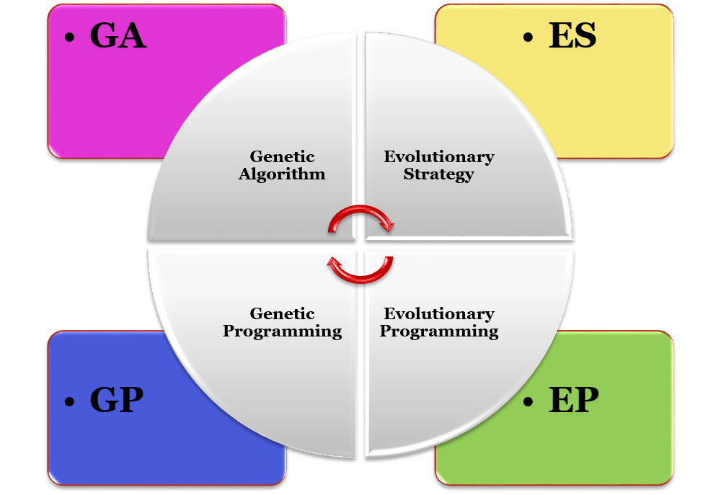
Brands of Evolutionary Algorithms
Fast in tracking goals
Real-Valued Optimizer
Rich in Theory
4/35

Slide 5
Summary
Representation
Recombination
Mutation
Real-valued Vector
Discrete or intermediary
Gaussian perturbation
Parent Selection
Survival Selection
Speciality
Uniform Random
(μ,λ) or (μ+λ)
5/35

Slide 6
What mutation do you propose?
An individual in ES:
0.1 | 21.1 | -14 | 0.2 | 0.4 | 0.2 | 1 | 3
6/35

Slide 7
What mutation do you propose?
0.1 | 21.1 | -14 | 0.2 | 0.4 | 0.2 | 1 | 3
Randomly Selected
0.1 | 21.1 | 10 | 0.2 | 0.4 | 0.2 | 1 | 3
Randomly Generated
7/35

Slide 8
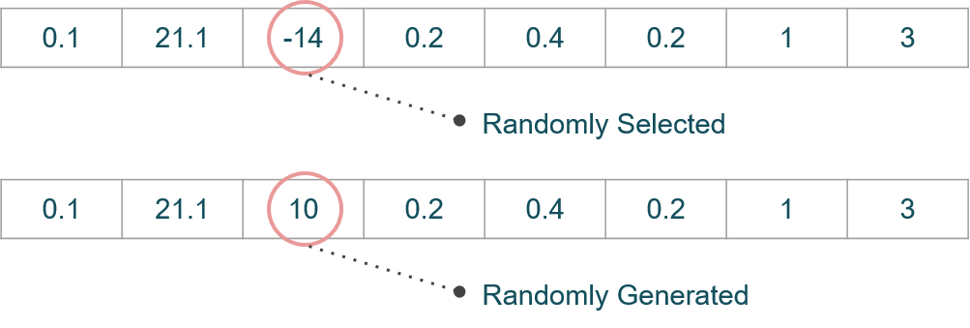
Mutation Properties
Introducing New Genetic Material
Taking Short Steps
Does not Satisfy
second Condition
8/35

Slide 9
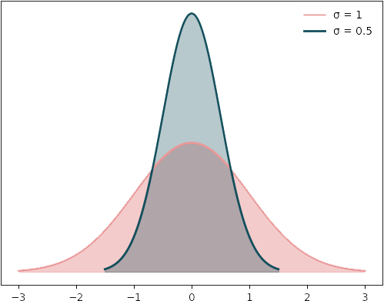
Mutation: Gaussian Perturbation
Gene value + z
z Values Drawn From Normal Distribution N(ξ,σ)
Mean is set to 0
Variation is called mutation step size
Explore or Exploit?
σ
Explore or Exploit?
9/35

Slide 10
Parameter Control
Parameter Setting
Before Run
Durring Run
Parameter Tunning
Deterministic
Adaptive
Self-Adaptive
10/35

Slide 11
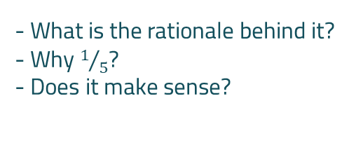
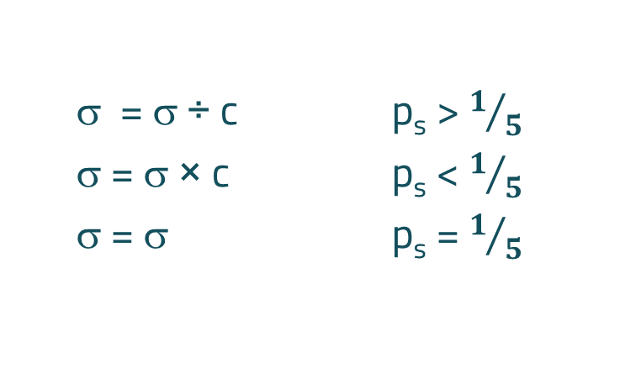
$1/5$ success rule
σ = σ ÷ c p_{s} > $1/5$
σ = σ × c p_{s} < $1/5$
σ = σ p_{s} = $1/5$
where p_{s} is the % of successful mutations, 0.8 ≤ c ≤ 1
- What is the rationale behind it?
- Why $1/5$?
- Does it make sense?
11/35

Slide 12
Modern ES
Continuing to Utilize the Innovative Concept of Adaptation for Parameter Control
12/35

Slide 13
01
Self-Adaptation
What is the challenge of self-Adaptation?
13/35

Slide 14
What is the fitness function for σ? What is the fitness function for explore/exploit?
To calculate the fitness value for each solution, the distance from the goal must be known.
14/35

Slide 15
02
Mutation
Usage of self-Adaptation in mutation
15/35

Slide 16
Chromosome in ES
Object
Variables
x₁,…,x_{n}
Mutation
Step Size
σ₁,…,σ_{nσ}
Rotation Angle
α₁,…, α_{nα}
Strategy Variables
Not every component is always present
Full size: ⟨ x1,…,xn, σ1,…,σn ,α1,…, αk ⟩
where k = n(n-1)/2 (no. of i,j pairs)
16/35

Slide 17
Different schemas
⟨ x₁,…,x_{n}, σ ⟩
Case 1
⟨ x₁,…,x_{n}, σ₁,…, σ_{n} ⟩
Case 2
⟨ x₁,…,x_{n}, σ₁,…, σ_{n} ,α₁,…, α_{k} ⟩
Case 3
17/35

Slide 18
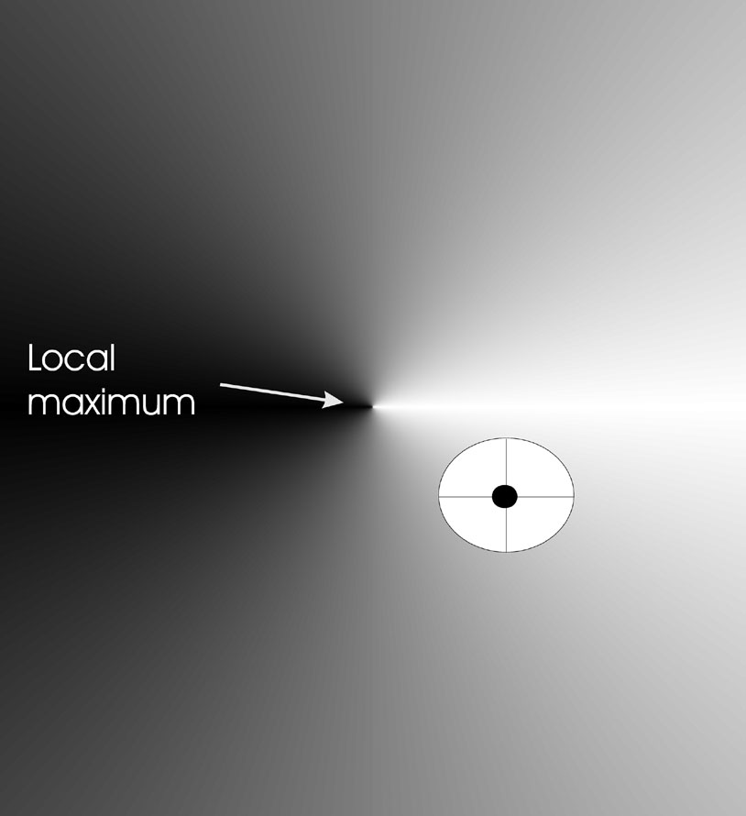
Mutation Case 1: Uncorrelated mutation with one σ
Gaussian Perturbation: changing value by adding random noise drawn from normal distribution
x’_{i} = x_{i} + N(0,σ)
- Why does a chromosome survive during the search process?
- If 'x' is good, does it imply that its associated 'σ' is also good?
18/35

Slide 19
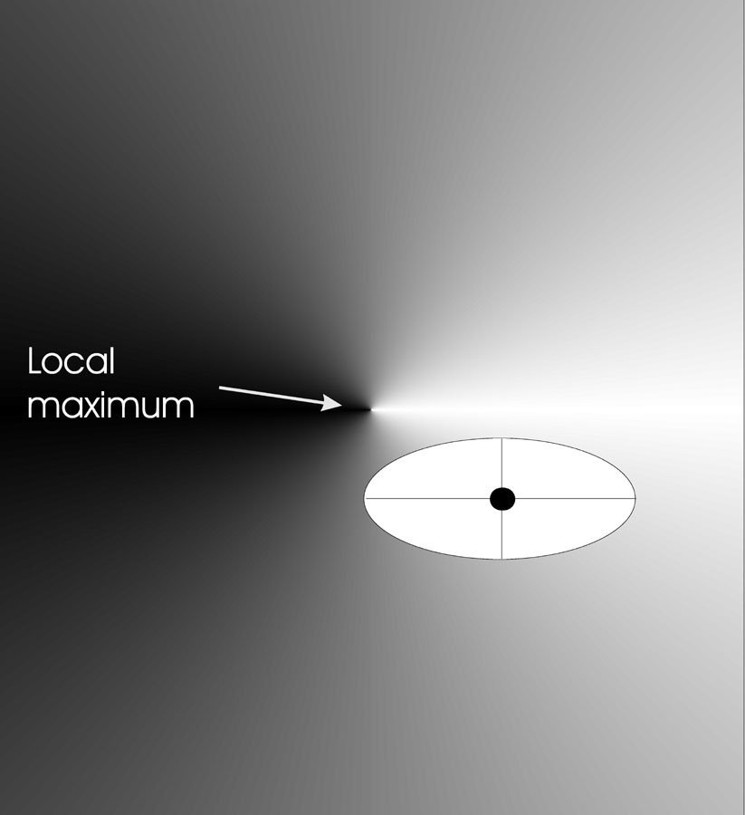
Mutation Case 2: Uncorrelated mutation with n σ’s
σ’_{i} = σ_{i} × exp(τ’ × N(0,1)
+ τ × N_{i} (0,1))
x’_{i} = x_{i} + σ’_{i} × N_{i} (0,1)
τ ∝ 1/(2 n)^{½} and τ’ ∝ 1/(2 n^{½}) ^{½}
σ’ < ε₀ ⇒ σ’ = ε₀
19/35

Slide 20
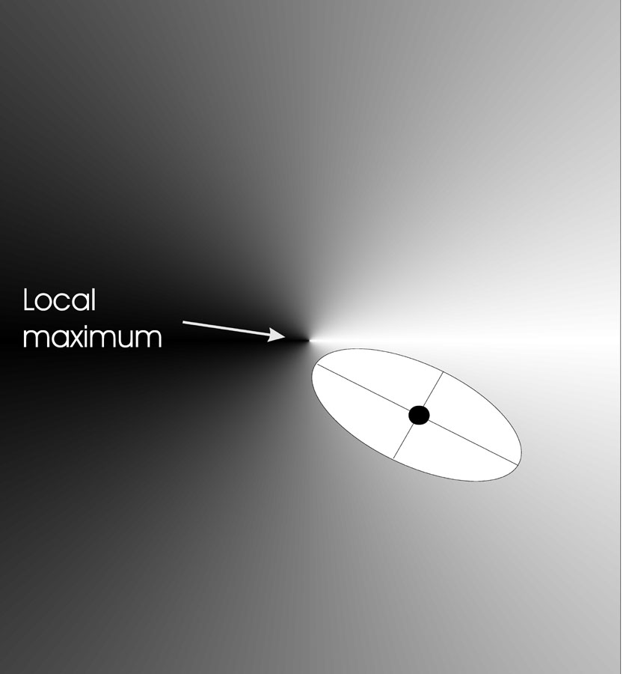
Mutation Case 3: Correlated mutations
σ’_{i} = σ_{i} × exp(τ’ × N(0,1)
+ τ × N_{i} (0,1))
α’_{j} = α_{j} + β × N (0,1)
x ’ = x + N(0,C’)
τ ∝ 1/(2 n)^{½} and τ ∝ 1/(2 n^{½}) ^{½}
β ≈ 5°
| α’_{j} | > π ⇒ α’_{j} = α’_{j} - 2 π sign(α’_{j})
σ’ < ε₀ ⇒ σ’ = ε₀
The covariance matrix C:
c_{ii} = σ_{i}²
c_{ij} = 0 if i and j are not correlated
c_{ij} = ½ • ( σ_{i}² - σ_{j}² ) • tan(2 α_{ij}) if i and j are correlated
20/35

Slide 21
Mutate σ First:
Now, indirectly, the quality of sigma can be inferred from the fitness of the object variables.
σ’ = σ × exp(τ ×N(0,1))
x’_{i} = x_{i} + σ’×N(0,1)
τ ∝ 1/ n^{½}
σ’ < ε₀ ⇒ σ’ = ε₀
- Why not use σ’ = σ + τ × N(0,1)?
- Why use adaptation techniques?
- General rule for adaptation.
21/35

Slide 22
03
Recombination
Mutation alone is often sufficient to drive evolutionary progress, without the need for recombination. Why?
- Can mutation fulfill the same roles attributed to recombination?
22/35

Slide 23
Recombination
Recombination
Creates one Child
Acts per variable / position by either
From two or more parents by either:
Averaging parental values
Selecting one of the parental values
Using two selected parents to make a child
Selecting two parents for each position
23/35

Slide 24
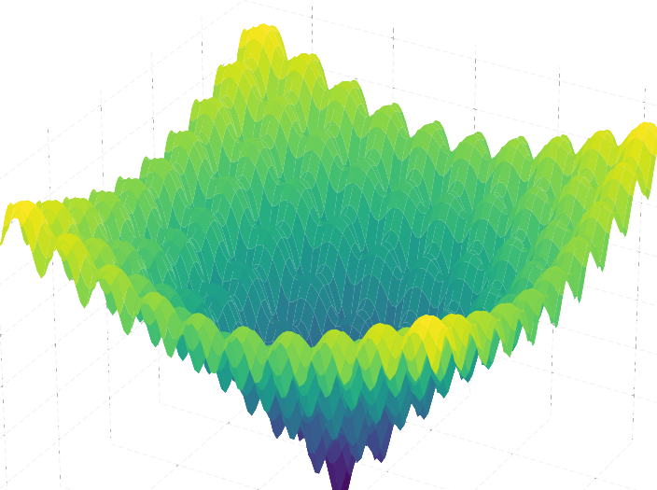
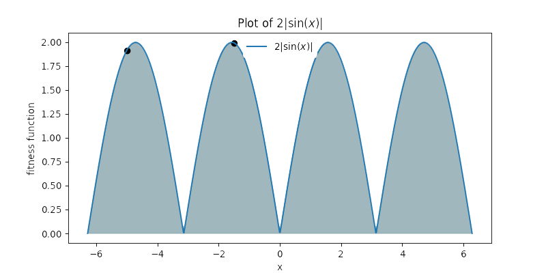
Multi-Parent Recombination
It does not always serve as a good technique,
such as multi modal problems like Ackley function.
24/35

Slide 25
Recombination Properties
Recombination of Parents Information
Taking Large Steps
0.1 | 21.1 | -14 | 0.2 | 0.4 | 0.2 | 1 | 3
8 | 1 | 7.5 | 0.2 | 0.2 | 6.3 | 2 | 1
- Does intermediary recombination recombine parents information?
- Recombination can not be useful for Continuous Space
25/35

Slide 26
Recombination:
 | Two fixed parents | Two parents selected for each i
z_{i} = (x_{i} + y_{i})/2 | Local intermediary | Global intermediary
z_{i} is x_{i} or y_{i} chosen randomly | Local discrete | Global discrete
26/35

Slide 27
04
Parent Selection
Selection based on individual fitness increases selection pressure.
27/35

Slide 28
Uniform Random Parent Selection
ES parent selection is unbiased - every individual has the same probability to be selected.
Less selection pressure compared to survival selection.
28/35

Slide 29
05
Survival Selection
Sorts the population individuals based on their fitness.
29/35

Slide 30
Survival Selection
Typically, λ = 7μ. Why?
Challenges of Self-Adaptation:
Ensuring control parameters influence the fitness value of the chromosome.
Accurately estimating fitness values.
Generational Survival Selection. Why?
30/35

Slide 31
Generational Survival Selection
Better in leaving local optima
Better in following moving optima
By using the + strategy, bad σ values can survive in ⟨x,σ⟩ too long if their host x is very fit
31/35

Slide 32
06
Experiment
Does ES self-adaptation really work?
32/35

Slide 33
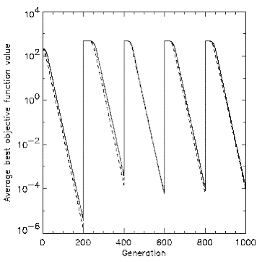
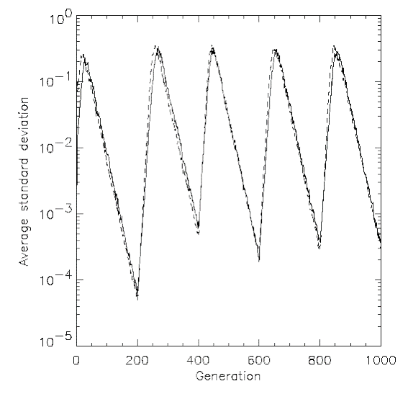
A moving Optima Problem
Average Standard Deviation
(diversity of the population)
Average best Objective value
- What if generational survival selection had not been implemented?
33/35

Slide 34
Conclusion
μ > 1 to carry different strategies
λ > μ to generate offspring surplus
Not “too” strong selection, e.g., λ ≈ 7 μ
(μ,λ)-selection to get rid of misadapted σ‘s
Mixing strategy parameters by (intermediary) recombination on them
34/35

Slide 35
Reference
Eiben, A. E., & Smith, J. E. (2015). Parameter Control in Evolutionary Algorithms. In Introduction to evolutionary computing (2nd ed., pp. [131 - 146]). Springer. DOI:10.1007/978-3-662-44874-8
Eiben, A. E., & Smith, J. E. (2015). Evolutionary Strategies. In Introduction to evolutionary computing (2nd ed., pp. [101 - 103]). Springer. DOI:10.1007/978-3-662-44874-6
Eiben, A. E., Raue, P.-E., & Ruttkay, Zs. (1994). Genetic algorithms with multi-parent recombination. In Y. Davidor, H.-P. Schwefel, & R. Männer (Eds.), Parallel problem solving from nature—PPSN III (pp. 78-87). Springer Berlin Heidelberg. https://doi.org/10.1007/3-540-58484-6_269
35/35

