Slide 1

Evolutionary Strategy
Advanced Algorithm

Slide 2
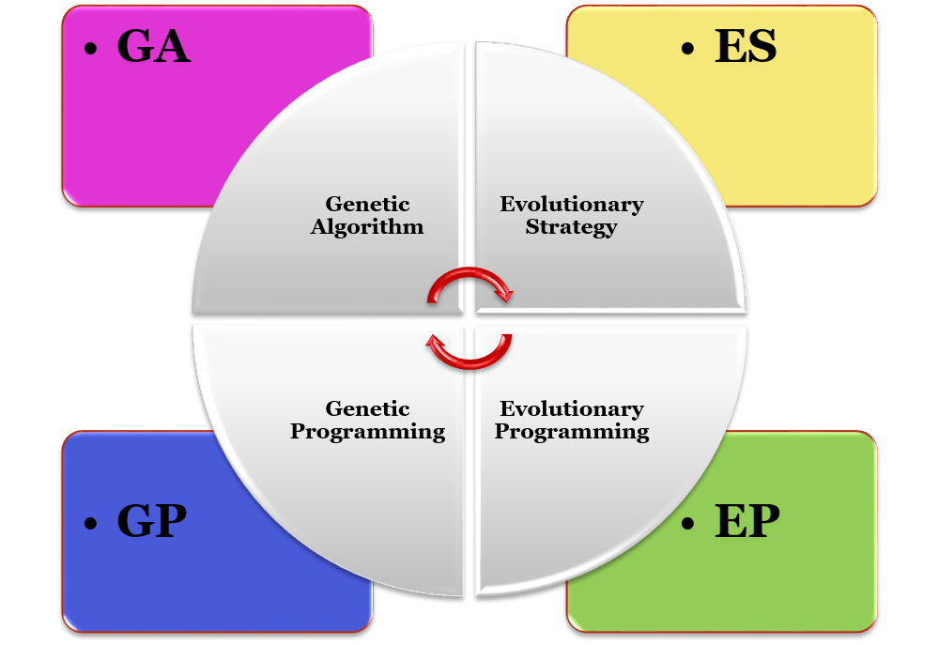
Brands of Evolutionary Algorithms
Fast in tracking goals
Real-Valued Optimizer
Rich in Theory

Slide 3
Algorithm Flowchart
ES and GA serve as frontiers.

Slide 4
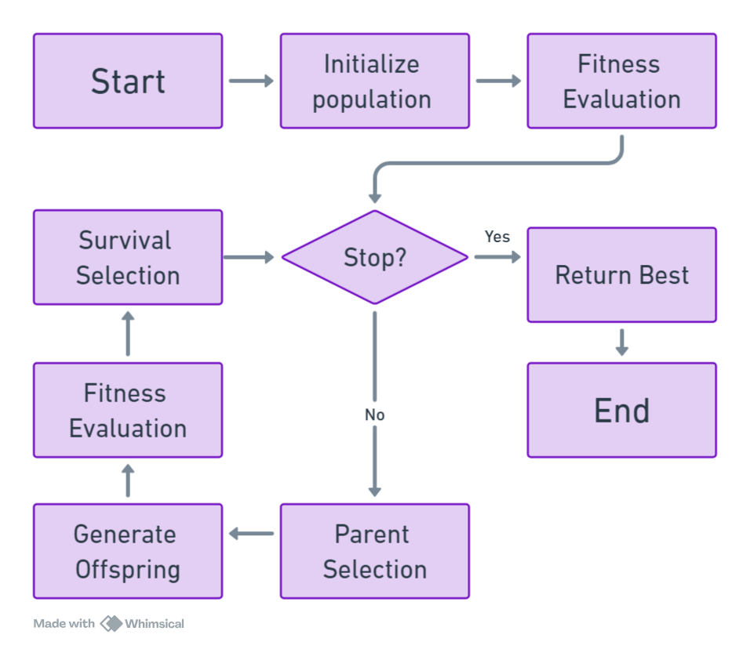
ES Algorithm Flowchart
Start
Initialize Population
Fitness Evaluation
While Not Stopping Criteria Met:
1. Parent Selection
2. Generate Offspring
3. Fitness Evaluation
4. Survival Selection
Return Best Candidate

Slide 5
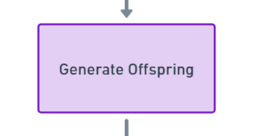
The Big Difference Between ES and GA

Slide 6
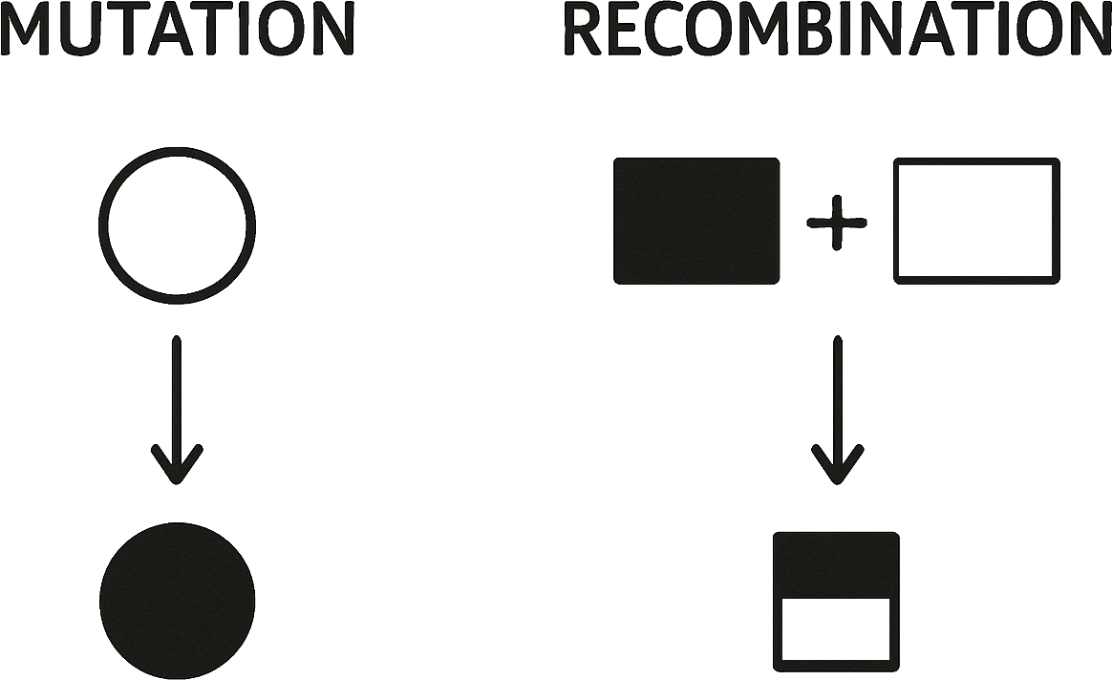
Generating Offspring
Introducing new genetic material
Taking short Step
Recombination of Parents Information
Taking Large Steps

Slide 7
Mutation
Mutation for Continuous Representation
15/35

Slide 8
What mutation do you propose?
An individual in ES:
0.1 | 21.1 | -14 | 0.2 | 0.4 | 0.2 | 1 | 3
Replacing randomly selected gene with a randomly generated number
Adding a randomly generated number to one of genes
….

Slide 9
Problem with this type of Mutation
0.1 | 21.1 | -14 | 0.2 | 0.4 | 0.2 | 1 | 3
Randomly Selected
0.1 | 21.1 | 10 | 0.2 | 0.4 | 0.2 | 1 | 3
Randomly Generated

Slide 10
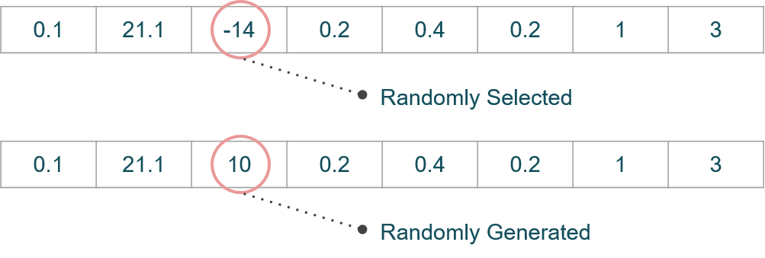
Mutation Properties
Introducing New Genetic Material
Taking Short Steps
Does not Satisfy
second Condition

Slide 11
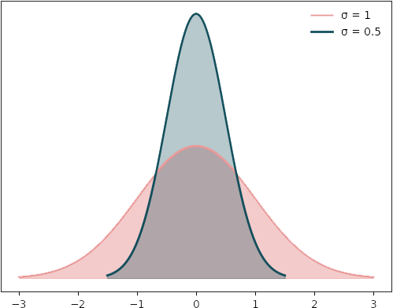
Mutation: Gaussian Perturbation
Gene value + z
z Values Drawn From Normal Distribution N(ξ,σ)
Mean is set to 0
Variation is called mutation step size
Is it better to have fixed sigma value or dynamic?
Explore or Exploit?
σ
Explore or Exploit?

Slide 12
Parameter Control
Parameter Setting
Before Run
Durring Run
Parameter Tunning
Deterministic
Adaptive
Self-Adaptive
without using any
feedback from the search
feedback from the search

Slide 13
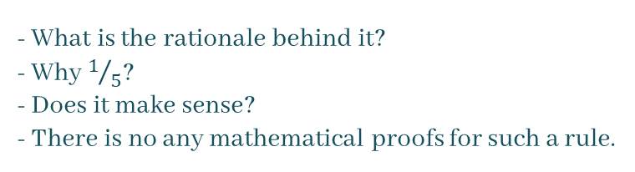
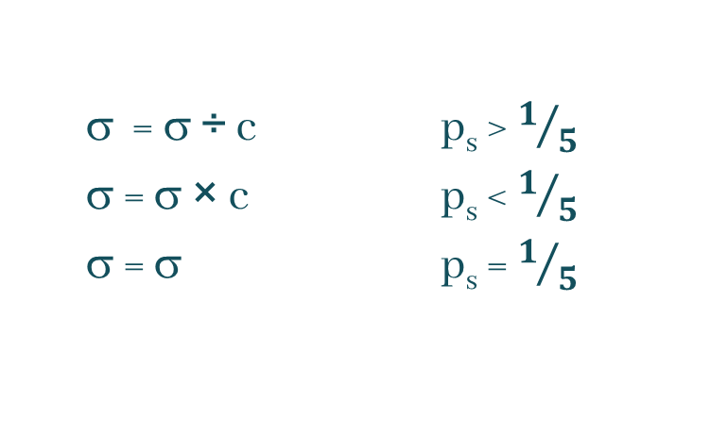
$1/5$ success rule – Adaptive Mutation
σ = σ ÷ c p_{s} > $1/5$
σ = σ × c p_{s} < $1/5$
σ = σ p_{s} = $1/5$
where p_{s} is the % of successful mutations, c is set by user 0.8 ≤ c ≤ 1
- What is the rationale behind it?
- Why $1/5$?
- Does it make sense?
- There is no any mathematical proofs for such a rule.

Slide 14
Self-Adaptation in ES Mutation
How to self-adapt mutation parameters?

Slide 15
Chromosome Representation in ES
Not every component is always present
Full size: ⟨ x1,…,xn, σ1,…,σn ,α1,…, αk ⟩
where k = n(n-1)/2 (no. of i,j pairs)
Schema
Object
Variables
x₁,…,x_{n}
Mutation
Step Size
σ₁,…,σ_{nσ}
Rotation Angle
α₁,…, α_{nα}
Strategy Variables

Slide 16
Different schemas
⟨ x₁,…,x_{n}, σ ⟩
Case 1
⟨ x₁,…,x_{n}, σ₁,…, σ_{n} ⟩
Case 2
⟨ x₁,…,x_{n}, σ₁,…, σ_{n} ,α₁,…, α_{k} ⟩
Case 3
Case 3 is applied less frequently than the other two cases due to its higher computational complexity.
In practice, most problems can be effectively addressed using Case 1 alone.

Slide 17
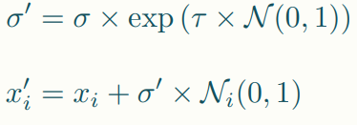
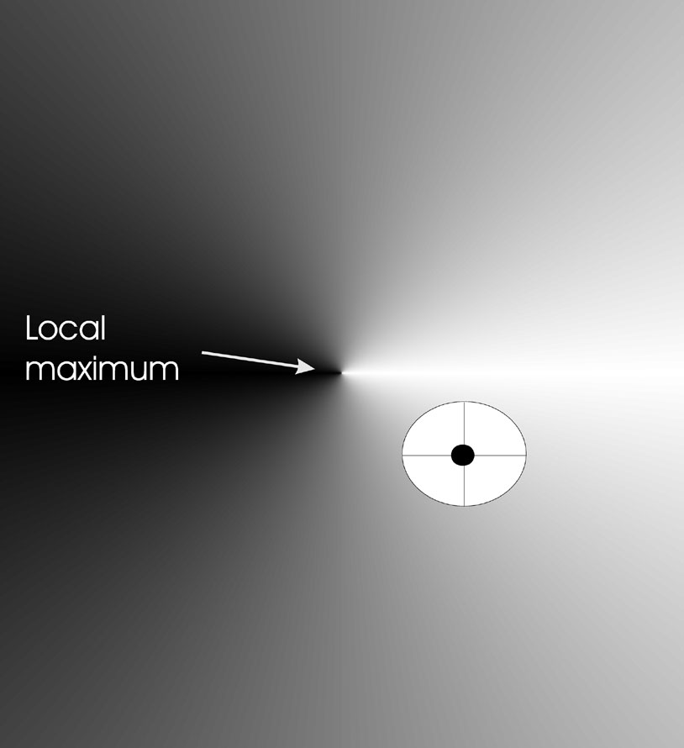
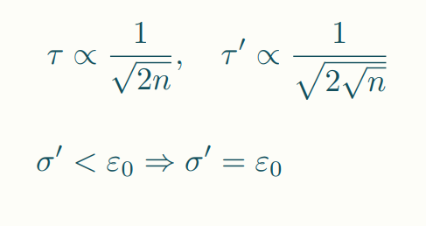
Mutation Case 1: Uncorrelated mutation with one σ
Gaussian Perturbation: changing value by adding random noise drawn from normal distribution
Problem Space
n is dimension of our search space
x2
x1

Slide 18
Mutation Case 1: Uncorrelated mutation with one σ
σ is the current step size (mutation strength).
𝒩(0,1) is a standard normal distribution.
The exponential function ensures that σ' stays positive.
The larger the minimum allowable mutation step size, the higher the exploration rate.
n is dimension of our search space

Slide 19
Mutation Case 1: Uncorrelated mutation with one σ
τ is set by the user.
τ is a learning rate or scaling factor that determines how drastically σ is allowed to change.
Larger τ more exploration.
As n increases, τ decreases.
This stabilizes mutation: in high-dimensional spaces, we don’t want σ changing wildly.
n is dimension of our search space

Slide 20
Mutation Case 1: Example
1. Mutate sigma:
N(0,1)=0.5
σ ′ = σ * exp(τ * N(0,1)) = 3 * exp ( 0.267 * 0.5 )
≈ 3 * 1.143 = 3.429 > 0.01
2. Mutate xi:
z = [−0.2, 1.0, −0.5, 0.3, 0.1, −0.7, 0.8]
x’_1 = 0.1 + 3.429 * (−0.2) = 0.1 − 0.686 = −0.586
x’_2 = 21.1 + 3.429 * 1.0 = 21.1 + 3.429 = 24.529
…
n = 7 → τ= 0.267
= 0.01
Parent:
0.1 | 21.1 | -14 | 0.2 | 0.4 | 0.2 | 1 | 3
Offspring:
−0.59 | 24.53 | -15.71 | 1.23 | 0.74 | -2.2 | 3.74 | 3.429

Slide 21
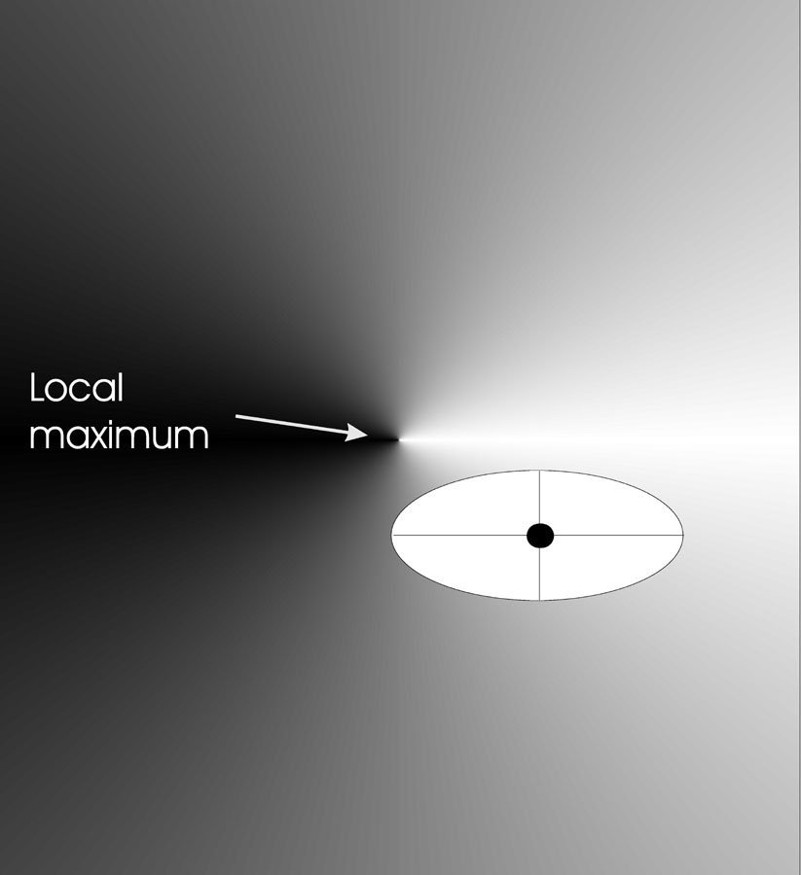
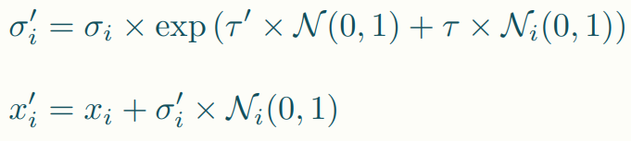
Mutation Case 2: Uncorrelated mutation with n σ’s
Problem Space
x2
x1

Slide 22
Mutation Case 2: Uncorrelated mutation with n σ’s
Symbol | Description
τ′ | Global learning rate — shared across all dimensions. Controls overall change in mutation step sizes.
τ | Local learning rate — specific to each dimension. Adds individual noise for each σᵢ.

Slide 23
Mutation Case 2: Example
Global noise: 𝑁(0,1)=0.4
Local noise per σ: [0.1, −0.2, 0.3, 0.0]
Object-level noise: [0.2, −0.5, 1.0, −0.1]
1. Mutate Sigma:
σ1′​=0.4 * exp (0.5 * 0.4 + 0.354 * 0.1) ≈ 0.506 > 0.01
σ2′​=0.2 * exp (0.5 * 0.4 − 0.354 * 0.2) ≈ 0.228 > 0.01
….
2. Mutate xi:
x1′​= 0.1 + 0.506 * 0.2 = 0.1 + 0.1012 = 0.2012
x2′ = 21.1 + 0.228 * (−0.5) = 21.1 − 0.114 = 20.986
…..
n=4 → τ′ = 0.5 τ = 0.354
= 0.01
Parent:
0.1 | 21.1 | -14 | 0.2 | 0.4 | 0.2 | 1 | 3
Offspring:
0.20 | 20.99 | −12.64 | −0.17 | 0.51 | 0.23 | 1.36 | 3.67

Slide 24
How do we measure whether we’re exploring or exploiting effectively?
A good solution often depends on how it was found.
Fitness of object variables
→ feedback on the quality of strategy parameters

Slide 25
Mutate σ :
- The quality of sigma can indirectly be inferred from the fitness of the object variables.

Slide 26
Mutate σ : Maximization Example
Old Sigma
Fitness: 0.2
0.3 | 7.1 | -5 | 0.6 | 0.4 | 0.5 | 0.5 | 1
Fitness: 0.2
0.3 | 7.1 | -5 | 0.6 | 0.4 | 0.5 | 0.5 | 3
Updated Sigma

Slide 27
Mutate σ : Maximization Example
Updated Sigma
Decision Variables (x_i)
Fitness: 0.2
0.3 | 7.1 | -5 | 0.6 | 0.4 | 0.5 | 0.5 | 3
Fitness: 0.7
0.1 | 21.1 | -14 | 0.2 | 0.4 | 0.2 | 1 | 3
With this procedure,
is the fitness value related to the updated sigma,
and can it indicate the quality of the mutation step?

Slide 28
Recombination
Mutation alone is often sufficient to drive evolutionary progress, without the need for recombination.
Recombination is less effective in continuous spaces,
not due to their infinite dimensionality,
but because the individuals tend to be highly diverse.

Slide 29
Recombination
Recombination
Creates one Child
Acts per variable / position by either
From two or more parents by either:
Averaging parental values
Selecting one of the parental values
Using two selected parents to make a child
Selecting two parents for each position

Slide 30
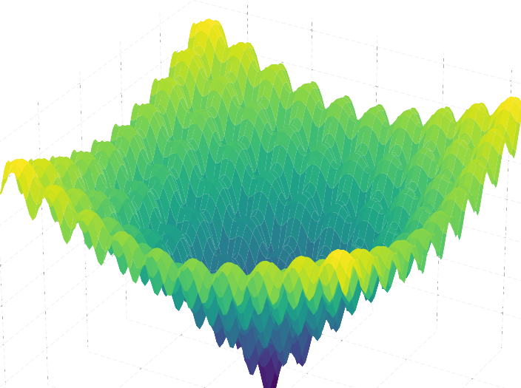
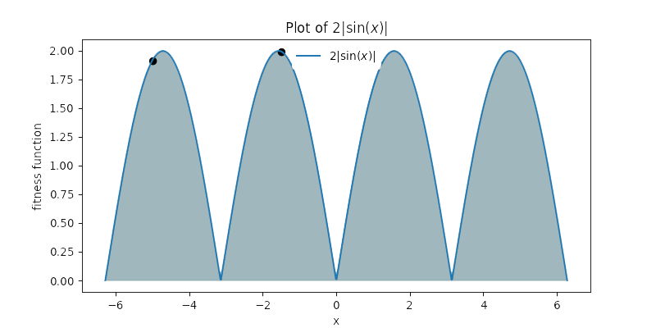
Multi-Parent Recombination
It does not always serve as a good technique,
such as multi modal problems like Ackley function.

Slide 31
Recombination:
 | Two fixed parents | Two parents selected for each i
z_{i} = (x_{i} + y_{i})/2 | Local intermediary | Global intermediary
z_{i} is x_{i} or y_{i} chosen randomly | Local discrete | Global discrete

Slide 32
Intermediary Recombination
Recombination of Parents Information
Taking Large Steps → can be also done by mutation
0.2 | 21 | -14 | 0.2 | 0.4 | 0.3 | 1 | 3
Parent 1
8 | 1 | 7 | 0.2 | 0.2 | 6.3 | 2 | 1
Parent 2
- Does intermediary recombination recombine parents information?
4.1 | 11 | -3.5 | 0.2 | 0.2 | 3.3 | 1.5 | 2
Offspring

Slide 33
Discrete Recombination
Recombination of Parents Information
Taking Large Steps → can be also done by mutation
0.2 | 21 | -14 | 0.2 | 0.4 | 0.3 | 1 | 3
Parent 1
8 | 1 | 7 | 0.2 | 0.2 | 6.3 | 2 | 1
Parent 2
8 | 21 | -14 | 0.2 | 0.4 | 6.3 | 1 | 3
Offspring

Slide 34
Survival Selection
Which one fits ES better? (μ,λ) or (μ+λ) ?

Slide 35
Survival Selection
Typically, λ = 7μ. Why?
To Eliminate Bad Strategy Parameters
Each individual has not just the solution (x) but also its strategy parameters (like σ).
Some may have bad σ values (e.g., too small or too large mutation).
By creating many offspring and selecting only the best, bad σ values die out naturally.
Strategy | Selection Pool | Selection Pressure | Keeps Parents? | Common Use Case
(μ, λ) | From λ offspring only | High | Discards | Self-adaptation, exploration
(μ + λ) | From μ parents + λ offspring | Lower | Keeps best | Elitism, dynamic/ noisy problems

Slide 36
Survival Selection
Which One to Use?
Both are used in practice, but chosen depending on the problem:
Use (μ, λ) when you want to force diversity and eliminate bad strategy parameters faster.
Use (μ + λ) when dealing with dynamic or noisy environments, or when elitism is needed.
Strategy | Selection Pool | Selection Pressure | Keeps Parents? | Common Use Case
(μ, λ) | From λ offspring only | High | Discards | Self-adaptation, exploration
(μ + λ) | From μ parents + λ offspring | Lower | Keeps best | Elitism, dynamic/ noisy problems

Slide 37
Generational Survival Selection for ES
Better in leaving local optima
Better in following moving optima
By using the + strategy, bad σ values can survive in ⟨x,σ⟩ too long if their host x is very fit

Slide 38
Parent Selection
Selection based on individual fitness increases selection pressure.

Slide 39
Uniform Random Parent Selection
Selection Pressure
Determines how strongly better individuals are favored during selection
Too high → Fast convergence, but may miss better global solutions
Too low → Slow and possibly inefficient search
In Evolutionary Strategies (ES):
To moderate selection pressure (especially since survival selection is highly pressured)
Parent selection is unbiased: every individual has the same probability of being selected

Slide 40
Experiment
Does ES self-adaptation really work?

Slide 41
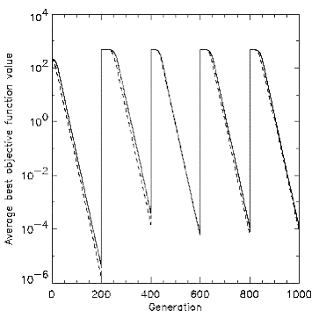
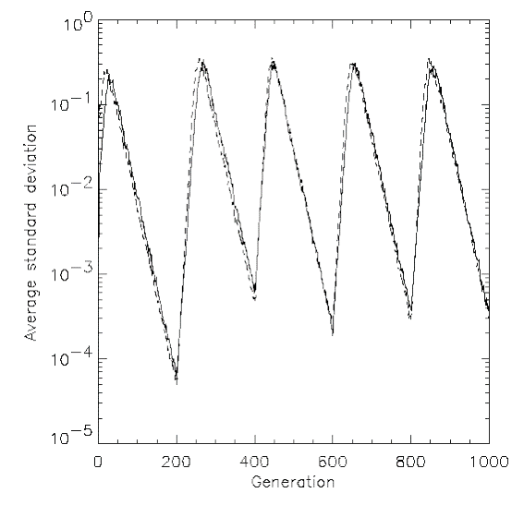


Moving Optima Problem (Dynamic Optimization Task)
Objective: Evaluate an algorithm's adaptability in a dynamic environment.
Setup: Every 200 generations, the global optimum is shifted 100 units further
The fitness landscape changes over time, requiring the population to track the moving target
Average best Objective value
Average Standard Deviation
(diversity of the population)
- What if generational survival selection had not been implemented?

Slide 42
Conclusion
μ > 1 to carry different strategies
λ > μ to generate offspring surplus
Not “too” strong selection, e.g., λ ≈ 7 μ
(μ,λ)-selection to get rid of misadapted σ‘s
Mixing strategy parameters by (intermediary) recombination on them

Slide 43
Reference
Eiben, A. E., & Smith, J. E. (2015). Parameter Control in Evolutionary Algorithms. In Introduction to evolutionary computing (2nd ed., pp. [131 - 146]). Springer. DOI:10.1007/978-3-662-44874-8
Eiben, A. E., & Smith, J. E. (2015). Evolutionary Strategies. In Introduction to evolutionary computing (2nd ed., pp. [101 - 103]). Springer. DOI:10.1007/978-3-662-44874-6
Eiben, A. E., Raue, P.-E., & Ruttkay, Zs. (1994). Genetic algorithms with multi-parent recombination. In Y. Davidor, H.-P. Schwefel, & R. Männer (Eds.), Parallel problem solving from nature—PPSN III (pp. 78-87). Springer Berlin Heidelberg. https://doi.org/10.1007/3-540-58484-6_269

