Slide 1

Genetic Programming
Advanced Algorithm

Slide 2
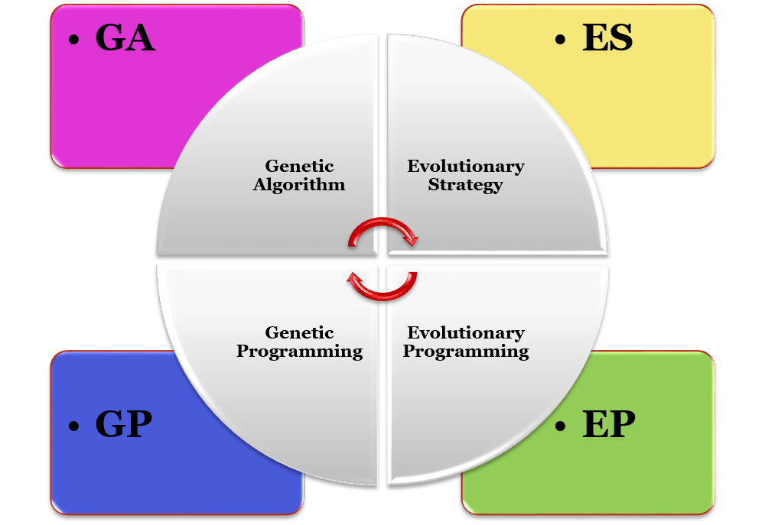
Brands of Evolutionary Algorithms
Variable Length
Large population size
Hierarchal representation

Slide 3
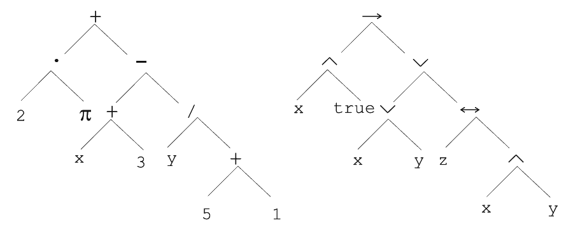
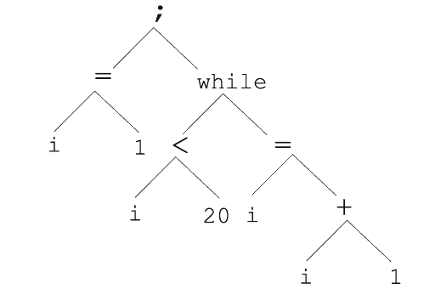

Parse Trees
Parse trees are well-suited for representing hierarchically structured data that arises from grammar-based systems.
i=1;
while (i < 20)
{
i = i+1;
}
(x ∧true) → ((x∨y)∨(z ↔ (x∧y)))

Slide 4
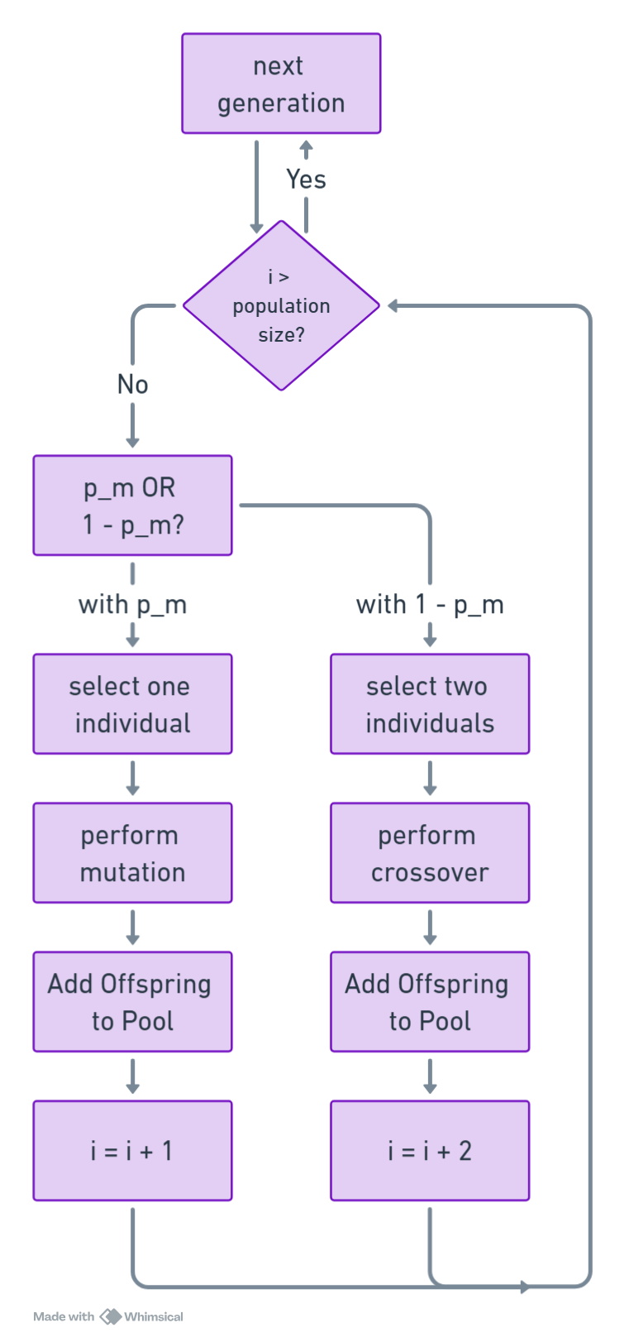
GP Algorithm Flowchart
Start
Initialize Population
Fitness Evaluation
While Stopping Criteria Met:
While i < population_size:
if not p_m:
1. Two Parents Selection
2. Recombination
3. i += 2
else:
1. One Parent Selection
2. Mutation
3. i += 1
Fitness Evaluation
Survival Selection
Return Best Candidate

Slide 5
Why to Use GP?
Unlike black-box models (e.g., neural networks), the output of GP is a symbolic expression or source code, which can be analyzed, validated, or modified by humans.
GP can represent and evolve solutions as:
Symbolic expressions
Program trees
Decision rules
Mathematical models

Slide 6
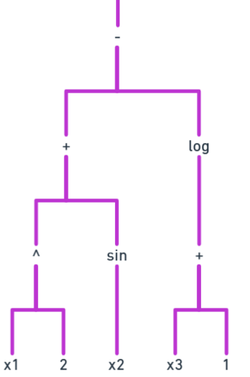
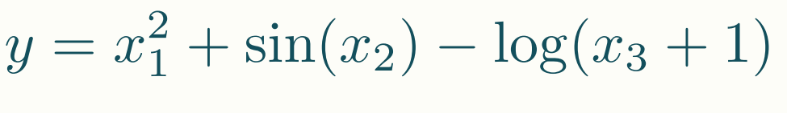
Symbolic Regression sample problem for GP
x₁ | x₂ | x₃ | y
1.0 | 0.5 | 1.0 | 0.83
2.0 | 1.0 | 2.0 | 3.78
-1.0 | -0.5 | 0.5 | 0.10
0.0 | 3.0 | 1.0 | -0.56
1.5 | -1.0 | 0.0 | 1.39
-2.0 | 2.5 | 3.0 | 3.21
0.5 | 1.5 | 2.0 | 0.17
-1.5 | 0.0 | 0.5 | 1.84
3.0 | -2.0 | 2.5 | 6.83
2.5 | 2.0 | 1.5 | 5.89
Target Formula:
What can be considered a proper fitness function?
What else is important besides accurate value prediction?
MSE, RMSE, and similar metrics are common choices.
Formula complexity—simpler formulas are generally better.

Slide 7
How to evaluate Programs Generated?
Evaluation Criterion | Purpose
Fitness/Error Metrics | Measure predictive accuracy
Test/Validation Performance | Ensure generalization
Model Complexity | Control overfitting and improve interpretability

Slide 8
Representation
Parse Trees can encode almost everything.

Slide 9
Representation
Function Set (F):
These are non-terminal symbols—operators or control structures used to build the internal nodes of the trees. (with the arities of function symbols)
Terminal Set (T):
These are leaf nodes—constants or variables that appear at the bottom of the trees.
F = { +, -, *, /, <, =, ;, while, →, ↔, ∨, ∧ }
T = { x, y, z, 1, 2, 3, 5, 20, true, π }

Slide 10
Representation - validity
Adopting the following general recursive definition:
Every t ∈ T is a correct expression
f(e₁, …, e_{n}) is a correct expression if f ∈ F, arity(f)=n and e₁, …, e_{n} are correct expressions
There are no other forms of correct expressions
Which of the following expressions would be considered valid in Genetic Programming representation??
2 + 1
"Ali" + 2
true / 5
x < "hello“
sqrt("world")
In general, expressions in GP are not typed. This feature is known as the closure property.

Slide 11
Population Initialization
Full Method
Grow Method
Ramped Half-and-Half
Ensures diversity in tree shapes and sizes.
Uses a maximum depth (Dmax) for initial trees.
Each tree is generated using one of two methods (chosen randomly):
All branches grow to exactly depth = Dmax.
Internal nodes (d < Dmax) are selected from the Function Set (F).
Leaf nodes (d = Dmax) are selected from the Terminal Set (T).
Creates uniform, balanced trees.
Branches can stop growing at different depths, up to Dmax.
Nodes at depth < Dmax are chosen randomly from F ∪ T.
Creates varied, unbalanced trees.
across multiple depths → richly diverse initial population
Population Size in GP is large around 10,000.

Slide 12
Parent Selection
Over-selection is Highly Pressured

Slide 13
Parent Selection Over-selection
Used when population sizes are large (often thousands).
simple selection methods like tournament or roulette-wheel may lose focus
they can become too random or not selective enough.
Aims to increase selection pressure and focus on the best individuals.
Rank the population based on fitness (best to worst).
Split the population into two groups:
Top x% → “elite” group (e.g., top 10–20%).
Bottom (100−x)% → “non-elite” group.
During parent selection:
80% of selections are made from the elite group.
20% of selections come from the non-elite group (to preserve diversity).

Slide 14
Mutation
Mutation tends to increase trees depth.

Slide 15
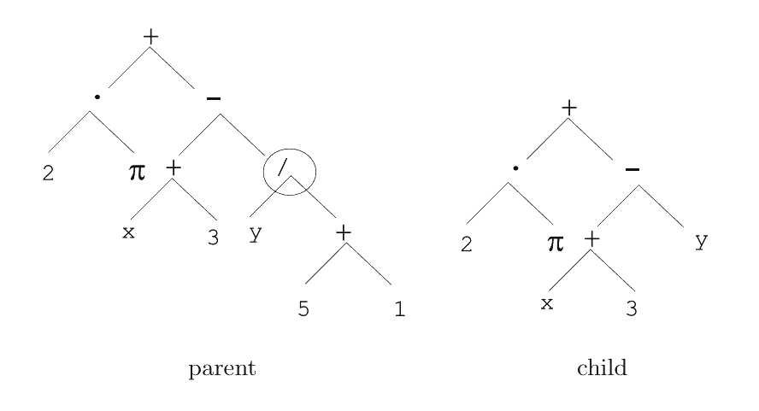
Mutation
A random node in the tree is selected for mutation.
The subtree starting at that node is replaced with a new randomly generated subtree.
The new subtree is created similarly to those in the initial population, respecting maximum depth and width limits.
Mutation allows structural diversity and introduces new sub-expressions into the population.
Because deeper levels of the tree have more nodes, mutations often occur lower in the tree.
This means the child tree can become larger than the parent (increased depth/complexity).

Slide 16
Mutation Parameters
The first probability:
deciding between mutation and crossover (recombination).
The second probability:
deciding where in the tree mutation happens — on an internal node vs a terminal.
GP differs from other Evolutionary Algorithms (EAs), which usually rely more heavily on mutation.
This is due to the belief that crossover acts like a macromutation, shuffling large parts of trees effectively.

Slide 17
Recombination
Recombination is considered a macromutation.
Children might be in a different size of their parents.

Slide 18
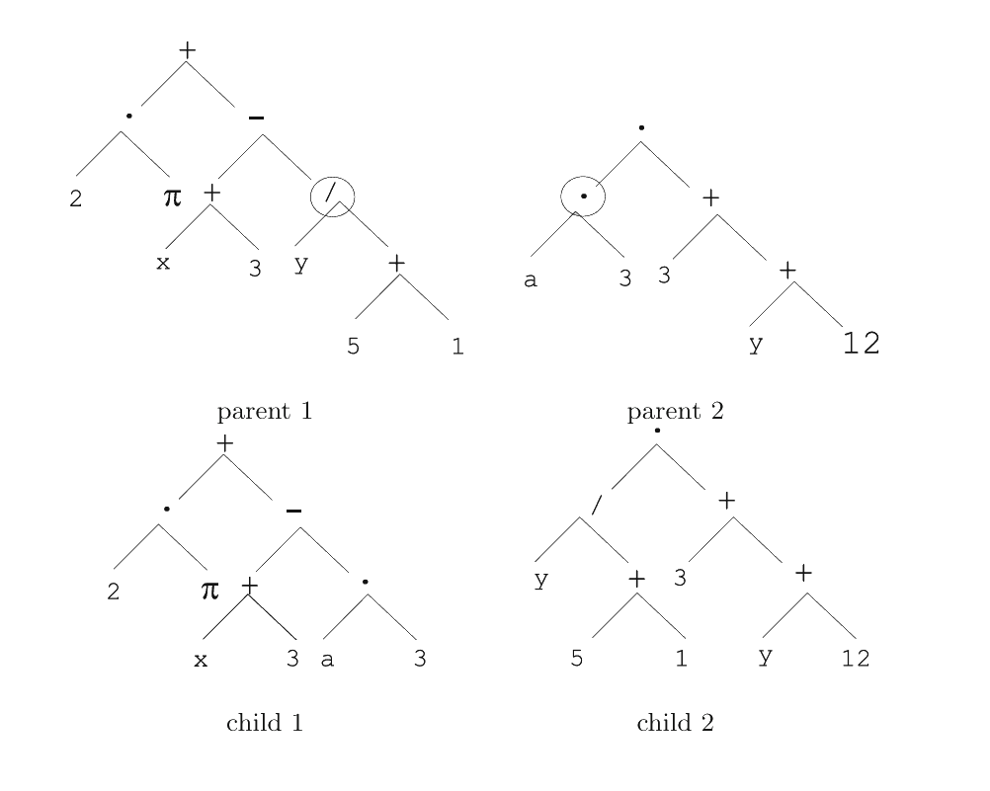
Recombination
Recombination creates offspring by swapping genetic material between two parents.
Technically a binary operator: produces two children from two parent trees.
The most common method is subtree crossover:
1. A random node is selected in each parent.
2. The subtrees rooted at those nodes are swapped.

Slide 19
Recombination Parameters
Probability of selecting crossover instead of mutation (at the junction).
Probability of selecting internal nodes as crossover points (vs. terminal nodes).
Children may have greater depth/size than parents.
This behavior differs from traditional EA crossover, which often preserves structure or size.

Slide 20
Survival Selection
Which one fits GP better? (μ,λ) or (μ+λ) ?

Slide 21
Survival Selection
Typical: generational scheme
Replacing parents with their offspring
Recently steady-state is becoming popular for its elitism

Slide 22
Problem
Survival of the Fattest
32/35

Slide 23
What Is Bloat in GP?
Bloat is when trees (programs) in a GP population keep growing larger and larger as the evolution proceeds.
It’s often called "survival of the fattest" — because bigger trees tend to survive, even when they don’t perform better than smaller ones.
Over time, this leads to:
Inefficient, oversized trees
Slower evaluations
Harder to interpret solutions

Slide 24
Why Does Bloat Happen?
Variable-Length Representation
In GP, trees can vary in size, unlike fixed-length genomes in other algorithms.
Because size can grow with each mutation or crossover, growth tends to accumulate unless it's actively controlled.
Neutral Code (Introns)
Some large parts of a tree might not affect output, but still get passed on.
These "neutral" parts don’t hurt fitness, so they accumulate silently, increasing size.

Slide 25
Why Is Bloat a Problem?
Slows down computation (evaluating big trees is expensive).
Wastes memory/resources.
Reduces generalization (overfitting).
Makes the final solution harder to understand and maintain.

Slide 26
How to Control Bloat?
Max Tree Size → Hard limit on depth/size
Define a maximum depth or node count.
If mutation/crossover would create a tree that’s too large → reject it.
This acts like a hard constraint.
Parsimony Pressure → Penalize large trees in fitness
Add a penalty to the fitness function for large trees.
Formula: Fitness = Raw Fitness − c × Size Penalty
Multi-objective Methods → Balance performance and size
Treat performance and tree size as two separate objectives.
Use methods like Pareto optimization to select trees that offer the best trade-off.

Slide 27
Summary
Representation
Recombination
Mutation
Tree Structures
Exchange of Subtrees
Random Change in Trees
Survival Selection
Parent Selection
Speciality
Over-Selection
(μ,λ)
Variable Chromosome Length

Slide 28
Conclusion
Supports variable-length solutions, enabling flexible model structures.
Can discover both structure and parameters of solutions automatically.
Prone to bloat, but can be managed with constraints or parsimony pressure.
Mutation or crossover is applied — but not both at the same time.

Slide 29
Reference
Yao, X., Ong, Y.-S., & Jin, Y. (2008). Introduction to evolutionary computation (Vol. 53). Chapter 4: Representation, Mutation, and Recombination. Springer.
Yao, X., Ong, Y.-S., & Jin, Y. (2008). Introduction to evolutionary computation (Vol. 53). Chapter 6: Popular Evolutionary Algorithm Variants. Springer.

