Slide 1

Multi-view graph convolutional networks with attention mechanism
Ali Mahmoodi
Atefe Rajabi

Slide 2
Introduction
Importance of graph data in various AI applications
Limitations of single-view GCNs
Introduction to Multi-View Graph Convolutional Networks (MAGCN)

Slide 3
Problem Statement
Single-view topology's limitations
Importance of considering multiple views

Slide 4
MAGCN Overview
Incorporation of multiple adjacency matrices
Attention mechanism for feature aggregation
Framework overview

Slide 5
MAGCN Architecture
Multi-GCN (unfold) block: Handling multiple views
Attention block: Aggregating information from different views
Multi-GCN (merge) block: Final classification

Slide 6
Graph GAP

Slide 7
Datasets
Label Rate: indicating the proportion of labeled nodes used for training in semi-supervised learning
Cora
Nodes: 2,708
Edges: 5,429
Features: 1,433
Classes: 7
Label Rate: 0.052
Citeseer
Nodes: 3,327
Edges: 4,732
Features: 3,703
Classes: 6
Label Rate: 0.036
Pubmed
Nodes: 19,717
Edges: 44,338
Features: 500
Classes: 3
Label Rate: 0.001

Slide 8
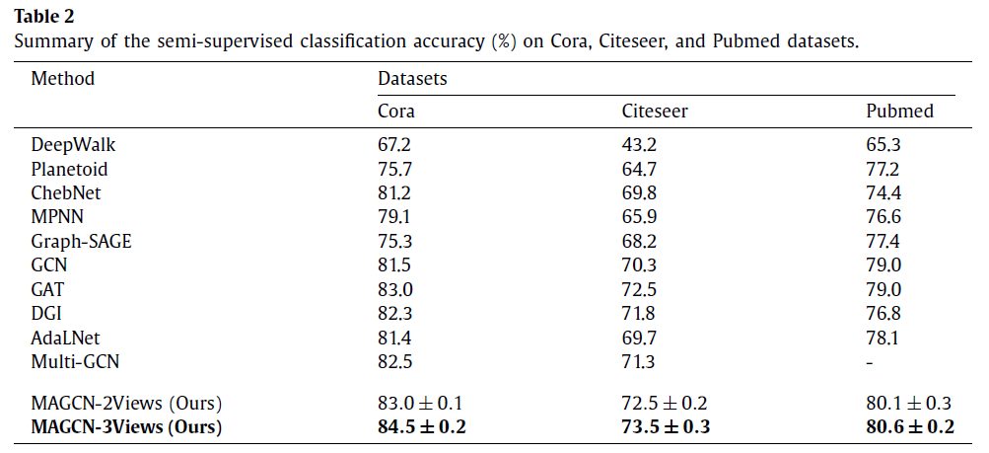
Experiments

Slide 9
Results
Cora: 0.83
Citeseer: 0.71
Pubmed: 0.79

Slide 10
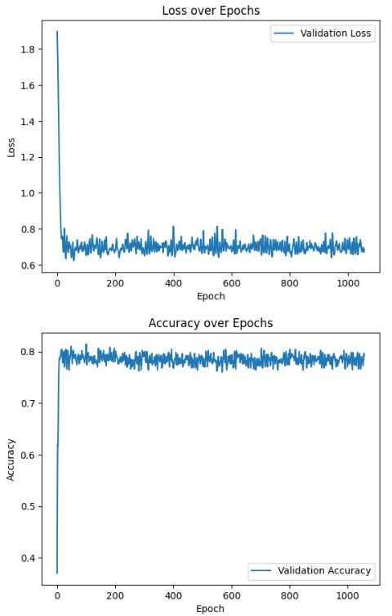
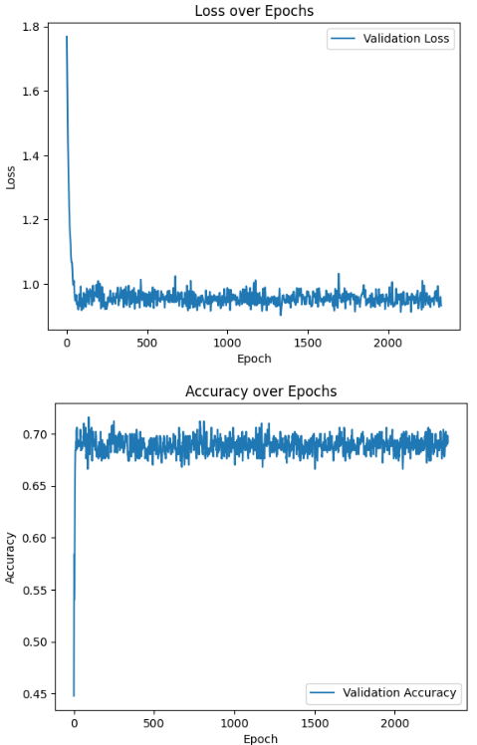
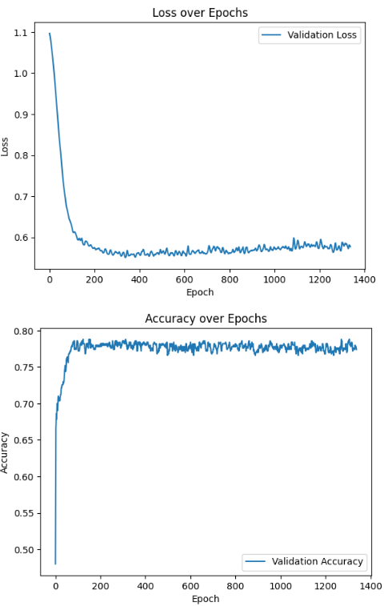
Plots
Cora
Citeseer
Pubmed

Slide 11
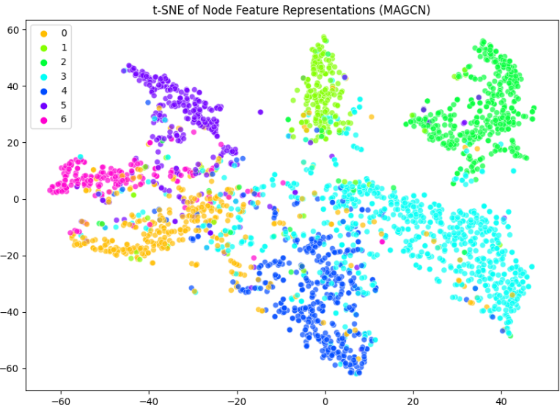
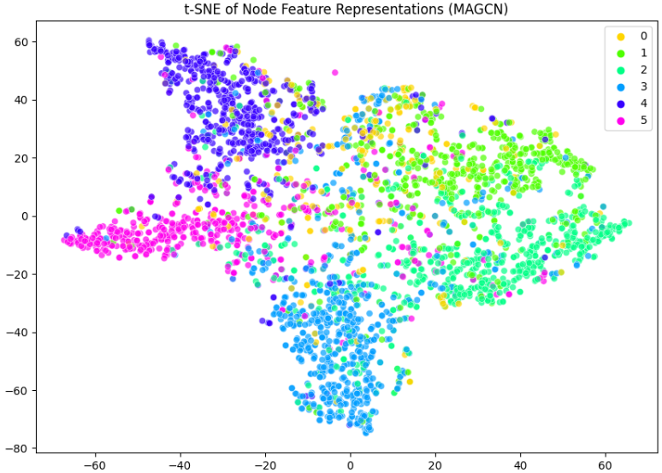
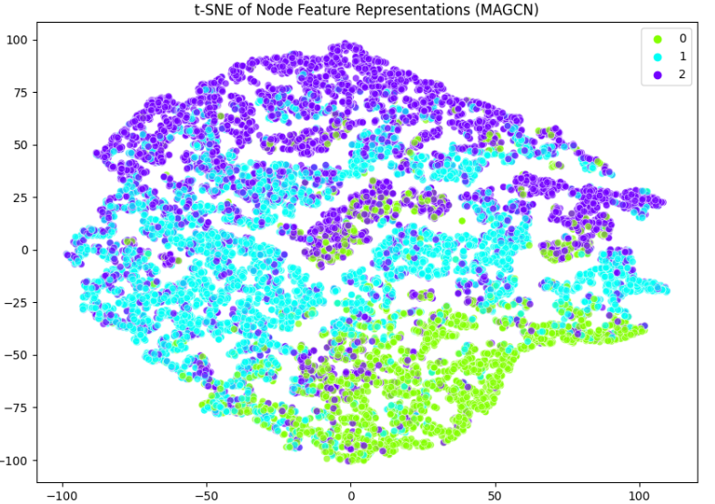
t-SNE Visualization
Cora
Citeseer
Pubmed

