Slide 1
A Novel Approach to Persian Text Sentiment Analysis through Density Distribution Modeling
Atefe Rajabi
Sepehr Radmard

Slide 2
Content
Problem Definition
Related works
Dataset Report
Preprocessing
Normalization
Tokenization
Stop Word Generation
Word Embedding
Outlier Detection
Handling Data Imbalance
Classifiers and Clusterers:
Results
Dimensionality Reduction
Proposed Approach

Slide 3
Problem Definition:
Sentiment Analysis
Companies Assessment
Leads to Improvement

Slide 4
Dataset Report
Unique words: 50106
Unique words after preprocessing: 28088
Number of Samples: 62938
Class Negative: 17055
Class Neutral: 5720
Class Positive: 40163
Imbalanced

Slide 5
Preprocessing
Clean Text
Normalization
Tokenization
Remove Stop Words

Slide 6
Clean Text:
Check for NaN
Convert to String
Remove Zero-Width Non-Joiner Characters
Remove URLs and Emails
Remove Numbers
Remove English Alphabets
Remove Repeated Characters
Remove Specific Characters
Remove Special Characters
Remove Extra Spaces

Slide 7
Normalization:
using Hazm's Normalizer
Removing Diacritics
Normalizing Perso-Arabic Characters
Normalizing Half-Space Characters
Removing Non-Standard Characters
Normalization of Numbers
Normalization of Punctuation
Normalizing Hamzeh
Normalization of Kashida

Slide 8
Tokenization:
using Hazm's word_tokenize
Splits the text into words or tokens

Slide 9
Remove Stop Words:
“stop_words.txt” is generated:
Based on the inverse document frequency (IDF)
Stop words: IDF scores below the min_idf_threshold or above the max_idf_threshold
min_idf_threshold: 2
max_idf_threshold: 11
number of detected Stop words: 22560
load set of stop words from the file
remove those stop words

Slide 10
Word Embedding:
using FastText
Aggregating Vectors
Two method implemented:
1:
Consider Dictionary and word embedding
Aggregating weighted by TF-IDF scoresUsing
2:
For each sample, Consider tokens and each Word Embeded vector
Calculating Average of these vectors, representing sentence

Slide 11
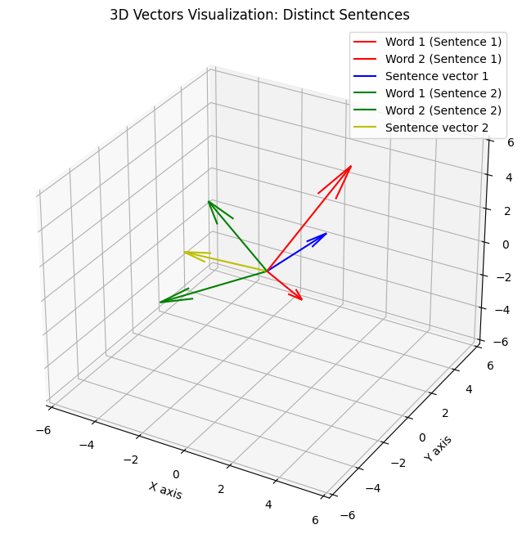
Word Vectors Aggregating (Mean):

Slide 12


Outlier Detection:
Z-score:
Outlier Counts for Each Class threshold is : 3
IQR:
Outlier Counts for Each Class alpha is : 3

Slide 13
Handling Imbalanced Data:
using imbalanced-learn
Resampling Techniques:
RandomUnderSampler
RandomOverSampler
SMOTE

Slide 14
Classifiers:
Softmax
OVA
OVO

Slide 15
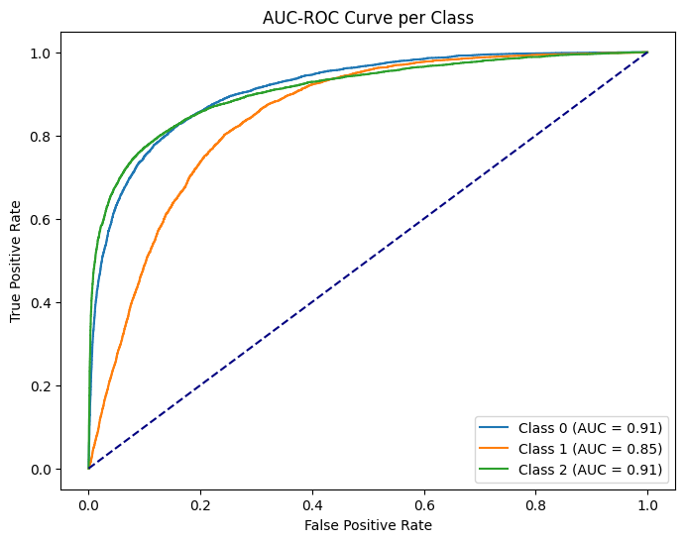
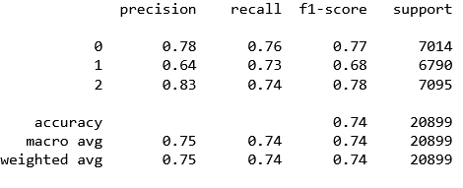
Softmax:
Test Accuracy: 0.74
Train Accuracy: 0.74
AUC-ROC per class:
Class -1: 0.91
Class 0: 0.85
Class 1: 0.91
Classification Report:
Confusion matrix:
260 | 70 | 9
47 | 253 | 41
18 | 78 | 255

Slide 16
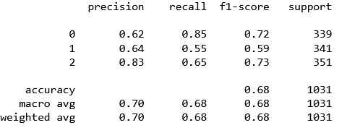
OVA:
Test Accuracy: 0.68
Train Accuracy: 0.67
Classification Report:
Confusion matrix:
289 | 40 | 10
117 | 188 | 36
58 | 65 | 228

Slide 17
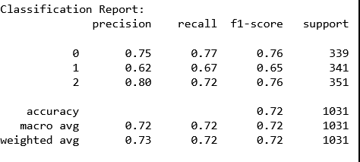
OVO:
Test Accuracy: 0.72
Train Accuracy: 0.72
Classification Report:
Confusion matrix:
265 | 65 | 26
65 | 222 | 52
33 | 70 | 242

Slide 18
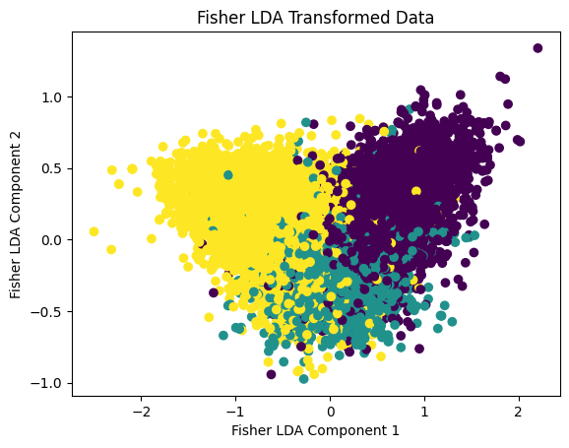
Dimensionality Reduction:

Slide 19
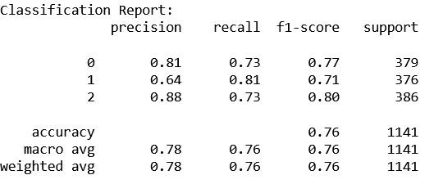
KDE:
Test Accuracy: 0.76
Train Accuracy: 0.74
Classification Report:
Confusion matrix:
275 | 93 | 11
41 | 306 | 29
22 | 82 | 282

Slide 20
Comparison:
The KDE classifier has the highest test accuracy
The KDE classifier shows the highest macro averaged F1-score
Particularly strong results for class 2

Slide 21
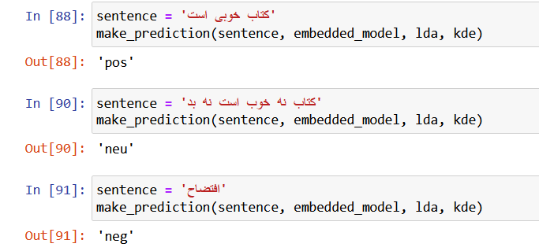
Test:

