Slide 1
Session 1: Data and AI
Understanding why data is essential for AI models
Exploring how AI learns from data
Recognizing patterns
Roadmap
What is EDA?

Slide 2
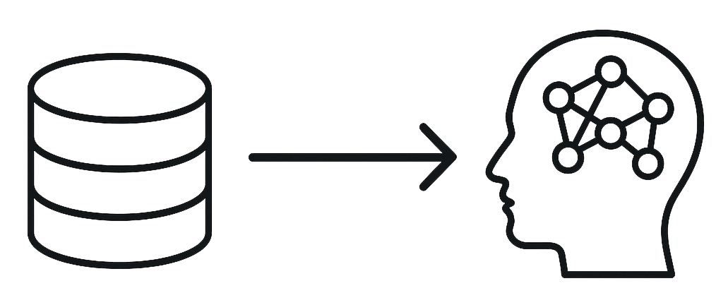
Why Data is Required for AI Models
Data is the foundation of AI models — without it, models cannot learn.
AI learns patterns, relationships, and insights from examples.
The more relevant and high-quality data we have, the better the AI performs.
Garbage in, garbage out — poor data leads to poor AI predictions.

Slide 3
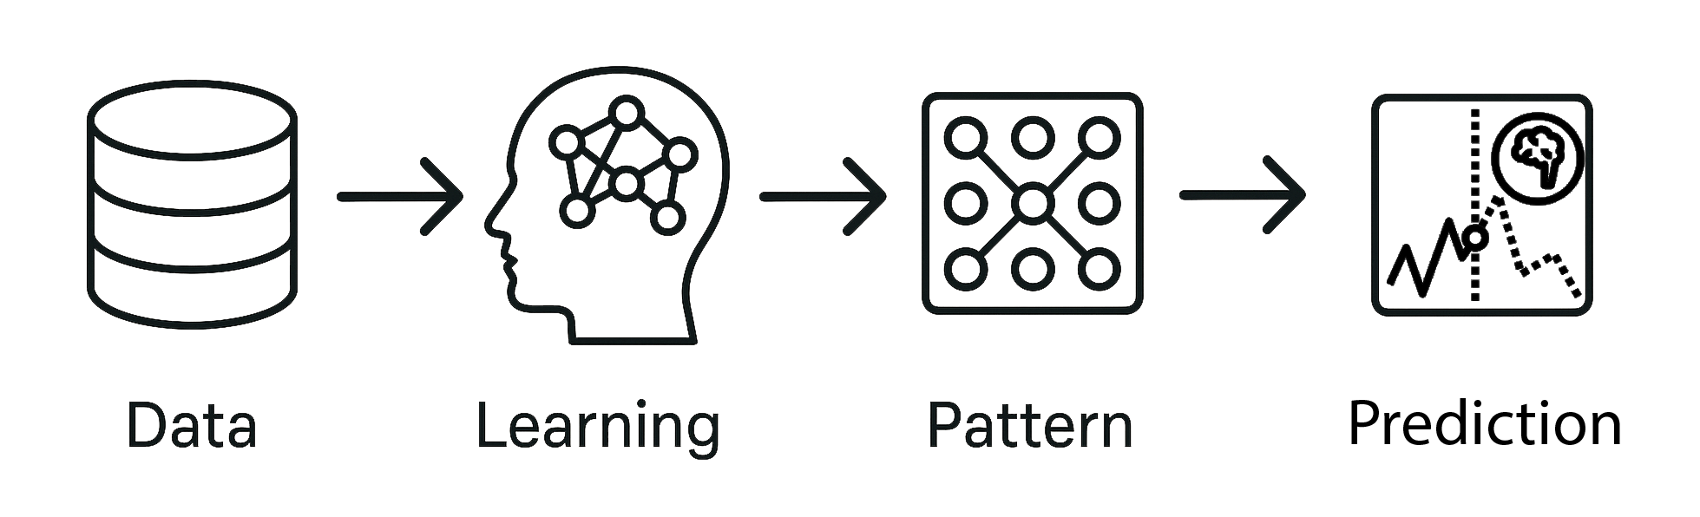
How AI Models Work
1. Input Data → Feed data into the model.
numbers, text, images, or anything relevant.
2. Pattern Recognition → Model identifies trends and relationships.
It might notice that certain values in a blood test often appear in patients with a specific disease.
3. Learning → Adjusts internal parameters to improve accuracy.
think of these like ‘knobs’ it tunes to get better predictions.
4. Prediction → Produces results based on learned patterns.
AI can predict outcomes it hasn’t seen before, based on what it has learned from the data.

Slide 4
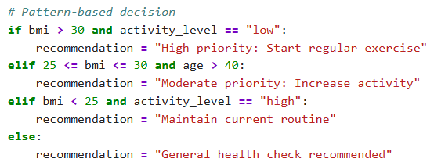
Data and Pattern Recognition
Data contains hidden patterns that AI can uncover.
A pattern is a relationship between inputs and outputs that repeats often enough to be useful.
Example: In medical datasets, certain features may indicate higher disease risk.
AI models find patterns humans might miss.
Visualization tools help humans interpret these patterns.

Slide 5
Roadmap
Introduction to Artificial Intelligence and Practical Tools
Overview of basic AI concepts, introduction to key Python libraries (NumPy, Pandas, Scikit-learn), and basic data preprocessing techniques.
Supervised Learning
Learning fundamental algorithms such as Linear regression, Logistic Regression and Decision Trees with model performance evaluation.
Unsupervised Learning
Exploring clustering algorithms like K-Means and their applications in analyzing unlabeled data.
Deep Learning Basics
Introduction to Artificial Neural Networks, focusing on MLP architecture and training simple models with Keras.
Natural Language Processing (NLP) Project
Conducting a sentiment analysis project using LSTM models and text data, including preprocessing, modeling, and performance evaluation.

Slide 6
Data Science Workflow
Data Collection: From a database, CSV, or API
Exploratory Data Analysis (EDA): Visualizing, summarizing, and spotting patterns
Data Cleaning: Handling missing values, removing duplicates, etc.
Modeling: Classification, regression, clustering, etc.
Evaluation: Accuracy, precision, recall, etc.
Deployment: Use model in production or business setting

Slide 7
What is EDA?
EDA (Exploratory Data Analysis) is the process of exploring datasets to summarize their main characteristics.
Purpose: Understand the data before building models.
Analogy: Like checking ingredients before cooking — know what you have, how fresh it is, and if anything is missing.

Slide 8
Why EDA is Important
Detect errors or missing data early.
Spot trends, patterns, and relationships.
Choose the right features for modeling.
Avoid bad data entering the model.

Slide 9
Steps of EDA
Understand the context — what does the dataset represent?
Inspect the structure — rows, columns, data types.
Check completeness — missing values, duplicates.
Summarize statistics — mean, median, standard deviation.
Spot patterns & outliers — box plots, scatter plots.
Visualize relationships — correlations, group comparisons.

Slide 10
Types of EDA
Univariate Analysis — single variable (histograms, value counts).
Bivariate Analysis — relationship between two variables (scatter plots, bar charts).
Multivariate Analysis — multiple variables (heatmaps, pair plots).

Slide 11
Common EDA Visualizations
Histograms — distribution of values.
Boxplots — outliers & spread.
Scatter plots — relationships.
Heatmaps — correlations.

