Slide 1

Probability
The MEnTe Program
Math Enrichment through Technology
Title V East Los Angeles College
Click one of the buttons below
or press the enter key
©2003 East Los Angeles College. All rights reserved.
TOPICS
BACK
NEXT
EXIT

Slide 2
Topics
Introduction
Empirical Probability
Theoretical Probability
Compound Events
Addition Rule
Multiplication Rule
for Independent Events
Multiplication Rule
for Dependent Events
Counting Principles
Odds
Permutations
Combinations
Permutations of
Repeated Objects

Slide 3
Probability Introduction
When we speak of the probability of something happening, we are referring to the likelihood—or chances—of it happening. Do we have a better chance of it occurring or do we have a better chance of it not occurring?

Slide 4
Generally, we talk about this probability as a fraction, a decimal, or even a percent—
the probability that if two dice are tossed the spots will total to seven is 1/6
the probability that a baseball player will get a hit is .273
the probability that it will rain is 20%

Slide 5
Empirical Probability
Some probabilities are determined from repeated experimentation and observation, recording results, and then using these results to predict expected probability. This kind of probability is referred to as empirical probability.

Slide 6
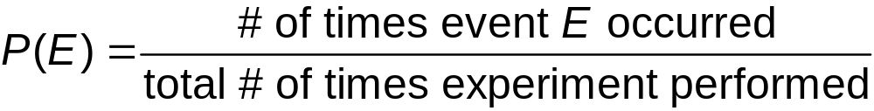
If we conduct an experiment and record the number of times a favorable event occurs, then the probability of the event occurring is given by:

Slide 7
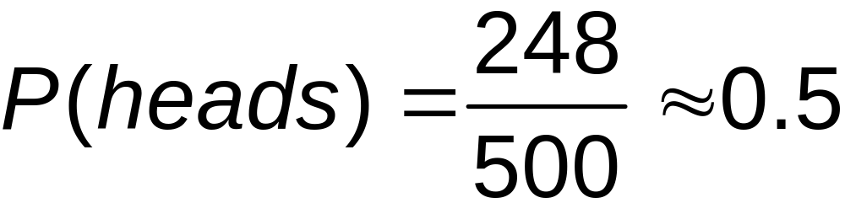
We can see this in the following example. If we flip a coin 500 times and it lands on heads 248 times, then the empirical probability is given by:
Remember

Slide 8
Theoretical Probability
Other probabilities are determined using mathematical computations based on possible results, or outcomes. This kind of probability is referred to as theoretical probability.

Slide 9
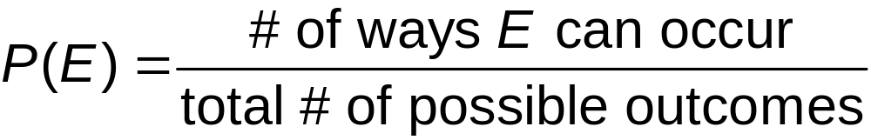
The theoretical probability of event E happening is given by:

Slide 10
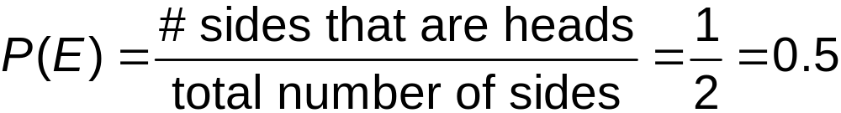
If we consider a fair coin has two sides and only one side is heads, and either side is likely to come up, then the theoretical probability of tossing heads is given by:
Remember

Slide 11
While in both cases illustrated for tossing a heads the probability comes out to be 0.5, it should be noted that empirical probability falls under the Law of Large Numbers which basically says that an experiment must be conducted a large number of times in order to determine the probability with any certainty.

Slide 12
You can flip a coin ten times and have heads come up seven times, but this does not mean that the probability is 0.7. The more times a coin is flipped, the more certainty we have to determine the probability of coming up heads.

Slide 13
Other examples of theoretical probability are found in determining the probability of drawing a certain card from a standard deck of cards.
A standard deck has four suits: spades (♠), hearts (♥), diamonds (♦), and clubs (♣). It has thirteen cards in each suit: ace, 2, 3, . . ., 10, jack, queen, and king. Each of these cards is equally likely to be drawn.

Slide 14
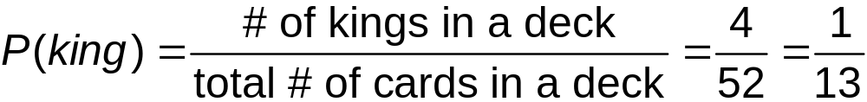
The probability of drawing a king is given by:
Remember

Slide 15
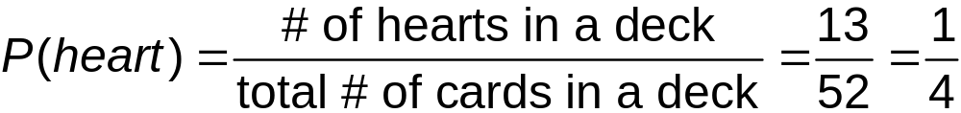
The probability of drawing a heart is given by:
Remember

Slide 16
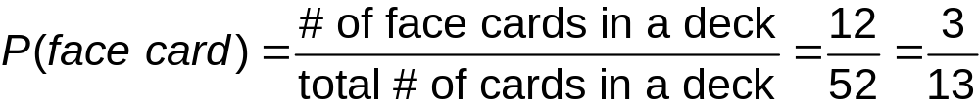
The probability of drawing a face card (jack, queen, king) is given by:
Remember

Slide 17
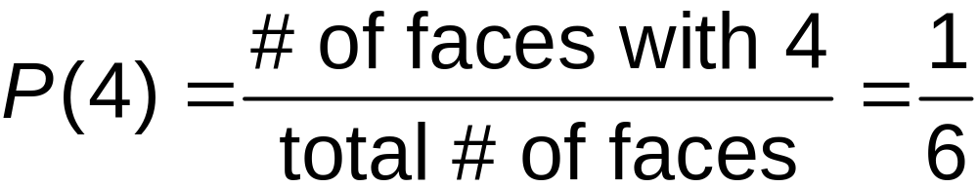
Dice (singular is die) are cubes that have spots on each side. The spots are usually numbered from 1 to 6. When a fair die is tossed, each side has an equally likely chance of ending up on top. The probability of tossing a die and having a 4 end up on top (this is called rolling a 4) is given by:

Slide 18
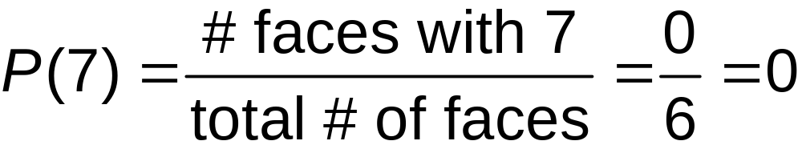
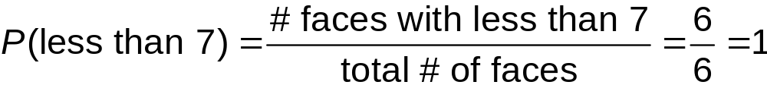
The probability of tossing a die and rolling a 7 is given by:
The probability of tossing a die and rolling a number less than 7 is given by:

Slide 19
These examples lead to four rules or facts about probability:
1. The probability of an event that cannot occur is 0.
2. The probability of an event that must occur is 1.
3. Every probability is a number between 0 and 1 inclusive.
4. The sum of the probabilities of all possible outcomes of an experiment is 1.

Slide 20
The complement of an event is all outcomes where the desired event does not occur. We can say the complement of E is not E (sometimes written as Ē or
E ).

Slide 21

Since any event will either occur or it will not occur, by rule 4 previously discussed, we get:
Remember
Rule 4: the sum of the probabilities of all possible outcomes of an experiment is 1.

Slide 22

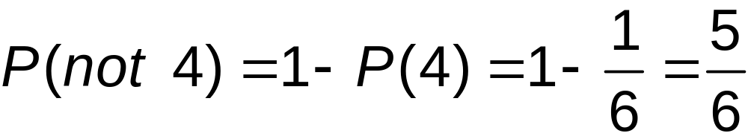
can also be stated as:
So the probability of tossing a die and not rolling a 4 is:

Slide 23
Compound Events
A compound event is an event consisting of two or more simple events. Examples of simple events are: tossing a die and rolling a 5, picking a seven from a deck of cards, or flipping a coin and having a heads show up.

Slide 24

An example of a compound event is tossing a die and rolling a 5 or an even number. The notation for this kind of compound event is given by . This is the probability that event A or event B (or both) will occur.

Slide 25
In the case of rolling either a 5 or an even number on a die, the probability is arrived at by using the fact that there is only one way to roll a 5 and there are three ways to roll an even number.

Slide 26
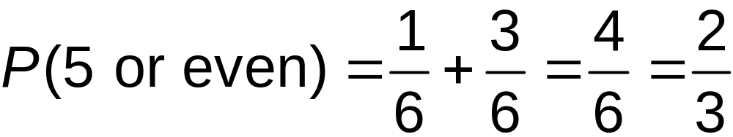
So, out of the six numbers that can show up on top, we have four ways that we can roll either a 5 or an even number. The probability is given by:
Probability of rolling a 5
Probability of rolling an even number

Slide 27
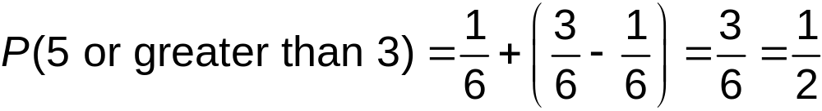
Notice however, if we want the probability of rolling a 5 or rolling a number greater than 3. There are three numbers greater than 3 on a die and one of them is the 5. We cannot count the 5 twice. The probability is given by:
Probability of rolling a 5
Probability of rolling the same 5
Probability of rolling a number greater than 3

Slide 28
Addition Rule
This leads to the Addition Rule for compound events. The statement of this rule is that the probability of either of two events occurring is the probability for the first event occurring plus the probability for the second event occurring minus the probability of both event occurring simultaneously.

Slide 29
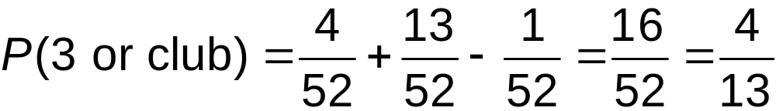
Stated mathematically the rule is given by:
Thus, the probability of drawing a 3 or a club from a standard deck of cards is:
Cards with a 3
Cards with clubs
Card that is a 3 and a club

Slide 30

If two events are mutually exclusive, they cannot occur simultaneously. Therefore, , and the Addition Rule for mutually exclusive events is given by:

Slide 31
Multiplication Rule for Independent Events
Independent events are events in which the occurrence of the events will not affect the probability of the occurrence of any of the other events.

Slide 32
When we conduct two independent events we can determine the probability of a given outcome in the first event followed by another given outcome in the second event.

Slide 33
An example of this is picking a color from a set of crayons, then tossing a die. Separately, each of these events is a simple event and the selection of a color does not affect the tossing of a die.

Slide 34


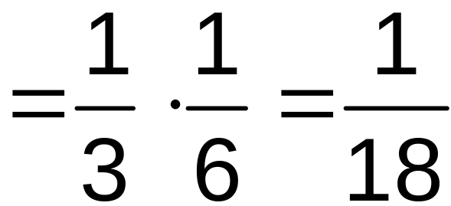
If the set of crayons consists only of red, yellow, and blue, the probability of picking red is . The probability of
tossing a die and rolling a 5 is . But
the probability of picking red and rolling a 5 is given by:

Slide 35
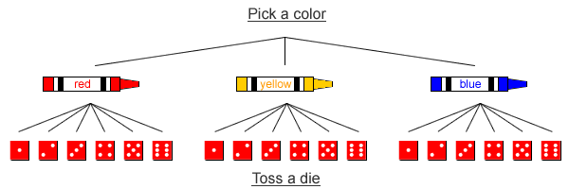
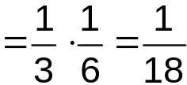
This can be illustrated using a “tree” diagram.
Since there are three choices for the color and six choices for the die, there are eighteen different results. Out of these, only one gives a combination of red and 5. Therefore, the probability of picking a red crayon and rolling a 5 is given by:

Slide 36
The multiplication rule for independent events can be stated as:
This rule can be extended for more than two independent events:

Slide 37
Multiplication Rule for Dependent Events
Dependent events are events that are not independent. The occurrence of one event affects the probability of the occurrence of other events. An example of dependent events is picking a card from a standard deck then picking another card from the remaining cards in the deck.

Slide 38
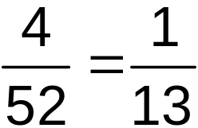
For instance, what is the probability of picking two kings from a standard deck of cards? The probability of the first card being a king is . However, the probability of the second card depends on whether or not the the first card was a king.

Slide 39
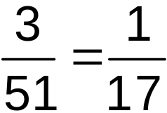

If the first card was a king then the probability of the second card being a king is .
If the first card was not a king, the probability of the second card being a king is .
Therefore, the selection of the first card affects the probability of the second card.

Slide 40
When we are looking at probability for two dependent events we need to have notation to express the probability for an event to occur given that another event has already occurred.

Slide 41
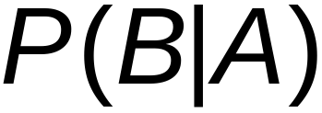
If A and B are the two events, we can express the probability that B will occur if A has already occurred by using the notation:
This notation is generally read as “the probability of B, given A.

Slide 42
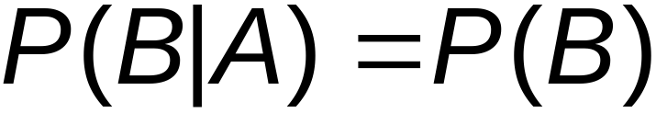
The multiplication rule can now be expanded to include dependent events. The rule now reads:
Of course, if A and B are independent, then:

Slide 43
As an example, in a group of 25 people 16 of them are married and 9 are single. What is the probability that if two people are randomly selected from the group, they are both married?

Slide 44
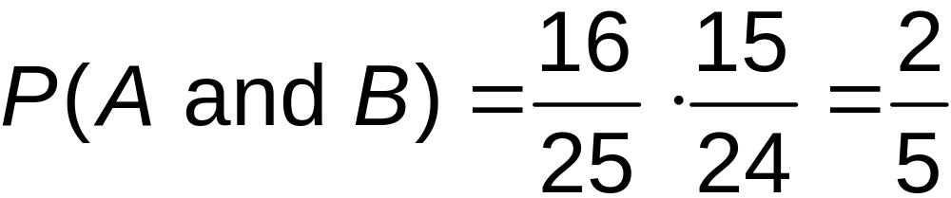

If A represents the first person chosen is married and B represents the second person chosen is married then:
Here, is now the event of picking another married person from the remaining 15 married persons. The probability for the selection made in B is affected by the selection in A.

Slide 45
Counting Principles
Sometimes determining probability depends on being able to count the number of possible events that can occur, for instance, suppose that a person at a dinner can choose from two different salads, five entrees, three drinks, and three desserts. How many different choices does this person have for choosing a complete dinner?

Slide 46
The Multiplication Principal for counting (which is similar to the Multiplication Principle for Probability) says that if an event consists of a sequence of choices, then the total number of choices is equal to the product of the numbers for each individual choice.

Slide 47
If c₁,c₂, c₃, …,c_{n}, represent the number of choices that can be made for each option then the total number of choices is:
c₁ c₂ c₃ … c_{n}
For our person at the dinner, the total number of choices would then be
2 5 3 3=90 different choices for combining salad, entrée, drink, and dessert.

Slide 48
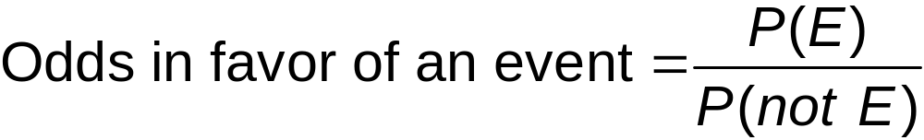
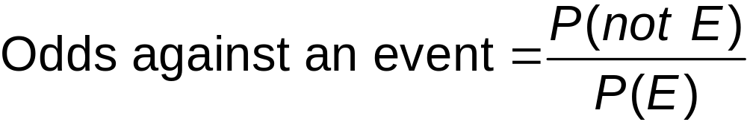
Odds
Odds are related to probability, but there are slightly different computing rules for figuring out odds. The odds of an event occurring is given by:
And the Odds of an event not occurring is given by:
Press the right arrow key or the enter key to advance the slides

Slide 49
Notice that these are reciprocals of each other and the odds for an event not happening are not determined by subtracting from 1, as in the case for determining the probability of an event not happening.
Probability of an event not happening

Slide 50
Permutations
A permutation is an arrangement of objects where order is important. For instance the digits 1,2, and 3 can be arranged in six different orders --- 123, 132, 213, 231, 312, and 321. Hence, there are six permutations of the three digits. In fact there are six permutations of any three objects when all three objects are used.

Slide 51
In general the number of permutations can be derived from the Multiplication Principal. For three objects, there are three choices for selecting the first object. Then there are two choices for selecting the second object, and finally there is only one choice for the final object. This gives the number of permutations for three objects as 3 2 1=6.

Slide 52
Now suppose that we have 10 objects and wish to make arrangements by selecting only 3 of those objects. For the first object we have 10 choices. For the second we have 9 choices, and for the third we have 8 choices. So the number of permutations when using 3 objects out of a group of 10 objects is 10 9 8=720.

Slide 53

We can use this example to help derive the formula for computing the number of permutations of r objects chosen from n distinct objects r ≤ n. The notation for these permutations is and the formula is:

Slide 54

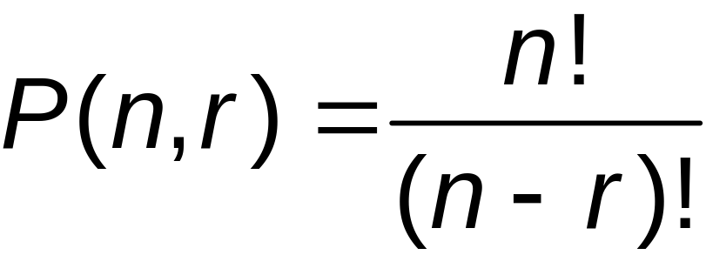
We often use factorial notation to rewrite this formula. Recall that:
And
Using this notation we can rewrite the Permutation Formula for as

Slide 55
It is important to remember that in using this formula to determine the number of permutations:
1. The n objects must be distinct
2. That once an object is used it cannot be repeated
3. That the order of objects is important.

Slide 56
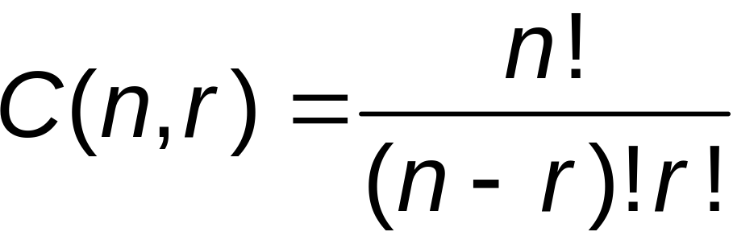
Combinations
A combination is an arrangement of objects in which order is not important. We arrange r objects from among n distinct objects where r ≤ n. We use the notation C(n, r) to represent this combination. The formula for C(n, r) is given by:

Slide 57
The Combination Formula is derived from the Permutation Formula in that for a permutation every different order of the objects is counted even when the same objects are involved. This means that for r objects, there will be r! different order arrangements.

Slide 58

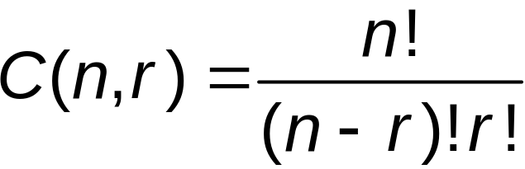
So in order to get the number of different combinations, we must divide the number of permutations by r!. The result is the value we get for C(n, r) in the previous formula.
Permutation Combination

Slide 59
Permutations of Repeated Objects
It is possible that in a group of objects some of the objects may be the same. In taking the permutation of this group of objects, different orders of the objects that are the same will not be different from one another.

Slide 60
In other words if we look at the group of letters in the word ADD and use D₁ to represent the first D, and D₂ to represent the second, we can then write the different permutations as AD₁D_{2,} AD₂D_{1,} D₁AD_{2,} D₂AD_{1,} D₁D₂A, and D₂D₁A.

Slide 61
But if we substitute the Ds back for the D₁ and D₂, then AD₁D₂ and AD₂D₁ both appear as ADD, and the six permutations become only three distinct permutations.
Therefore we will need to divide the number of permutations by 2 to get the number of distinct permutations.

Slide 62
In permutations of larger groups of objects, the division becomes a little more complicated.
To explain the process, let us look at the word WALLAWALLA. This word has
4 A’s, 4 L’s, and 2 W’s.

Slide 63
Consider that there are 10 locations for each of these letters. These 10 locations will be filled with 4 A’s, and since the A’s are all the same, the order in which we place the A’s will not matter. So if we are filling 10 locations with 4A’s the number of ways we can do this is
C(10, 4).
Remember

Slide 64
Once these 4 locations have been filled, there remain 6 locations to fill with the 4 L’s. These can be filled in C(6,4) ways, and the last 2 locations are filled with the W’s in C(2,2) ways.

Slide 65
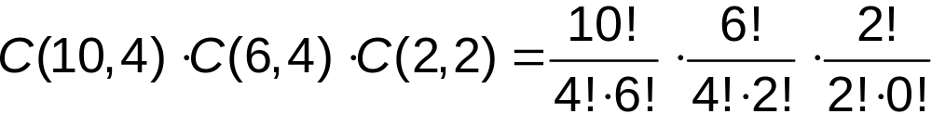
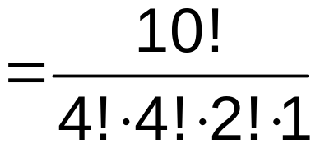
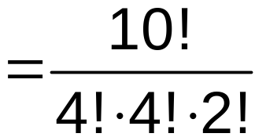
Finally, we multiply these together to get

Slide 66
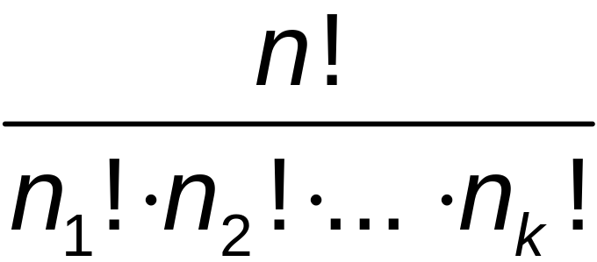
This leads to the general formula for permutations involving n objects with
n₁ of one kind, n₂ of a second kind, …and n_{k} of a kth kind.
The number of permutations in this case is:
where n=n₁+n₂+…n_{k}.

Slide 67



Counting other choices sometimes requires a bit more reasoning to determine how many possibilities there are.

Slide 68
Suppose there are three cards that are each marked with a different letter, A, B, or C. If the cards are face down, and a person can pick one, two or all three of the cards, what is the possibility that the person will pick up the card with the letter A on it?
?

Slide 69
In this case there are three ways that one card can be picked. Out of these there is only one possibility of picking the A.
First way
Second way
Third way
A is picked!

Slide 70
There are three ways of picking two cards. Out of these three pairs, there are two that will include the A.
First way
Second way
A is picked!
Third way
A is picked!

Slide 71
There is only one way to pick all three cards, and of course, if all three cards are picked, the A will always be included.
A is picked!

Slide 72

So there are a total of seven ways the cards can be picked if the person can pick one, two, or all three cards. Of these choices, four of them will include the A, so the probability that the A will be picked is:
Possibilities of picking the A card
Total # of ways to pick the three cards

Slide 73
Contact Us At:
The MEnTe Program / Title V
East Los Angeles College
1301 Avenida Cesar Chavez
Monterey Park, CA 91754
Phone: (323) 265-8784
Fax: (323) 415-4109
Email Us At:
menteprogram@yahoo.com
Our Websites:
http://www.matematicamente.org
http://www.mente.elac.org

