Slide 1


SIMATS ENGINEERING
SAVEETHA INSTITUTE OF MEDICAL AND TECHNICAL SCIENCES
Intelligent Test Case Generation And Automated Defect Detection Framework For E-commerce Application
CSA3717-SOFTWARE TESTING
Presented by:
BALAGURU.S (192312070)
SHERALI AHMED(192312369)
B REDDY BALU(192312499)
MOHAMEED ASFAR ALI S(192421107)
GUIDED BY
DR KRISHNARAJ MONY

Slide 2
INTRODUCTION
Software testing verifies that an application works as expected and meets user requirements.
Manual test case design and defect logging are time-consuming and error-prone.
E-commerce applications need frequent regression testing across login, search, cart, checkout and payment.
Frequent releases and complex user flows make full manual testing impractical.
It executes the tests through UI and API automation and detects defects automatically.
Defects are classified by severity and presented on an analytics dashboard.

Slide 3
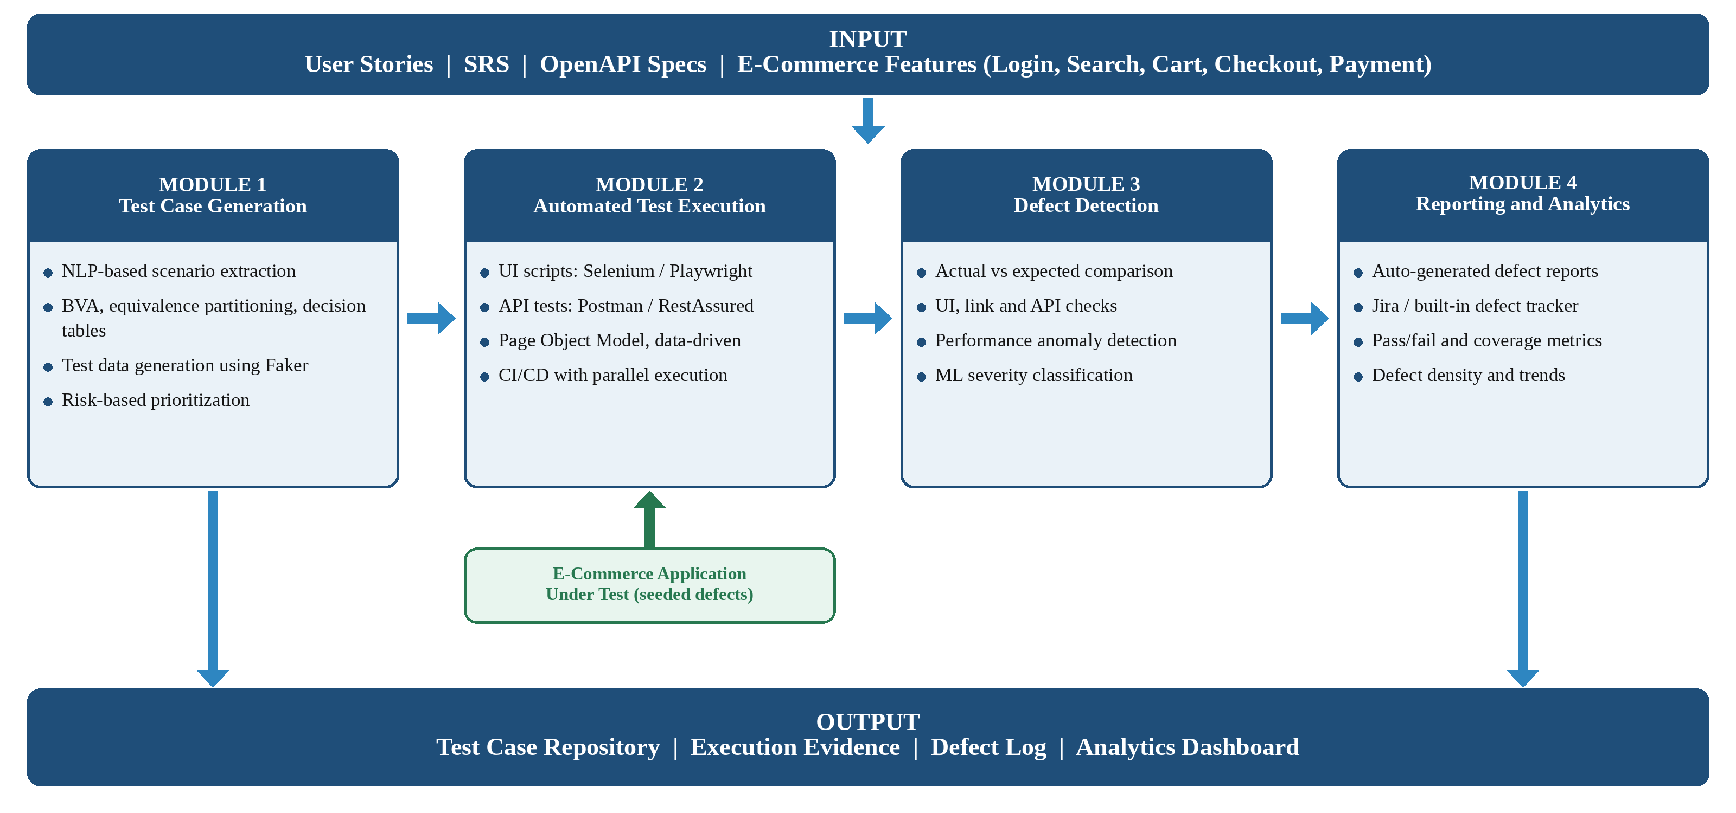
SYSTEM DESIGN/METHODOLOGY

Slide 4
OBJECTIVES
To generate test cases automatically from requirements and user stories.
To apply test design techniques such as BVA and equivalence partitioning.
To generate valid, invalid and edge-case test data.
To automate UI and API test execution for an e-commerce application.
To detect and classify defects by type and severity.
To report results through a defect log and analytics dashboard.

Slide 5
APPLICATIONS AND ADVANTAGES
Applications
E-commerce website quality assurance.
Regression testing in CI/CD pipelines.
Test automation for online retail platforms.
Advantages
Reduces manual test design effort.
Improves test coverage and consistency.
Easily extended to other web applications.

Slide 6
MODULE 1:
INTELLIGENT TEST CASE GENERATION
Parse user stories, SRS and OpenAPI specifications.
Extract testable scenarios using NLP techniques.
Apply boundary value analysis and equivalence partitioning.
Use decision tables and state transition for the order lifecycle.
Generate valid, invalid and edge-case test data using Faker.
Store test cases in a structured repository.

Slide 7
MODULE 2:
AUTOMATED TEST EXECUTION
Convert test cases into Selenium or Playwright UI scripts.
Create API tests using Postman or RestAssured.
Use the Page Object Model with data-driven testing.
Run tests on multiple browsers in parallel.
Capture logs, screenshots and API responses for every run.
Store raw results as evidence for defect analysis.

Slide 8
MODULE 3:
DEFECT DETECTION AND CLASSIFICATION
Compare actual and expected results to flag failures.
Detect UI issues, broken links and API mismatches.
Identify performance anomalies from execution logs.
Classify defect type and severity using a machine learning model.
Train and validate the model on historical defect data.
Measure detection rate against seeded defects.

Slide 9
MODULE 4:
DEFECT REPORTING AND ANALYTICS
Auto-generate defect reports with steps to reproduce.
Attach screenshots, logs and API responses as evidence.
Assign severity and priority to every defect.
Show pass/fail rate and test coverage on a dashboard.
Display defect density and distribution by module.
Track execution trends across test runs.

Slide 10
CONCLUSION
The framework automates test design, execution and defect analysis.
Test cases and test data are generated directly from requirements.
UI and API automation reduce manual regression effort.
Defects are detected, classified and reported automatically.
The dashboard gives clear insight into coverage and quality.
Future scope: LLM-based test generation and self-healing scripts.

Slide 11
REFERENCES
□
1. Tasarsu, M. et al. (2026). Test Case Generation Using Large Language Models: A Systematic Literature Review. Cluster Computing.
2. Li, T. et al. (2026). Large Language Models for Automated Web-Form-Test Generation: An Empirical Study. ACM TOSEM.
3. Mallipeddi, S. et al. (2025). AutoQALLMs: Automating Web Application Testing Using Large Language Models (LLMs) and Selenium. Computers.
4. (2025). Intent Based E2E Automated Test Case Generation for Web Applications Using LLM. IEEE COMPSAC.

Slide 12


