Slide 1
Application of Linear Algebra Genetics
Gina Chein
Ben Weeks
Ian Perkins
(Insert Date)

Slide 2
The Question
“Take Home” for slide
Notes:
“breathing lung, beating heart, metabolic liver, flowing kidney, peristalsing gut, reactive airway, contracting skeletal muscle, skin barrier, blood-brain barrier, reproductive/endocrine testis and self-renewing bone marrow.”

Slide 3
Current Solutions
Notes:
the piezoelectric effect can be described as the the link between electrostatics and mechanics.
Contractility for cardiac muscles = metric for their health

Slide 4
A linear approach.

Slide 5
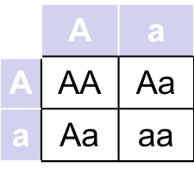
Trait Dominance
Traits can be simply modeled through the use of Punnet Squares.
In this way we can show the cross for two heterozygous parents.
This is helpful to display the change for more than.
A Punnet Sqaure

