Slide 1
PART FIVE · STRATEGY DECISIONS
From data to decisions
3 questions, 3 dashboards — 2,867 orders · 9 platforms · 4 months
Notes:
~30 sec. So far we used AI to write and to listen. Now we use it to decide. Same data the founder has; three decisions every small brand faces.

Slide 2
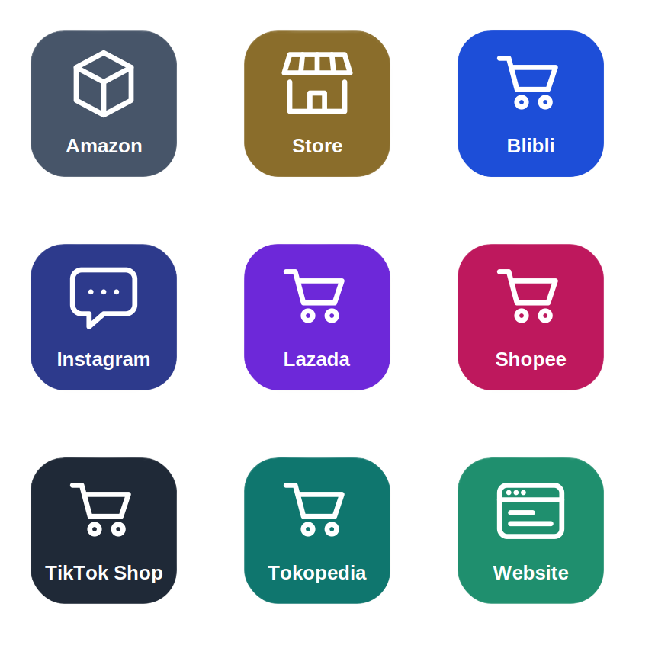
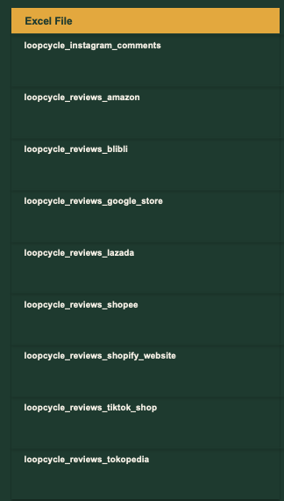
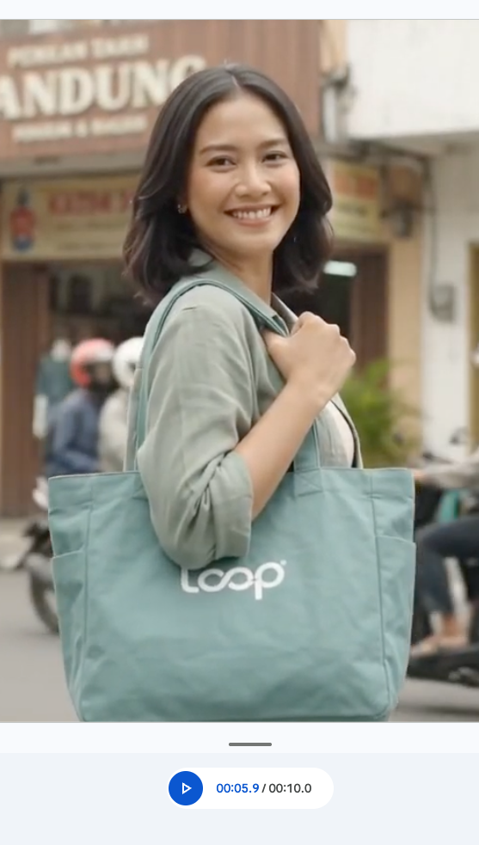
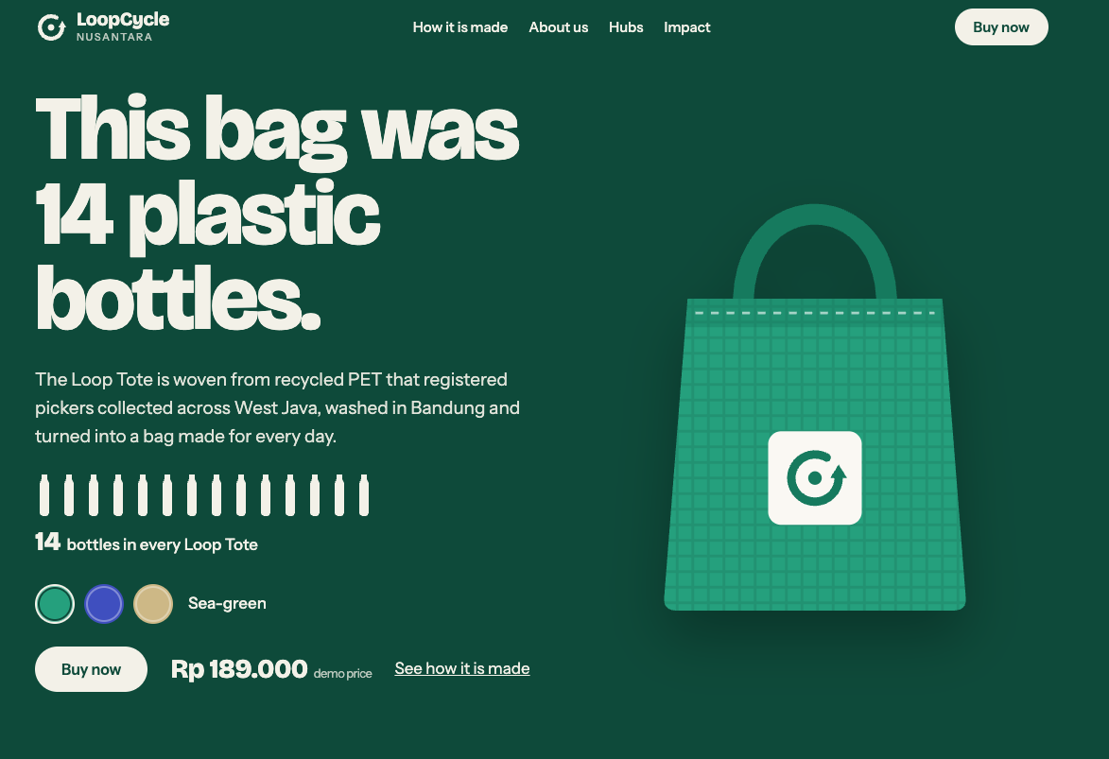
STRATEGY DECISIONS · SETUP
The story so far… now, where do we put our money?
Designed an Insta Reel to launch Loop Tote
Launched Loop Tote
Loop Tote sold on various platforms
Listened to reviews & comments
Notes:
~30 sec. Recap the arc: we launched the Loop Tote, sold it on 9 platforms and listened to reviews. Reviews told us what customers feel. Sales data tells us what they do.

Slide 3
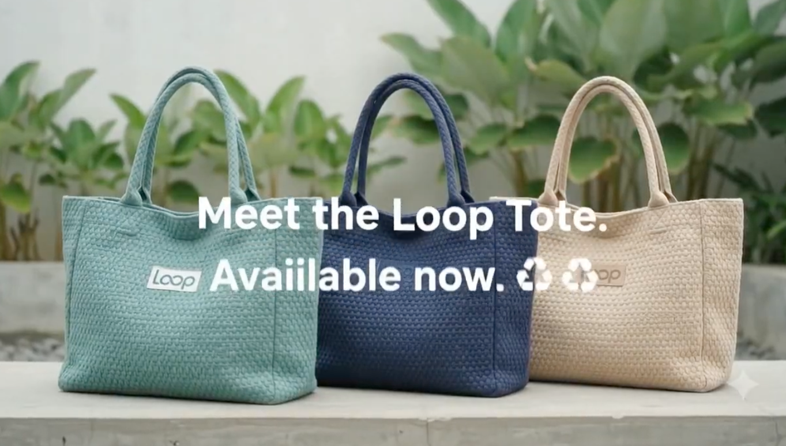
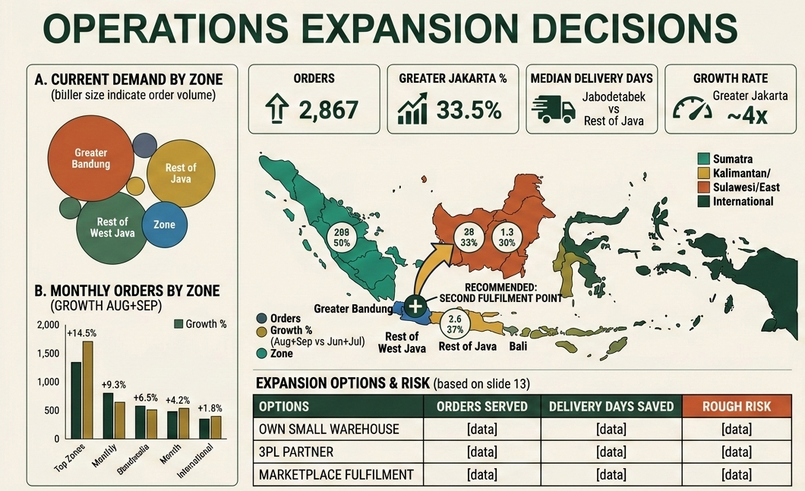
STRATEGY DECISIONS · SETUP
The story so far… now, where do we put our money?
Improved the Quality & Launched Loop Tote 2.0
Loop Tote 2.0 sold on various platforms
Do we Expand ?
Notes:
~30 sec. Recap the arc: we launched the Loop Tote, sold it on 9 platforms and listened to reviews. Reviews told us what customers feel. Sales data tells us what they do.

Slide 4

Three decisions, three dashboards
01
02
03
Marketing
Product
Operations
Where should our marketing budget go?
Which products should we make more of?
Where should we invest in warehouses and delivery?
HOW EACH EXERCISE WORKS
Step 1 builds the dashboard. Step 2 makes the call, and argues against it.
Notes:
~1 min. Each exercise is two prompts in the same chat: build the dashboard, then make the decision and stress-test it. The dashboard is the evidence. The decision is still yours.

Slide 5




What a decision dashboard needs
Headline numbers
Comparisons
KPI cards on top: orders, gross profit, margin.
Charts that put the options side by side.
So what
Honesty
One line under every chart: what it means for the decision.
Sample sizes, and what the data can't tell us.
Notes:
~1.5 min. A pretty chart is not a decision tool. The fourth card matters most: AI will happily fill gaps, like an ad budget we never gave it. Every prompt today asks for all four.

Slide 6


What we will be using
Files you need
What we don't have
All: loopcycle_tote_orders.csv (2,867 orders)
Marketing: audience location and age/gender
Ops: audience location, abandoned checkouts
Advertising spend or cost per click
Buyer age or gender (Instagram audience only)
A warehouse field: we assume Bandung
Anything after 27 Sep 2026
Notes:
~1 min. Funnel files: shopify_checkout_funnel_daily, shopee_, tokopedia_, lazada_, blibli_ and tiktok_shop_product_funnel_daily. Say the right-hand column out loud; it is the trap in Exercise 1. If an AI quotes ROAS or cost per click, it invented it.

Slide 7
STRATEGY DECISIONS · SHARED CONTEXT
Paste this first, before any exercise
1
Open a new chat in ChatGPT, Claude or Gemini.
COPY THIS PROMPT
- Every answer is one table of insights and one chart, with a one-line "so what" under each. Nothing more.
2
Paste this context block first.
3
Attach your exercise's files, then paste its Step 1 prompt.
4
Stay in the same chat for Step 2.
Notes:
~3 min. Paste once per chat. The rules are the point: profit not revenue, sample sizes, and no invented spend or demographics. The last rule is what makes every answer a dashboard.

Slide 8
MARKETING · STEP 1 OF 1
Where is our marketing working?
1
Attach loopcycle_tote_orders.csv and loopcycle_audience_location.csv
COPY THIS PROMPT
Question: where is our marketing working, and where is it wasted?
Table: group traffic_source into funnels (Instagram = instagram / bio_link, dm, story_reply, comment, whatsapp_click, whatsapp · Marketplace = marketplace_search, recommended, marketplace_campaign, shop_page · Store = walk-in · Other = everything else). For each funnel show orders, gross profit, margin % and gross profit per order.
Chart: for the top 10 cities, share of Instagram reach (reached, this_month) next to share of online orders. Exclude the Bandung store.
Then 3 bullets: where marketing works best, and where it is wasted.
2
Paste the prompt.
3
Follow-up: "Which chart would change a founder's mind?"
4
Check: did it invent an ad budget or cost per click? It shouldn't.
Notes:
~10 min. Listen for: Instagram earns ~IDR 146k gross profit per order vs ~113k on marketplaces (margin 46.5% vs 40.5%). Singapore and Kuala Lumpur take ~7% of Instagram reach and almost never buy; Depok (1.81), Medan (1.72), Cimahi (1.59), Bekasi (1.52) and Bogor (1.41) over-convert, Jakarta city is 0.64. Gift Set and Quiz images earn ~119 orders per 1,000 reach; the Batik reel only 14.5 but drove 545 attributed orders. If an AI quotes ROAS or CPC, stop the room: that's invented.

Slide 9
PRODUCT · STEP 1 OF 2
Which products make us money?
1
New chat: paste the shared context, attach the loopcycle_tote_orders.csv file.
COPY THIS PROMPT
Question: which products make us money?
Table: one row per SKU with orders, gross profit, gross profit per unit, first sale date, days on sale, and gross profit per day on sale.
Chart: gross profit per day on sale, by SKU.
Then 3 bullets: how does the ranking change when we account for launch dates?
2
Paste the prompt.
3
Follow-up: "How does the ranking change per day on sale?"
4
Check: are Batik and Gift Set judged on their days on sale?
Notes:
~10 min. The trap is time. On totals Sea-green leads (IDR 123.5M gross profit). Batik launched 4 Sep and made IDR 59.7M in 24 days, about 2.5M a day vs Sea-green's 1.3M a day in September; in September Batik outsold Sea-green 449 to 299 orders. Gift Set: IDR 144k profit per unit, highest of all. If someone's AI puts Batik in Watch because it looks small, ask what question they actually asked.

Slide 10
PRODUCT · STEP 2 OF 2
Which products should we make more of?
1
Stay in the same chat.
COPY THIS PROMPT
We can make 1,000 extra totes next month.
Table: split them across SKUs, with expected gross profit and one reason for each.
Chart: expected gross profit of your split, by SKU.
End with one sentence: how much of Batik's success might be launch novelty?
2
Paste the prompt.
3
Follow-up: "Write this as a 5-line note to our production lead."
4
Ask: "What would you need to see next month to change your mind?"
Notes:
~10 min. Good answers lean to Batik and Sea-green but hedge on novelty: core colours fell Aug to Sep (Sea-green 365 to 299, Indigo 263 to 204, Sand 217 to 168) while Batik launched, so some Batik sales may be borrowed. Batik and Gift Set are missing from Amazon, TikTok Shop and Lazada. Bulk: 6 orders, 7.6% of all gross profit, lowest margin; a B2B channel to develop, not a SKU to make more of.

Slide 11
OPERATIONS · STEP 1 OF 2
Where are our customers?
1
New chat: paste the shared context, attach loopcycle_tote_orders.csv.
COPY THIS PROMPT
Question: where is our demand, and how well do we reach it? Every order ships from Bandung.
Group customer_city into zones: Greater Bandung (Bandung, Cimahi, Garut, Sumedang) · Jabodetabek (Jakarta, Bekasi, Depok, Bogor, Tangerang, South Tangerang) · Rest of Java · Sumatra · Kalimantan/Sulawesi/East · Bali · International. Exclude the Bandung store.
Table: one row per zone with orders, share of orders, gross profit, and median delivery days (delivered_date minus order_date).
Chart: monthly orders by zone, June to September.
Then 3 bullets: where is demand concentrated, growing, and slowest to reach?
2
Paste the prompt.
3
Follow-up: "Redo it by province. Why does it change?"
4
Check: are Bekasi, Depok and Bogor in Jabodetabek?
Notes:
~10 min. The trap is geography. By province, West Java is 51% of orders: 'build near Bandung'. By zone, Jabodetabek is 960 orders (33.5%), IDR 138M gross profit, grew 3.95x and is served at a median 3 days from Bandung. Ask the room: who got West Java, who got Jakarta?

Slide 12
OPERATIONS · STEP 2 OF 2
Where should we expand?
1
Same chat.
COPY THIS PROMPT
Recommend one location for a second fulfilment point.
Table: compare three options — our own small warehouse, a 3PL partner, or marketplace fulfilment. For each: orders it would serve, delivery days saved, main risk.
No chart needed. End with one sentence: which zones should we serve through partners instead?
2
Paste the prompt.
3
Follow-up: "What is the cheapest experiment to test this in 60 days?"
4
Ask: "Which zones would you serve through partners instead?"
Notes:
~10 min. The honest finding in question 2: slow delivery isn't visibly hurting yet. Returns don't rise with delivery days and abandonment reasons look the same near and far. So the case for Jabodetabek is growth, profit and same-day potential (15% already choose instant couriers), not fixing a pain. Outer islands are better served by marketplace fulfilment than an own warehouse.

Slide 13



ONE IDEA TO TAKE WITH YOU
Before you spend, find the constraint.
AI builds the dashboard. You choose the question.
Up next: share-back and questions.
Notes:
~1 min. Every exercise had a hidden bottleneck: a leaking checkout, a launch date, a misleading column. The AI didn't find it on its own; the prompt did.

Slide 14


MASTERCLASS · AI FOR CONTENT CREATION
Thank You
ASEAN Oct 2026
Notes:
Close. Thank participants; share the repo link and the prompts.

