Slide 1

The C Programming Language
Version:1.0 – By Priya Jasnani

Slide 2
Objectives
At the end of this session you will understand:
•
•
Internal Architecture of Computer Need of Translators(Compiler and Interpreter)
Tokens of C
•

Slide 3
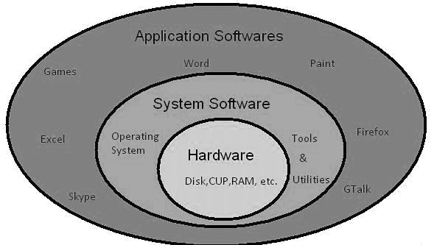
Internal architecture of Computer system

Slide 4
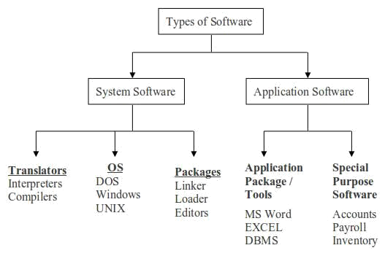
Types of software's

Slide 5

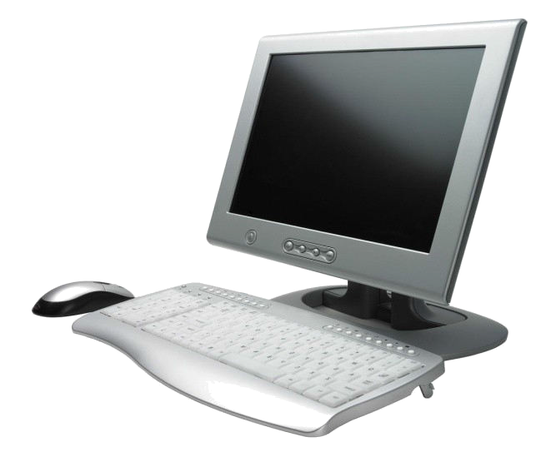
Communication between User and Machine
User
Machine
User want to interact with machine but machine only knows language in the form of 0’s and 1’s i.e. Bit (Binary Language)
•
So Binary language is also known as Machine level language but it is difficult to understand because it is in the form of bits.
So user want language that is close to user and we know it as High level language .
High level language is just like English language, all instructions are in friendly approach.
•
•

Slide 6
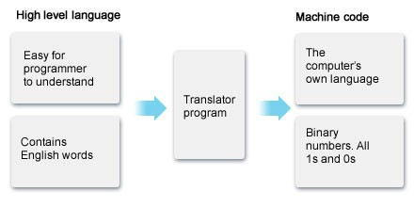


Need of Translator
•
Computer only understands Binary language and user only understands High level language.
•
So there are two types of translators 1)Compiler
2)Interpreter

Slide 7
Compiler and Interpreter
Compiler
It scans the entire program first and then translates it into machine code
Interpreter
It converts the code into an intermediate code before converting it into the machine code.
Each part of the code is interpreted and then execute separately in a sequence.
An error is found in a part of the code it will stop the interpretation of the code without translating the next set of the codes.

Slide 8
History of programming language
low-level languages:-
Those are machine languages and machine- dependent.
Fully binary, and symbolic so not code efficient.
Such languages are-
Fortran
Algol 60
Cobol
Basic
Simula 67
Pascal

Slide 9
Need of C Language
C is called as Middle level language.
▪
Behaves as High Level Language through Functions - gives a modular programming
It gives access to the low level memory through Pointers As its a combination of these two aspects, its neither a High
Level nor a Low level language ,so C is Middle Level Language.
▪
▪

Slide 10
History of C Language
•
Developed at Bell Laboratories in 1972 by Dennis Ritchie.
Features were derived from earlier language called “B” (Basic Combined Programming Language – BCPL)which is developed by Ken Thompson in 1970’s.
Invented for implementing UNIX operating system
•
•

Slide 11
C Programming Basics
Each language is made up of two parts,
▪
▪
Vocabulary Grammar
In programming language,
▪
▪
Vocabulary means Tokens Grammar means Syntax

Slide 12
C Tokens
Basic buildings blocks which are constructed together to write a C program.
Identifiers
Variables
Constants
Character Set
Keywords
Data types
Operators

Slide 13
Identifier
•
•
Unique name given to identify units E.g.int Num
Num is identifier given to integer variable

Slide 14
Variable
Name given to the location in a memory which is used to hold the value.
The value of the C variable may get change in the program.
C variable can hold values like integer, float point, character etc.
E.g. Age, height etc.
•
•
•

Slide 15
Constant
•
Name given to the location in a memory which is used to hold the value .
Values can not be modified by the program once they are defined.
Constant might be belonging to any type like integer, float point, character etc.
E.g. Pi value=3.14
•
•
•

Slide 16
Character set
C language have collection of different character set which contain
Alphabets | A-Z, a-z
Digits | 0-9
Special symbols | !,@,#,$,%,^,&,*,(,),_, +,=,-

Slide 17
Keywords
•
•
•
Keywords are pre-defined words in a C compiler. Also known as Reserved words.
Each keyword is meant to perform a specific function in a C program.
Since keywords are referred names for compiler, they can’t be used as variable name.
C language have 32 keywords.
•
•

Slide 18
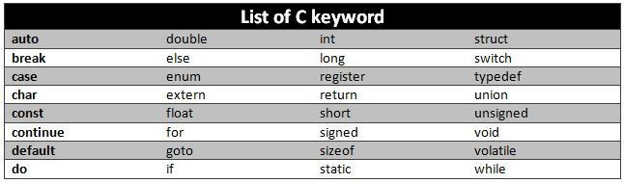
Keywords

Slide 19
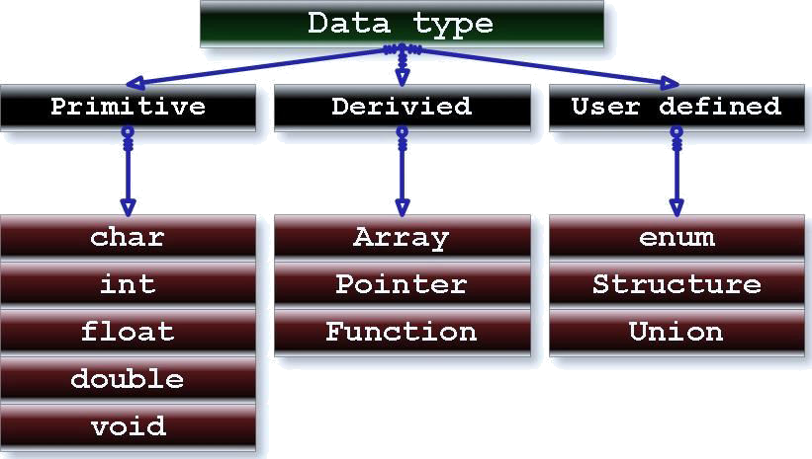
Datatypes

Slide 20
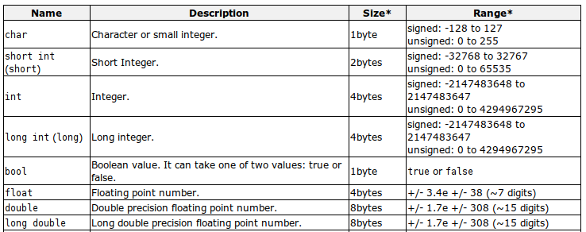
Range of Data type

Slide 21
Declaration of Variable
Syntax-
Data_type variable_name;
Integer data types:
Keyword int is used for declaring the variable with integer type.
For example: int var1;
Floating data types:
Variables of floating types can hold real values(numbers).
Keywords either float or double is used for declaring floating type variable.
For example: float var2;
Character types:
Keyword char is used for declaring the variable of character type.
For example: char var4='h';

Slide 22
Operators in C
•
Symbol that tells the compiler to perform specific mathematical or logical operations.
Types of operators-
•
▪
▪
▪
▪
▪
▪
Arithmetic Operators Relational Operators Increment Operator Decrement Operator Logical Operators Conditional Operator

Slide 23
Arithmetic Operators
•
Used to perform arithmetic operations.
Operator | Description | Example(A=10,B =20)
+ | Adds two operands | A | + B will give 30
- | Subtracts second operand from the first | A | - B will give -10
* | Multiplies both operands | A | * B will give 200
/ | Divides numerator by de-numerator | B | / A will give 2
% | Modulus Operator and remainder of after an integer division | B | % A will give 0

Slide 24
Relational Operators
Operator
Description
Example(A=10,B=20)
==
Checks two operands are equal or not, if yes then condition becomes true.
(A == B) is not true.
!=
Checks two operands are equal or not, if values are not equal then condition becomes true.
(A != B) is true.
>
Checks left operand is greater than right operand, if yes then condition becomes true.
(A > B) is not true.
<
Checks left operand is less than right operand, if yes then condition becomes true.
(A < B) is true.
>=
Checks left operand is greater than or equal to the right operand, if yes then condition becomes true.
(A >= B) is not true.
<=
Checks left operand is less than or equal to right operand, if yes then condition becomes true.
(A <= B) is true.

Slide 25
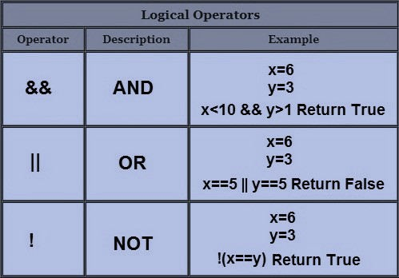
Logical Operators
They evaluate each operation result in terms of 0 and 1.
Logical Operators are three type as
▪
▪
▪
AND- (&&)
OR-(||)
NOT-(!)

Slide 26

Increment Operator(++)
•
Increment operator increase the value of subsequent by 1. value may be increase according to the programmer.
Increment operator are two types as follows :
•
▪
▪
Post increment Pre increment
Post increment |  | Pre increment
A=10 B=A ++ | A=11 | A=10 B=++A | A=11
 | B=10 |  | B=11

Slide 27
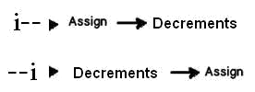
Decrement Operator(--)
Decrement operators decrease the value to one, two and so on.
Two type as,
▪
▪
Post decrement Pre decrement
Post Decrement |  | Pre Decrement
A=10 B=A-- | A=9 | A=10 B=--A | A=9
 | B=10 |  | B=9

Slide 28
Conditional
Operator(?:)
Ternary operator
Syntax:
condition ? result1 : result2
If the condition is true, result1 is returned else result2 is returned.
•
•
•

Slide 29
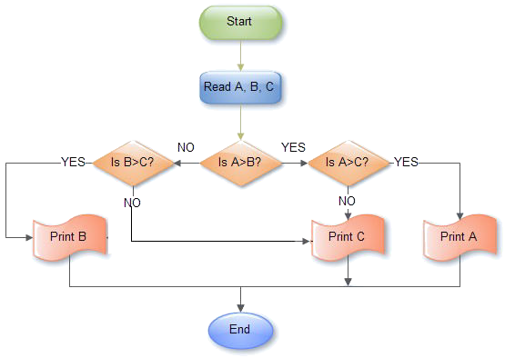
Largest no among 3 no's using conditional Operator
Max=(A>B) ? ((A>C)?A:C) : ((B>C)?B:C)

