Slide 1
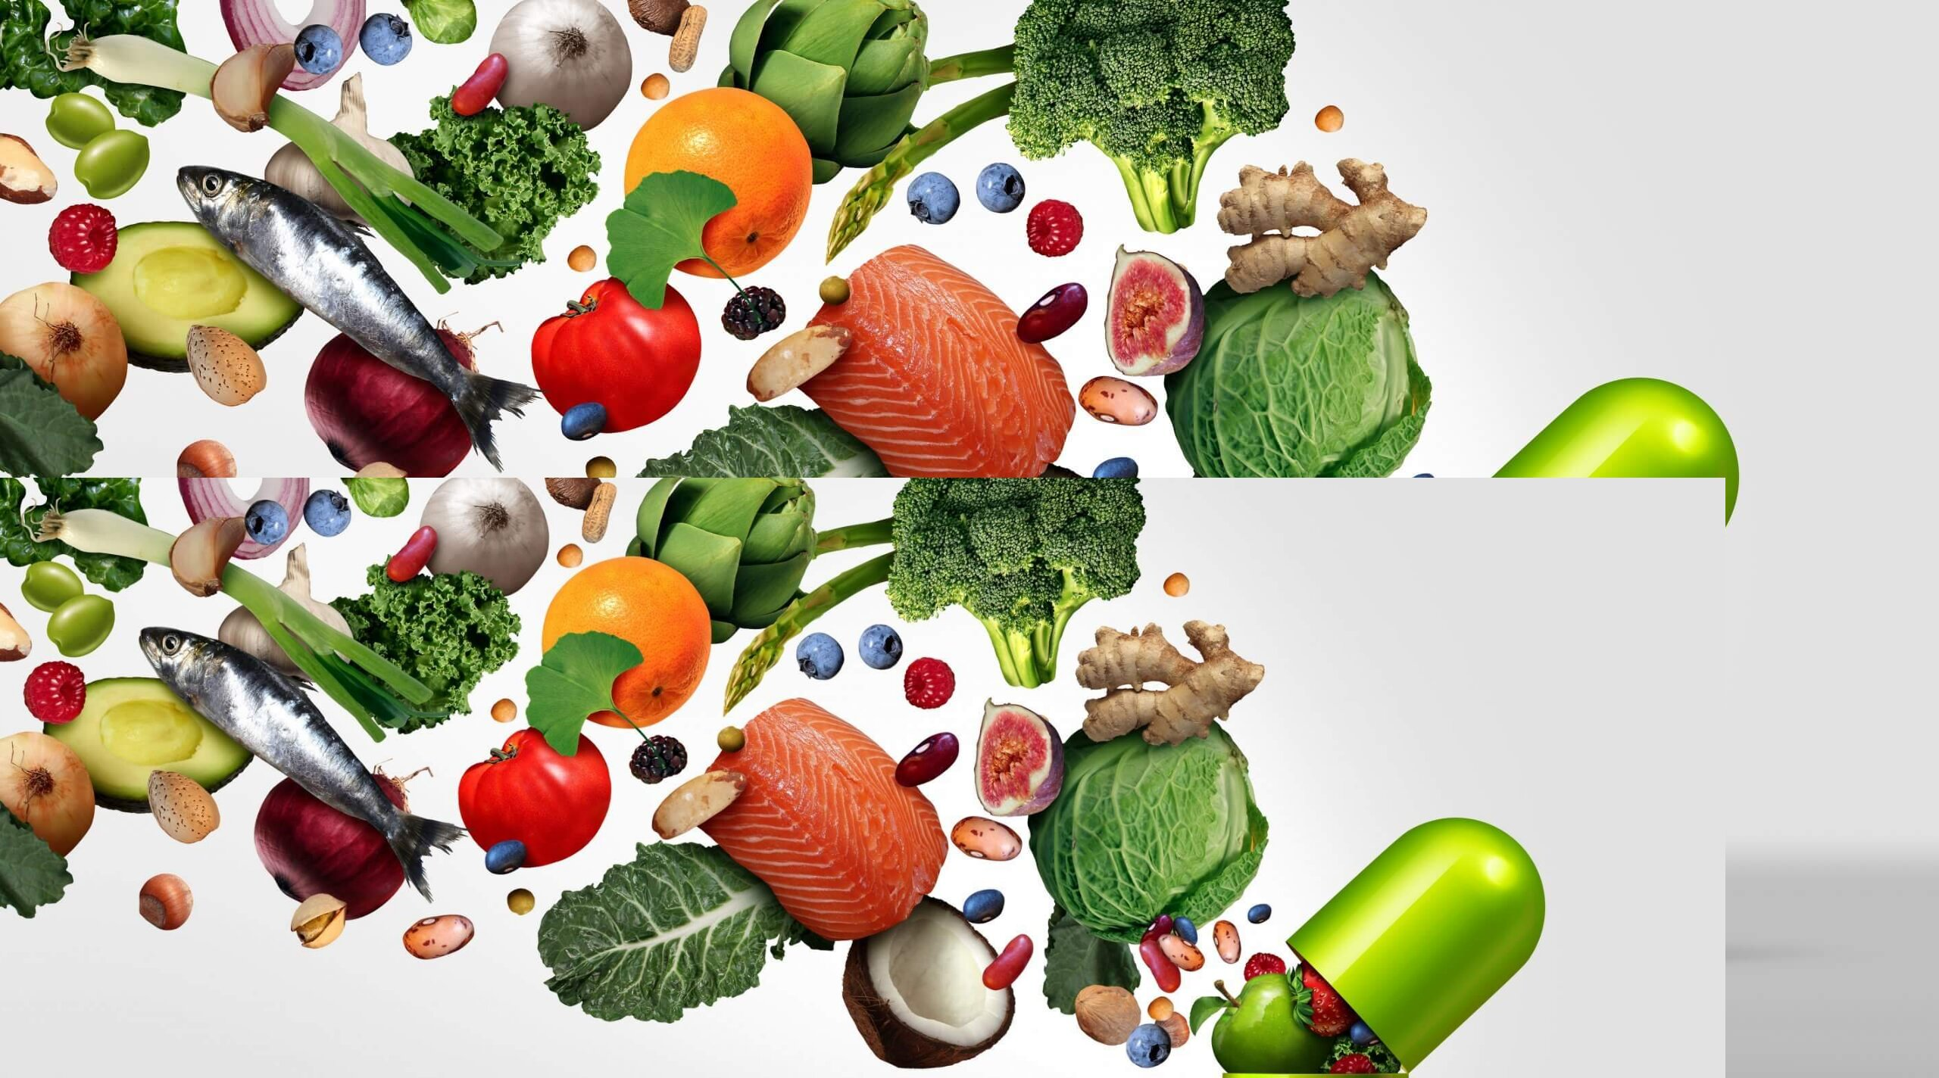

q
The Adult Nutrition Market In India
By : -
Bhashkar Singh
Bhagalpur College of Engineering

Slide 2





OUTLINE
Market scenario & dynamics
Industry-level analysis
Key players
Reference

Slide 3
Market Scenario and Dynamics
Market Potential: Indian Nutrition market size was estimated at USD 35.29 billion in 2023 and is Expected CAGR 8.0% from 2024 to 2030.

Slide 4
Driving Factors of the Growth in the Adult Nutrition Market in India
Consumers Awareness
Lifestyle Diseases
Growing Elderly Population
Rising Disposable Income
Retail Sector Expansion

Slide 5
Evolving Trends in the Indian Adult Nutrition Market
Supplement Diversity: Growth of various supplement forms like gels, bars, and ready-to-drink products.​
Natural Ingredients: Increased use of herbal extracts in supplements.​
Plant-Based Proteins: Rising demand for plant-based protein supplements.​
Innovative Formulations: Introduction of new product formulations.​
Functional Foods: Growing popularity of foods with health benefits beyond basic nutrition.​
Personalized Nutrition: Increased demand for personalized nutrition due to health consciousness.​
Online Services: Adoption of online health and nutrition services driving market growth.​
As per EY FCI global survey,
94% of Indians are worried about health.
82% of respondents see “healthy” as important buying factor.
40% are willing to pay a premium.

Slide 6

Challenges Faced by the Adult Nutrition Market in India
Regulatory Compliance: Companies must follow strict laws about product ingredients and health claims. Non-adherence can lead to penalties and reputational damage.​
Quality Control: Consistency in product quality is a challenge due to variable natural ingredients and complex production processes. Inadequate quality control can result in ineffective or harmful products.​
Supply Chain Infrastructure: Despite the surge in demand, India’s diverse geography and complex supply chains hinder the efficient distribution of products.​
Consumer Education: Many consumers are unaware of nutraceuticals’ benefits, usage, and differences. Thus, educating them is crucial for market growth.​
Brand Differentiation and Competition: The total market size in India is relatively small compared to the global market, leading to fierce competition among existing players.​

Slide 7

Challenges of Entering the Adult Nutrition Market in India
Regulatory Compliance: The Indian market, largely prescription-based, faces significant regulatory challenges, raising safety and quality concerns in the largely unregulated supplement market.​
Supply Chain Issues: Supply chain inefficiencies are a major growth barrier for 60% of Indian supplement manufacturers, particularly in rural areas.​
Consumer Awareness: Despite low awareness, internet usage has boosted consumer knowledge about nutraceutical use and chronic disease prevention.​
Counterfeit Products: The Indian nutraceutical market is threatened by counterfeit products, which confuse consumers and undermine trust in natural products.​
Pricing: High prices limit the adoption of nutraceuticals in the Indian market, despite the expected rise in demand.

Slide 8

Competitive Landscape of the Nutrition Market in India
Market Leadership: Six years ago, foreign brands held about 80% of the market. However, India has become a strong competitor in the global nutrition and supplement market due to its long history, abundant knowledge, access to raw materials, increased production of herbal extracts, and dominance in many export markets as a preferred supplier.
Market Volume: Every year, the market sees the entry of at least 50 brands at the national level and hundreds more at the regional level.
Competitive Landscape: A new nutrition index in India is promoting competition among food and beverage firms, leading to healthier portfolios. The 2023 India Nutrition Index assessed the top 20 Indian F&B manufacturers, accounting for 36% of total packaged food sales.
Transformation Path: Seven out of the 20 indexed companies are on a transformation journey, setting (re)formulation targets in line with dietary guidelines for sodium, saturated fat, and sugar. Half of them have implemented nutrition strategies, indicating a commitment to a healthier future.

Slide 9
Key Players
Name | Business Model | Revenue In FY’23 | Geographic Presence | Tie-Ups / Acquisitions
Hindustan Unilever Limited (1933) | Distributors, E-commerce | ₹8,000 Cr. | Pan-India presence with its headquarters in Mumbai. | Acquisition of GSK CH India , Adityaa Milk
Dabur India Ltd (1884) | Direct Sales, Distributors, E-commerce | ₹12,404.01 Cr. | Pan-India presence with its headquarters in Ghaziabad, Uttar Pradesh. | Tie-up with Indian Oil for Distribution
Herbalife International India Pvt Ltd (1998) | Direct Sales | Over ₹500 Cr. | Operates in Tier 1 & 2 cities of India with its headquarters in J. P. Nagar, Bengaluru | Partnership with IIMB to Drive Sustainable Supply Chain Practices

Slide 10
Key Players
Name | Business Model | Revenue FY’23 | Geographic Presence | Tie-Ups / Acquisitions
Amway Corporation, Inc. (1959) | Direct selling and multi-level marketing | ₹1,800 Cr. | Operates in Tier 1 & 2 cities of India with its headquarters in Jasola, New Delhi | Tie-up with ITC
Zydus Wellness Limited (1988) | Direct selling, Distributors, E-commerce | ₹1,555.10 Cr | Pan-India presence with its headquarters in Ahmedabad, Gujarat | Acquisition of Carnation Nutra
Patanjali Ayurved Limited (2006) | Direct selling, Distributors, E-commerce | Approx. ₹900000 Lakhs | Pan-India presence with its headquarters in Bijwasan enclave, New Delhi | Acquisition of Ruchi Soya’s Food

Slide 11
REFERENCE
India . World Bank Open Data. (n.d.). https://data.worldbank.org/country/IN
India, E. (2022, February 18). EY report: The confluence of food, pharmaceuticals, ayurveda and technology paving the way for the rise of India’s Consumer Health and Nutrition Sector. EY US - Home. https://www.ey.com/en_in/news/2022/02/the-confluence-of-food-pharmaceuticals-ayurveda-and-technology-paving-the-way-for-the-rise-of-indias-consumer-health-and-nutrition-sector
Nutraceuticals market in India. (n.d.). https://www2.deloitte.com/content/dam/Deloitte/in/Documents/consumer-business/immersion/Nutraceuticals%20market%20in%20India.pdf
Published by A. Minhas, & 18, S. (2023, September 18). India: Retail market size 2026. Statista. https://www.statista.com/statistics/935872/india-retail-market-size/
India dietary supplements market size & share [2032]. Size & Share [2032]. (n.d.). https://www.imarcgroup.com/india-dietary-supplements-market
India’s nutraceutical market growth: . (n.d.). https://foodprocessingindia.gov.in/newsletter/emailer/two
India Today. (2023, December 8). Nutrition Industry in India: Emerging trends and growing presence. India Today. https://www.indiatoday.in/information/story/nutrition-industry-in-india-emerging-trends-and-growing-presence-2473465-2023-12-08
Unicommerce, T. (2024, January 5). Nutraceutical industry in India – trends, challenges, solutions. unicommerce.com. https://unicommerce.com/blog/nutraceutical-industry-trends-challenges-solutions/#:~:text=Regulatory%20Compliance%2C%20Quality%20Control%2C%20Consumer,Market%20in%20the%20upcoming%20years
Dabur ties up with Indianoil for direct-to-home sales. The Economic Times. (n.d.). https://economictimes.indiatimes.com/industry/cons-products/fmcg/dabur-ties-up-with-indianoil-for-direct-to-home-sales/articleshow/89768932.cms
Wikimedia Foundation. (2024, May 4). Herbalife. Wikipedia. https://en.wikipedia.org/wiki/Herbalife#

Slide 12


