Slide 1
Sentinel
Agentic incident auto-investigation
The first feature of Mission Control — an application operations platform.
Automating the investigation of production incidents — from alert to root cause and proposed fix.
Project proposal · Draft for discussion
Notes:
One-line pitch: we turn a manual, senior-engineer-dependent investigation loop into a deployable agent that diagnoses incidents and proposes fixes. Sentinel is the first feature we ship of a broader platform, Mission Control. Working name 'Sentinel' — placeholder.

Slide 2
THE PROBLEM
An alert tells you something broke — not why, or how to fix it
• Splunk alerts fire off application logs and raise a ticket in ServiceNow.
• The ticket says "this alert fired, here's the error message" — and little else.
  – No root-cause analysis. No context. No proposed fix.
• A senior engineer must then manually investigate every ticket.
• Investigation is the slowest, most repetitive phase of incident response — and it bottlenecks on a handful of people.
Notes:
Set up the pain: the alerting system detects symptoms but does no diagnosis. Humans carry the entire investigation load.

Slide 3
HOW IT WORKS TODAY
The current manual investigation loop
Alert fires
(Splunk)
Ticket raised
(ServiceNow)
Engineer reads
logs manually
Cross-checks code
& other systems
Reproduces &
diagnoses
Writes up fix
for dev team
Slow. Serial, manual evidence-gathering inflates mean-time-to-diagnosis.
Person-dependent. Knowledge concentrated in a few senior engineers.
Lossy. Findings live in tickets and people's heads; recurring patterns aren't captured.
Notes:
Walk the loop left to right. Emphasise that steps 3-5 are pure manual toil that the agent can take over.

Slide 4
WHY NOW
The loop is already proven — manually
• A custom Splunk MCP server (already built at NatWest) lets an AI assistant query logs on demand.
• Connected to the codebase, it already investigates incidents and surfaces root causes — it has been "phenomenal" in practice.
• Today this is run by hand, per incident. The opportunity is to automate and productise it.
• Timing: teams (e.g. Complaints) are onboarding the alerting system now — early enough to build automation in from the start.
Notes:
This de-risks the pitch: we're not proposing something speculative — we're automating a workflow that already works manually.

Slide 5
THE PROPOSED SOLUTION
Sentinel — an agent that investigates incidents automatically
• Triggers automatically on a qualifying ServiceNow incident — no human kick-off.
• Pulls the relevant logs (Splunk), inspects the deployed codebase, and queries supporting systems (DB, Snowflake, S3) as needed.
• Reasons about the failure inside an isolated playground environment.
• Delivers a structured report: Overview → Investigation → Root Cause → Proposed Fix or Synopsis, with a confidence level.
• Posts findings back to the ticket / Teams; a human reviews and approves.
Notes:
This is the 'what'. Keep it outcome-focused; architecture comes next.

Slide 6
HOW SENTINEL WORKS
End-to-end investigation flow
Detect &
triage
Plan
investigation
Gather evidence
(logs · code · data)
Correlate &
find root cause
Fix in playground
or synopsise
Human review
& approve
• Iterative, cost-aware log retrieval — searches and narrows rather than dumping everything.
• Every diagnosis carries a confidence level and a full evidence trail.
• Every tool call and decision is logged for a complete audit trail.
Notes:
The playground step (highlighted) is where it validates a candidate fix safely before proposing it.

Slide 7
TWO VALUABLE OUTCOMES
Fix it — or fast-track the human
A — Validated fix
B — Investigation synopsis
Reproduces the issue and develops a fix in an isolated playground.
Tests it before proposing — zero production risk.
Proposed for human review, e.g. as a pull request.
When a reliable fix isn't possible, delivers what it found.
Overview, evidence, root-cause hypothesis, suggested next steps.
Gives the human a major head start — speeds up resolution.
Partial automation still wins: ~70% resolved + ~30% accelerated is a brilliant outcome.
Notes:
Key commercial framing: value does not require solving 100%. Even partial coverage plus acceleration of the rest is a strong ROI story.

Slide 8
ARCHITECTURE
Built to scale and to swap parts out
• LangGraph orchestration — a stateful, multi-phase investigation graph with durable state, human-in-the-loop, and full observability.
• MCP-first integration — reuses the existing Splunk MCP; each new system or incident type is a new connector + playbook, not a rewrite.
• Model-agnostic LLM — swap between Bedrock, self-hosted/in-VPC, or local (LM Studio / Ollama) by configuration. No vendor lock-in.
• Codebase enrichment (Intent Layer) — hierarchical, in-repo context so the agent understands the architecture before reading a line of code.
• Fully deployed inside the client environment — one isolated instance per client.
Notes:
Three pillars to land: MCP-first (scales), model-agnostic (compliance/lock-in), in-client (data never leaves). Intent Layer is the quality multiplier.

Slide 9
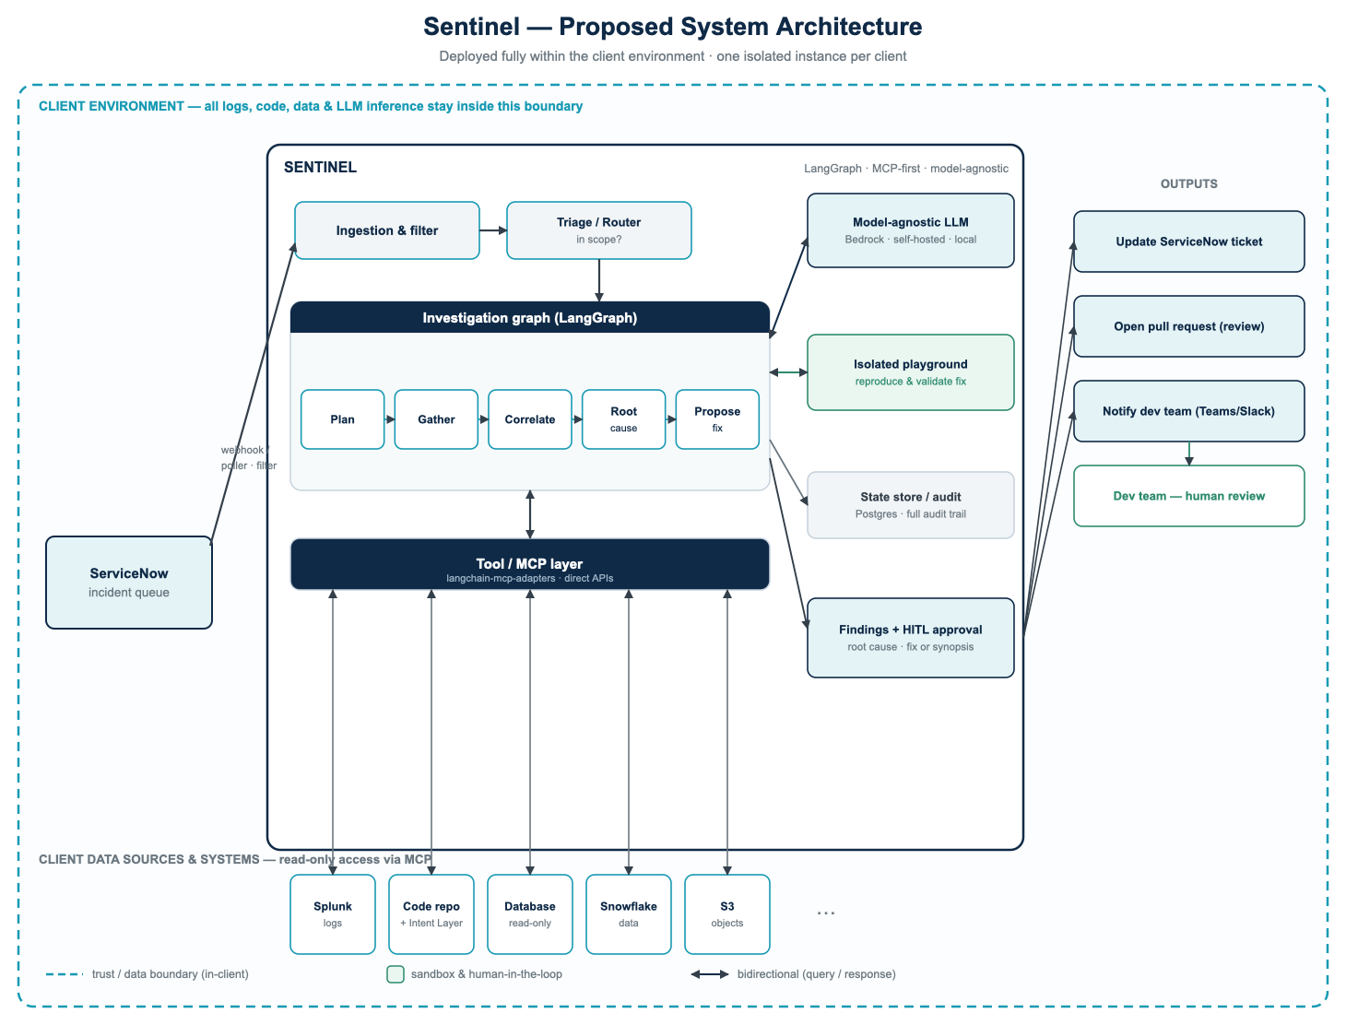
ARCHITECTURE
Proposed system architecture
Notes:
Companion visual to the architecture slide: ServiceNow -> ingestion/triage -> LangGraph graph -> MCP layer -> read-only data sources; model-agnostic LLM + isolated playground on the right; all inside the client boundary; outputs go back to ticket / PR / Teams for human review.

Slide 10
BUILT FOR THE BANK
Security, compliance & governance — first-class
Read-only, least privilege
Human-approved by default
Fully in-client
No write access to production. Scoped credentials.
Fixes validated in a sandbox, proposed for review.
All logs, code, data & inference stay inside your boundary.
Complete audit trail
Model choice you approve
Sensitive-data handling
Every tool call and decision logged and attributable.
Run only models your security teams have signed off.
Screening/redaction before anything reaches the model.
Notes:
This slide is what gets you past infosec. Lead with read-only + in-client + human-in-the-loop.

Slide 11
WHERE WE START
Prove it on lower-tier systems first
• Begin on Tier 3 platforms — low criticality, ~3-day resolution turnaround.
• An instant automated investigation there turbocharges the monitoring teams' resolution-time KPIs and dashboards.
• Demonstrate value and build trust with zero risk to business-critical systems.
• Then scale up the tiers as confidence grows.
Notes:
Tier 1 needs instant human action; Tier 3 has slack we can fill — easy, low-risk, KPI-boosting first win.

Slide 12
HOW IT SCALES
One system today — the whole estate over time
• MCP-first design means new incident types and new systems are additive, reusing the core agent, governance and reporting unchanged.
• Start with Splunk-driven incidents on microservices; broaden to any incident type the queue receives.
• Progressive autonomy — automation is earned: human-approved first, then opt-in auto-apply on lower-tier systems once the track record is proven (always audited and reversible).
• Applicable across independent business areas, each with many candidate systems.
Notes:
Land the scalability story without internal targeting specifics. Progressive autonomy reassures: we don't ask for trust up front, we earn it.

Slide 13
THE BIGGER PICTURE
Sentinel is the first feature of Mission Control
• Mission Control is an operations cockpit for the teams that monitor and support many applications across a shared incident queue.
• It organises incidents per application, centralises monitoring dashboards, and — through Sentinel — auto-investigates and resolves them.
Sentinel
Incident cockpit
Dashboard hub
Analytics
Auto-investigation
& resolution
Per-application,
historical view
QuickSight, Tableau
in one place
MTTR, trends, KPIs
◆ ships first
Application catalog — the shared foundation (apps · tiers · repos · log indices · data sources)
ServiceNow stays the system of record — Mission Control works off it, not instead of it.
Notes:
Frame: we ship Sentinel first (the wedge and the differentiator). It is the first feature of a broader platform, Mission Control, for the monitoring teams that own many apps. Same in-client deployment. ServiceNow stays authoritative. The dashboard hub and analytics follow on the same application-catalog foundation. Keep the focus on Sentinel; this slide just shows where it's heading. (The knowledge-capture benefits this enables are on the next slide.)

Slide 14
BEYOND RESOLUTION
A compounding knowledge dividend
Sentinel and the support team run on captured knowledge — so the platform turns it into a durable, growing asset:
Smoother handovers (KT)
Tribal knowledge, captured
Documentation that pays off
Dev → support knowledge transfer gets a structured, lasting home instead of fading meetings — and it's reusable for every future joiner.
The quirks, edge cases and process lore that live in people's heads become explicit and durable — de-risking key-person dependency. Knowledge survives staff turnover.
Sentinel uses your docs to diagnose incidents, so good documentation finally shows measurable payoff — faster, better resolution, visible per app.
A virtuous cycle: the more you capture, the better Sentinel and your support team perform — and the more visible the payoff of capturing it.
Notes:
PRESENTER FRAMING — keep these as UPSIDE, never criticism: (1) frame as 'the platform rewards and surfaces good knowledge', not 'your docs are bad'; (2) it's a MULTIPLIER, not a prerequisite — Sentinel works on logs + code regardless. Order the story from the cleanest point: lead with KT/handover (pure operational win), then tribal-knowledge capture (bus-factor / survives turnover), then the documentation flywheel (docs finally pay off, visible per-app KPIs).

Slide 15
THE VALUE
Why this matters
Faster resolution
Senior-engineer leverage
Consistency
Compresses the slowest phase — time-to-diagnosis.
Frees scarce expertise from repetitive triage.
Every in-scope incident gets a thorough investigation.
Knowledge capture
Low-risk proving ground
Partial automation wins
Recurring failure patterns become a durable asset.
KPI gains on Tier 3 before critical systems.
Resolve some, accelerate the rest — net big gain.
Notes:
Baseline these metrics before rollout so the 'after' delta is provable.

Slide 16
ENGAGEMENT MODEL
Low-commitment start, scalable rollout
1 · Platform analysis
2 · Proof of Concept
3 · Scaled rollout
A short, fixed-fee analysis of a target platform — scopes the work and prices the implementation up front.
Stand up Sentinel on that platform and demonstrate it on real incidents — proof before commitment.
Implement platform by platform (fixed-price or T&M). Shared components built once; only platform-specific work per system.
Each platform is slightly different — its knowledge base and data-access needs drive the incremental cost.
Notes:
Client-safe commercial framing. Keep specific numbers for the live conversation. The analysis-first step de-risks pricing for both sides.

Slide 17
Next steps
1. Align on a target platform for a Proof of Concept.
2. Run the fixed-fee platform analysis to scope & price it.
3. Deliver the PoC on real incidents and review the results.
4. Agree the rollout plan across systems and areas.
Let's pick one platform and prove it.
Sentinel first — the foundation for Mission Control.
Notes:
Close with a concrete, low-commitment ask: agree one platform and run the analysis. Momentum over perfection. Sentinel is step one toward Mission Control.

