Slide 1
Streamlining Upstream/Downstream Pipelines with Argo Workflows
Shahril Kamaruzzaman

Slide 2




About Me
Shahril Kamaruzzaman
Head of Technology, Engineering and Data @ Bank Islam
https://carillpower.github.io/shahril_kamaruzzaman/

Slide 3
Agenda
Current Challenges in Data Orchestration
What is Argo Workflows?
How Argo Workflows benefits from K8s ?
Authentication & RBAC Architecture
Workflow Architecture & Components
Features for Data Engineering
Argo Workflows vs Airflow
Extras
Q & A

Slide 4
Current Challenges in Data Orchestration
TLDR;
In data pipelines, upstream refers to source systems and ingestion (APIs, databases, files), while downstream refers to consumption and serving layers (analytics, ML models, dashboards).
OPERATIONAL CHALLENGES
WORKLOAD CHALLENGES
Scaling workflow workers
Python dependency conflicts
Infrastructure maintenance overhead
Difficult multi-team isolation
Complex CI/CD integration
Resource inefficiency
Python ETL
Spark jobs
DBT transformations
Machine learning workloads
API ingestion
Containerized applications
Notes:
TLDR
1. Before we deep dive into the 'how,' let’s start with 'why.' Orchestrating data is basically like managing a massive, 24/7 kitchen. We have Upstream, its like our suppliers bringing in raw ingredients like APIs and databases sources and Downstream, which is the finished meal served to our customers via analytics, Silver/Gold tables under data medallion design or ML models.
Operation Challenges
2. But currently, our 'kitchen' is a bit chaotic. We face Operational Challenges like 'dependency conflicts.' Example is like Engineer complain 'it works on my machine' problem and also where one task needs Python version A, but another needs version B, and they just won't play nice together.
3. Also for the senior role that managing the orchestration, u got several overhead u need to maintain
4. Commonly also you would struggle with Resource Inefficiency. In many old systems, we keep 'workers' (servers) running all the time even when they aren't doing anything, which is like paying kitchen staff to stand around waiting for an order. It’s expensive and hard to manage.
Workload Challenges
5. When comes to workload, its like every task having its own recipe, therefore may require different utensils .. Example of utensils is like spark, dbt, API , container etc
Therefore for this, you may need a services that pretty much cater this situation by itself

Slide 5
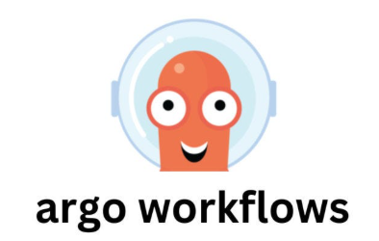
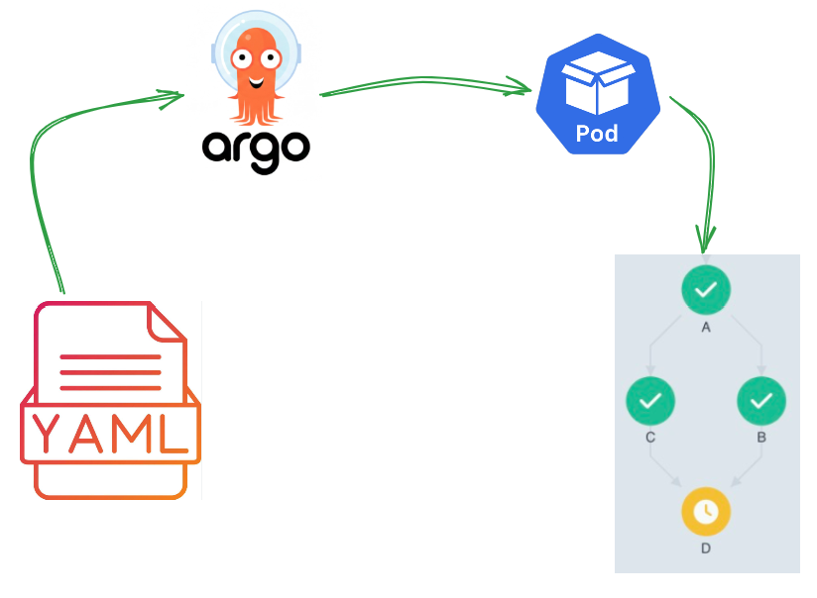
What is Argo Workflows?
TLDR;
Argo Workflows is a Kubernetes-native workflow engine where each workflow step executes as a Kubernetes pod.
CORE CONCEPT
Kubernetes CRD-based
Container-native execution
Declarative YAML workflows
DAG orchestration
Event-driven capable
GitOps friendly
Notes:
TLDR
So, enter Argo Workflows. It is 1 of service feature under Argo family
It is purely a Kubernetes-native engine. In plain English, it’s a system designed specifically to live inside Kubernetes and treat every single step of your work as a Pod.
Think of a Pod as a small, temporary shipping container. It holds everything that specific task needs to run. Once the task is done, the container disappears. No mess, no leftovers.
Core Concept
It have its own dedicated Custom Resource Definition of itself
What is CRD? Basically it’s a kubernetes object,
what is kubernetes object? I’ll show the example on next slides
It’s a container based execution
Every workflow manage via YAML language, which main language for K8s itself to declare a manifest
It uses a DAG (Directed Acyclic Graph). The definition may sound sophisticated and hard, actually it’s more like fancy way of saying a 'one-way flow chart.' You define your steps in YAML and Argo ensures Step A finishes before Step B starts.
It’s equip with poking mechanism which capable for event-driven design
And of courses CI/CD ready
Show Image

Slide 6
How Argo Workflows benefits from K8s?
KUBERNETES CAPABILITY
ARGO WORKFLOWS
Pods
Each task becomes a pod
Namespaces
Multi-tenant isolation
Role-binding
Native security model
Service Accounts
Fine-grained permissions
ConfigMaps
Centralized configuration
AutoScaling
Dynamic pipeline scaling
Secrets
Native secret injection
Persistent Volume
Shared storage support
Notes:
1. As nature of Argo lives inside Kubernetes itself, it gets all the 'superpowers' of K8s for free.
2. Here list of common well known K8s object capability and how Argo make use of it
Kubernetes Capability
3. Terang satu2 each k8s tu how argo pivot it
4. So basically Argo does not integrate with Kubernetes, it is actually emphasize the kubernetes native capability itself

Slide 7
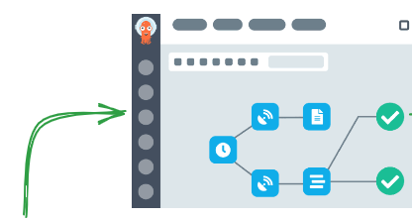
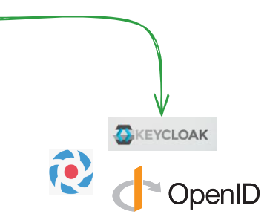

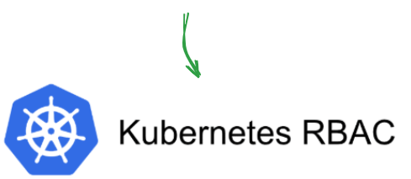
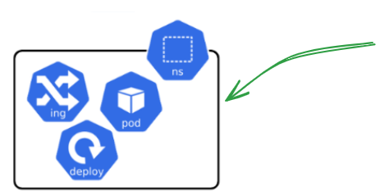
Authentication & RBAC Architecture
ARCHITECTURE FLOW
AUTHENTICATION
User login via username/password
OIDC integration using Dex / KeyCloak / SSO
Centralized identity management
AUTHORIZATION
Kubernetes-native RBAC
Team-based access control
Namespace isolation
Notes:
1. Now, let’s talk security. Before we start, maybe I can help to clear up the silver lining between what is Authentication and what is Authorization
Authentication: Is a way for u to confirms user’s identity to access upon certain system
Authorization: Is a way for u to determines that dedicated user, what are they allowed to access or perform under ur system
Authentication
2. We don't want just anyone clicking 'delete/deploy’ on our pipelines. Argo use Authentication to verify who you are. Argo can link this to Single Sign-On like KeyCloak or Dex, so you can log in with your existing company ID or dedicated username
FYI to anyone that never heard of it, KeyCloak or Dex is another system that specialized upon OIDC (OpenID Connect) design
Authorization
3. Then we have RBAC—or Role-Based Access Control. As mention this defines what you can do. This is where it make use of K8s RBAC solution like service account and role binding object
4. From here, you can define a team-based access control and namespace isolation
5. Think of it like a condo access given by the guard, if you r a visitor, upon register u can access into the building but only residents access is granted to use related facilities
6. By combining these, it ensure that even in a huge organization, related teams can work in total isolation and safety.
Architecture flow
7. Here basically simple diagram of it
A developer -> goes to Argo Workflow UI -> Autheticate using favorable OIDC service -> Get Authorize base on attaches service Account to related group/user -> granted towards related namespace or object

Slide 8
Workflow Architecture & Component
COMPONENT
PURPOSE
SUPPORTING COMPONENT
Argo Server
UI & API
Artifact Storage
Workflow Controller
Ochestrate Workflow
Workflow Templates
K8s API Server
Create Pods
Cron Workflows
Workflow Executor
Execute Tasks
Event Triggers
Artifact Repository
Store logs & Output
EXAMPLES …
Submit Workflow
Argo Controller
Pod Created
Task Executer
Logs & Artifact Stored
Notes:
Component
1. Let’s look under the hood. There are a few main parts making the magic happen. To simplify :-
Show list
The Argo Server is like the 'receptionist'—it provides the UI and the API you interact with.
Then it got Workflow Controller which more like the 'project manager.' It reads your YAML instructions and tells the Kubernetes API to create the Pods.
Then, the Workflow Executor is the actual worker inside that pod doing the heavy lifting.
Finally, when a task is done, it sends its logs and results to the Artifact Repository. Think of this as the 'filing cabinet' where all the evidence of the work is stored for later review.
2. To simplify, its like this lah
Purpose
Supporting Component
3. Apart of it, it also got supporting component that complete the orchestrator, like :-
Artifact Storage: where u can integrate with any S3 solution like minio / aws S3 / gcp cloud storage / azure blob storage / alibaba OSS
Workflow templates: for u to standardize certain task method
Cron Workflow: for scheduling purpose
Event Triggers: where u can integrate with another Argo solution which is Argo Event and Argo Sensor
Examples
4. Terang step on example

Slide 9
Data Engineering Features
CORE FEATURES
PLATFORM FEATURES
DAG Ochestration
Container Native Execution
Cron Scheduling
GitOps Friendly Deployment
Retry Policy
K8s Autoscaling support
Parameterized Workflows
Multi Tenant Isolation
Parallel Execution
Workflow Templates
Manual / Event Driven Trigger
Notes:
1. Here are the Core Features of Argo Workflow that strengthen Data Ochestration
Core Feature
2. Yet still, as the key advantage of Argo Workflow is anything that is runnable inside a container can become a workflow step.
Platform Feature
3. Therefore, apart of it serving Data Engineering POV, with right architecture it also can meet Platform Engineering model especially on micro service

Slide 10
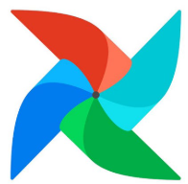
Argo Workflow vs Airflow
CAPABILITY
ARGO WORKFLOW
AIRFLOW
Traditional analytics engineering
K8s Native
Excellent
Partial
Execution Model
Pod-per-Task
Worker Based
SQL-centric orchestration
Language Dependency
Any language
Mostly Python
Mature enterprise ecosystems
Scaling Model
K8s AutoScaling
Airflow Worker Scaling
Multi Tenancy
Namespace Based
Complex
GitOps Integration
Excellent
Moderate
UI Maturity
Moderate
Excellent
Ecosystem
Growing
Matured
container-first architecture
Platform Eng models
DataOps/MLOps convergence
Notes:
1. Now, lets go to might be a heated page, what does it make any difference with Airflow itself
I believe everyone’s here that hav use Airflow would know how matured and important Airflow is to Data Engineering as orchestration solution for BAU task
2. Just to let everyone aware, I’ve use Airflow way back since 2018 therefore pretty much can say I also a fan of Airflow
3. Thus having experience and familiar on both, here im jotting down some of the things tht differ between both side and what I love towards each of it
Capability
4. Simplify satu2
5. So now, as we basically understand the thin-line differences between both, how would I decide which is better to my organization if I want to deploy or enhance my current infrastructure
6. Of coz, this is not entirely best practice but its good as a baseline for u guys know
Airflow/Argo
7. For me as designing end-2-end solution myself, I’d go for Airflow if (click 1 by 1):-
I have a team of traditional data engineer myself where mainly well verse in python language
90% of BAU pipeline are SQL heavy DML process, so I can make use of various build in Operator like PostgreSQLOp or MySQLOperator
My organization are already in enterprise ecosystem where everything pretty much have its own dedicated team to solutionize the decision
7. For argo itself, I’d go for it if (click 1 by 1):-
I want to setup a roadmap of container-first mindset as solution architecture
I want to adopt platform engineering model together like micro service solution
I want to closer the gap of Data Analysis and Online Learning together to build various ML feature store
8. All in all, the important comparison that I could express upon this 2 service is
- With Airflow, when comes to Kubernetes, it is often use as executor plugin via its own build-in Operators
- With Argo, the Kubernetes IS the execution engine.

Slide 11
Extras: Challenges & Lesson Learned
CHALLENGES
LESSON LEARNED
YAML learning curve
Design namespace strategy early
UI less mature than Airflow
Standardize templates early
pod debugging complexity
Parameterize Input/Output
K8s knowledge required
Implement centralized logging
Define RBAC clearly
Notes:
Challenges
1.Base on the beauty of the service and hurdle I’ve learn, as usual I want to be real with u, its not all sunshine and rainbows, here are some of big challenges that u may face towards the journey to Argo Workflow
2. Terang satu2 challenge
Argo simplifies Kubernetes-native orchestration, but operational Kubernetes knowledge remains essential.
Lesson learned
3. Here are my biggest lesson learned that could be very helpful to everyone
4. Terang satu2
In the end, the goal isn’t juz to run code, its to create a system tht run concept of DRY or set and forget so u can focus on building feature, not fixing pipelines

Slide 12
Demo

Slide 13
Questions

Slide 14
About Me
Shahril Kamaruzzaman
Head of Technology, Engineering and Data @ Bank Islam
https://carillpower.github.io/shahril_kamaruzzaman/
Notes:
* Introduce yourself briefly
* Mention role and background in data engineering / platform engineering
* Set context for why this topic matters to you and the organization
1. before we start, here are tidbits about me
2. I'm Shahril, currently I am Head of Technology, Engineering and Data at Bank Islam looking through breakthrough upon any opportunity on Business towards adapting Digital Transformation

Slide 15
Agenda
Current Challenges in Data Orchestration
What is Argo Workflows?
How Argo Workflows benefits from K8s ?
Authentication & RBAC Architecture
Workflow Architecture & Components
Features for Data Engineering
Argo Workflows vs Airflow
Extras
Q & A

Slide 16
Current Challenges in Data Orchestration
TLDR;
In data pipelines, upstream refers to source systems and ingestion (APIs, databases, files), while downstream refers to consumption and serving layers (analytics, ML models, dashboards).
OPERATIONAL CHALLENGES
WORKLOAD CHALLENGES
Scaling workflow workers
Python dependency conflicts
Infrastructure maintenance overhead
Difficult multi-team isolation
Complex CI/CD integration
Resource inefficiency
Python ETL
Spark jobs
DBT transformations
Machine learning workloads
API ingestion
Containerized applications
Notes:
TLDR
1. Before we dive into the 'how,' let’s start with 'why.' Orchestrating data is basically like managing a massive, 24/7 kitchen. We have Upstream—that’s our suppliers bringing in raw ingredients like APIs and databases sources—and Downstream, which is the finished meal served to our customers via analytics and ML models.
Operation Challenges
2. But currently, our 'kitchen' is a bit chaotic. We face Operational Challenges like 'dependency conflicts.' Example is like Engineer complain 'it works on my machine' problem—where one task needs Python version A, but another needs version B, and they just won't play nice together.
3. Also for the senior role that managing the orchestration, u got yada yada
4. Commonly also you’d struggle with Resource Inefficiency. In many old systems, we keep 'workers' (servers) running all the time even when they aren't doing anything, which is like paying kitchen staff to stand around waiting for an order. It’s expensive and hard to manage.
Workload Challenges
5. When comes to workload, its like every task having its own recipe, therefore may require different utensils .. Example of utensils is like spark, dbt, API , container etc
Therefore for this, you may need a services that pretty much cater this situation by itself

Slide 17
What is Argo Workflows?
TLDR;
Argo Workflows is a Kubernetes-native workflow engine where each workflow step executes as a Kubernetes pod.
CORE CONCEPT
Kubernetes CRD-based
Container-native execution
Declarative YAML workflows
DAG orchestration
Event-driven capable
GitOps friendly
Notes:
TLDR
So, enter Argo Workflows. It is 1 of category feature under Argo family
The simplest way to describe it? It’s a Kubernetes-native engine. In plain English, it’s a system designed specifically to live inside Kubernetes and treat every single step of your work as a Pod.
Think of a Pod as a small, temporary shipping container. It holds everything that specific task needs to run. Once the task is done, the container disappears. No mess, no leftovers.
Core Concept
It have its own dedicated Custom Resource Definition of itself
What is CRD? Basically it’s a kubernetes object,
what is kubernetes object? I’ll show the example on next slides
It’s a container based execution
It’s manage via well-known YAML language, which main language for K8s itself to declare a manifest
It uses a DAG (Directed Acyclic Graph). The definition may sound sophisticated and hard, actually it’s more like fancy way of saying a 'one-way flow chart.' You define your steps in YAML (which is basically a structured grocery list), and Argo ensures Step A finishes before Step B starts.
It’s equip with poking mechanism which capable for event-driven design
And of courses CI/CD ready
Show Image

Slide 18
How Argo Workflows benefits from K8s?
KUBERNETES CAPABILITY
ARGO WORKFLOWS
Pods
Each task becomes a pod
Namespaces
Multi-tenant isolation
RBAC
Native security model
Secrets
Native secret injection
ConfigMaps
Centralized configuration
AutoScaling
Dynamic pipeline scaling
Service Accounts
Fine-grained permissions
Persistent Volume
Shared storage support
Notes:
1. As nature of Argo lives inside Kubernetes itself, it gets all the 'superpowers' of K8s for free.
2. Here list of common well know features under K8s environment
Kubernetes Capability
3. Terang satu2 each k8s tu how argo pivot it
All of this kubernetes capability is what we call it kubernetes object
4. So basically Argo does not basically integrate with Kubernetes, its actually emphasize the kubernetes native philosophy
For example, it uses Namespaces. Imagine your company has 10 different teams; Namespaces are like separate, soundproof offices so Team A’s work doesn't accidentally mess up Team B’s work."
"It also handles AutoScaling. If you suddenly have 1,000 tasks to do at 2:00 AM, Kubernetes just 'hires' more virtual workers to handle the load and 'fires' them when the work is done. You only pay for what you actually use."
"It also uses Secrets—this is like a secure vault for your passwords and API keys—so your sensitive data isn't just floating around in plain text."

Slide 19
Authentication & RBAC Architecture
ARCHITECTURE FLOW
AUTHENTICATION
User login via username/password
OIDC integration using Dex / KeyCloak / SSO
Centralized identity management
AUTHORIZATION
Kubernetes-native RBAC
Team-based access control
Namespace isolation
Notes:
1. Now, let’s talk security. Before we start, maybe I can help to clear up the silver lining of what is Authentication and what is Authorization
Authentication: Is a way for u to confirms the user’s identity to access upon certain system
Authorization: Is a way for u to determines upon the authenticated user, what does the verified user is allowed to access or perform under ur system
Authentication
2. We don't want just anyone clicking 'delete' on our pipelines. We use Authentication to verify who you are. We can link this to SSO (Single Sign-On) like KeyCloak or Dex, so you can log in with your existing company ID.
FYI to anyone that never heard of it, KeyCloak or Dex is another system that specialized upon OIDC (OpenID Connect) solution
Authorization
3. Then we have RBAC—or Role-Based Access Control. As mention this defines what you can do. It make use of K8s RBAC solution like service account and role binding.
4. From here, you can define a team-based access control and namespace isolation
5. Think of it like a hotel key card: a guest can open their own room, but only define guest can open their define safety box
6. By combining these, it ensure that even in a huge organization, related teams can work in total isolation and safety.

Slide 20
Workflow Architecture & Component
COMPONENT
PURPOSE
SUPPORTING COMPONENT
Argo Server
UI & API
Artifact Storage
Workflow Controller
Ochestrate Workflow
Workflow Templates
K8s API Server
Create Pods
Cron Workflows
Workflow Executor
Execute Tasks
Event Triggers
Artifact Repository
Store logs & Output
EXAMPLES …
Submit Workflow
Argo Controller
Pod Created
Task Executer
Logs & Artifact Stored
Notes:
Component
1. Let’s look under the hood. There are a few main parts making the magic happen. To simplify :-
The Argo Server is like the 'receptionist'—it provides the UI and the API you interact with.
The it got Workflow Controller which more like the 'project manager.' It watches your YAML instructions and tells the Kubernetes API to create the Pods.
Then, the Workflow Executor is the actual worker inside that pod doing the heavy lifting.
Finally, when a task is done, it sends its logs and results to the Artifact Repository. Think of this as the 'filing cabinet' where all the evidence of the work is stored for later review.
2. To simplify, its like this
Purpose
Supporting Component
3. It also got supporting component that complete the orchestrator, like :-
Artifact Storage: where u can integrate with any S3 solution like minio / aws S3 / gcp cloud storage / azure blob storage / alibaba OSS
Workflow templates: for u to standardize certain task method
Cron Workflow: for scheduling purpose
Event Triggers: where u can integrate with another Argo solution which is Argo Event and Argo Sensor for streaming process
Examples
4. Terang step on example

Slide 21
Data Engineering Features
CORE FEATURES
PLATFORM FEATURES
DAG Ochestration
Container Native Execution
Cron Scheduling
GitOps Friendly Deployment
Retry Policy
K8s Autoscaling support
Parameterized Workflows
Multi Tenant Isolation
Parallel Execution
Workflow Templates
Manual / Event Driven Trigger
Notes:
1. Here are the Core Features of Argo Workflow that strengthen Data Ochestration
Core Feature
Platform Feature
2. Yet still, the key advantage of Argo Workflow is anything that is runnable inside a container can become a workflow step.
3. Due to that, as the scopes mainly serve Data Engineering POV, with right architecture it also can meet Platform Engineering model especially on micro service
4. list it out, terang satu2
"For the engineers in the room, here is the 'cool stuff.' Argo supports Cron Scheduling, which is like setting a recurring alarm clock for your data jobs—for example, 'run this every Monday at 8:00 AM.'"
"It also has a Retry Policy. If a task fails because of a temporary network glitch, Argo doesn't just give up; it can try again automatically 3 minutes later."
"And my favorite: Parallel Execution. Instead of doing Task 1, then 2, then 3, Argo can run 100 tasks at the exact same time if you have the resources. It’s a massive time-saver."

Slide 22
Argo Workflow vs Airflow
CAPABILITY
ARGO WORKFLOW
AIRFLOW
K8s Native
Excellent
Partial
Execution Model
Traditional analytics engineering
Pod-per-Task
Worker Based
Language Dependency
Any container
Mostly Python
SQL-centric orchestration
Scaling Model
K8s AutoScaling
Airflow Worker Scaling
Multi Tenancy
Namespace Based
Complex
Mature enterprise ecosystems
GitOps Integration
Excellent
Moderate
UI Maturity
Moderate
Excellent
Data Ecosystem
Growing
Matured
K8s Complexity
Lower
Higher
K8s-first architecture
Platform Eng models
DataOps/MLOps convergence
Notes:
### Presenter Notes
- I’ve use Airflow way back since 2018 and having experience and familiar on both, im jotting down what main differences on both side and what I’d love on both
- This slides not gonna be pro towards any of the tools as its not compete each other, yet with proper solutioning it can integrate between them to get best of both
* Keep this balanced and objective
* Avoid positioning as replacement-only discussion
* Emphasize use-case suitability
## Important Comparison
- With Airflow, Kubernetes is often an executor plugin.
- With Argo, Kubernetes IS the execution engine.
1. Now, lets go to might be a heated page, what does it make any difference with Airflow itself
2. Just to let everyone aware, I’ve use Airflow way back since 2018 therefore pretty much can say I also a fan of Airflow
3. Thus having experience and familiar on both, here im jotting down that differ between both side and what I’d love towards each of it
Capability
4. Simplify satu2
Airflow
5. For me as designing end-2-end solution myself, I’d go for Airflow if :-
I have a team of traditional engineering myself where mainly in python language
90% of BAU pipeline are SQL heavy DML process
My organization are already in enterprise ecosystem where everything pretty much have its own dedicated team to solutionize the decision
Argo
6. For argo itself, I’d go for it if :-
I’ve supported capability of k8s-first mindset as architecture solution
I’m adopting platform engineering model as micro service solution
I’d require to converge the gap of Data Analysis and Online Learning together to build modern way of ML feature store
7. And for that, the important comparison that I could express upon this 2 service is
- With Airflow, when comes to Kubernetes, it is often use as executor plugin via its own build in Operators
- With Argo, the Kubernetes IS the execution engine.
"The big question: 'Why not just use Airflow?' Airflow is great—it’s the 'old guard.' It’s very mature and has a massive ecosystem. If you are doing traditional, SQL-heavy data work, it's a solid choice."
"However, Argo is Excellent at K8s-Native operations. In Airflow, managing Python versions across different tasks can be a nightmare. In Argo, because every task is its own container, Task 1 can be Python, Task 2 can be R, and Task 3 can be Java. They never touch each other."
"In short: Airflow is for traditional analytics; Argo is for the modern, containerized world of MLOps and Platform Engineering."

Slide 23
Extras: Challenges & Lesson Learned
CHALLENGES
LESSON LEARNED
YAML learning curve
Design namespace strategy early
UI less mature than Airflow
Standardize templates early
pod debugging complexity
Parameterize Input/Output
K8s knowledge required
Implement centralized logging
Define RBAC clearly
Notes:
## Important Reality
Argo simplifies Kubernetes-native orchestration, but operational Kubernetes knowledge remains essential.
### Presenter Notes
* This slide improves credibility
* Be transparent about tradeoffs
* Explain operational maturity requirements
"I want to be real with you—it’s not all sunshine and rainbows. There is a YAML learning curve. Writing these files can feel like a chore until you get the hang of it. Also, because it's so tied to Kubernetes, you do need to understand K8s basics to debug effectively."
"My biggest Lesson Learned? Design your Namespace strategy early. Don't put everyone in the same room; it gets messy fast. Also, standardize your templates. If every team writes their tasks differently, you'll have a hard time maintaining them."
"In the end, the goal isn't just to run code—it's to create a system that is 'set and forget' so you can focus on building features, not fixing pipelines."

Slide 24
Demo

Slide 25
Questions

