Slide 1

Transition from Physical Media to Streaming
Nature of Enterprise Computing – Group 15
By: Cezary Janus, Akaisha Gurung, Domagoj Jurisic, Chris Kiala and Jamiu Kusimo

Slide 2
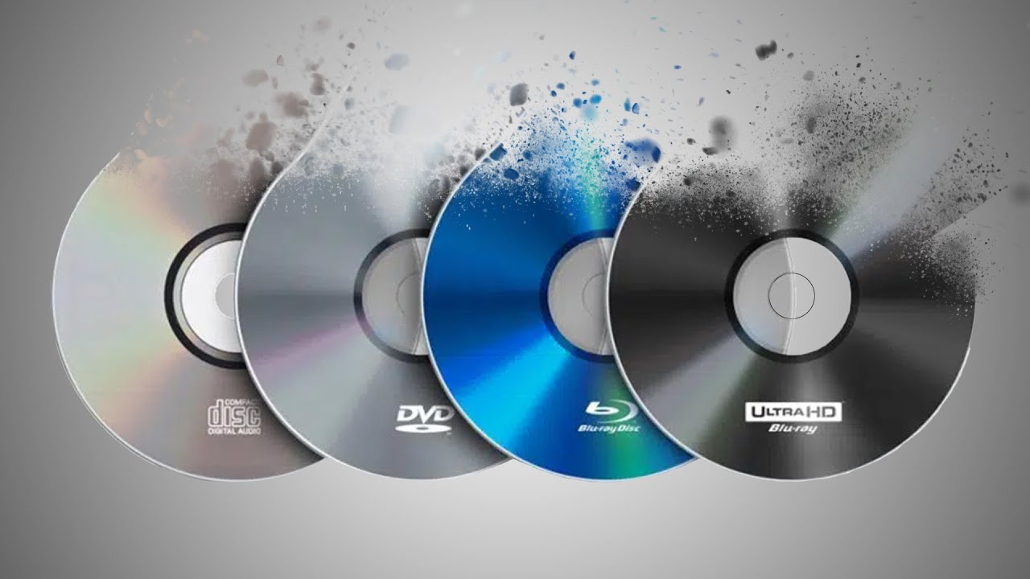
What our project is about:
Transition from CD’s, DVD’s and VHS towards services like Spotify and Netflix
Historical Development of it
Looking it it from business and (x) viewpoints
Considering ethical implications of it

Slide 3
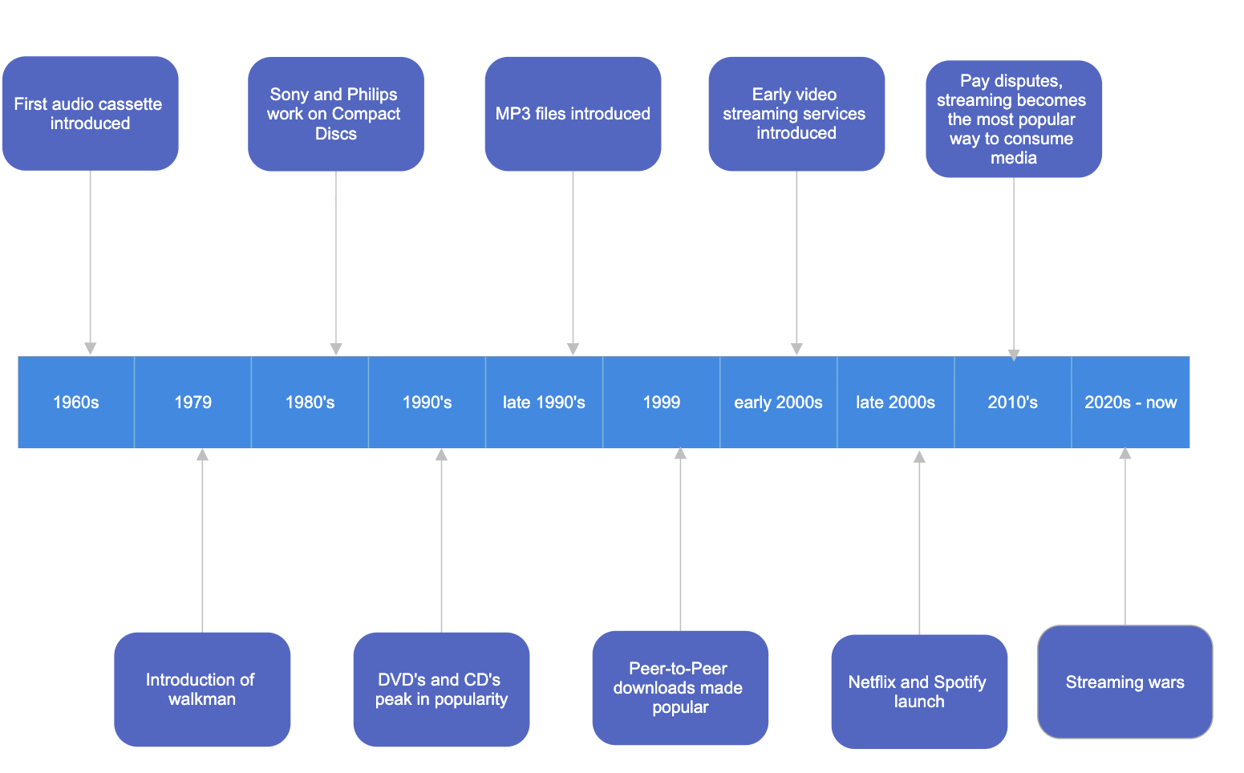
Historical Timeline

Slide 4
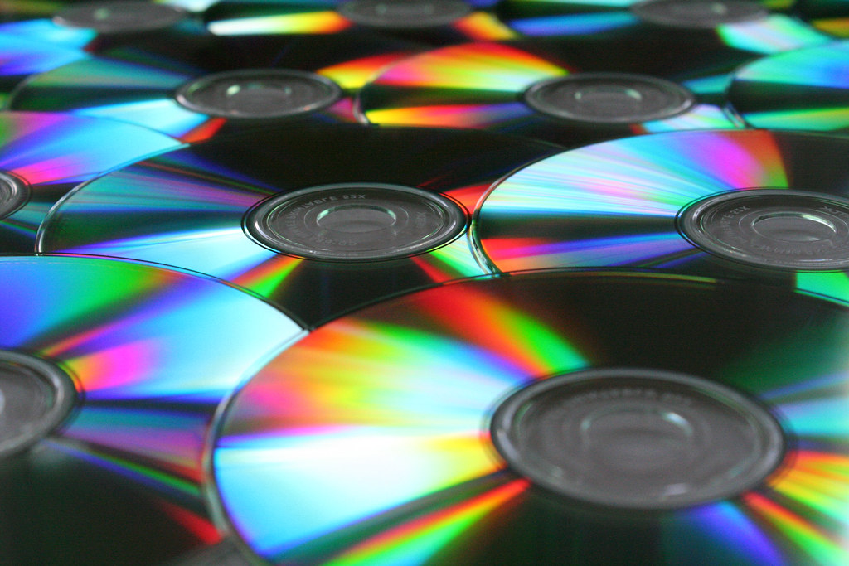
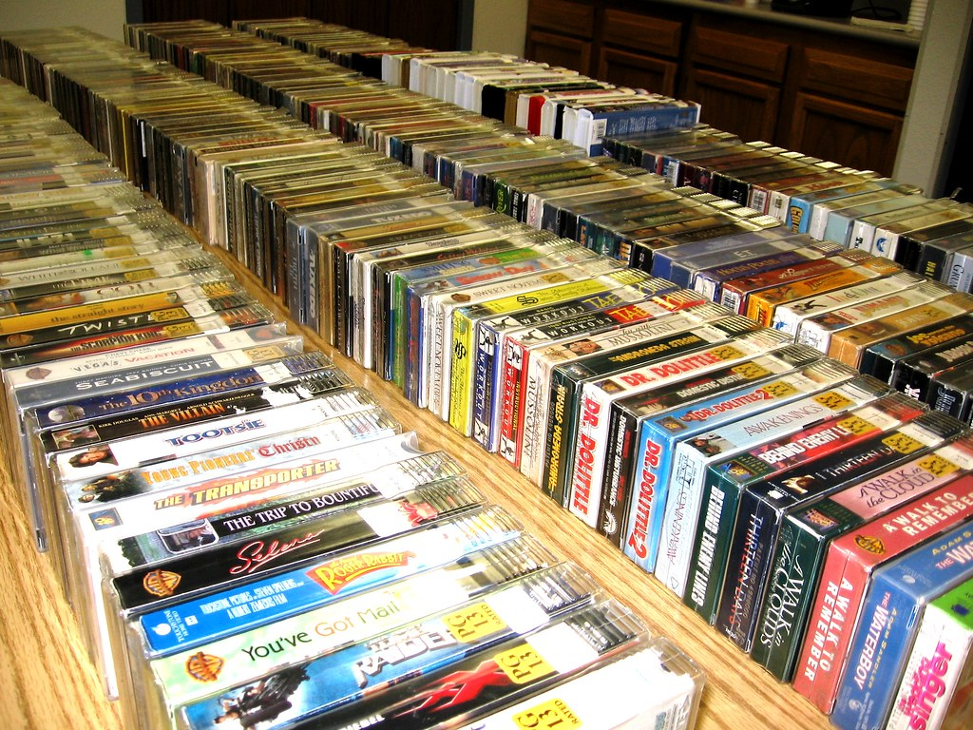
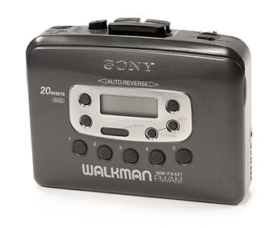
Physical Era
Media was mostly consumed on cassettes, CD’s, DVD’s, vinyl records and VHS
It was expensive and inconvenient for users
Walkman, introduced in 1979, introduced the “mixtape culture” – similar to Playlists nowadays
CD’s
VHS Tapes in Stores
Walkman

Slide 5
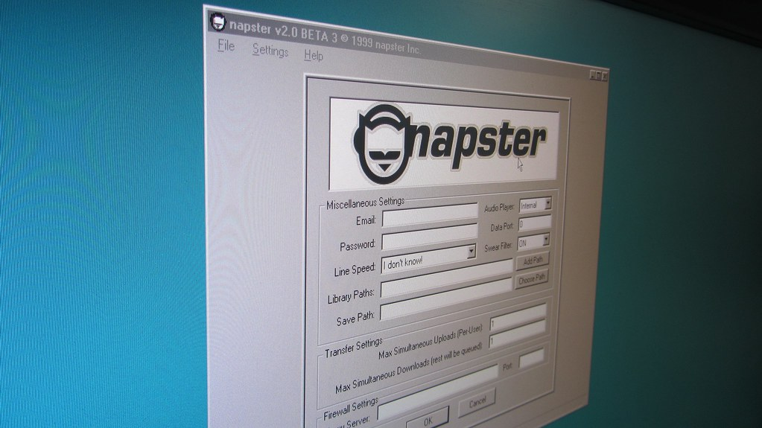
Transitional Period
MP3 File introduced in the 1990s compressing size of audio files
Peer-To-Peer era launched by Napster; filesharing erupted in popularity
Napster entered a legal battle with the music industry and shut in 2001
Peer-To-Peer era clearly showed that the idea of free music was revolutionary for customers
This Photo by Unknown Author is licensed under CC BY-SA

Slide 6
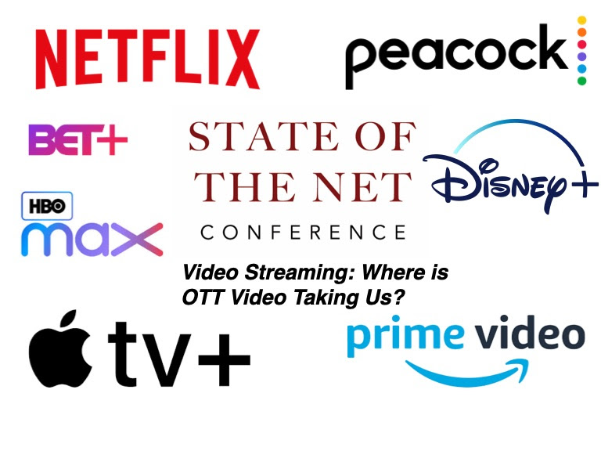
Streaming Era
Apple launches iTunes offering digital downloads for less than $1
iPod released and becomes a symbol of portable listening
YouTube launched streaming user-generated content
Spotify and Netflix launch in late 2008’s
Netflix produces and releases 2013 shifting from simply licensing content
Spotify faces pay disputes
Competition grows; studios create their own streaming apps instead of licensing.
Streaming wars started.

Slide 7

Business Viewpoint
Shifts from one-time revenue to steady monthly income
Major content investments
Customers pay for access not ownership
Location restrictions
Studios pulling and cancelling shows
Strong Competition
Investors push price increases and ad-supported tiers

Slide 8
Societal Viewpoint
Accessibility
01
COVID-19 accelerated streaming popularity
02
Increase in piracy due to price hikes
03
Platform loyalty through original series
04
Reduced demand of physical media
05

Slide 9
Ethical Considerations
Dark patterns make cancellation difficult
Privacy concerns
Pay disputes
Environmental impact
Content can disappear at any time

Slide 10
Thank you for listening!
Any questions?

